Slide 1
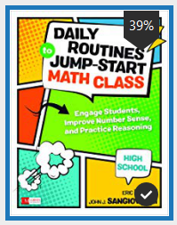
Jump Start Math Routines Eric Milou
Andy Witczak
Kentwood Public Schools

Slide 2
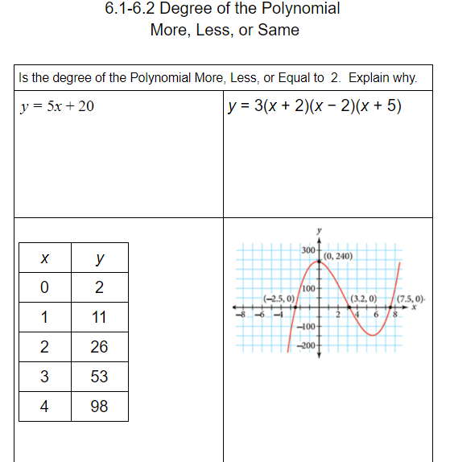
More or Less www.openmiddle.com

Slide 3
Why it Matters…
This routine helps students with Mathematical Practice 2 (reason abstractly and quantitatively) and Mathematical Practice 7 (look for and make use of structure).
In addition, it asks students to
1. determine efficient strategies for computing;
2. compare estimates with actual results;
3. estimate sums, differences, products, and quotients;
4. ask themselves if an answer is reasonable;
5. consider when and whether a calculation tool is needed;
6. identify whether their computations are accurate; and
7. defend their reasoning and the approaches of others.
Milou, Eric. Daily Routines to Jump-Start Math Class, High School (Corwin Mathematics Series) (p. 41). SAGE Publications. Kindle Edition.

Slide 4
What to Do…
WHAT TO DO
1. Present a few expressions, equations, or graphs to students.
2. Have them decide how the results will compare to a given benchmark. As noted, this is a mental mathematics opportunity. Students should not use tools to find exact values.
3. Provide time for students to reason.
4. Have students share their ideas with a partner before having a whole-class discussion.
5. Begin the whole-class discussion by identifying who believed which of the choices met the benchmark question.
6. Ask students to share how they made their decisions. As students share their thinking, it is important to probe thinking and ask clarifying questions rather than ask questions to establish how they thought about the expression. Here are some questions you might ask: • How did you estimate your solution? • Might there have been a more precise estimate? • Did you approach the expression in a different way? • How are different strategies similar?
7. Honor and explore both accurate and flawed reasoning.
8. Consider providing exact values after discussion so that students can compare and confirm their more or less estimates.
Milou, Eric. Daily Routines to Jump-Start Math Class, High School (Corwin Mathematics Series) (p. 42). SAGE Publications. Kindle Edition.

