Slide 1
Number Pattern Pictures (more than Quick Images)
Nancy K. Mack, Ph.D.
Grand Valley State University
mackn@gvsu.edu
Math in Action
February 22, 2020

Slide 2
Snowflake

Slide 3
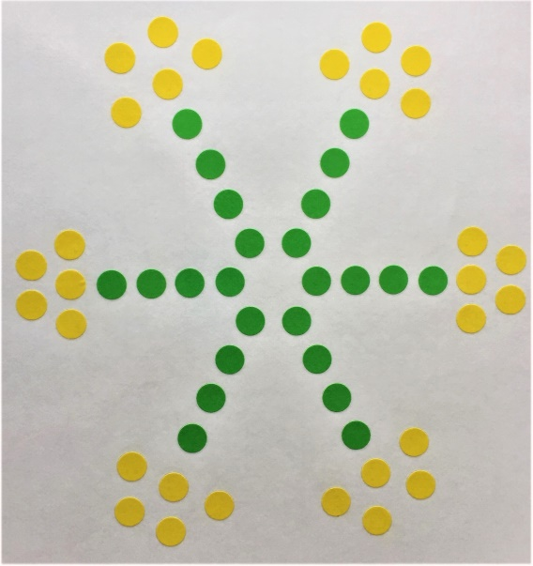
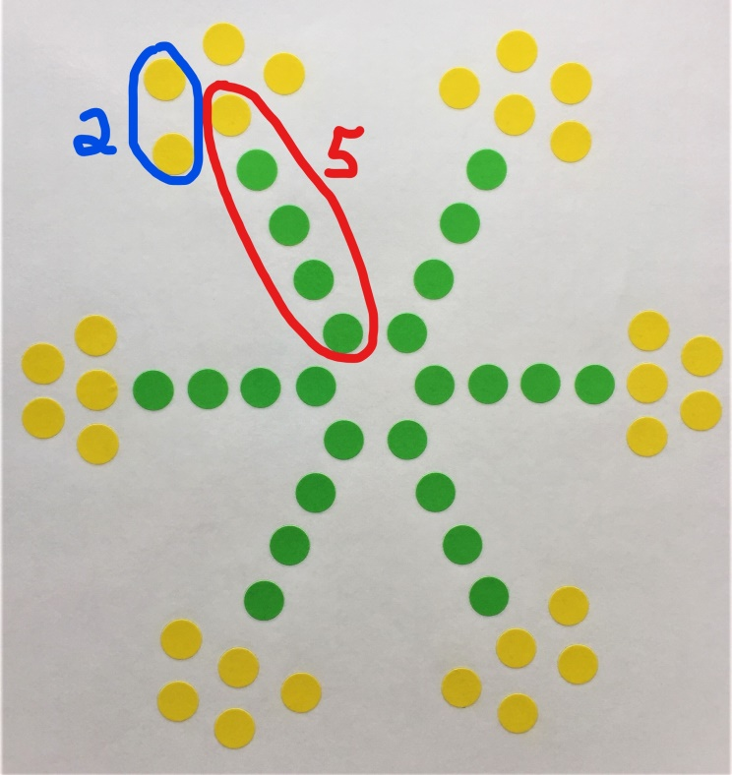
Snowflake Strategy 1 - Maleigha
First I counted by 5’s: 5, 10, 15, 20, 25, 30. Then I counted by 2’s: 2, 4, 6, 8, 10, 12, 14, 16, 18, 20, 22, 24. Then I added 24 plus 30 and got 54.

Slide 4
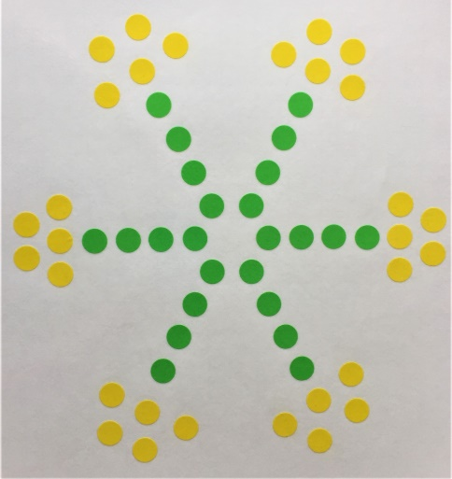
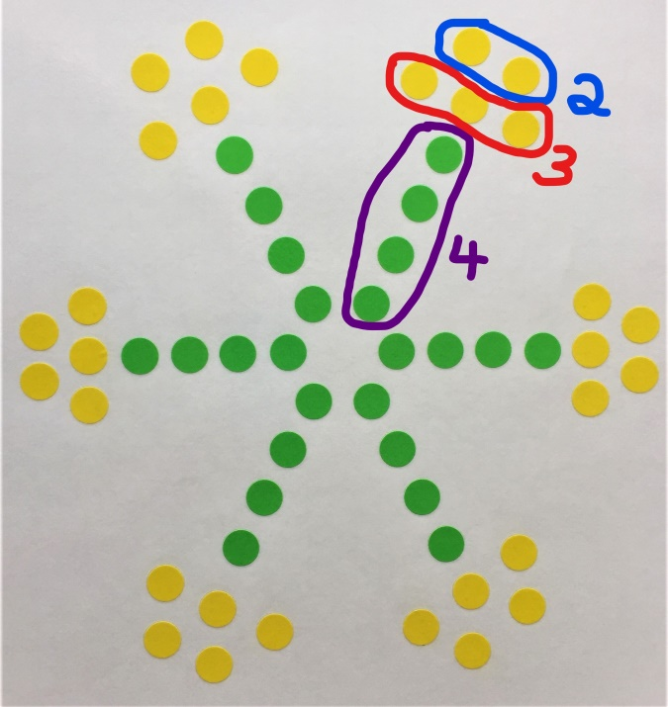
Snowflake Strategy 2 - Michael
I saw 6 groups of 2, that’s 12.
Then I saw groups of three and there were 6 of those. I know that’s 18. Eighteen plus 12, hmm. Well, 18 plus 10 is 28 and there’s 2 more, so it’s 30. Then there are 6 groups of 4. I know that’s 24 and 24 plus 30 is 54.

Slide 5
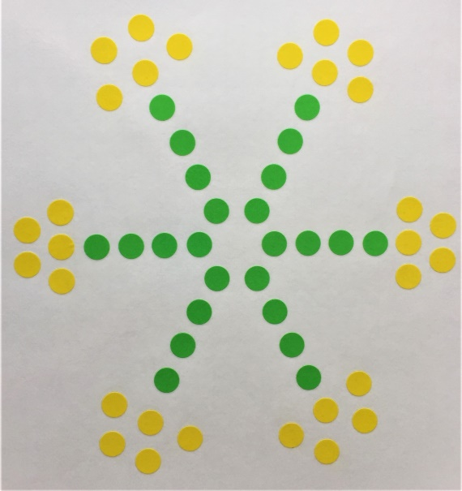
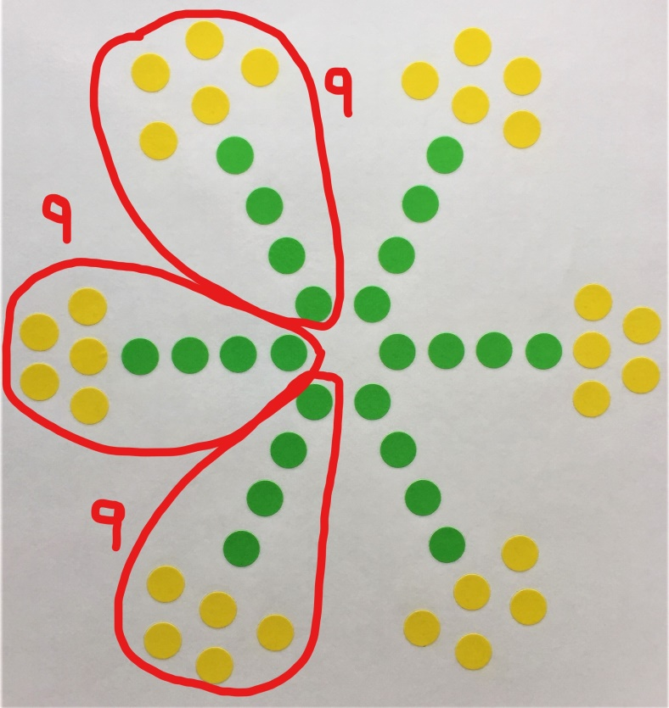
Snowflake Strategy 3 – Elijah
I did 3 groups of 9 then doubled it. Three groups of 9 is 27 and 27 plus 27 is 54.

Slide 6
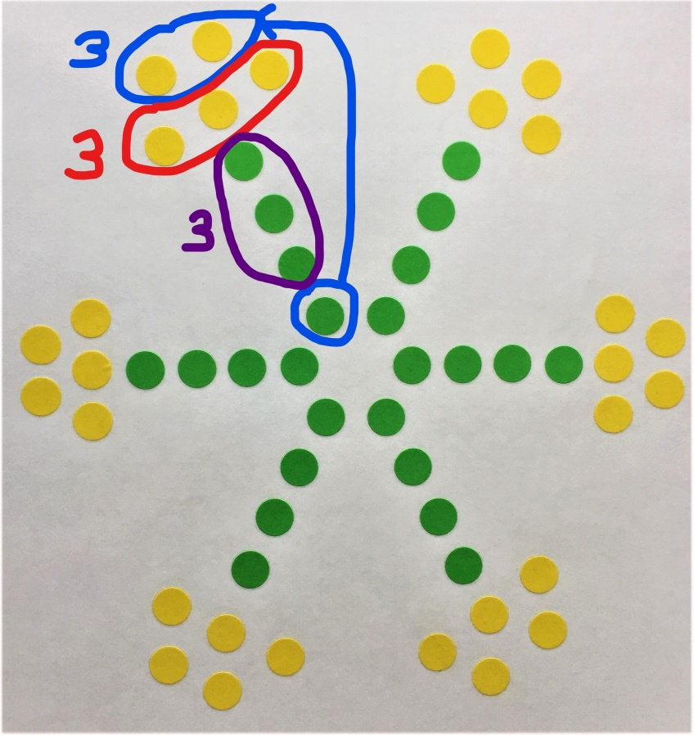
Snowflake Strategy 4 - Riley
I counted by 3’s: 3, 6, 9, 12, 15, 18…42, 45, 48, 51, 54.

Slide 7
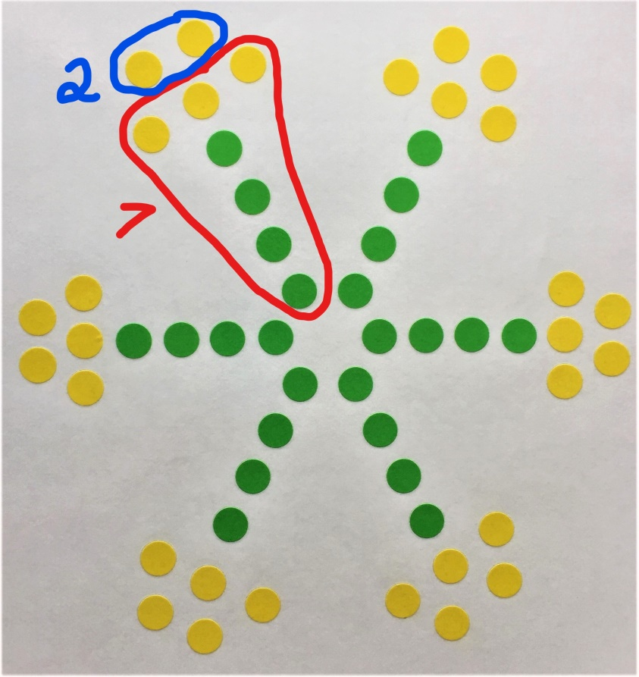
Snowflake Strategy 5 - Emma
There’s 6 groups of 7, that’s 42 and there’s six groups of 2, that’s 12. Forty-two plus 12 is 54.

Slide 8
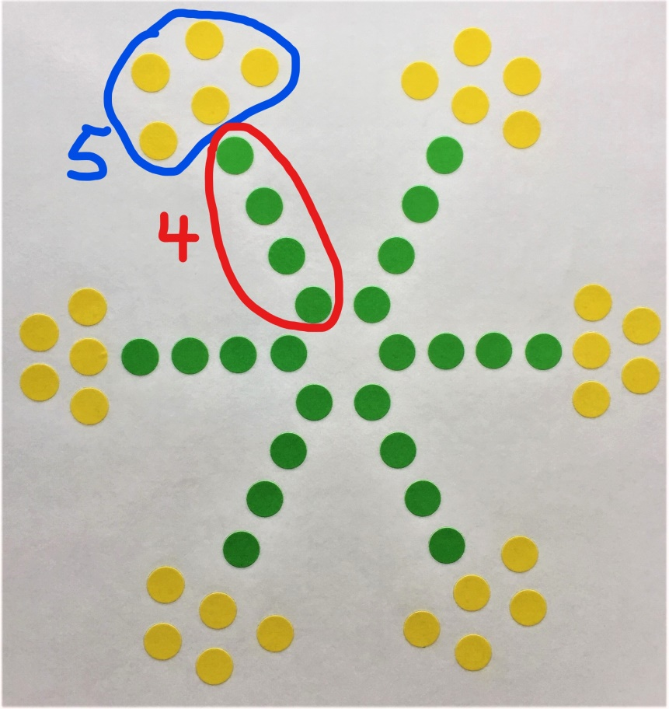
Snowflake – Author’s Strategy
I made groups of five and groups of four. How might I have done this?

Slide 9
My Goals
Engage all students in
Successfully solving problems beginning on Day 1.
Developing understanding of concepts related to number facts.
Looking for & using patterns to solve problems.
Realizing that problems can be solved in a variety of ways and using various strategies to solve problems.
Describing, discussing, and comparing strategies.
Seeing mathematics as creative and beautiful.

Slide 10
Structure & Procedures
Solve problem mentally or with pencil & paper.
Students suggested use strategies other than counting by ones, if possible.
Silent thumbs up when ready to share strategy & answer.
Class shares 3-5 different strategies in detail.
Discuss how various strategies are similar/different as shared.
Determine who used author’s strategy or how it could be used to solve the problem.

Slide 11
Creating Pictures – My Thinking
Accessible to all students.
Vary problem being solved, sometimes determining the total number of dots and sometimes not.
Use at least one number pattern all students know.
Picture involves portions that can be decomposed or composed in various ways based on number patterns.
Sometimes color matters and sometimes it does not.
Think ahead for ways to gradually extend to more complex pictures. (ex: work towards array)
Sources of inspiration for pictures – nature, quilt patterns, animals, mathematical representations, & etc.

Slide 12
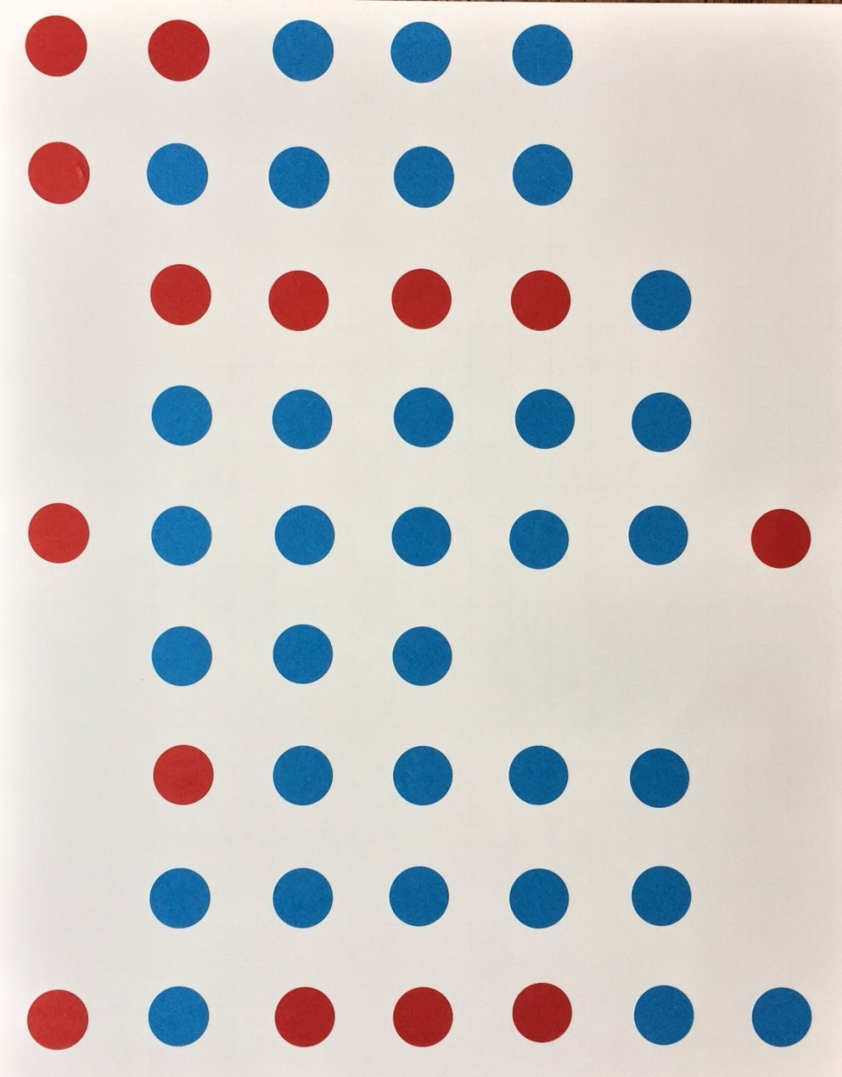
Red & Blue – Total Number of Dots?

Slide 13
Red & Blue – Update on My Thinking
All students worked with groups of five in some way and very comfortable doing this.
Some students beginning to see arrays and some relating arrays and multiplication.
All students asked for something more challenging next time.
Need to include groups of five and extend beyond this.

Slide 14
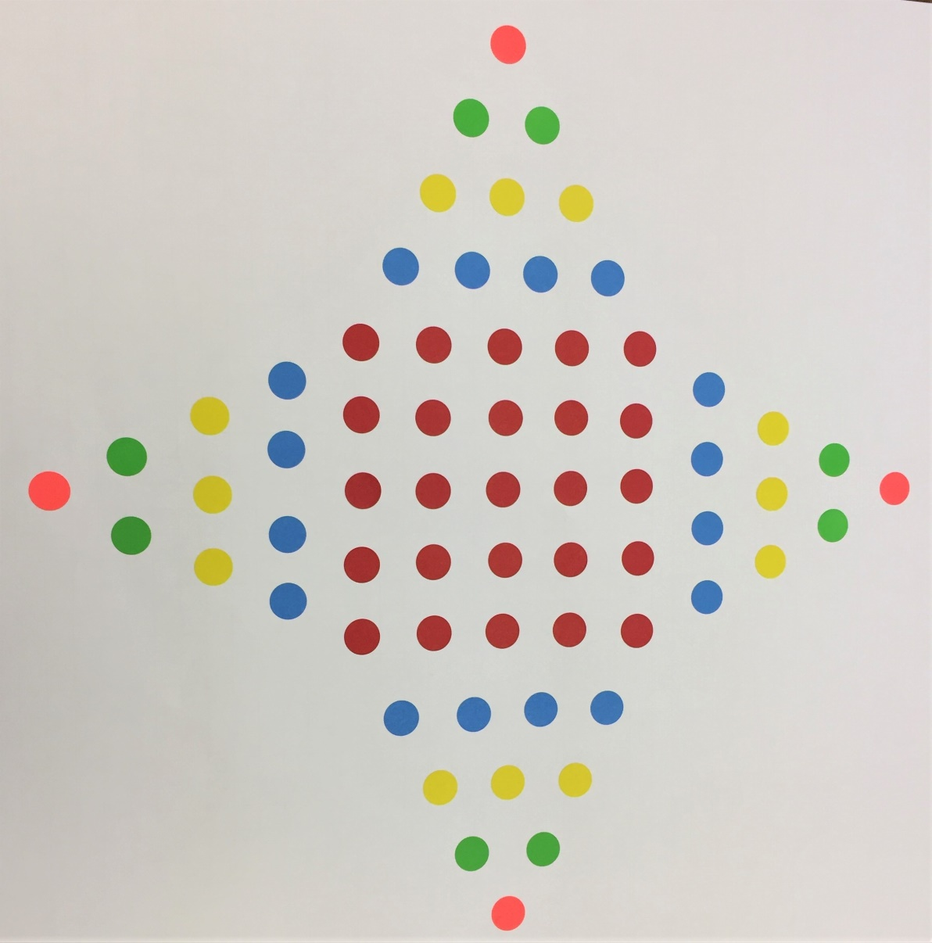
4 pointed-Star – What Problem Should We Solve?

Slide 15
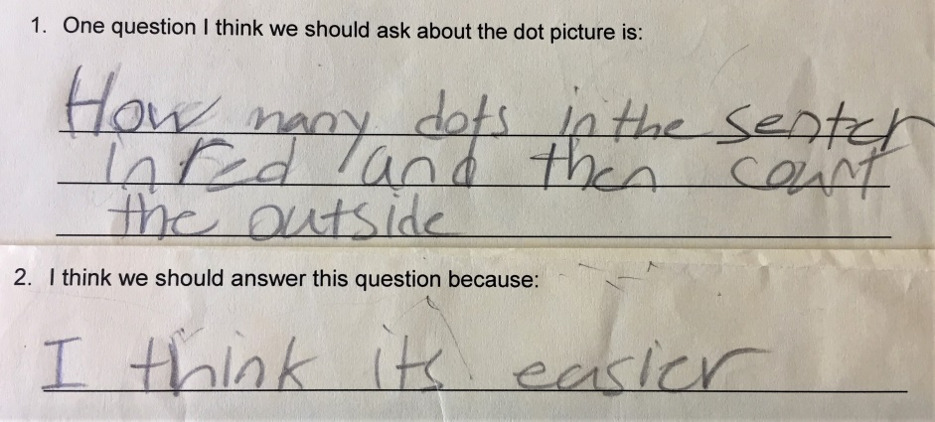
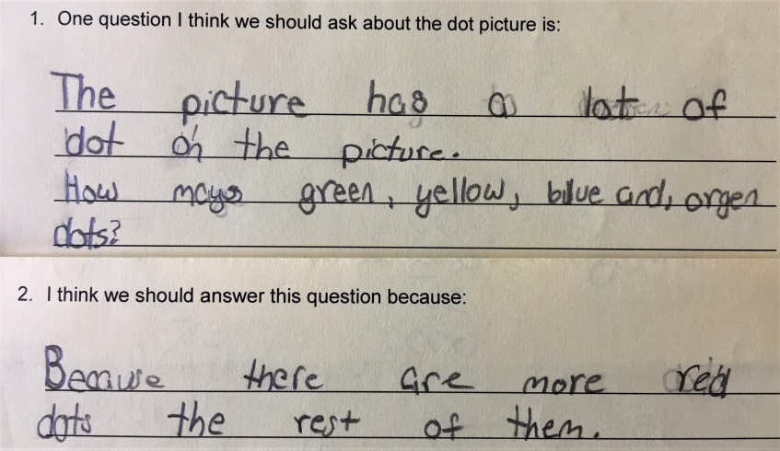
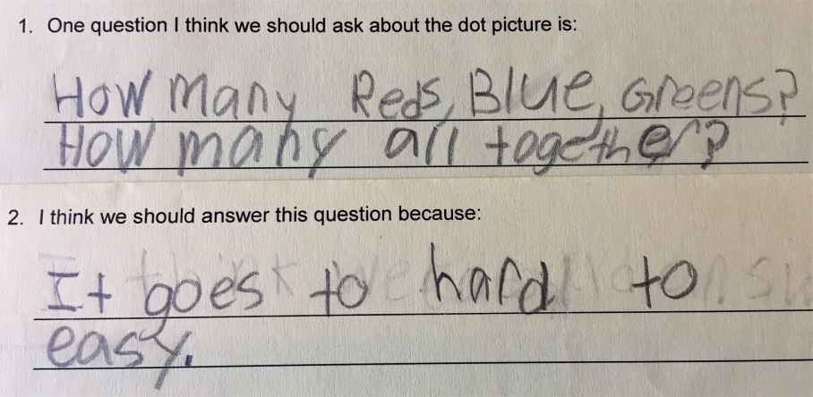
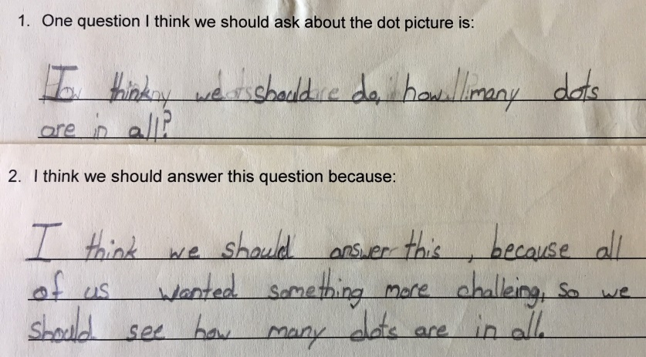
Children’s Questions
Emma Aniyah
Isabella Christina

Slide 16
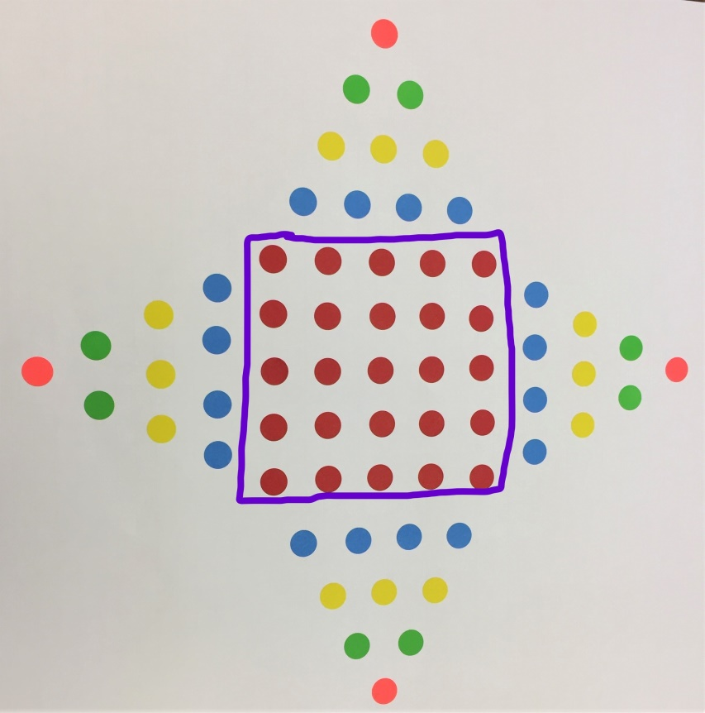
4-pointed Star Strategy 1 – Michael
There’s a 5 by 5 array in the middle. Five times 5 is 25. Then I counted the blue by 4’s: 4, 8, 12, 16. Sixteen plus 25 is 41. Next, I counted the yellow by 3’s and got 12. Twelve plus 41 is 53. I counted the green by 2’s and got 8. Eight plus 53 is 61. Then I counted the orange, 1, 2, 3, 4. Four plus 61 is 65.

Slide 17
4-pointed Star Strategy 2 – Lacey
I counted the orange first by ones and got 4.
Then I counted the greens by twos, 6, 8, 10, 12.
Then I counted the yellow by threes, 15, 18, 21, 24.
Then I counted the blues by fours, 28, 32, 36, 40.
Then I counted the red in the middle by fives, 5, 10, 15, 20, 25.
Then I added 25 and 40 and got 65.

Slide 18
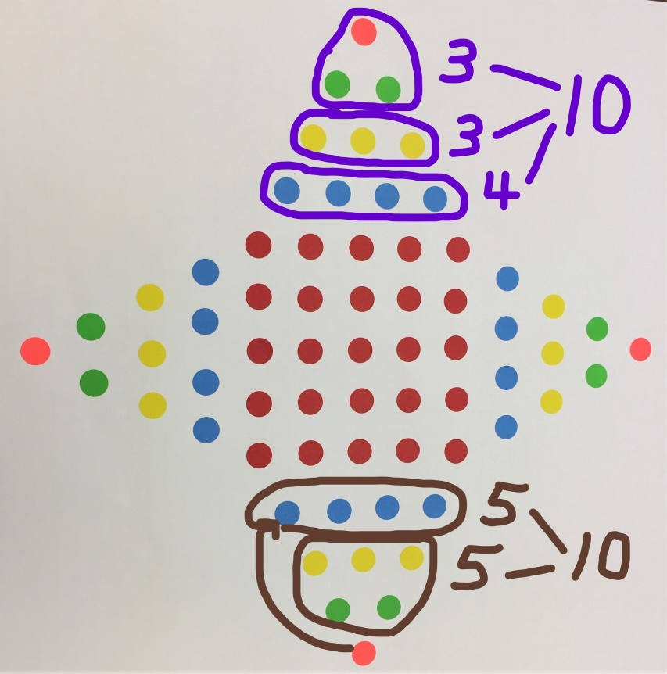
4-pointed Star Strategy 3 – Emma & Gabby
Emma: The red in the middle is 25 because it’s a 5 x 5 array. One star (point) is 10. I did 4 plus 3 plus 3. That’s ten. There are four tens, that’s 40. Forty and 25 are 65.
Gabby: I did almost the same thing as Emma but I did it in a different way. I counted the red by fives and I made fives in each star so there are 10 in a star..

Slide 19
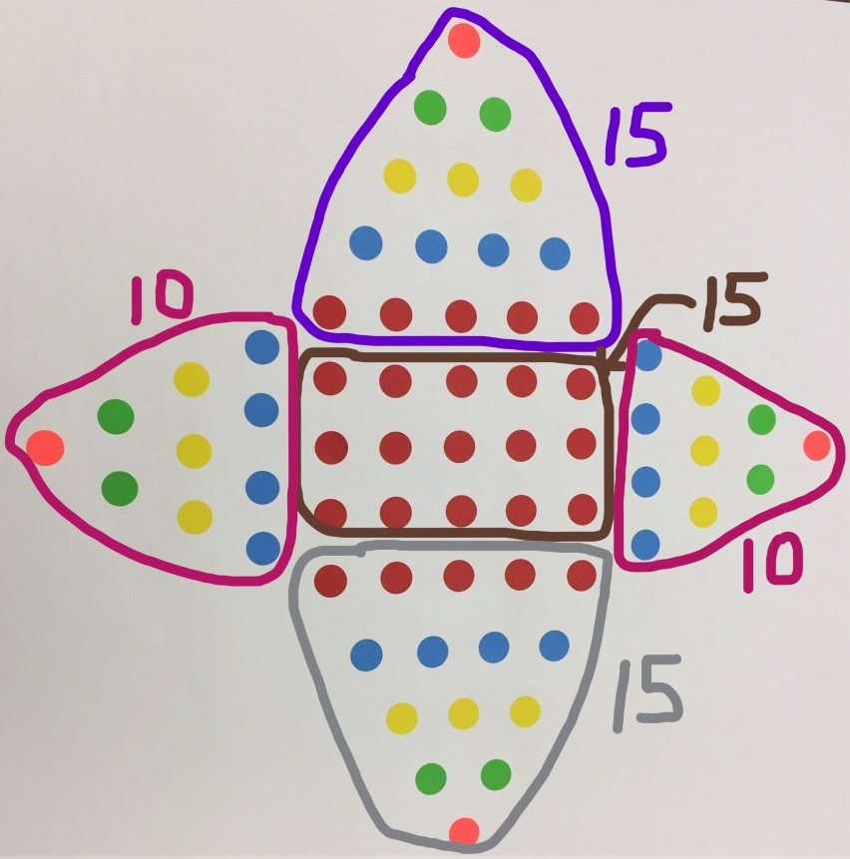
4-pointed Star Strategy 4 – Elijah
There’s 3 groups of 15 and 2 groups of 10. Three groups of 15 is 45 and 2 groups of 10 is 20. Twenty plus 45 is 65.

Slide 20
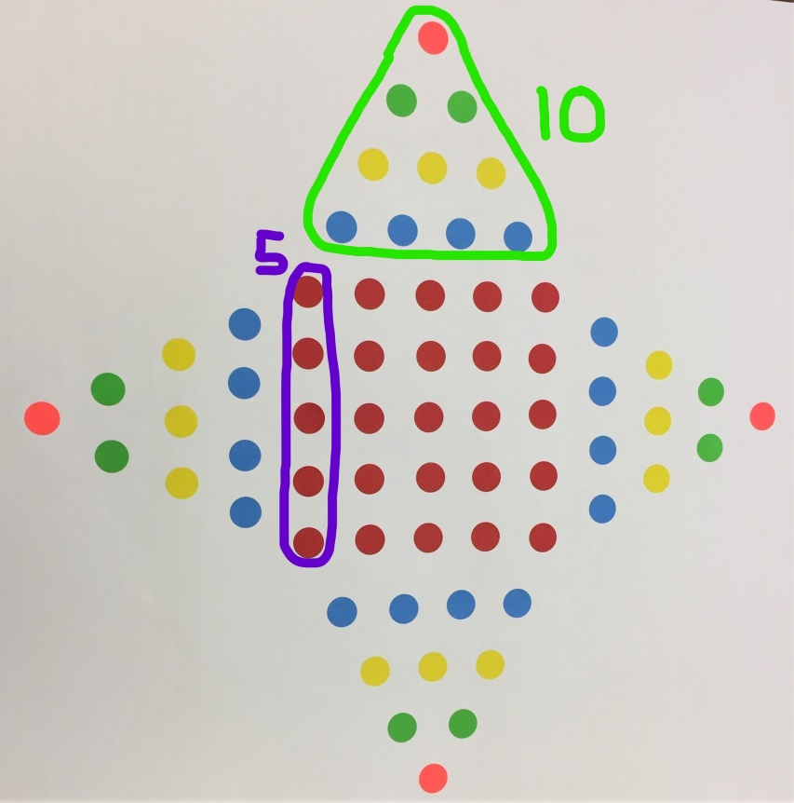
4-pointed Star - Author Strategy
I made groups of 5 and groups of 10. How might I have done this?

Slide 21
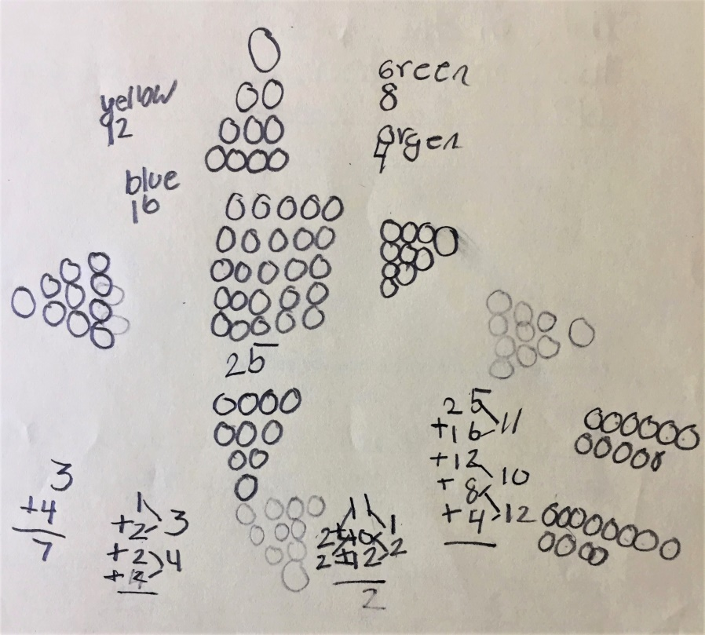
4-pointed Star Strategy – Aniyah
I did the red in the middle first. I counted by 5’s: 5, 10, 15, 20, 25. Next, I saw there were four stars (points on the stars) so I did those by the colors. First, I counted the blues (by ones) that was 16. Then I counted the yellow (by ones), that’s 12. I counted the green (by ones), that was 8, and then I counted the orange (by ones) that was 4. I got…

Slide 22
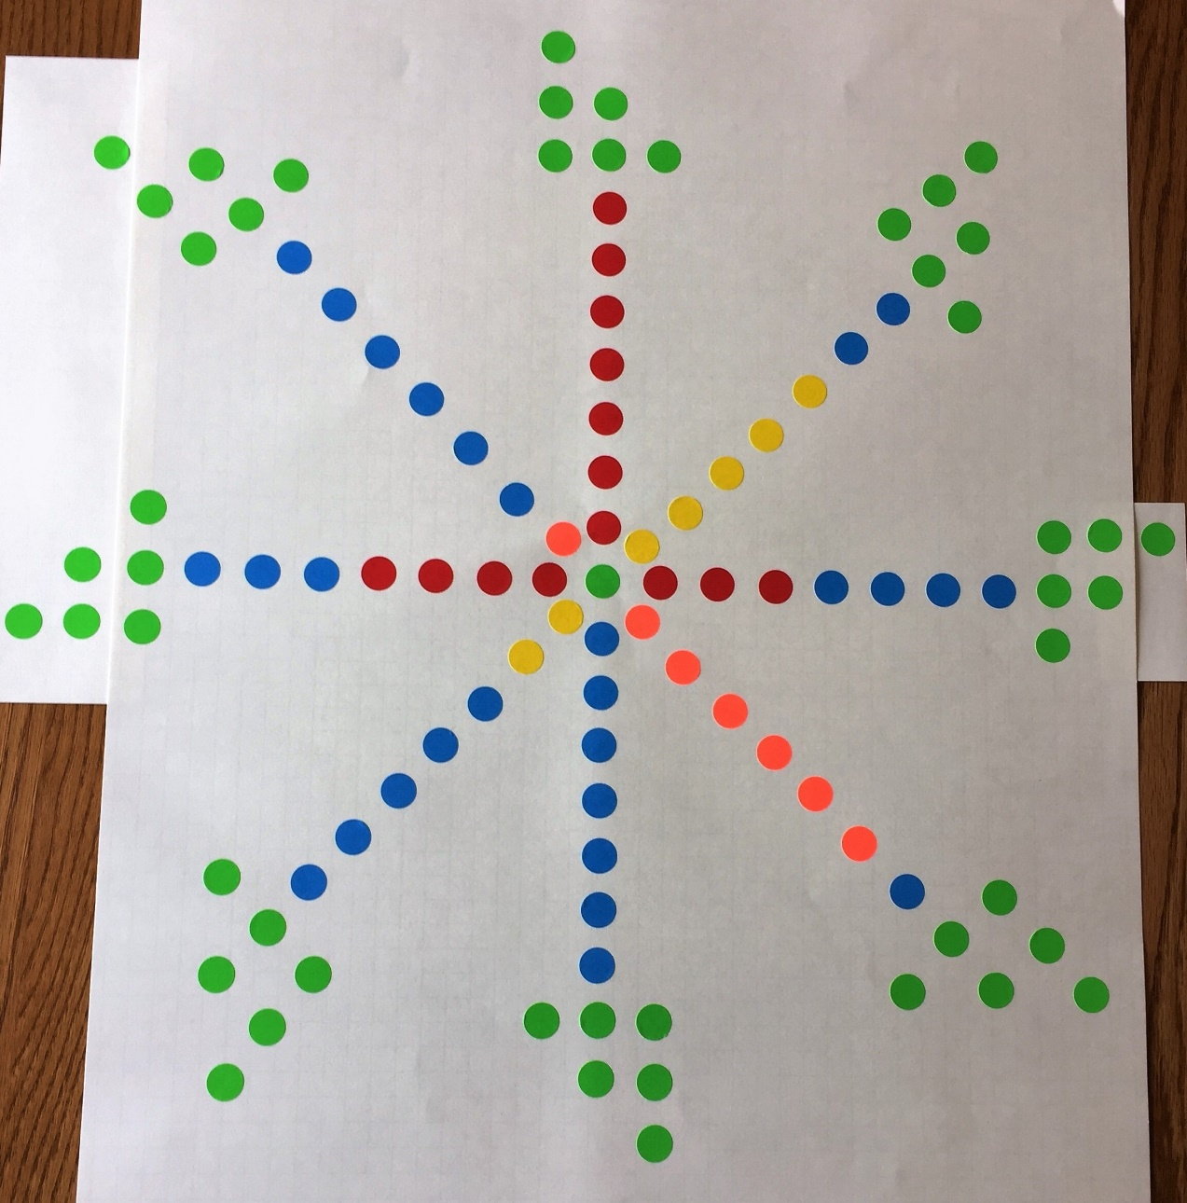
Too Ambitious?

Slide 23
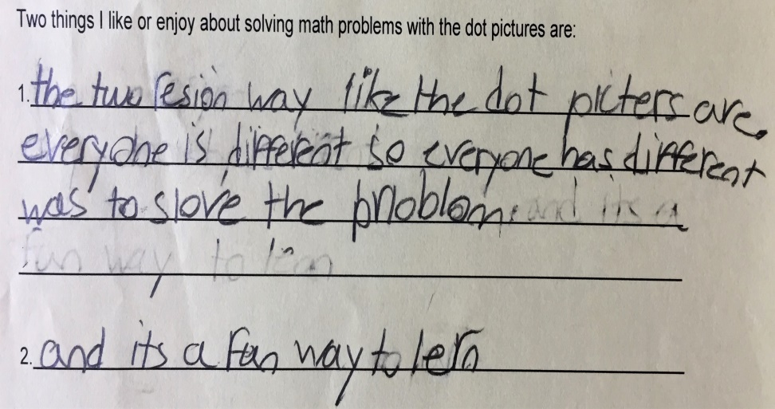
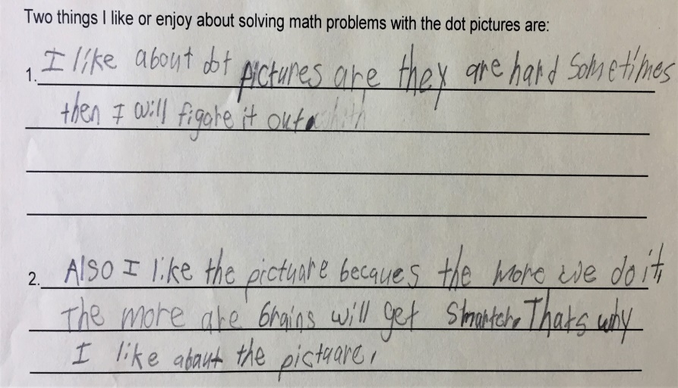
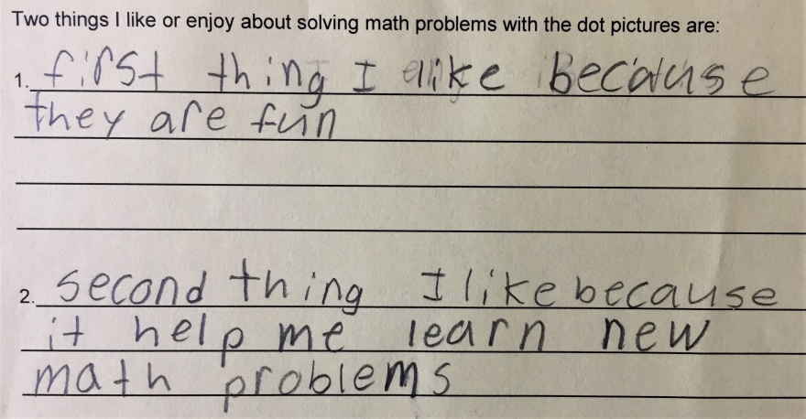
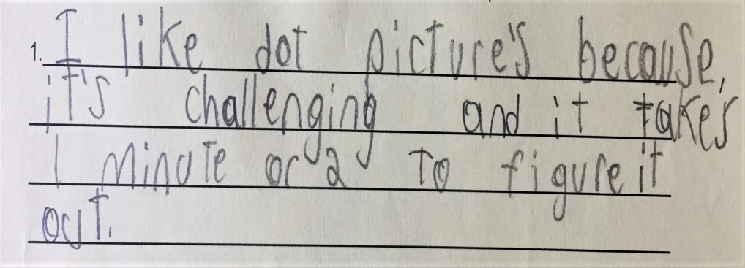
Why Liked Solving Picture Problems
Emma Maria
Isabella Jesse

Slide 24
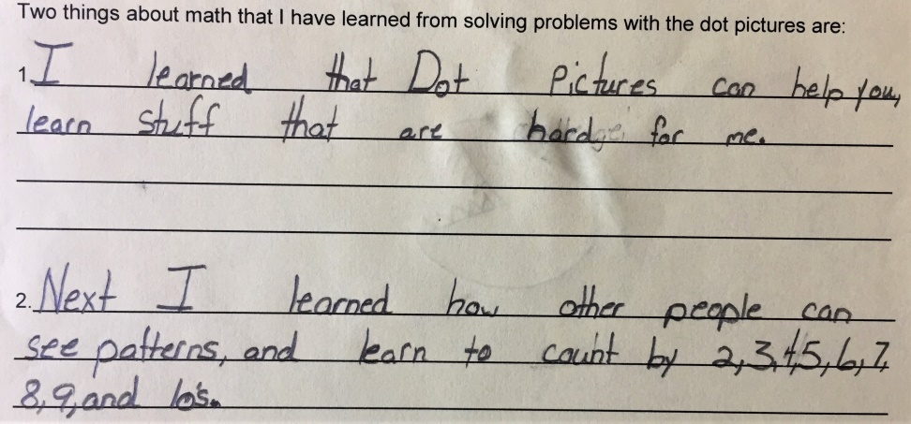
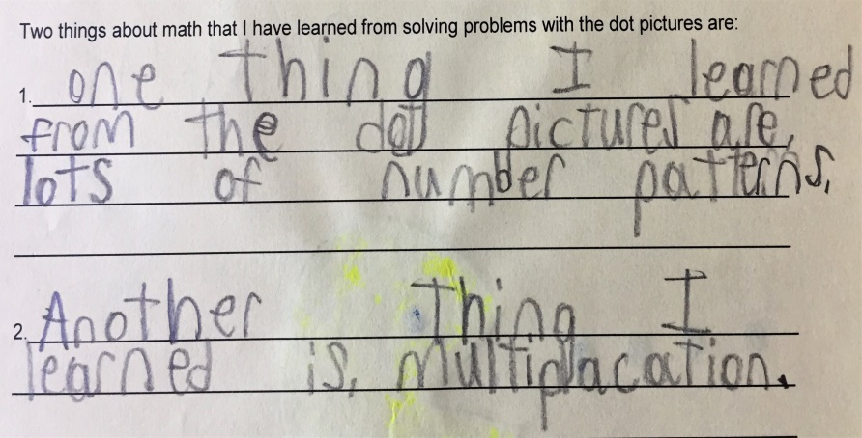
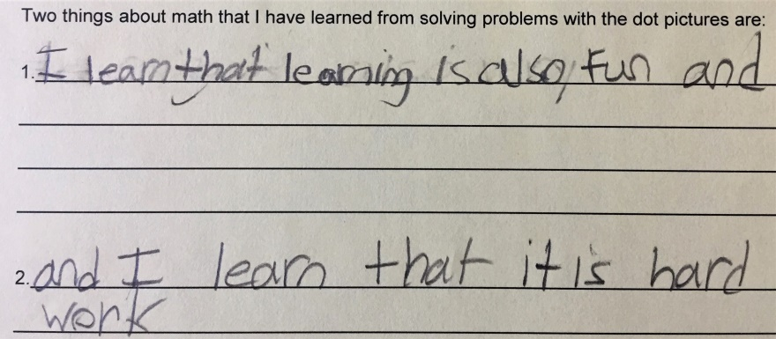
What Learned from Picture Problems
Christina Jesse
Emma

Slide 25
Student Project - Create Own Picture
Choose two number patterns.
Create a physical model or picture model. Explain where each number pattern is in the model.
Create a model on graph paper. Revisions okay.
Create the final picture on poster board. Revisions okay.
Pose a problem to solve and show two different ways to solve the problem.
Extension: Write an equation for the picture.

Slide 26
Example 1 – Project Parts

Slide 27
Example 2 – Project Parts

Slide 28
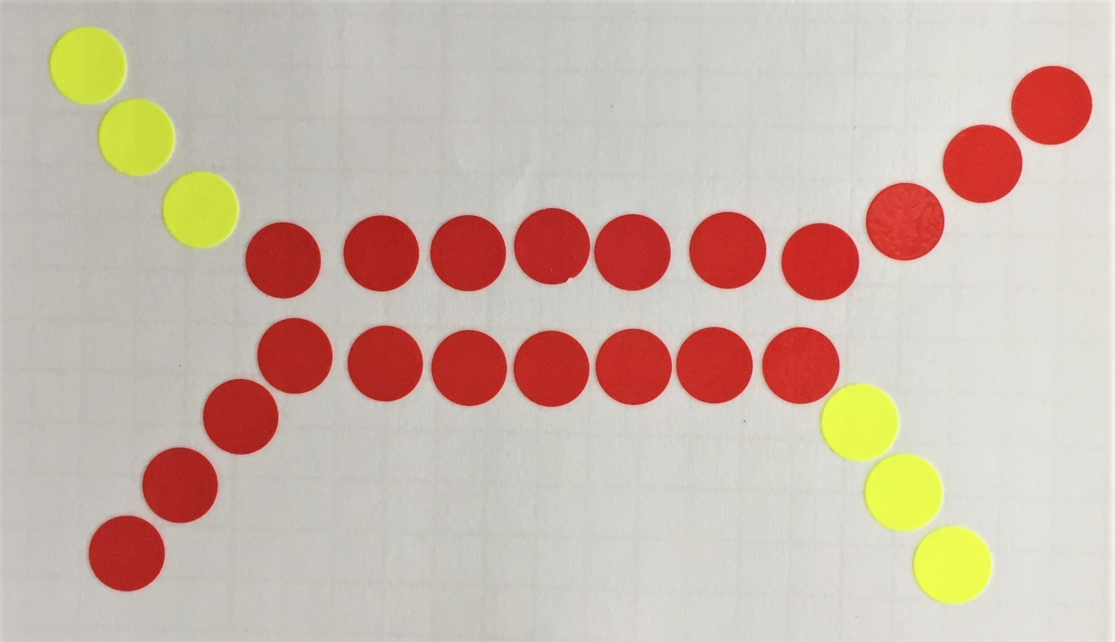
Student Project – Jessica

Slide 29
Student Project – Abdullah

Slide 30
Comparing Pictures

Slide 31
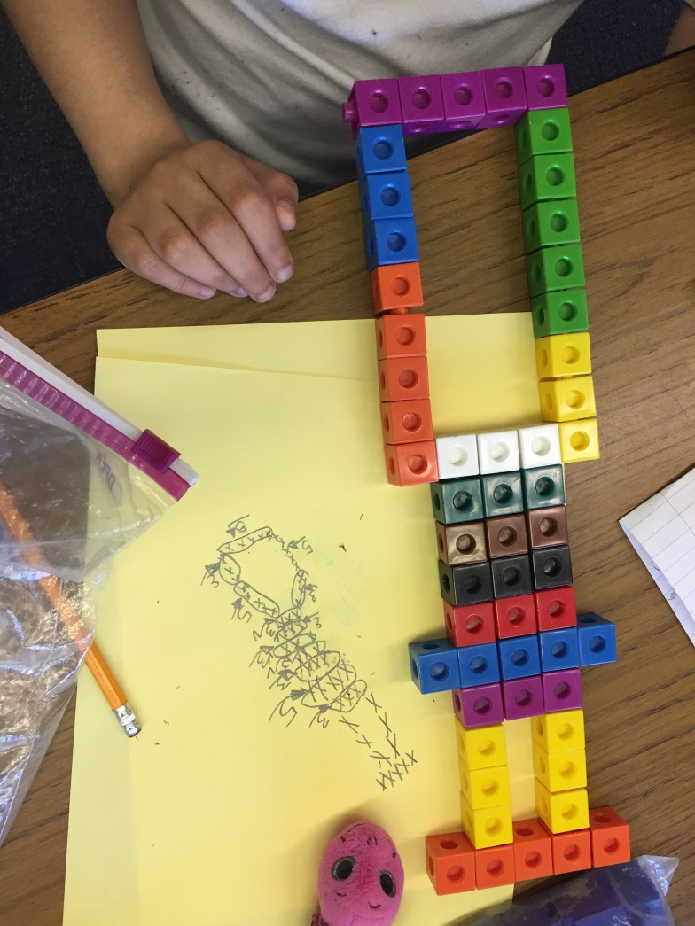
Student Project - Arianna

Slide 32
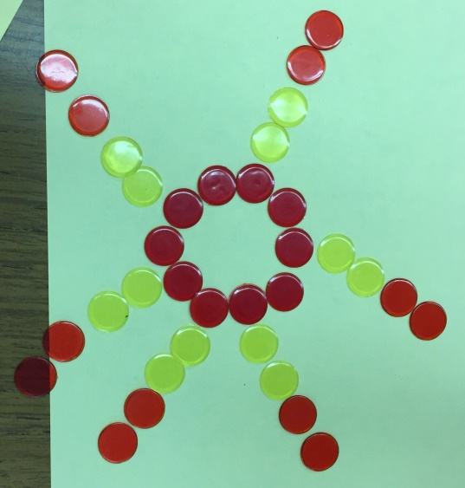
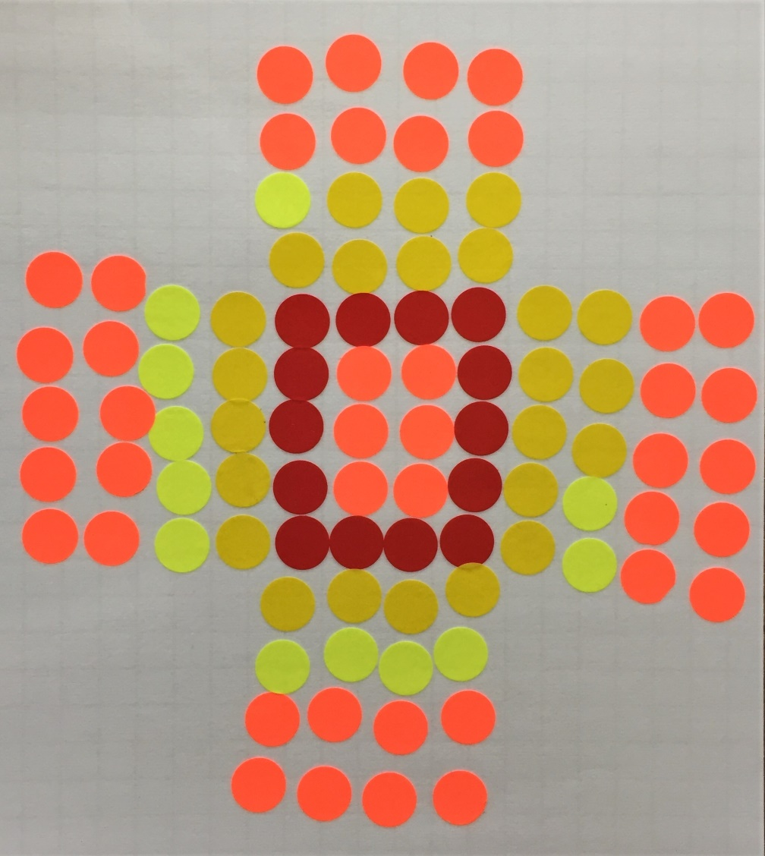
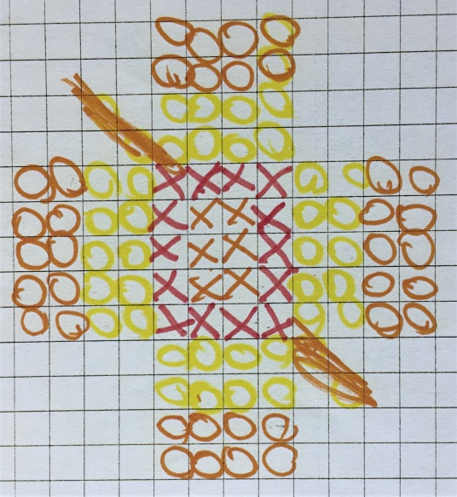
Student Project - Emma

Slide 33
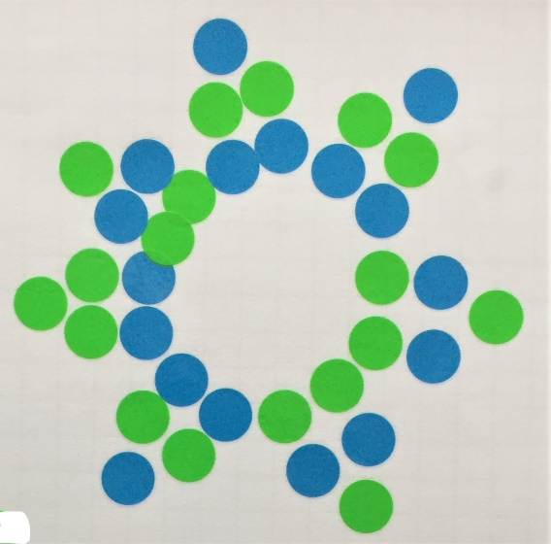
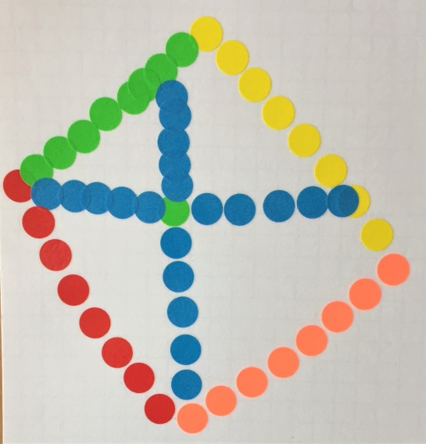
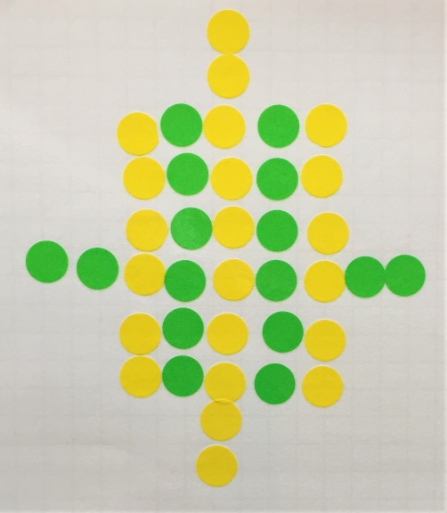
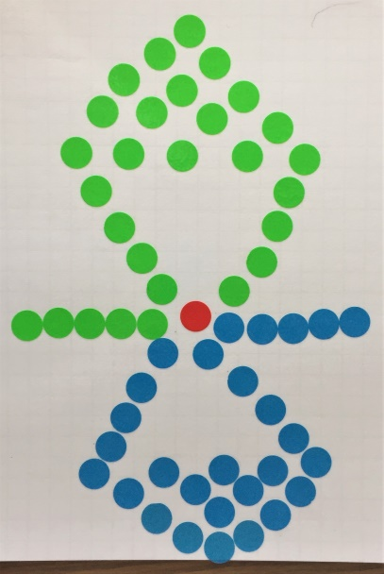
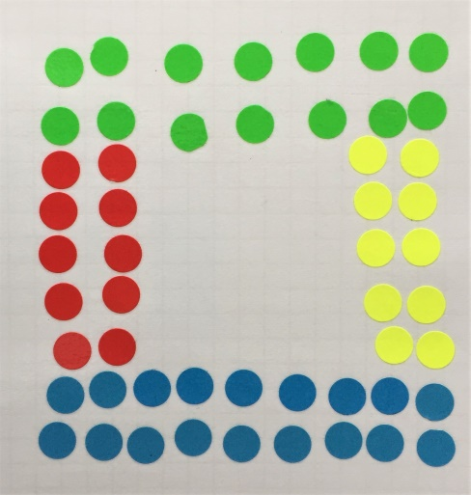
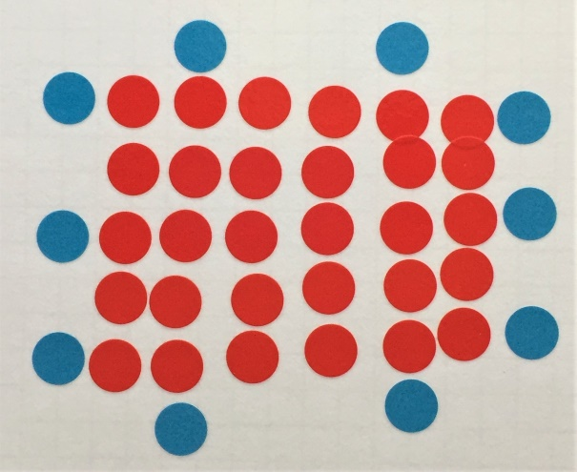
Other Final Student Pictures

Slide 34
Thank You for Coming!!!

