Slide 1
Mathematical Puzzles and Games
Math in Action
Saturday, February 22, 2020
Joseph J. Spencer, Ph. D.
Aquinas College
spencjos@Aquinas.edu

Slide 2
I want to present a collection of short activities I have found over the years that can be done in a relatively short time with little preparation but have interesting mathematical content. The activities will include games, puzzles and “tricks”.

Slide 3
5 Alive
Write down any natural number.
Add the next natural number.
Add 9 to this sum.
Divide by 2.
Subtract your original number.

Slide 4
5 Alive
What happens:
The result will always be 5.

Slide 5
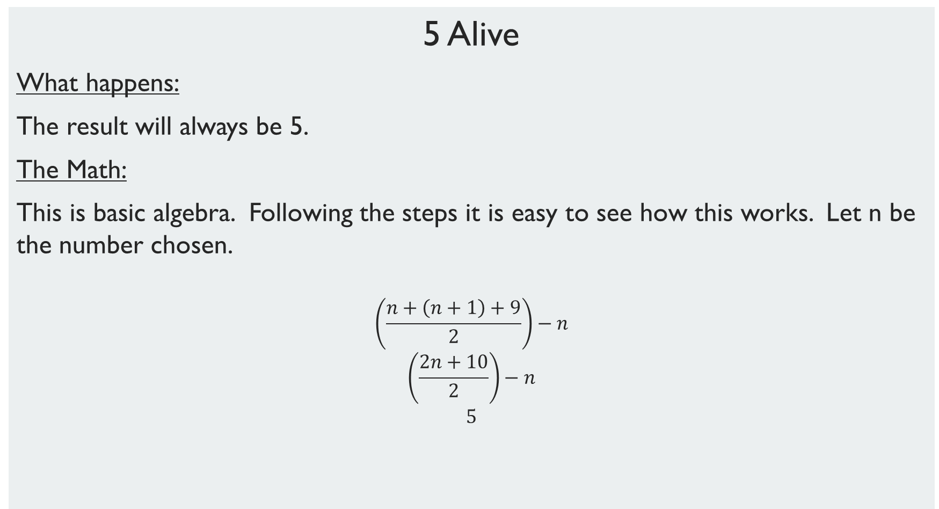
5 Alive
What happens:
The result will always be 5.
The Math:
This is basic algebra. Following the steps it is easy to see how this works. Let n be the number chosen.
$$\left(\frac{n+\left(n+1\right)+9}{2}\right)−n$$
$$\left(\frac{2n+10}{2}\right)−n$$
$$5$$

Slide 6
I Predict!
On this paper is a number, don’t look at it.
Write down any natural number from 50 to 100.
Add the number I tell you to your number.
Remove the leading digit of the sum from step 3 and add the digit to this resulting number.
Compare number from part 4 from you original number you wrote down in part 2, subtract the smaller one from the larger one.
Look at the number predicted on the paper from part 1.

Slide 7
I Predict!
How It works:
On the piece of paper, write a number from 1 to 50. In step 3, have the person add the number that is 99 minus your number.
The Math:
We notice that the sum of the number the person chose and the number you will have them add will always be between 100 and 199. So when removing the first digit you will be subtracting 100. Let’s let s = the secret number and x the number chosen by the person. When you comparing the numbers in step 5, the original number will always be the larger one. The calculations work out to be
x – (x + (99 – s) – 100 + 1) = s
From step 5

Slide 8
Magic Cards
Silently pick an integer from 1 to 63. Tell which cards the number is on.
 |  |  | A
1 | 3 | 5 | 7 | 9 | 11 | 13 | 15
17 | 19 | 21 | 23 | 25 | 27 | 29 | 31
33 | 35 | 37 | 39 | 41 | 43 | 45 | 47
49 | 51 | 53 | 55 | 57 | 59 | 61 | 63
 |  |  | B
2 | 3 | 6 | 7 | 10 | 11 | 14 | 15
18 | 19 | 22 | 23 | 26 | 27 | 30 | 31
34 | 35 | 38 | 39 | 42 | 43 | 46 | 47
50 | 51 | 54 | 55 | 58 | 59 | 62 | 63
 |  |  | C
4 | 5 | 6 | 7 | 12 | 13 | 14 | 15
20 | 21 | 22 | 23 | 28 | 29 | 30 | 31
36 | 37 | 38 | 39 | 44 | 45 | 46 | 47
52 | 53 | 54 | 55 | 60 | 61 | 62 | 63
 |  |  | D
8 | 9 | 10 | 11 | 12 | 13 | 14 | 15
24 | 25 | 26 | 27 | 28 | 29 | 30 | 31
40 | 41 | 42 | 43 | 44 | 45 | 46 | 47
56 | 57 | 58 | 59 | 60 | 61 | 62 | 63
 |  |  | E
16 | 17 | 18 | 19 | 20 | 21 | 22 | 23
24 | 25 | 26 | 27 | 28 | 29 | 30 | 31
48 | 49 | 50 | 51 | 52 | 53 | 54 | 55
56 | 57 | 58 | 59 | 60 | 61 | 62 | 63
 |  |  | F
32 | 33 | 34 | 35 | 36 | 37 | 38 | 39
40 | 41 | 42 | 43 | 44 | 45 | 46 | 47
48 | 49 | 50 | 51 | 52 | 53 | 54 | 55
56 | 57 | 58 | 59 | 60 | 61 | 62 | 63

Slide 9
How it works:
Add the upper left hand numbers in each “card” that was indicated.
The Math:
This could be used in introducing different bases, or just base 2. Or just the idea that every positive integer can be represented uniquely as the sum of powers of 2.
Each of the cards represents a value in base 2.
For example, in binary 43 = 101011₂ since 43 = 32 + 8 + 2 + 1. So 43 appears on cards F, D, B and A only.
.
F | E | D | C | B | A
2⁵ | 2⁴ | 2³ | 2² | 2¹ | 2⁰
32 | 16 | 8 | 4 | 2 | 1

Slide 10
Digitellus
Write down a four digit number.
Now write down the first two digits of that number.
For the number from part 2, add to it the next integer.
Multiply the sum from part 3 by 5.
Add a zero to the end of the number from part 4.
Tell me any number from 10 to 99 and add it to the number from part 5.
Add the last two digits from the original number from part 1.
Tell me the number from part 7. Your original number is…

Slide 11
Digitellus
How it Works:
By subtracting the sum of 50 and the number picked in part 6 we find the original number

Slide 12
Digitellus
The Math:
We will write a four digit number expanded as 1000a + 100b + 10c + d,
Where the a, b, c and d are the digits. Writing the first two digits as number is 10a + b.
Adding the next: 20a + 2b + 1.
Multiplying by 5: 100a + 10b + 5.
Adding the zero: 1000a + 100b + 50.
Adding the extra number x and the original last two digits gives
1000a + 100b + 10c + d + x + 50.

Slide 13
The Lost Digit
Write down a four digit number with no zeros.
Add the digits and write down the sum.
Cross out one of the digits in the original four digit number and write down the resulting three digit number.
Subtract the sum of the digits from step 2 from the three digit number from step 3.
What is the number from step 4? I will tell you the value of the digit you crossed out in step 3.

Slide 14
The Lost Digit
How it works:
Take the sum of the number given step 5. Then subtract this sum from the smallest multiple of 9 greater than the sum.
The Math:
This could be used in studying place value and modular arithmetic. The main idea used here is that for any positive integer N, N is congruent mod 9 with the sum of its digits. You may recall the rule that a number is divisible by 9 (or by 3) if and only if the sum of the digits of the number is divisible by 9 (or 3). Explaining this is a good way to cover place value if your students need reinforcement of this topic.

Slide 15
The Lost Digit
The Math: (continued)
So how does this find the lost digit? Let us define the following:
N = original four digit number
S = sum of the four digit number
d = the digit removed from N
R = the three digit number that resulted from removing d from N.
We now can note the following:
N – R ≡ d (mod 9) since the sum of N’s digits is d greater than the sum of R’s digits
S – R ≡ d (mod 9) since N ≡ S (mod 9)
R – S ≡ -d (mod 9)
And –d would then be congruent to the sum of the digits of R – S. The additive inverse of d (mod 9) is easily found by subtracting d from the smallest multiple of greater than d.

Slide 16
Time Travel
The Detroit Tigers were in the 1909 World Series, 111 years ago.
Write down a secret four digit time travel code.
Subtract 111 from your code.
Rearrange the digits from the result in step 3.
Subtract the smaller of the numbers from steps 3 and 4 from the larger number.
Add the digits from this difference. If you do not have a one digit number, add the digits from the sum you found, which should now be a one digit number.
Now add 111 to this one digit number you found in step 6.
Subtract the age you will be at the end of this year.
The last two digits of this number will be the last two digits of the year you were born.

Slide 17
Time Travel
The Math
Steps 1 and 2 don’t matter. If you take any integer 10 or greater and rearrange the digits, the difference in the numbers will be a multiple of 9. As with Digitellus and Lost Digit, place value can be used to explain this. We see that using the same digits will give number that are congruent modulo 9. So the sum of the difference will always be 9. Adding 111 to 9 gives 120 (“current” year) and subtracting your age from the “current” year gives a number with the last two digit of the year you were born.

Slide 18
Take Away Games
1-9 Takeaway
Rules:
A game for two players. Start with a pile of tokens. (Just writing the number down works as well.) Players alternate turns taking any number from 1 to 9 tokens away. The player who takes the last token wins.
Play a game that starts with 47 token. Then try 50.

Slide 19
Take Away Games
1-9 Takeaway
Winning Strategy:
Always take tokens away leaving a multiple of 10. Eventually you will 10 and your opponent will have to leave you with fewer than 10 tokens.

Slide 20
Take Away Games
1-3-4 Take Away
Rules:
A game for two players. Start with a pile of tokens. Players alternate turns taking either 1, 3, or 4 tokens from the pile. The player who takes the last token wins.
(Alternate rules, the player who takes the last token loses.)
Play a game that starts with 15 token. Then try 12.

Slide 21
Take Away Games
1-3-4 Take Away
Winning Strategy:
Every number of tokens can be classified as a winning or losing position. Once identified, a player just needs to always take tokens to leave their opponent in a losing position. The skill developed with this game is “thinking backwards”.

Slide 22
Take Away Games
1-3-4 Take Away
Let’s make a table to identify losing positions. We will use this convention:
O – After your turn your opponent is in a losing position
X – After your turn your opponent is in a winning position
Continuing this line of thought we can find the winning and losing positions.
(Note there are more sophisticated ways to analyze this game.)
# of tokens
0 | 1 | 2 | 3 | 4 | 5 | 6 | 7 | 8 | 9 | 10 | 11 | 12
O | X | O | X | X | X | X | O | X | O | X | X | X

Slide 23
Take Away Games
Two Pile, 1, 3 4
Rules:
A game for two players. Start with two piles of tokens. Players alternate turns taking 1, 3, or 4 tokens from one of the two piles. The player who takes the last token wins.
Play a game that starts with 9 and 12 tokens. Then try 11 and 11.

Slide 24
Take Away Games
Two Pile, 1, 3 4
Winning Strategy:
Similar to the one pile game you need to think backwards.
 |  | Pile 1
 |  | 0 | 1 | 2 | 3 | 4 | 5 | 6 | 7 | 8 | 9 | 10 | 11 | 12
Pile 2 | 0 | 0 | X | 0 | X | X | X | X | 0 | X | 0 | X | X | X
 | 1 | X | 0 | X | 0 | X | X | X | X | 0 | X | 0 | X | X
 | 2 | 0 | X | 0 | X | X | X | X | 0 | X | 0 | X | X | X
 | 3 | X | 0 | X | 0 | X | X | X | X | 0 | X | 0 | X | X
 | 4 | X | X | X | X | 0 | X | 0 | X | X | X | X | 0 | X
 | 5 | X | X | X | X | X | 0 | X | X | X | X | X | X | 0
 | 6 | X | X | X | X | 0 | X | 0 | X | X | X | X | 0 | X
 | 7 | 0 | X | 0 | X | X | X | X | 0 | X | 0 | X | X | X
 | 8 | X | 0 | X | 0 | X | X | X | X | 0 | X | 0 | X | X
 | 9 | 0 | X | 0 | X | X | X | X | 0 | X | 0 | X | X | X
 | 10 | X | 0 | X | 0 | X | X | X | X | 0 | X | 0 | X | X
 | 11 | X | X | X | X | 0 | X | 0 | X | X | X | X | 0 | X
 | 12 | X | X | X | X | X | 0 | X | X | X | X | X | X | 0

Slide 25
Take Away Games
Two Pile Any Number
Rules:
A game for two players. Start with two piles of tokens. Players alternate turns taking any number of tokens from one of the two piles. The player who takes the last token wins.
Play a game that starts with 9 and 12 tokens. Then try 11 and 11.

Slide 26
Take Away Games
Two Pile Any Number
Winning Strategy:
The winning strategy is not complex. You want force your opponent to take the last token from one of the piles, leaving you to take all the tokens from the remaining pile and win. To do this, take tokens so both piles have the same number of tokens. If your opponent does not take all the tokens from one pile on their own, eventually you will leave them with one token in each pile.

Slide 27
Logic Problems
In the land of knights and knaves, knights always tell the truth, knaves always lie.
1. Two natives A and B address you as follows:
A says: Both of us are knights.
B says: A is a knave.
What are A and B?

Slide 28
Logic Problems
2. Another two natives C and D approach you but only C speaks.
C says: Both of us are knaves.
What are C and D?

Slide 29
Logic Problems
3. You then encounter natives E and F.
E says: F is a knave.
F says: E is a knave.
How many knaves are there?

Slide 30
Logic Problems
4. A stranger meets three natives and asks the first of them "Are you a knave?" The first native answers the question. The second native then reports that the first native denied being a knave. The third native says the first native is a knave. How many of these three natives are knaves? Explain you reasoning.

Slide 31
Logic Problems
A box contains three white hats and two black hats. The hats are put on three people’s heads without them knowing the color of the hats. Then the three people are put in a line where the person in the back can see the other two people’s hat, the middle person can see the front person’s hat and the person in the front can see no one’s hat. The person in the back says “I do not know what color my hat is”. Then the middle person says “I do not know what color my hat is”. The person in the front says “I know what color my hat is.” What color is the front person’s hat?

