Slide 1
NCSM’s Great Tasks for Mathematics 6 - 12:
2019 Math in Action Conference
GVSU
Allendale, MI

Slide 2
Who am I?
Jason Gauthier
Former HS Math teacher
Math Consultant at the Allegan Area Educational Service Agency
Central 1 Regional Director, NCSM
jgauthier@alleganaesa.org
@jgauthier13
www.whatsupwithmath.com
NCSM – Leadership in Mathematics Education
www.mathedleadership.org

Slide 3
Great Tasks Authors
Connie Schrock
Mathematics and Math Education, Emporia State University, Emporia, Kansas
Richard Seitz
Teacher and department head, Helena High School, Helena, Montana
Kit Norris
Mathematics Curriculum Specialist (K–12), Boston, Massachusetts
David Pugalee
Director for the Center for Mathematics, Science, & Technology Education University of North Carolina Charlotte, North Carolina
Fred Hollingshead
Math Coach, Shawnee Heights Middle School, Topeka, Kansas

Slide 4
Warm Up Activity
There are eight practices in the Common Core State Standards for Mathematics.
Let’s take a little quiz. List the practices.
Turn to your neighbor and compare your list.

Slide 5
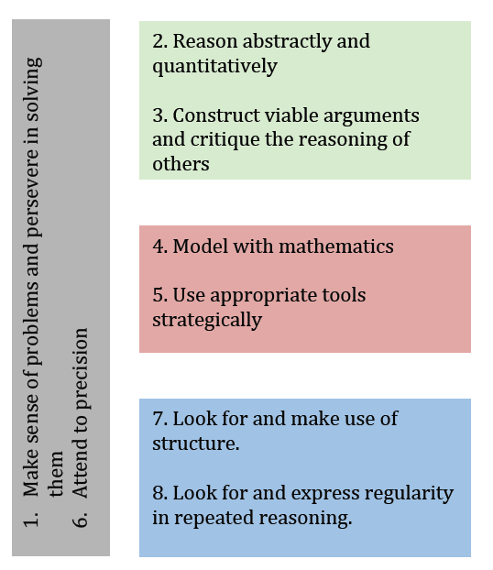
Standards for Mathematical Practice

Slide 6
A Mathematical Task . . .
is defined as a classroom activity, the purpose of which is to focus the students’ attention on a particular mathematical idea.

Slide 7
What is a [Rich] Task?
Rich tasks are . . .
Often have a “low floor and high ceiling”,
Might be set in contexts that are intriguing to learners.
Offer opportunities for initial success, yet challenge learners to think for themselves
Might allow learners to pose their own questions/problems
Allow for different methods and different responses
Encourage collaboration and/or discussion
Require students to make sense
Adapted from “Rich Tasks and Contexts” http://nrich.maths.org/5662

Slide 8
Think about this quote . . .
“In essence, rich tasks encourage children to think creatively, work logically, communicate ideas, synthesize their results, analyze different viewpoints, look for commonalities and evaluate findings. However, what we really need are rich classrooms: communities of enquiry and collaboration, promoting communication and imagination.”
“Rich Tasks and Contexts” http://nrich.maths.org/5562
Discuss these ideas with those at your table.
How do you create/use these types of tasks in your classroom?

Slide 9
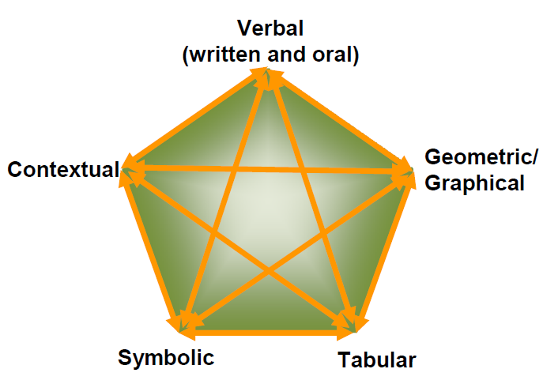
Tools and Representations are Key
Use multiple representations
Adapted from Lesh, R., Post, T., & Behr, M. (1987). Representations and Translations among Representations in Mathematics Learning and Problem Solving. In C. Janvier, (Ed.), Problems of Representations in the Teaching and Learning of Mathematics (pp. 33-40). Hillsdale, NJ: Lawrence Erlbaum.
Choose your tools wisely
Graphing calculator
Desmos
Spreadsheets
Graph paper
Thinking in patterns
Drawing and sketching

Slide 10
The Shrinking Square
Let’s do this!
Explore Activity – 30 minutes
Summary discussion – 15 minutes
How could you use this task in your classroom?
What mathematical connections could be made to this task?
Lower grade level?
In Algebra 1? Algebra 2?

Slide 11
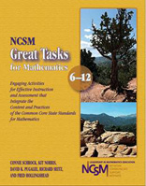
NCSM’s Great Task Books for K-5 and 6-12
http://www.mathedleadership.org/resources/shop.html
ISBN (6-12): 978-0-9890765-1-7
ISBN (K-5): 978-0-9890765-0-0

Slide 12
Thank you very much!
Jason Gauthier
NCSM Central 1 Regional Director
jgauthier@alleganaesa.org
@jgauthier13
www.whatsupwithmath.com
NCSM: www.mathedleadership.org

