Slide 1
Mathematical Modeling at the Secondary Level: Something to Talk About
Math in Action 2019
Jason Gauthier
www.whatsupwithmath.com
@jgauthier13

Slide 2
Mathematical Discourse
“Discourse stretches beyond discussion because it includes ways of representing, thinking, talking, agreeing, and disagreeing.” (Visible Learning for Mathematics, 2017, p. 136)

Slide 3
What is “mathematical modeling”?
Mathematical modeling is a process that uses mathematics to represent, analyze, make predictions, or otherwise provide insight into real-world phenomena. (GAIMME Report, 2016 , p. 8)
Using mathematics or statistics to describe (i.e., model) a real world situation and deduce additional information about the situation by mathematical or statistical computation and analysis.” (CCSSM Writing Team, 2013, p. 5)

Slide 4
Important Features of Mathematical Modeling
authentically connects to the real world, starting with ill-defined, often messy real-world problems with no unique correct answers.
is used to explain phenomena in the real world and/or make predictions about the future behavior of a system in the real world.
requires the modeler to be creative and make choices, assumptions, and decisions.
is an iterative process.
There are multiple paths open to the mathematical modeler and no one clear, unique approach or answer. (Cirillo, et al., 2016, p. 8-9, emphasis in original)
Math Modeling Teaching Principles
Modeling (like real life) is open-ended and messy
When students are modeling, they must be making genuine choices
Start big, start small, just start
Assessment sh0uld focus on process, not product
Modeling does not happen in isolation
Notes:
Take two minutes to read the slide.
Think about how the two lists are similar and different.
What stuck out to you? What do you feel is most important?
Share with a shoulder partner.

Slide 5
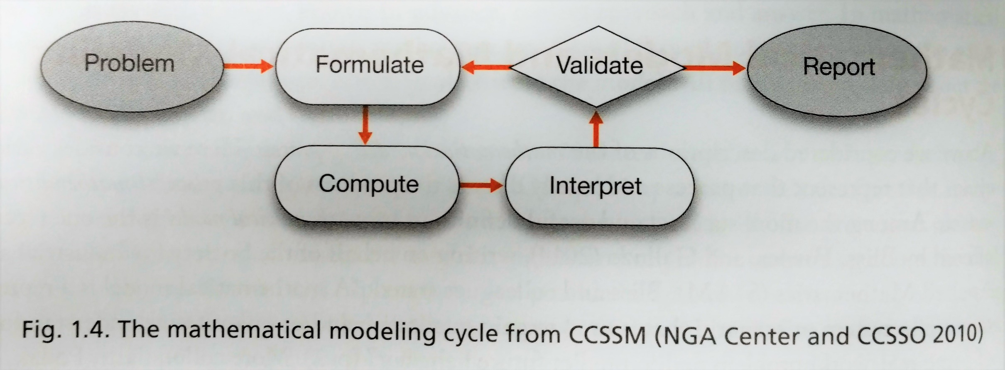
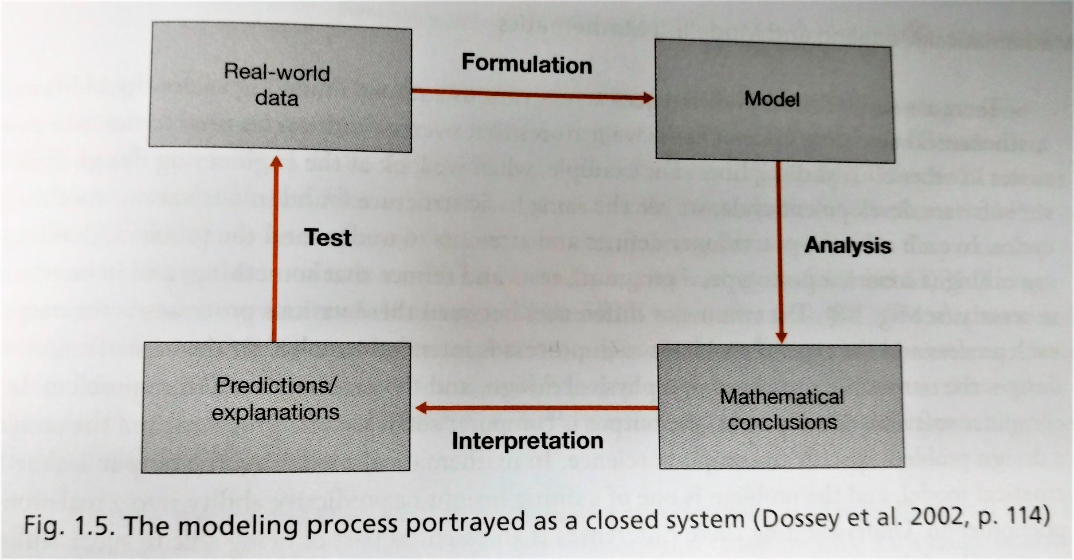
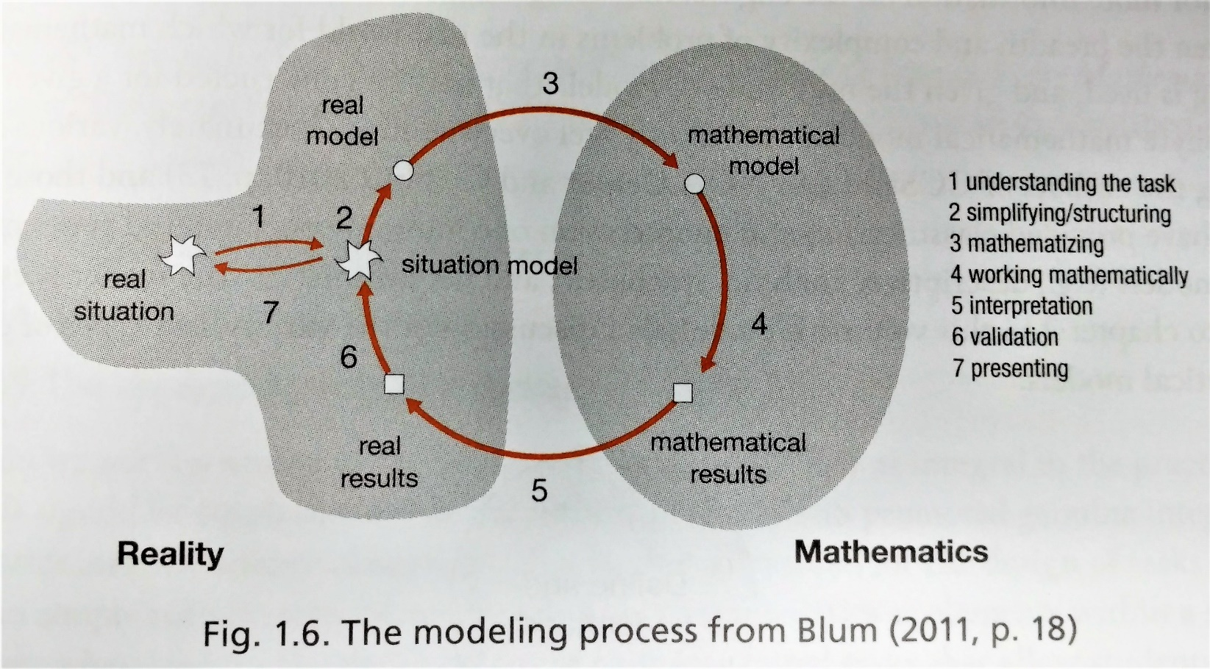
Mathematical Modeling Cycles

Slide 6
Mathematical Modeling Cycle, Expanded
Real-world Situation
Evaluate/Make Sense
Context-based Solution
Generalize
Assume
&
Simplify
Decontextualize &
Represent
Contextualize
Interpret
Mathematical Model
Mathematical Solution
Analyze & Solve
Test & Modify
The Mathematical Modeling Cycle, Expanded is adapted from Hirsch (2014, personal communication [graduate course discussion])

Slide 7
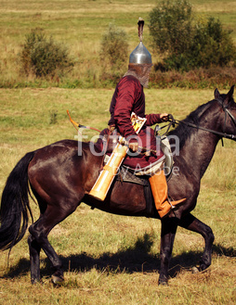
Let’s try a modeling problem . . .
German metalsmiths once claimed that they could cover a horse and rider with the gold from one gold mark. Is there any basis in reality for such a claim?

Slide 8
Estimation and Assumption
What might you need to know to figure this out?
Where might you find such information?

Slide 9
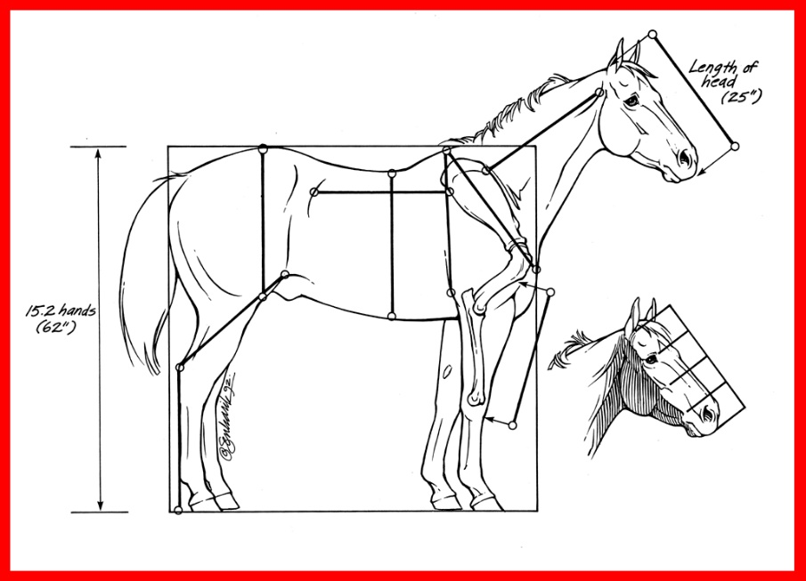
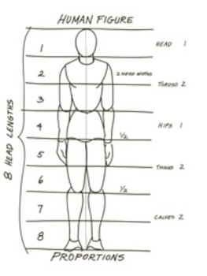
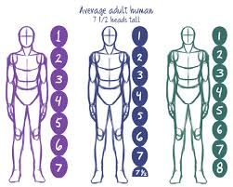
Commonly Available Information
Horses
Horses are measured in hands, height is to the withers (top of shoulder or rump)
1 hand is 4 inches
Avg. height:
15.2 hh (hands)
Riders
The average human is between 7 and 8 heads tall.

Slide 10
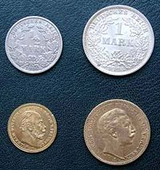
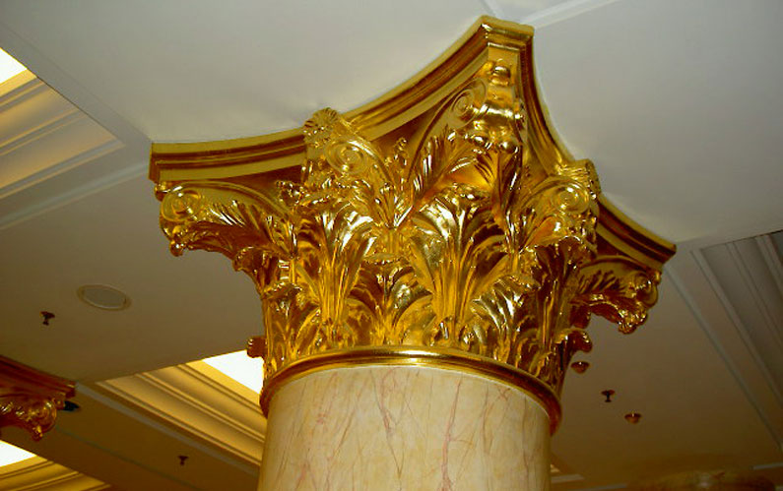
Gold Leaf and Coinage
German Gold Mark (1873-1914)
5 Mark (1877-1878) | 1.9912 g
10 Mark (1873-1914) | 3.9825 g
20 Mark (1873-1914) | 7.965 g
Gold coins were minted to a standard .900 fineness of 2790 Mark = 1 kg of gold

Slide 11
Model, Explain, Examine, Revise
After you’ve found your answer . . .
Write your group’s solution on poster paper
Include your assumptions and the information used
Gallery Walk
As you move around the room, compare solutions with other groups
Be sure to examine assumptions
Plan for Revision
Based on what you saw, how would you change your model?
Why would you make those changes?

Slide 12
Generalize Your Model
How might you generalize your model?
What are the variables in your model(s)?
Could you write a function that describes the process of hauling the mountain away? What kind of function would it be? How do you know?

Slide 13
Mathematical Modeling Cycle, Expanded
Real-world Situation
Evaluate/Make Sense
Context-based Solution
Generalize
Assume
&
Simplify
Decontextualize &
Represent
Contextualize
Interpret
Mathematical Model
Mathematical Solution
Analyze & Solve
Test & Modify
The Mathematical Modeling Cycle, Expanded is adapted from Hirsch (2014, personal communication [graduate course discussion])

Slide 14
A Thought on Modeling
“All models are wrong, but some are useful.”
- George Box

Slide 15
Discourse in Mathematical Modeling
Reflect on the following question:
What role did discourse play in your mathematical modeling activity today?

Slide 16
Sources
Cirillo, M., Pelesko, J. A., Felton-Koestler, M. D., & Rubel, L. Perspectives on modeling in school mathematics. In C. R. Hirsch & M. Montgomery (Eds.). Annual Perspectives in Mathematics Education 2016: Mathematical Modeling and Modeling Mathematics. Reston, VA: NCTM, 3-16.
Common Core Standards Writing Team. (2013). Progressions for the Common Core State Standards in Mathematics (draft) high school, modeling. Tucson, AZ: Institute for Mathematics and Education, University of Arizona.
Garfunkel, S. & Montgomery, M. (Eds.). (2016). Guidelines for Assessment and Instruction in Mathematical Modeling Education. Bedford, MA: Consortium for Mathematics and its Applications [COMAP] and Society for Industrial and Applied Mathematics [SIAM].
Hirsch, C. R. (2014). Personal communication [graduate course discussion].
Hirsch, C. R. & McDuffie, A. R. (Eds.). (2016). Annual Perspectives in Mathematics Education 2016: Mathematical Modeling and Modeling Mathematics. Reston, VA: NCTM.
Paulos, J. A. (1988). Innumeracy: Mathematical Illiteracy and Its Consequences. New York, NY: Hill and Wang.

Slide 17
Thank You!
jgauthier@alleganaesa.org www.whatsupwithmath.com @jgauthier13

