Slide 1
C²MATH Assessments
Common Core Mathematics Assessments Tested and Housed
Keith Barnes
St. Joseph County ISD
kbarnes@sjcisd.org

Slide 2
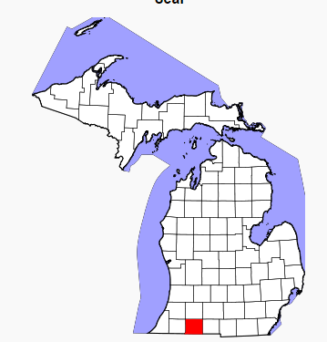
The “What”
St. Joseph county Math Teachers, by grade level or HS course taught, came together to:
Unpack content standards
Determine the “I knows…” and the “I cans…”
Determine the vocabulary
Write assessments
For every Common Core Standard K – 8, Algebra I, Geometry, and Algebra II

Slide 3
The Goal
To write common assessments for each Common Core Content standard.
To have teachers feel confident to pull any assessment anytime for any purpose.
The assessments would cover the standard COMPLETELY and DEEPLY.

Slide 4
Flexibility
Primarily used as a summative assessment
Pre- and Post-assessment
Formative
Practice
Homework
Can be used to help determine a Standards-based grade
Word Documents

Slide 5
Expectation
To give the entire assessment
Could be broken into parts given at different times of the year… but must be given entirely to determine PROFICIENCY.

Slide 6
Where are we now?
We are:
  Gathering data from 6th and 7th grade Math teachers and editing will be done in the Spring.
  Plan to do some common curriculum work around these assessments with Elementary teachers in the Fall.
  Making connections to the rigor of these assessments as I work with districts for their SAT preparations.

Slide 7
Elbow Partner
How might you use these assessments and/or the unpacked documents?

Slide 8
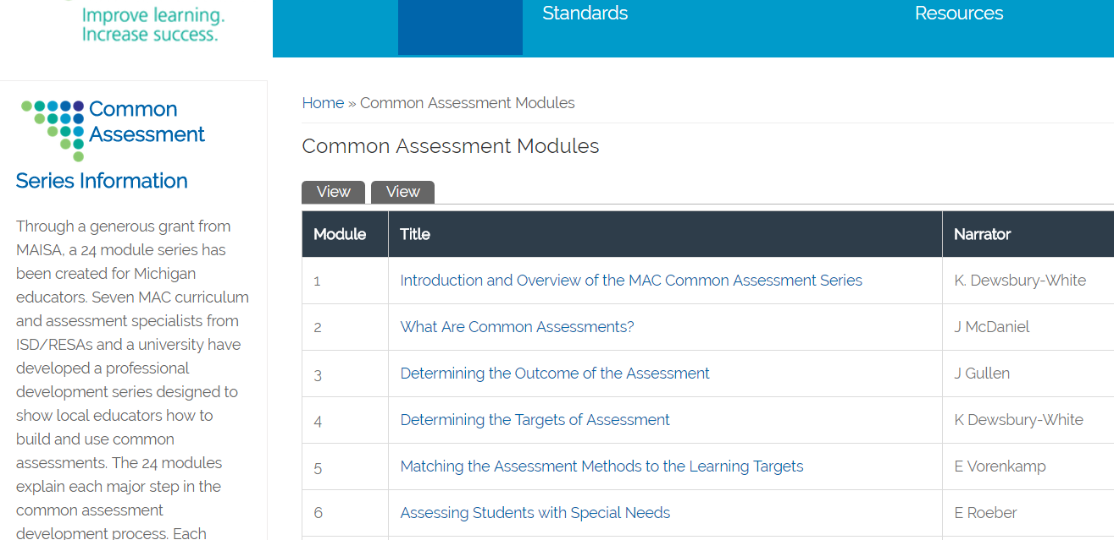
The “How” Used the Michigan Assessment Consortium
Common Assessment Module series as the assessment writing foundation

Slide 9
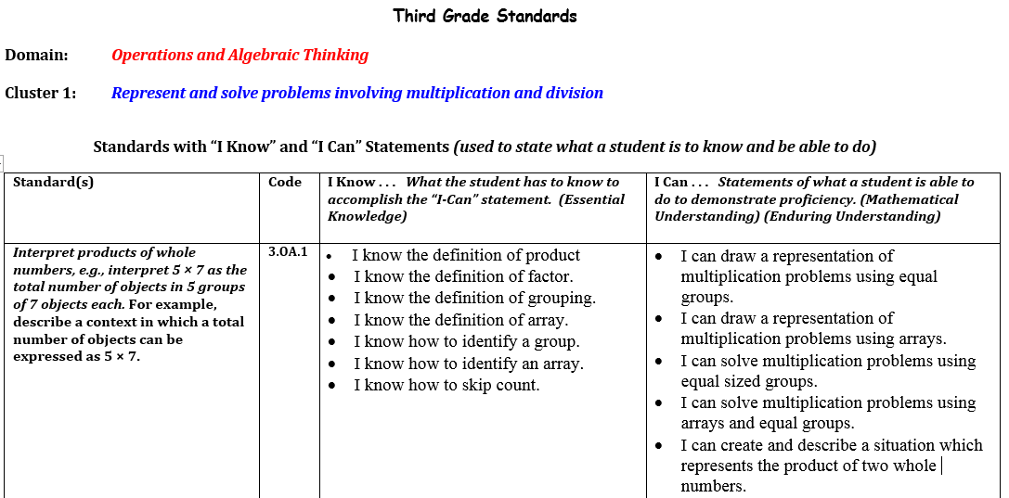
The Elementary and Middle School Unpacked Documents
We listed the “I knows…” and “I cans…” and Vocabulary

Slide 10
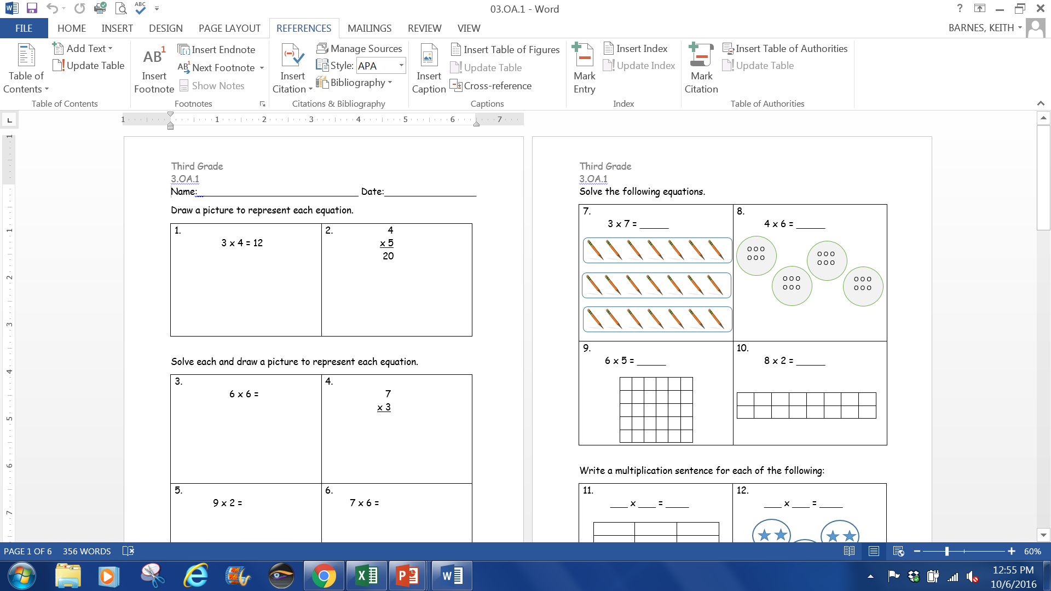
The Elementary and Middle School
Assessments
Problems written to every “I can…” statement.

Slide 11
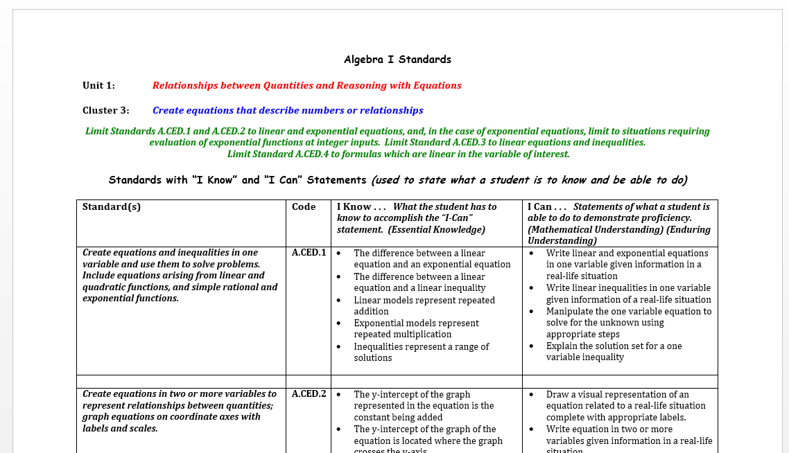
The High School Unpacked Documents
Grouped by clusters
Sometimes broken apart into smaller chunks

Slide 12
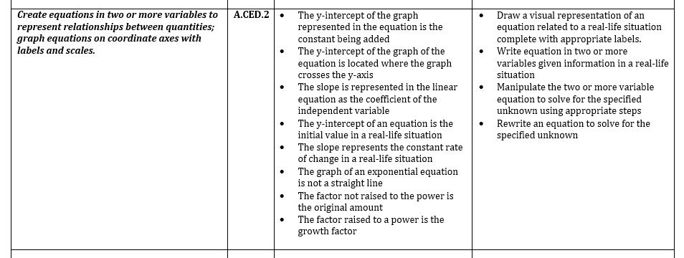
The High School Unpacked Documents
We listed the “I knows…” and “I cans…” and Vocabulary
A.CED.2

Slide 13
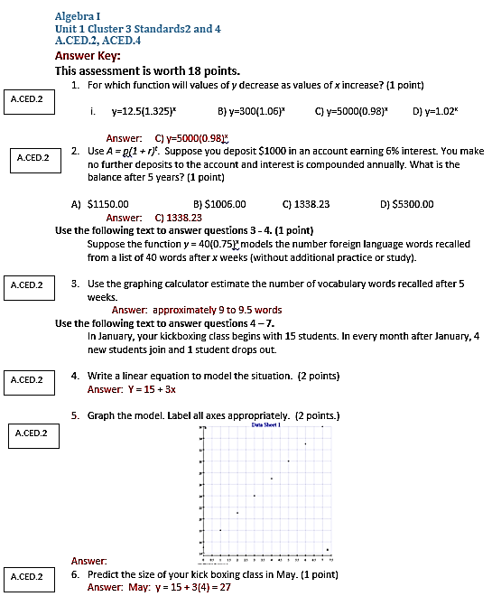
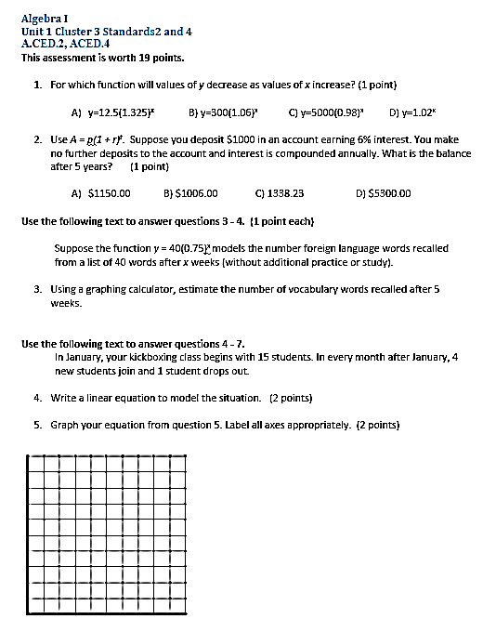
The High School Assessments
Problems written to every “I can…” statement.

Slide 14
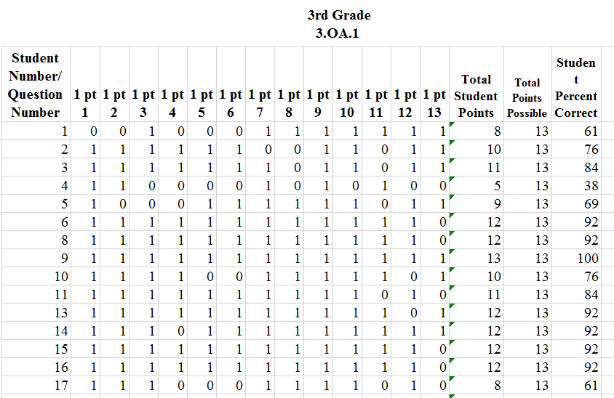
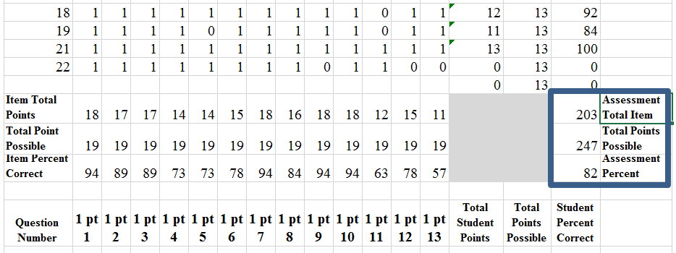
The Field Test
Teachers recorded data in a Excel spreadsheet and sent the data to me. I compiled data and gathered teachers to edit assessments… by item.

Slide 15
Elbow Partner
Now that you know a little more about them, how might you use these assessments and/or the unpacked documents?

Slide 16
The Site
http://tinyurl.com/c2mathassessments
Michigan Assessment Consortium:
  http://michiganassessmentconsortium.org/
  Keith Barnes
St. Joseph County ISD
kbarnes@sjcisd.org

