Slide 1
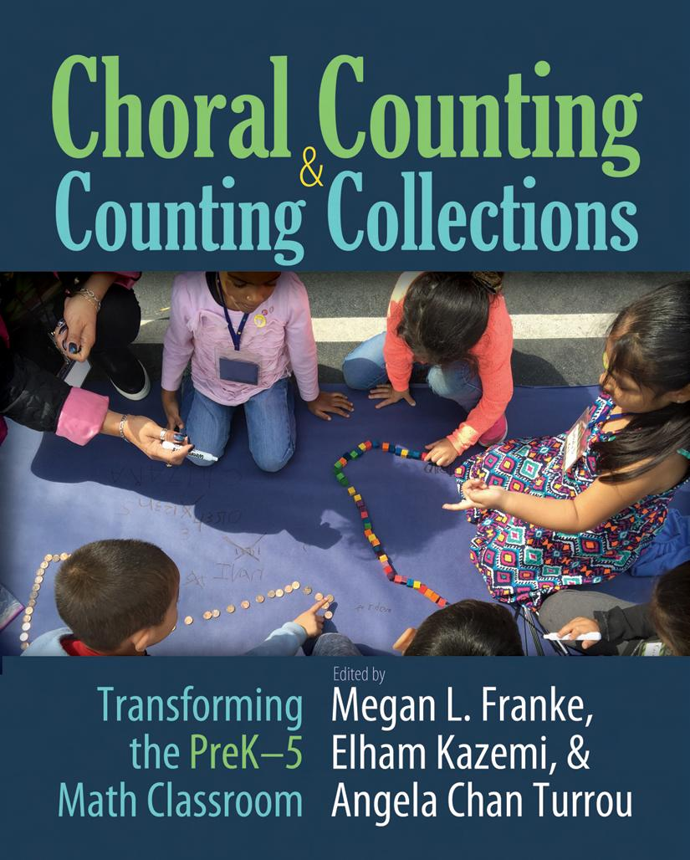
Choral Counting
How do we provide our learners opportunities to become robust in the three aspects of number?
Rusty Anderson Marcus Deja Andrew Smith
ISD Consultant ISD Specialist ISD Specialist
@RAnderson_Math @DejaMarcus @smithand1015
Notes:
Andrew

Slide 2
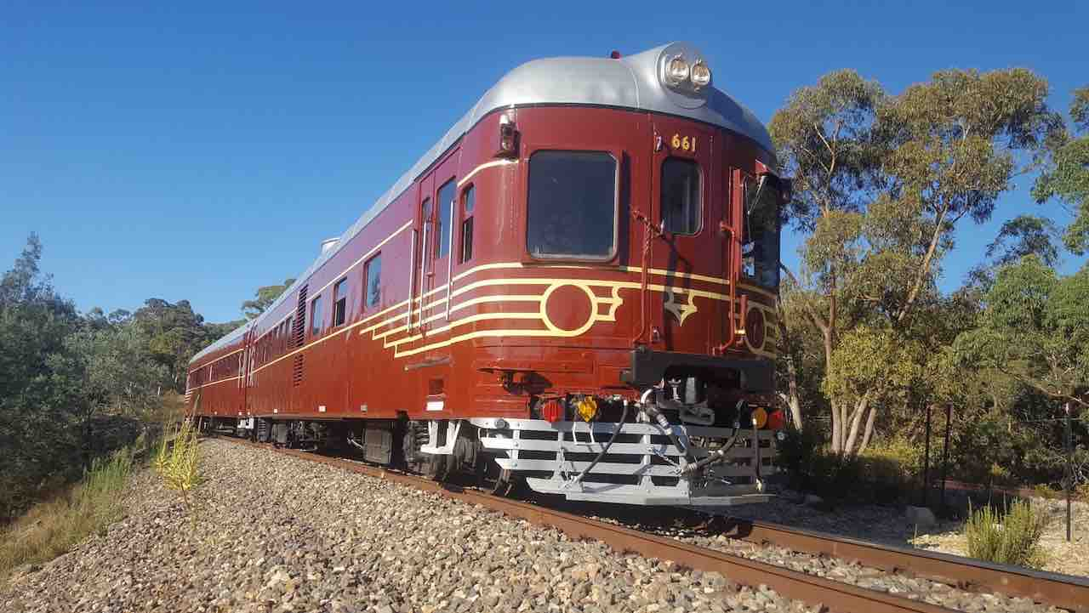
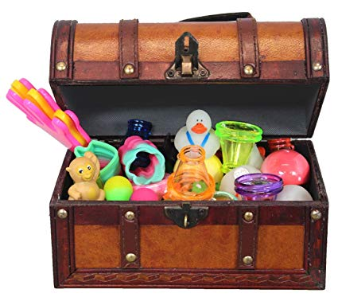

Slide 3
Inclusion Activity
4 Images Simile
Utilizing the image you selected from the previous screen & a simile describe how the start of the school year has been for your students.
My journey in learning and teaching mathematics has been as _________ as __________ because ____________.
Partner A shares. Partner B listens, pauses, paraphrases. Switch roles.
Be prepared to share out whole group.
Watch for non-verbal cue.
Why?: To provide every individual with an opportunity to enter the room

Slide 4
Purpose: To collaborate around the opening routine of choral counting and change our thinking or behavior to reflect choral counting as an opportunity for students to gain robustness in the three aspects of number.

Slide 5
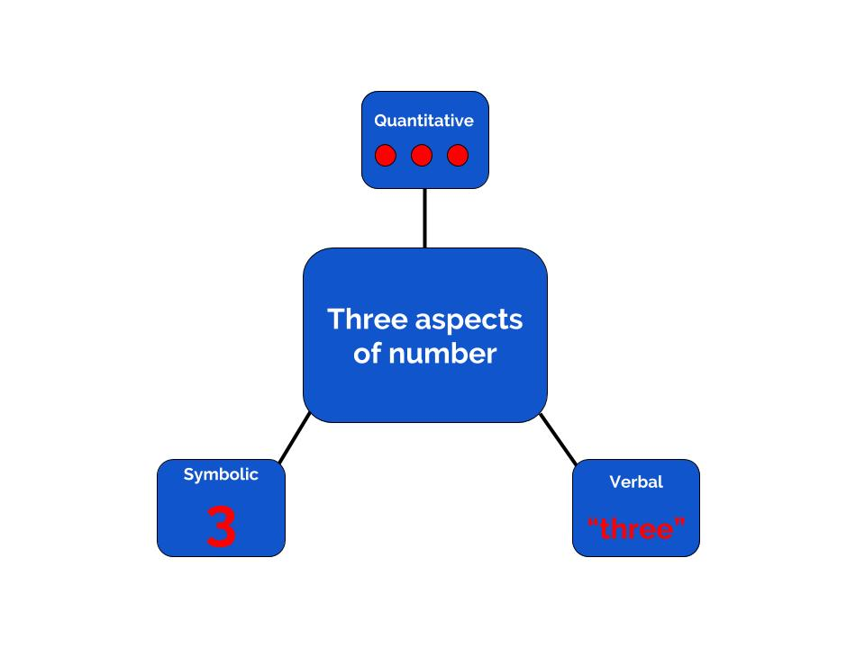
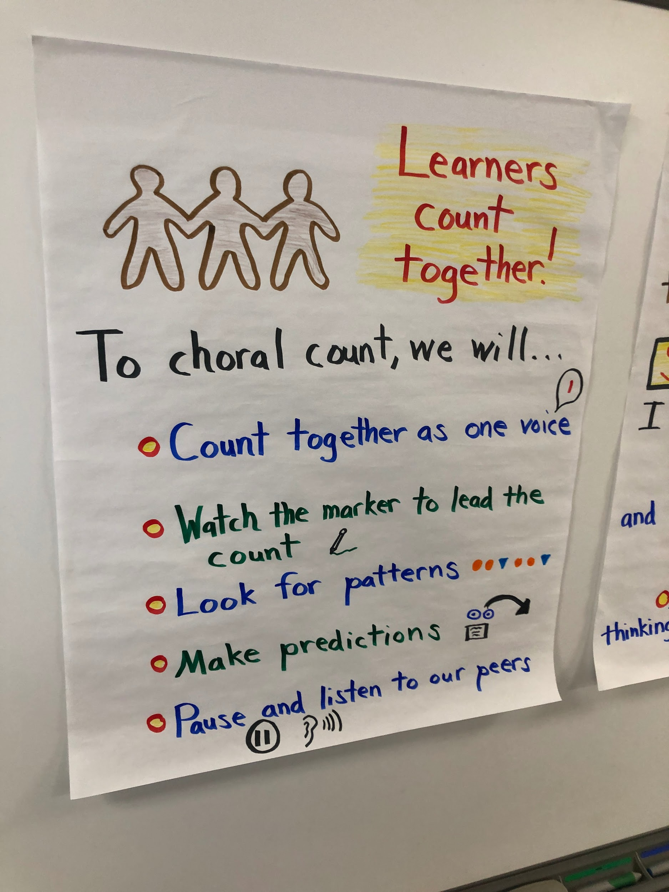
Learning Intentions & Success Criteria
LI - What might be the three aspects of number?
SC - I can name and explain the three aspects of number and how they are connected to choral counting.
LI - What might choral counting look and sound like?
SC - I can explain different characteristics of choral counting and what it might look and sound like with my learners.
LI - What roles might the teacher and students play during a choral count?
SC - I can describe my behaviors of facilitation and the role my students will play during this opening routine.

Slide 6
Agenda
Count with Purpose
What is Choral Counting?
Counting in Action
Campfires
Reflection & Action

Slide 7
Why Choral Counting?
Choral Counting

Slide 8
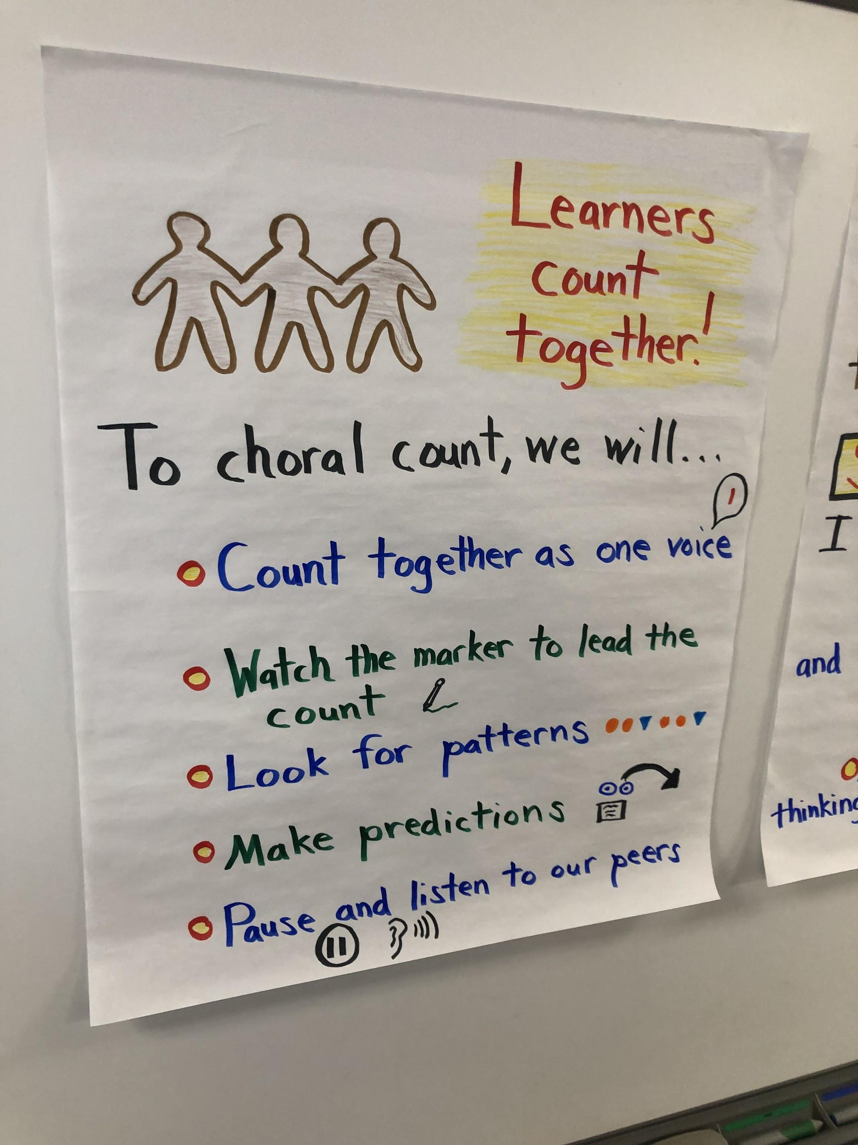
What is Choral Counting?
Key Concepts/Key Ideas
Individually read “Choral Counting in the Primary Grades” & “Big Mathematical Ideas” and annotate the text
After reading, turn & talk to an elbow partner utilizing,
A key concept/idea that resonated with me was...because…
An idea or detail I am wondering about is...because...
Partner A will share. Partner B will listen, pause, paraphrase, pause and inquire. Switch roles and repeat.
Be prepared to share out whole group.
Watch for non-verbal cue.
Notes:
Pgs. 79-82 - Rusty

Slide 9
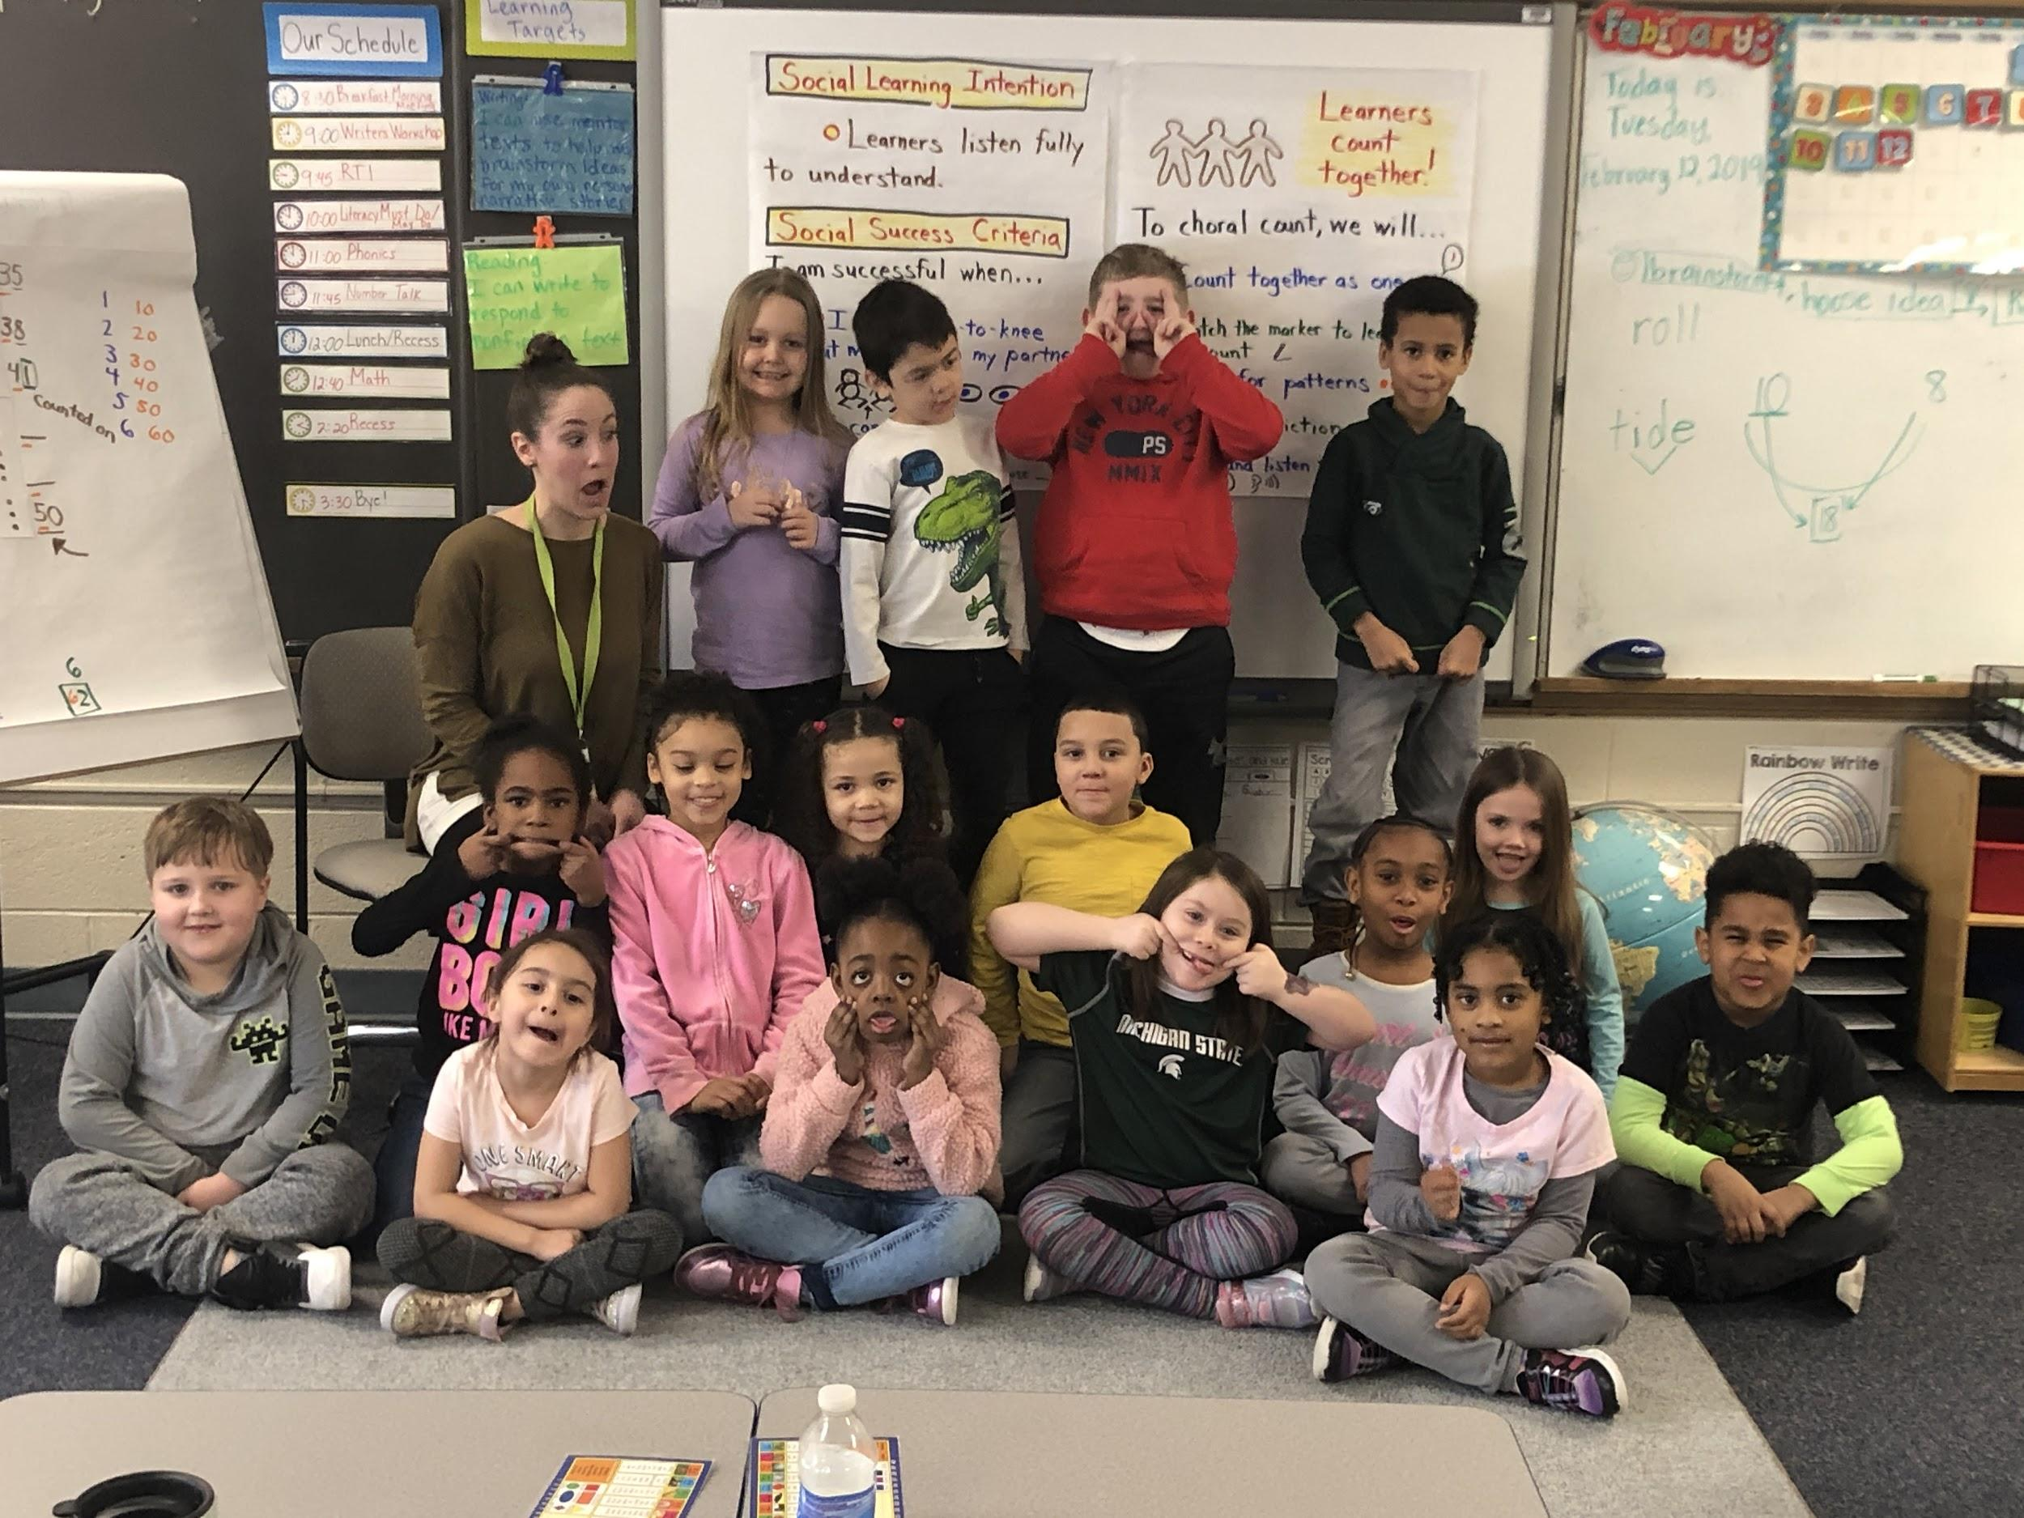
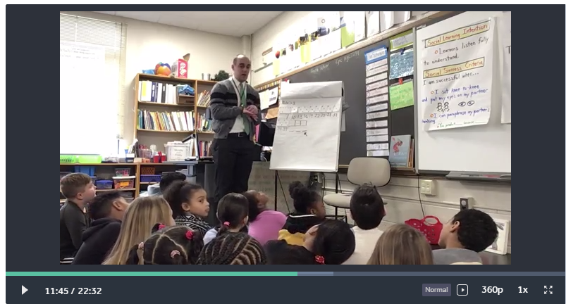
Choral Counting in Action
What might you notice/wonder about?:
-the routine
-the facilitator
-the students
-3 aspects of number

Slide 10
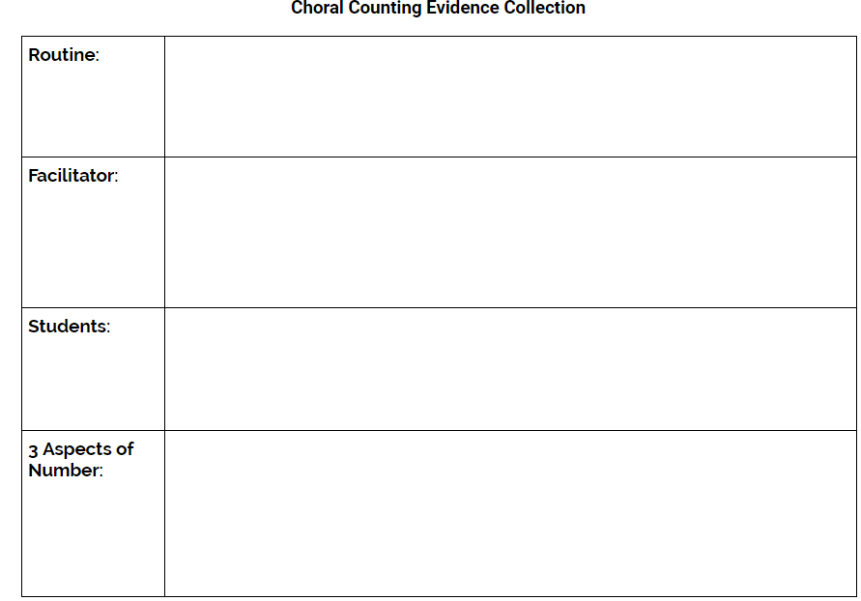
Standing Campfires
When prompted, stand and form a group of three.
In your standing campfire share noticings without crosstalk utilizing,
I noticed…
After noticings are exhausted, please feel free to offer up a wondering utilizing,
I noticed...and I wonder…
Engage in dialogue with your team members
Stay conscious of air time
Be prepared to share out
Watch for nonverbal cue
Notes:
Marcus

Slide 11
Reflection & Action
Behaviors/Actions: Reflecting on our time together today, what might be one thing you look forward to transferring back to the learners at your classroom or building?
Notes:
Index Cards - Stand and Share?

Slide 12
Thank you Godwin Heights!
Special thanks to Amy Schierbeek & the first grade learners at North Godwin Elementary who taught us all about choral counting for 5 days!

