Slide 1
[student name]
Change to your name
Secondary Admit Portfolio

Slide 2
ART 150 - 2D Design
Course Name
Course taken at “Great Lakes Community College”
Use this line if transfer work only

Slide 3
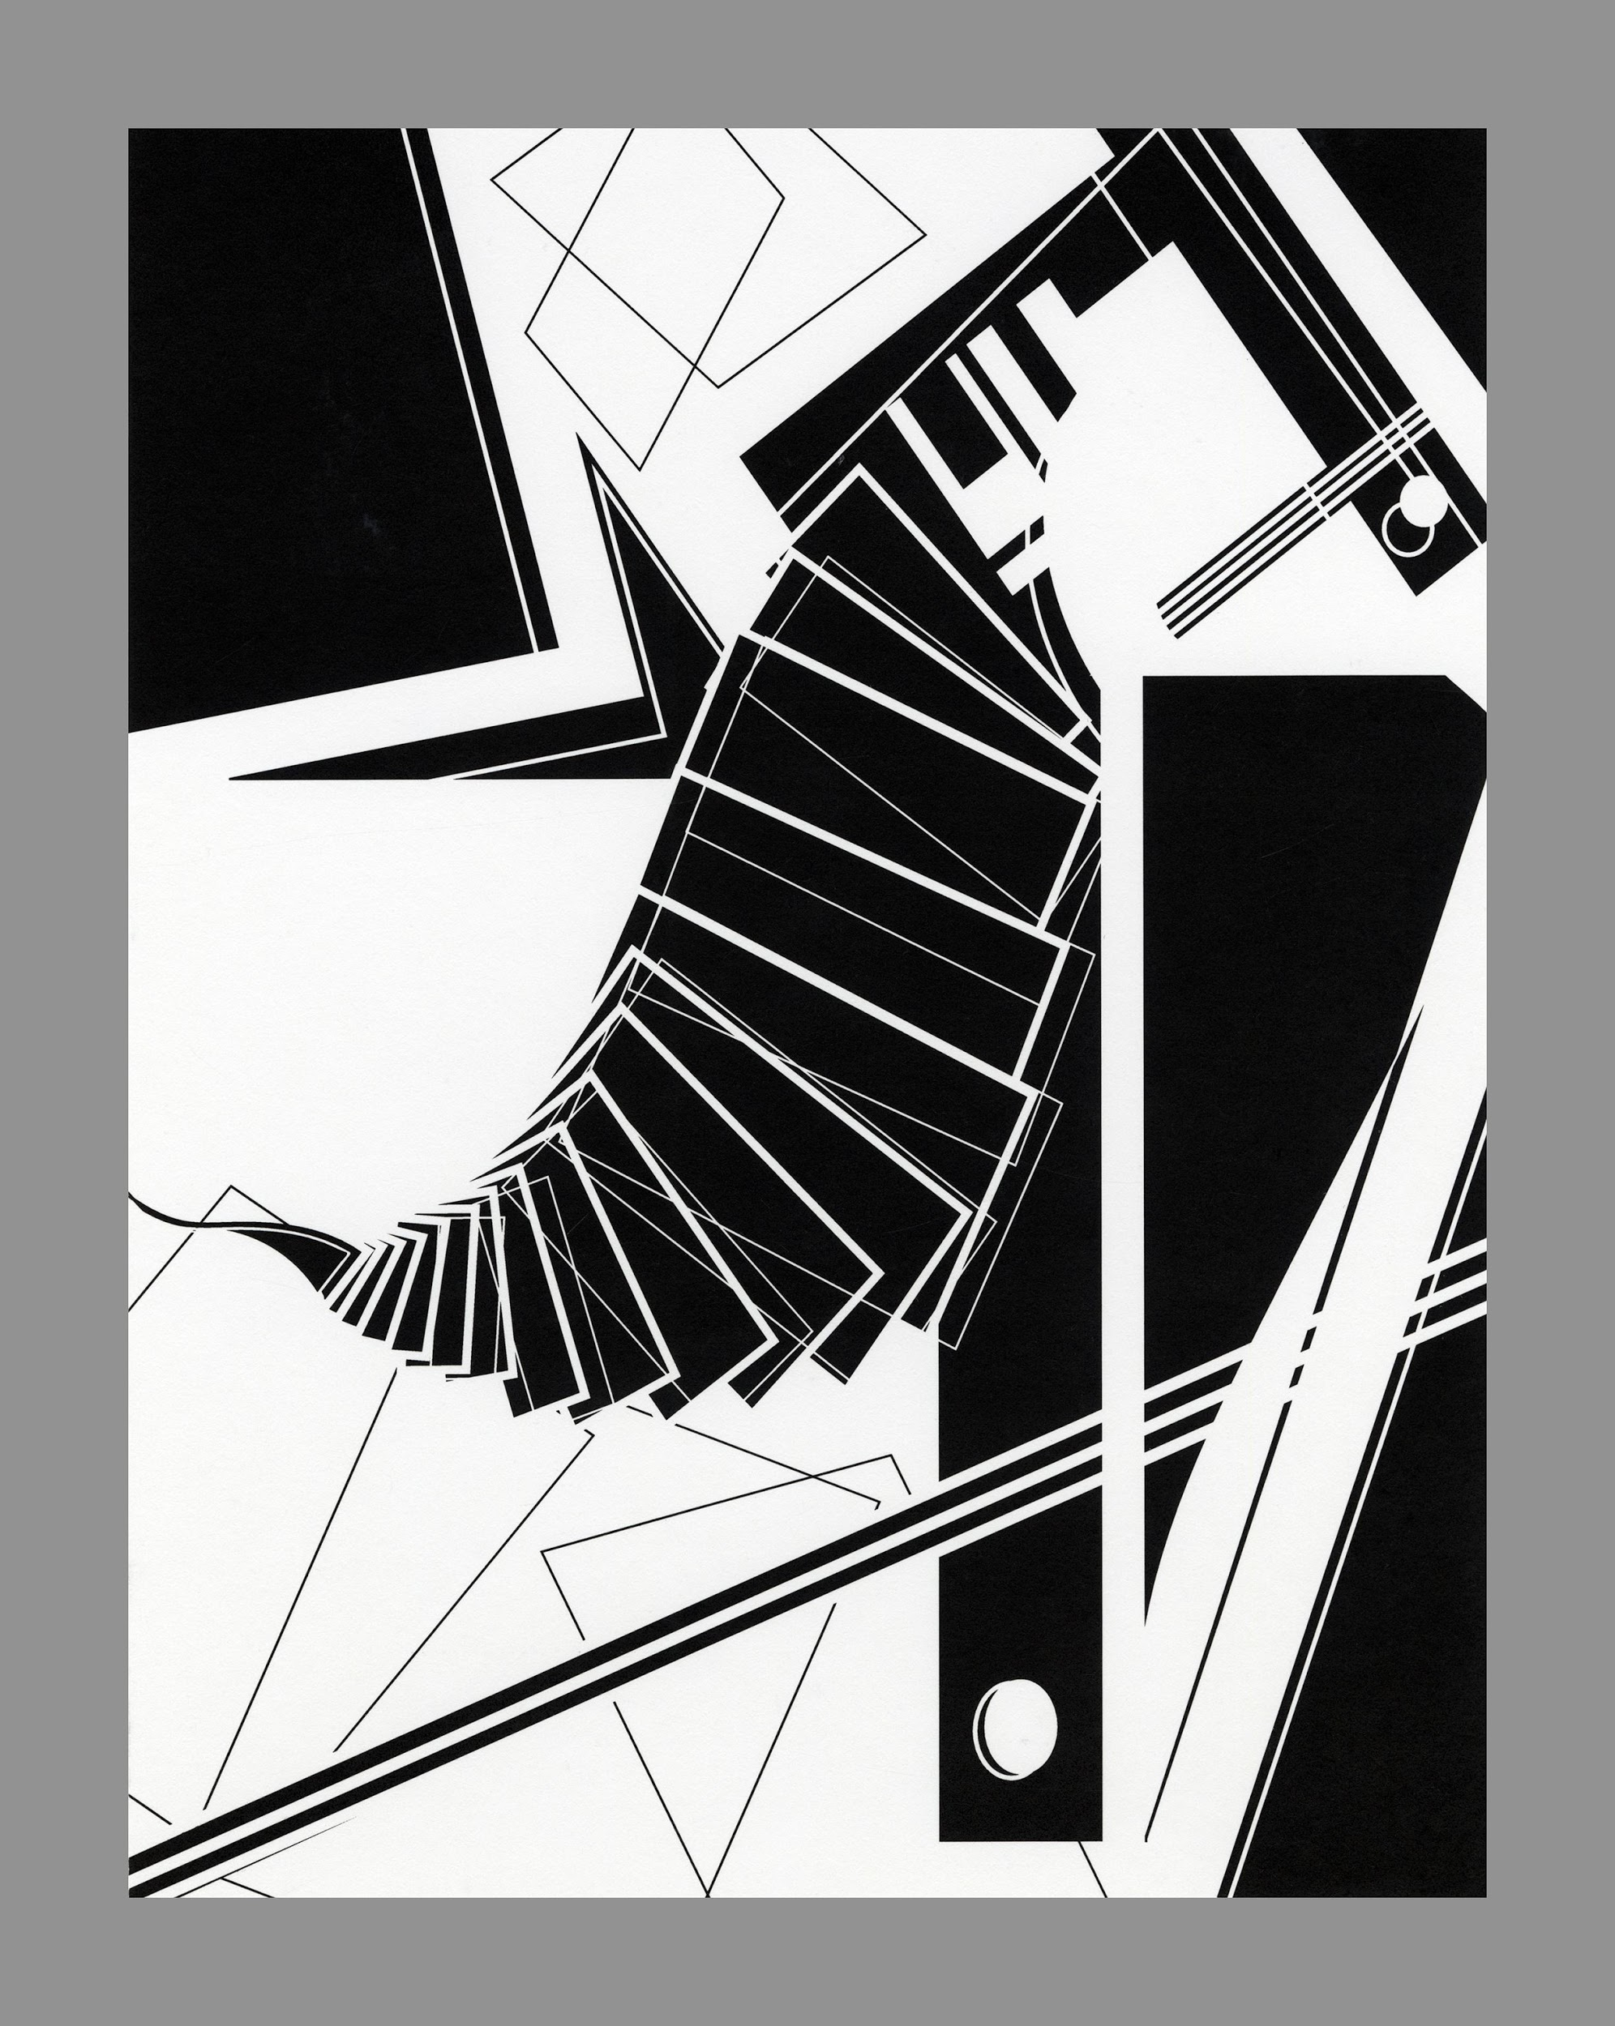
(*) For projects with multiple pieces (dyptichs or tryptichs), you can add all of them or just one.
Caption
Project, Media, Instructor

Slide 4
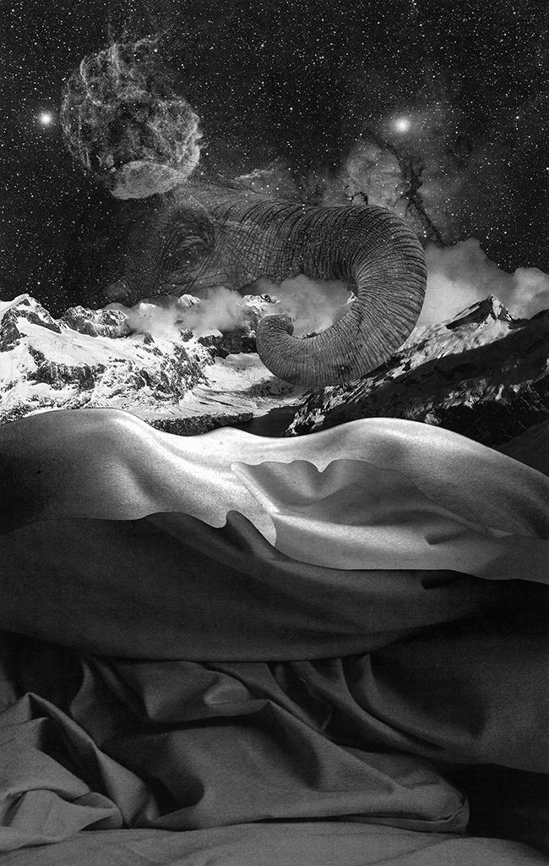
Project, Media, Instructor

Slide 5
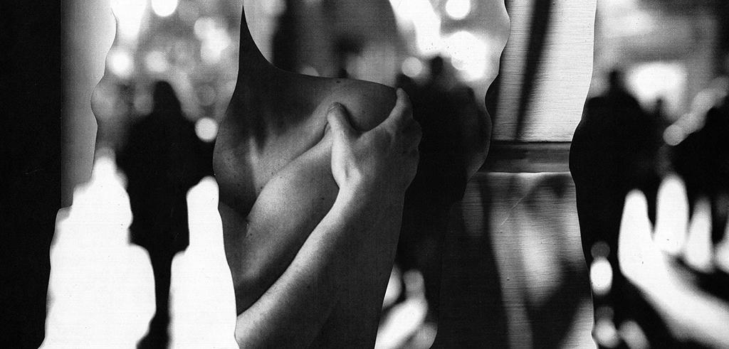
Project, Media, Instructor

Slide 6
ART 151 - 3D Design

Slide 7
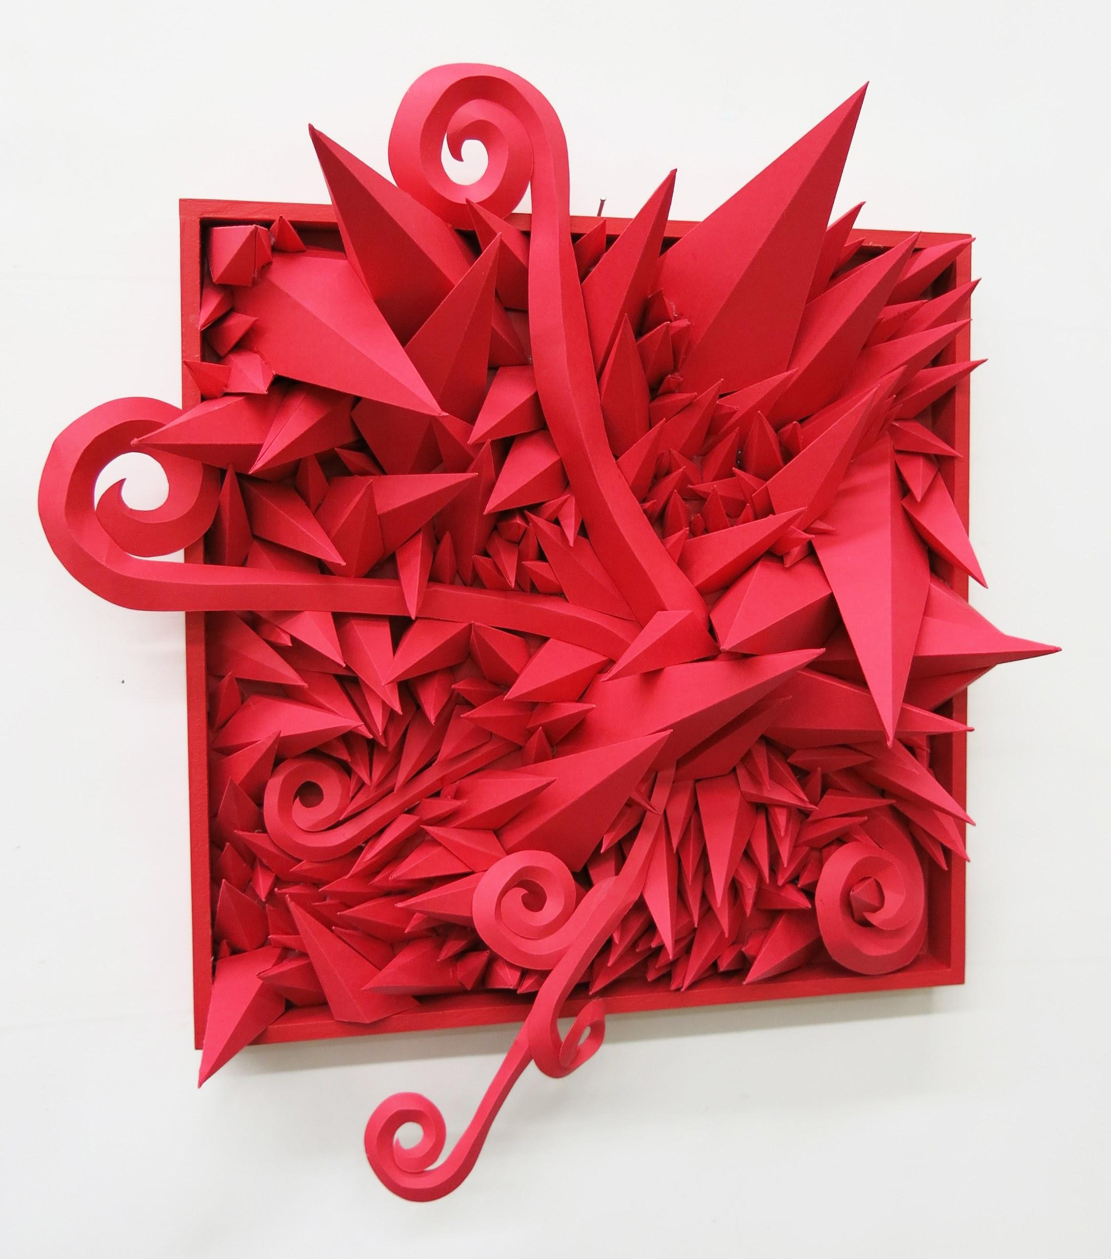
(*) For 3D projects, include multiple angles and/or details, so craft and form can be assessed.
Project, Media, Instructor

Slide 8
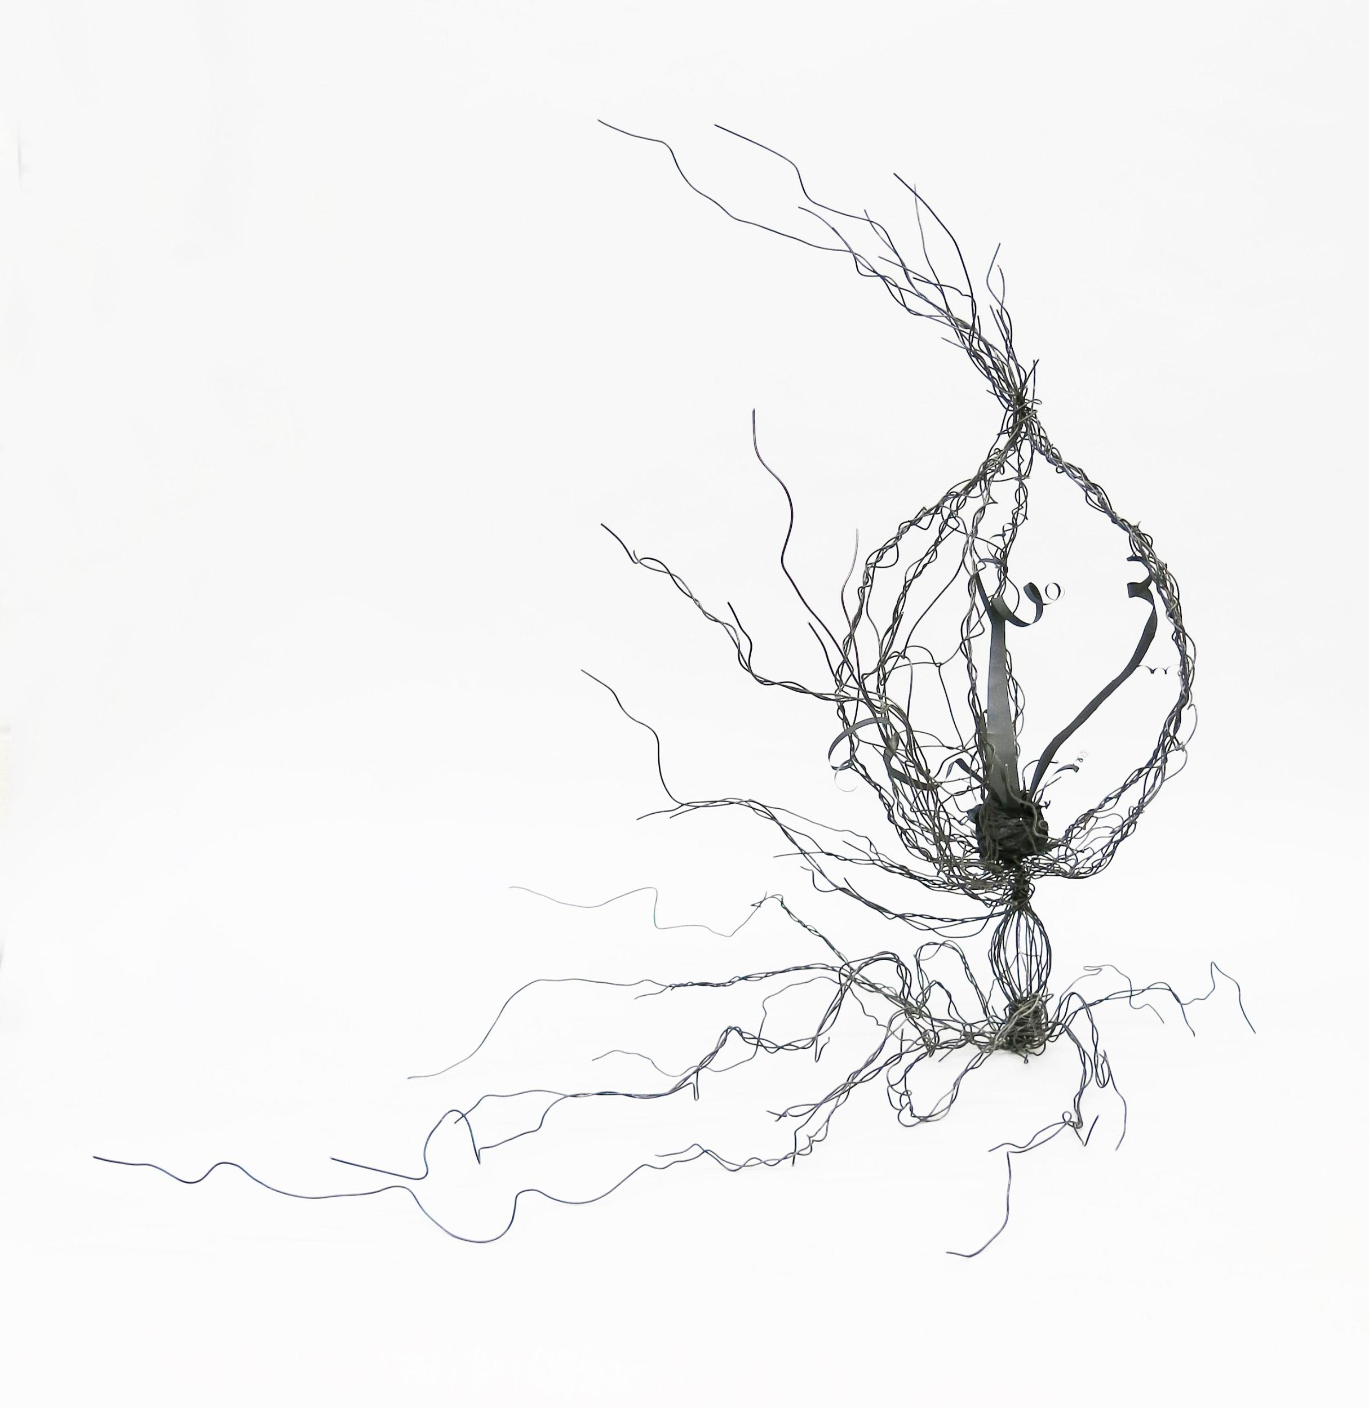
Project, Media, Instructor

Slide 9
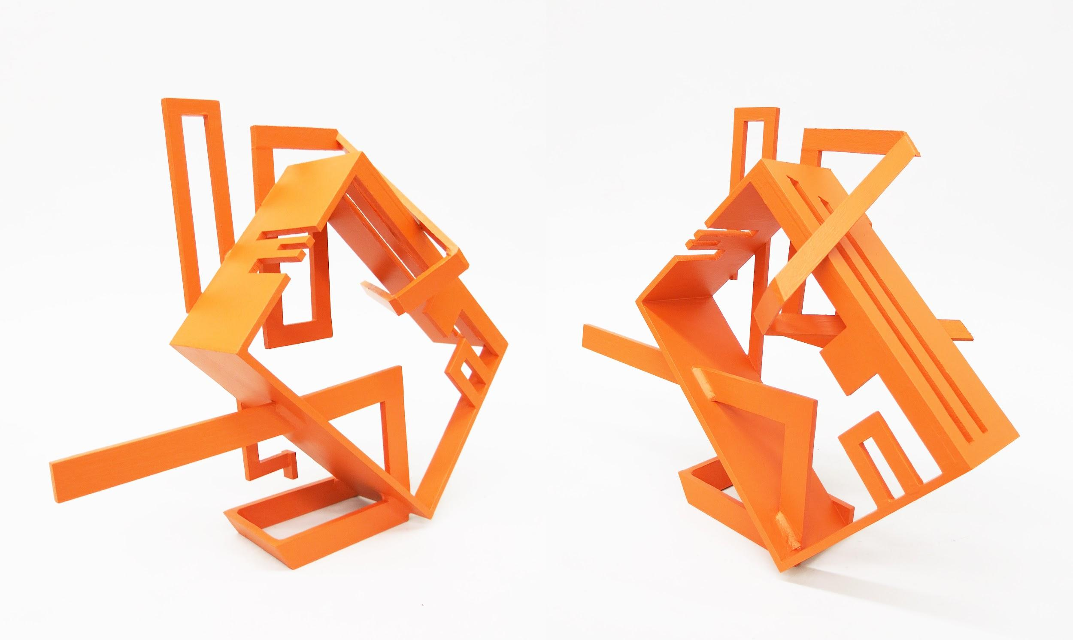
Project, Media, Instructor
(*) For 3D projects, include multiple angles and/or details, so craft and form can be assessed.

Slide 10
ART 152 - Color & Design

Slide 11
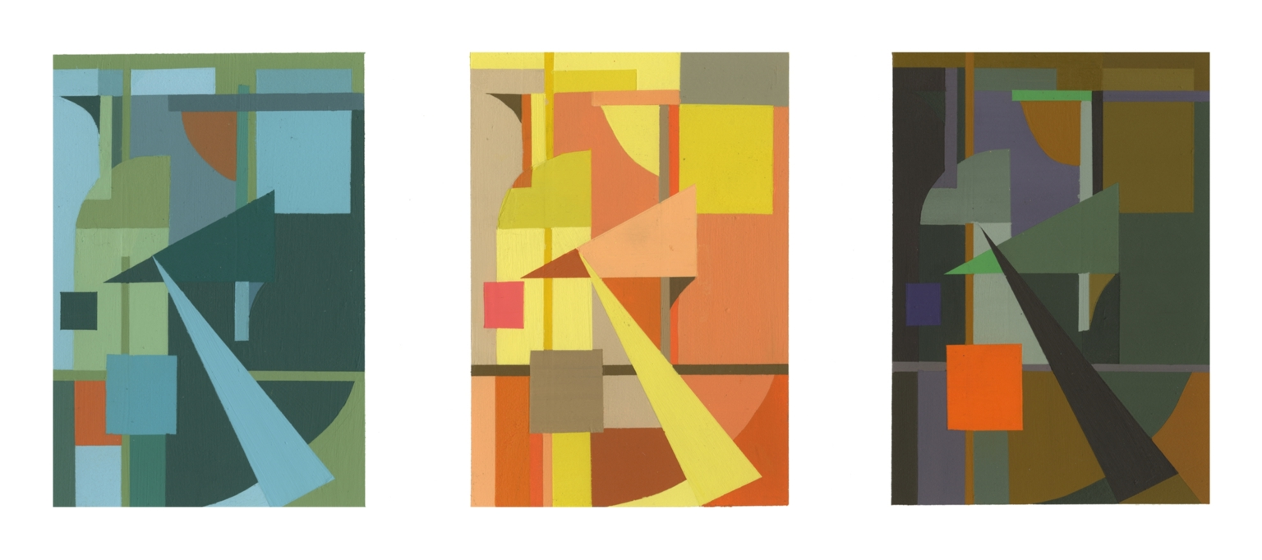
Project, Media, Instructor

Slide 12
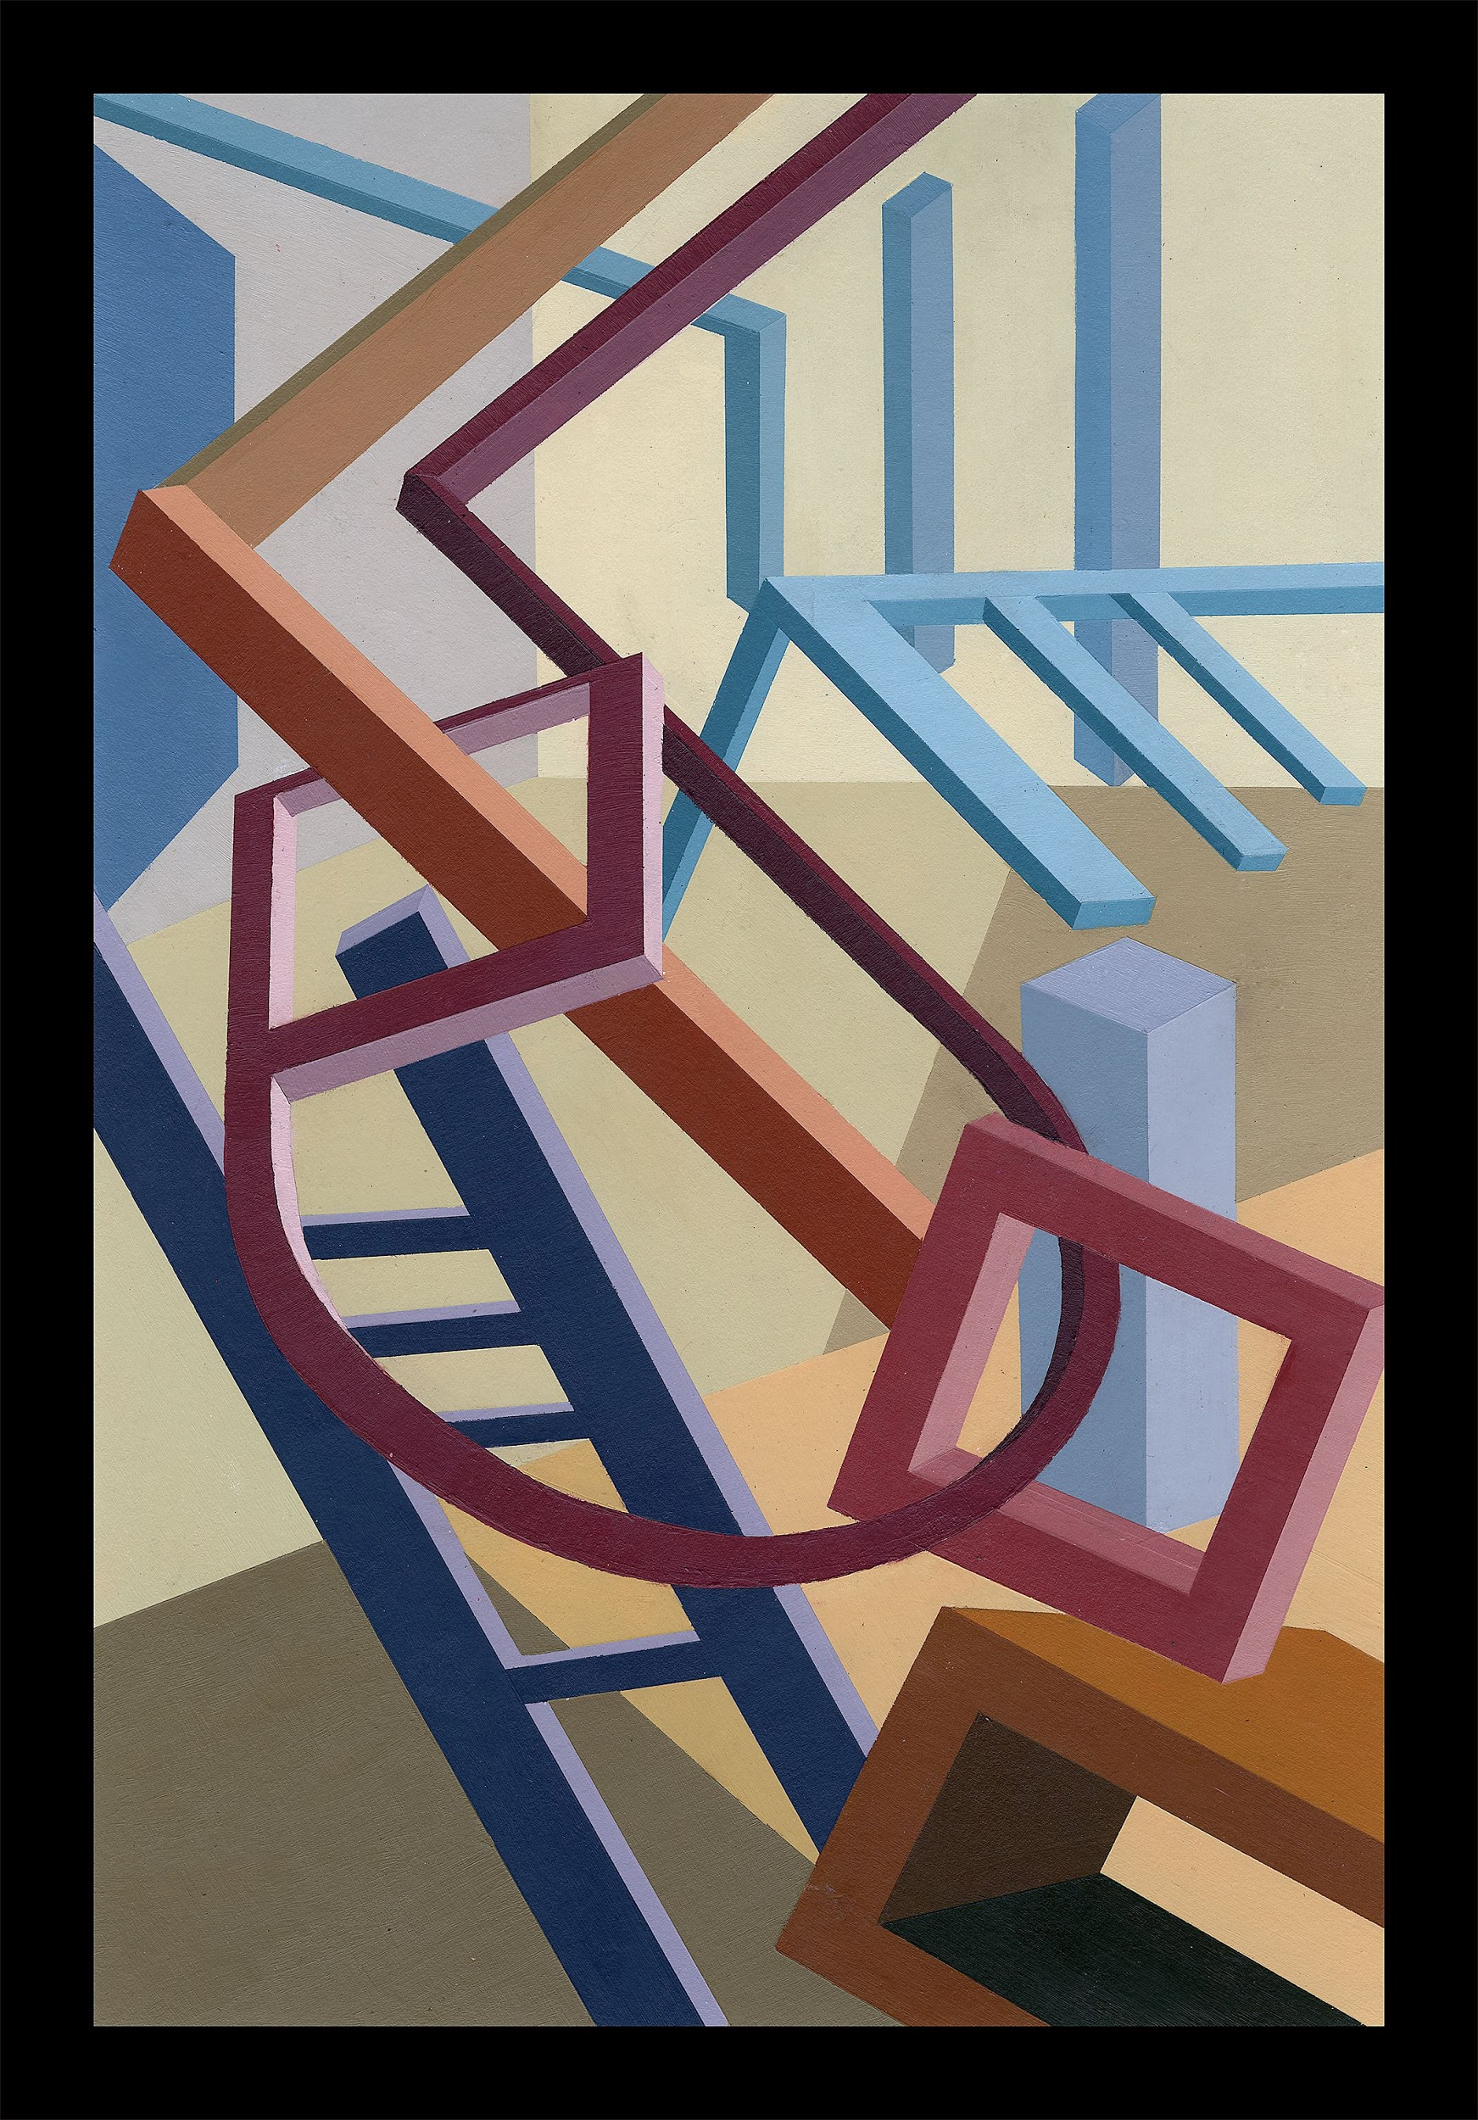
Project, Media, Instructor

Slide 13
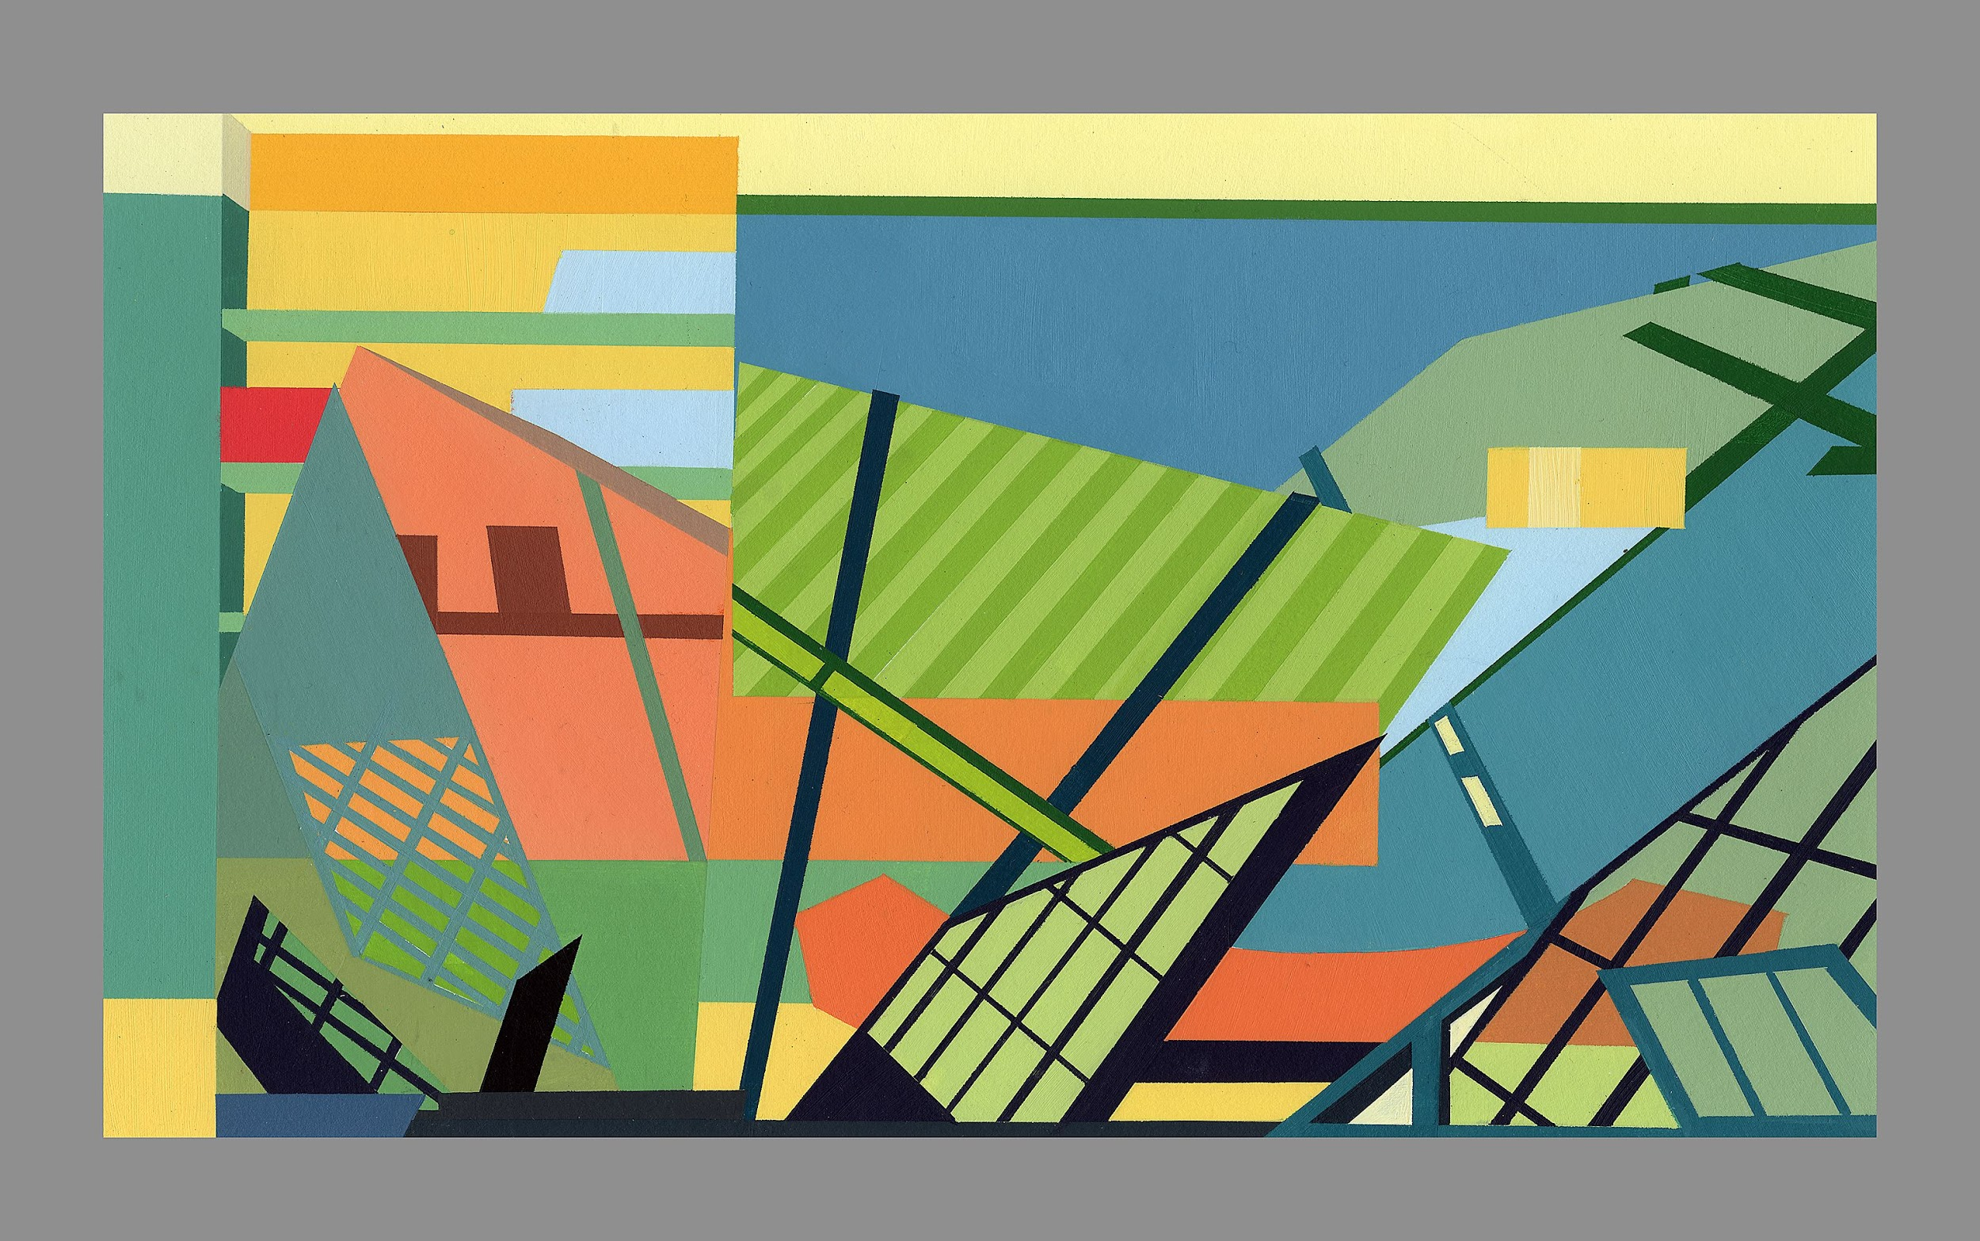
Project, Media, Instructor

Slide 14
ART 153 - Making & Meaning

Slide 15
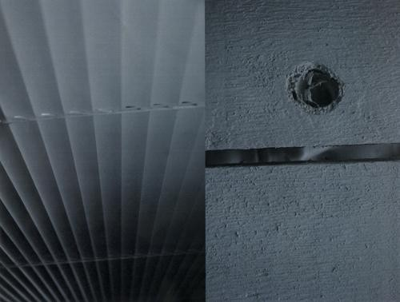
Project, Media, Instructor

Slide 16
Project, Media, Instructor

Slide 17
Project, Media, Instructor

Slide 18
ART 155 - Drawing I

Slide 19
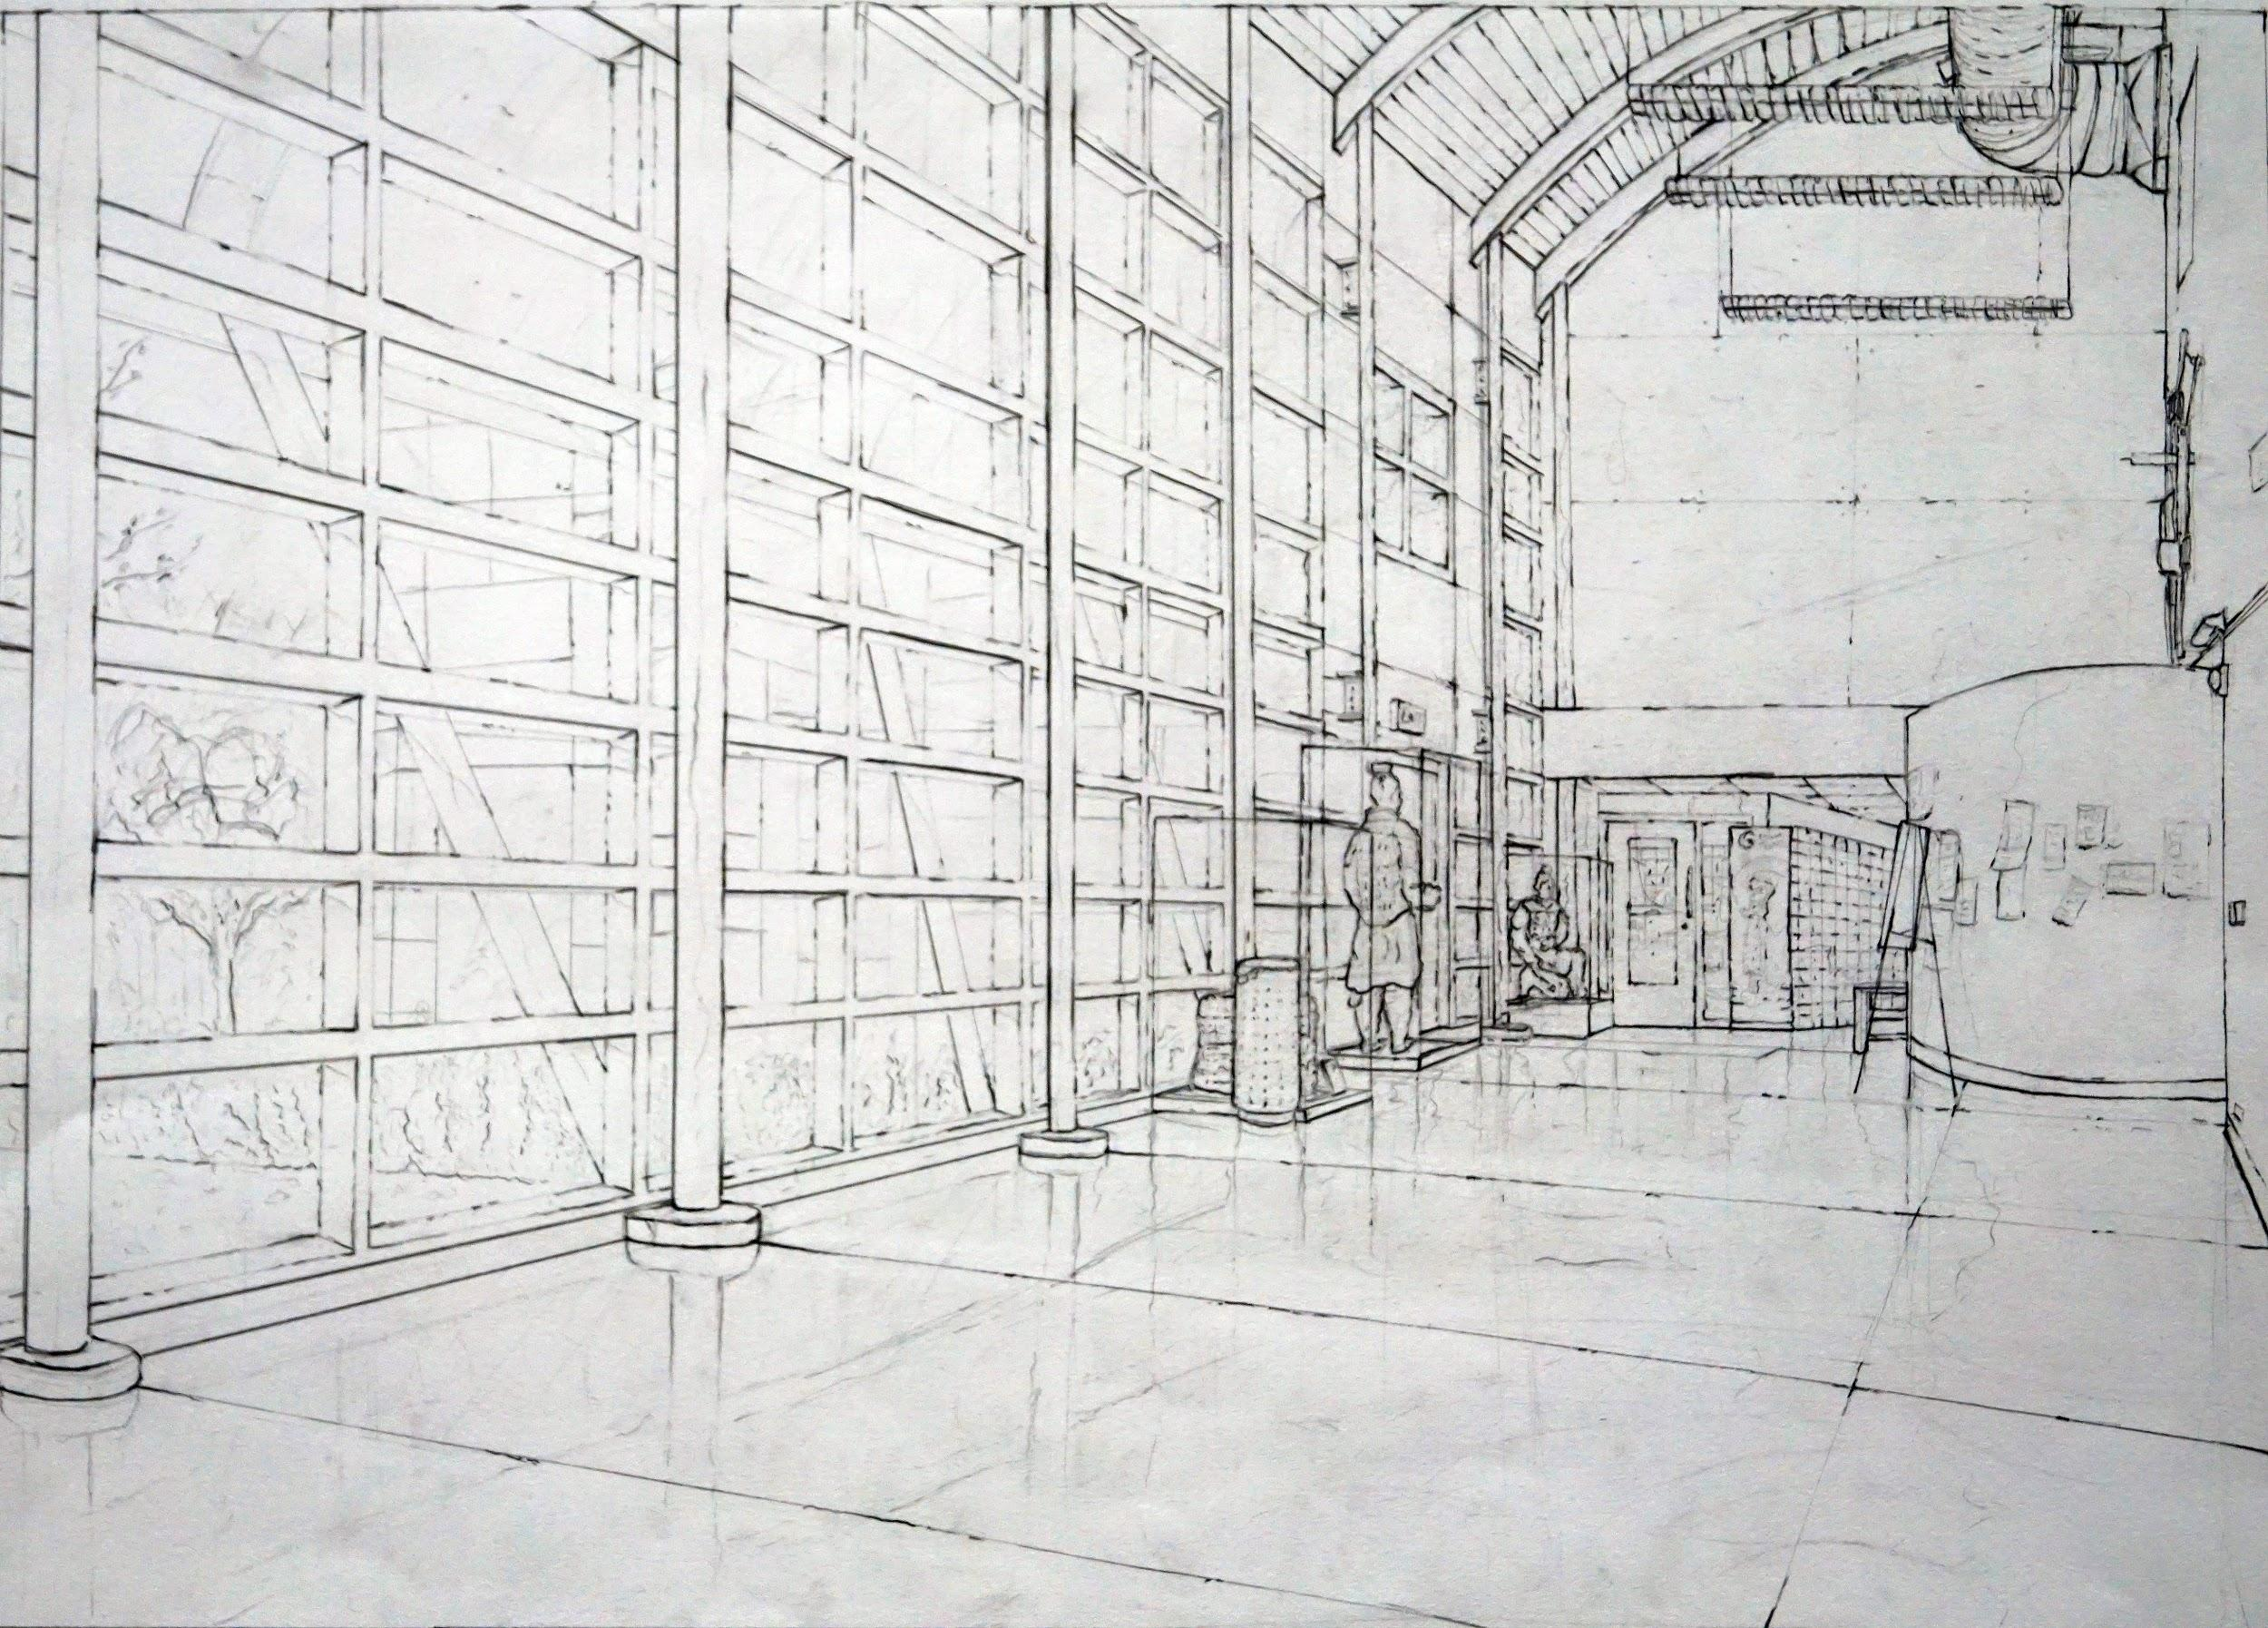
Project, Media, Instructor

Slide 20
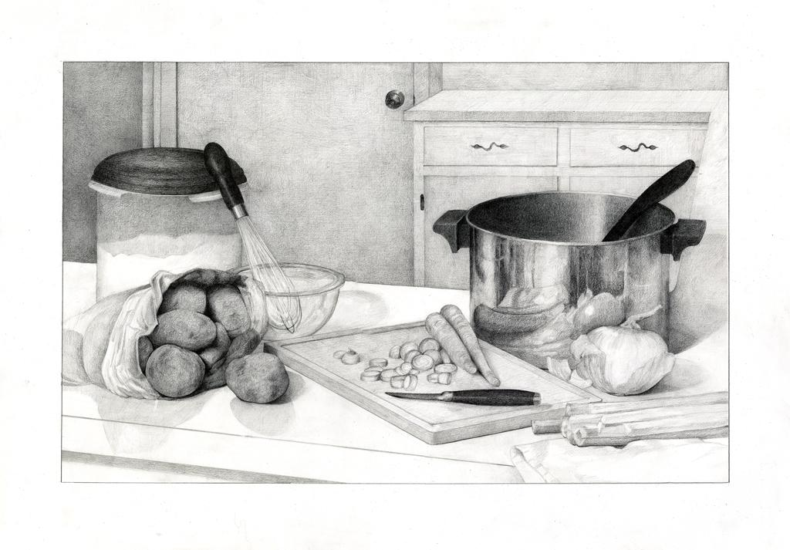
(*) If drawings need to highlight a certain detail or portion, feel free to do so.
Project, Media, Instructor

Slide 21
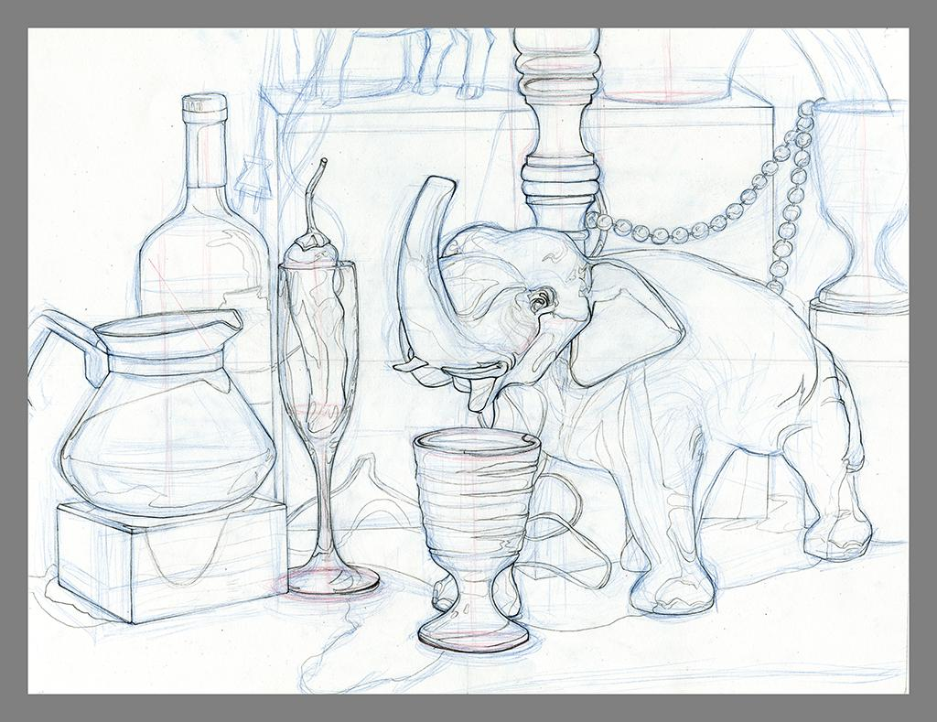
Project, Media, Instructor

Slide 22
ART 157 - Drawing II

Slide 23
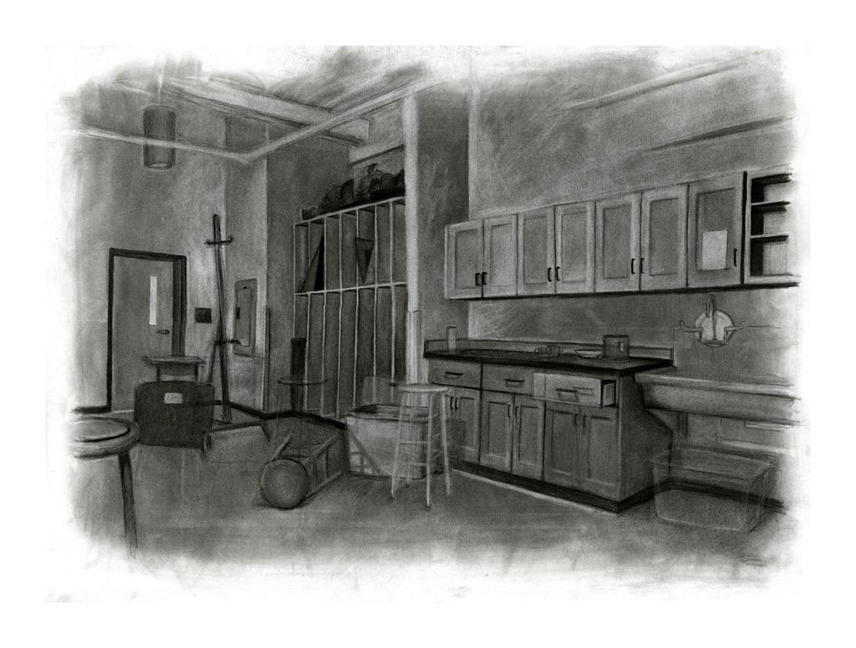
Project, Media, Instructor

Slide 24
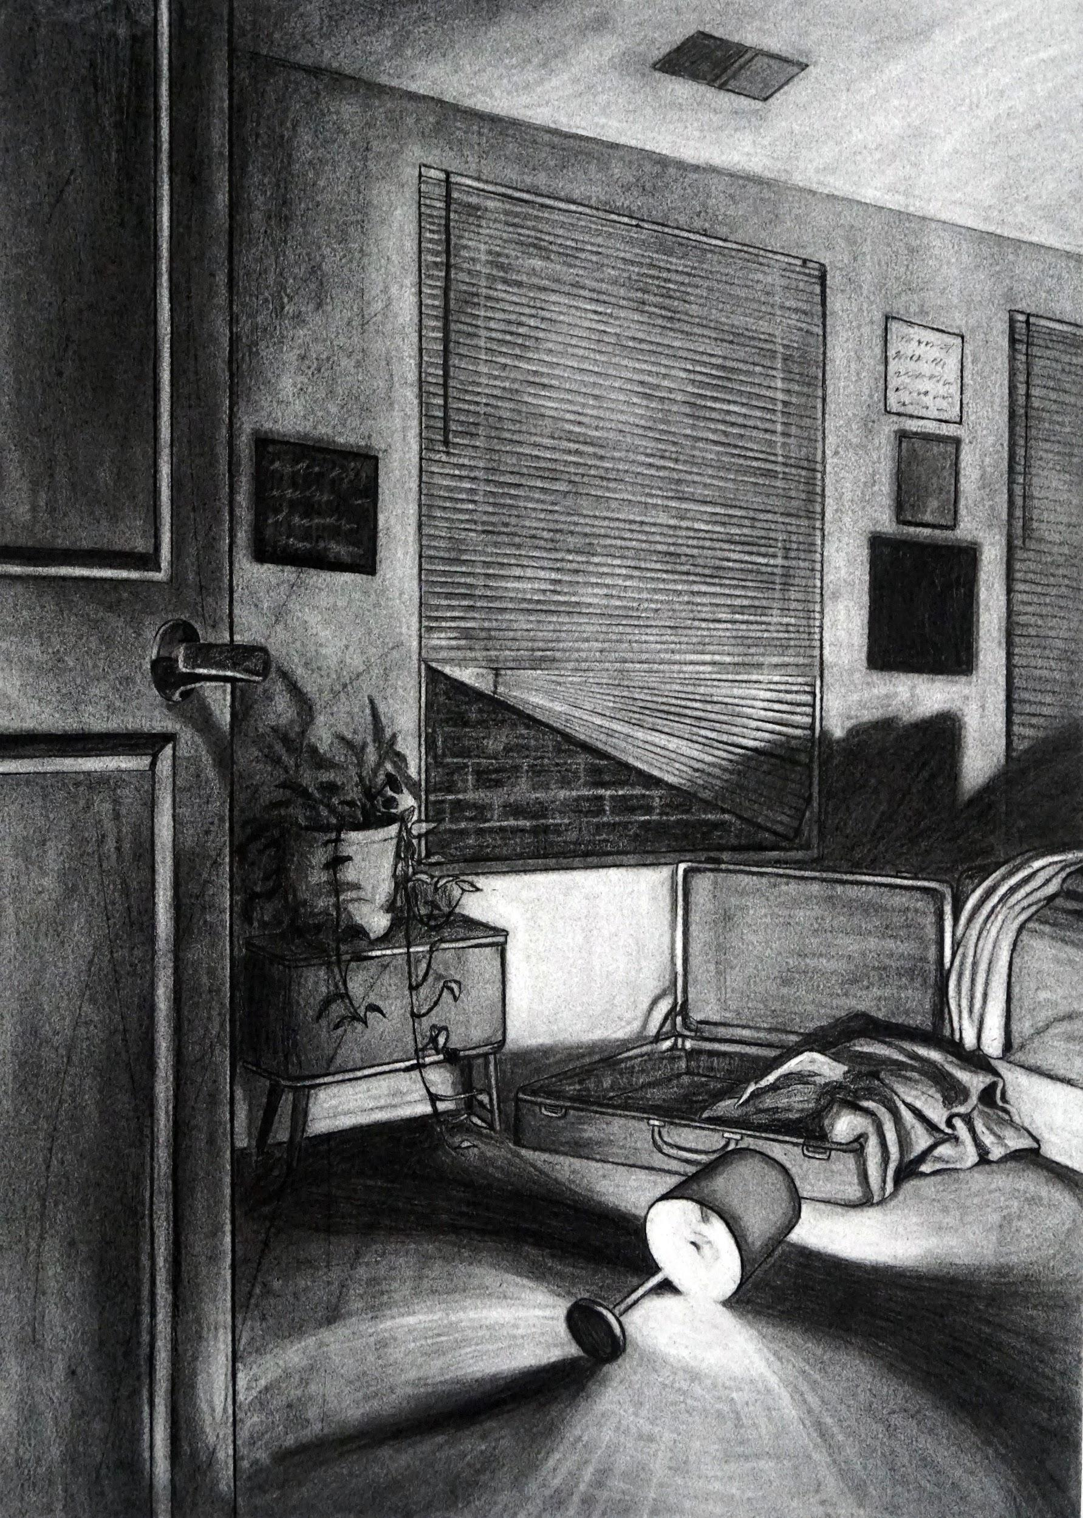
Project, Media, Instructor

Slide 25
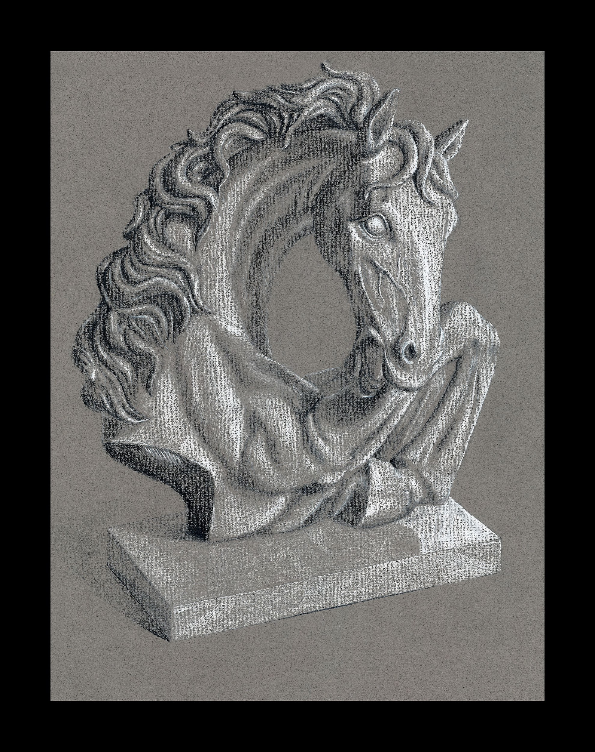
Project, Media, Instructor

