Slide 1

Slide Design Tips for Concurrent Session Presenters
Pew FTLC Annual Fall Conference on Teaching and Learning​

Slide 2
We're excited to have you share teaching insights and critically analyze different pedagogical approaches.
You may want to share PowerPoint Slides during your session to supplement the discussion.
If you choose to use PowerPoint Slides (or another slide deck type ), please make note of the following evidence-based strategies for designing slides. These strategies help your audience retain information and stay engaged!

Slide 3
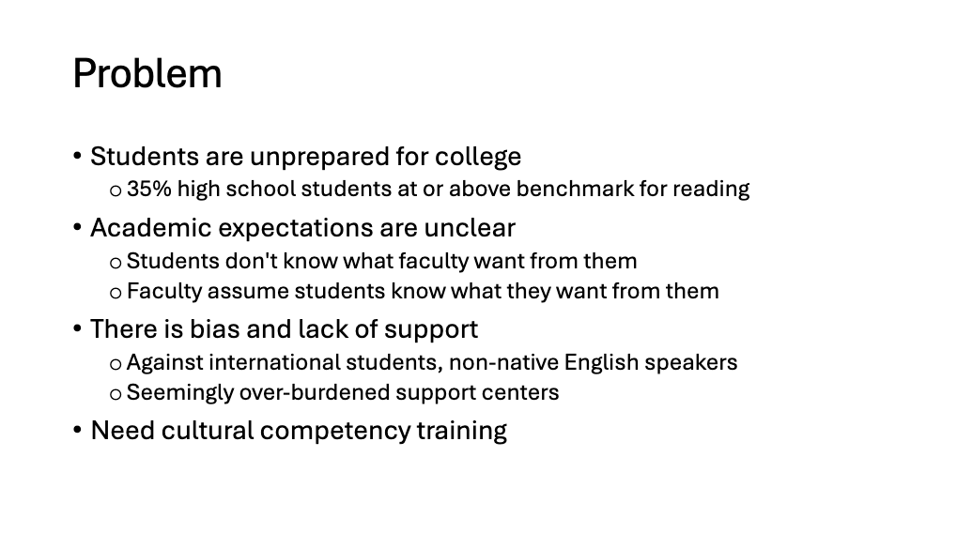
PowerPoint’s default design encourages you to use incoherent phrasal headings and bulleted lists.
This phrasal heading tells us the general topic of the slide, but not the main take-away.
Bulleted lists in the body of the slide are hard to read.

Slide 4
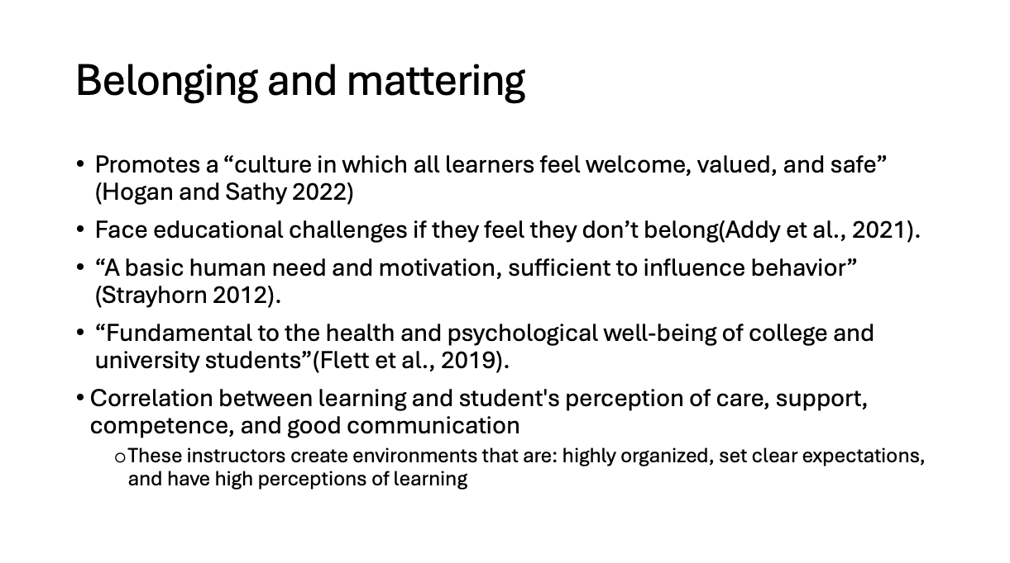
The default design may be helpful for the presenter reading from the slide, but is not designed for the audience’s needs.
In a text-heavy slide, the speaker and the slide compete for attention.
Audiences will either:
Toggle back and forth between listening and reading
Tune out the speaker and try to read the slide
Ignore the slide and try to listen to the speaker

Slide 5
We recommend designing your slides with the Assertion-Evidence Model.

Slide 6

The Assertion-Evidence model is based on dual-coding theory, which suggests pairing visual and verbal inputs improves retention.
Visual
Verbal

Slide 7
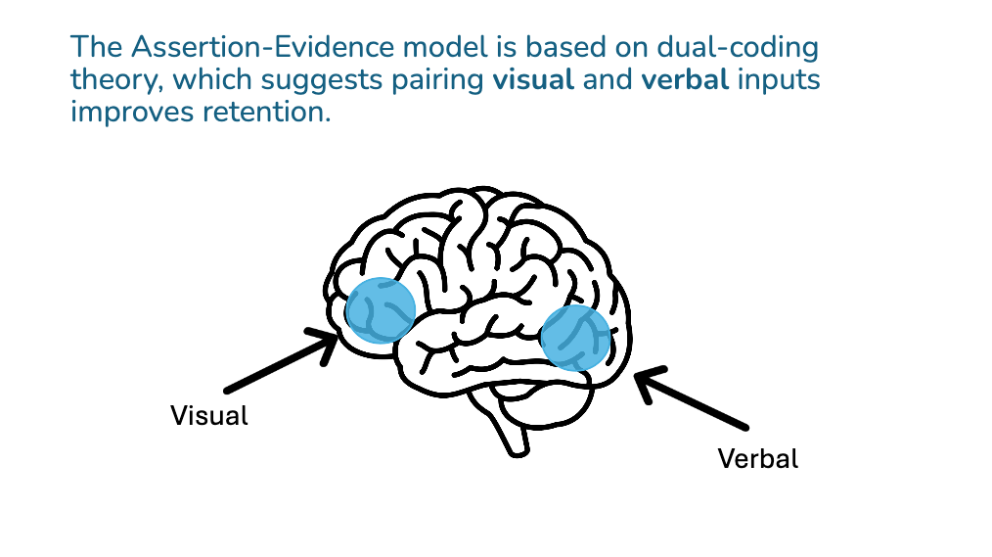
Think of your assertion like a newspaper headline.
Here's the assertion!
Here's the evidence!

Slide 8
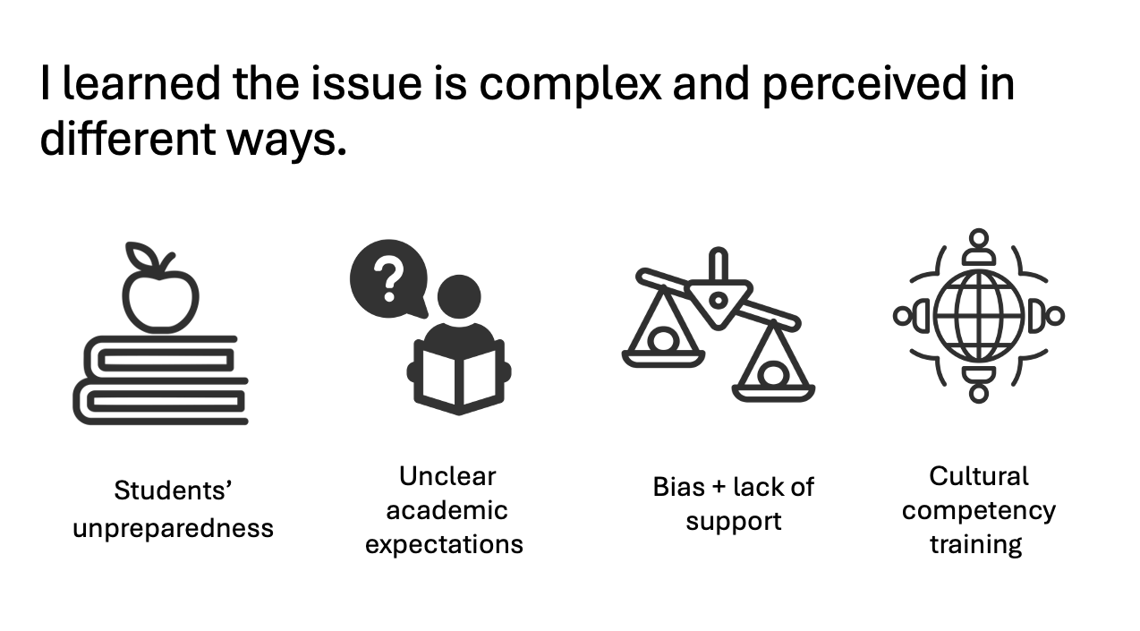
Research shows a sentence heading + visual body increases comprehension
Slide BEFORE using the
Assertion-Evidence Model
Slide AFTER using the Assertion-Evidence Model

Slide 9
Research shows a sentence heading + visual body increases comprehension
Here's the bottom line - assertion
Here's the visual evidence

Slide 10
When designing your slide, first identify the main takeaway.
In other words, what do you want the audience to know from this one slide? What is the bottom line?
That main takeaway = your slide header (aka assertion).

Slide 11
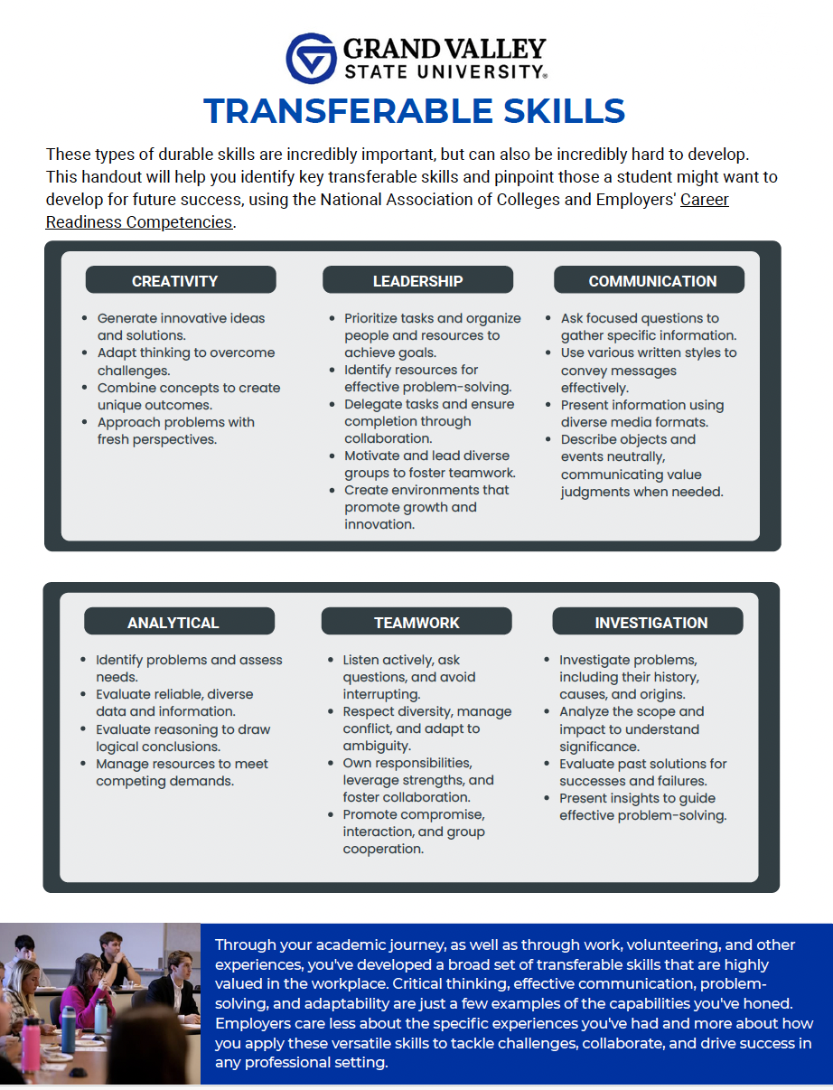
Have a lot of text you do want to share?
Consider printing it out on a handout.
Sample handout from the 2025 Fall Conference on Teaching and Learning, created by Rachel Becklin, Rachel Campbell, Bradford Dykes, Dana Hebreard, and Lisa Knapp

Slide 12
Questions?
Contact our Assistant Director, Maggie Goss. gossmar@gvsu.edu
(616) 331-3199

Slide 13
References
Alley, M., & Robertshaw, H. (2005). Rethinking The Design Of Presentation Slides. Technical Communication, 52(4), 417–426. https://doi.org/10.18260/1-2--11436
Alley, M. (2013). The Craft of Scientific Presentations: Critical Steps to Succeed and Critical Errors to Avoid. Springer. https://doi.org/10.1007/978-1-4419-8279-7
Nathans-Kelly, T., & Nicometo, C. G. (2014). Slide Rules: Design, Build, and Archive Presentations in the Engineering and Technical Fields. Wiley-IEEE Press.

