Slide 1
All Faculty (AF) Newsletter
Schedule: Wednesdays, every three weeks, two during busier seasons (New Faculty Orientation –NFO, Fall Conference on Teaching and Learning –FTC, Fall start)
General layout: Director’s Note, events/workshops/programs/reminders, Save the Dates and/or partner events
Who receives it: all faculty, all support staff, all admin. Lists updated every semester. Usually between 1,800-2,000 people
Philosophy: to continue to share learning experiences and resources for GVSU faculty, whether they be Pew FTLC, GVSU partner, or external opportunities
Program: “New” Emma vs Old Emma

Slide 2
Affiliate Faculty Newsletter
Schedule: Twice a semester, once in the summer
General layout: Assistant Director’s Note, events/workshops/programs/reminders, Affiliate Faculty policy reminders, Save the Dates and/or partner events
Who receives it: all Affiliate Faculty. Lists updated every semester. Usually between 219-225 per semester so far.
Philosophy: to continue to share learning experiences and resources for GVSU Affiliate Faculty, whether they be Pew FTLC, GVSU partner, or external opportunities, to encourage the continued building of community and excellence.
Program: “New” Emma vs Old Emma

Slide 3
Some General Data
Definitions:
Open Rate (OR): who is opening the newsletter
Click Rate (CR): who is clicking links
Click-to-Open Rate (CTOR): how many clicks per open
Highlights
Newsletters Sent F25:
AF - 7
NFO Cohort - 4
Affiliate - 2
+8.46% in opens
-.75% in CTO
+.45 CR
50% increase in newsletters sent
Best send time: Wednesdays 3-4PM
Best performing (OR):
Sept NFO Cohort - 84% OR
Oct NFO Cohort - 74% OR
Dec NFO Cohort - 71% OR
Sept Affiliate - 73% OR
Nov Affiliate - 72% OR
Best performing (CTOR):
Mid-September AF - 12% CTOR
Late August AF - 13% CTOR
Late Oct - 11% CTOR

Slide 4
TIMELINE
Pew FTLC
Affiliate Faculty Newsletter
01
02
03
04
05
Dates and Data
219-225 total sent per newsletter
We are here
06
3/25
9/25
11/25
2/26
4/26
6/25
69.4% Open Rate ( 152 opened)
7.2% CTO Rate (11 people clicked)
Biggest Clicks:
Calendar Hacks > 7 clicks
73.3% Open Rate (167 opened)
22.2% CTO Rate (37 people clicked)
Biggest Clicks:
Affiliate Promotion Policies > 10 clicks
Affiliate Handbook > 8 clicks
LCs > 7 clicks
71.9% Open Rate (161 opened)
16.2% CTO Rate (26 people clicked)
Biggest Clicks:
SSTI/LCs > 13 clicks
Teaching professor STLE > 8 clicks
71.2% Open Rate (156 opened)
18% CTO Rate (28 people clicked)
Biggest Clicks:
SSTI > 9 clicks*
Upcoming Event Calendar > 5 clicks
* 19 out of 45 total participants were affiliate faculty
Notes:
Strong Start Teaching Institute (SSTI)
Learning Community (LC)
Sponsored Teaching and Learning Event (STLE)

Slide 5
Website
Analytics (What Can We Know?)
Total Pageviews vs. Sessions vs. Total Users
Sessions
  A session is a single visit or interaction by a user with a website, consisting of a series of pageviews and other interactions within a specific time frame.
Sessions Per User
  Sessions per user is a metric that represents the average number of sessions generated by each individual user during their interactions with a website.
Views
  A view is a single instance of a webpage being loaded or displayed in a web browser.

Slide 6
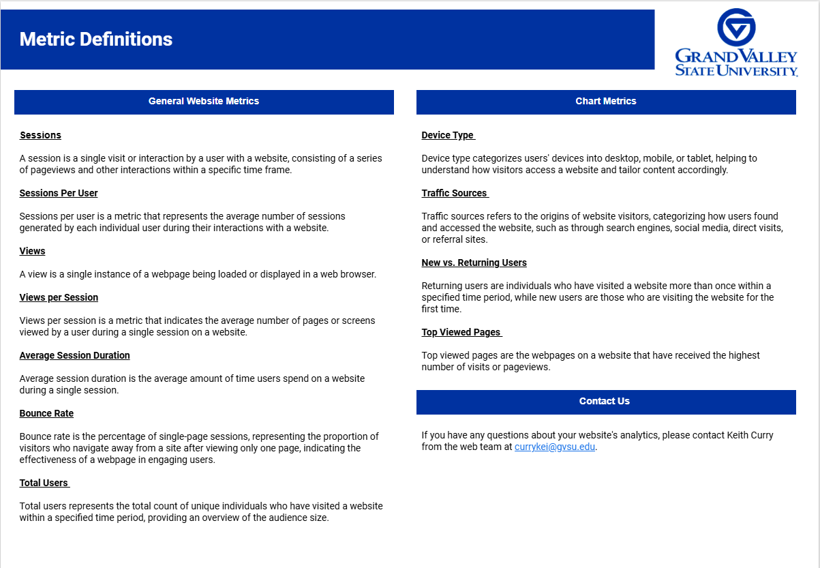
Screenshots of Analytics Info

Slide 7
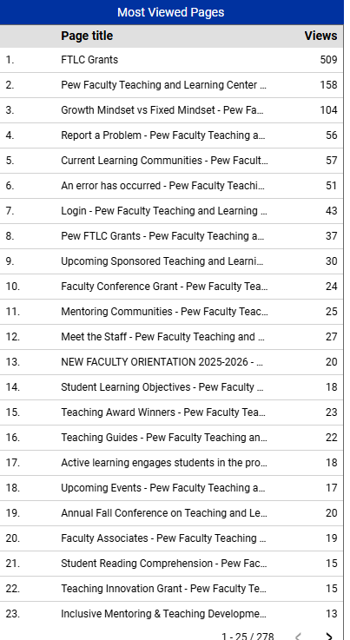
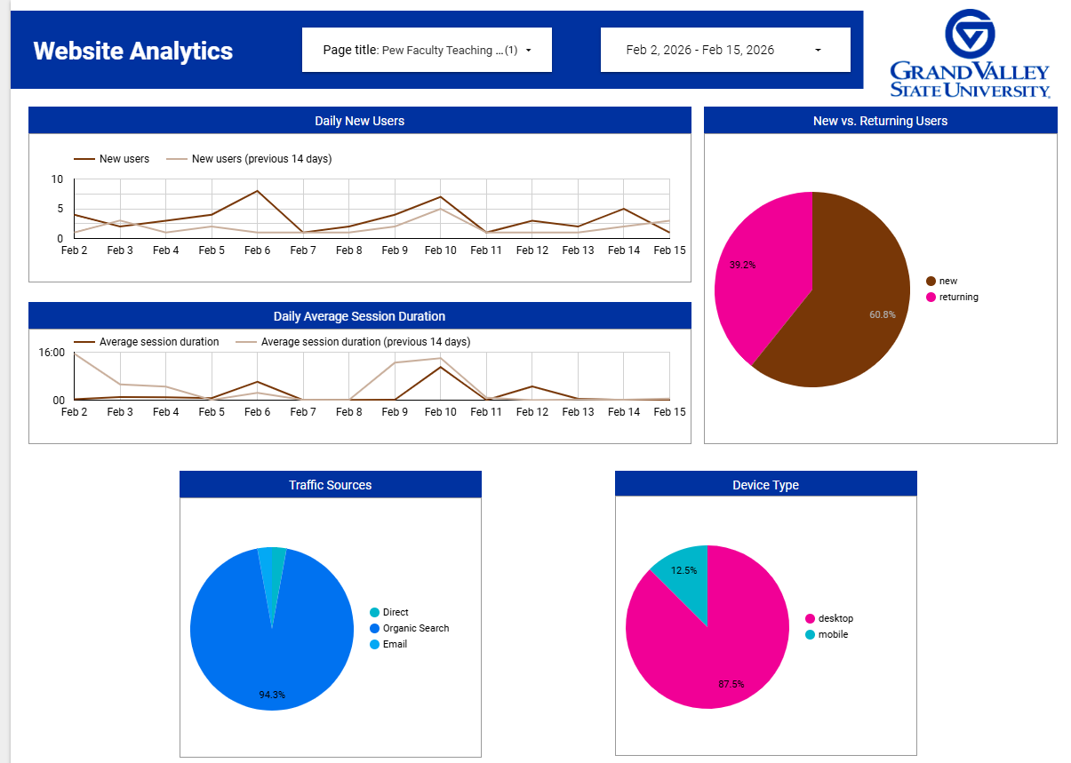
Screenshots of Analytics Info

Slide 8
CMS 4 to CMS 5 Migration
Why the change?
How does the change work?
What does this mean for the website?
CMS 4 is written in old programming and will eventually stop working. We need to move content to CMS 5 so the website can stay updated.
We’ll work closely with the webteam to migrate content and files from CMS 4 to CMS 5. Our office will determine which content will migrate.
It will take only a few days for the actual migration, but more time to decide what to migrate.
As you might’ve seen on other webpages, CMS 5 has a new look. Some of the content and modules have changed, too, so where something might be an “accordion” on the current website, that might become “tabs” in CMS 5.
The same accessibility tools are available in CMS 5.
Historical content might be displayed differently. More to come on this

