Slide 1
Community-Based Learning as Justice-Oriented Education Friday, January 16, 2015
Susan Carson Professor, GVSU College of Education
Brittany Dernberger Assistant Director, GVSU Women’s Center
Kanyn Doan Current GVSU Student
Rachel Hood Executive Director, WMEAC

Slide 2
Learning Objectives
Increased understanding of “justice learning,” an approach to community-based learning from a social justice perspective
Increased knowledge of the potential tensions that exist in community-based learning and explore tools to address these tensions
Notes:
Increased understanding of “justice learning,” an approach to community-based learning from a social justice perspective
Increased knowledge of the potential tensions that exist in community-based learning and explore tools to address these tensions. Want to give you some helpful take-a-ways

Slide 3
Agenda
Introductions
Justice Learning
Panel
Discussion/Q&A
Notes:
Introductions – learn more about who is in room
Justice learning – introduce this framework
Panel
Q&A/Discussion

Slide 4
Introductions
Please share your:
Name
Affiliation
Previous experience with service learning/ community engagement
OR what you hope to do in the future
Did this include a social justice/social change framework?
Notes:
Connection to service learning/community engagement and/or what you hope to do with service learning/community engagement in the future.
Whether or not this was from a social justice framework… (explicit, implicit, not at all connected)
LANGUAGE:
Many of these phrases are used interchangeably: service learning/community engagement; social justice/social change (come with their own ‘baggage’)
-Will continue to define terms during our time together

Slide 5
“Community service is an embodied encounter, noisy and ‘morally ambiguous’ - a noisy encounter that often does and should agitate us, teachers and students alike”
(Himley, 2004, as quoted in Butin, 2007)
Notes:
Reactions?
Messy! Not clean and clear-cut

Slide 6
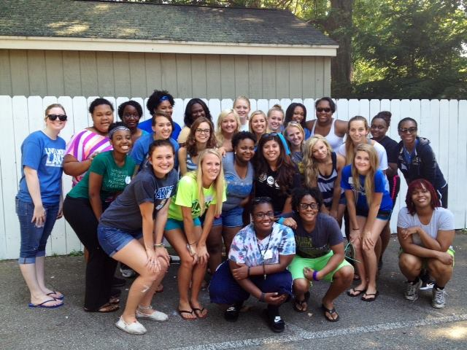
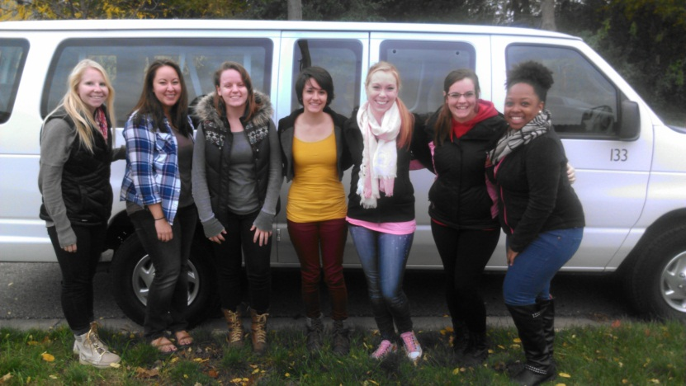
What is Service Learning?
Academic work linked with community-based engagement
Framework: respect, reciprocity, relevance, and reflection
Goal: tightly links research, teaching, and activism to foster individual, institutional, and community change
Potential for social justice education
Notes:
What does it mean to volunteer? What is Service Learning?
Volunteer – ask group to define
Service learning – more in depth, education, reflection, mutual w/ community partner
Example: serving a meal at a homeless shelter
Attempt to make “volunteer” more service learning – things to think about/reflect on
Define service learning
Linkage of academic work with community-based engagement within a framework of respect, reciprocity, relevance, and reflection
Ideal, Best case scenario: tightly links research, teaching, and activism to foster individual, institutional, and community change
*Engagement happening at multiple levels, impact happening at multiple levels
Deep and sustained service learning offers genuine venues within which social justice education can be experienced and experimented
“Charity”
Tangible, time-defined

Slide 7
What is Social Justice Education?
Positions education as a key tool for understanding and overturning oppressive conditions and practices in society
Process and a goal
Contextualizes seemingly individual oppression within social and cultural structures
Notes:
Define social justice
Social justice education: positions education as a key tool for understanding and overturning oppressive conditions and practices in schools and society
Both a process and a goal
Reversing implied deficits into positions of strength
Contextualizing seemingly individual oppression within social and cultural hegemonic structures
“Activism”
Never done, continuous journey
Neo-conservative strategies to link notions of “social justice” with partisan liberal activism
Two distinct entities: social justice and service-learning
In common: both broadly link the personal to the social and the classroom to the community

Slide 8
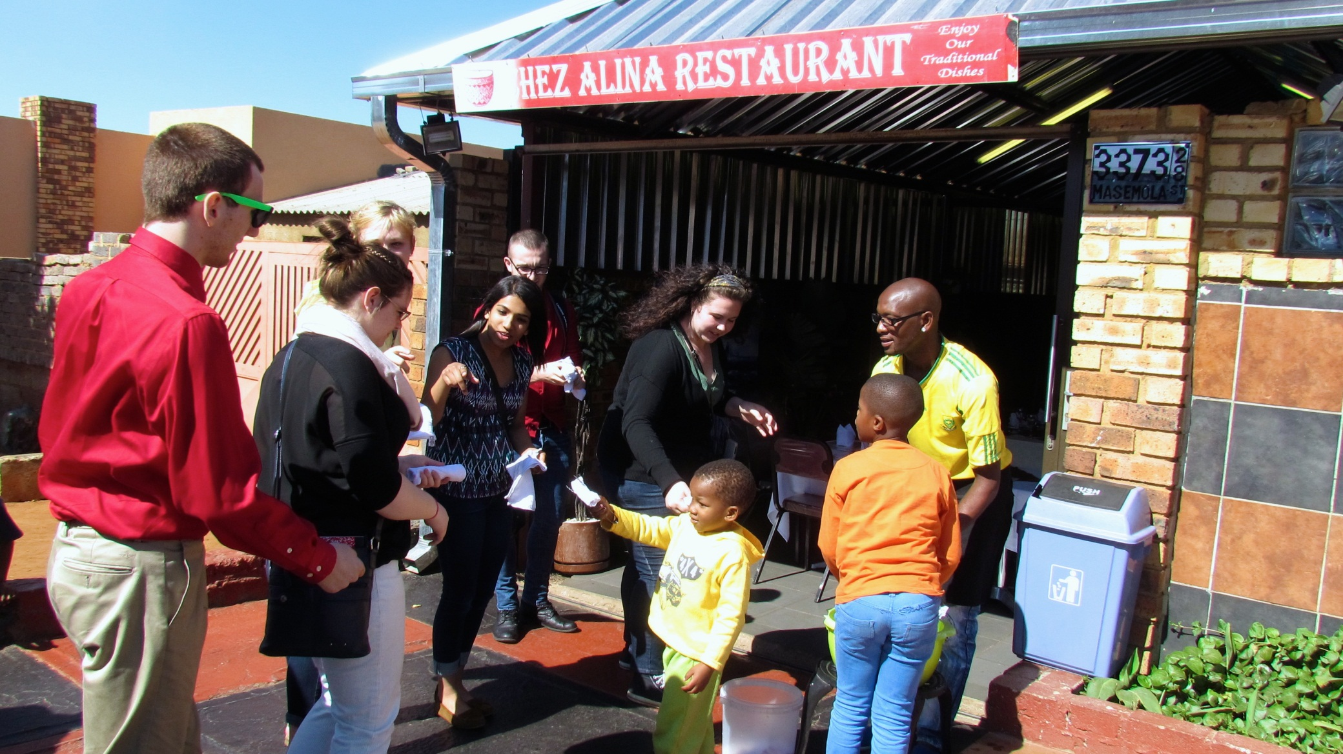
What is Social Justice Education?
Notes:
Photo: people of color “handing out” something to mostly white students

Slide 9
Tensions
Service Learning
Civic Engagement
Social Justice
Simplistic understanding of social problems
Inflated impact of change
Volunteer then disappear
Narrow focus on government and/or policy-based structures
Understand social problems and social change as limited by civic constraints
Ungoverned activism
Unrealistic and utopian
Lacking organization
Notes:
A larger criticism of all three- Impure, insufficiently rigorous, ethically and politically based.
Service learning
Social problems are caused by one issue (poverty=lack of jobs).
Social problems can easily be fixed with enough “help”
Getting course credit to volunteer and then disappear
“Charity”
Civic Engagement
Understand problems in the context only of government or other policy based structures (no interrogation of social norms)
Change can only occur by influencing political systems not dismantling, or other grass roots social justice solutions (no jobs, create more, not dismantle capitalism)
Social Justice
Activism by another name
Lofty goals with unattainable or even unclear agendas (occupy wall street)
No formal structure means no organization and immeasurable goals
Discussion: have you experienced these tensions? Agree/disagree with the premise?

Slide 10
Justice-Learning
Social Justice
Service Learning
Civic Engagement
Notes:
Author: Dan Butin, currently at Merrimack College (Founding Dean of School of Education)
Justice-learning: Intersection of service learning and social justice

Slide 11
Justice-Learning
Constantly problematizes
Requires “unlearning” oppressive assumptions before any other justice-centered work can be done
Avoids easy, specific, and pre-determined end-goals
Who controls the narrative?
“Border crossings” become “border inspections”
Notes:
Recent reading: “bearing witness” without doing so with the intent of “fixing someone else.”
Justice-learning (Dan Butin, 2007 article)
Premise: community-based practices are critical and natural spaces within which students learn to become activate and engaged citizens
Constantly problematizes: what resources do I provide? Why am I here? Constant critical question and examining of your own motives and assumptions
-Service learning committed to social justice may perpetuate oppressive conditions and assumptions
Must first and foremost help students “unlearn” their oppressive assumptions before any other justice-centered work can be done (what are examples of this?)
-Questions and recognizes top-down nature of knowledge production (i.e. racism, power, whiteness)
-Biases, micro-aggressions, way we’re socialized
Avoids easy, specific, and pre-determined end goals - - process is key (ambiguous and open-ended)
Goal should be to create tensions and dilemmas that must be reflected upon and resolved (dissonance)
Service-learning serves as the opening occasion for such dialogue and action rather than the concluding event
*Avoiding “knight in shining armor” mentality’
**Importance of pre-education
Makes visible the complexities of both the process and the goals being striven for
Who controls the narrative?
“good citizen” status
“border crossings” become “border inspections”
The very act of writing positions students as the ones who control the dialogue within which privilege, identity, and power are defined or obscured
“Fragile boundaries” – while the hoped-for social justice goals may not have been fully achieved, the service-learning practice served as an occasion by which to deepen one’s understanding of and commitment to further justice-oriented endeavors
Basic Expectations of Volunteers – Professionalism, GVSU student code
MANY more tensions, but highlight a few

Slide 12
Panel & Discussion
Susan Carson Professor, GVSU College of Education
Brittany Dernberger Assistant Director, GVSU Women’s Center
Kanyn Doan Current GVSU Student
Rachel Hood Executive Director, WMEAC
Notes:
Panel
Introduce yourself and talk about the work you do as it relates to justice-learning (What does this work look like?)
What are the benefits of doing justice-learning?
What challenges have you faced in doing this work? How do you avoid some of the potential tensions?
What tips/tools do you have for those in the room?

Slide 13
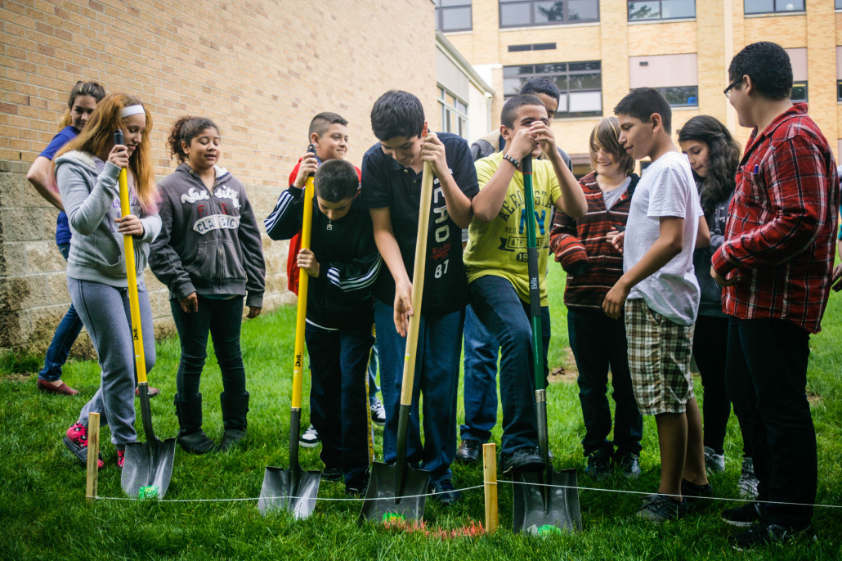
Questions? Thank you!
Notes:
Photo: WMEAC

