Slide 1
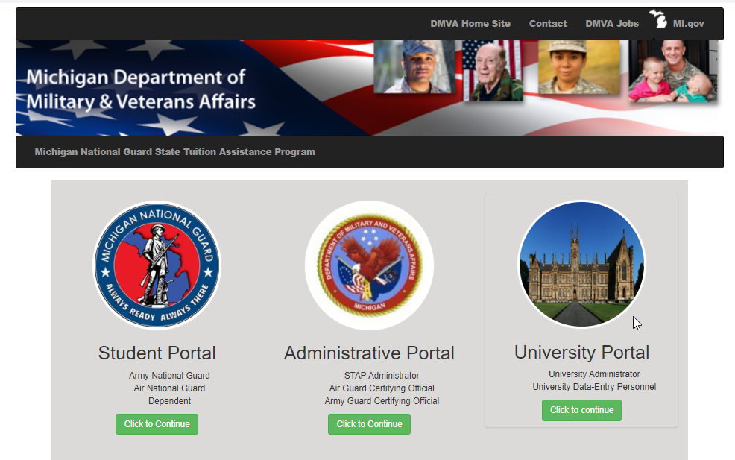
MINGSTAP Tutorial
New User Registration & Application Submission
The MINGSTAP Portal has 3 different log in options.
If you are a member of the Michigan National Guard or a dependent of a member you enter through the Student Portal.
Click the green button to continue.

Slide 2
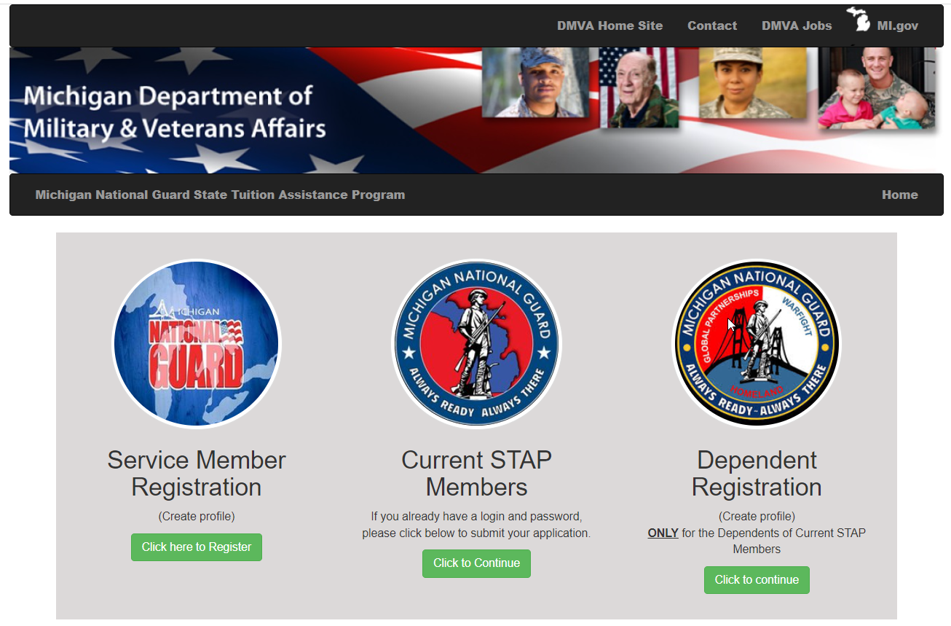
MINGSTAP Tutorial
New User Registration & Application Submission
If you have never used MINGSTAP you need to create a profile by clicking on the green button under Service Member Registration or Dependent Registration.
If you have already completed this step you can proceed by clicking on the green button under Current STAP Members.

Slide 3
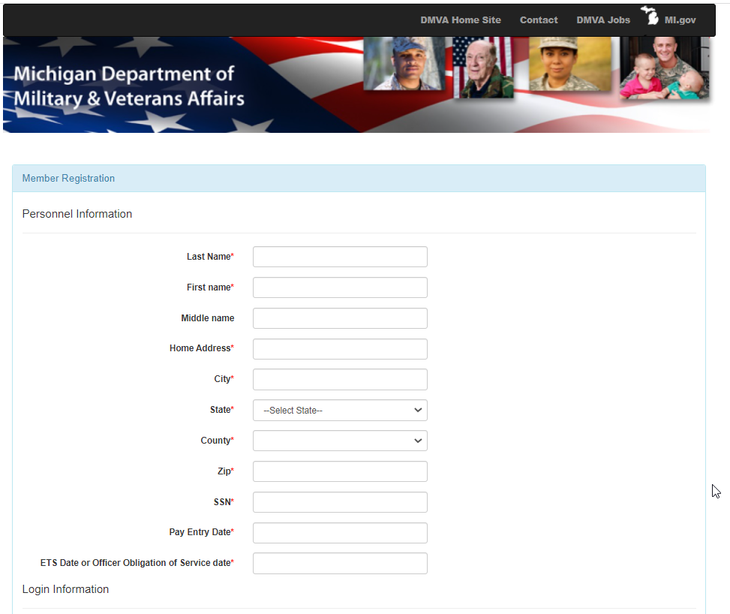
MINGSTAP Tutorial
New User Registration & Application Submission
New User Registration
Please complete the form.
You will need to click on the blue wording Terms and Conditions and accept all the terms and conditions.
Click Create Profile to complete the process.
Once this step is completed you can click on Current STAP Members

Slide 4
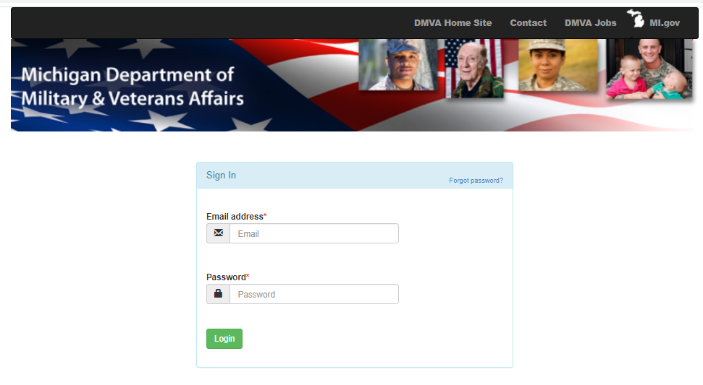
MINGSTAP Tutorial
New User Registration & Application Submission
Current STAP Members
If you are a current member, you will use the email and password you created to log in.

Slide 5
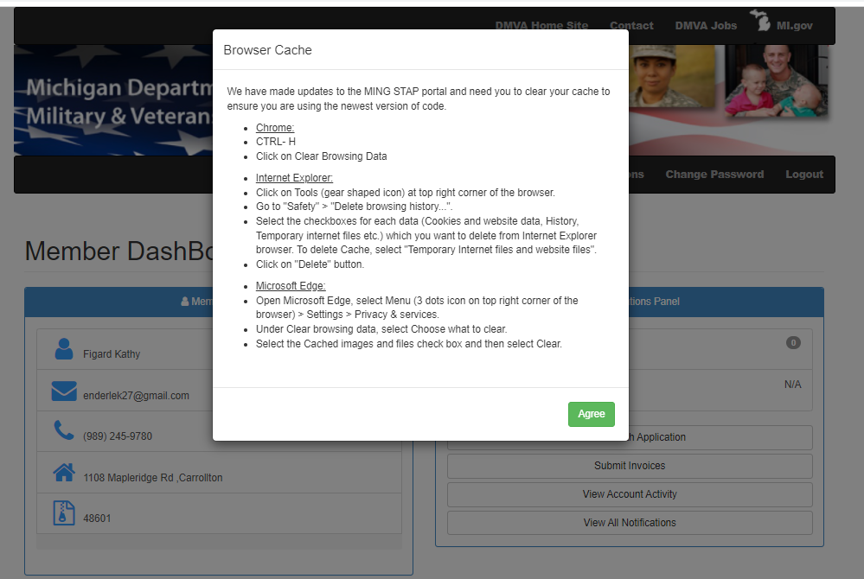
MINGSTAP Tutorial
New User Registration & Application Submission
We are continuing to improve the program and portal therefore we require you to clear your cache so you are using the most current version.
Click Agree after completing the instructions that relate to your browser.

Slide 6
MINGSTAP Tutorial
New User Registration & Application Submission
Application vs Invoice
One application is required for each academic year you wish to request reimbursement for.
  Applications open in April for the upcoming academic year. For example, April 1, 2022 - the application for the 2022-2023 academic year will open.
  The academic year runs from Fall 2022 though Summer 2023.
Applications are required to be submitted within 14 days of the start of class.
Application vs Invoice
Invoices (reimbursement requests) can be submitted multiple times during the academic year.
  Typically, most students will submit two invoices – one at the end of the Fall term and one at the end of the Winter/Spring term
Each invoice must contain the 3 documents necessary for us to process your request.
  OFFICIAL Transcript
  Invoice from school
  Proof of FTA usage or Proof of exemption

Slide 7
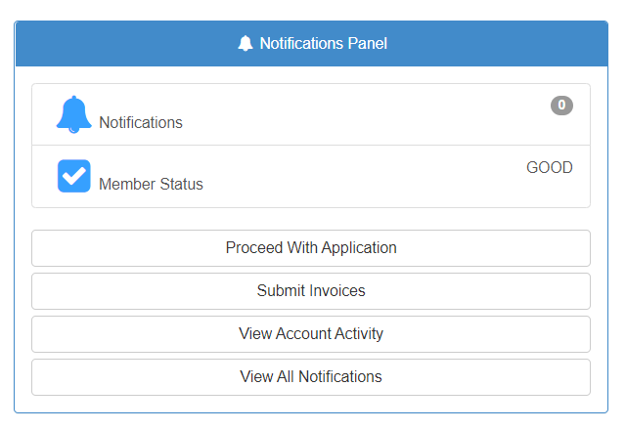
MINGSTAP Tutorial
New User Registration & Application Submission
You must submit an application each academic year by clicking on Proceed With Application.
Applications open for the new academic year on April 1st.
An academic year runs from Fall 2021 – Summer 2022, for example.
You can submit multiple invoice requests for each application by clicking on Submit Invoices.

Slide 8
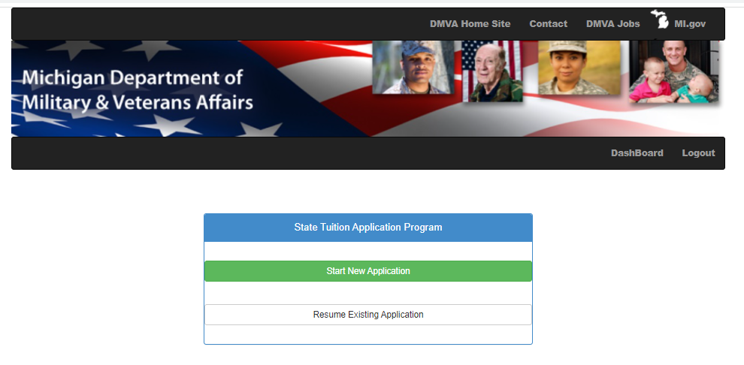
MINGSTAP Tutorial
New User Registration & Application Submission
Proceed With Application
You can choose from Start New Application or Resume Existing Application.
Most users will click Start New Application

Slide 9
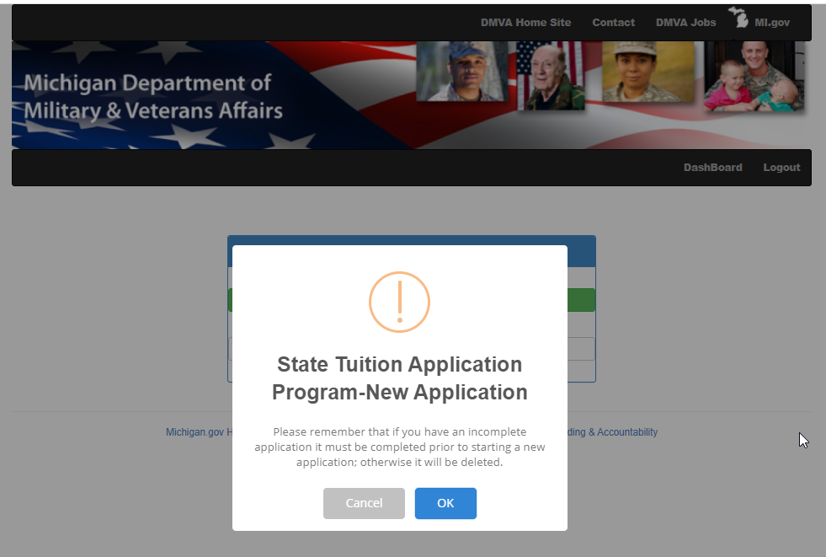
MINGSTAP Tutorial
New User Registration & Application Submission
The system will warn you that if you have an existing application by clicking on Start New Application that you will be deleting any other versions.
Click Ok to proceed or back out and click on Resume Existing Application

Slide 10
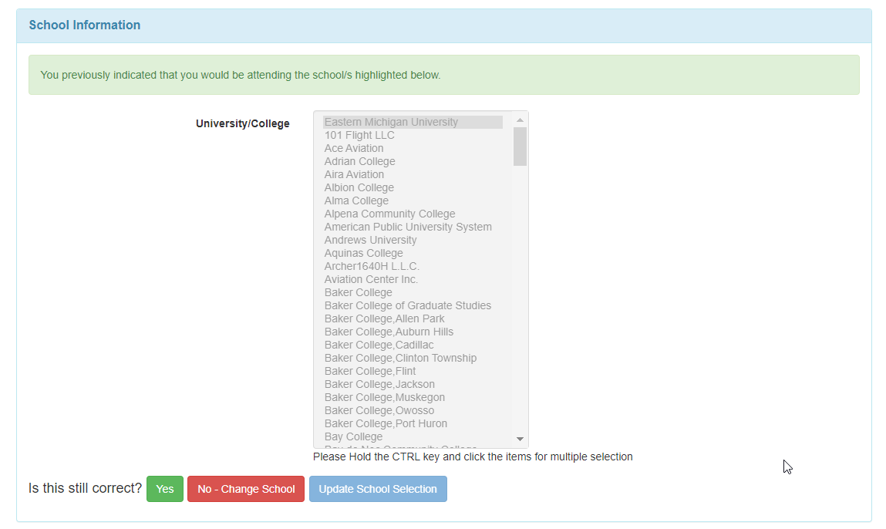
MINGSTAP Tutorial
New User Registration & Application Submission
Verify your school
If correct, click Yes.
If not, click No – Change School
  You will be asked if you wish to change your school.
  If yes, the system will clear your previous information and allow to select a new/multiple university.
  To save the change you must then click Update School Selection.
You can select more than one university, if necessary, by holding down the CTRL key and clicking on the various schools.

Slide 11
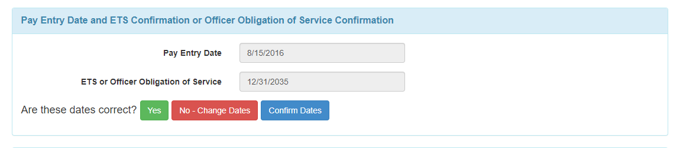
MINGSTAP Tutorial
New User Registration & Application Submission
Verify your Pay Entry Date and ETS Date or Officer Obligation of Service Confirmation.
You must be in the Michigan National Guard on the first and last day of class.
If yes, click Yes.
If not, click No – Change Dates
  You can now update the information.
  You must click Confirm Dates to save the new information.

Slide 12
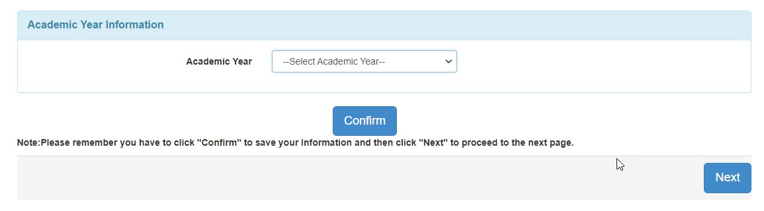
MINGSTAP Tutorial
New User Registration & Application Submission
Select the Academic Year.
If there is more than one academic year available, please be sure you are selecting the correct one.
You will be asked again to read and accept the terms and conditions.
Enter in your school issued student ID.
Click Confirm to save your information.
Then click Next

Slide 13
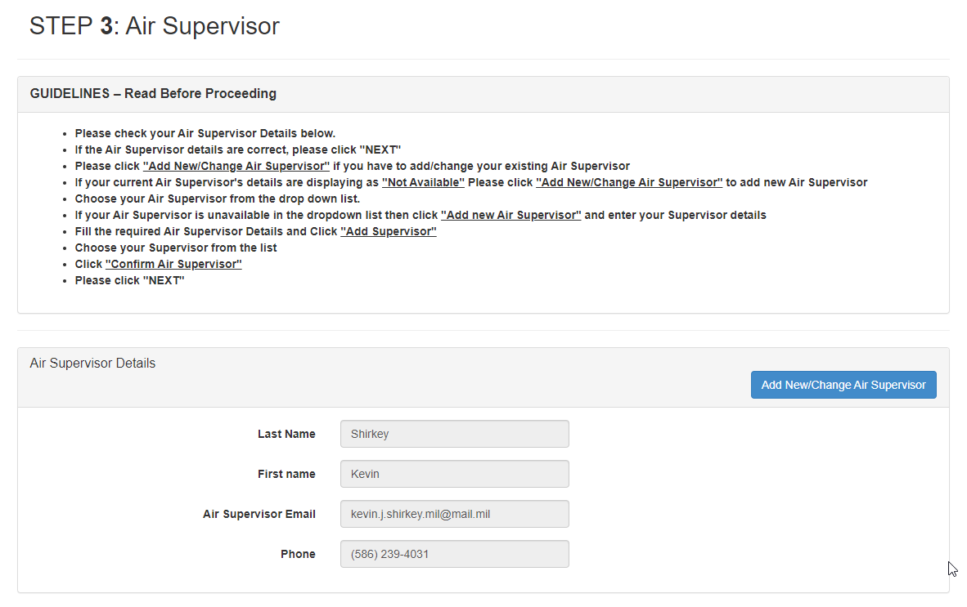
MINGSTAP Tutorial
New User Registration & Application Submission
If you are an Air Guard member you will need to select your Air Supervisor.
Please make sure this is correct because they will be the one certifying your application.
Click Next to continue.

Slide 14
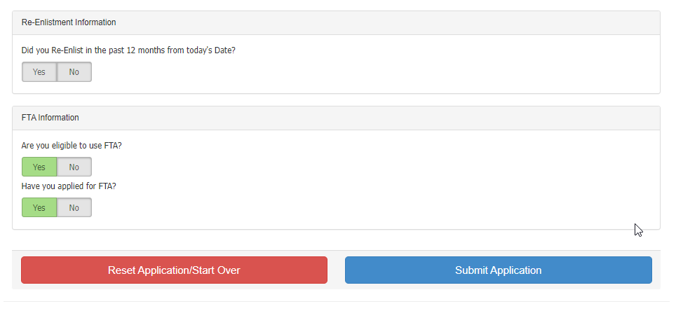
MINGSTAP Tutorial
New User Registration & Application Submission
You will see two more questions near the bottom of the FINAL STEP page. Please respond to those questions.
If you indicated you are eligible for FTA, you will be asked if you applied for FTA.
  If you say yes, then you can submit your application.
  If you say no, you must tell us why you did not apply for and use FTA.
If you indicated you are not eligible for FTA, you must select a reason for not being eligible.
If eligible for FTA you are REQUIRED to APPLY for and USE FTA in order to use MINGSTAP, unless you meet the criteria for one of the exceptions. Proof of the exemption will be required before we process invoices for reimbursement.
Make sure you apply for FTA in a timely manner, before the first day of class.
Once the questions have been completed you can submit your application.

Slide 15
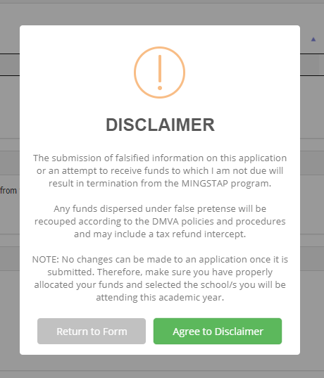
MINGSTAP Tutorial
New User Registration & Application Submission
After reading the disclaimer you can return to the form to make changes or agree to submit your application.

Slide 16
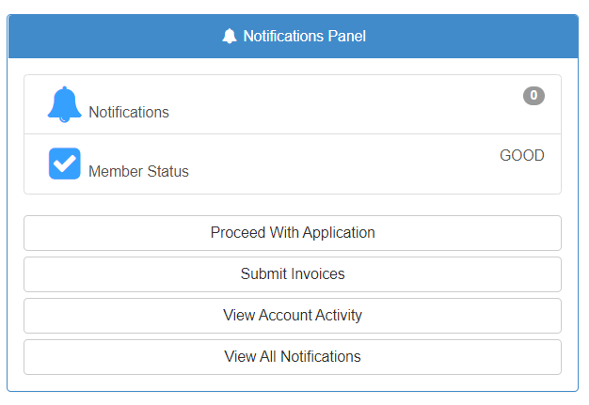
MINGSTAP Tutorial
Invoice Submission
Submit Invoices
You must click on this to request reimbursement for your classes once the semester is over.
You will need 3 documents to complete the process (PDF’s)
  OFFICIAL Transcript
  Invoice from school, that shows all charges (tuition, fees, room and board, etc) and aid received.
  Proof of FTA usage or proof of valid exemption.

Slide 17
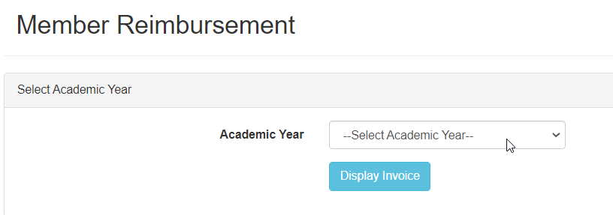
MINGSTAP Tutorial
Invoice Submission
Select the academic year.
You need to select the program you are working towards.
  Training Program
  Certificate Program
  Associates Degree
  Bachelors Degree
  Masters Degree
  Professional Degree
This selection is for the entire academic year.

Slide 18
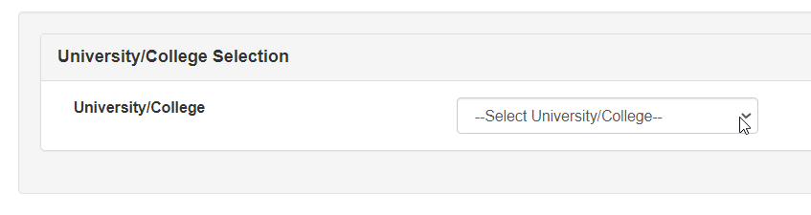
MINGSTAP Tutorial
Invoice Submission
Select the university you are submitting an invoice for.
If you are attending multiple universities make sure you select the correct one.

Slide 19
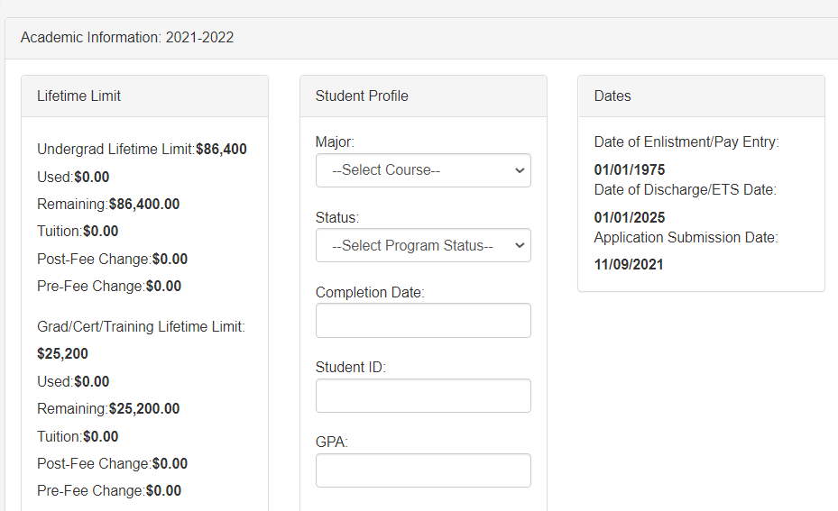
MINGSTAP Tutorial
Invoice Submission
Select your major – pick the closest one
Select your status
  In Progress – means you are still working on your degree/program
    Leave Completion Date blank
  Complete – means this is your last term etc.
    If complete – enter the date of completion.
Enter in your Student ID
Enter in your GPA – either cumulative or term
Click Next

Slide 20
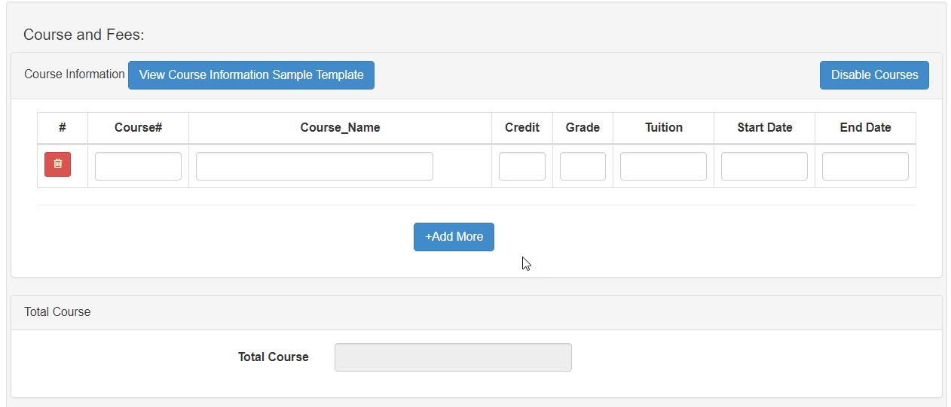
MINGSTAP Tutorial
Invoice Submission
Enter in your course information – you can click on view course information to see a sample.
Course number
Course name
Credit hours of class
Final Grade
Tuition – total cost of class up to $600 per credit hour
Example, 3 credit class x tuition per credit hour = 3 x $487.13 = $1461.39. This is the amount you enter into the tuition box.
The system will not allow you to enter more than $600 per hour. Do not try to hide additional costs by increasing the number of credits, etc. Or putting in the additional costs as a fee.
Enter the start and end date of the course in the mm/dd/yyyy format.

Slide 21
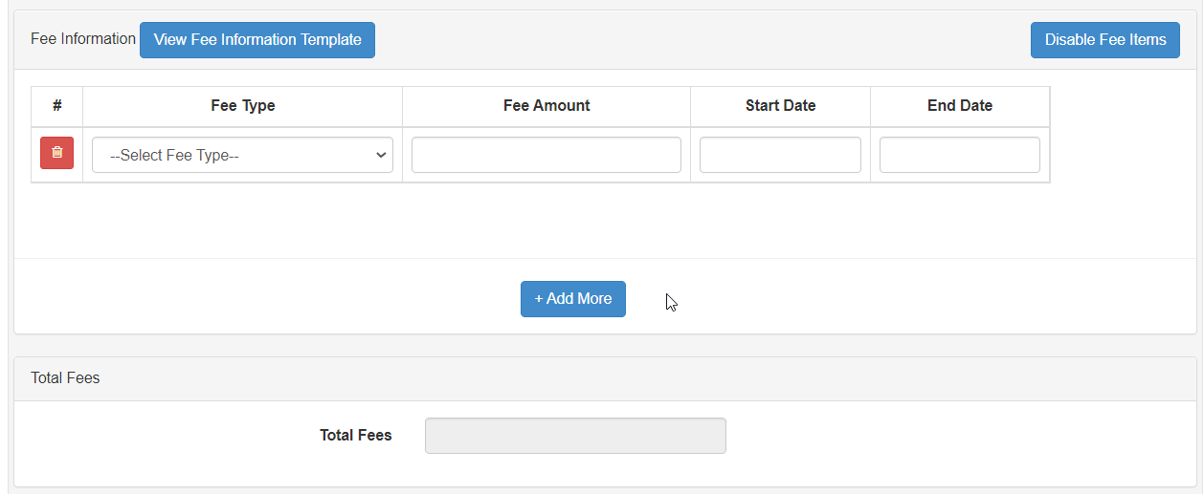
MINGSTAP Tutorial
Invoice Submission
Enter fee information – you can click – view Fee Information to see a sample
If you do not have fees you can click on Disable Fee Items
If you have fees select them and enter in the amounts
After all tuition and fees have been entered click next.

Slide 22
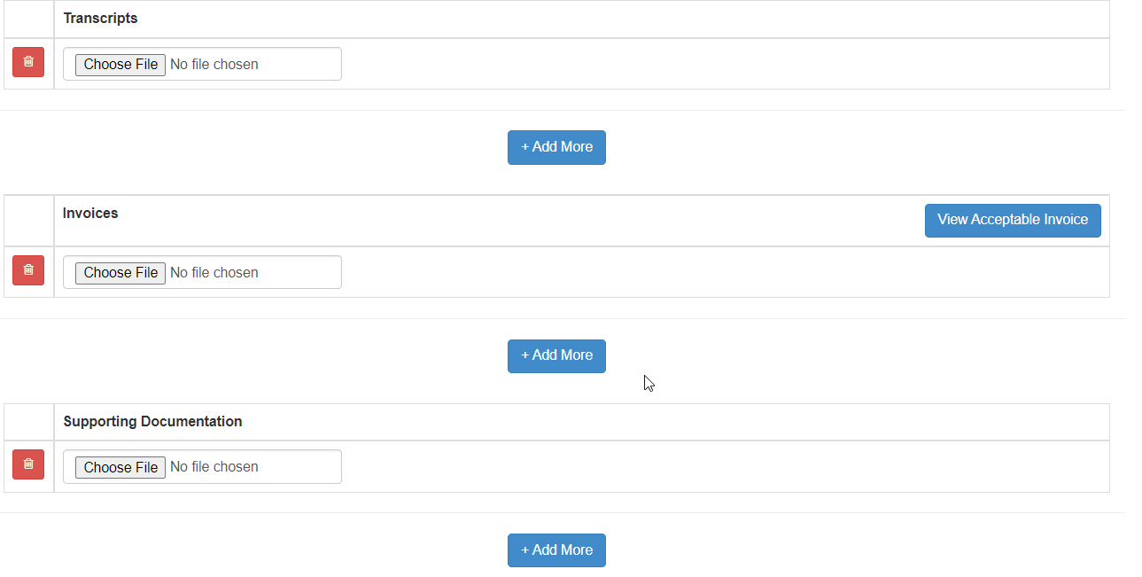
MINGSTAP Tutorial
Invoice Submission
You now need to add your supporting documentation.
All attachments need to be PDF’s.
  OFFICIAL Transcript
  Invoice from school
  Proof of FTA usage or Proof of Exemption
Submit once all documents are uploaded.

Slide 23
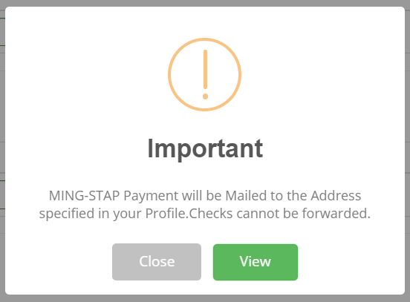
MINGSTAP Tutorial
Invoice Submission
You will receive a paper check in the mail.
Click view to confirm your mailing address.
If that is not the correct address update it and click confirm to save the new information.
It takes several seconds to save. Do not keep clicking the button.
Checks CANNOT be forwarded.

