Slide 1
Your Grandma Uses Technology Better Than You
with Veronica Kirin

Slide 2
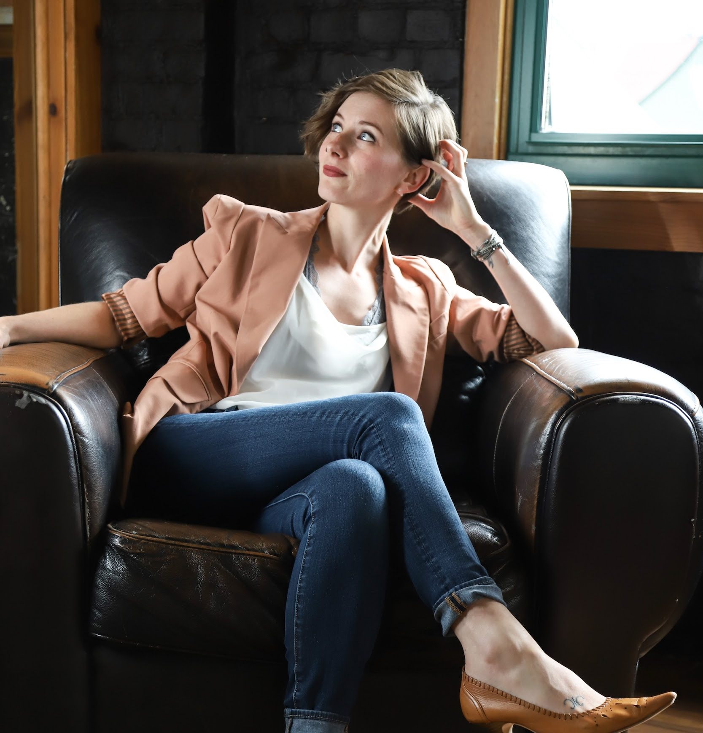
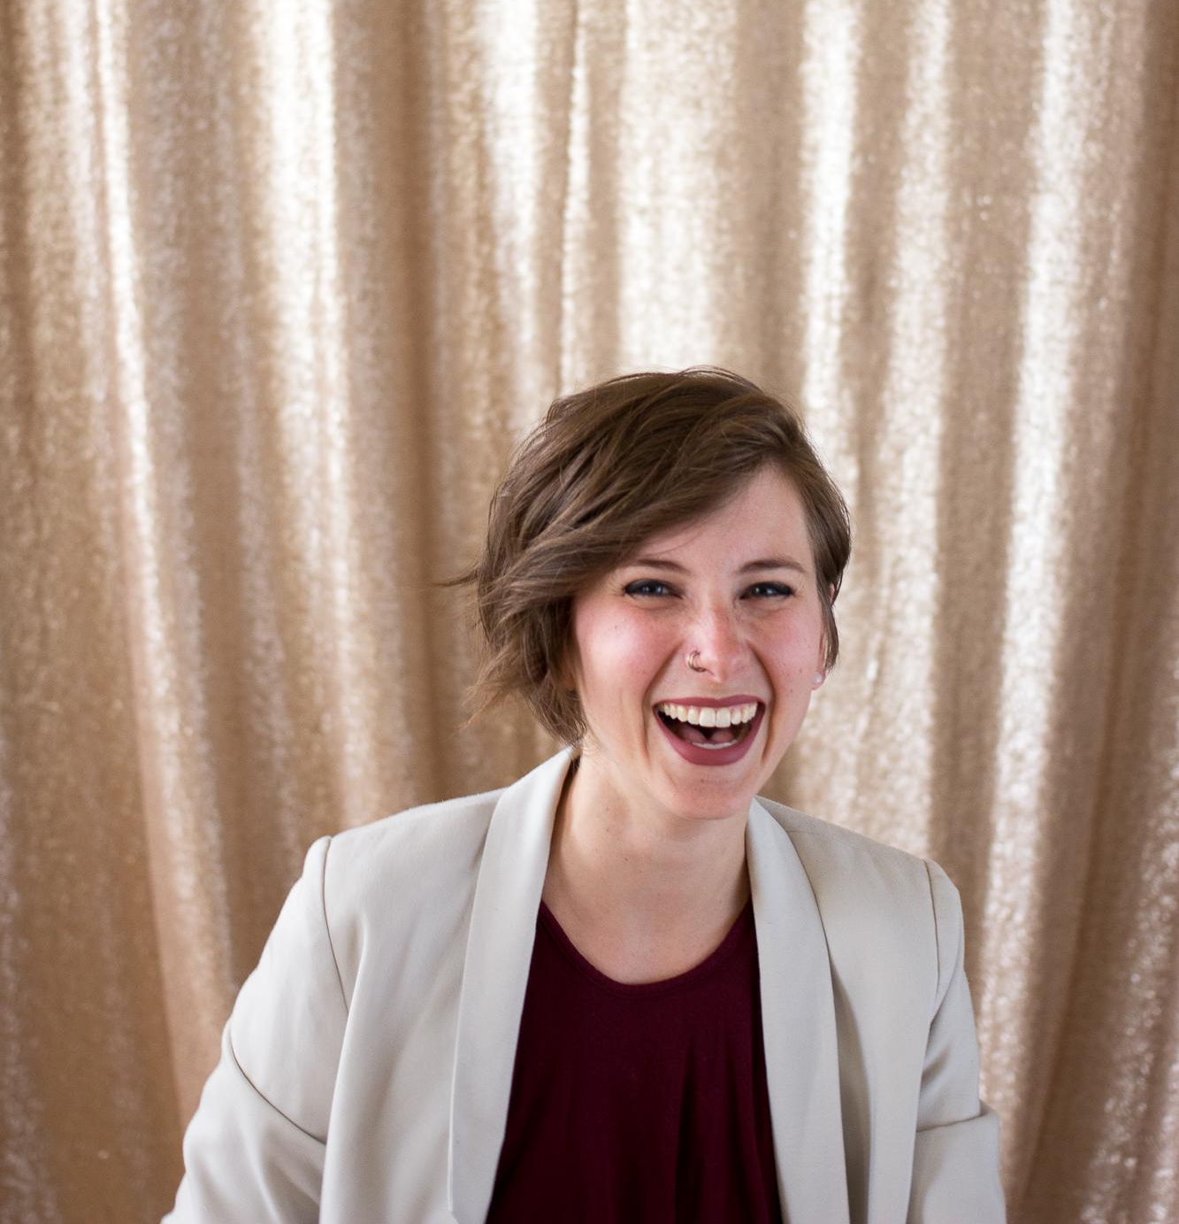
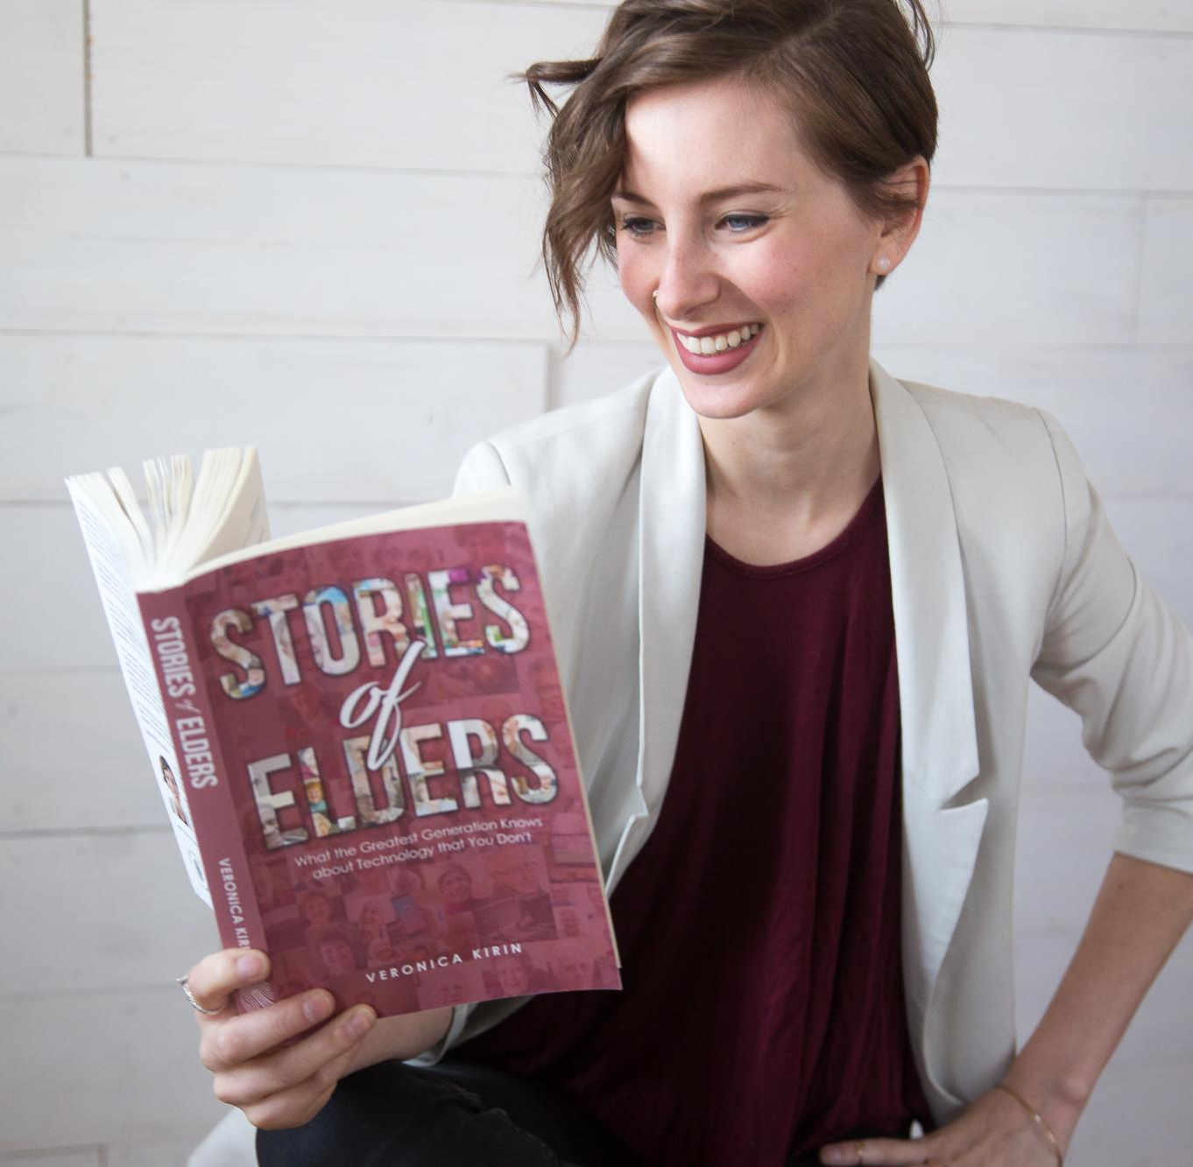
About Me
I’m an Anthropologist and Entrepreneur. I am also the author of Stories of Elders. I use my diverse background to coach other Entrepreneurs as they build an empire to change the world.
Anthropology
Nonprofits, Startups, Biz
GreenCup
Turbo

Slide 3
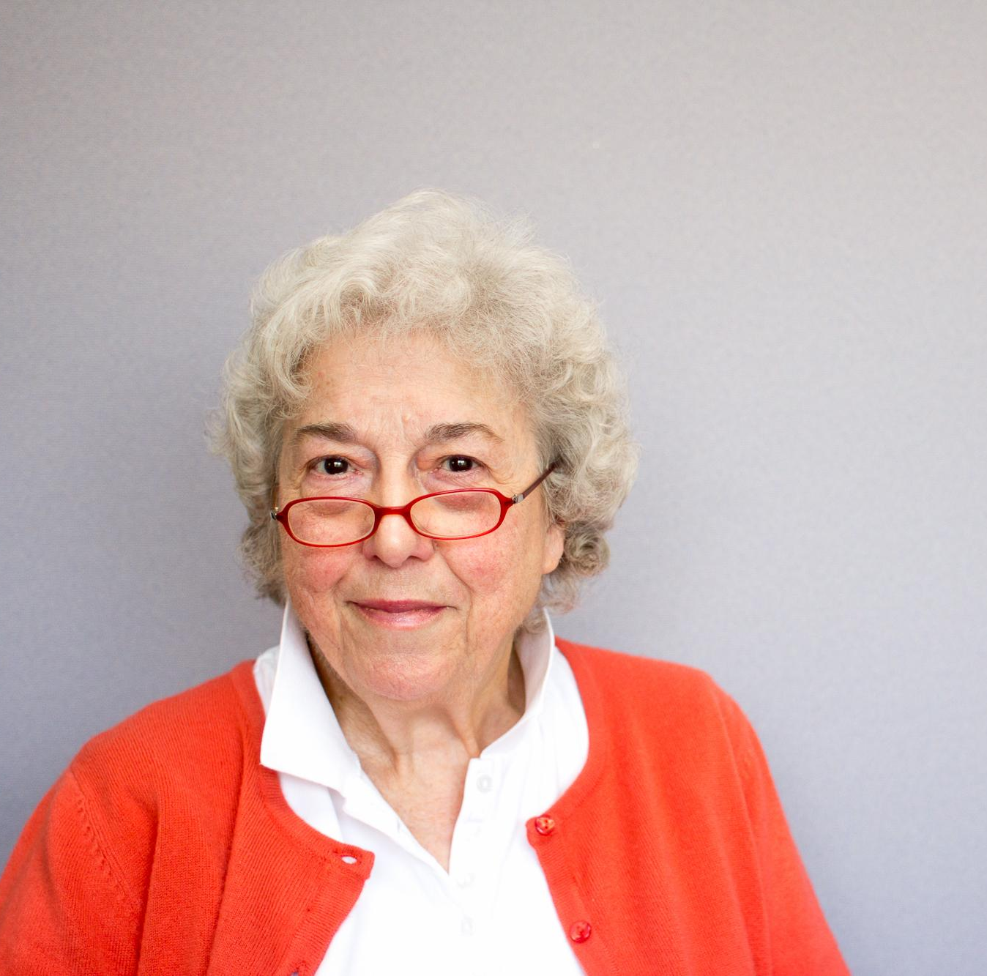
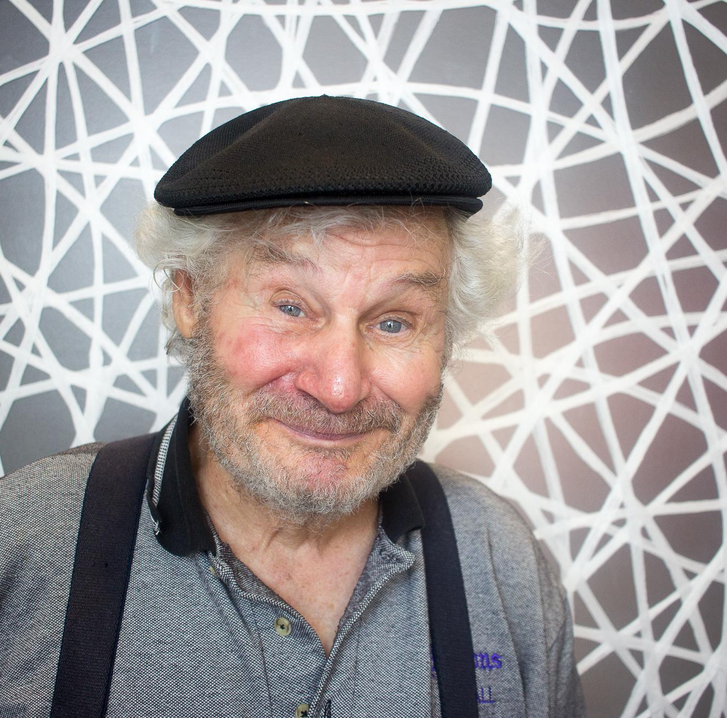
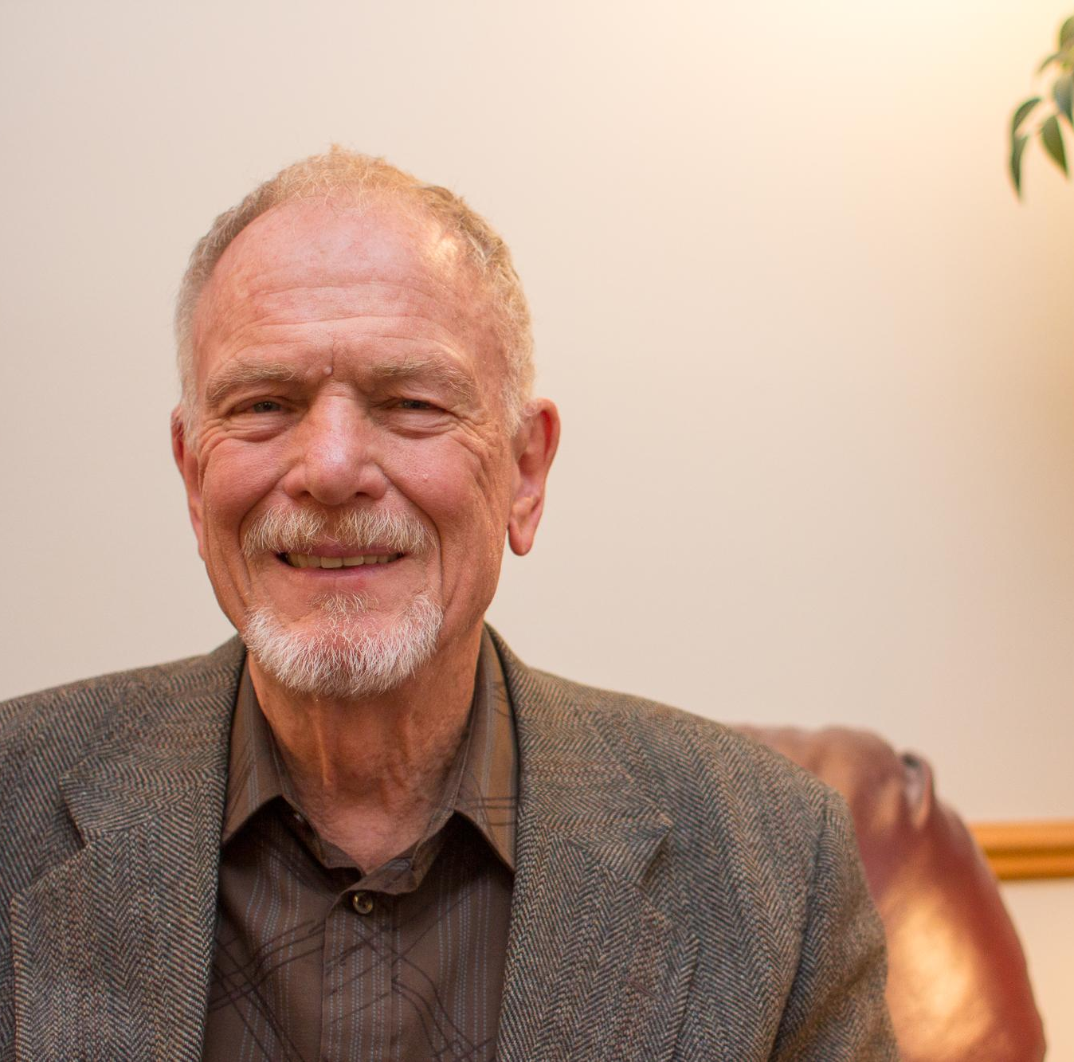
Stories of Elders
12,000 Miles
100 Elders
8,500 Years
1 Book
1 Documentary

Slide 4
Elders & Tech

Slide 5


Slide 6
Social Media, Smartphones, & Staying in Touch
Misconceptions about social media
Staying in touch with family
Concern for young people
Bob Johnson, Marge Darger, David Netterfield

Slide 7

I’ve got friends all over the world, and they’re different ages, and different cultures. What have I gained? I have gained an insight into the world that is vastly different because I actually have friends, I guess you could call it friends, from all over the world, and we can talk on a daily basis.
— Dave Chicoring, 1937

Slide 8
Our Elders & Intentionality

Slide 9
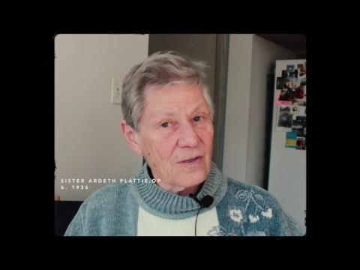

Slide 10
Impact
“I don’t want to learn to text.”
How will this affect my life?
Turning off the router, phone, and tv.
Adele Jones, Betty Segal, Eva Amundson

Slide 11
You can’t just go to sleep, you have to plug in or turn off, you know, so that’s an added pressure. The computer, as everyone knows who uses it, it’s a blessing and it’s a detriment.
— Harriet Berg, 1924

Slide 12
Intergenerational Communication

Slide 13
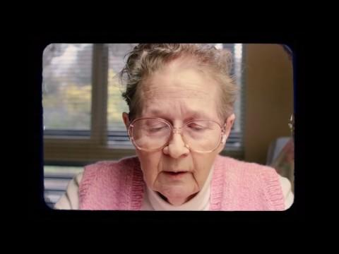

Slide 14
Talking & Listening
Put the phone down.
Ask “you” questions.
Slow down.
Tom Lawson, Jim Hayes, Grace Stinton

Slide 15
When you have a guest, you can’t pick up a book and read, but your guest can pick up her cell phone and send messages out to friends far away, in your presence, and ignore you…
And the other thing is you don’t know what they’re doing… So, they disappear. Yyoure in a room with somebody and they have disappeared, mentally… They should learn not to be so rude. They need to learn the management of it.
— Betty Segal

Slide 16
Stories of Elders
https://storiesofelders.com

