Slide 1
Boomers & Adventure Tourism: You Don’t Have to Stay Home!
Robert R Robins, Mark Gleason
& Paul Stansbie
Department of Hospitality & Tourism Management

Slide 3
Defining Adventure Tourism
Adventure Tourism is “physically bracing, adrenalin-driven, somewhat risky, with moments of exhilaration punctuated by many opportunities to assess and reassess what has been done or accomplished.”
(Muller & Cleaver, 2000, p. 156)

Slide 4
A Boomer’s Definition of Adventure Tourism
“A trip or travel with the specific purpose of activity participation to explore a new experience, often involving perceived risk or controlled danger associated with personal challenges, in a natural environment or exotic outdoor setting.”
(Sung, Morrison, and O’Leary, 1997)

Slide 5
“Adventure Tourism is what tourism should be today and definitely what tourism will be tomorrow.”
UNWTO Secretary-General Taleb Rifai
2012 Adventure Travel World Summit

Slide 6
The Market
Europe, North America and South America account for 70% of international departures.
AT travel market up 65% yearly since 2009.
AT travel sector valued at $263 Billion!
An additional $82 Billion spent for related gear, apparel & accessories.
Global spending by AT travelers increased from $593 per trip in 2009 to $947 in 2012.
(Hanisko, 2014)

Slide 7
Boomers & Travel
Boomer market is 78 million individuals.
Spend $157 Billion on trips every year.
Rank travel as No.1 leisure activity.
Boomers have a drive for self-improvement and authentic experiences.
(Gerber, 2013)

Slide 10
Hard & Soft Adventure
Hard Adventure
Refers to activities with high levels of real risk, requiring intense commitment, advanced skills and experience is required.
Soft Adventure
Refers to activities with a perceived risk, but low levels of real risk, requiring minimal commitment and beginning skills with no experience; most of these activities are self-lead or lead by experienced guides.

Slide 11
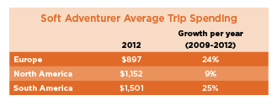
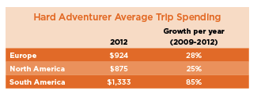
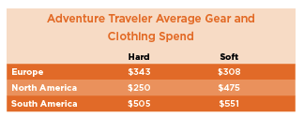

Slide 12
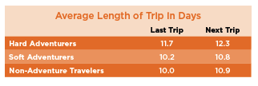

Slide 13
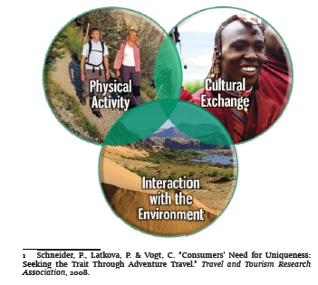

Slide 16
Boomers & AT
Find AT more appealing than previous cohorts.
They travel for personal satisfaction.
Crave adventurous and authentic learning experiences.
Want trips that are physically & intellectually challenging.
Travels that involve an inner journey and exploration of new places and cultures.
(Gibson & Singleton, 2013)

Slide 18
The “Older Generation”
Are fitter and more active than their parents.
More creative with how they spend their time & money.
Want to reconnect with the adventure and service ethos of their youth.
Reflects a generation that was the first to travel extensively in it’s youth.
Embrace the philosophy of making the planet a better place.
(Bahrampour, 2014)
Notes:
Peace Corps, Green Peace, WWF, Nature Conservancy

Slide 24
TOURISM VISION 2020
“The year 2020 will see the penetration of technology into all aspects of life. It will become possible to live one’s days without exposure to other people. But this bleak prognosis has a silver lining for the tourism sector. People in the high tech future will crave the human touch and tourism will be the principal means to achieve this.”
World Tourism Organization Report (1998)

Slide 25
The Future Tourist
The vast majority of the world’s population will never leave their own countries. It is estimated that only 7% of the population will be travelling internationally by 2020.
An older, more experienced individual, seeking increasingly ‘active’ as opposed to passive experiences in the existing main generating markets. The emphasis will be on both mental & physical stimulation.

Slide 26
Characteristics of the Market
Travel a necessity, not a luxury.
Market has traveled more than their predecessors.
They like creature comforts.
See themselves as forever young.
They want to have fun and they are willing to pay for luxury, expertise and convenience.

Slide 27
Studies Reveal Organizations Should…
Stimulate older persons to engage in tourism activities as a response to the present-day realities of social exclusion.
Improve the quality of life of older persons by improving access to beneficial uses of leisure time.
Contribute to the creation of a new and diversified tourism market, as a means of strengthening the economy and creating new jobs, and thus becoming an agent of social cohesion.

Slide 28
References
Adventure Travel & Trade Association. (2013). Adventure Tourism Market Study. The George Washington University Press: Washington, D.C.
Bahrampour, T. (2014, March 16). A fitter and more adventurous generation leaps, climbs and pedals into retirement. The Washington Post. Retrieved from http://www.washingtonpost.com/local/a-fitter-and-more-adventurous-generation-leaps-climbs-and-pedals-into-retirement/2014/03/15/bc5e7524-a8e0-11e3-8599-ce7295b6851c_story.html
Gerber, S. (2013, August 01). The hottest trends in Boomer travel. Forbes. Retrieved from http://www.forbes.com/sites/nextavenue/2013/08/01/the-hottest-trends-in-boomer-travel/
Gibson, H. & Singleton, J. (Eds.) (2015). Leisure and aging: Theory and practice. Champaign, IL.: Human Kinetics
Hanisko, C. (2013). New adventure tourism report reveals $263B market, up 65% per annum since 2009. Adventure Travel News. Retrieved from http://www.adventuretravelnews.com/new-adventure-tourism-report-reveals-263b-market-up-65-per-annum-since-2009
Muller, T. & Cleaver, M. (2000). Targeting the CANZUS baby boomer explorer and adventurer segments. Journal of Vacation Marketing, 6(2), 154-169.
Plog, S. (2005). Targeting Segments: More Important Than Ever in the Travel Industry (Chapter 14). Global Tourism. Burlington, MA: Elsevier. pp.271-293
Schneider, P., Latkova, P. & Vogt, C. (2008). “Consumers” need for uniqueness: Seeking the trait through adventure travel. Travel and Tourism Research Association.
Stowell, S., Doyle, C., Lamoureux, K., Duverger, P., Martin, N., Heyniger, C., & Schneider, P. (August, 2010). Adventure tourism market report. Xola Consulting.
Sung, H. H., Morrison, A. M., & O’Leary, J. T. (1997). Definition of adventure travel: Conceptual framework for empirical application from the providers' perspective. Asia Pacific Journal of Tourism Research, 1(2), 47-67.
World Tourism Organization (2014), AM Reports, Volume 9. Global Report on Adventure Tourism, UNWTO, Madrid.

Slide 29
QUESTIONS?

