Slide 1
Sexual Health Promotion in Long Term Care
Art and Science of Aging Conference
February 22, 2019
Sally Pelon, PhD, LMSW
Lihua Huang, PhD, MSW
GVSU School of Social Work

Slide 2
Myths about Sexuality in Aging
Older people are asexual;
Sexuality does not exist in old age;
One must appear youthful in order to express sexuality (Rowntree, 2014).
Sexuality among older people is comical;
Sexuality among older people is disgusting;
Sexuality in older adults is medical;
Sexual activity in long-term-care (LTC) facilities is against rules;
Assumed to be heterosexual (Dominguez & Barbagallo, 2016).

Slide 3
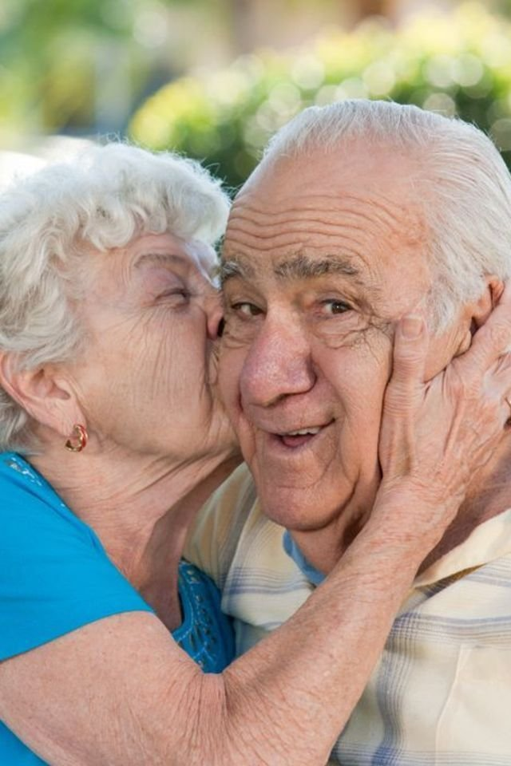
Sexuality = Procreation
Historically there has been an association between sexual expression and procreation, marriage, and physical attractiveness (Bentrott & Margrett, 2011)
Sexual expression has been deemed an essential component to human well-being throughout a life span, ironically, with the exception of late adulthood (Bentrott & Margrett, 2011 )

Slide 4
WHO Working Definition of Sexuality
Central aspect of being human throughout life encompasses sex, gender identities and roles, sexual orientation, eroticism, pleasure, intimacy and reproduction.
Sexuality is experienced and expressed in thoughts, fantasies, desires, beliefs, attitudes, values, behaviors, practices, roles and relationships.
While sexuality can include all of these dimensions, not all of them are always experienced or expressed.
Sexuality is influenced by the interaction of biological, psychological, social, economic, political, cultural, legal, historical, religious and spiritual factors (WHO, 2006).

Slide 5
Early Evidence of Sexuality in Later Life
Masters and Johnson (1962, 1963) dismantled many long-standing myths and misconceptions that aging is associated with sexual dysfunction:
Given reasonably good health and availability of an interested partner, there is no absolute age when sexual abilities disappeared;
Many older men and women are perfectly capable of excitement and orgasm well into their 70’s and beyond.
Intimacy is comforting to patients (Erikson, Erikson, & Kivnick, 1986).
Men may continue their reproductive abilities well into old age.

Slide 6
Biological Changes and Sexual Response
Reduction of estrogen and testosterone levels leads to specific changes in sexual responses (Hinchliff & Gott, 2011; Masters & Johnson, 1962; 1963)
Lowered estrogen levels can cause vaginal dryness and thinning and loss of elasticity in the vaginal tissue;
Women may also experience a reduction in the intensity of orgasms and an extension in the time it takes to become sexually aroused ;
Some degree of urogenital atrophy in women may cause pain for women during sexual intercourse;
Reduction in testosterone levels in men diminishes ability to postpone ejaculation and experience an increase in the time needed to achieve an erection.

Slide 7
Roles of Sexuality and Intimacy
Sexuality central to sense of self, self-esteem, and body image in later life
(Johnson, 1996; Moore, 2010);
The majority of older adults are considered sexuality as an important
part of life (Lindau et al., 2007);
Regular, consensual, sexual expression contributes to physical &
psychological well-being, and reduces physical and mental health
problems associated with aging (DeLamater, 2012).

Slide 8
Impact of Medical Conditions
A number of medical disorders impairing blood supply or innervation of genital tissue are associated with lack of sexual interest, arousal and orgasmic disorders, and general discomfort with sex;
Most common conditions:
Cardiovascular disease (CVD), diabetes, depression, breast and prostate cancers, HIV/AIDS, cognitive impairment and dementia, and osteoarthritis.
Men’s sexual desire and performance are more likely affected by health problems than by hormonal insufficiency.

Slide 9
High Proportion of Sexually Active Older Adults
High rates of sexually active older people:
About half of the population ages 57-85;
About one third of people ages 75-85 (Lindau & Gavrilova, 2010).
46% of the oldest men (70+) reported engaging in masturbation in the past year;
33% of the oldest women reported (DeLamater, 2012).

Slide 10
Different Focus
Older persons continue to have sexual feelings and needs, either being capable or not (Dominguez, 2016);
Different from youth culture, sexuality in later life focuses more on intimacy or relationships than arousal (Lichtenberg (2014) ;
Intimacy is comforting to patients (Erikson, Erikson, & Kivnick, 1986).
LTC staff observe dementia patients do not resist intimacy and seem glad to see their partners when they visit (Belluck, 2015; Kaplan, 2015; Kimchi et al., 2016).

Slide 11
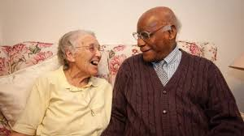
Definition
Widening definition of sexual expression and activities in later life (Frankowski & Clark, 2009; Hinchliff & Gott, 2011):
Intercourse is merely one of the ways in which sexuality and intimacy are expressed;
Masturbation is common among older adults that may be widowed or not have a partner;
Physical intimacy: Intimate touch; kissing; holding hands; cuddling , gardening, playing “footsy” and being close and intimate without having intercourse.

Slide 12
Forms of Sexual Activity
Holding hands | Signs of companionship
Flirting/teasing | Masturbation
Hugs | Genital touch stimulation
Kissing | Intercourse
Cuddling | Oral sex
Romantic affection | Anal sex

Slide 13
Sexuality/Intimacy and LTC
Desire to engage in sexual activity is not eradicated or decreased as a result of admission into a LTC facility (Mahieu, Van Elssen & Gastmans, 2011);
Cognitive impairments don’t necessarily eliminate one’s ability for “recognizing their desire for intimacy and pursuing a meaningful relationship” (Hebrew Homes, 2011).

Slide 14
High Rates of Sexually Active LTC Residents
62% of 100 men and 30% of 102 women over 80 years had had recent intercourse in LTC facilities;
87% of men and 68% of women had had physical intimacy of some sort (as cited in Dominguez & Barbagallo, 2016).
81% of men and women ( m= 82 years old) from 15 LTC facilities reported sexual desire, but were currently inactive because of lack of opportunity (as cited in Dominguez & Barbagallo, 2016).

Slide 15
Low Rates of ISB of Dementia Patients
Reported rates of inappropriate sexual behavior (ISB) among dementia patients are 2-25% (Dominguez & Barbagallo, 2016);
ISB examples (Dominguez & Barbagallo, 2016):
Sexually explicit language
Inappropriate touching of another person;
Request unnecessary genital care
View pornography in public
Disrobe in public
Handle genitals or masturbate in public;
Get in bed with another resident.

Slide 16
Dementia and Sexuality (Doll, 2012)
Type of Dementia | Description | Effect on Sexuality
Alzheimer’s Disease | Most commonly known • Caused by plaques in the brain | Mixed • Later stages of result in apathy
Vascular | Caused by poor blood flow • Stroke, diabetes, hypertension | Usually results in apathy •
Lewy bodies | Abnormal protein deposits in nerve cells in the brain stem | Unknown
Frontotemporal | Pick’s disease • Brain cell damage • Decline- social skills/emotional apathy | May cause hypersexuality
Huntington’s Disease | Inherited • Impaired judgment, mood swings, depression, memory loss | From lack of will to live to sexual disinhibition
Parkinson’s Disease | May not always result in dementia • Tremors, muscle tightness, speech problems | Usually results in apathy • Medications may cause hypersexuality

Slide 17
Barriers to Sexual Well-Being in LTC
Profile of Older Adults in LTC
85+ population to approx. 5.5 million in 2010; projected to 6.6 million in 2020 (19% for that decade)
74 percent of LTC residents are widowed and single women: availability of sexual partners is scarce (Villar et al, 2014)

Slide 18
Barriers to Sexual Well-Being in LTC
Profile of Older Adults in LTC
Prevalence of chronic illness and dependence are high: negatively impacts sexual desire and behavior (Villar et al., 2014)
Medications have detrimental side effects on sexual desire (Hillman, 2008)

Slide 19
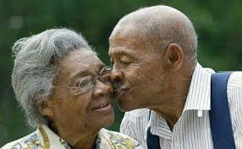
Barriers to Sexual Well-Being in LTC
Profile of Older Adults in LTC
Older adults may be more reluctant to openly discuss sex
Residents may feel judged by others: informal control of behavior
Villar et al., 2014

Slide 20
Barriers to Sexual Well-Being in LTC
Attitudes Regarding Sexuality in Older Adults
Staff view sexuality as irrelevant or potentially disruptive (Villar et al., 2014)
Staff do not see sexuality as something to be promoted or proactively addressed (Villar et al., 2014)
Reactions to residents’ sexual expression typically paternalistic, discouraging, or rejecting (Villar et al., 2014)
Staff with limited to no training on issues related to sexual expression and may be uncomfortable (Gilmer et al., 2010)

Slide 21
Barriers to Sexual Well-Being in LTC
LTC Design and Organization
Highly structured environments with constant oversight and monitoring: little to no room for privacy to express sexual need (Bauer et al., 2013; Darnaud et al., 2013)
Shared rooms, unlocked doors, staff enter rooms unannounced
Bauer et al., 2013

Slide 22
Barriers to Sexual Well-Being in LTC
LTC Staff and Family Issues
Lack of privacy related to personal information: shared openly among staff, concern that staff may discuss or mock their sexual interest (Villar et al., 2014)
Staff may inform family members of resident relationships without their consent (Villar et al., 2014)
Family members with difficulty acknowledging or accepting need for sexual expression (Gilmer et al., 2010)

Slide 23
Barriers to Sexual Well-Being in LTC
Legal Concerns and Consent
Cognitive impairments and their impact on residents’ ability to consent to sexual activity (Wilkins, 2015; Syme, 2016)
How to balance autonomy with protection from harm (Roelofts et al., 2015)

Slide 24
Sexuality and Human Rights
Sexuality is an integral part of the personhood of every human being in all societies;
Sexual rights are human rights related to sexuality;
Sexual rights are universal, interrelated, interdependent and indivisible;
Sexual rights’ protection and promotion should be part of the daily existence of all individuals;
Sexuality should be recognized as a positive aspect of life.

Slide 25
Sexual Rights of Older Adults
International organizations have recognized and demanded sexual rights as universal rights based on inherent freedom, dignity and equality of all human beings (WHO, 2000; IPPF, 2006);
Older adults shall have rights to:
Access the highest attainable standard of sexual health;
The absence of sexually transmitted disease;
Access to sexual education, and
Decisions to be sexually active or not.

Slide 26
Rights in LTC
LTC residents are guaranteed specific rights under the federal 1987 Nursing Home Reform Law;
Sexual expression is not explicitly stated, but several rights relevant to sexuality are addressed:
Privacy;
Confidentiality regarding personal affairs;
Right to make independent choices, personal decisions; to private, unrestricted communication with visitors of one’s personal choosing; to be free from all forms of abuse and restraints

Slide 27
Rights in LTC
Rights are enhanced by coinciding federal regulations (42 CFR 483.10)
Right to “dignified existence, self-determination, and communication with and access to persons/services inside and outside the facility”
More broadly, the right to exercise rights “as a resident of the facility and as a citizen or resident of the U.S.“
LTCFs must promote these rights in a manner that enhances quality of life; ensures dignity, choice, and self-determination, while affording residents privacy to engage in safe, consensual sexual expression.

Slide 28
Consequences Of Denying Sexual Rights
Barriers to self-expression can have adverse effects on one’s self-esteem;
Older adults lack accurate information about sexuality;
There has been rising rates of HIV/AIDS in older adults.
Diagnosis tends to be made later and the disease course is faster.
Often perceived as low risk for HIV/AIDS and are not targeted as high risk population for HIV by public health agencies.

Slide 29
Consequences Of Denying Sexual Rights
Sexual assault is unreported and unrecognized in older adults;
Sexual expression is overlooked, ignored, or even discouraged in LTC, even for LTC professionals consider sexual health is important and support consensual sexuality among residents:
43% of professionals (n=52) report never taking a sexual history (Balami, 2011) ;
51% LTC administrators and social workers (n-340) report they would respectfully responses to sexual express; 32 % would be disgusted, 20% would panic, and 20% would ignore the behavior (Doll, 2013)

Slide 30
Societal Barriers to Sexual Well-Being
Society helps to impose barriers which results in the sexuality of older adults being devalued (DeLamater, 2012).
Older adults are often not seen as sexual beings which matriculates into interactions between caregivers and residents (Rheaume & Mitty, 2008);
Inaccurate views people have in regards to older adults and sexuality negatively affects the professional relationships older adults have with their physicians and caregivers.

Slide 31
Barriers in Health Care System
Many healthcare providers do not ask questions about sexual health during examinations with their patients (Farrell & Belza, 2012);
Some reasons stated:
Lack of adequate training in school
Not enough time to discuss sexual health
Not wanting to offend or embarrass their patients

Slide 32
Case Study: Call for Clearer LTC Policies
Rayhons, a 78-year old retired farmer and former state legislator, had been charged with sexual abuse in the third degree in 2014, a month after his wife Donna’s death at the age of 78.
Iowa State prosecutors and Donna’s daughters from a previous marriage accused him of having sex with the ailing woman even after doctors told him that her dementia made her no longer able to consent.
Rayhons pleaded not guilty to the charges, testifying that all he had done on the night in question was pray, hold hands and kiss.
Rayhon was eventually found not guilty.

Slide 33
Sexual Rights Intervention and Practice
Mandatory training for professional licensure and staff training
Build awareness of sexual expression and consent and address it directly
Requirements for LTCFs to have a sexual express policy in place
‘Knock first’ policies, do not disturb signs, wider beds, pushing beds together
Syme et al., 2016

Slide 34
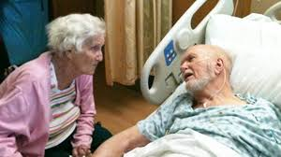
Sexual Rights Intervention and Practice
Respect right of residents with capacity to consent to engage in sexual activity, as long it is not illegal
Refrain from revealing confidential information about residents’ participation in sexual and intimate acts to family members or others not directly involved in care
Syme, 2017

Slide 35
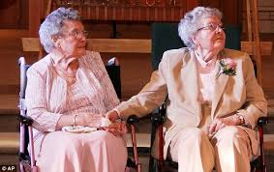
Sexual Rights Intervention and Practice
Respect that residents who do no have capacity to consent, are still sexual beings
Remember that not every resident is heterosexual
Address one’s own attitudes and behaviors toward older people and sex generally
Syme, 2017

Slide 36
Sexual Rights Intervention and Practice
Expert behavioral health and social workers available, particularly regarding consent issues
Ongoing education about sexual issues, barriers and expression for staff, family
Formalized sexual assessment: initially and ongoing, consent forms
Syme et al., 2016

Slide 37
Sexual Rights Intervention and Practice
Capacity to Consent: flexible and based on individual resident’s needs
Recognize resident's dignity and autonomy
Recognize potential benefits of sexual and intimate expression
Consider capacity to consent and potential risk of harm
Explore challenges of LTC environment
Syme & Steel, 2016

Slide 38
Thank you!
QUESTIONS?

Slide 39
References:
Belluck, P. (2015). Iowa man found not guilty of sexually abusing wife with Alzheimer’s. The New York Times. Retrieved from https://www.nytimes.com/2015/04/23/health/iowa-man-found-not-guilty-of-sexually-abusing-wife-with-alzheimers.html
Doll, G. A. (2012). Sexuality & long-term care: Understanding and supporting the needs of older adults. Baltimore, MD: Health Professions Press, Inc.
Doll, G. M. (2013). Sexuality in nursing homes: Practice and policy. Journal of Gerontological Nursing, 39(7), 30-37.
Dominguez, L.J., & Barbagallo, M. (2016) Aging and sexuality. European Geriatric Medicine, 7(6), 512-518.
Erikson, E. H., Erikson, J. M., & Kivnick, H. Q. (1994). Vital involvement in old age. NY: WW Norton & Company.Yes
Gewirtz-Meydan, A., Even-Zohar, A., & Werner, S. (2018). Examining the Attitudes and Knowledge of Social Work and Nursing Students on Later-Life Sexuality. Canadian Journal on Aging/La Revue canadienne du vieillissement, 37(4), 377-389.
Kaplan, S. (2015). Former Iowa legislator Henry Rayhons, 78, found not guilty of sexually abusing wife with Alzheimer’s. The Washington Post. Retrieved from https://www.washingtonpost.com/news/morning-mix/wp/2015/04/23/former-iowa-legislator-henry-rayhons-78-found-not-guilty-of-sexually-abusing-wife-with-alzheimers/?utm_term=.1f7f681dfec8
Kimchi, E. Z., Sewell, D. D., Dolin, G., & Karlawish, J. (2016). You let my Mother do what?! Sexual intimacy and decision-making capacity in cognitively impaired older adults. The American Journal of Geriatric Psychiatry, 24(3), S35-S36.
Lichtenberg, P. A. (2014). Sexuality and physical intimacy in long-term care. Occupational therapy in health care, 28(1), 42-50.
Masters, W. H., & Johnson, V. E. (1962). The sexual response cycle of the human female. III. The clitoris: anatomic and clinical consideration. Western journal of surgery, obstetrics, and gynecology, 70, 248.
Masters, W. H., & Johnson, V. E. (1963). The sexual response of the human male. I. Gross anatomic considerations. Western journal of surgery, obstetrics, and gynecology, 71, 85.
Stahl, K. A. M., Bower, K. L., Seponski, D. M., Lewis, D. C., Farnham, A. L., & Cava-Tadik, Y. (2018). A Practitioner’s Guide to End-of-Life Intimacy: Suggestions for Conceptualization and Intervention in Palliative Care. OMEGA-Journal of Death and Dying, 77(1), 15-35.
Syme, M. (2017). Supporting safe sexual and intimate expression among older people in care homes. Nursing Standard (2014+), 31(52), 52.
Syme, M.L., Lichtenberg, P., & Moye, J. (2016). Recommendations for sexual expression management in long term care: A qualitative needs assessment. Journal of Advanced Nursing, 72(10), 2457-2467.
Tarzia, L., Fetherstonhaugh, D., & Bauer, M. (2012). Dementia, sexuality and consent in residential aged care facilities. Journal of Medical Ethics, 38(10), 609-613.
Villar, F., Celdran, M., Faba, J., & Serrat, R. (2014). Barriers to sexual expression in residential aged care facilities: Comparison of staff and residents’ views. Journal of Advanced Nursing, 70(11), 2518-2527.
World Health Organization. (2006). Defining sexual health: report of a technical consultation on sexual health, 28-31 January 2002, Geneva. World Health Organization.
Yelland, E. & Hosier, A. (2015). Public attitudes toward sexual expression in long term care: Does context matter? Journal of Applied Gerontology, 36(8), 1016-1031.

