Slide 1
Just do it: Cognitive Behavioral Strategies for Promoting Healthy Sexuality With Aging
Christina Pierpaoli Parker, MA, Phd Candidate

Slide 2
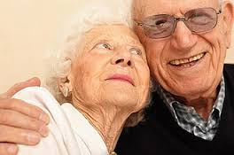
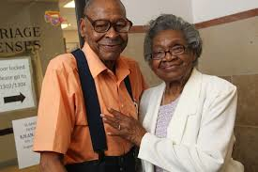
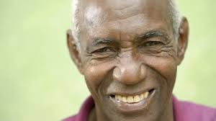
Objectives
Describe the relationship(s) between thoughts, feelings, and health behavior
Learn and apply specific cognitive & behavioral skills to promote successful aging & healthy, safe sexuality

Slide 3
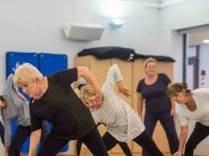
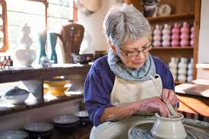
Presentation Overview
Overview of late life sexuality
      What has been your lived experience with eye disease? Other disabilities?
Introduction of Cognitive Behavioral Model
      What is it + why does it matter?
      Let’s take a breather!
Cleaning out the filter
      Cognitive strategies
Getting busy with behavioral activation
      What it is
      How it looks
      How you can get busy today!

Slide 4
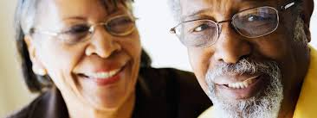
Sex & aging: An overview
Adults living longer and healthier lives, stimulating significant study of sexuality after 60.¹
  Lindau et al. 2007
  DeLamater et al. 2012
  Brody et al., 2010
Contrary to ageist attitudes and beliefs, ² many adults remain sexual into later life, particularly if partnered and in good health ^{3,4} though expression of that sexuality may change
Sex increasingly recognized as an indicator of successful aging & health, linked to⁵:
  Improved CVD health;
  Improved QoL
  Reduced depressive symptoms
  Lower BMI
Notes:
1. (DeLamater, 2012)
2. Kaas 1981
3. Lindau et al.. 2007,
4. Karraker et al., 2011
5.. Ports et al., 2014

Slide 5
Overview continued
Normative physical changes accompanying aging, however, may impact sexual functioning (e.g. arousal, desire, satisfaction) particularly among older adults with chronic medical conditions ^{6, 7}
Sexual dysfunction appears to affect 25% of older men, and 47% of women, though illness, medication, and surgery explain greater variance in sexual dysfunction than aging alone ^{8,9}
The most common issues—difficulties with vaginal lubrication in women and erectile dysfunction (ED) in men—may start from gradual, systemic reductions in estrogen and testosterone ^{10, 11} but also have cognitive-behavioral underpinnings and treatments
Notes:
For women, the consequences of this decline vary a great deal, from none to severe, though the presence of serious symptoms (e.g. dyspareunia, or vaginal pain) appears uncommon (DeLamater, 2012). Men— who show more gradual declines in testosterone than women experience in estrogen— may experience slower and less firm erections, fewer orgasms, and longer refractory periods (Aubin & Heiman, 2004).

Slide 6
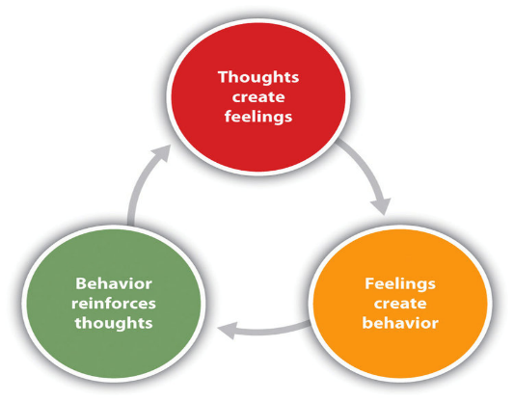
A cognitive-behavioral approach
Cognitive behavioral theorizing assumes that thoughts influence feelings and behaviors, and that thoughts, feelings, and behaviors have reciprocal and synergistic relationships
When we learn how to change unhelpful thoughts and behaviors, we can change feelings and attendant outcomes
Interrupt at cognitive level
Behavioral level
Notes:
Asking these questions because they influence our experience with disease
General overview of CBT – the idea that the way we process information influences how we feel and behave
In clinical psychology, CBT targets the reduction or elimination of dysfunctional thinking styles and behavioral patterns that maintain impairment

Slide 7
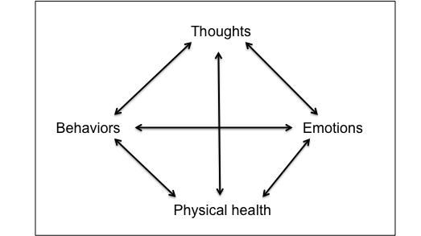
A cognitive-behavioral approach to healthy aging
“I will never lose weight. I am disgusting.”
Sad, defeated, hopeless
Emotional eating
Social withdrawal
Low physical activity
Weight gain, pain
Notes:
Given high rate of physical comorbidities and sexual dysfunction in later life, CBT model has been adapted to meet older adults’ unique needs

Slide 8
Behavior vs. Cognition
Behavior
(things we do)
Cognition
(things we think)
Notes:
Today we will focus on behavioral component- the things that we do

Slide 9
| The cycle of distress |
Increased physical sensations
Strong negative emotion
Reaction
Sometimes, you get so overwhelmed, you just want it to stop.
Increased heart rate, shortness of breath, pain
Increased distress
Notes:
I want to introduce our first simple behavior

Slide 10
| The cycle of distress |
Increased physical sensations
Strong emotion
Reaction
Increased heart rate, shortness of breath
Deep breathing interrupts the physical process and can reduce emotional distress
Increased distress
Notes:
Emotional distress gets in the way of all sorts of health behaviors and even sex itself

Slide 11
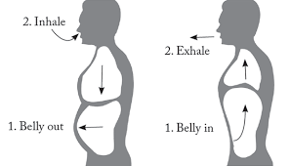
Diaphragmatic Breathing
Involves taking slow, even breaths into the diaphragm (stomach area) instead of the chest
Slower, deeper breathing associated with enhanced blood oxygenation, which may promote relaxation above and beyond meditative features of deep breathing.

Slide 12
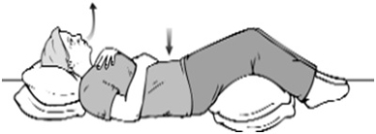
Let’s practice!
Notes:
Learning how to deep breathe helps you to create a healthier, more flexible space from which to behave in a way that promotes your goals

Slide 13
So what?
Effective stress management and emotional regulation strategies play critical roles in sexual wellness, particularly because high levels of negative affect (e.g. anxiety, depression) can compromise the various components of sexual functioning, including desire and arousal (Rellini et al., 2010)
Individualized interventions including mindfulness that focus on relaxation, breathing, awareness, and acceptance appear to improve sexual functioning
Attitudes and beliefs about performance oriented intercourse
Anxiety
ED & sexual dysfunction
Avoidance

Slide 14
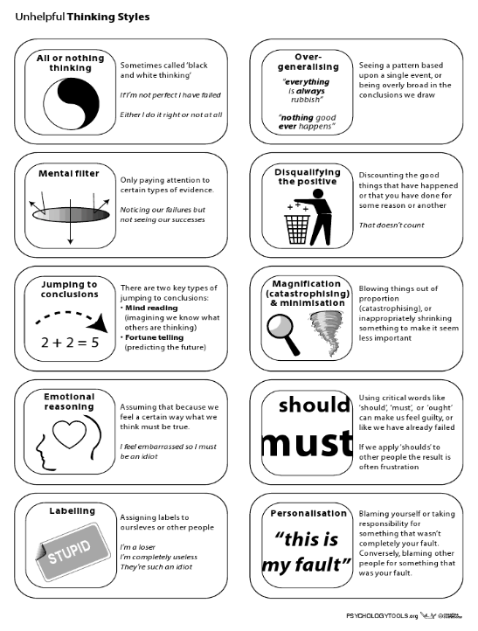
Notes:
An exaggerated or irrational thought pattern involved in perpetuating and maintaining psychological states

Slide 15
A cognitive-behavioral approach to healthy aging & sexuality
Context/ situation | Thought | Feeling | Behavior | Outcome
Sees body in underwear | “I am so old and ugly. Who would ever want to love or touch this?” | Sad, unattractive | Avoids physical touch & intimacy with partner | Pushes partner away; strains relationship
Partner loses erection during intercourse/experiences less firm erection | “I must be unattractive or a poor sexual partner. This is my fault.” | Guilty, embarrassed, shameful | Stops having intercourse | Partners begin avoiding sex; continue to see intercourse as performance and only form of sex
Has questions and concerns about vaginal discomfort during intercourse | “Good women shouldn’t do those things or ask their doctors questions like that. I should just keep my mouth shut and avoid the embarrassment” | Anxious, shameful, worried | Avoids asking and problem-solving with provider | Continues to experience painful, unpleasant sex. Pain worsens.
Internalized ageism (Levy, 2002; 2009)
Notes:
how might this play out in the context of aging, healthy, and sexuality?
-discuss role of internalized ageism: a form of in-group discrimination in which older adults marginalize and discriminate against other people, or themselves
Derived from Zusman’s (1966) Social Breakdown Syndrome, the Geriatric Sexuality Breakdown Syndrome (GSBS; Kaas, 1981) describes the psychosocial mechanisms through which adults internalize ageist messages impacting their sexuality. It assumes that sexual expression depends on several factors, including prevailing mores concerning sexual behavior, actual physical capacities, the individual’s past history of sexual response, and available partners. In later years, when relationships among these contributing factors change, so does sexual expression (Kaas, 1981). Because few healthy, sex positive models exist for older adults, many rely on ageist sociocultural cues about sexuality to orient their behavior (Kaas, 1981). These cues emerge from myths about the unnaturalness and amorality of late life sexuality, stemming from biological reductionist ideas about the fading procreate potential in later life coupled with visceral reaction to imaging parentialized/grandparentialized adults as asexual (Kaas, 1981). As with other modes of stereotyping, these cues color what older adults and their health providers perceive as “appropriate” within social parameters, fostering internalized ageism (Levy, 2009; Syme et al., 2018) stifling healthcare communication, and perpetuating sexual dysfunction (Weeks, 2002; Ports et al., 2014; Wimberly et al., 2006). A recent qualitative study of older adults, for example, revealed that many women experienced internalized ageism and endorsed sexist attitudes about their own sexuality (Syme et al., 2018).

Slide 16
Cognitive Tools
Understand cognitive distortions
Increase awareness of unhelpful thoughts
Learn how to question, challenge, de-catastrophize & reframe
Examples: Are my thoughts accurate? Helpful? What could I say to myself that would be more accurate, positive, or helpful? What would I say to someone I love and respect?

Slide 17
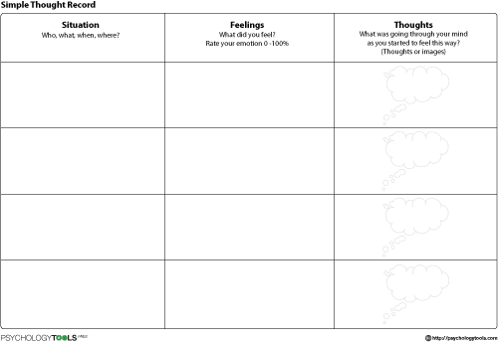
Increase Awareness of Unhelpful Thoughts + Behaviors

Slide 18
A cognitive-behavioral approach to healthy aging & sexuality
Context/ situation | Thought | Feeling | Behavior | OutOutcomecome
Sees body in underwear | “I am so old and ugly. Who would ever want to love or touch this?” | Sad, unattractive | Avoids physical touch & intimacy with partner | Pushes partner away; strains relationship
Partner loses erection during intercourse/experiences less firm erection | “I must be unattractive or a poor sexual partner. This is my fault.” | Guilty, embarrassed, shameful | Stops having intercourse | Partners begin avoiding sex; continue to see intercourse as performance and only form of sex
Has questions and concerns about vaginal discomfort during intercourse | “Good women shouldn’t do those things or ask their doctors questions like that. I should just keep my mouth shut and avoid the embarrassment” | Anxious, shameful, worried | Avoids asking and problem-solving with provider | Continues to experience painful, unpleasant sex. Pain worsens.
Internalized ageism (Levy, 2002; 2009)
Notes:
how might this play out in the context of aging, healthy, and sexuality?
-discuss role of internalized ageism: a form of in-group discrimination in which older adults marginalize and discriminate against other people, or themselves
Derived from Zusman’s (1966) Social Breakdown Syndrome, the Geriatric Sexuality Breakdown Syndrome (GSBS; Kaas, 1981) describes the psychosocial mechanisms through which adults internalize ageist messages impacting their sexuality. It assumes that sexual expression depends on several factors, including prevailing mores concerning sexual behavior, actual physical capacities, the individual’s past history of sexual response, and available partners. In later years, when relationships among these contributing factors change, so does sexual expression (Kaas, 1981). Because few healthy, sex positive models exist for older adults, many rely on ageist sociocultural cues about sexuality to orient their behavior (Kaas, 1981). These cues emerge from myths about the unnaturalness and amorality of late life sexuality, stemming from biological reductionist ideas about the fading procreate potential in later life coupled with visceral reaction to imaging parentialized/grandparentialized adults as asexual (Kaas, 1981). As with other modes of stereotyping, these cues color what older adults and their health providers perceive as “appropriate” within social parameters, fostering internalized ageism (Levy, 2009; Syme et al., 2018) stifling healthcare communication, and perpetuating sexual dysfunction (Weeks, 2002; Ports et al., 2014; Wimberly et al., 2006). A recent qualitative study of older adults, for example, revealed that many women experienced internalized ageism and endorsed sexist attitudes about their own sexuality (Syme et al., 2018).

Slide 19
Cognitive Tools
Understand cognitive distortions
Increase awareness of unhelpful thoughts
Learn how to question, challenge, de-catastrophize & reframe
Examples: Are my thoughts accurate? Helpful? What could I say to myself that would be more accurate, positive, or helpful? What would I say to someone I love and respect?

Slide 20
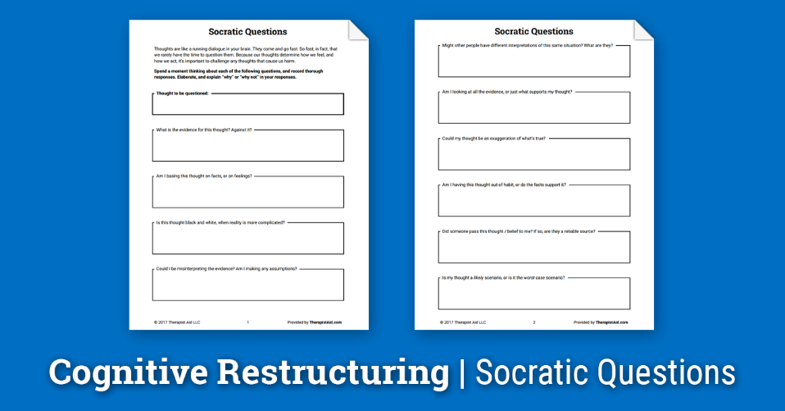
Cognitive Restructuring: Socratic Questioning
Examples: Are my thoughts accurate? Helpful? What could I say to myself that would be more accurate, positive, or helpful? What would I say to someone I love and respect?

Slide 21
Cognitive Restructuring: De-Catastrophizing
Sometimes called the “What If?” technique, this helps to reduce anxiety associated with cognitive distortions. When done correctly, it highlights that worst-case scenarios don’t necessarily constitute catastrophes.
Patient: I worry that I won’t be able to get an erection, or that I’ll embarrass myself. This leads me to getting so nervous that I often can’t get an erection.
Therapist: So, what if those things do come true? What if you do get an erection or feel embarrassed?
Patient: Well, we probably won’t have sex
Therapist: what if you don’t have sex? What happens then?
Patient: I guess nothing. Or something else. We just won’t have sex.
Notes:
Distortions as exaggerated views of reality that can influence behavior

Slide 22
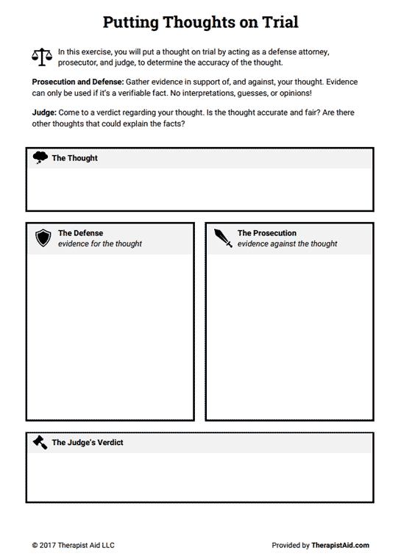
Putting Thoughts on Trial learning To evaluate & Weigh The Evidence
My partner thinks I am unattractive (after weighing self)
I could tell by the way he looked at me
I don’t go to the gym as much as I should
We often discuss our weight
My partner often compliments me
We’ve been together for 10 years
He demonstrates his attraction (e.g. holds me)
Everyone feels unattractive from time to time
Evidence supports that partner thinks I am attractive. This probably has more to do with me than husband.

Slide 23
Let’s practice!
Context/ situation | Thought | Feeling | Behavior | Outcome
Sees body in underwear | “I am so old and ugly. Who would ever want to love or touch this.” | Sad, unattractive | Avoids physical touch & intimacy with partner | Pushes partner away; strains relationship
Context/ situation | Thought | Feeling | Behavior | Outcome
Sees body in underwear | “I am still worthy of love and affection even if I don’t look the way I’d like to right now. I can take steps to reach my physical goals” | Disappointed but motivated | Goes to the gym and walks on treadmill, kisses husband | Feels accomplished and connected; experiences intimacy
Notes:
Remember, changing thoughts or behavior can change feelings

Slide 24
Your Turn!
Step 1: Identify recent situation, automatic thought, feeling, behavior
Step 2: Identify distortion
Step 3: Practice cognitive reframing on distorted, automatic thought
Hint: The point isn’t to delude yourself with saccharine and unbelievable alternative thoughts. The idea is to generate more accurate, compassionate thoughts– not fantasies or affirmations.

Slide 25
Practice continued
Context/ situation | Thought | Feeling | Behavior | Outcome
Has questions and concerns about vaginal discomfort during intercourse | “Good women shouldn’t do those things or ask their doctors questions like that. I should just keep my mouth shut and avoid the embarrassment” | Anxious, shameful, worried | Avoids asking and problem-solving with provider | Continues to experience painful, unpleasant sex. Pain worsens.
Context/ situation | Behavior | Thought | Feeling | Outcome
Has questions and concerns about vaginal discomfort during intercourse | Learns how to assertively and confidently discuss her concerns | “I know it feels uncomfortable to ask but sexuality is a health issue like anything else. A competent provider will honor and respect my questions without judgment” | Empowered, informed, confident, proud | Learns about using silicone (vs. water-based) lubricants; experiences painless intercourse
Notes:
Note that you can change

Slide 26
Practice continued
Context/ situation | Thought | Feeling | Behavior | Outcome
Partner loses erection during intercourse/experiences less firm erection | “I must be unattractive or a poor sexual partner. This is my fault.” | Guilty, embarrassed, shameful | Stops having intercourse | Partners begin avoiding sex; continue to see intercourse as only “real” form of it
Context/ situation | Thought | Feeling | Behavior | Outcome
Partner loses erection during intercourse/experiences less firm erection | “Sometimes this happens, and there are all sorts of reasons for it that have nothing to do with me. What else is on the menu?” | Curious, hopeful, secure | Embraces an erotic, non-intercourse scenario | Arousal and pleasure that may nor may not flow to intercourse
Notes:
Note that you can change

Slide 27
A cognitive-behavioral approach
Cognitive behavioral theorizing assumes that thoughts influence feelings and behaviors, and that thoughts, feelings, and behaviors have reciprocal and synergistic relationships
When we learn how to change unhelpful thoughts and behaviors, we can change feelings and attendant outcomes
Interrupt at cognitive level
Behavioral level
Notes:
Asking these questions because they influence our experience with disease
General overview of CBT – the idea that the way we process information influences how we feel and behave
In clinical psychology, CBT targets the reduction or elimination of dysfunctional thinking styles and behavioral patterns that maintain impairment

Slide 28
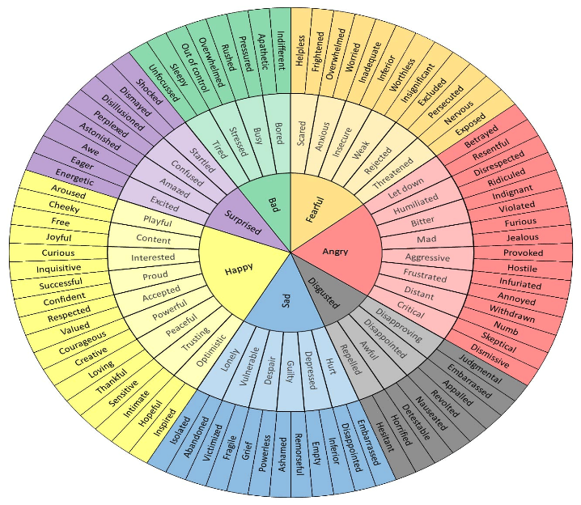
Thoughts Do not = Feelings
Notes:
Feelings and thoughts not the same

Slide 29
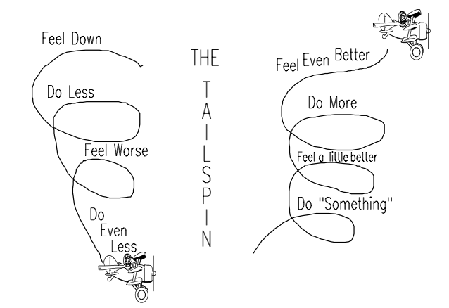
Behavioral activation (BA)
Clinical tool used to increase engagement in reinforcing, mood-boosting activities
When we feel sad, depressed, or lonely we sometimes avoid and isolate, which can worsen symptoms
Notes:
Feelings influence behavior
Predicated on activity theory & behavioral activation theories – that successful aging occurs when older adults stay active and maintain social interactions, and that behavioral activation maintains positive mood
Once you have made space, you can start getting busy in the way you’d like to!
BA = based on the idea that as individuals become depressed, they tend to engage in increasing avoidance and isolation, which serves to maintain or worsen symptoms

Slide 30
Downward Spiral
Illustration on left shows that “giving in to the “slowed down” feeling that comes with negative mood (e.g. sadness, loneliness) can perpetuate a downward spiral
Do less → feel worse → do even less, etc.

Slide 31
“That which you most need will be found where you least want to look.” – Carl Jung / “In filth it shall be found” – Carl Jung

Slide 32
Upward Spiral
Illustration on right shows how a person can withdraw from a downward spiral
Engage in something meaningful→ feel a little better→ do more → feel even better
Notes:
We can induce upward spirals in providing socially meaningful opportunities for older adults

Slide 33
Examples
Feels blue
Feels more energized
Goes for walk
Feels better
Calls friend

Slide 34
Examples – Responsive Desire
Feels no desire
Desire increases
Gently touches partner
Arousal
Starts kissing
Opposite action – the “just do it” principle

Slide 35

Behavioral approaches to optimizing & managing sexual functioning
Notes:
Be open to asynchronous and erotic scenarios– like mutual masturbation, manual + rubbing stimulation– when sex does not flow to intercourse
Maintain positive health habits
Learn and embrace psychological and psychosexual skills to help cultivate and maintain desire, pleasure, eroticism, and satisfaction
If necessary, seek medical interventions (e.g. vaginal creams, physical therapy)
HAVE FUN WITH IT!

Slide 36
Basic behavioral interventions
Eating a whole foods diet
Overweight & obesity can cause diabetes, cardiovascular disease (CVD), and pain.
Diabetes & CVD are two known risk factors for erectile dysfunction.
Alcohol & tobacco use increase risk
Getting adequate sleep
Sleep takes out the brain’s trash, “resetting” us cognitively, emotionally, and physically
Too sleepy? Probably not having sex. More sleep = more energy to have sex
Engaging in exercise + movement
Cardiovascular training increases hippocampal density
Reduces pain, increases strength & stamina
Among women, yoga shown to increase blood flow to vaginal region, muscle tone, and reduce vaginal pain
Regulating mood & stress
High levels of negative affect can affect sexual functioning, including desire and arousal
Practicing mindfulness-based exercises, including deep breathing and progressive muscle relaxation, can help
Practicing assertive communication
Learning how to identify your (health/sexual) needs and communicate them clearly prevents & solves problems
Know your options
Knowledge about your health & sexuality empowers you to ask about your concern as well as understand your needs and options
Notes:
A commitment to health optimization and successful aging can also promote sexual wellness, even in the face of disability and normal changes to the cardiovascular, endocrine, and nervous systems (McCarthy & Pierpaoli, 2015). What promotes health for the physical body—a whole-foods diet, adequate sleep, exercise, adherence to medical recommendations, and stress management— promotes health for the sexual body and brain too (McCarthy & Pierpaoli, 2018; Ngandy et al., 2015).

Slide 37
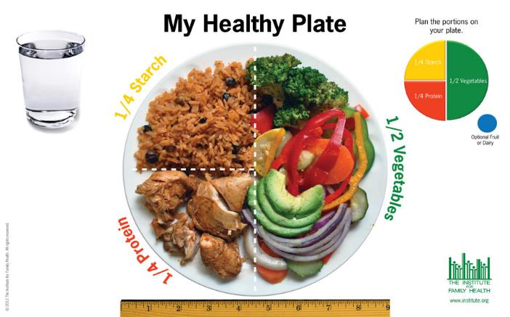
Eating a whole foods diet

Slide 38
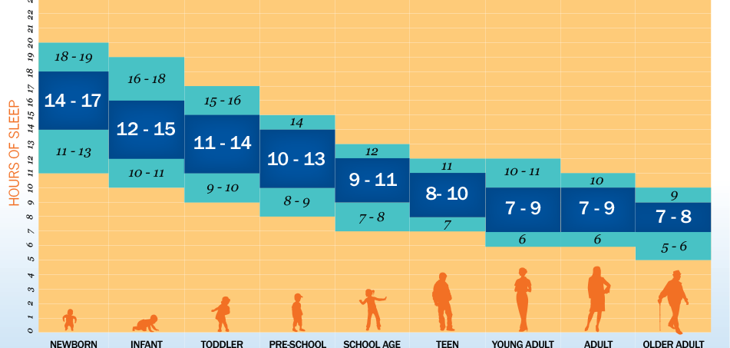
Getting adequate sleep

Slide 39
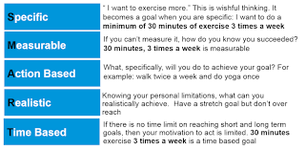
Engaging in exercise & movement

Slide 40
Regulating mood & stress

Slide 41
Behavioral Tool 1: Activity monitoring
Important to assess (objectively) what you are doing during the week so yon can understand what to modify
Use an Activity Monitoring Form to evaluate:
              What you did
              Pleasure (P): How much you enjoyed activity, from 1-10
              Mastery/accomplishment (M), from 1-10
              Overall mood, from 1-10
You can access the form here: https://psychologytools.com/worksheets/free/english_us/daily_monitoring_form_free_en-us.pdf

Slide 42
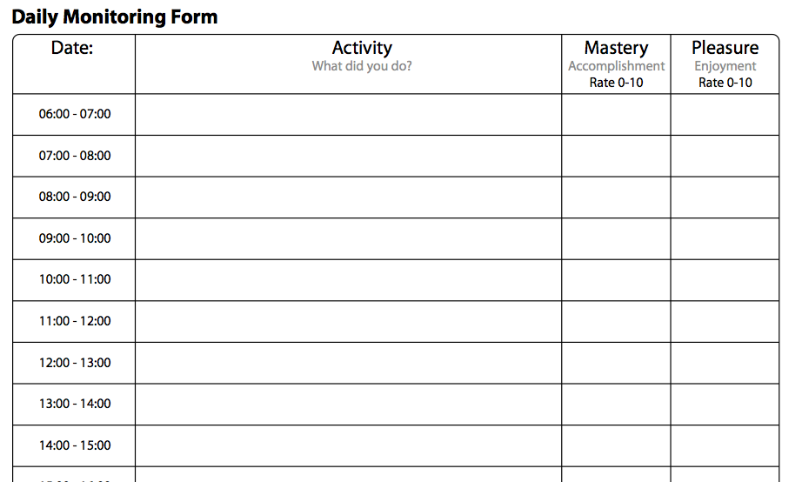
Activity Monitoring Form
Got dressed
2
1
Threw out trash
5
2
Sat on porch
2
4
Prepared healthy lunch
6
6
Notes:
Can adapt for different sexual scenarios

Slide 43
Activity Monitoring Form
Once you have completed the form, review it and answer the following:
            1. Were there periods of time when you experienced pleasure?
            2. What kinds of activities gave you pleasure?
            3. When do you have higher pleasure? When lower?
            4. Do you see any connection between your mood and your activities?

Slide 44
Activity Scheduling: Scheduling Pleasant Activities
It can be helpful to schedule pleasant activities into your week using an Activity Schedule
          Important to keep activities simple and achievable! Why?

Slide 45
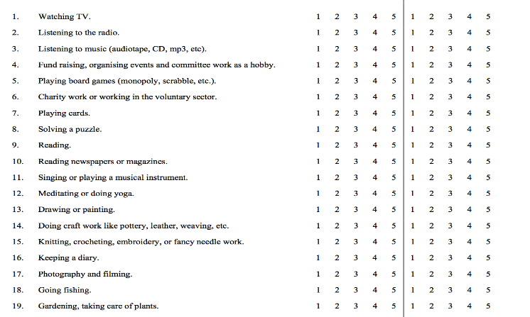
Simple, Fun, Achievable activities
What are some of yours?
Visit here to get some ideas: https://www.robertjmeyersphd.com/download/Pleasant%20Activities%20List%20(PAL).pdf

Slide 46
Identifying Pleasant Activities
It is helpful to identify other pleasant activities you might plan to try in the future. Here are some questions that may help orient you:
    1. What used to be pleasurable in the past?
    2. Why did you stop specific pleasurable activities?
    3. If barriers to an activity are real and can’t be modified, what might be a good substitute?
    May also be important for you to find activities that fit with your values and give you a sense of purpose.
You may think: “I don’t enjoy anything anymore” or “I can’t do anything anymore.” This type of all-or-nothing thinking an keep you from engaging in pleasant activities.

Slide 47
Write down 2-3 new activities you could try, given your limitations- we all have them!

Slide 48
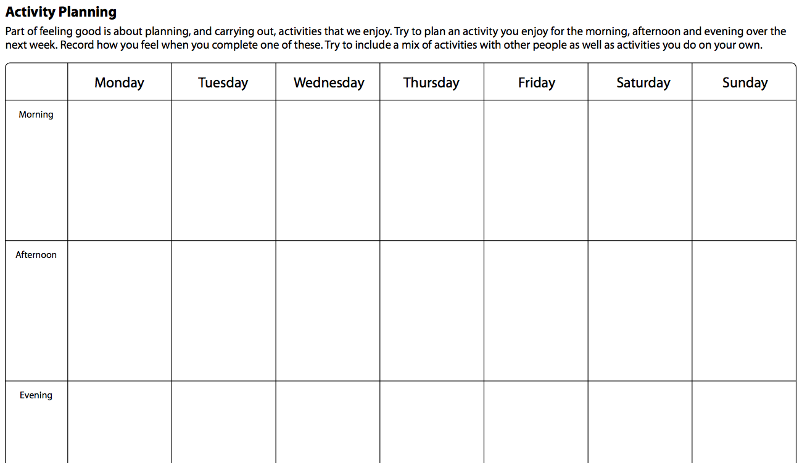
Activity Scheduling
https://psychologytools.com/worksheets/free/english_us/activity_planning_free_en-us.pdf
Notes:
How do you feel when you have something to look forward to?

Slide 49
Ways of reinforcing ourselves
Positive self-talk
Cuddling with someone with love
Doing something relaxing
Doing something exciting
Buying something small
Buying something big
Self-care
Notes:
Add slide about venues available for older adults

Slide 50
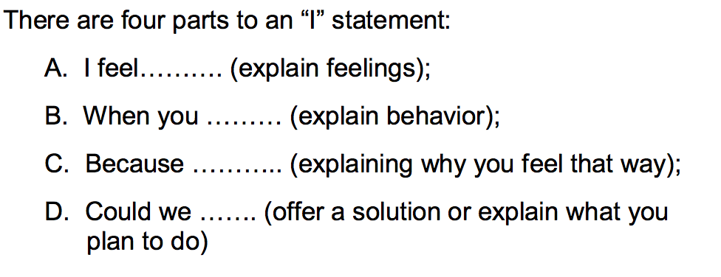
Practice assertive communication
Getting adequate sleep
Regulating mood & stress
High levels of negative affect can affect sexual functioning, including desire and arousal
Practicing mindfulness-based exercises, including deep breathing and progressive muscle relaxation, can help
Engaging in exercise + movement
Cardiovascular training increases hippocampal density
Reduces pain, increases strength & stamina
Among women, yoga shown to increase blood flow to vaginal region, muscle tone, and reduce vaginal pain
People have difference love languages
Notes:
Love languages also

Slide 51
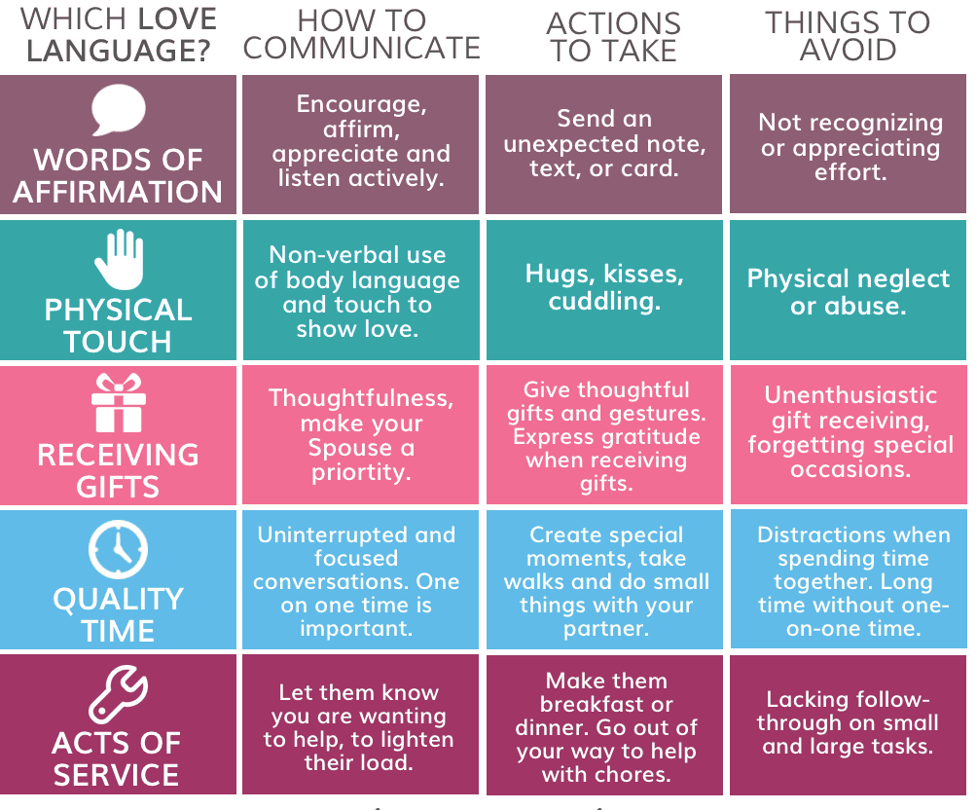

Slide 52
Getting adequate sleep
Regulating mood & stress
High levels of negative affect can affect sexual functioning, including desire and arousal
Practicing mindfulness-based exercises, including deep breathing and progressive muscle relaxation, can help
Engaging in exercise + movement
Cardiovascular training increases hippocampal density
Reduces pain, increases strength & stamina
Among women, yoga shown to increase blood flow to vaginal region, muscle tone, and reduce vaginal pain
Practicing assertive communication
Learning how to identify your (health/sexual) needs and communicate them clearly prevents & solves problems
Know your options
Notes:
So many options on the menu

Slide 53
Oral sex
Mutual masturbation
Masturbation
Cuddling +
Using toys+
Exchanging fantasies
Managing changes to sex with aging
Erotic touch
+
Eroticism

Slide 54
Episode of ED
Explore non-intercourse erotic scenarios
Feels pleasure and sense of pride/beating the odds
Increased sense of sexual self-efficacy & problem-solving
Improved sexual functioning
thoughts

Slide 55
Hormone therapy/creams
Urologists/Gynecologists
Exercise to manage pain
Physical therapists
Biopsychosocial/ whole person treatments + behavior modification
Functional medicine providers
Medication management & reconciliation
Internal medicine/endocrinology

Slide 56
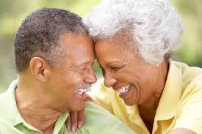
Having fun + not take it all so seriously!

Slide 57
Thank you!
Christina Pierpaoli Parker, MA
Email: cmpierpaoli@crimson.ua.edu
Website: https://www.psychologytoday.com/us/experts/christina-pierpaoli-parker

