Slide 1


Menopause, Manopause, and Redefining Sexuality
Justine Braford BS, LMSW, CST
Nisha McKenzie PA-C, CSC, IF
Notes:
Andropause
”Who’s in the room?”

Slide 2


Changes…
Men, Women, All?
Sleep patterns
Metabolism
Notes:
Raise hands for changes – hair, skin, nails, metabolism,..

Slide 3
Menopause
Cessation of menstrual cycles for 12 consecutive months
What are hormones?
“…mood, sense of well-being, body image, self-esteem, and how a woman feels about her partner turned out to be far stronger predictors of her level of sexual desire than a single hormone”
“In clinical trials, testosterone was found to improve women’s sexual desire, but it did little to improve their sexual satisfaction or feelings of pleasure”
  Lori Brotto “Better Sex Through Mindfulness”

Slide 4
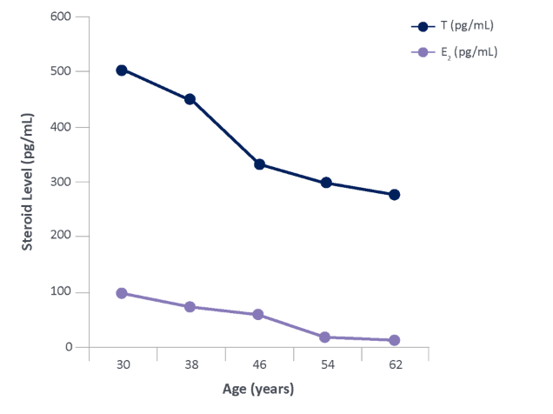
Estrogen and Testosterone
> 400 functions in our bodies
Notes:
Nisha – add estrogen notes – functions of estradiol

Slide 5
Vulvovaginal Atrophy
Approximately 64 million women in the US are in menopause
~half suffer with pain during sex due to menopause (~32 million)
55% of those with dyspareunia – moderate to severe
Dyspareunia due to vulvovaginal atrophy (VVA) is chronic and progressive, and likely to continue without treatment
Patient surveys show only ~ 4% of women attribute their vaginal symptoms to VVA
Studies show ~ 70% of women do not bring up their atrophy symptoms to their health care provider
Notes:
Cultural, embarrassment, religious, social,

Slide 6
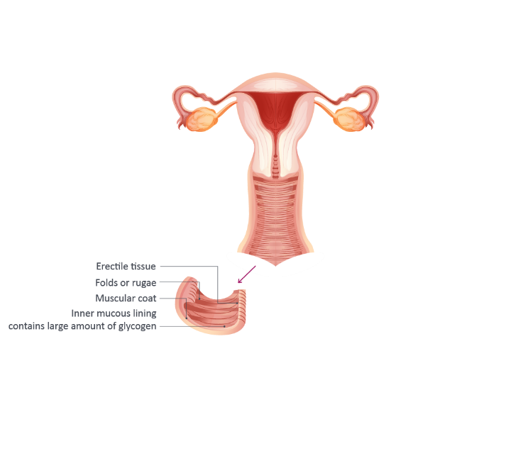
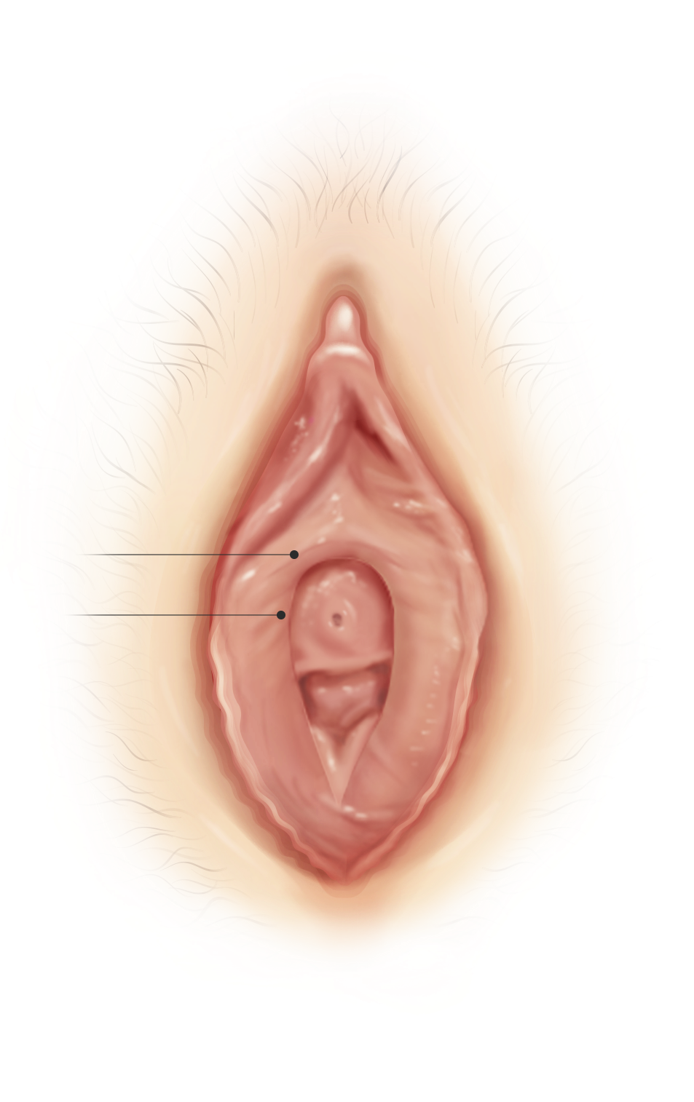
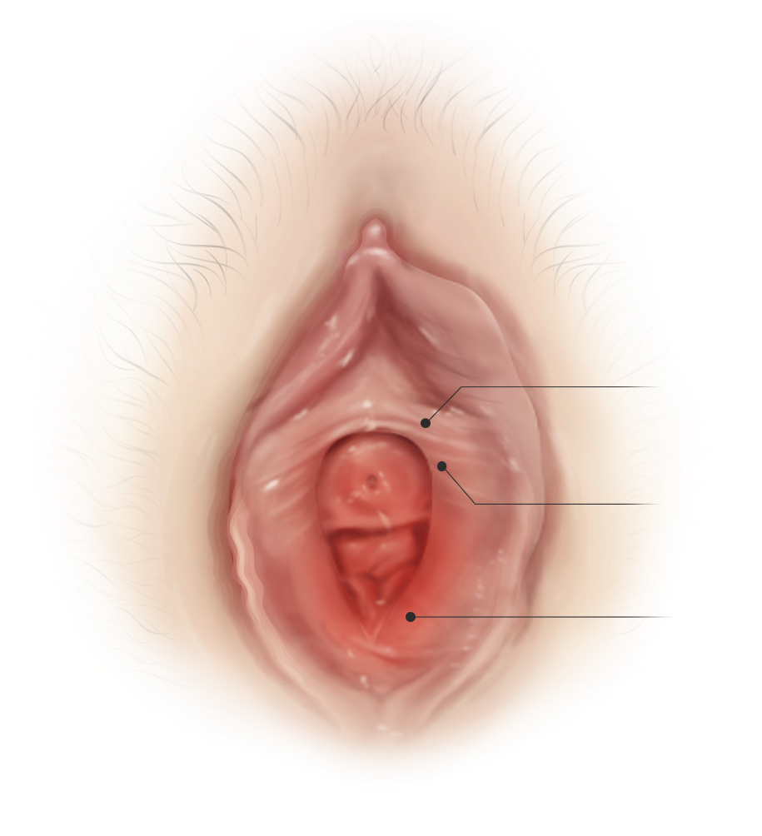
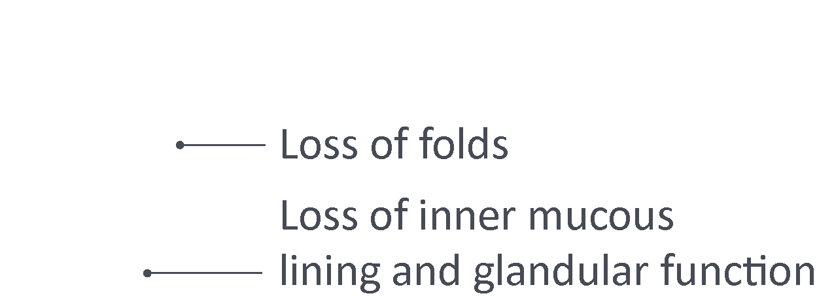
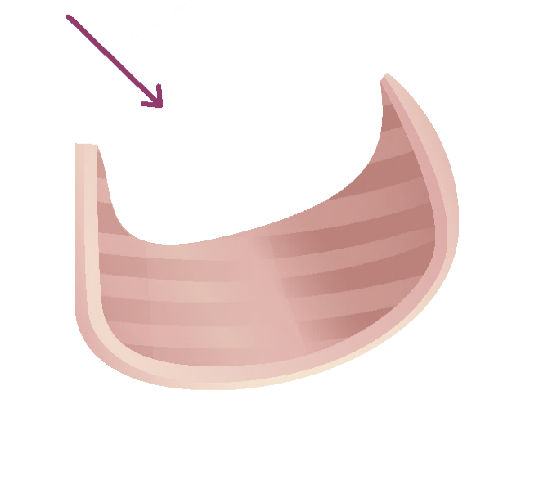
Vaginal Health
Estrogenized vaginal tissue is rich in glycogen
Glycogen is substrate for lactobacilli, which convert glucose into lactic acid
Normal vaginal pH 3.5-4.5
Pink and rugated
Pale and
friable
Increased elasticity
Decreased elasticity
Irritated
areas may
be red

Slide 7
Manopause
Cognitive decline
Prevalence of clinical depression increases
  Subclinical depression in men is both underdiagnosed and under-researched
Erectile dysfunction increases from age 50-80 from 5% to 50%
  Androgen therapy rarely reverses
  Typically a vascular issue
Starting at age 40, muscle mass decline and fat mass increase
Risks of testosterone therapy
  Prostate ca?
  CV disease?
Korenman SG. Manopause. 2000. Western Journal of Medicine. August; 173(2): 80.

Slide 8
Life Expectancy
1900s = 41 yrs
Current = 84.5 yrs (declining due to substance abuse and despair)
In 2030, 1 in 5 persons in the USA will be 65 or older
From where do we derive QUALITY of life?
  How does this interplay with sexuality?
Notes:
Leading to pleasure

Slide 9
Most Common Presenting Concerns
Low Desire
Pain disorders
Pleasure
Arousal
Notes:
Concerns are complex and often overlap the level that we discuss today is very introductory

Slide 10
A Team Approach
Gynecologic and Obstetrical Care
Sexual Health Medicine
Psychopharmacology
Physical Therapy
Psychotherapy
On-Site Store
To Come….
Dietitian and Massage Therapy

Slide 11

General Approach
Complete and compassionate history-taking
  Description, Onset, Understanding, Previous Treatment, Expectations
  Check assumptions (assumed heterosexuality, assumed monogamy, celibacy in single women, importance of sexuality, practices/BDSM)
  Walk alongside the individual or couple (not behind or in front)
Education including terminology, anatomy, and specific sex education
  Remember “nobody wants to be seen as ‘dumb’ about sex”
Physical exam/Sex Counseling
  Care for self – vaginal care
Sex/Relationship Therapy
  SLOWLY Complete psychosocial history on presenting client or couple (attachment history, sexual history, relationship history, trauma history)
  Grief work
  Focus on resiliencies
  Address Anxiety First
  Offer evidence-based interventions to try at home
  Get them talking about sex with one another in session
  Acquaintance with one’s own body (mirror exercise and self-touch)
  Basics of self-care and stress management
Notes:
Older adults are more likely to be open to sexual fluidity or increasing their reportoire

Slide 12
General Etiology and Areas to Explore
It’s usually worth exploring:
Body image
Hormonal
Relational
Stress
Sociocultural
Economic and financial
Religious factors
History of trauma
Pain and painful reactions
Medication changes
Illness (STI, chronic, or general health concerns)
Mobility
Mental health history
Other considerations
Attachment history
Detailed sexual history
Undiagnosed issue like autism spectrum, ADD, mood dysregulation, dementia, anxiety, depression

Slide 13
Desire Discrepancy
“I feel like I could live the rest of my days without ever having sex again, but my partner feels frustrated and like I don’t love him/her any more. How do I make myself want to have sex again?”
Desire discrepancy
  Does it cause distress? (HSDD)
In men, one of the most common causes of sexual activity cessation is loss of erectile functioning—Which can look like loss of desire to a partner who is unaware.

Slide 14
Approach
Complete and Compassionate History-Taking
Physical Exam – is pain affecting desire?
  Assess anatomy – look for prolapse
  Q tip test
  Vaginal pH
  Pelvic floor muscle exam
  General psych eval - HSDD?
  Possible urogenital cultures
  Vulvoscopy
Sex therapy/Sex Counseling
  Address grief and loss first
  Dual control model
  Spontaneous versus responsive desire

Slide 15
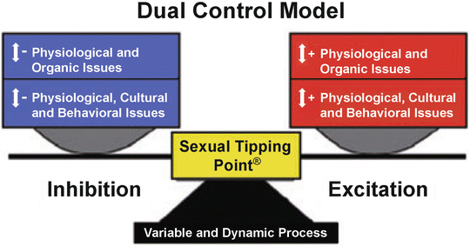
Dual Control Model
Notes:
Work to “Turn Off The Offs” and “On the Ons”

Slide 16
Pain Disorders
“’Down there’ has always hurt. Tampons, everything…I want to have a satisfying sex life but I tense up anytime my partner comes near that area.”
OR “After_________(menopause, childbirth, trauma) I have pain. I’ve been told to ‘just relax’ or ‘do it more often’ but it’s not getting any better and I totally avoid sex now.”
Genito-Pelvic Pain and Penetration Disorders (GPPPD):
  Dyspareunia due to atrophy
  Vaginismus
  Overactive pelvic floor
  Vestibulodynia

Slide 17
Approach
Complete and compassionate history-taking (DOUPE and assumptions)
Thorough history and exam to elicit root of pain
  Q tip test
  Vaginal pH
  Pelvic exam
Psychoeducation
Referral to Pelvic Floor Physical Therapy where appropriate
Depending on the presentation and patient openness, Sex Therapy
  STOP the painful activity to begin with
  Focus in on anxious and trauma reactions (usually unconscious)
  Trauma therapy
  Mindfulness training
  Pain meditation
  Gradual home In-vivo exposure to stimuli sometimes including existing pain sometimes imaginal

Slide 18
Pleasure
  “My sex life is not exciting. Orgasm isn’t intense or even existent in most cases. I’d just really rather not. I do it mainly for my partner, but even they are noticing and that’s upsetting to them.”
  Anorgasmia (Primary versus Secondary)
Notes:
Pleasure is the measure: NOT orgasm, frequency, size, rigidity etc.

Slide 19
Approach
Complete and compassionate history-taking (DOUPE and Assumptions)
Psychoeducation to include Basson Model and socialization around pleasure
Physical Exam and Possibly referral to PT
  Hormonal status
  Clitoral atrophy
  R/O pain
Sex Therapy
  Generalized or acquired
  Grief work
  Basson model
  Emphasis on narratives about pleasure including gender roles
  Self-exploration (you aren’t “given” pleasure)
  Suggestions for increasing stimulus (eroticism, toys, repertoire)
  Differentiation
  Mindfulness and progressive touch exercises
  Erotic focus
  “Pleasure is the measure”
Notes:
NEXT Slide for pictures of WHO is Entitled to Pleasure***

Slide 20
Who Is Entitled to Pleasure?
Notes:
Young, White, Affluent, Men, Heterosexual, Able-Bodied

Slide 21
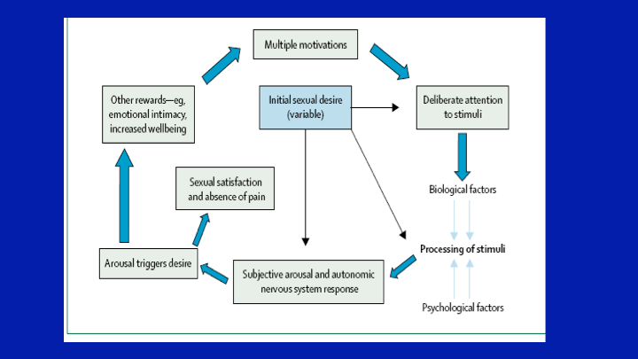
Basson Non-Linear Model
Notes:
-Emphasis on willingness, motivation, intentionality, and individual sexual satisfaction versus performance
-Calls into question the need for desire to exist prior to arousal, They are neither distinctly separate nor exactly the same
-Supports variances in sexual response and acknowledges the biopsychosocial nature of sexual response

Slide 22
Arousal
“I don’t produce wetness like I used to, it just takes me a while to really ‘get in the mood’”
OR “I have difficulty getting/maintaining erections”
OR “It takes me too long to ejaculate/orgasm”

Slide 23
Approach
Complete and compassionate history-taking (DOUPE and assumptions)
Psychoeducation to include Basson Model and Genital Non-Concordance, and “Shoulds”
Complete physical exam/Sex counseling
  In Men:
    Testosterone steady until age 50 then slow decline (usually T replacement is small effect-use only with hypogonadism)
    Shrinkage of testicles, decreased seminal fluid are normal
    Discuss PDE5 Inhibitors including option for daily dosage
    Orgasm without ejaculation
  In women
    Evaluate tissue – hormonal status/atrophy
    Q tip test
    Educate re: normal changes in sensory awareness
Sex Therapy
  Grieve
  Arousal awareness (mindfulness)
  Re-define “sex”
  Re-frame “problem” as opportunity to evolve and grow
  The sexual menu
  Cultivate flexibility, not rigidity!

Slide 24


Slide 25
Products/Devices
Lubricants
Moisturizers
Vestibular massage
Vibe therapy
Choosing a vibrator
Notes:
Condom safety
Prelude for Peyronies
Fiera
Wand is good for arthritis, high powered and multi-use

Slide 26
Final Tips
You don’t have to “Know it all” to ask the question
Use inclusive language, “Spouse, partner…”
Normalize with “Many people experience this…”
Maintain lists of specific information like lubricants, sexual health websites
Encourage the use of web searches like, “Sexual health and____” versus “Sex”
Assume the person needs to know, “As perhaps you already know…”

Slide 27
Resources
Headspace and Insight Timer
Sex Matters for Women, Foley
Naked At Our Age, Price
Lubricant Guide
Biopsychosocial Assessment and Treatment of Sexual Problems in Older Adults, Foley (2015)
AASECT
ISSWSH
NAMS

Slide 28

Questions???

