Slide 1



A New Tool for Assessing Financial Decision Making Abilities in Older Adults
APS Training 2015
Peter A. Lichtenberg, Ph.D, ABPP
Director IOG and Professor of Psychology
Wayne State University Institute of Gerontology
p.lichtenberg@wayne.edu

Slide 2
Acknowledgements
Research team at WSU APS
Lisa Ficker, Ph.D. Cynthia Farrell
Annalise Rahman –Filipiak, MA Rachel Richards
Evan Gross, MA
Michael Sugarman, MA Legal Colleagues
Daniel Paulson, Ph.D. Sandy Mall
Howard Collens
Elder Law of Michigan Pat Simasko
Ron Tatro
Keith Morris Oakland County SAVE task force
MiCPA Expert Panelists
Judith Trepeck Funders:
National Institute of Justice
Retirement Research Foundation

Slide 3
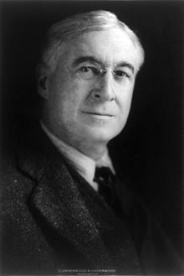
“Old age is always 15 years older than I am.”
~Bernard Baruch, Age 84
United Nations Diplomat

Slide 4
Objectives
Describe Capacity Assessment
Examine different aspects of financial decision making
Discuss the research on how cognitive decline impacts decision making
Review Types of Financial Exploitation
Examine new methods of Assessment for decision making capacity

Slide 5

“Doctor, I need to know if..”
Client can…
Make own medical decisions
Manage own finances (conservatorship)
Manage living independently (guardianship)
Create or change will/trust (testamentary)
Make his or her own medical decision
Notes:
Conservatorship refers to an individual’s financial capacity. That is the ability to independently manage one’s own financial affairs in a manner consistent with one’s desires. Legally, this includes the ability to enter contracts, to donate or gift monies. Each of these may have separate state statutes associated with them.
Living independently is a valued aspect of American society. A person living independently is thought of a self-sufficient and accountable for his or her actions. Guardianship refers to state statutes relative to incapacity to live independently. This typically includes some level of conservatorship as well.
Creating or changing a will is also a prized right in American society. Although Testamentary capacity is a form of financial capacity, it is highlighted here because most states have specific statutes relative to this capacity.
Health care professionals must remember that it is their ethical imperative to preserve autonomous decisions of the patient wherever possible. The assessment for capacity must consider whether there are ways to enhance of protect autonomy

Slide 6
Capacity versus Competency
Capacity denotes a clinical status determined by a health care professional
Competency denotes a legal status determined by a judge
Burden of proof lies with alleging party
Notes:
It is important for a health care professional not to make statements about competency in his or her report. Competency denotes a legal status and not a clinical opinion. Capacity refers to the clinician’s opinion about the status of the person he or she evaluated.

Slide 7

Clinician role in Competency
Judges look to Experts to apply clinical data to the legal standards
Capacity assessments often form the basis of competency decisions
Notes:
Nevertheless, judges look to clinical experts to provide opinions about incapacity. The the capacity assessment often forms the basis for the judge’s decision.

Slide 8
5 Aspects of clinical capacity assessment
Clinical Diagnoses: dementia, depression, substance abuse?
Critical to review records of others thoroughly and incorporate those records into one’s own evaluation
Notes:
Accurate diagnoses is an important beginning point for a capacity assessment. Determining whether there is a presence of a mental disorder, including dementia, and at what stage this is represents the standard of clinical care that is necessary for an expert. Be aware of the practice guidelines for your profession. An expert should be adhering to these practice guidelines as they represent the standard of care in the field.

Slide 9
Clinical Diagnosis Cont.
Diagnostic procedures should meet highest standards of profession: Practice Guidelines
Commonly used assessment procedures/laboratory tests
Staging (in cases of dementia)- Clinical Dementia Rating (CDR)
Global Deterioration Scale GDS
c. FDA-approved or other treatments—well documented
Notes:
Two good examples of practice guidelines are staging and medication use. Staging of dementia is often included in a practice guideline. It serves a useful clinical purpose, but also a useful perspective for capacity. Determining someone to be in the mild stage of Alzheimer’s disease, for example, makes it a higher probability that they will be competent for some decisions as social judgment is often relatively intact.
A second example is FDA approval of medication. Standard of care is best supported by use of a drug in an FDA approved fashion.

Slide 10
2. Specific Capacity Assessment
Financial management
Medical consent
Self-care
Notes:
In cases where there are ways to directly examine the capacity in question, it is important to do so. In addition to the choice about monetary distribution for example, what are the person’s basic money skills and have these eroded from an earlier point in time. There are vignettes that help assess a person’s ability to process the issues involved in a medical decision.

Slide 11
3. Awareness of Deficit and Ability to Compensate
Ethical Directive: Clinicians aim to enhance client autonomy to the best of their abilities
Are there compensatory strategies available: recognition v recall, memory notebooks, etc.
Very hard to determine how to use this—clinical judgment
Notes:
Are there settings and/or techniques that assist the older person in enhancing his or her capacity?

Slide 12
4. Evidence of Any Undue Influence
Not typically formal part of legal statute
Ex: Blum’s IDEAL model
  Isolation
  Dependency
  Emotional Manipulation and/or Exploitation of Vulnerability
  Acquiescence and
  Loss
Notes:
Blum emphasizes the vulnerability of the older adult, and the isolation of the older adult from others that so often occurs. In addition there is a growing dependency on the perpetrator that is experienced.
Although this is an important aspect to the capacity evaluation it is often not a part of specific state statutes including testamentary capacity.

Slide 13
4. Evidence of Any Undue Influence
Susan Bernatz SCAM model
Susceptibility
Confidential Relationship
Active Procurement
Monetary Loss
Notes:
Interactional model between perpetrator and older victim. The similarities with Blum’s model include the confidential or special relationship, the active role of the perpetrator in the financial transactions.

Slide 14
5. Apply clinical data to legal standards
Calls for specific application of clinical data to specific legal standards
Can include both statutes and case law issues—attorney should be able to assist you on this
Notes:
Ask the attorney you are working with to provide you with case law and/or state statutes specific to the capacity in question.

Slide 15
Financial Competency
Cornerstone assessment in most FE cases
Competency=Autonomy
Incapacity= Need for Protection
BALANCING ACT: OVER-PROTECTION AS HARMFUL AS UNDER-PROTECTION

Slide 16
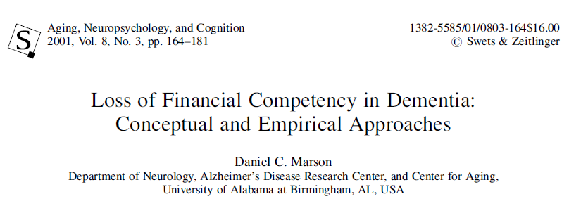

Slide 17
Marson’s Financial Capacity Domains
Basic Monetary Skills
Financial Conceptual Knowledge
Cash Transactions
Checkbook Management
Bank Statement Management
Financial Judgment
Bill Payment
Knowledge of Assets/Estate Arrangements

Slide 18
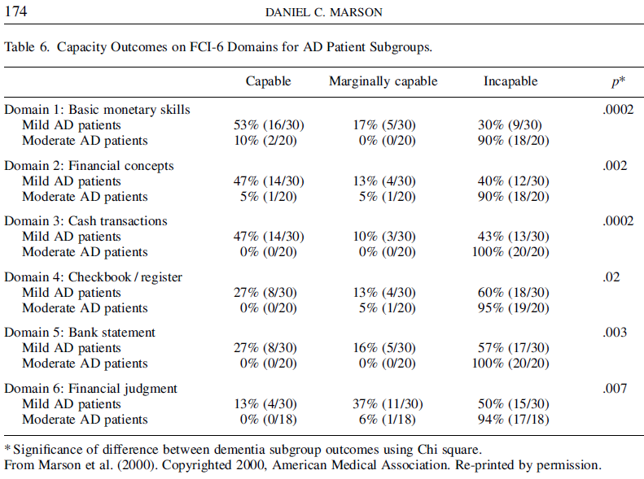



Slide 19
Two Types of Financial Capacity
Executional
Decision-Making

Slide 20
Findings from Population-Based Studies
Random samples help us understand the range of individual differences
Hsu and Willis: 10 year study of couples where one person had cognitive decline:
Money management problems preceded giving up control of finances
33% of persons with dementia remained the primary financial decision maker

Slide 21
Boyle et al. 2013
25% of sample where one partner was cognitively in the range of dementia retained decision making capacity despite loss of executional skills

Slide 22
Dangerous Combination
Early
Cognitive
Decline
Impaired Financial
Decisional Skills
Vulnerability to Financial Exploitation
(1) the potential loss of financial skills and financial judgment;
and (2) the inability to detect and therefore prevent financial exploitation.
Stiegal 2012

Slide 23
Elder Abuse
Viewed in similar fashion to domestic violence
Physical abuse cases can be extreme and upsetting
Until recently financial exploitation seen as lower priority as the harm was not perceived to be as great.
Alzheimer’s Disease research pays little attention to elder abuse

Slide 24
Financial Exploitation Focus Recently Re-Emerged
MetLife Study– impact estimated at 2.9 Billion dollars per year, and 10% increase between 2008-2010.
Study measured media coverage not incidence

Slide 25

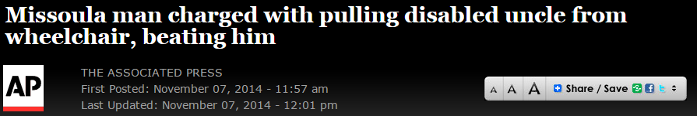
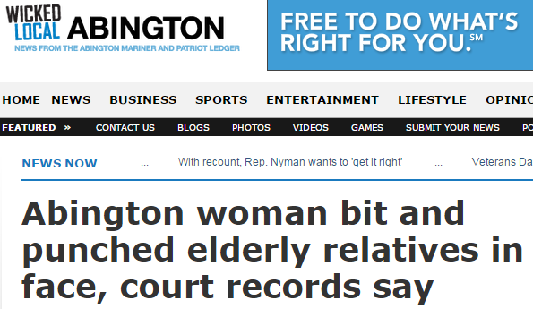


Slide 26




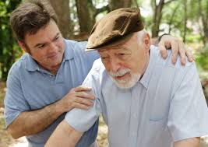

Six Domains of Financial Exploitation
SIGNS OF POSSIBLE FINANCIAL EXPLOITATION
MONEY MANAGEMENT DIFFICULTIES
COERCION
Conrad et al. (2010)
FINANCIAL ENTITLEMENT
ABUSE OF
TRUST
THEFT & SCAMS
Notes:
Theft & Scams - Ex. Misuse of ATM or credit card
Abuse of Trust - Convincing a loved one to turn over home title ‘for his/her sake’
Financial Entitlement - “I’m going to inherit this money anyway…”
Coercion - Being pressured into changing a will
Signs of Possible Financial Exploitation – Ex. Frequent requests for money
Money-Management Difficulties – Ex. Not enough money to pay bills

Slide 27
Types of Financial Exploitation Cases
Hybrid FE: More likely to co-habitate and suffer from dementia; Lost an average of $185,574; also suffered physical abuse and/or neglect
Pure FE: Lost an average of $79,422; theft most common form (47%); fraud (32%)
Jackson and Hafemeister (2012)

Slide 28
Model:
Financial Decisional Abilities
Formed 2 New Scales:
Lichtenberg Financial Decision Making Rating Scale (LFDRS)
Lichtenberg Financial Decision Screening Scale (LFDSS)

Slide 29



Overall Goal:
Assessment at Point of Decision

Slide 30
Using Person-Centered Principles for Financial Capacity
People are more than the sum of their cognitive abilities
Traditional approaches overemphasize deficits and under-emphasize strengths
Subjective experience of PWD remains important

Slide 31


Groundbreaking Work of Appelbaum and Grisso 1988
Originally for capacity for psychiatric treatment and guardianship, then health decisions
ID 4 aspects of decision making: Communicating
  Choice
  Understanding
  Appreciation
  Reasoning

Slide 32


Differing Legal Standards
for Capacity
Capacity to enter into a contract (e.g. real estate)-- Estate of Erickson 202 Mich APP 329, 331, 508 NW2d 181 (1993) indicates that person executing a real estate contract such as a home equity loan must possess sufficient mind to understand, in a reasonable manner the nature and effect of the act in which he is engaged.
Testamentary capacity in Michigan requires (per MCLA 700.2501, 700.7601) that the person making a will
  Understand the purpose of the document;
  Has the ability to know the nature and extent of his or her property;
  Knows the natural objects of his of her bounty; and
  Has the ability to understand in a reasonable manner the general nature and effect of his or her in signing the will (or trust per 700.7601).
Rationale/Reasoning—implicit to these, but so important to consider

Slide 33
Expert Panelists
Using the Concept Mapping Model (Conrad et al., 2010) we then assembled two groups of experts:
  6 were engaged in financial-capacity work across the nation and
  14 were local and worked directly, on a daily basis, with older adults making sentinel financial decisions and transactions
4 phone conferences held total (2 per group)

Slide 34
Conceptual Model for LFDRS
Contextual Factors
Financial Situational Awareness
Psychological Vulnerability
Undue Influence
Past Financial Exploitation
Intellectual Factors
Express:
Choice
Rationale
Understanding
Appreciation
Integrity of Financial Decisional Ability
Consistency with Values

Slide 35
Peter A. Lichtenberg PhD, ABPP, Lisa J. Ficker PhD & Annalise Rahman-Filipiak MA (2015):
Financial Decision-Making Abilities and Exploitation in Older African Americans:
Preliminary Validity Evidence for the Lichtenberg Financial Decision Rating Scale (LFDRS),
Journal of Elder Abuse & Neglect, DOI: 10.1080/08946566.2015.1078760
Lisa J. Ficker, Ph.D.
Wayne State University
Institute of Gerontology
87 E Ferry Street
Detroit, MI 48202
Annalise Rahman-Filipiak, M.A.
Wayne State University
Institute of Gerontology
87 E Ferry Street
Detroit, MI 48202
Peter A. Lichtenberg, Ph.D., ABPP*
Wayne State University
Institute of Gerontology
87 E Ferry Street
Detroit, MI 48202
313-664-2633 (phone)
313-663-2667 (fax)
p.lichtenberg@wayne.edu

Slide 36
Table 1: Descriptive Statistics for Sample Characteristics (n = 69)
 | % (n) | M (SD)
Age |  | 69.59 (5.99)
Gender
Female | 89.9 (62)
Male | 10.1 (7)
Education |  | 14.75 (2.48)
WRAT-R Reading Grade Level |  | 10.40 (3.00)

Slide 37
Current Financial
Decision or Transaction
Investment/Estate Planning 18%
Major Purchase 64%
Financial difficulty (e.g. bankruptcy) 18%
Peter A. Lichtenberg, Ph.D., ABPP, Wayne State University

Slide 38
Table 2: Financial Exploitation and Decisional Ability Concern Frequencies (n = 69)
 | % (n)
Financial Exploitation
Yes | 18.81 (13)
No | 81. 2 (56)
Decisional Ability Concerns
Major Concerns | 4.3 (3)
Some Concerns | 7.2 (5)
No Concerns | 88.4 (61)

Slide 39
Table 3: Correlations between LFDRS Decisional Ability and Subscale Scores, Demographic, Cognitive, and Functional Variables (n = 69)
 |  | Age | Education | MMSE | ILS Money Mgmt.
Decisional Ability | r | .126 | .235* | .327** | .254*
Financial Situational Awareness | r | -.053 | -.124 | -.084 | .043
Psychological Vulnerability | r | -.024 | -.098 | .004 | -.001
Current Decision Total | r | .163 | -.011 | -.226* | -.204*
Past Decision Total | r | -.019 | -.062 | -.061 | -.037
Undue Influence | r | .040 | -.028 | .026 | -.054
Age | r |  |  | -.101 | -.080
Education | r |  |  | .254* | 240**
Note. ** = Significant at α =.005 level * = significant at α =.05 level

Slide 40
Table 4: Correlations between LFDRS Subscales (n=69)
 |  | 1 | 2 | 3 | 4 | 5 | 6
1. Decisional Ability | r |  | -.304** | -.210* | -.364** | .095 | -.221*
2. Financial Situational Awareness | r |  |  | .388** | .171 | .085 | .284**
3. Psychological Vulnerability | r |  |  |  | -.047 | .167 | .266**
4. Current Decision Total | r |  |  |  |  | -.070 | .066
5. Past Decision Total | r |  |  |  |  |  | .158
6. Undue Influence | r |  |  |  |  |  | ---
Note. ** = Significant at α =.005 level * = significant at α =.05 level

Slide 41


Results
χ² = 12.2, p = .002 Overall, how satisfied are you with your finances?**
Satisfied | 23.1 (3) | 41.1 (23)
Neither satisfied nor dissatisfied | 15.4 (2) | 46.4 (26)
Dissatisfied | 61.5 (8) | 12.5 (7)
χ² = 13.5, p = .001 How confident are you in making big financial decisions?**
Confident | 23.1 (3) | 76.8 (43)
Unsure | 69.2 (9) | 19.6 (11)
Not confident | 7.7 (1) | 3.6 (2)
Financial Exploitation
No Financial Exploitation
Financial Exploitation
No Financial Exploitation

Slide 42

Results Continued
χ² = 14.1, p = .001 How worried are you about having enough money to pay for things?**
Not at all worried | 7.7 (1) | 41.1 (23)
Somewhat worried | 46.2 (6) | 50.0 (28)
Very worried | 46.2 (6) | 8.9 (5)
χ² = 5.7, p = .017 Do you regret or worry about financial decisions you've recently made?**
No | 30.8 (4) | 71.4 (40)
Yes | 69.2 (9) | 28.6 (16)
Financial Exploitation
No Financial Exploitation
Financial Exploitation
No Financial Exploitation

Slide 43
Lichtenberg Financial Decision Screening Scale (LFDSS)
10 items: To be administered in an interview format
Multiple choice
Focuses on the 4 intellectual factors and potential for undue influence
Professional does the rating on each item and does not just record older adult’s responses.
Overall judgment score based in part on don’t know or inaccurate responses.

Slide 44


What Our Approach Is
and What It Is Not
It Is:
It Is Not:
A way to understand the older adult’s perspective on the situation
Part of an assessment, just as observation, record reviews and other interviews are
A novel way to assess informed decision making
A check the box and look at the score test
A complete interview: it often raises more questions
Something that takes the place of the interviewer’s skills

Slide 45
Pilot Data 2014: 2 Studies– APS and Other Front Line Professionals
Other Front Line Professionals
APS
28 cases 64% cases substantiated
18 substantiated; 11 women, 7 men
No differences between groups in age, education
78 cases attorneys, FP, Health Care
12% base rate of concerns (13 of 78)
No differences between groups in age, education

Slide 46
Independent Samples t-Tests for the LFDSS Total Risk Score for Current Financial Decision
 |  | M (SD) | t | df | p
LFDSS Total for Current Decision | Some or Major Concerns Decisional Ability | 15.00 (6.6) | 5.47 | 106 | .0001
 | No Concerns | 8.56 (2.1)
LFDSS Total for Current Decision | APS Case Substantiated | 14.50 (6.3) | 3.06 | 26 | .005
 | APS Case Not Substantiated | 8.20 (2.0)
LFDSS Total for Current Decision | Professional Case: Do not move forward | 17.42 (6.8) | -4.41 | 77 | .001
 | Professional Case: Move forward w/ decision | 8.63 (2.1)

Slide 47
LFDSS Item comparisons:
FE v non FE
Impact on Finances: 33% negative; 23% inaccurate vs. 1% negative and 3% inaccurate
Risk Level: 24% high risk; 33% inaccurate about risk level vs. 4% high risk and 1% inaccurate
Decision itself: 42% inaccurate about decision in question vs 2%

Slide 48
LFDSS Instructions
The LFDSS is a structured, multiple choice interview that should be administered in a standardized fashion. In introducing the LFDSS to the older adult, read out loud the following one-sentence explanation:
“I am going to ask you a set of questions to better understand the financial transaction/decision you are making or have already made. Please answer these as best you can and feel free to elaborate on any of your answers.”

Slide 49

LFDSS Questions 1-5
Lichtenberg, 2013©
Decisional Ability Questions 1-2
Questions 3-5
3. What is the purpose of you decision?
  Benefit self, plan, peace of mind
  Benefit family (whom?)
  Benefit charity (which?)
  Benefit someone else (whom?)
  Don’t know/inaccurate
4. What is the primary financial goal?
  Earn money through investment
  Share wealth
  Give someone access to my money
  Gift someone or a charity (Which?)
  Don’t know/inaccurate
5. How will this decision impact you now and over time?
  Improve financial position
  No impact
  Negative impact/debt
  Don’t know/inaccurate
What is the financial decision you are making?
  Investment planning (retirement, insurance, portfolio balancing)
  Estate planning (will, beneficiary, gifts)
  Major purchase (home, car, renovations)
  Don’t know/inaccurate
Was this your idea or did someone suggest it or accompany you?
  My idea
  Someone else suggested/drove me here
  Don’t know/inaccurate
Scale cannot be used without permission of Dr. Lichtenberg

Slide 50

LFDSS Questions 6-10
Lichtenberg, 2013©
Questions 6-7
Questions 8-10
6. How much risk is involved?
  Low risk or none
  Moderate risk
  High risk
  Don’t know/inaccurate
7. How may someone else be negatively affected?
  No one will be negatively affected
  Family members (who and why?)
  Someone else (who and why?)
  Charity (which and why?)
  Don’t know/inaccurate
8. Who benefits most from this financial decision?
  I do
  Family
  Friend
  Caregiver
  Charity/organization
  Don’t know/inaccurate
9. Does this decision change previous planned gifts or bequests to family, friends, or organizations?
  No
  Yes (who and why?)
  Don’t know/inaccurate
10. To what extent did you talk with anyone regarding this decision?
  Not at all
  Mentioned it (to whom?)
  Discussed in depth (with whom?)
  Don’t know/inaccurate
Scale cannot be used without permission of Dr. Lichtenberg

Slide 51
Case Example #1
Case #1: A 68-year-old high school graduate is considering buying a new home for her grandson.
She has relatively few resources herself and this purchase would put her at risk for financial hardship
She will lack access to the cash she will spend and that she will be responsible for the mortgage payments
She would be financially responsible should her grandson decide to no longer pay the monthly bills.
Grandson is marginally employed and has no financial resources; making an investment in him a significant risk.

Slide 52
LFDSS and Case Example #1
LFDSS Questions and Answers:
#2 Your idea or did someone else suggest this? “My grandson’s idea but I like it.”
#4 Primary financial goal? She is unsure.
#5 How will decision impact you now and over time? She says it will improve her position but Rater said that is inaccurate.
#6 How much risk to your financial well-being? She says none; Rater says that there is moderate to high risk and therefore response is inaccurate.
#8 Who benefits most from this decision? She reports “I do” but clearly grandson would be major beneficiary.

Slide 53

Case Outcome #1
The Rater marks this a 0 for Decisional Abilities, “Major Concerns,” and Substantiates case
Let’s Review:
The woman in question communicates:
  Choice (buy a home for her grandson)
  Rationale (he will have a nice place to live)
But the woman lacks:
  Understanding (goal, who benefits)
  Appreciation (financial impact, risk to financial well-being)

Slide 54
Case Example #2
Case #2: 77 year old high school educated woman.
#1 Decision: To name daughter POA and add daughter to her bank account
#2 Daughter suggested it
#5 Daughter is going to use money but promises to pay back
#6 No risk
#8 States she benefits most

Slide 55
Case Outcome #2
Woman has clear dementia
Outcome: Restitution in process, no criminal charges

Slide 56
Case Example #3
Case #3: 86 year old man; master’s degree
#1 Financially support his daughter
#2 His idea
#3 Purpose: Benefit family—love her
#4 Impact on finances: None/slight
#6 Risk to financial well being: Small
#8 Who benefits most: Family
#10 Discuss with? No one

Slide 57
Case Outcome #3
No Decisional Ability Concerns
Case not substantiated for FE

Slide 58
When to Use the LFDSS
When you want to better understand an older adult’s financial decision(s) or transaction(s)
Build Rapport first— then ask some of the easy questions about finances—
How confident with financial decisions,?
How anxious about money decisions?
Any financial decisions you regret or worry about?
When administering the scale: Make it conversational and not robotic/don’t rapid fire questions
Ask for clarification and elaboration on items after scale has been administered

Slide 59
What To Do When You Have Concerns
Use a counseling/education approach with your clients
Find ways to bring a third party in to discuss matter also
Slow process down—do not execute documents that day and make older person return
Call Adult Protective Services if Financial Exploitation is discovered and cannot be resolved.

Slide 60

Susan MacNeill Lichtenberg
Ph.D., ABPP (1963-2014)
Lichtenberg Scales: The last collaboration with my late wife and colleague

Slide 61
Contact Information:
Join Me in Work on This Scale
Peter Lichtenberg, Ph.D.
Email: p.lichtenberg@wayne.edu
Phone: Office 313-664-2633
Cell 248-497-3088
Fax: 313-664-2667

