Slide 1
It’s Our Party & We’ll Fly if We Want To!
How the Encore Movement is
Re-defining Our “Second Acts”

Slide 2
The Encore Movement

Slide 3
Encore Innovation Fellows
Mary McLoughlin
mmcloughlin@grfoundation.org
Tom Rademacher
trademacher@grfoundation.org
Jane Royer
jroyer@grfoundation.org
Tera Wozniak Qualls
tqualls@grfoundation.org

Slide 4
National Movement
Started with Marc Freedman’s book “encore”
Encore.org is building a movement to tap the skills and experience of those in midlife and beyond to improve communities and the world.
Spearheading efforts to engage millions of people in later life as a vital source of talent to benefit society.
Encore.org’s ultimate goal is to create a better future for young people and future generations.

Slide 5
Our Goals Locally
“Second Acts for a Greater Grand Rapids”​
Inspire innovation among individuals and organizations to create models for significant service in the second half of life. ​
Raise the visibility of individuals and organizations taking innovative approaches to achieving the Encore vision. ​
Build the capacity of individuals and organizations to expand opportunities for people to connect and contribute to the community. ​
Link individuals and organizations in networks and communities to support and sustain continuous learning and improvement.

Slide 6
The Research

Slide 7
Aging Statistics
Older Population in 2013
65 years or older numbered 44.7 million
14% of the US population, about 1 in 7 Americans
Older Population in the Future
65 years of older will number 98 million by 2060, more than double their number in 2013
21.7% of the population by 2040

Slide 8
Facts about Aging
Aging is normal and lifelong
Aging is cumulative with well-being in later life dependent on earlier experiences
Aging is distinct from disease and decline

Slide 9
Characteristics of Older Adults
A growing population with unprecedented longevity
Highly heterogeneous
High degree of social and economic impact

Slide 10
Building Momentum for Encore Careers
* Surveys from 2008, 2011, and 2014
In 2014, there were likely 29 million potential entrepreneurs.
Interest in Encore Careers has grown by 17%
28 % of respondents said they were highly interested in encore careers, which are paid or pro bono roles aimed at solving community needs
12% (down from 30% in 2011) shared they were worried about earning enough income in their social-impact career
Interest in entrepreneurship rose by 56%

Slide 11
Building Momentum for Encore Careers
* Surveys from 2008, 2011, and 2014
22% of respondents believe advancing the social good is a strong motivation to start a new business or nonprofit
Personal economics are not a powerful determinant of interest in encore careers
Concerns about encore income:
One in five respondents earning less than $30,000
One in eight respondents earning between $30,000 + $60,000
One in twelve respondents earning $60,000 or more

Slide 12
The Golden Window
“After many years juggling extensive responsibilities at work and at home [older workers] struggle to pinpoint what it is they want to do next, or how to find opportunities to contribute.”

Slide 13
Encore Careers: Unprecedented Opportunties
“Companies that turn longstanding employees into loyal ambassadors are contributing directly to improving the quality of life in communities where their employees and customers live and work.”

Slide 14
Implications for Civic and Social Contributions
How can we facilitate the contributions of older adults and expand opportunities for lifelong learning and service?

Slide 15
Types of Opportunities
Launching, starting, shifting
High impact work
Fellowships
Volunteer or probono work
Interim positions
Board members
Full or part time staff

Slide 16
The Stories

Slide 17
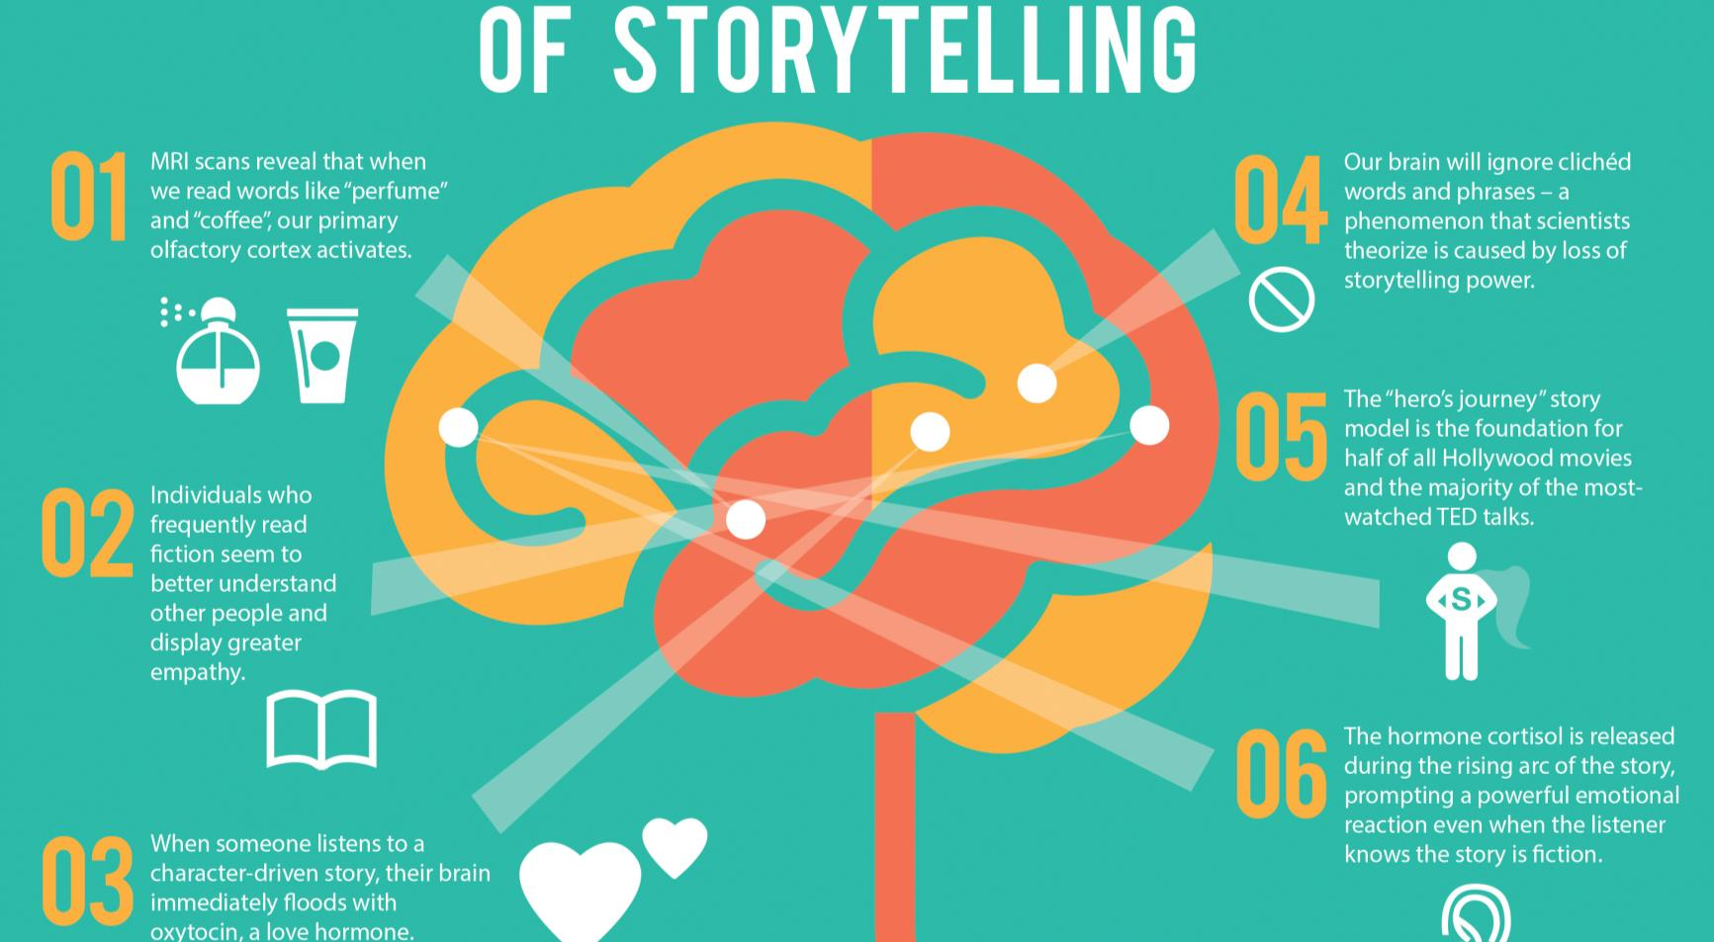

Slide 18
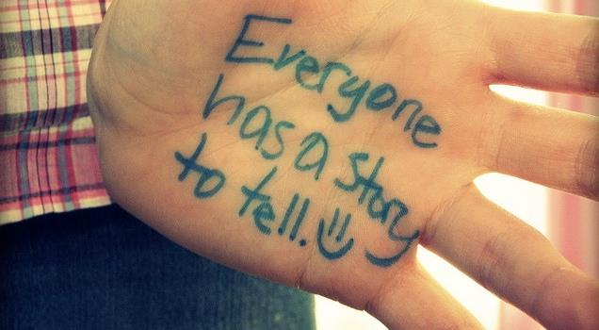

Slide 20
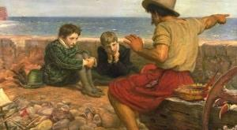

Slide 23
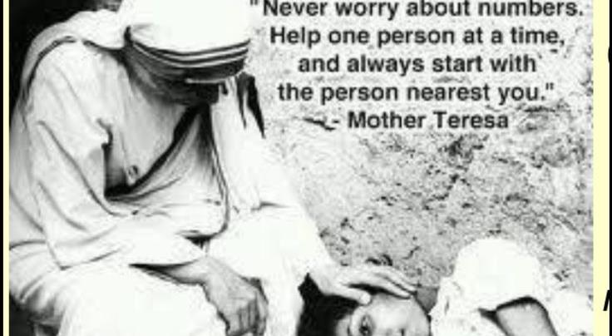

Slide 24
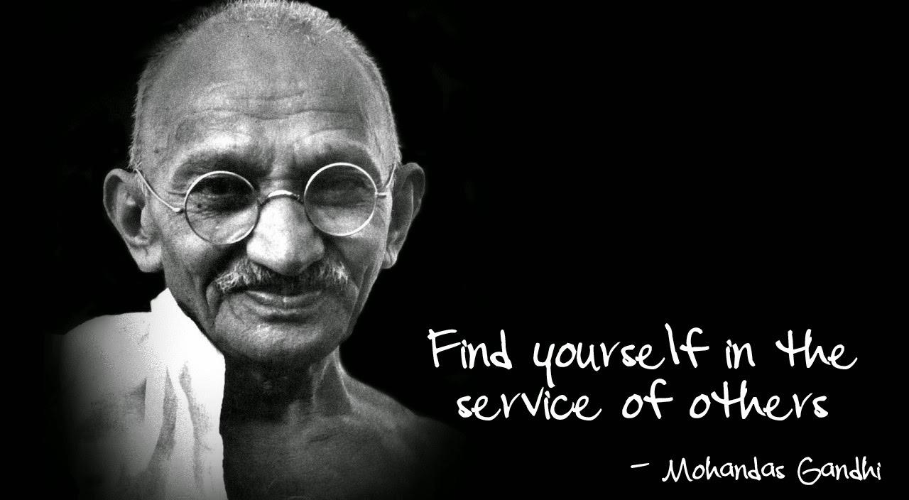

Slide 25
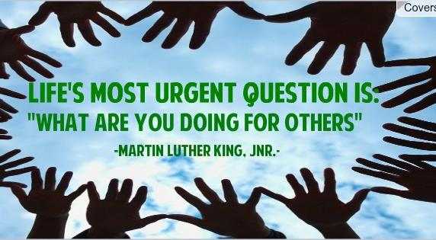

Slide 26
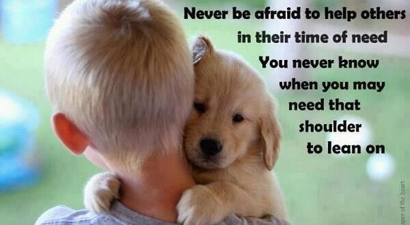

Slide 27
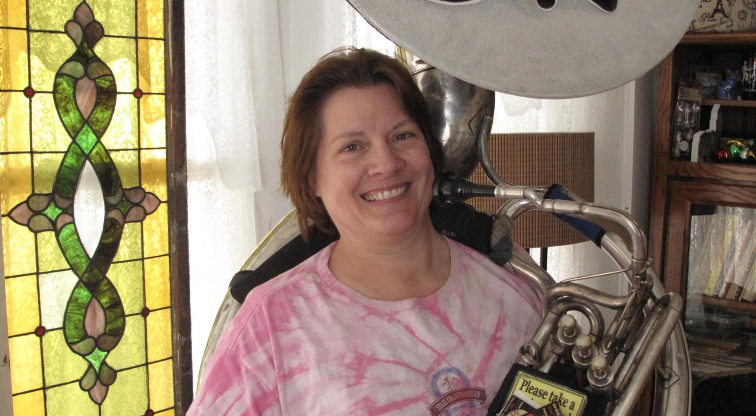

Slide 28
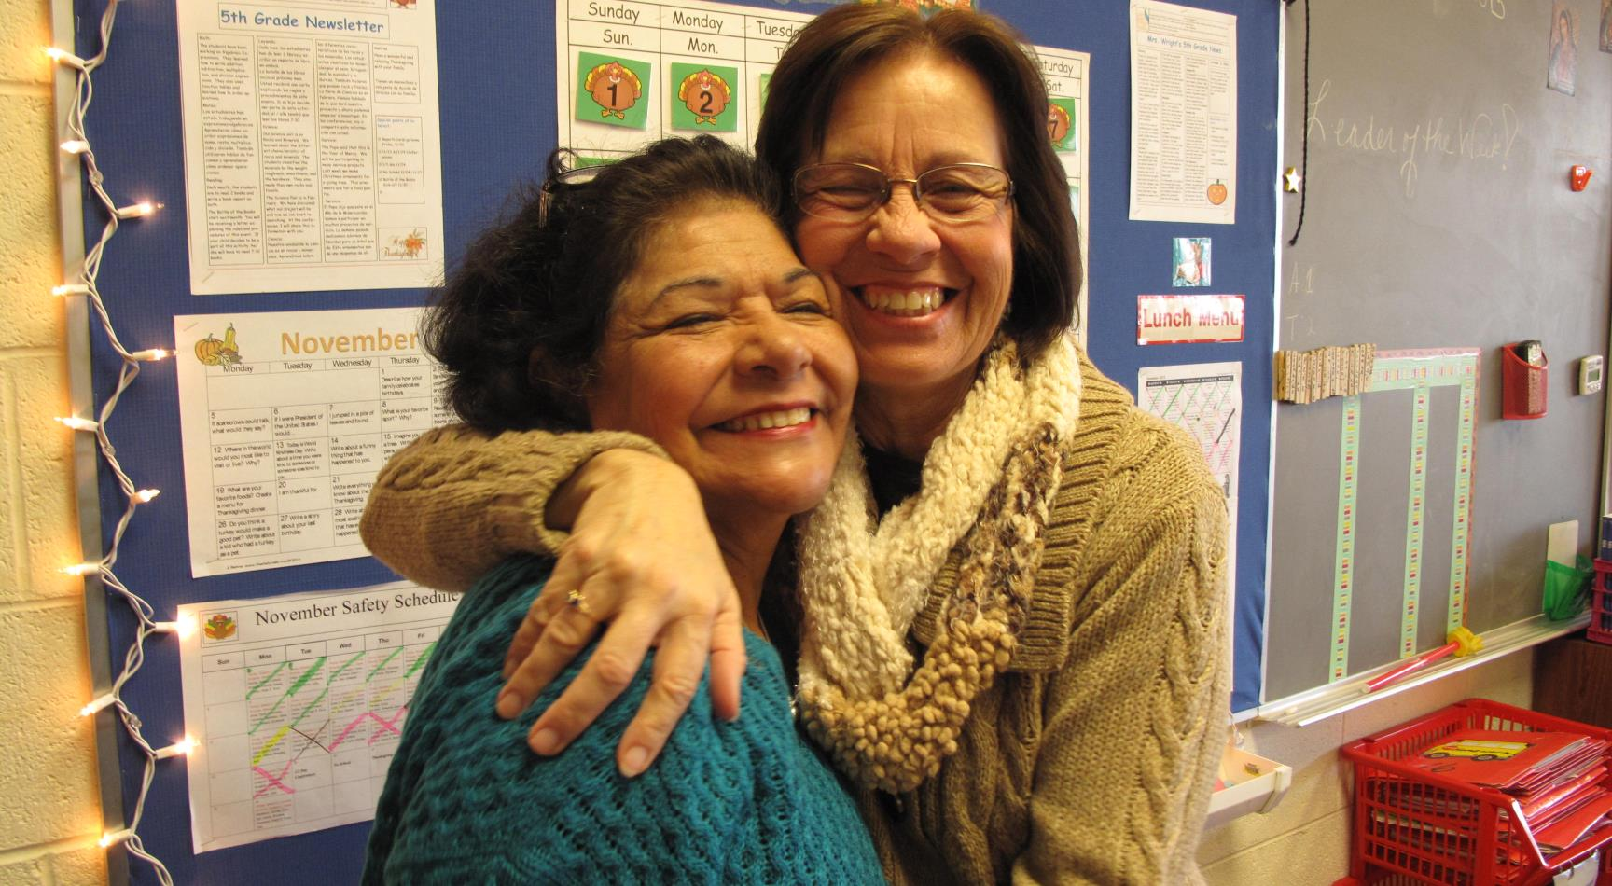

Slide 29
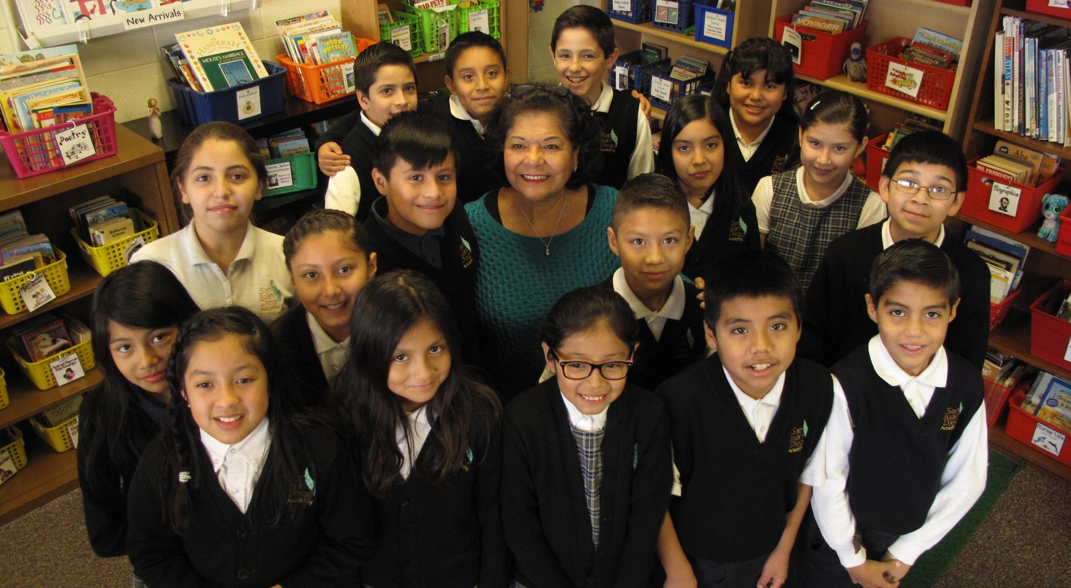

Slide 30
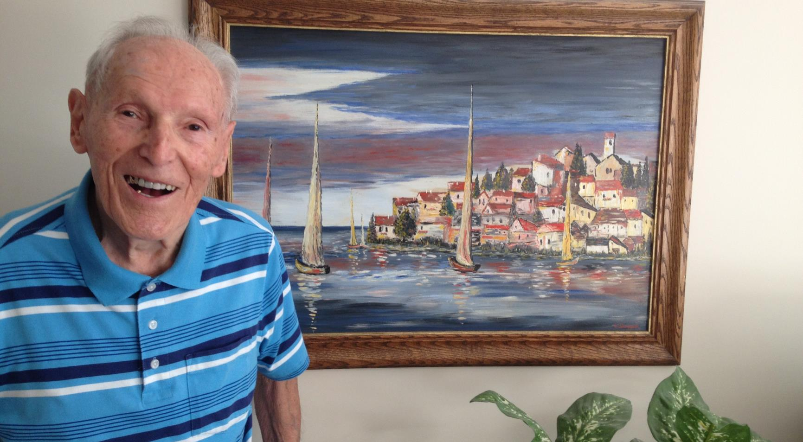

Slide 31
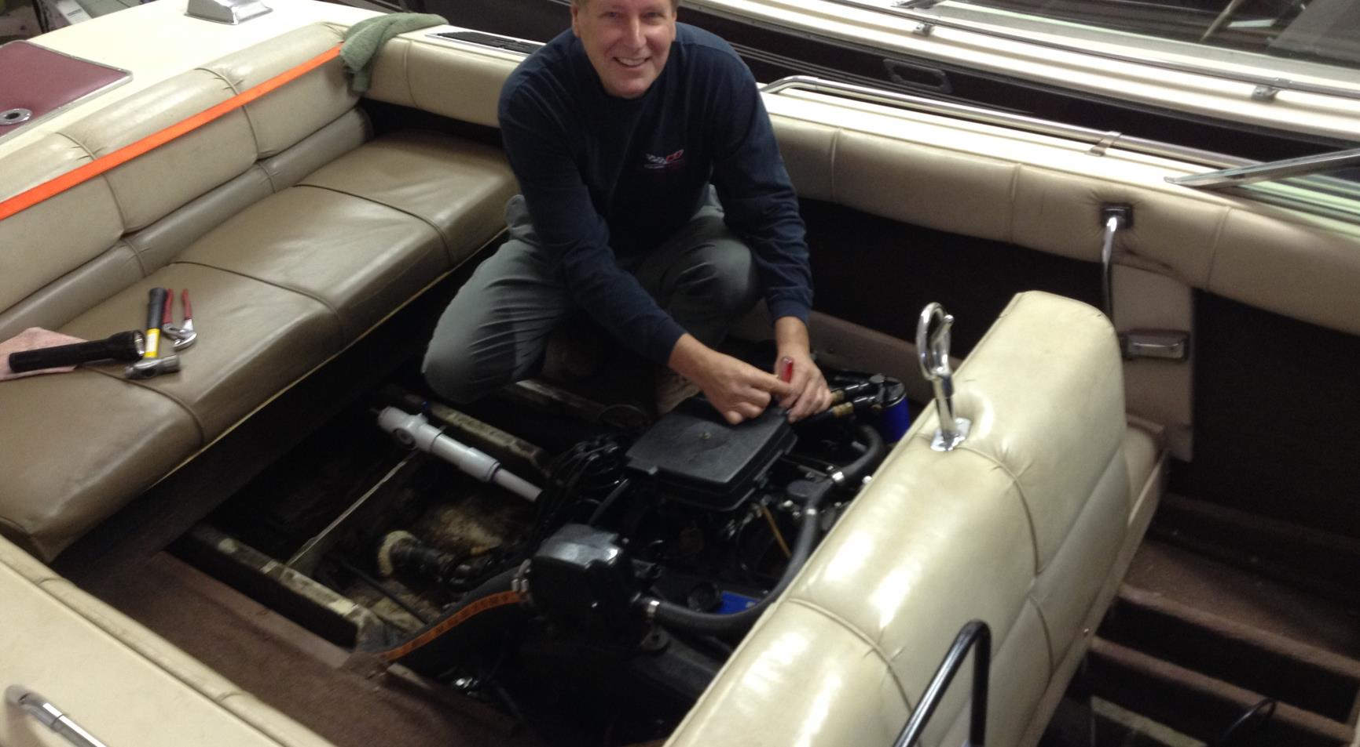

Slide 32
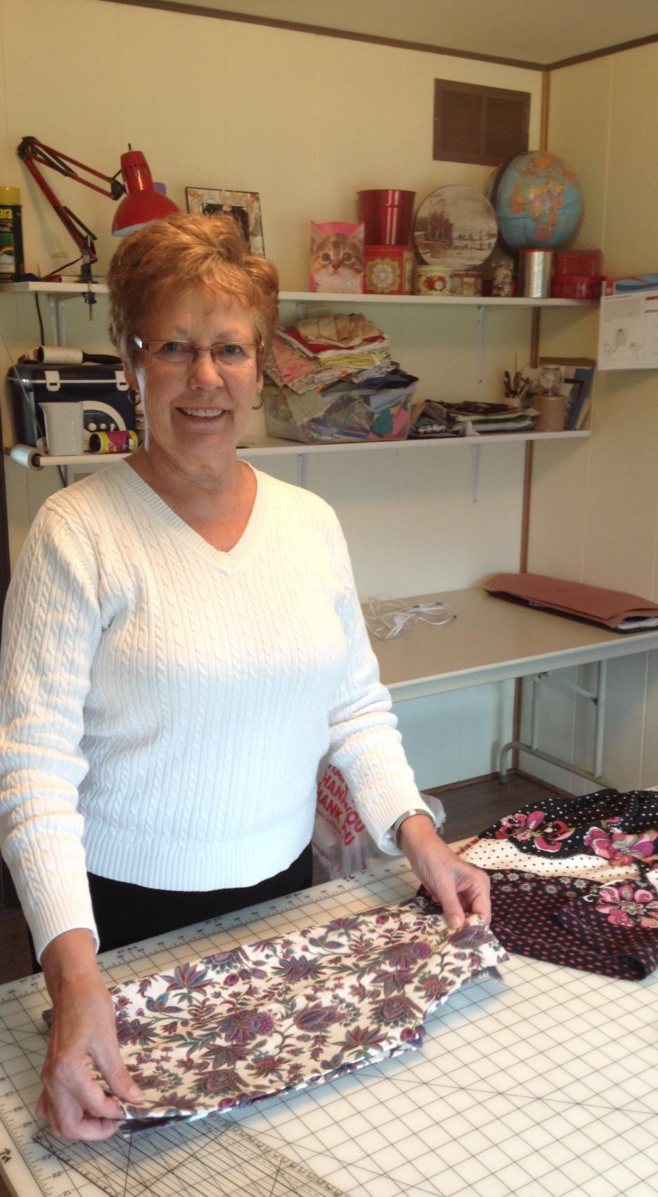

Slide 33
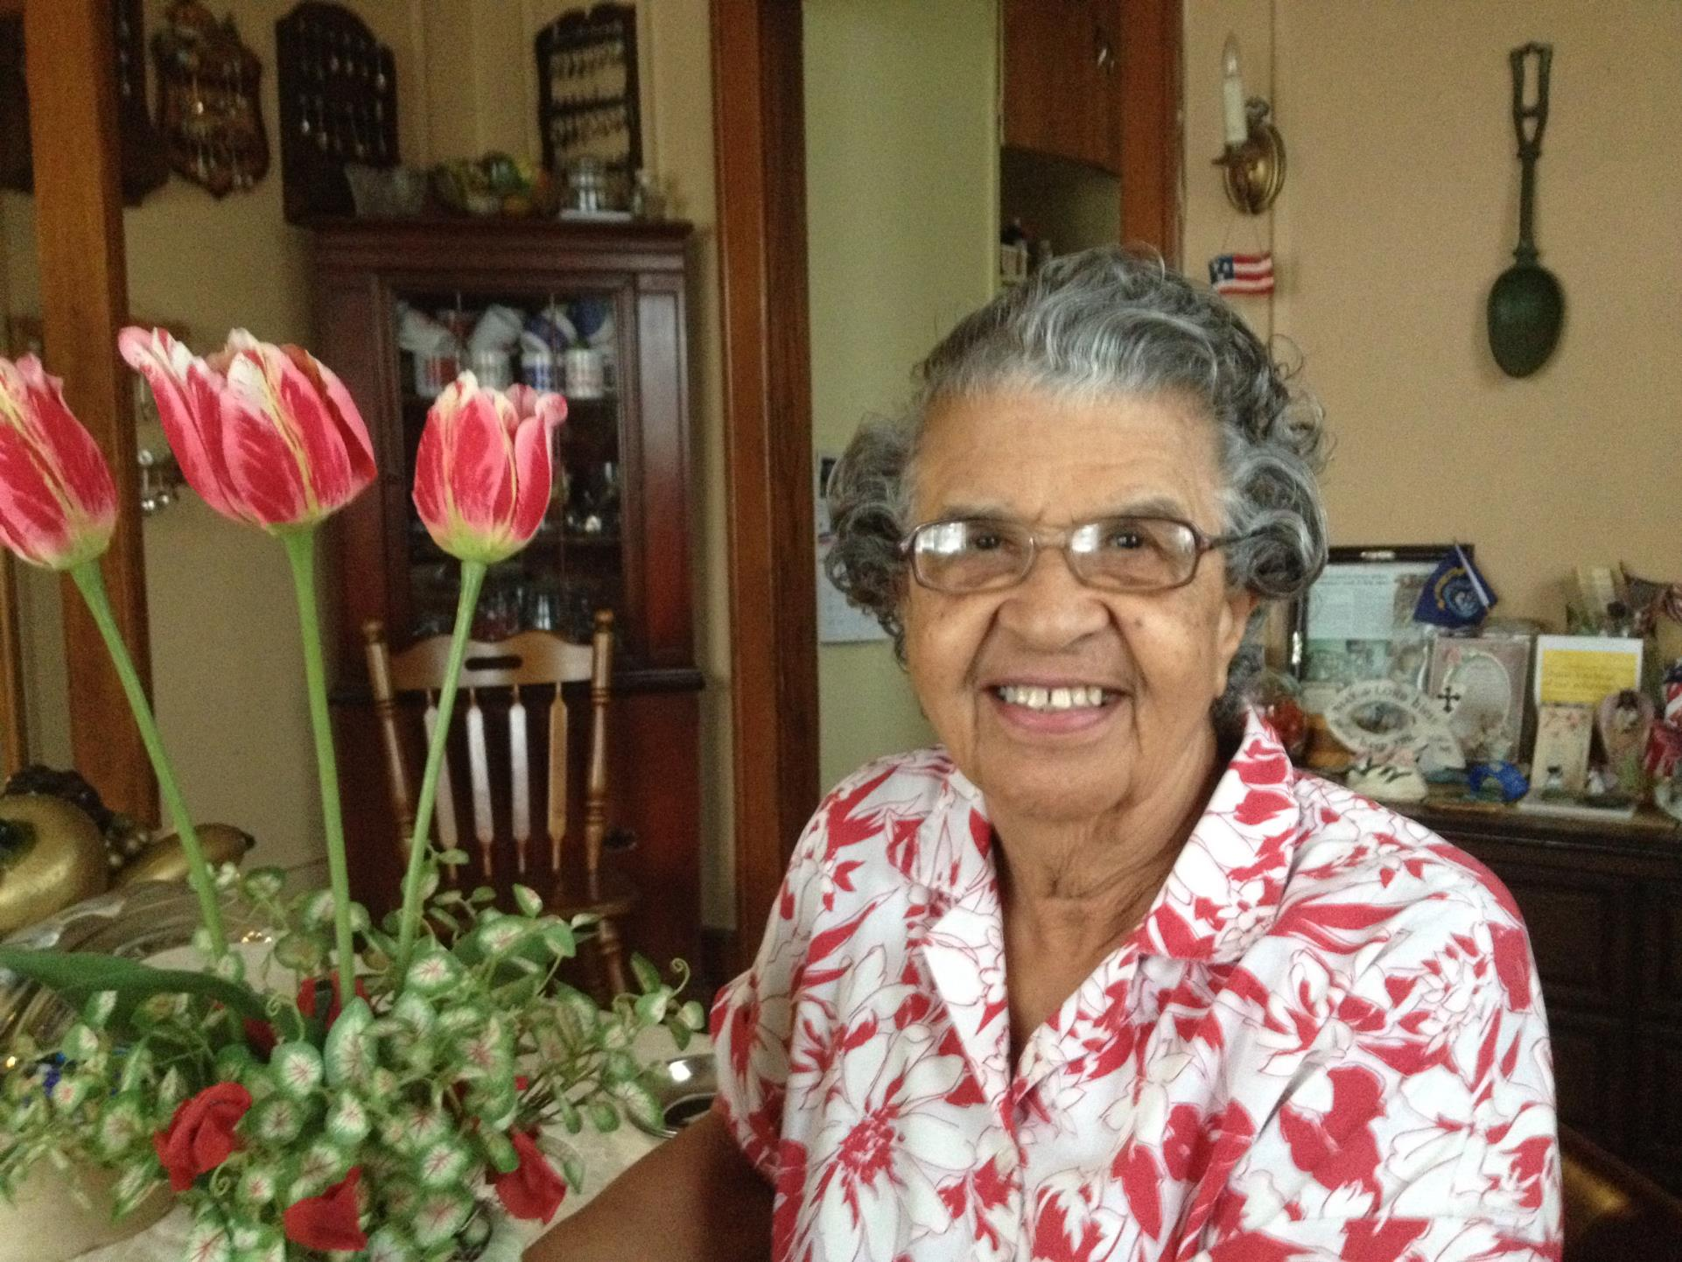

Slide 34
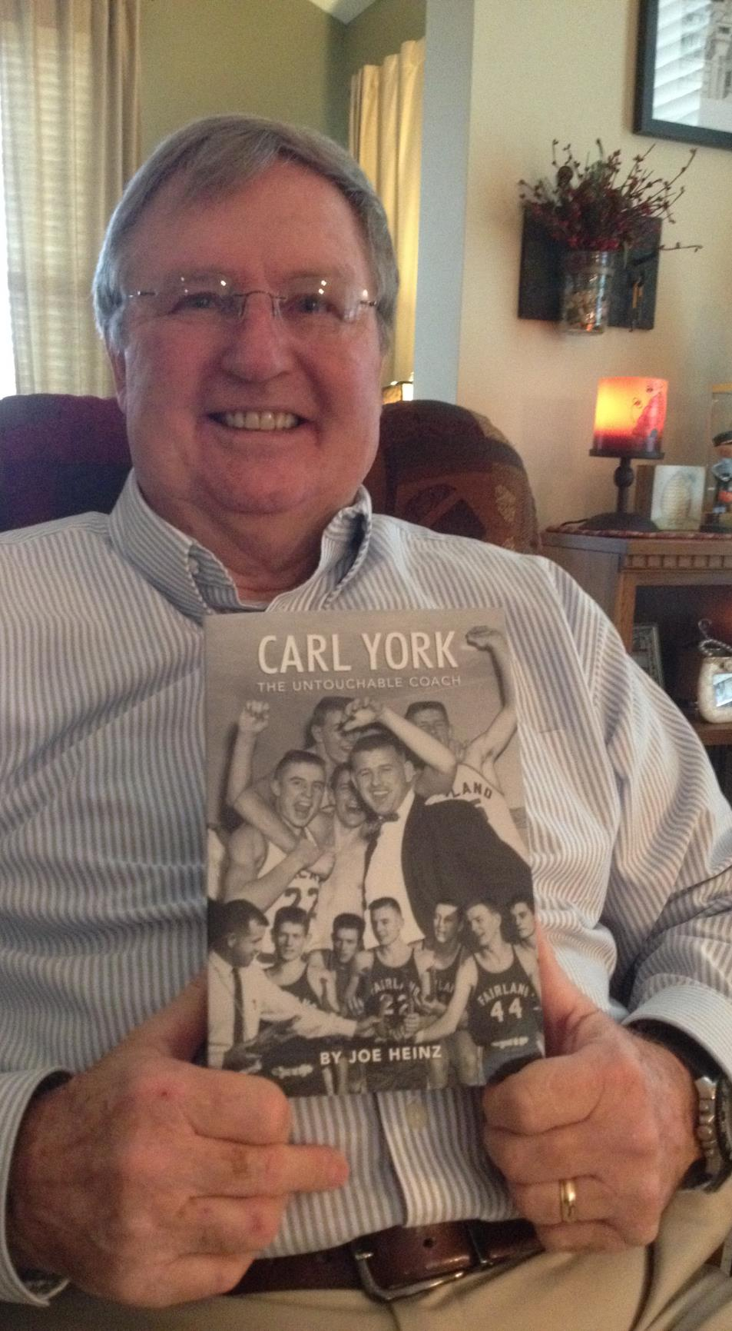

Slide 35
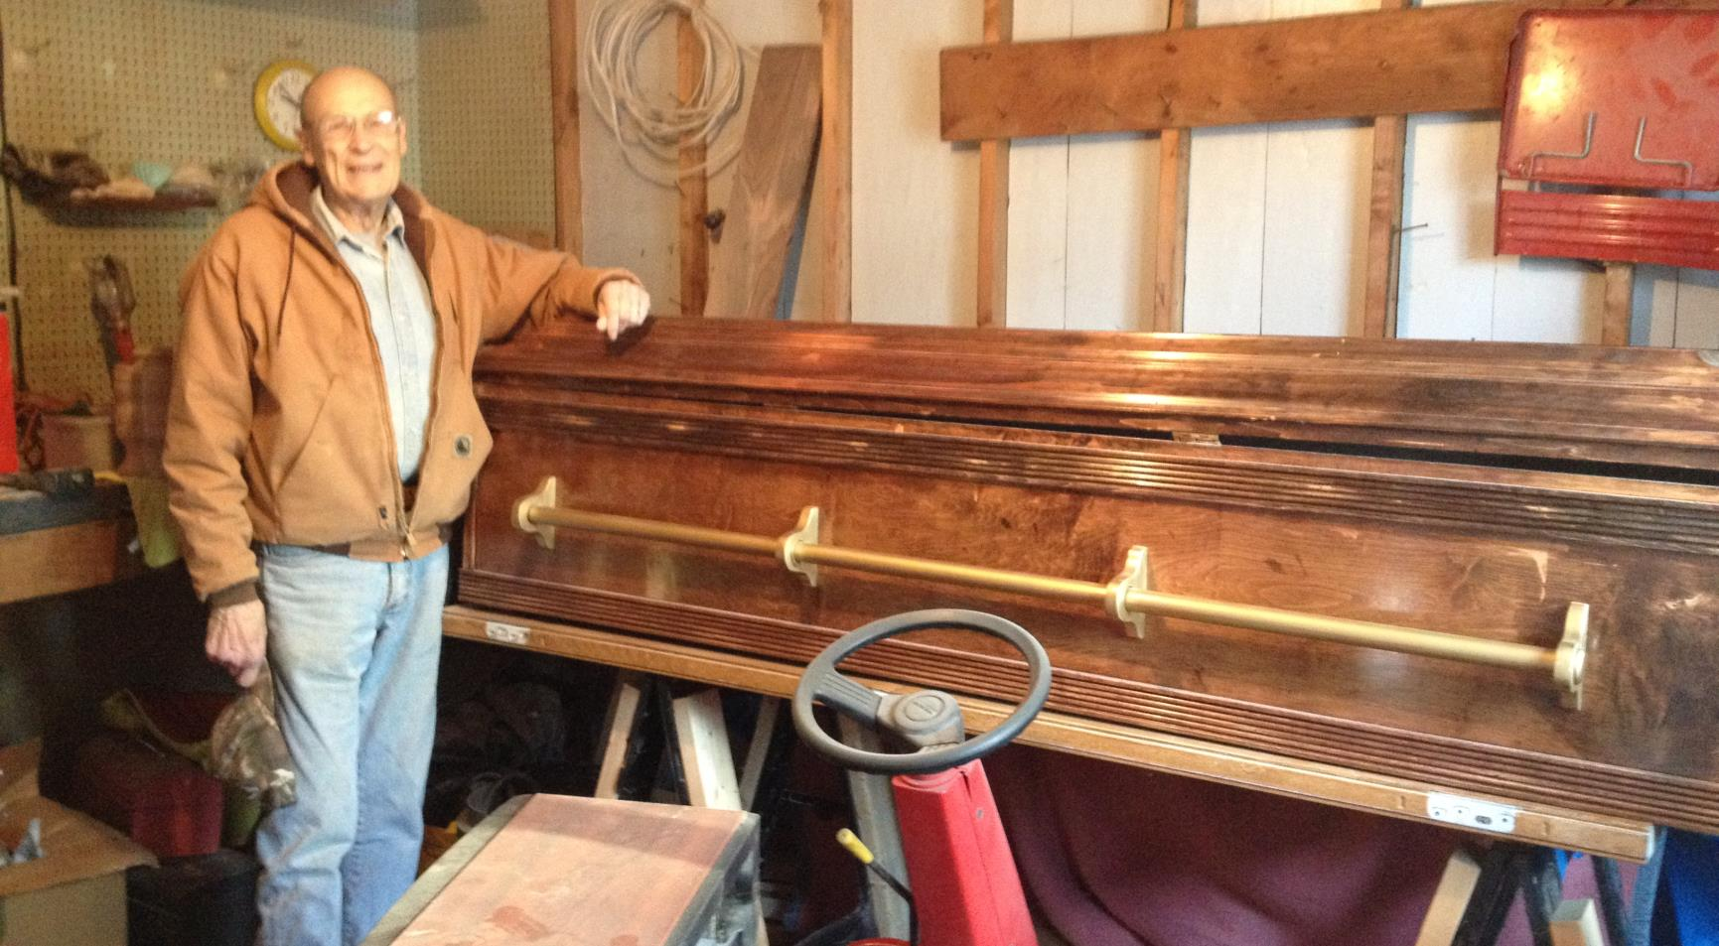

Slide 36
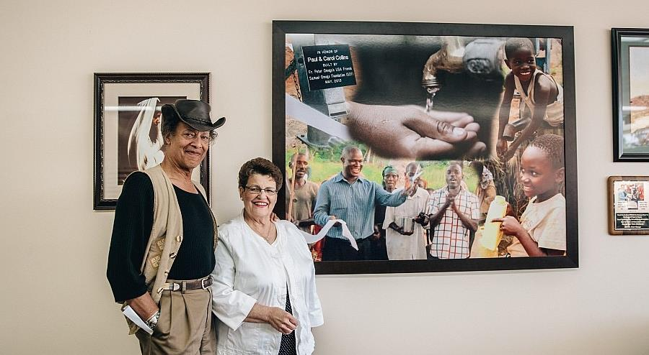

Slide 37
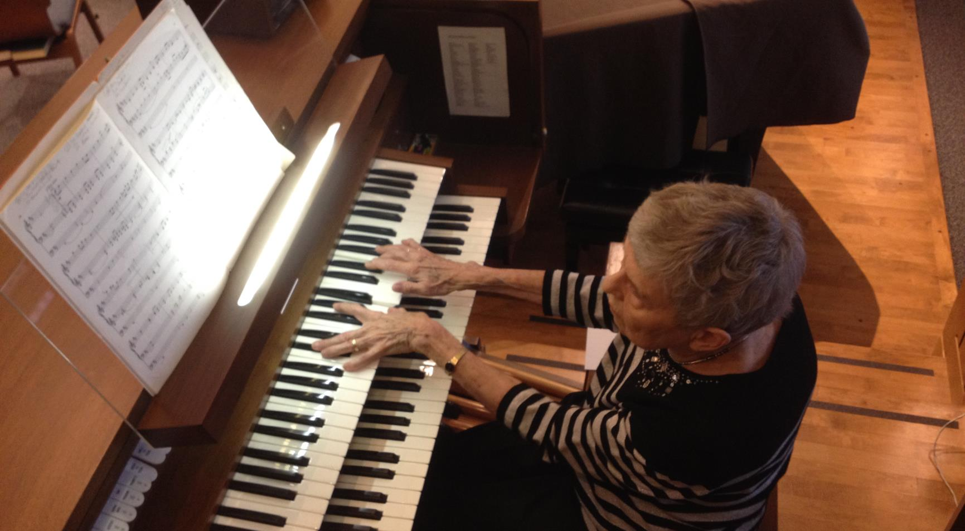

Slide 38
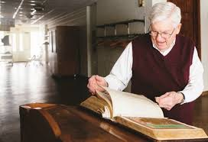

Slide 39
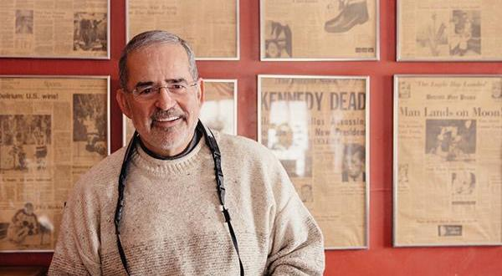

Slide 40
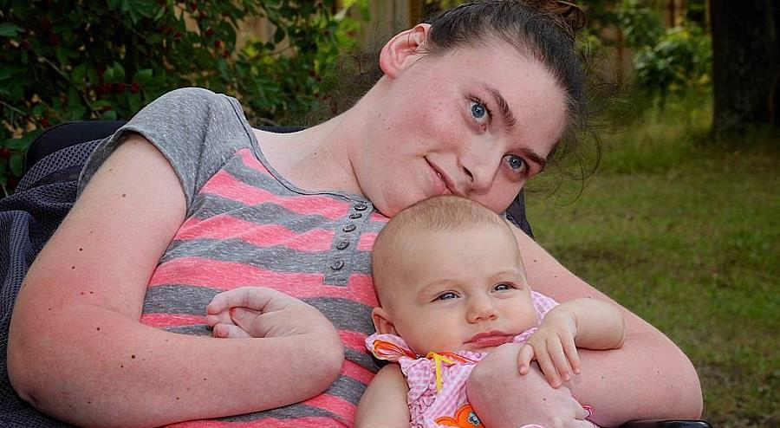

Slide 41
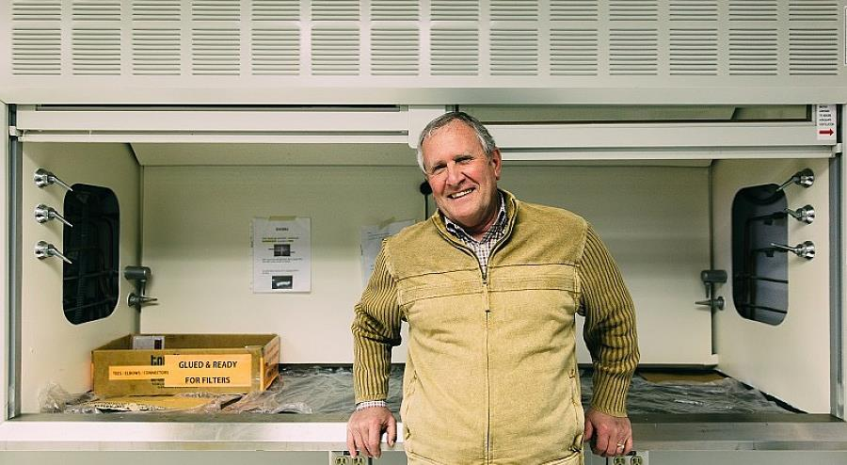

Slide 43
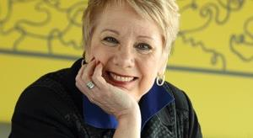
What’s YOUR Encore?!

