Slide 1
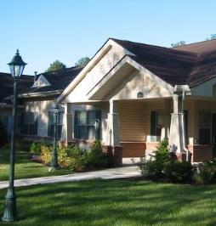
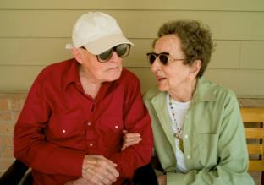
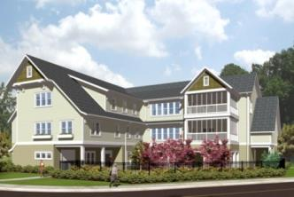
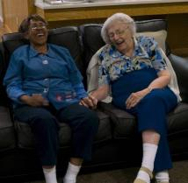
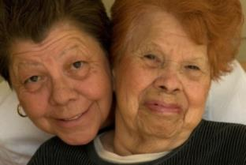
THE GREEN HOUSE® Project: A Proven Prescription for Success

Slide 2
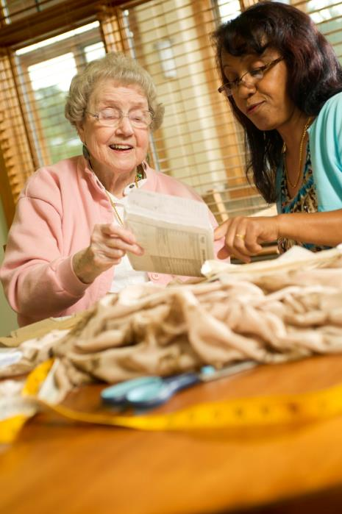
Cheryl VanBemden, RN, NHA
Director of Residential Living, Porter Hills
Marla DeVries, BA
Director of Resource Development, The GREEN HOUSE Project

Slide 3
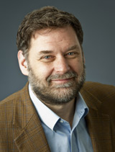
Dr. Bill Thomas, Geriatrician
What Afflicts Elders is not Medical
Loneliness, Helplessness and Boredom
Eden Alternative Founder
Replace institutional care with person-centered care
Create a more home-like environment
The Next Step
Recognized the limitations of existing structures
Green House Model
Founded The Green House Project

Slide 4
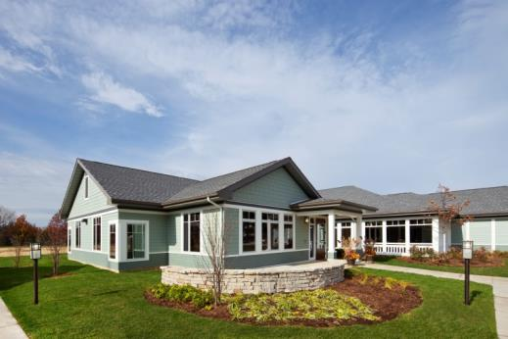
The Green House Model
Changes three things:
Architecture
Philosophy of care
Organizational structure
Improves
Quality of life for residents
Quality of care
Family satisfaction
Staff satisfaction
Radical paradigm shift about how we think about care, within current regulatory and reimbursement structures
Physical Environment
Philosophy of Care
Organizational Practices
Notes:
Review the items on the slide:
Roots of The Green House model are found in the principles and philosophy of the Eden Alternative
The Green House model redefines three areas that work together to create a new model of care:
Philosophy of care
Architecture/physical environment
Organizational structure and practices
Works within the current regulatory system – The Green House Project works with you to review the state regulations and seeks to meet or exceed the regulations. We are now in 25 states and have built a good track record with state-based regulatory compliance
The Green House improves the quality of life for both the elders and the staff

Slide 5
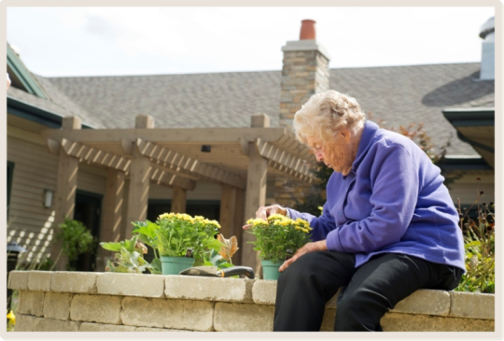
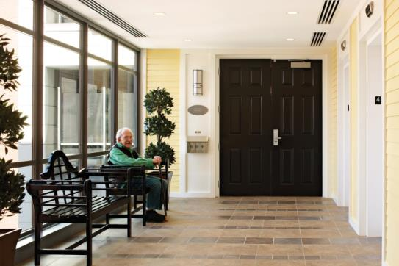
Meaningful Life
Living, growing, thriving
Choice, autonomy and control
Place decisions with elders or as close
to them as possible
Facilitate deep knowing & reciprocity
Support a life worth living:
Engagement
Enjoyment
Purpose
Continued growth

Slide 6
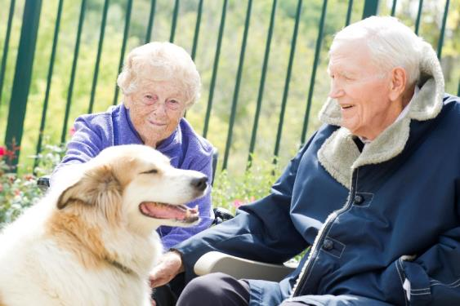
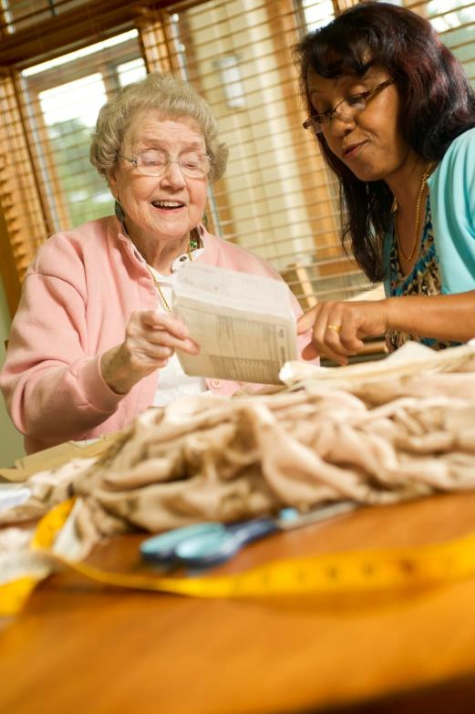
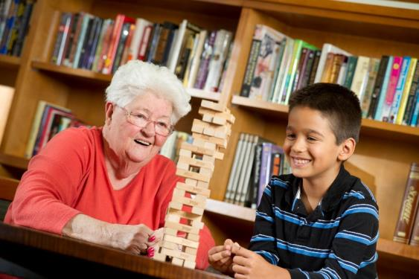
Meaningful Life

Slide 7
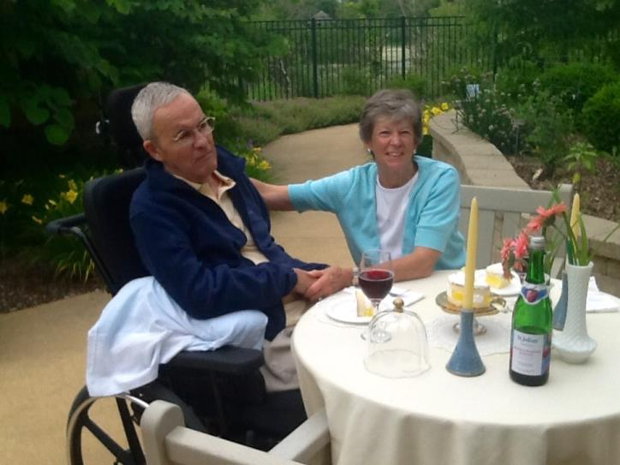
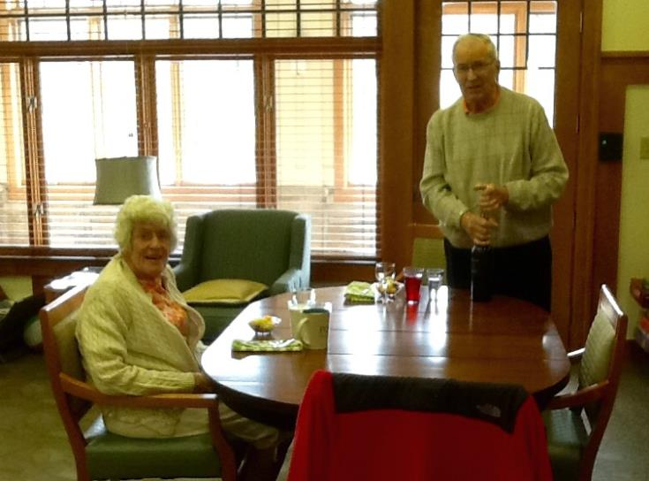
Meaningful Life

Slide 8
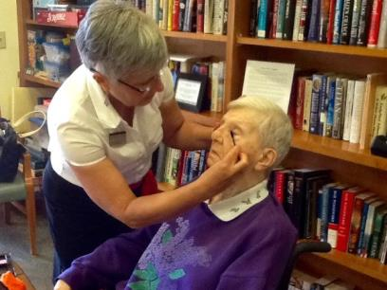
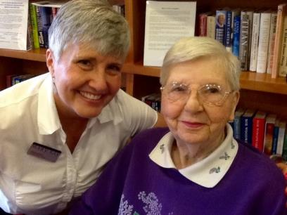
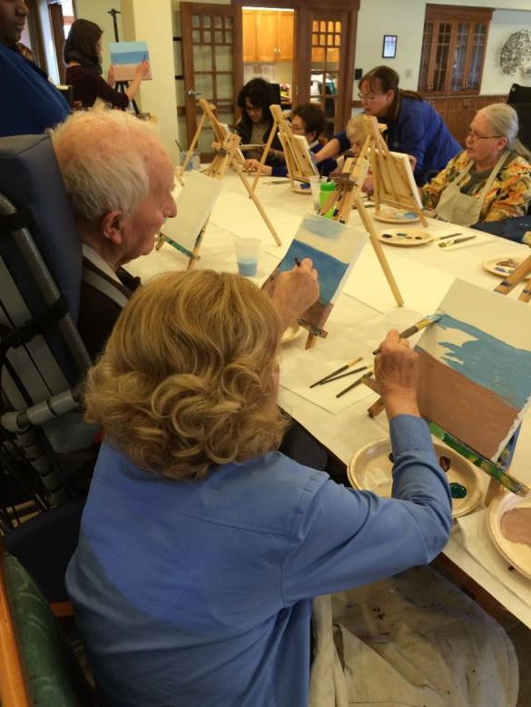
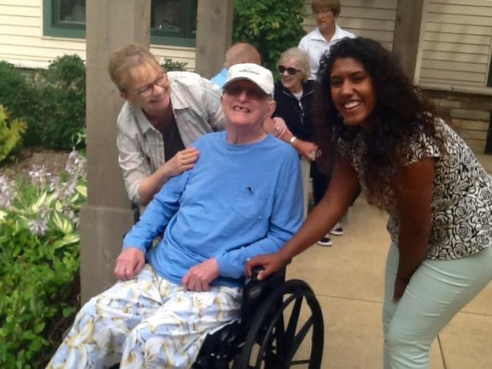
Meaningful Life

Slide 9
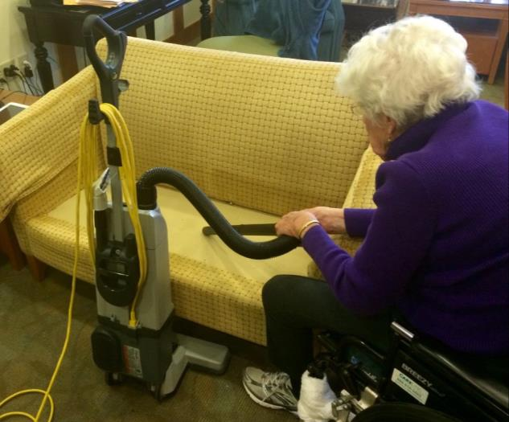
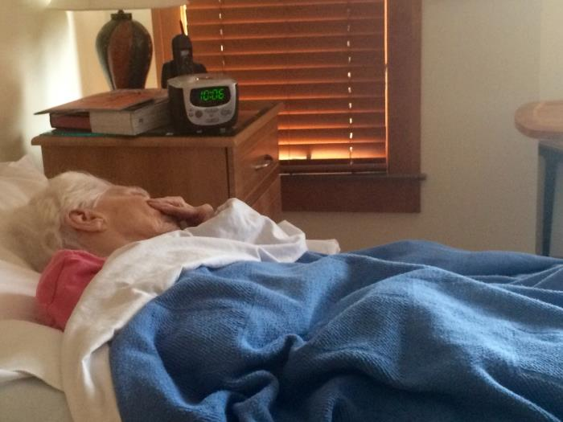
Meaningful Life

Slide 10
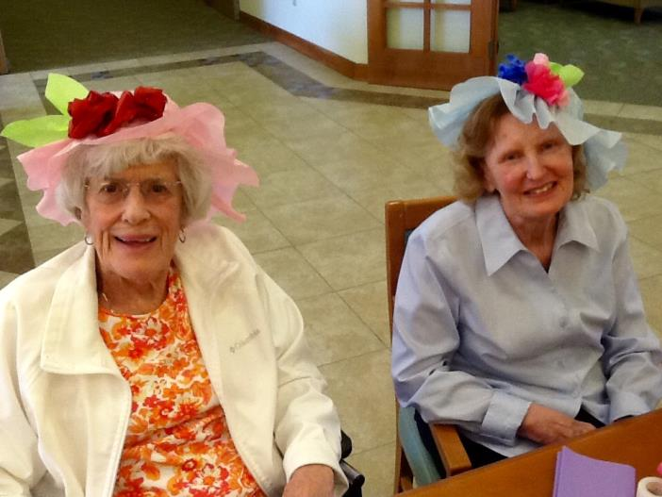
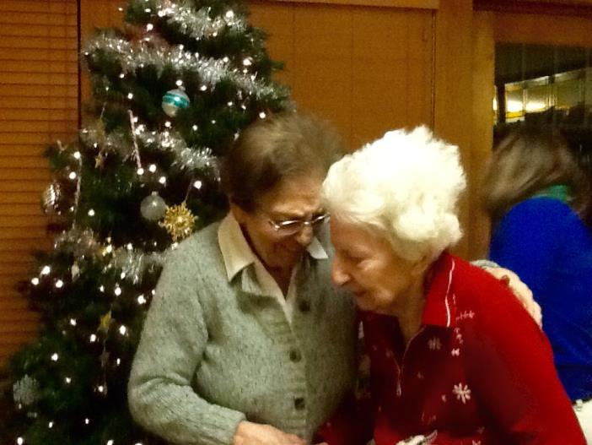
Meaningful Life

Slide 11
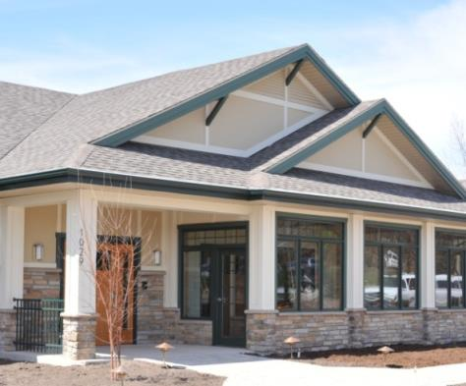
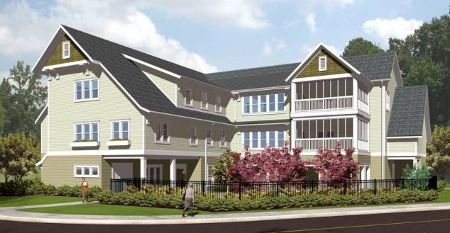
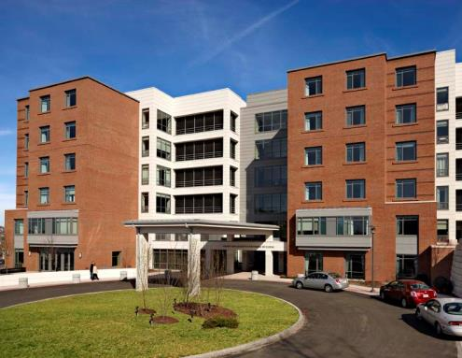
Real Home
Similar to surrounding community
Warm, Smart and Green
Intentional Community
Notes:
Green House® homes are designed to look like a home in which an elder would have lived in his community.
Therefore, designs vary from place to place.
In rural and suburban communities, there will be single-family homes, in urban areas, high rises.
Warm: welcoming/connection
Smart: High Tech, High Touch
Green: Growth
Intentional Community: really make a choice to have those connections, honoring individual rituals, needs and preferences
Convivium: good food with good people– everyone has a place at the table!

Slide 12
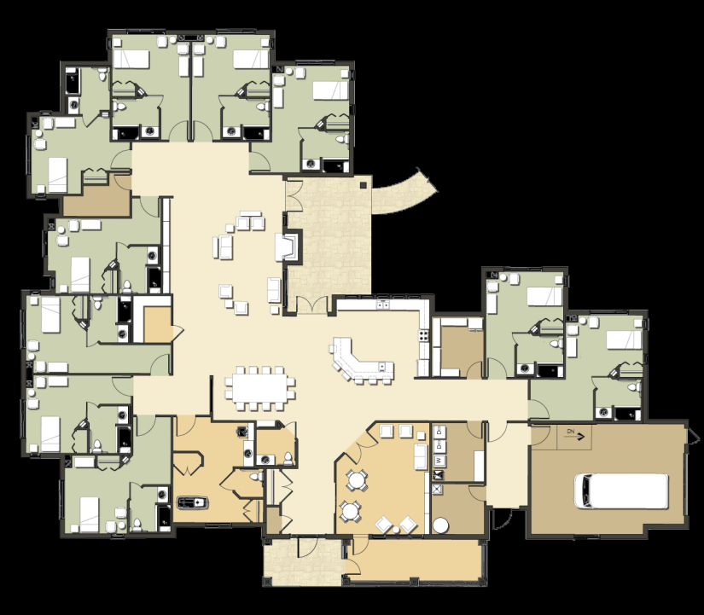
Residential Floor Plan Example
Home to 10 – 12 elders
Private rooms & baths
Small scale, intimate spaces
Good sight lines
Lots of natural light
Exterior space immediately accessible
Porter Hill’s Green House home, Grand Rapids, MI
Notes:
Green House creates a small scale environment (no more than 10 elders) organized around the hearth to support intentional community and strong relationships
Green House provides private bedrooms and bath to provide sanctuary and autonomy.
Open kitchen becomes elder/staff activity and socialization hub as well as appetite stimulant.
Houses fully detached to prevent institutional creep.
Design supports intensive services and oversight through proximity, sightlines, lifts, & technology.
Design creates therapeutic environment, encouraging self-reliance through short distances and safe environment.

Slide 13
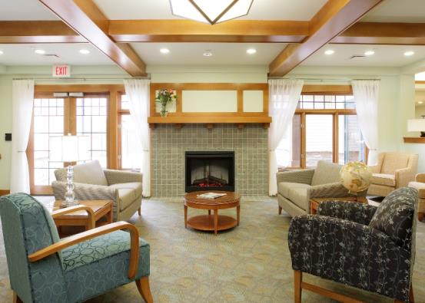
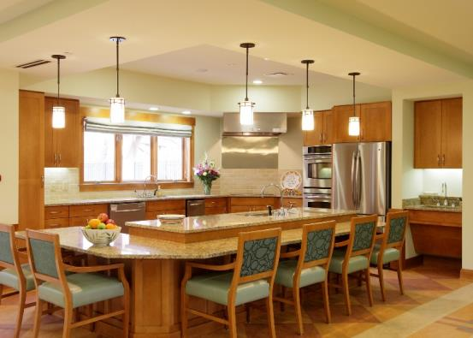
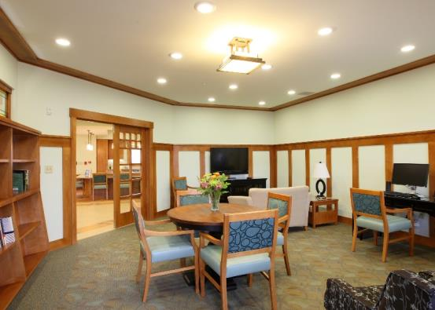
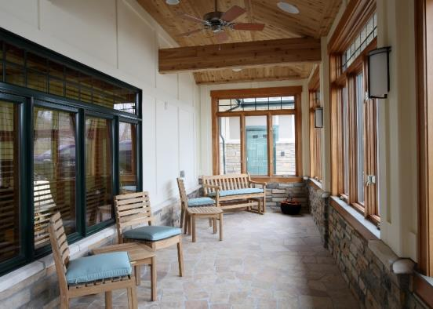

Real Home – Kitchen and Hearth
Notes:
The open living room/kitchen/dining room design of the green house lends itself to the building of relationships within the house.
Open access to elders except at busiest times
Elders can prepare food with supervision
Built-in safety features allow open kitchen to be part of elder’s life
"No social group, whether a family, a work group or a school group, can survive without a constant informal contact among its members"
The hearth offers those opportunities and creates a natural focus for talk, dreams and thought. It opens the space in the house and creates a central connection with other spaces and activities.

Slide 14
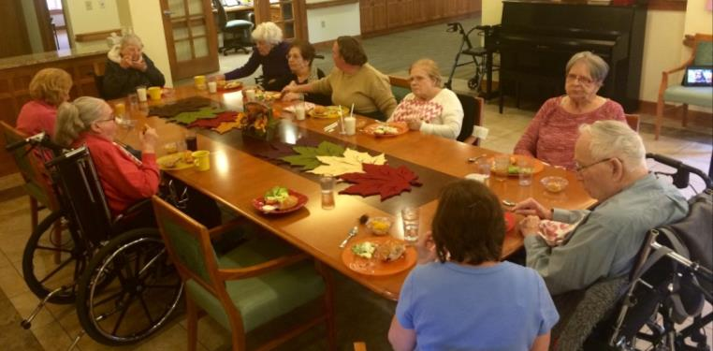
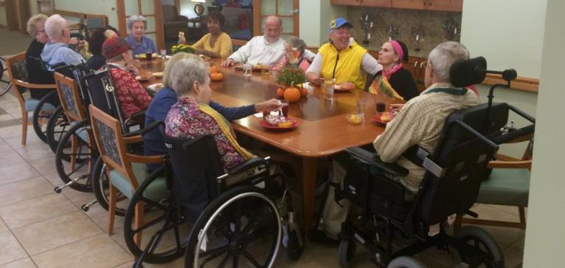
Real Home - Convivium

Slide 15
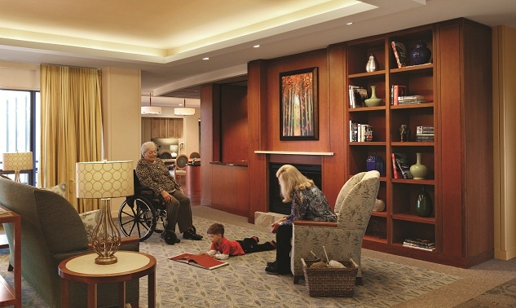
Real Home - Living Room

Slide 16
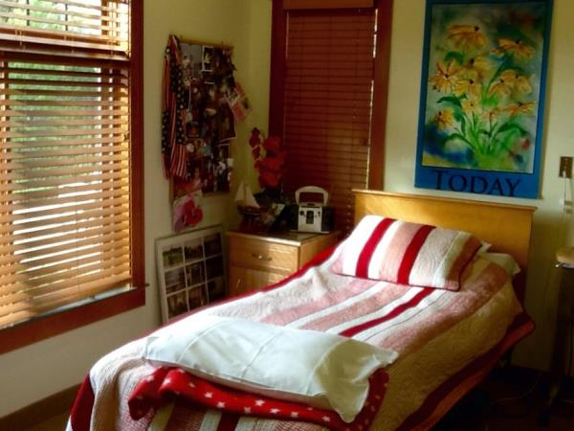
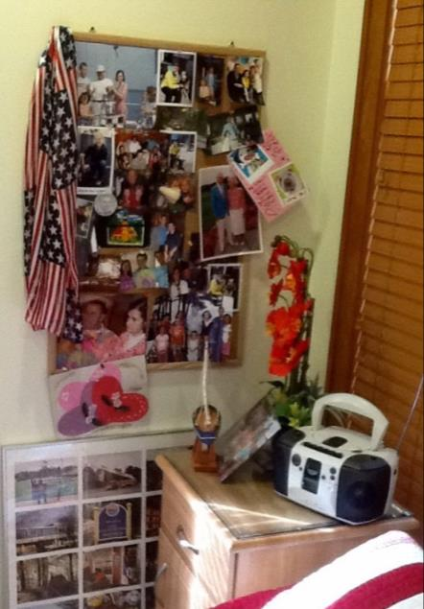
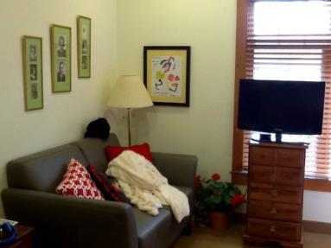
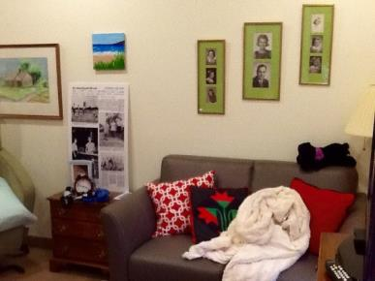
Real Home – Private Bedrooms

Slide 17
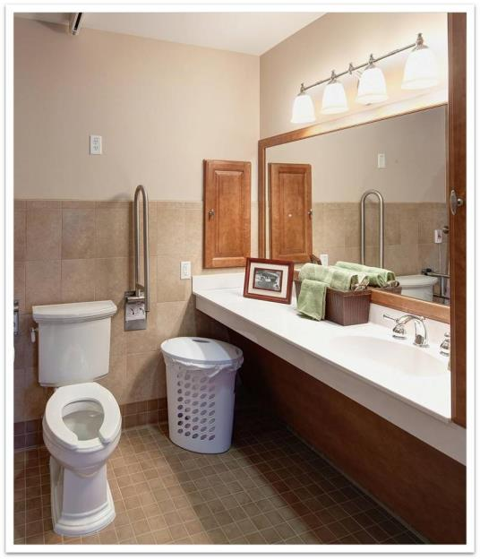
Real Home - Private Baths

Slide 18
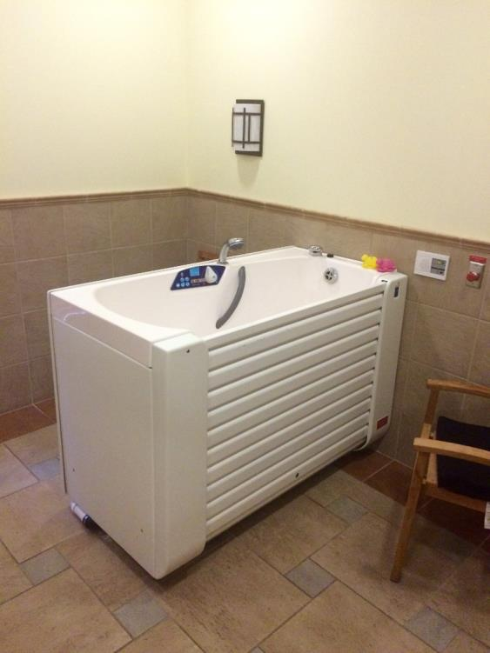
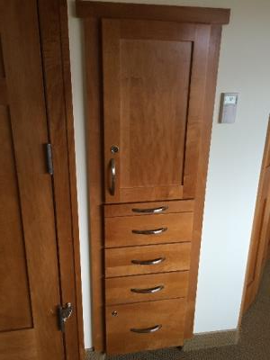
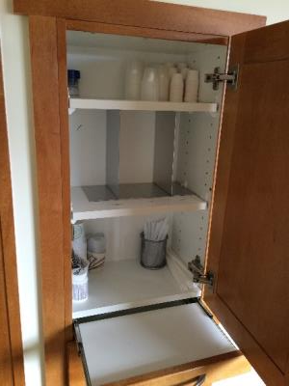
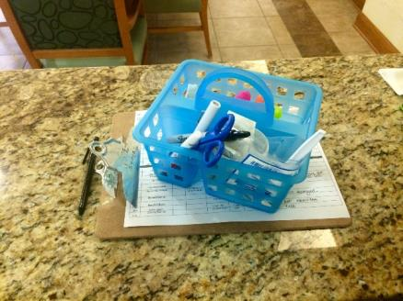
Real Home – Medicine Cabinets and Spa
Notes:
Key locked
Key with nurse
Refrigerated meds and narcotics locked in office
All meds prepared in room

Slide 19
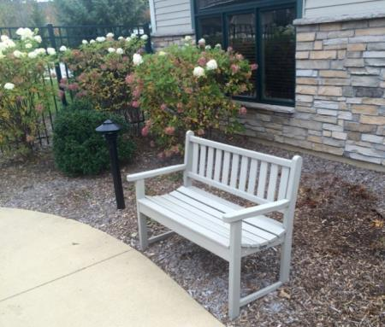
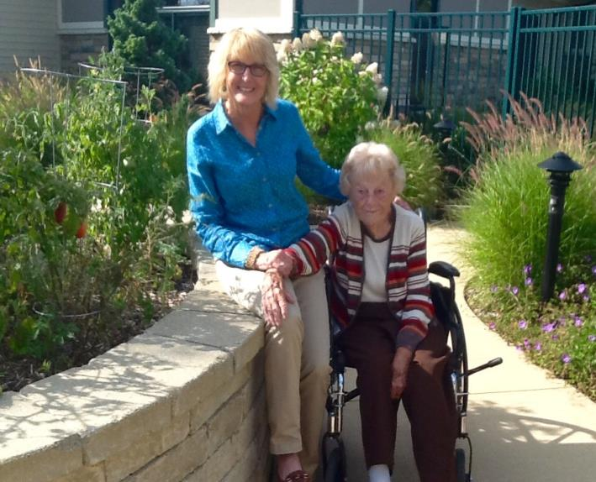
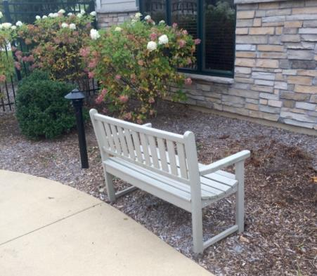
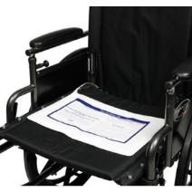
Real Home – Easy Access to Outdoors

Slide 20
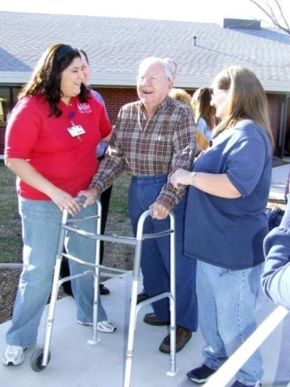
Empowered Staff
Organizational Redesign
Places the elder at the heart of the organizational chart
Coaching approach to leadership
Redefines roles and responsibilities of the direct care worker, nurses and the clinical support team
Physical Environment
Organizational Practices
Philosophy of Care
Notes:
This is a very brief overview of each Green House Model core value:
Empowered staff– review bulleted items on the slide
We will spend a larger portion of our time today on this core value because as you prepare for the FFM process, understanding “Empowered Staff” and the redesign of the organization will help inform your operational decisions.
In The Green House model, an empowered workforce is possible because beliefs and behaviors change at the leadership level and are shared throughout an organization. One fundamental belief is that direct care workers possess vital information about Elders that only a close-relationship can engender. Thus, the organization must be structured to ensure Elders and their care partners have a pivotal role in deciding how care is provided.
The organizational structure in The Green House model challenges traditional nursing home hierarchy. The typical nursing home hierarchy is flattened to create a circular organizational chart with the Elders at the center. Shahbazim, the direct care staff who work within self-managed work teams (SMWT), have primary responsibility for the day-to-day care of the Elders and the smooth functioning of Green House homes. They work in partnership with Nurses and other Clinical Support Team (CST) members to meet the needs of Elders. This versatile role allows for more meaningful interactions in the home, which leads to higher satisfaction and improved clinical outcomes.

Slide 21
Traditional Nursing Home Organization
Administrator
Director of Nursing
ADON
RN Supervisors
LPN’s
C.N.A.’s
Dietary Supervisor
Cooks
Diet Techs
Dishwasher
Environmental
Supervisor
Housekeeping
Supervisor
Housekeepers

Slide 22
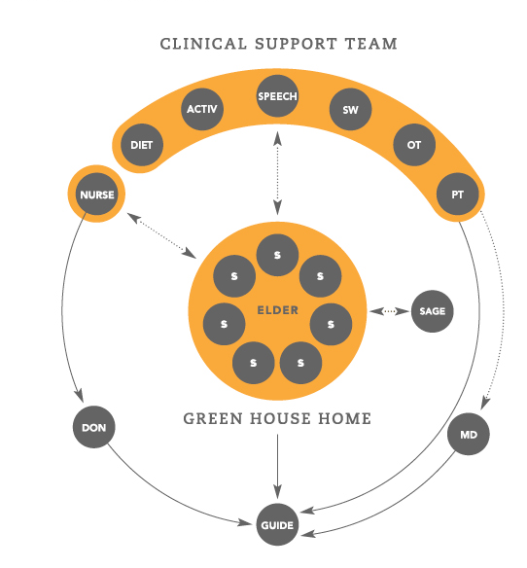
Organizational Transformation
Notes:
The clinical support team is the interdisciplinary team
The Guide – facilitates the collaboration between the shahbazim and the cstm.
Clinical support team operates as coaching partners
Review the items on the slide
Traditional roles redesigned to balance care with treatment to support high quality of life
Clinical Support Team staff operates as coaching partners
Shahbazim – work in partnership with support of Guide, Director Of Nursing (DON), and Medical Director
Guide facilitates collaboration between all care and clinical partners
Shahbazim coached and held accountable by the Guide
Nurses coached by and accountable to the DON
Think Home Care!
Care Role Model
Gerontological Expert
Care Partner
Mentor and Teacher

Slide 23
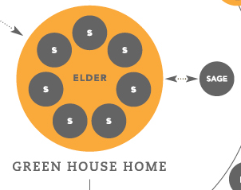
Empowered Staff: Self Managed Teams
Staffed by Shahbazim – a versatile staff position accountable for direct care, light house keeping, laundry, cooking, activity and life in the home
Shahbaz position allows direct care staff to organize as needed to best meet elders’ preferences and needs
Relationship focus creating the opportunity for people to be well-known
Notes:
Elders Rule– they are at the center of the model and surrounded by the Self-Managed Work Team (SMWT) of Shahbazim
Shahbaz (plural: Shahbazim): a versatile staff position accountable for direct care, light housekeeping, laundry, cooking, activity and life in the home.
Shahbazim protect, sustain and nurture each elder. They work within a SMWT to create a home that best aligns with the needs and preferences of elders and leads to better outcomes than in the traditional setting
Coordinator roles within the home
Places the elder at the heart of the organizational chart
Calls for a radical change in leadership style to a coaching approach
Redefines the role and responsibilities of the direct care worker, nurses and the clinical support team

Slide 24


Empowered Staff

Slide 25


Empowered Staff - Training
CNA – required as a foundation
128 Hours add’l training:
Safe food handling
CPR / First Aid
Culinary skills
Home maintenance/
management skills
48 hours Green House Training:
Dementia care
Critical Thinking for Clinical Excellence
Communication
Teamwork skills
Policies & Procedures

Slide 26

Direct Care Staffing
Total hours per elder per day = 5 - 5.2
(10-elder home)
Nurses:
One Nurse per two houses days
One Nurse per two - three houses evenings and nights
Total: 1 - 1.2 hrs per elder per day
Shahbazim:
Two Shahbazim days & evenings
One Shahbaz overnight
Total: 40 hrs total per day, 4 hrs per elder per day
Notes:
In the United States, these contact hours are significantly high than in a traditional nursing home.

Slide 27



Total Time Per Resident Day
Traditional Nursing Home
Green House Home
60 fewer minutes per day

Slide 28

Work Flow Study
Transport: .77 hours less transportation time per elder per day in GH homes
Waiting for Meals: 1.1 hours less waiting time for meals per elder per day in GH homes & more interaction in GH homes while waiting
Breakfast Flexibility: 1.3 hours longer breakfast period in GH homes (1 hour vs. 2.3 hours)
Direct Engagement: Over 4 times as much direct engagement in GH homes vs.. traditional per elder per day (23.5 mins. vs. 5.2 mins.)

Slide 29


Short-Term Rehab in GH Homes
A real home is the best place to recover and get back home:
Home layout
Medication management
Private rooms with private bathrooms
Home cooked meals
Access to fresh air and sunlight
Rehab in a real home
Lower ratios and consistent assignment
Leonard Florence Center for Living
Length of stay – 19.2 days
Re-hospitalization rate – 9.6%
Medicare rates - $325 - $570+/day

Slide 30


Consumer Demand
60% of Caregivers would Pay More
75% of Caregivers would Drive Further
Average National Occupancy of 98%+

Slide 31


Research on the Green House Model
The Green House model is the only evidence-based culture change model
Research team from: Harvard, University of Wisconsin-Madison, Pioneer Network, University of North Carolina, and Health Management Strategies

Slide 32
Factors Influencing Substantive and Sustainable Change
Conditions for
Empowerment
Comprehensive
Change
…necessary for an empowered workforce
…creates opportunities
SUBSTANTIVE AND SUSTAINABLE CHANGE
Decision-
making
Intention
and Systems
…erodes or reinforces change – one decision at a time
…to monitor and manage success
Notes:
Comprehensive Change creates opportunities for maximizing impact.
Sustaining Change requires intention and systems that monitor and manage success.
How decisions are made will either erode or reinforce change one decision at a time.
Achieving an empowered workforce requires creating the conditions for empowerment.

Slide 33


Evaluating the Green House Model
Residents and Family Satisfaction
Improved quality of resident life
Improved quality of care
Improved family satisfaction
Engagement & Quality of Care
Higher direct care time
Increased engagement with elders
Improved care outcomes
Staff
Improved staff satisfaction
Less job-related stress

Slide 34

Seniors Housing & Care Journal*- Financial Impact
Operating Costs:
Comparable in costs to traditional nursing homes
Occupancy increases:
GH homes average 96%
National average 85% and falling
Private pay occupancy increases:
GH homes increased private pay days by 24%
Nationally, NHs lost 8% private pay days in same period
Private pay rates increase with private rooms
Short-term Medicare, HMO occupancy increases with all private rooms
Financial Implications of The GREEN HOUSE Model. Seniors Housing & Care Journal, 2011 Volume 19 Number 1

Slide 35

Momentum
Operating
185 homes
On 40 campuses
In 28 states (AK, AL,
AR, AZ, CA, CO, FL, GA, IL, KS,
KY, MA, MD, MI, MN, MS, MT,
NE, NJ, NY, OH, PA, TN,
TX, VA, WA, WI, WY)
In Development
150+ homes
On 25 campuses
In 5 additional states
(IN, MO, NC, NH, RI)

Slide 36




Contact Information
Marla DeVries | Cheryl VanBemden
Director of Resource Development THE GREEN HOUSE Project Ph: 571-345-6485 mdevries@thegreenhouseproject.org | Director of Residential Living Porter Hills Ph: 616-942-5975 cvanbemden@porterhills.org
We did the best we could with what we knew. And when we knew better, we did better.
-Maya Angelou

