Slide 1
Food Matters: Healthy Choices for Body & Brain
Priscilla J. Kimboko, Ph.D.
Art & Science of Aging Conference
February 8, 2013

Slide 2
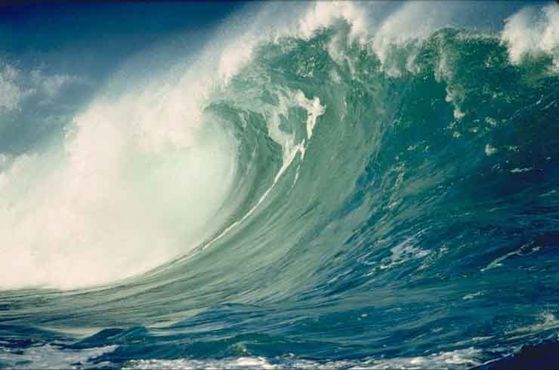
Tsunami of Obesity in US

Slide 3
Obesity Statistics
World Health Organization
& US DHHS. NIH.NIDDK

Slide 4
International Data
Global Problem (2005)
1.6 billion adults overweight (age 15+)
400 million adults obese
20 million children under age 5 overweight
Current Trends – by 2015
2.3 billion adults overweight
700 million - obese

Slide 5
Growing Problem
Since 1960’s prevalence of obesity among adults has more than doubled [from 13.5 to 35.7%)
Obesity prevalence mostly stable from 1999 to 2010:
Slight increases among MEN (overall); black women and Mexican American women
Among children and adolescents, the prevalence of obesity increased in the 1980’s and 1990’s but mostly stable at 17%
From NIDDK, Overweight and Obesity Statistics, 2012)

Slide 6
US Data: National Institute of Diabetes, Digestive & Kidney Diseases (NIDDK)
Fast Facts
More than 2 in 3 adults overweight or obese
More than 1 in 3 adults obese
More than 1 in 20 adults – extremely obese
About 1/3 of children adolescents (6-19) are overweight or obese
More than 1 in 6 children considered obese
From National Health and Nutrition Examination Survey (2009-2010)

Slide 7
Michigan Obesity Rates
Adult Obesity rate, 30.4% (2010)
Among 12 most obese states
Projected to rise to 59.4% by 2030 (if no change in average BMI)
Projected to rise to 53.4% if BMI overall is reduced 5%
From Trust for America’s Health: F as in Fat: how Obesity Threatens America’s Future (2012) - with Robert Wood Johnson Foundation

Slide 8
Defining Obesity/BMI
Obesity = excessively high amount of body fat or adipose tissue in relation to lean tissue, with Body Mass Index (BMI) greater than 30
Overweight = BMI>25 to 30
Normal weight = BMI between 18 and 24

Slide 9
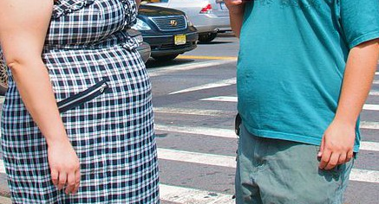
Why do we get FAT?

Slide 10
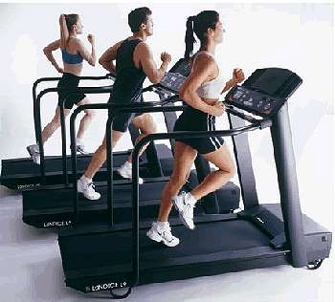
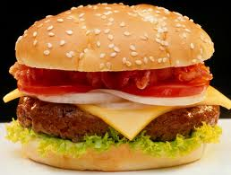
Too much food, too little exercise?
Calories OUT
Calories IN

Slide 11
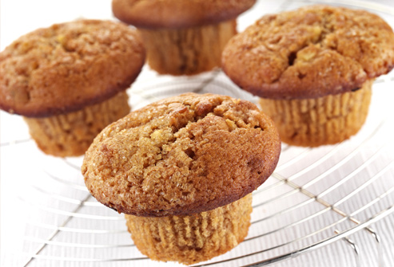
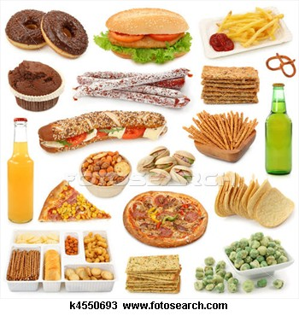
COMFORT foods!
Bran muffins?
Fatty foods?

Slide 12

SWEET, SALT, FAT
Standard
American
Diet
enshrined!

Slide 13
HEALTH RISKS WITH S.A.D.
HEART DISEASE
DIABETES
HIGH BLOOD PRESSURE
OBESITY
HIGH CHOLESTEROL
ARTHRITIS/JOINT PROBLEMS
DEPRESSION/STRESS
DEMENTIAS ?

Slide 14
Health Risks with Obesity
TYPE 2 DIABETES
HEART DISEASE
HIGH BLOOD PRESSURE
NONALCOHOLIC FATTY LIVER DISEASE
OSTEOARTHRITIS
SOME CANCERS (BREAST, COLON, ENDOMETRIAL, KIDNEY)
STROKE

Slide 15
See the Similarities?
Risks of SAD
Risks of OBESITY
HEART DISEASE
DIABETES
HIGH BLOOD PRESSURE
OBESITY
HIGH CHOLESTEROL
ARTHRITIS/JOINT PROBLEMS
DEPRESSION/STRESS
DEMENTIAS ?
TYPE 2 DIABETES
HEART DISEASE
HIGH BLOOD PRESSURE
NONALCOHOLIC FATTY LIVER DISEASE
OSTEOARTHRITIS
SOME CANCERS (BREAST, COLON, ENDOMETRIAL, KIDNEY)
STROKE

Slide 16
Getting Fatter & Sicker
Other comorbidities:
Fatty liver disease
Kidney disease
Polycystic ovarian syndrome
Orthopedic problems
Sleep apnea
Gallstones
depression

Slide 17
Diabesity
"Our ancient genes and our modern environment have collided." Our bodies store excess calories as fat. In ancient times calories were hard to come by. Today, fast food and junk food are everywhere. Coupled with our increasingly inactive lifestyle, the result is obesity.”
Francine Kaufman, M.D, Director, Center for Diabetes, Endocrinology, and Metabolism at Children's Hospital in Los Angeles

Slide 18
Diabesity further defined…
Continuum of abnormal biology that ranges from mild insulin resistance to full-blown diabetes
Downstream symptoms that result from problems with diet, lifestyle, and environmental toxins interacting with our unique genetic susceptibilities
Mark Hyman, MD, 2011

Slide 19
Diabesity – Dementia Connection
Recent studies show that type 2 diabetes is a risk factor for Alzheimer’s disease, vascular dementia, and other types of dementia because cardiovascular problems associated with diabetes are also associated with dementia
Glucose is not used properly in the brains of people with Alzheimer’s disease
Beta amyloid plaques which build up in the brains of people with AD have been shown to prevent insulin receptors in the brain from doing their job.
Some have suggested that Alzheimer’s is ‘type 3 diabetes’
Alzheimer’s Society of Canada, 2011.

Slide 20
Who is at Fault?
The current formulation of gluttony, sloth, diet and exercise, while accepted by virtually everyone, is based on faulty premises and myths that have taken hold in the world’s consciousness. Obesity is not a behavioral aberration, a character flaw, or an error of omission.
Our current thinking is based upon correlation, supposition and conjecture.
Robert H. Lustig, M.D. Fat Chance: Beating the Odds Against Sugar, Processed food, Obesity and Disease. 2012

Slide 21

The CAUSES of Obesity

Slide 22

Consider Standard American Diet – industrial food
The Standard American Diet - now the Industrial Global Diet - is killing us all…slowly.
Robert Lustig

Slide 23
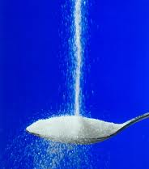
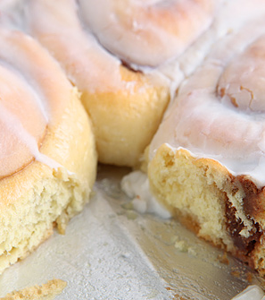
NEW/OLD Answers

Slide 24
Consider: Insulin
Obesity is a disorder of excess fat accumulation, not voluntary overeating or inactivity, caused by an imbalance in hormonal regulation of adipose tissue and fat metabolism.
Insulin is the primary regulator of fat storage. When insulin levels are elevated–either chronically or after a meal–we accumulate fat in adipose tissue. When insulin levels fall, we release fat and oxidize it for fuel.
Elevated blood insulin levels increase hunger and the drive to eat, while decreasing energy expenditure and activity
By stimulating insulin secretion, carbohydrates make us fat and ultimately cause obesity
In short: Carbohydrates drives insulin, which drives fat.
Source: Gary Taubes: Why We Get Fat and What to Do About It.

Slide 25
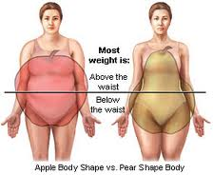
Apple vs. Pear * Belly Fat
People with abdominal obesity (the characteristic “apple” or pot belly shape, rather than those with “pear” shaped backsides or extra subcutaneous fat) tend to secrete more insulin after eating and have high basal insulin levels, ultimately leading to elevated blood glucose, triglycerides, elevated blood pressure, unfavorable cholesterol ratios, and a host of other issues

Slide 26
Consider FAST FOOD
Our bodies have not kept up with the high fructose, salt and fat laden foods that industry produces cheaply!

Slide 27
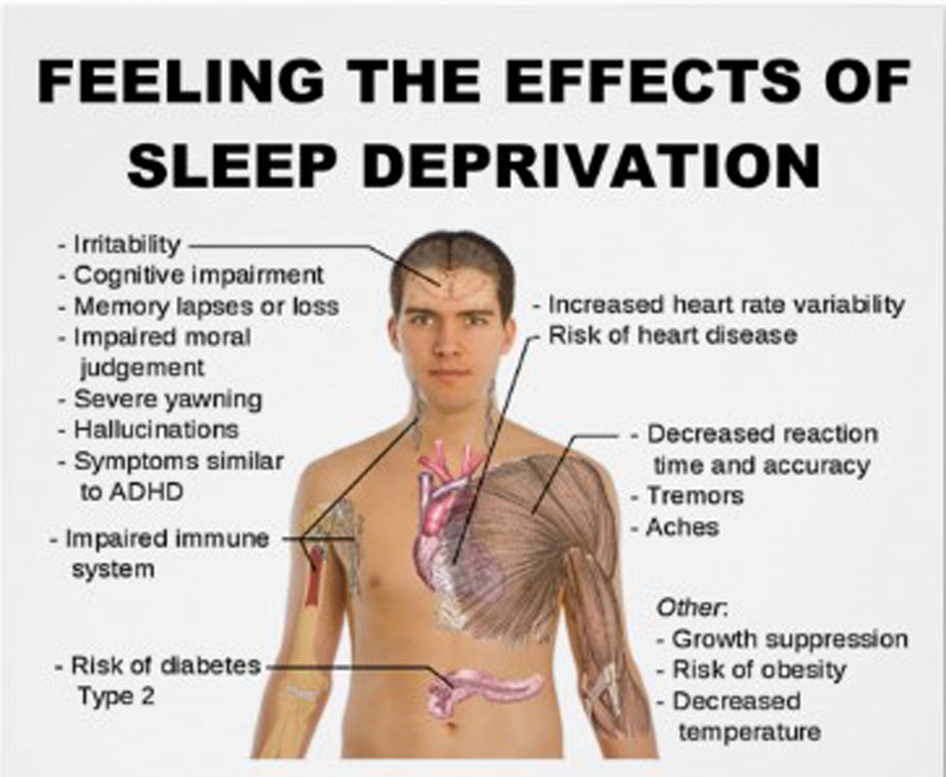
Consider Sleep Deprivation
Normal sleep needs of adults is six hours
Sleep deprived people eat more simple carbohydrates than people who get adequate sleep
Hormones Ghrelin increases with less sleep, triggering hunger feelings
May also be more likely to skip breakfast

Slide 28
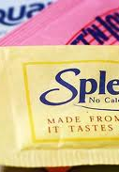
Consider Diet Sweeteners
Artificial sweeteners disrupt the normal hormonal and neurological signals that control hunger and satiety…preferred taste sweetness is potentially addictive…
Give up stevia, aspartame, sucralose, sugar alcohols unless you want to slow down your metabolism, gain wait, and become an addict.
They make you hungrier, slow your metabolism, give you bad gas, and make you store fat
Dr. Mark Hyman

Slide 29
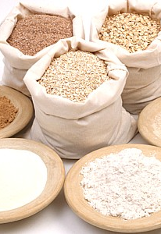
Consider Processed Grains
White rice and white flour act like sugar in the body
If you have ‘diabesity’ you can’t easily handle any flour, even whole grain

Slide 30
Consider Inflammation
Belly fat is more metabolically active…and drives inflammation, which in turn promotes diabetes, cardiovascular disease, dementia and aging –
visceral/[belly] fat kills you…
Studies of humans have demonstrated that sucrose consumption correlates with the degree of liver inflammation
Inflammation can be measured by C-reactive protein (CRP) test
Robert Lustig: Fat Chance: Beating the Odds Against Sugar, Processed Food, Obesity, and Disease.

Slide 31
Consider Stress
Emotional hunger comes on suddenly
Emotional hunger craves specific comfort foods
Emotional hunger often leads to mindless eating
Emotional hunger isn’t satisfied once you’re full
Emotional hunger isn’t located in the stomach
Emotional hunger often leads to regret, guilt, or shame.
From:
Helpguide.org: Emotional eating: How to recognize and stop emotional eating. http://www.helgpuide.org/life/emotional_eating_stress_cravings.htm

Slide 32
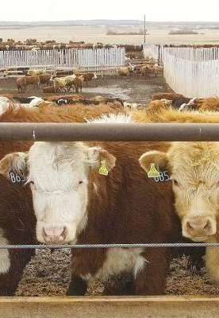
Consider CAFO
Concentrated Animal Feeding Operations = CAFO
a significant contributor to diet-related diseases, and the spread of food-borne illnesses. The intensive concentrations of animals in such crammed and filthy conditions dependent on antibiotic medicines and steady streams of subsidized industrial feeds poses serious moral and ethical considerations for all of us.

Slide 33
Consider Low Vitamin D
Studies show that persons who are obese are also low in Vitamin D.
People who are obese may be less able to convert vitamin D into its hormonally active form
Because Vitamin D is fat-soluble, it is likely that the Vitamin D obese people take in is distributed in fat tissue and not in the blood
Web MD: Salynn Boyles, Obesity linked to lower vitamin D levels: researchers say obese people may need more Vitamin D in their diet.
From http://www.webmd.com/vitamins0and-supplements/news 20101217/obesity-linked-lower-vitamin-d-levels.

Slide 34
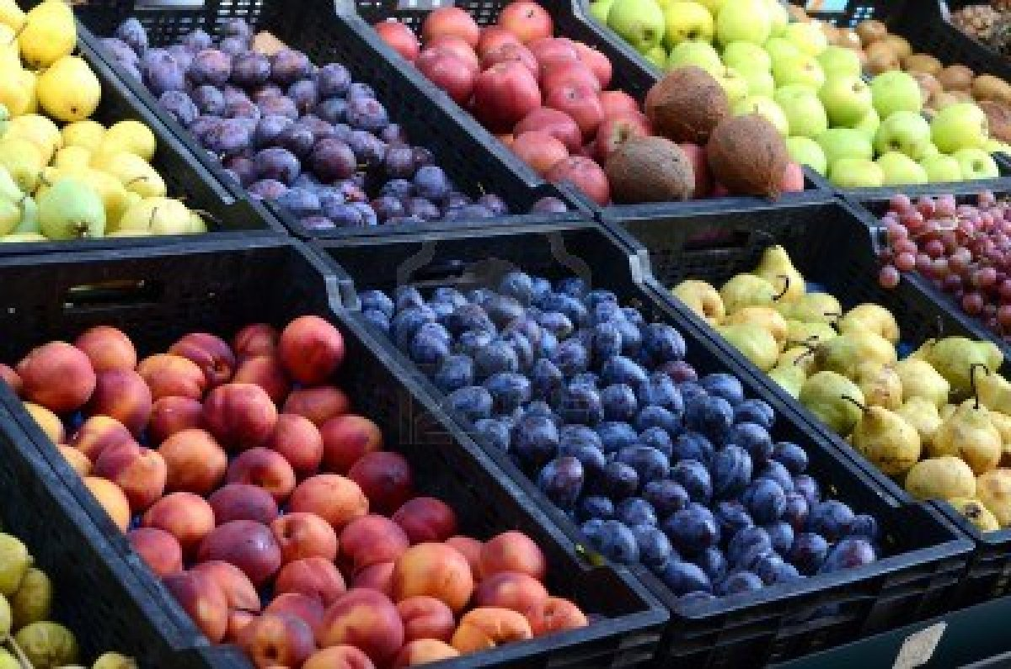
Conclusions? Food Matters
Your daily food choices matter….otherwise your body must struggle to overcome bad choices, and diabesity occurs…with all its negative consequences for your brain and body!

Slide 35
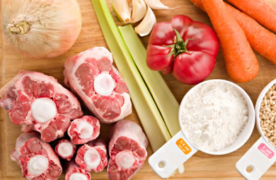
Diabesity prevention
Fresh, organic “green” vegetables, and fresh grass fed meats such as beef, pork, free range chickens, lots of fish that provide Omega 3 oils…

Slide 36
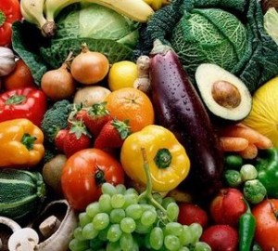
Low Carb Fresh Food KEY
Farmer’s market and/or raise your own – even in small spaces you can grow some fresh vegetables and fruits

Slide 37
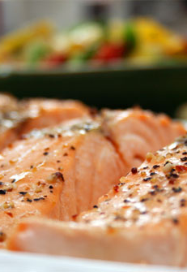
Stave off Dementia with Food
…. green leafy vegetables and cruciferous vegetables like broccoli, is associated with a reduced rate of cognitive decline.
“Mediterranean diet” had a 28 percent lower risk of developing MCI and a 48 percent lower risk of progressing from MCI to Alzheimer’s disease
Eat vegetables, legumes, fruits, , fish, olive oil, moderate amounts of alcohol, dairy products, lean meat, and poultry.
Daniel Amen

Slide 38
Low Carb Diet – historically prescribed
Exclude rice, bread, potato, macaroni, pies, cakes, sweet desserts, free sugar, candy, cream, etc.
Eat moderate amounts of lean meat, fish, fowl, eggs, cheese, coarse grains, skimmed milk
Avoid carbohydrates, particularly sweets, starches, and refined carbohydrates
Include small servings of fruit, lots of green vegetables
Robert Melchionna, early 1950’s reducing diet prescribed at New York hospital (as quoted in Gary Taubes: Good Calories, Bad Calories, 2007
Notes:
Inspired to get started – by Gary Taubes Book…Had been diagnosed as pre-diabetic, had begun to feel the Brain Fog, lack of energy and focus that insulin resistance causes…
Caring for my husband with dementia & diabetes

Slide 39
What to do about Obesity?
A Personal Journey

Slide 40

Personal Story
Notes:
2008 - Public meeting

Slide 41
UltraHealth
Seven Steps to treating Diabesity
Step 1 - Boost your nutrition
Step 2 – Regulate your hormones
Step 3 – Reduce Inflammation
Step 4 – Improve Digestion
Step 5 – Maximize Detoxification
Step 6 – Enhance Energy Metabolism
Step 7 – Soothe Your Mind
Mark Hyman, The Blood Sugar Solution: The UltraHealthy Program for Losing Weight, Preventing Disease and Feeling Great Now!

Slide 42
What we can do
Replace fattening carbohydrates with animal products high in fat
Eat as much fat and protein as you want, but avoid carbohydraytes
Lose weight
HDL (good) cholesterol up
Triglycerides down
Blood pressure down
Total cholesterol stays about the same
LDL cholesterol went up slightly
Risk of heart attach decrease (Taubes)

Slide 43
Diets that work
Many good ones that work – because they restrict fattening carbohydrates – sugars, starches, grains and moderate fruits
They look like the guidance offered in the 40’s and 50’s
Avoid starches, grains, sugars, anything made from them (bread, pastries, candies, juices, sodas) and monitor how much fruit and nonstarchy vegetables you body can tolerate
Avoid artificial sweeteners which trigger insulin - which triggers fat storage
Stick to leafy green vegetables which have a very low glycemic index
Sugars are addictive in the brain in the same way as cocaine, heroin, nicotine. (Taubes)

Slide 44
Atkins Diet - 9 months
Sets few limits on the amount of food you eat but severely restricts the kinds of food allowed on your plate: no refined sugar, milk, white rice, or white flour products
Allows you to eat foods traditionally regarded as "rich": meat, eggs, cheese, and more
Reduces your appetite in the process
You're eating almost pure protein and fat. You can consume red meat, fish (including shellfish), fowl, and regular cheese (not "diet" cheese, cheese spreads, or whey cheeses). You can cook with butter, have mayo with your tuna, and put olive oil on your salads.
Notes:
Followed for – Aug 1, 2011 to April 30, 2012 – weight loss = 23 pounds, with Atkins philosophy that allowed fats, bacon, but significantly restricted carbohydrates – no sugars, breads, or grains
Bought eggs from local organic farm – free range, fed organic grains; bought grass fed beef, chickens, pork
Still OBESE – waist size, waist to height ratio; Series of tests through work: still had blood pressure, blood sugar, and related issues; many risk factors, sleep disruptions,
Husband on it as well, reduced the amount of carbs, but did not reduce the fruits – he ate great amounts of fruit

Slide 45
Low glycemic - Medifast
A quick weight loss diet, with portion-controlled meal replacements [PCMR}, that are low glycemic, and no sugar (altho’ using sugar substitutes)
These are another form of ‘fast food’ with small portions and frequent meals
Combine with Lean (protein sources) and Green (vegetables/very low carb)
Goal – rapid weight reduction to achieve normal BMI, then go to Maintenance Diet for Optimal Living
Notes:
Followed now for 9 months – weight loss another 45 pounds…Total weight loss is 68 pounds
Other changes:
A1C is in normal range (no longer prediabetic)
Cholesterol is in normal range
Blood pressure is in normal range
Husband on the same program –
His A1C now less than 8 (which doctor had set as goal)
He has loss about 30 pounds

Slide 46
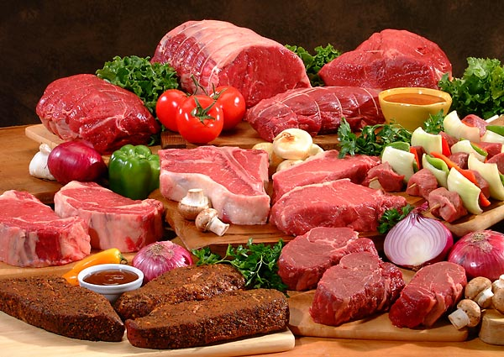
Primal Diet – Mark Sisson
Notes:
Starting now

Slide 47
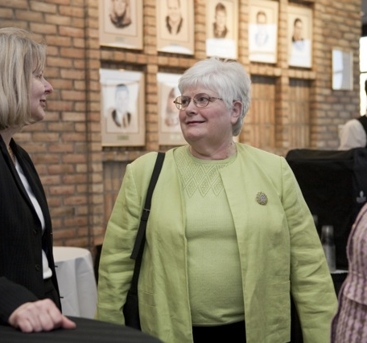

Change is Possible!
March 2009
August 2012

Slide 48
Getting Started

Slide 49

Know Your Numbers
BMI
Waist-to-height ratio
Record fruits and vegetables eaten
Sleep
Blood Pressure
Complete Blood Count
Metabolic Panel
HgA1C test for diabetes
Vitamin D level
Thyroid
C-reactive protein
Homocysteine

Slide 50
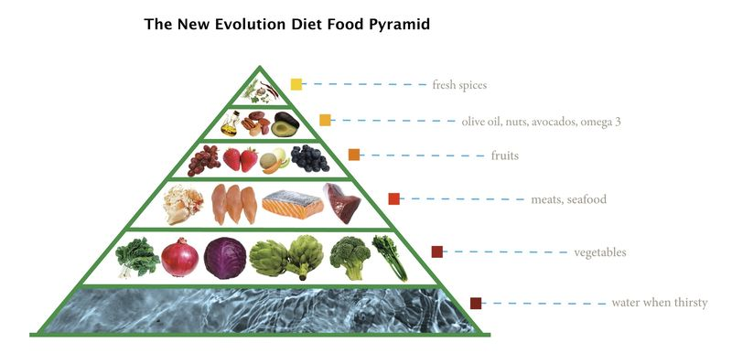
Paleo Diet Food Pyramid

Slide 51
References
Amen, Daniel G. (2011) The Amen solution: The brain healthy way to get thinner, smarter, happier. New York: Three Rivers Press.
Andersen, Wayne Scott. (2008) Dr. A’s habits of health: the path to permanent weight control and optimal health. Annapolis MD: Habits of Health Press.
Bailor, Jonathan, Paine, John, Black, Hillel, Bailor, Mary Rose, Manson, JoAnn E., & Kelesidis, Theodoros (2012) The smarter science of slim: What the actual experts have proven about weight loss, diet, and exercise.
De Vany, Arthur. (2011) The new evolution diet: What our Paleolithic ancestors can teach us about weight loss, fitness and aging.
Duhigg, Charles. (2012). The power of habit: Why we do what we do in life and business. New York: Random House.
Hyman, Mark. (2012) The blood sugar solution: The ultrahealthy program for losing weight, preventing disease and feeling great now. New York: Little, Brown.

Slide 52
La Puma, John and Rebecca Powell Marx (2008). Chef MD’s big book of culinary medicine: A food lovers’ road map to losing weight, preventing disease, and getting really healthy. New York: Three Rivers Press.
Lustig, Robert. Sugar: The bitter truth. [video] http://www.youtube.com/watch?v=dBnniua6-oM
Lustig, Robert, (2012) Fat chance: Beating the odds against sugar, processed food, obesity and disease. New York: Hudson Street Press.
Sisson, Mark. (2011) The primal blueprint 21day total body transformation. Malibu, CA: Primal Nutrition Ranch.
Taubes, Gary (2011) Why we get fat and what to do about it. New York: Alfred A. Knopf, Borzoi Books.
Thompson, Helen (2012) Sugar free diet simplified: a concise and easy to read guide on learning to identify and overcome sugar.
Wahls, Terry L. M.D., Minding my mitochondria: how I overcame secondary progressive multiple sclerosis (MS) and got out of my wheelchair, 2nd edition. Iowa City: TZ Press.
Westerman, Eric C., Phinney, Stephen D. & Volek, Jeff, S. (2010) The new Atkins for a new you: the ultimate diet for shedding weight and feeling great. New York: Fireside.

