Slide 1

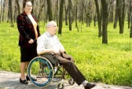

Exercise and Successful Aging: Maintaining Function and Quality of Life
Michael Shoemaker, DPT, PhD, GCS
John Stevenson, PT, PhD

Slide 2
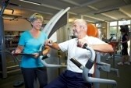
Outline
Basic Aging Changes Relevant to Movement and Function
Effects of Exercise to Counter Effects of Aging and Disease
Readiness to Exercise
Exercise Guidelines

Slide 3
Disclosures
Drs. Shoemaker and Stevenson currently serve as graduate faculty in the Doctor of Physical Therapy program at GVSU
Neither represents a commercial interest in products or services regarding this topic
No conflicts of interest

Slide 4
Objectives
At the end of this session, the attendee will be able to:
  Understand how normal physiological changes in aging affect physical function
  Assess readiness to engage in fitness and recreational activities for older participants
  Suggest appropriate exercise and physical activities that could improve function and quality of life

Slide 5
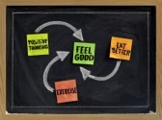
Aging, Disease, and Exercise
Exercise Physiology
Cardiovascular, Pulmonary, Musculoskeletal, Aerobic Capacity Changes with Age
Changes Associated with Disease
Effects of Exercise
Evidence

Slide 6
Aging, Disease, and Exercise:
The Big Picture
Movement and physical function require adequate muscle contraction and force production, which requires…
  Adequate muscle fiber size and efficient energy production, which requires…
    Adequate physical stimulus, oxygen delivery, carbon dioxide clearance, which requires
      Maintained activity levels, cardiac output, lung ventilation

Slide 7
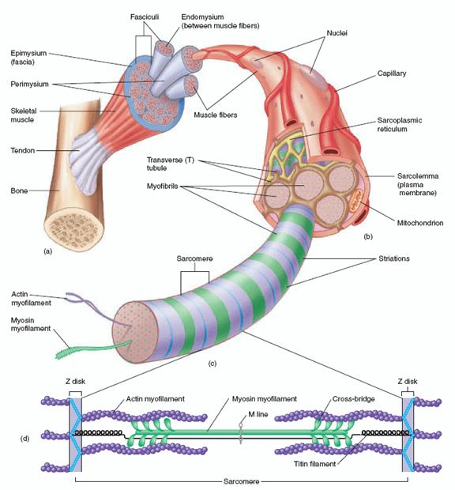
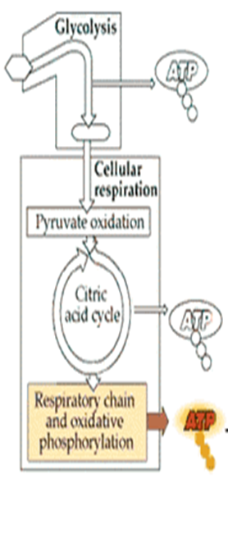
Aging, Disease, and Exercise:
The Big Picture
http://otah2o.wikispaces.com/file/view/skeletal_muscle.jpg/220615510/682x628/skeletal_muscle.jpg

Slide 8
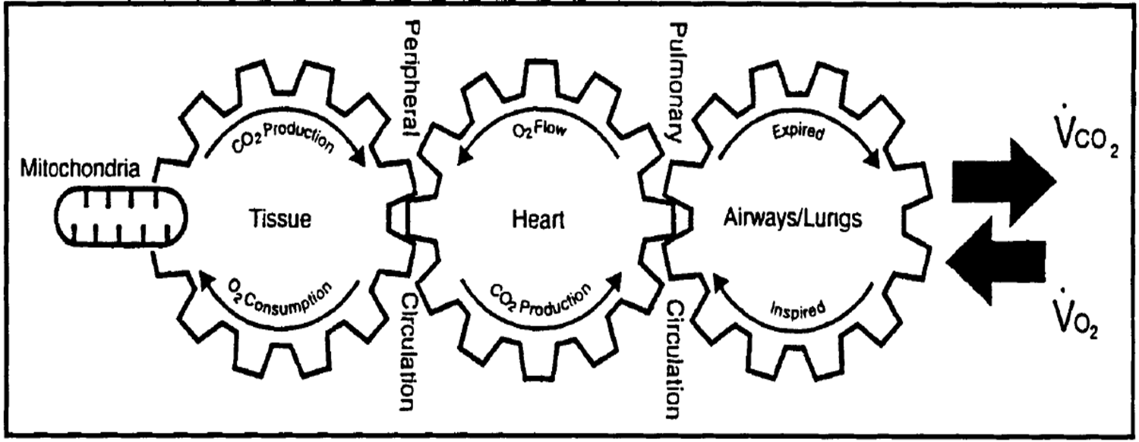
Aging, Disease, and Exercise:
The Big Picture
From: Dean and Frownfelter, Mosby 2006

Slide 9
Aging, Disease, and Exercise:
Age-Related Changes
Pulmonary System
  Decreased movement of O2 in and CO2 out of lungs and bloodstream
    Less efficient gas exchange
    More rigid rib cage
    Lung elastic tissue diminished
    Increased fibrous tissue
    Diminished compliance
    Respiratory muscles decline
    Reduced alveolar surface area
    Increased resistance to airflow
    Reduced vital capacity
    Reduced diffusing capacity
    Ventilation/Perfusion imbalance

Slide 10
Aging, Disease, and Exercise:
Age-Related Changes
Cardiovascular Changes
  Reduced delivery of oxygen-rich blood to working muscle
    Decline in LV diastolic function
    Attenuated maximum heart rate
    Arterial stiffness
    Myocardial stiffness
    Systolic blood pressure
    Diastolic blood pressure

Slide 11
Aging, Disease, and Exercise:
Age-Related Changes
Muscular Changes
  Decreased force production and increased susceptibility to muscle fatigue
    mass (20-40%)
    fiber number
    fiber size (esp. Type II)
    contraction velocity
    mitochondrial function
    oxidative enzyme capacity
    Motor latencies increase
    Decreased size and number of alpha motor neurons
    Degeneration of the neuromuscular junction
    Greater proportional loss of leg muscles associated with decreased locomotor activity with age

Slide 12
Aging, Disease, and Exercise:
Age-Related Changes
Changes in Other Systems
  Insulin sensitivity
  Glucose tolerance
  Immune function
  Bone mass/strength/density
  Collagen cross-linkage, thinning cartilage, tissue elasticity
  Proprioception
  Gait velocity
  Gait stability

Slide 13
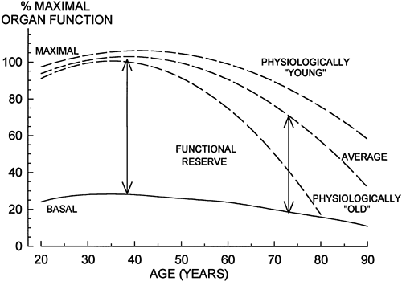
Aging, Disease, and Exercise:
Summary of Age-Related Changes
End Result: Decreased Reserve Capacity- Increased effort required and decreased ability to accomplish physical work
  Aerobic capacity peaks between 15-30
    Declines with age
      Approximately 10% per decade after age 25-30
  Anaerobic threshold occurs at lower work rates
http://web.squ.edu.om/med-Lib/MED_CD/E_CDs/anesthesia/site/content/figures/4061F01.gif

Slide 14
Functional Capacity Changes Associated with Disease
New/Compounded Illness
Illness Risk Factors
Reduced Physical Activity
Increased Disease Risk
Most of the deleterious effects of chronic illness on functional capacity are related to behavior and patterns of physical activity!

Slide 15
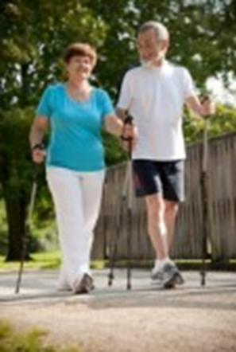
Effects of Exercise
Pulmonary
  Ensures that lung function does not act as a limit to exercise and activity tolerance
    Training attenuates decline in lung capacity
    Specific, targeted exercise such as inspiratory training (vs. general exercise) may increase lung function

Slide 16
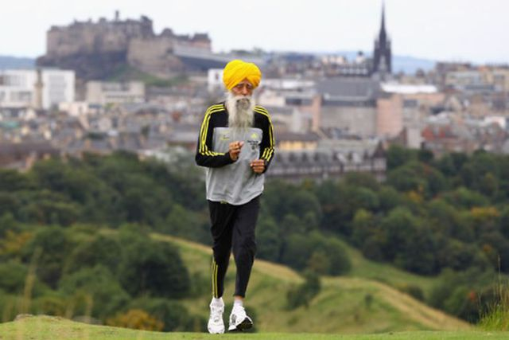
Effects of Exercise
Cardiovascular
  Improved or maintained cardiac output and delivery of oxygen-rich blood to working muscle
    Increased SV
    Enhance diastolic LV filling
    Increased LVEDV (preload)
    Reduced LVESV

Slide 17
Effects of Exercise
Musculoskeletal
  Muscular strength and endurance is improved (up to 40-150%)
    Muscle mass increases due to increased muscle fiber size (up to 20-40%)
    Increased mitochondrial size and number within muscle cells to process oxygen and generate energy for contraction
    Enhanced muscle fiber recruitment
    Prevent bone density loss

Slide 18
Effects of Exercise
Other Benefits
    Lower prevalence and incidence of depressive symptoms, including insomnia, stress, and chronic illness
    Improved immediate and delayed memory performance

Slide 19
Effects of Exercise
Summary: Exercise is key to successful aging
  Prevents functional decline and maintains independence
  Reduces fall risk
  Improved mood and health-related quality of life
  Faster recovery after hospitalization and elective surgery
  Cardiovascular risk factor reduction
http://web.squ.edu.om/med-Lib/MED_CD/E_CDs/anesthesia/site/content/figures/4061F01.gif

Slide 20
Specific Effects of Exercise on Disease
Diabetes
  Exercise improves insulin sensitivity
  Primary prevention demonstrated
Osteoporosis
  Stabilization or increased bone density in pre- and postmenopausal women with resistive or weight-bearing exercise
  1-2% per year difference from controls

Slide 21
Specific Effects of Exercise on Disease
Dyslipidemia
  Not a lot of data in elderly
  No clear primary and secondary prevention data
  Exercise associated with less atherogenic profiles
  Duration and frequency factors
  Weight loss (or fat loss) associated with increased HDL
  Gender differences with training: less training effect on HDL in women

Slide 22
Specific Effects of Exercise on Disease
Hypertension
  Most trials cross sectional and cohort
  Lower pressures in active individuals
    5-10 mm Hg
    Type and intensity
  Greater training effect in those with mild to moderate hypertension
    6-7 mm Hg drop in systolic and diastolic pressure
    Effect present in low-to-moderate exercise

Slide 23
Specific Effects of Exercise on Disease
Peripheral Vascular Disease
  Reduced claudication pain
  Greater walking distance
  Improved functional endpoints
Coronary Artery Disease
  Benefits in select patients
Arthritis
  Improved functional status
  Faster gait
  Lower depression
  Less pain
  Less medication use
  Strength and endurance training benefit

Slide 24
Effects of Exercise: Evidence
28 subjects compared to 20 age-matched controls
Healthy men and women, 70-83 years old
1 year commitment to exercise program
  2 supervised exercise classes per week, focused on strength training at 60% of 1 RM
  1 home exercise routine per week, using therabands
Significant gains were made in both muscle function and functional abilities, as well as daily habitual activity
Capodaglio P, Edda MC, Facioli M, Saibene F. Long-term strength training for community-dwelling people over 75: impact on muscle function, functional ability, and life style. Eur J Appl Physiol. 2007;100:535-542.

Slide 25
Effects of Exercise: Evidence
Health, Aging, and Body Composition Study
  3,075 black & white men & women, aged 70-79
  Classified according to amount of activity
    Inactive
    Lifestyle active (physically active throughout day)
    Exerciser
  Found exercising adults (those performing 20-30 min of mod-intensity exercise most days of the week) had better physical function than inactive adults or lifestyle-active adults
    Though the active adults had protection against decline in functional limitations, only the exercising adults demonstrated an improvement in functional capacity
Brach JS, Simonsick EM, Kritchevsky S, Yaffe K, Newman AB. The association between physical function and lifestyle activity and exercise in the health, aging and body composition study. J Am Geriatr Soc. 2004;52(4):502-509.

Slide 26
Effects of Exercise: Evidence
Health, Aging, and Body Composition Study
  3,075 black & white men & women, aged 70-79 followed for 4.5yrs
  Classified according to amount of activity
    Inactive
    Lifestyle active (physically active throughout day)
    Exerciser
Reaffirmed the role of activity and exercise in preventing functional limitation, in addition to preventing the onset of mobility limitation (2x greater risk of mobility limitation)
Among inactive and active, but non-exercisers, absence of walking increased risk of mobility limitation
Rubin SM et al. Type and Intensity of Activity and Risk of Mobility Limitation: The Mediating Role of Muscle Parameters. J Am Geriatr Soc 53:762–770, 2005.

Slide 27
Effects of Exercise: Evidence
307 inactive 65 year-old males and females
Randomized to DVD-based home exercise program or control
  Intervention included a progressive exercise sessions focusing on balance, strength, and flexibility 3x/wk for 6 months
Intervention group demonstrated significant improvements in balance, gait speed, and lower extremity strength
McAuley E et al. Effects of a DVD-Delivered Exercise Intervention on Physical Function in Older Adults: J Gerontol A Biol Sci Med Sci. 2013 September;68(9):1076–1082.

Slide 28
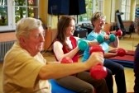
Readiness to Exercise
Contraindications
Risk Factors
  Orthopedic, Cardiovascular
Exercise Stress Testing
Can I Exercise?
  Musculoskeletal Problems, Fall Risk

Slide 29
Readiness to Exercise: Contraindications
Relative
Absolute
Acute illness
Undiagnosed chest pain
Uncontrolled diabetes
Uncontrolled hypertension
Uncontrolled asthma
Uncontrolled CHF
Musculoskeletal problems
Weight loss and falls
Inoperable Aortic Aneurysm
Cerebral aneurysm
Malignant ventricular arrhythmia
Critical aortic stenosis
End-stage CHF
Terminal illness
Behavioral problems

Slide 30
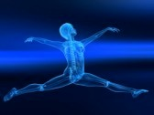
Readiness to Exercise
For everyone else…
  What does the patient want?
  What does the patient need?
  What are the patient’s orthopedic risk factors?
  What are the patient’s cardiac risk factors?

Slide 31
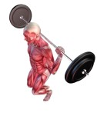
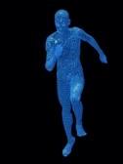
Readiness to Exercise:
Orthopedic Risk Factors
Susceptible to injury
High intensity resistance
High impact aerobics

Slide 32
Readiness to Exercise:
Cardiac Risk Factors
Non-modifiable
  Age (men>55, women>65)
  Gender (male)
  Family History
Modifiable
  Smoking
  Hypertension
  High cholesterol
  Physical inactivity
  Diabetes Mellitus
  Obesity
  Stress

Slide 33
Readiness to Exercise:
The American Heart Association recommends that asymptomatic older individuals with 1 or more risk factors, prior to starting a vigorous exercise program, notify their physician who might consider stress testing
ACC/AHA 2002 Guideline Update for Exercise Testing. American
College of Cardiology and American Heart Association Practice
Guideline

Slide 34
Readiness to Exercise:
Exercise Stress Test
High risk individual
Generally no indication for individual planning mild to moderate exercise

Slide 35

Readiness to Exercise
Consider other impairments
  Vision
  Hearing
  Adaptive devices
  Environmental issues

Slide 36
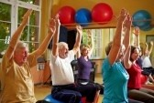
Readiness to Exercise: Can I Exercise?
Exercise appropriate in frail elderly
Exercise appropriate with co-morbidities
Exercise appropriate in functional impairment and disability

Slide 37
Can I Exercise with Musculoskeletal Problems?
Low Back Pain: type of exercise should accommodate your pain (e.g. flexed/bent positions such as a recumbent bicycle for spinal stenosis)
Osteoarthritis: accommodate pain with type of exercise; use caution with joint deformity
Rheumatoid Arthritis: accommodate pain; not during flare-ups; risk for cardiovascular disease

Slide 38
Can I Exercise if I am at Risk for Falling?
Use an appropriate assistive device and/or have assistance for a walking program
Select smooth, indoor surfaces (e.g. shopping mall)
Have an option for sitting when you get tired
May consider seated exercise (recumbent stepper, recumbent bike)

Slide 39
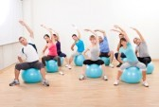
Exercise Guidelines
What is exercise?
How do I exercise?
Borg Dyspnea Scale
Getting Started
Modes of Exercise
Evidence
Other considerations

Slide 40
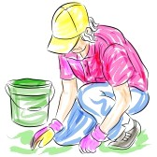
Exercise Guidelines: What Is Exercise?
Lifestyle choices
Organized sports
Unstructured play
Household and occupational tasks

Slide 41
Exercise Guidelines:
How Do I Exercise?
F.I.T.T.
  Frequency: 3-5 days per week; the lower the intensity, the greater the frequency
  Intensity: moderately vigorous=breaking a sweat, raising your heart rate, but still being able to carry-on a conversation; perceived exertion < 3
  Time: 20-30 minutes; the lower the intensity, the longer the time
  Type: walking, recumbent bicycle, swimming etc

Slide 42
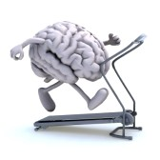
Exercise Guidelines:
How Do I Exercise?
Duration
  30 minutes
Frequency
  Most days
Intensity
  Borg Scale 12-14
  55-75% of maximal heart rate

Slide 43
Exercise Guidelines:
Borg Dyspnea Scale
0 Nothing at all
.5 very, very slight (just noticeable)
1 very slight
2 slight (light)
3 moderate
4 somewhat severe
5 severe (heavy)
6
7 very severe
8
9
10 very, very severe (almost max)
Borg, G.A.V. Psychophysical bases of perceived exertion. Medicine and Science in Sports and Exercise 1982;14(5):377-381.

Slide 44
Exercise Guidelines: Getting Started
ACSM Exercise Guidelines for Healthy Aerobic Activity
  Exercise 3-5 days each week
  Warm up 5-10 minutes before aerobic activity
  Maintain intensity for 30-45 minutes
  Gradually decrease intensity of workout, then stretch to cool down during last 5-10 minutes
  If weight loss is goal, 30 minutes, 5 days a week

Slide 45
Exercise Guidelines: Getting Started
Most likely you will need to start with interval training: short periods of exercise (2-10 minutes) that total 15-20 minutes. Then start working toward longer intervals
Start with low intensity. You should feel like you are working a little, but your breathing should be comfortable.

Slide 46
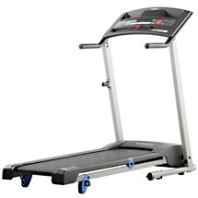
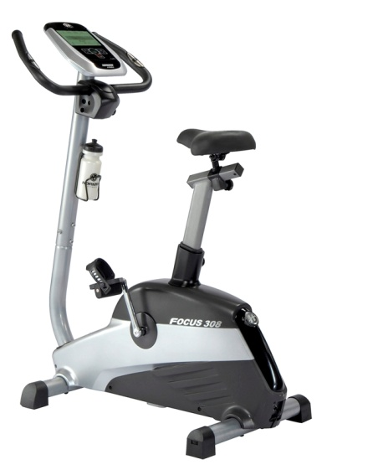
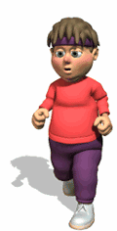
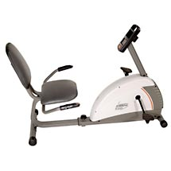
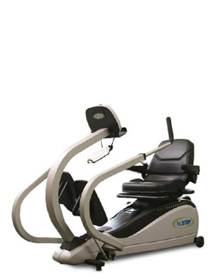

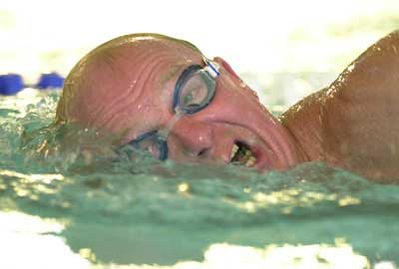
Exercise Guidelines:
Getting Started

Slide 47
Exercise Guidelines:
Getting Started
Discuss your cardiovascular risk factors and your medical history with your physician or other health professional prior to starting an exercise program
It would help to receive instruction and vital sign monitoring from a health professional initially to individualize your program
    Physical therapist
    Nurses, respiratory therapists, and exercise physiologists involved with cardiac and pulmonary rehabilitation

Slide 48
Exercise Guidelines: Modes of Exercise
General Activities
Aerobic
  Walking
  Sports
Resistance
  Supervision/technique
  Benefit with one set
Flexibility
  Static stretch
Balance
  Risk assessment
  Dynamic and static balance

Slide 49
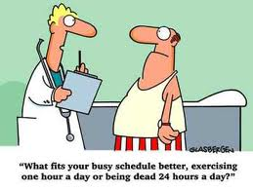
Exercise Guidelines:
Evidence
Requires lifestyle alteration
Training programs, especially for elderly women, need to focus on longer duration programs to alter strength
All gains can be lost if exercise program is stopped

Slide 50
Exercise Guidelines:
Considerations for Elderly Women
Set physical activity targets for particular groups who are at a higher risk of a sedentary lifestyle
Plan facilities, schedules, and other aspects of the social and physical environment to minimize potential barriers to increased participation
Encourage women in their middle years to become and remain highly active. This offers long term protection against osteoporosis and cardiovascular disease and can significantly reduce the national health care bill for older adults
Target older women, especially those who live alone as a result of widowhood, divorce, or separation. Women may live longer than men but they experience more limitations
Consider low cost and accessible physical activity opportunities and facilities for those with lower income and educational brackets

Slide 51
Exercise Guidelines:
Keep it Fun
Exercise in groups or with a partner
Pick an activity you enjoy
Watch TV or listen to music while you exercise
Change it up: e.g. walking in summer, recumbent bike in the winter
Set specific goals for yourself
Ask friends and family to hold you accountable to your plan

Slide 52
Exercise Guidelines:
Other Considerations
Stay active. Inactivity should be your nemesis!!
Try not to exercise alone
Avoid high temperature and high humidity
Drink plenty of fluids
Follow your physician’s directions about how to manage your chronic diseases, including proper use of medications

Slide 53
Resources
Degens H, Korhonen MT. Factors contributing to the variability in ageing. Maturitas 73: 197– 201, 2012
Visser M, Schaap LA. Consequences of sarcopenia. Clin Geriatr Med 27:387-399, 2011.
Clark BC, Manini TM. Functional consequences of sarcopenia and dynapenia in the elderly. Curr Opin Clin Nutr Metab Care 13(3): 271–276, 2010.
Capodaglio P, Edda MC, Facioli M, Saibene F. Long-term strength training for community-dwelling people over 75: Impact on muscle function, functional ability, and life style. Eur J Appl Physiol 100: 535–542, 2007
Visser M, Kritchevesky SB, Goodpaster BH, et al. Leg muscle mass and composition in relation to lower extremity performance in men and women aged 70 to 79: The Health, Aging and Body Composition Study. J Am Geriatr Soc 50:897–904, 2002.
Brach JS, Simonisck EM, Kritchevesky S, et al. The association between physical function and lifestyle activity and exercise in the Health, Aging and Body Composition Study. J Am Geriatr Soc 52:502–509, 2004.
Visser M, Simonsick EM, Colbert LH, et al. Type and intensity of activity and risk of mobility limitation:The mediating role of muscle parameters. J Am Geriatr Soc 53:762–770, 2005.

Slide 54
Questions or Comments?u

