Slide 1

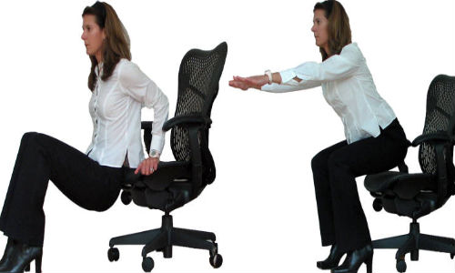
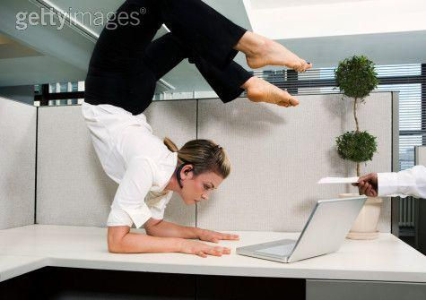
The More You Move…
The More You Live!
Or… a little movement does a lot,
benefits of interrupting your day
Steve Glass, Ph.D.,FACSM
Lindsey DesArmo, MPA, CPT

Slide 2


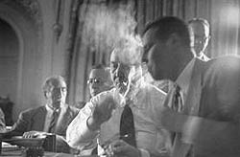

Is this a healthy situation?
Inactivity and Smoking carry equal risk!!

Slide 3

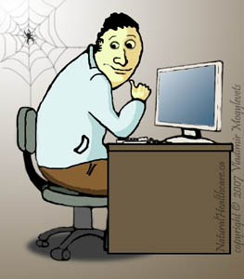

We tend to live sedentary lives
We live in a busy, stress-filled world
Much of our work is done sitting
Leisure activity or no activity.. Little exercise

Slide 4

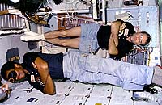
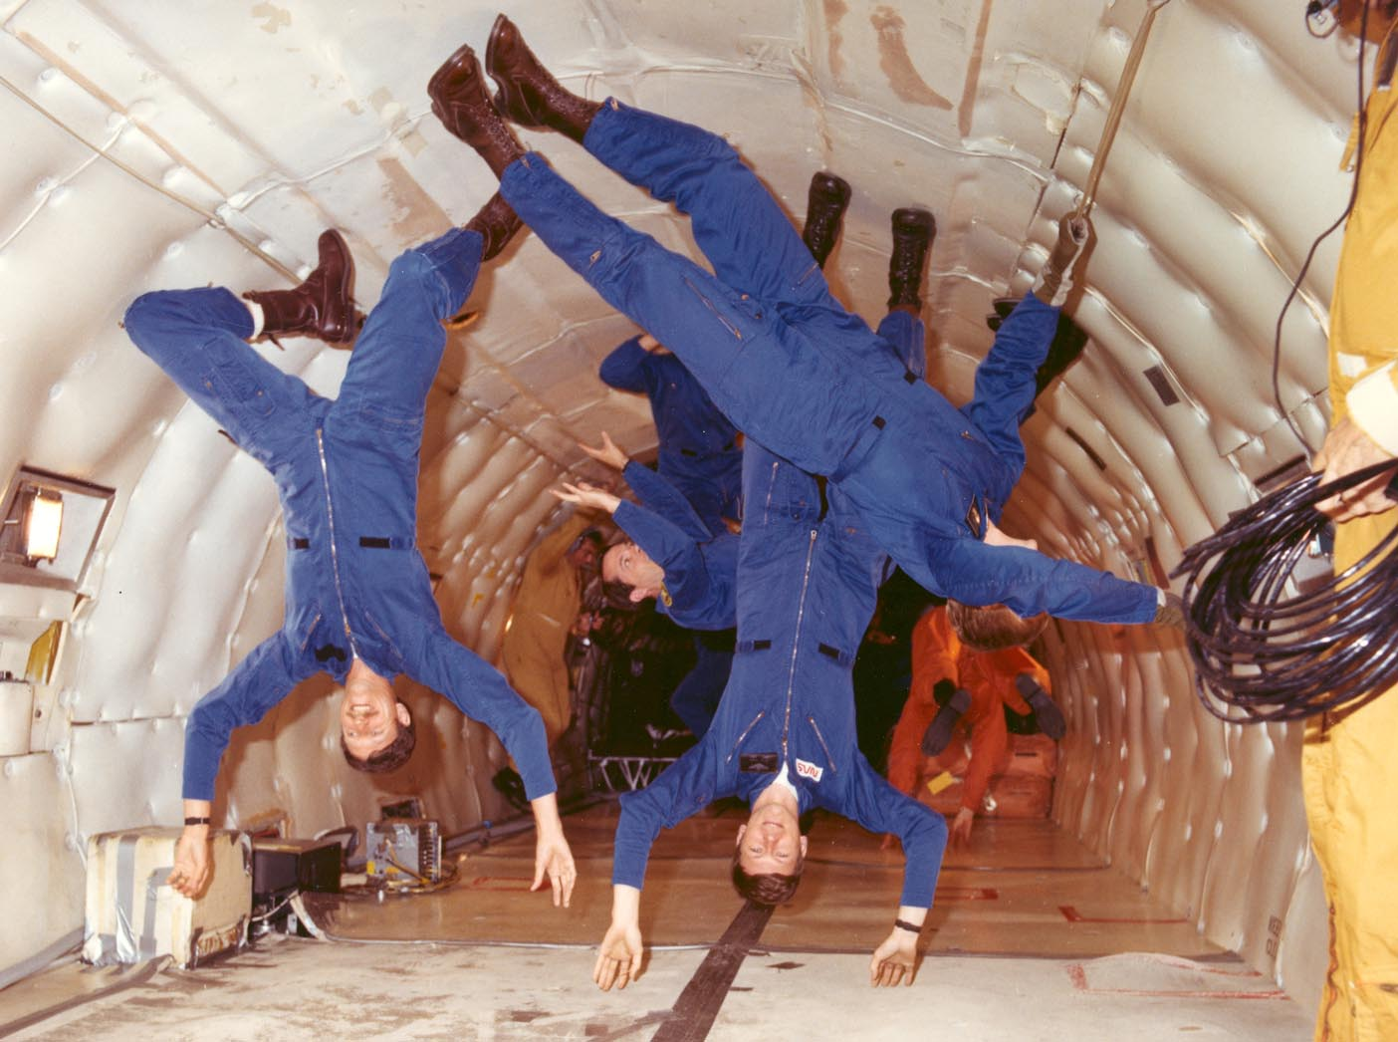
The Human Body Does NOT Like it!
30 days in space results in large drops in muscle mass, bone density, blood volume, heart size….
Gravity is our friend!

Slide 5

Is Aging.. Aging? Or maybe ….
Aging
  Loss of Aerobic Fitness
  Loss of bone
  Muscle loss
  Balance problems
  Immune system decline
  Blood vessel control loss (dizziness)
Bed rest-Space Flight
Everything you see on the left
In 30 -120 days

Slide 6
Green is Good!
Active
Fitness
Inactive
10 20 30 40 50 60 70 80 90
Age (y)

Slide 7
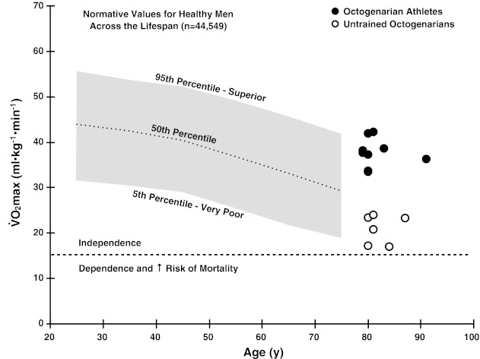
Stay Moving… stay fit
J Appl Physiol (1985). 2013 January 1; 114(1): 3–10.

Slide 8
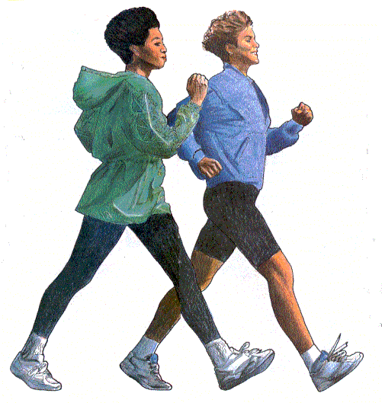

Level 3= walking 3-5 days per week!
Well, mostly cancer, and heart disease
Death Due
to All causes
1 2 3 4 5

Slide 9
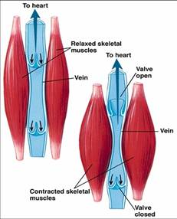
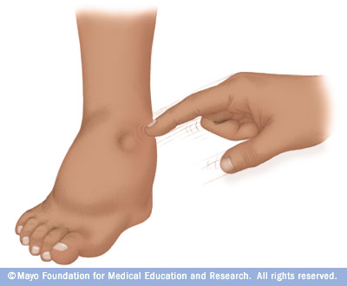
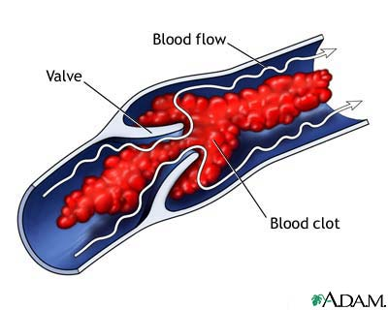
Blood Vessels Like Movement
Prolonged sitting reduced the ability of a blood vessel to expand and contract.
This can happen in as little as 2 hours!
Blood can pool.
Tissue Edema
Vein Pain!
Muscle contractions pump blood through veins
Moving blood will not clot as easily

Slide 10
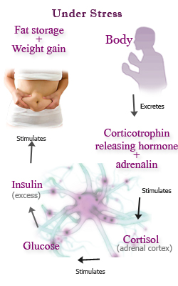

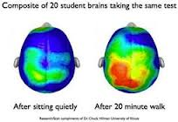

Your Brain Likes Movement!
Improved cognitive function
Exercise Reduces the Stress Response
Improved Mood

Slide 11
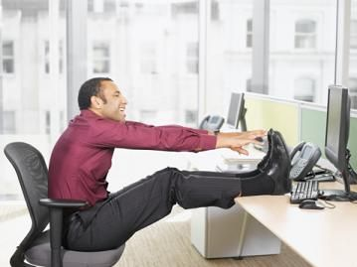
Sold! Exercise is Good
(so what do I do?)
How often?
How much?
What crazy activity is this
guy going to tell me to do?
I work for a living! When can I do this!!!?!

Slide 12
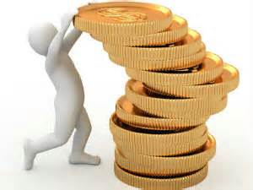
The Ideal goal: 30 minutes per day
Accumulate!
Large Muscle Groups, Aerobic Exercise
Strengthening Exercises for Major Muscles
Where is the bathroom? Try the next floor up!
Even 10 minutes helps!
Do you take a 15 min break in the morning?
Who does errands that involve walking… you?

Slide 13
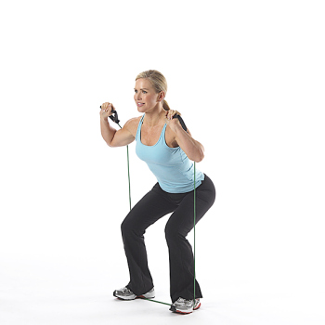
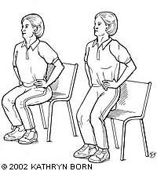
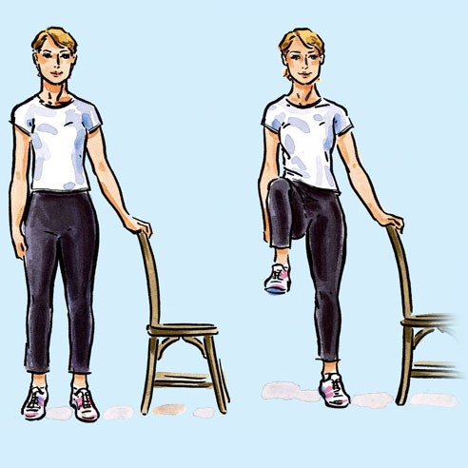
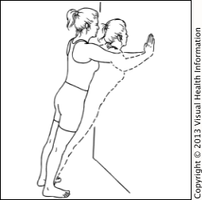

Just Move!

Slide 14
Let’s begin with a question:
What is your physical work or home environment like? Take a few minutes to describe in as much detail as possible:
  Your location
  Items such as desks and chairs
  People, layout around you.
  Any other things you have noticed about your physical environment.
Notes:
Before we get moving, think about a physical space you are in for most of your day. Is it set up to support a healthy lifestyle? What is in place to support you?
-Examples of policies-Standing desks, exercise release time, signage and walking paths, stairs,

Slide 15

No equipment necessary!
Stair climbing
Quadriceps extension
Stand up and reach
Wall push ups/desk push ups
Arm workout-over under, alternate, bounce the ball
Triceps dips
Notes:
12-15 each, repeat 2-3 times if only one exercise or one set of 15 and run through entire set

Slide 16

Resistance Tubing: your new best friend
Chest Press
Reverse Fly
Overhead Triceps Extension
Biceps Curl
Inner and outer thigh exercises
Side Crunch
Notes:
One run through at 15 each

Slide 17
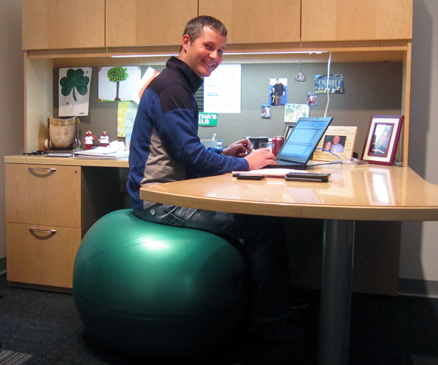
Working on the ball
Sitting
Sitting with quadriceps extension
Wall squats and squat variations
Chest squeeze
Lat Pull down
Abdominal crunch

Slide 18


Who needs expensive gym equipment?
Everyday items to use in your workout at home or the office:
  Ideas? Write down 5 items from your own home or office you can use to increase your physical activity.
Notes:
Remember your environment? Go back to that picture, what are everyday items you could use to get creative and incorporate fitness into your day. Share your five items with someone across the room.

Slide 19
Additional Tips to Increase your Activity Level: Making time for exercise
Make the most of your commute
Look for opportunities to stand
Trade your office chair for a fitness ball
Place items out of reach
Schedule a walking meeting when practical
Take the stairs whenever you can

Slide 20

Additional Tips to Increase your Activity Level: Making time for exercise
Squeeze in a few 10 minute walks
Claim the back row of the parking lot
Get up earlier
Schedule exercise appointments and reminders throughout the day.
Rethink your rituals
Make household chores count
Be active watching TV
Notes:
We just went through over 20 different exercises you can easily fit into your day.
.

Slide 21
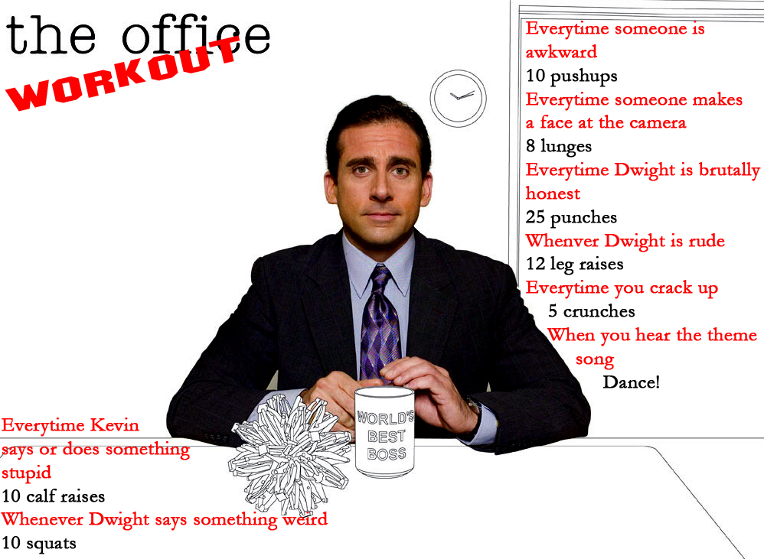

Slide 22
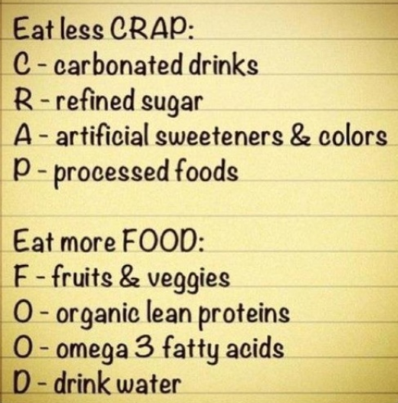
Notes:
http://pinterest.com/pin/259097784784324358/
Remember:
Just because you get in those extra steps doesn’t mean you can eat anything you want!
It is a balance between physical activity and what you are eating. Don’t negate your limited activity time!
-Woman lifting the tape dispensers had huge candy jars on her desk.
Dietary sources of omega-3 fatty acids include fish oil and certain plant and nut oils. Fish oil contains both docosahexaenoic acid (DHA) and eicosapentaenoic acid (EPA), while some nuts (such as English walnuts) and vegetable oils (such as canola, soybean, flaxseed, linseed, and olive oils) contain alpha-linolenic acid (ALA).
There is supportive evidence from multiple studies that suggests the intake of recommended amounts of DHA and EPA in the form of dietary fish or fish oil supplements lowers triglycerides; reduces the risk of death, heart attack, dangerous abnormal heart rhythms, and strokes in people with known cardiovascular disease; slows the buildup of atherosclerotic plaques ("hardening of the arteries"), and lowers blood pressure slightly. However, high doses may have harmful effects, such as an increased risk of bleeding. Although similar benefits have been proposed for alpha-linolenic acid, the scientific evidence is less compelling, and the beneficial effects may be less pronounced.
Some species of fish carry a higher risk of environmental contamination, such as with methylmercury.
Retrieved on 2.21.2013 from http://www.mayoclinic.com/health/fish-oil/NS_patient-fishoil

Slide 23
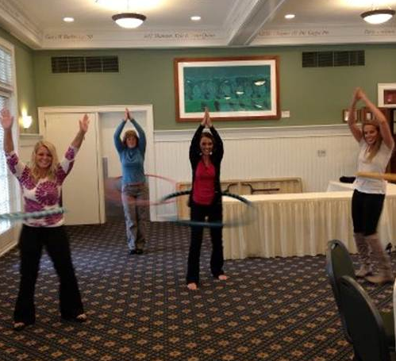
Thank you!

