Slide 1
Aging as a mindset:
How we think of age may influence how we age
Part Two:
A Discussion of the Stereotype Embodiment Theory by Levy
Presented by:
Jing Chen, PHD
Department of Psychology
Grand Valley State University

Slide 2
Positve | Negative | Neutral
accomplishment | aches | assisted walking
accumulated knowledge | acts like a "know it all" | change in sexual appetite
active | angry | devices
adrenaline junkies | bad attitued | expirence
adventure | bad with technology | funny
advice giver | bitter | glasses
altruistic | bone loss | glasses
attentive | bordem | glasses
bodies don't matter | change in eyesight | glasses
bright | confused | gray hair
calmer | cranky | gray hair
care free | cranky | grey hair
care free | crippled | grey hair
caring | cynical | grey hair
caring | cynical | grey hair
caring | cynical | grey hair
cheerful | decreased mobility | hard of hearing
child like | decreased mobility | has glasses
cliques not important | decrepid | hearing aids
close to after life | dependent | lots of medication
comfy clothes | depressing | money
considered cute | depression | no schedule
curious | depressive | reflective
cute | dieases | retirement
determined | dimentia | role model
elderly cuteness | dimentia | set in their ways
encouraging | disabled | short
enjoy life | diseases | sleep as long as you want
entertaining | diseases | slow moving
expirenced | don’t look as young | slower
expirenced | entitled | slower
expirenced | forgetful | slower
expirenced | fragile | smell spicey
expirenced | fragile | stagnant
expirenced | frail | stubborn
expirenced | gray hair | talks loud
expirenced life | gray hair | wealth
family oriented | grey hair | white hair
free time | grey hair | wrinkels
free time | grey hair | wrinkels
free time | grey hair | wrinkels
free time | grey hair | wrinkels
frugal | grey hair | wrinkels
full of life | grouchy | wrinkels
fun | grouchy | wrinkels
fun | grouchy | wrinkels
generous | grouchy
generous | grouchy
get away with anyhting | grumpy
get to spend more time with family | grumpy
giving | grumpy
giving | grumpy
good bakers | grumpy
good cooks | hair loss
good listeners | hard of hearing
good story teller | hard of hearing
grand kdis | hard to please
grand kids | health issues
grand kids | hearing aids
grand kids | hearing loss
grand kids | helplessness
grand kids | hunched
grandparents | ill
great advice | ill
great talker | illness
grey hair | impatient
happy | inactive
happy | irritable
happy | irritable
happy | irritable
healthly | irritable
historical | irritable
honorable | judge
ill filter | less active
informative | less energy
innocent | lonliness
intersting | lose touch with people
jolly | loss of bladder control
joyful | loss of hair
kids | loss of hearing
kind | loss of senses
kind | loss of vision
knowledgable | many friends begin to pass
knowledgable | mean
knowledge | mean
less stress | medical issues
life expirence | memory loss
looks don't matter | memory loss
lovable | memory loss
medicare | memory loss
medicare | memory loss
memories | mental fatigue
more assistance | mental loss
more family ties | more checkups
more help | nastolgic
more hobbies | nursing home
more knowledge | pains
more leisure time | pencling death
more respect | physical aliments
more time | physical aliments
more time with grand kids | physical body change
naps | physical loss
no obligations | physical weakness
patient | poor cognition
patient | poor eyesight
precious clothes | prone to illness
proud | racist
relaxation | receding gums
respect | sad
respectable | slow
retired | slow
retired | slow
retired | slow
retired | slow
retirement | slow
retirement | slow down
retirement | slow moving
retirement | slow moving
retirement | slow reaction time
rich | slow-minded
seasoned | slower
smart | slower memory
smiling | slower memory
snowy | slower movement
social security | smelly
social security | smelly
social security | sore
story telling | strange style
story telling | stubborn
story telling | stubborn
stronger family ties | stubborn
stronger family ties | stubborn
sweaters | stubborn
sweet | stubborn
understanding of world | technologically challenged
vacation | tired
well-traveled | unmotivated
wisdom | vision/hearing loss
wisdom | vision/hearing loss
wisdom | vision/hearing loss
wisdom | vision/hearing loss
wisdom | weaker body
wise | weaker body
wise | weaker body
wise | weaker body
wise | white hair
wise | wrinkeled
wise | wrinkels
wise | wrinkled
wise | wrinkled
wise | wrinkled
wise | wrinkled
wise | wrinkles
wise | wrinkles
wise | wrinkles
wise | wrinkles
wise | wrinkley
wiser | wrinkly
wiser | wrinkly
wiser | wrinles
wisom
About Age Stereotypes:
How do GVSU students think about older adults?
Surveyed the students who were taking an aging class (N=50):
Positives adjectives: 161 words
Negative adjectives: 160 words
Neutral: 46 words

Slide 3
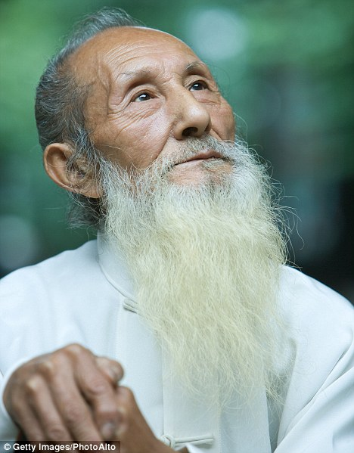
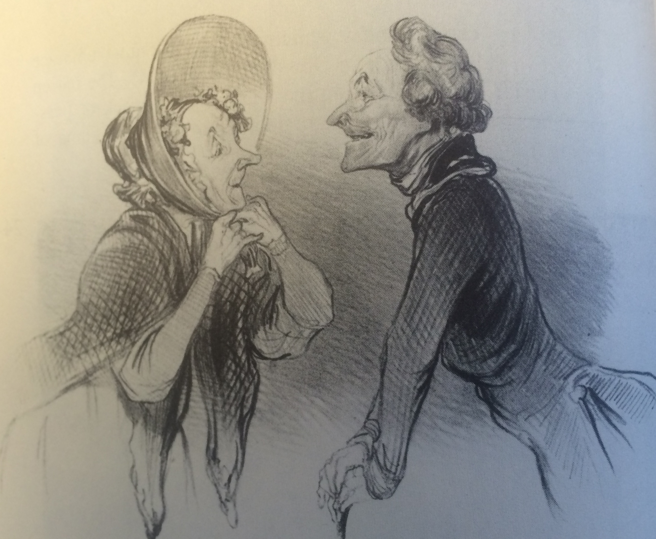
The Positives
Wisdom or wise (23 times)
Experienced (9 times) and knowledgeable (4 times),
Family-oriented (grand children),
Care free (cliques not important, comfy clothes, body does not matter, look does not matter),
Generous and caring
French artist: Daumier – Always Joyful, 1864

Slide 4
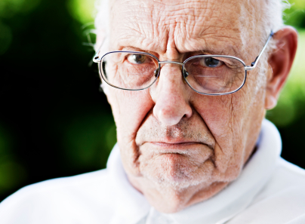
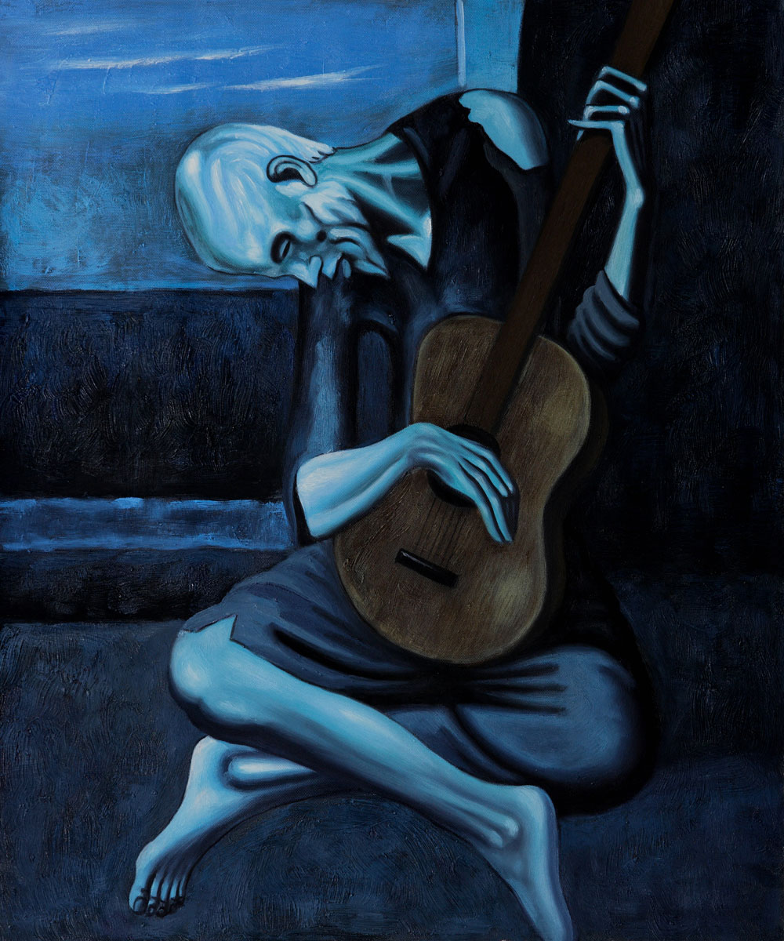
The Negatives
Grumpy and irritable (23 times)
Stubborn
Slow (15 times)
Memory loss
Dementia
Frail and disabled
Illnesses
Hearing loss and poor eyesight
Strange style
Smelly
Technically challenged
Racist
Picasso - The old guitarist, 1903

Slide 5
The Stereotype Embodiment Theory:
A Psychosocial Approach to Aging
Levy, 2009
Stereotypes are embodied
Assimilated from the culture → Self-definitions →
Influence cognitive and physical functions

Slide 6
There are four components in Levy’s theory (Levy, 2009):
Age stereotypes become internalized across the life span
It can operate unconsciously
It gains self-relevance
It utilizes multiple pathways

Slide 7
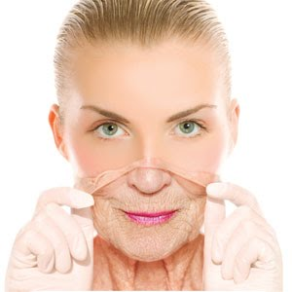
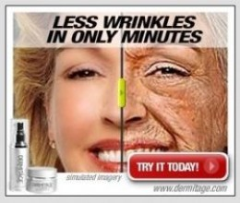
1. Internalization of age stereotypes across the life span
Levy, 2009
Children were exposed to age stereotypes through a variety of ways
Young adults more susceptible to negative age stereotypes because they are not directed to them and feel no need to defend them.

Slide 8
2. Age stereotypes can operate subconsciously
Levy, 2009
Pre-Memory
Test
Post-
Memory
Test
Priming:
Perception without Awareness
Levy, 1996

Slide 9
Levy, 1996
Negative age-related primes:
Alzheimer's
Decline
Dependent
Senile
Misplaces
Dementia
Dying
Forgets
Confused
Decrepit
Incompetent
Diseased
Positive age-related primes:
Guidance
wise
Alert
Sage
Accomplished
Learned
Improving
Advise
Creative
Enlightened
Insightful
Astute

Slide 10
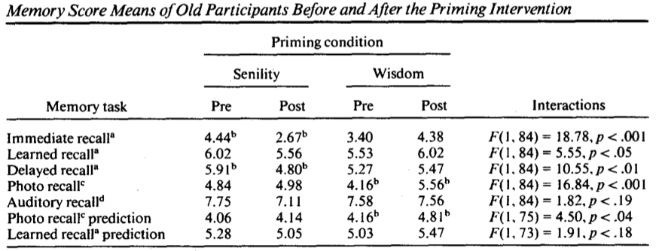
Immediate Recall
Levy, 1996

Slide 11
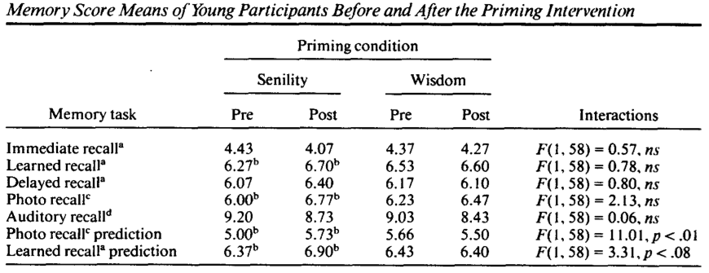
Immediate Recall
Levy, 1996

Slide 12
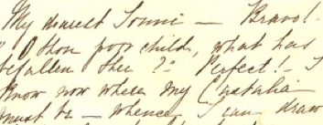
Hand-writing and age stereotypes – Levy, 2000
Hand-writing samples were collected before and after subliminal exposures to either positive or negative age stereotypes.
Hand-writing samples are judged on six attributes: accomplished, confident, deteriorating, senile, shaky, and wise.
Judges were able to distinguish what kind of stereotypes the writers were subjected to.

Slide 13

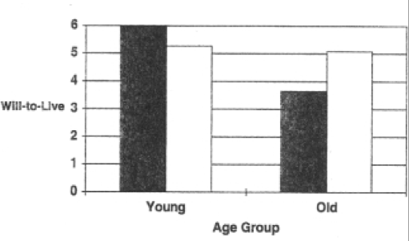
3. Age stereotypes become self-relevant with time
Levy, 2009
We all become “old” at some point of our lives.
Subjective onset of old age may make age stereotypes become self-relevant (Levy, Ashman, & Dror, 2000).
We may not be prepared to resist the negative age stereotypes.
Levy, Ashman, & Dror, 2000
Levy, 1996

Slide 14
4. Age stereotypes can influence us through psychological, behavioral, and physiological pathways Levy, 2009
The psychological pathway – Self fulfilling prophecies
The behavioral pathway – Healthy practices
The Physiological Pathway – Responses to Stress

Slide 15
The psychological pathway – Self fulfilling prophecies
Levy & Leifheit-Limson, 2009
Subliminally present older adults with four different primes:
48 age-stereotype words:
Positive-Cognitive: Sage, Alert
Negative-Cognitive: Dementia, Confused
Positive-Physical: Fit, Hardy
Negative-Physical: Feeble, Shaky

Slide 16
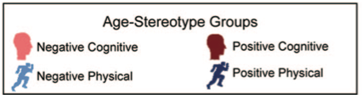
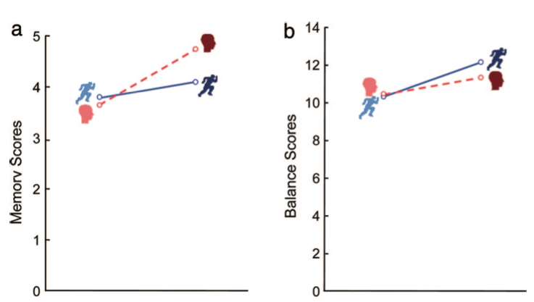
Positive
Positive
Negative
Negative
Levy & Leifheit-Limson, 2009

Slide 17
The behavioral pathway – Healthy practices
Levy & Myers, 2004
The Ohio Longitudinal Study of Aging and Retirement: 1975-1998
N = 241 participants, Age 50 and older in 1975
Baseline measure of aging self-perceptions:
Things keep getter worse as I get older
I have as much pep as I did last year
As you get older, you are less useful
As I get older, things are as I thought they would be.
Outcomes - Preventive health behavior:
Physical examines
Balanced diet
Weight control
Seatbelt use
Exercises
Alcohol consumption
Smoking
Follow medication directions

Slide 18
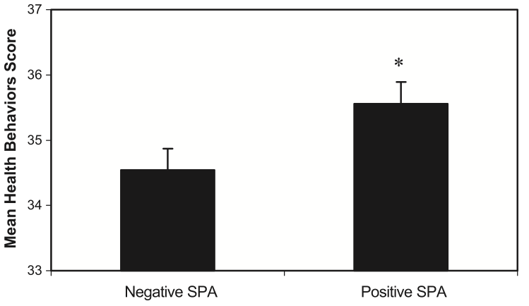
Self perception of Aging and Preventive Health Behaviors:
Levy & Myers, 2004
Controlled for age, education, functional health, gender, race, and self-rated Health.

Slide 19
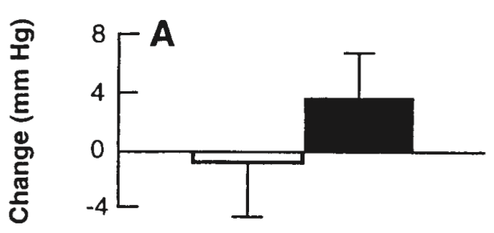
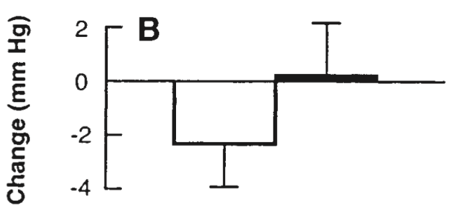

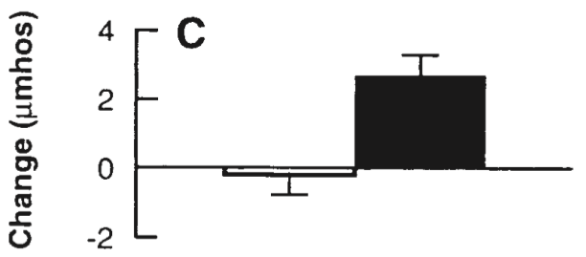
The Physiological Pathway – Responses to Stress
Levy, Hausdorff, Hencke, & Wei, 2000
After subliminally subjected to positive and negative age stereotypes
Systolic Blood Pressure
Diastolic Blood Pressure
Skin Conductance

Slide 20
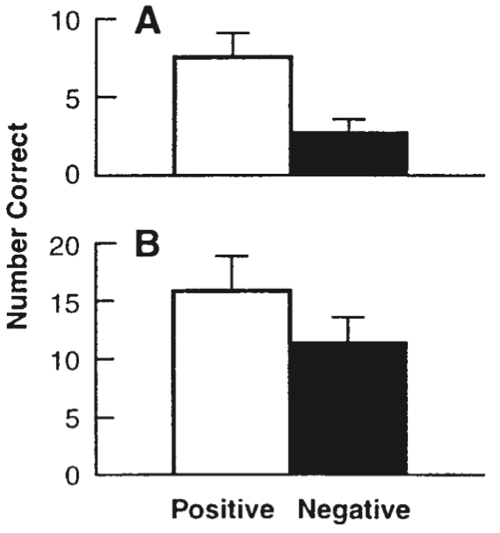
Mathematical Self-efficacy
Mathematical Performance
Levy, Hausdorff, Hencke, & Wei, 2000

Slide 21
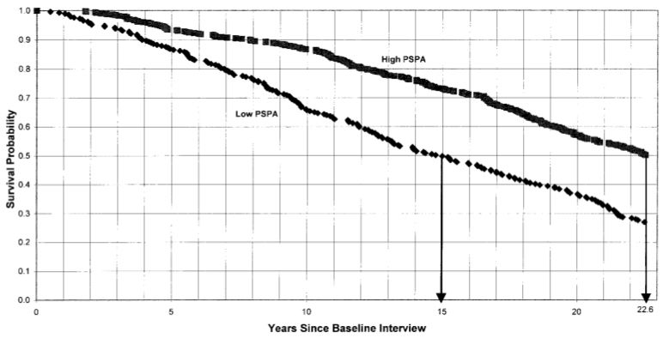
Longevity and Self-Perceptions of Aging
Levy, Martin, Slade, Kunkel, & Kasl, 2002
The Ohio Longitudinal Study of Aging and Retirement, 1975-98
Self-perceptions of aging measured up to 23 years earlier
People with more positive self-perceptions of aging lived 7.5 years longer
Covariates are controlled: age, gender, SES, and functional health

Slide 22
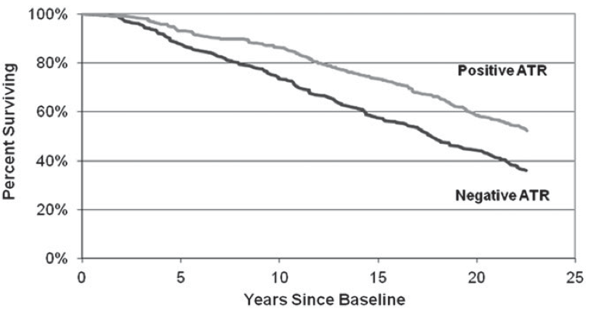
Attitude Toward Retirement and Longevity
Lakra, Ng, & Levy, 2012
The Ohio Longitudinal Study of Aging and Retirement, 1975-98
Attitudes toward retirement measured up to 23 years earlier
People with more positive ATR at the start lived 4.9 years longer
Covariates are controlled: age, gender, marital status, race, employment status, SES, and functional health.

Slide 23
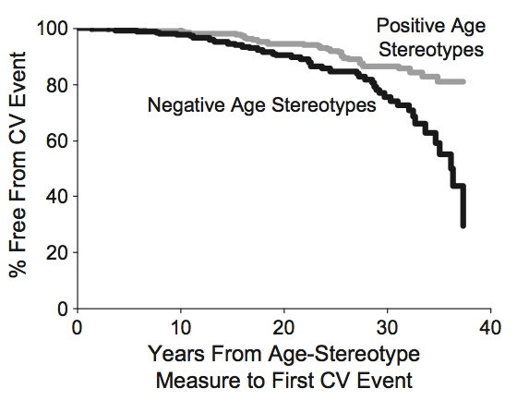
Negative Age-Stereotypes and the First Cardiovascular Event
Levy, Zonderman, Martin, Slade, & Ferrucci, 2009
The Baltimore Longitudinal Study of Aging
People who had more negative age stereotypes were more likely to experience first cardiovascular event in the next 38 years.
Covariates are controlled: age, depression, BMI, elevated blood pressure, family history of cardiovascular death, education, marital status, number of chronic conditions, race, self-rated health, serum total cholesterol, and smoking history.

Slide 24
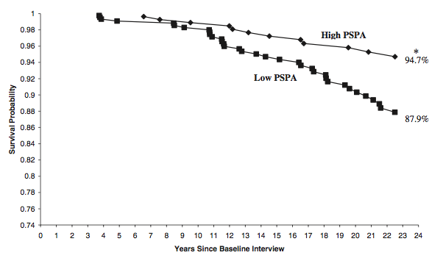
Self-Perception of Aging and Respiratory Mortality
Levy & Myers, 2005
The Ohio Longitudinal Study of Aging and Retirement, 1975-98
Higher baseline positive self-perceptions of aging were significantly less likely to die of respiratory causes over the next 23 year.
Covariates are controlled: age, gender, marital status, functional health, SES, loneliness, and self-rated health.

Slide 25
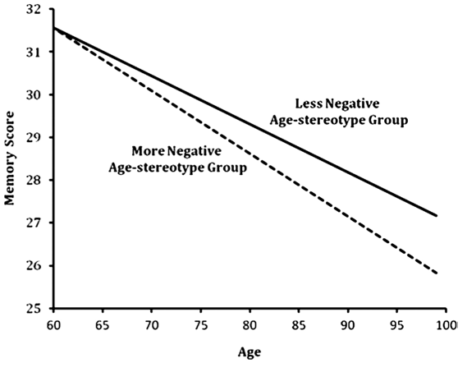
Memory Decline and Negative Age-Stereotypes
Levy, Zonderman, Martin, Slade, & Ferrucci, 2011
The Baltimore Longitudinal Study of Aging
Over 38 years, significant worse memory performance for people with more negative age stereotypes (30.2% greater decline).
70 years old: 3.14 years older
80 years old: 6.16 years older
90 years old: 9.18 years older
Covariates are controlled: age, depression, education, marital status, number of chronic conditions based on hospital records, race, self-rated health, and sex.

Slide 26
So far, evidence has shown that self-perceptions of age stereotypes are uniquely associated with cognitive and physical functions over time
Negative age stereotypes may have profound detrimental effects on our physical health and cognitive functions.
We have a lot of work to do to change the culture:
Here is a Facebook study…..

Slide 27

Images of Older adults in Facebook:
Levy, Chung, Bedford, & Navrazhina, 2014
Analyzed 84 Facebook sites that meet:
Have descriptions about individuals aged 60 years or old
Open membership
Not created for commercial purposes
84 groups, a total of 25,489 members
The mean age of creators and members was 20-29 (all <60)
Creators were identified as living on five continents:
51% from North America 8% from Asia and 8% from Australia
32% from Europe 1% from Africa
All descriptions were in English 65% of the creators were men

Slide 28
Results of the Facebook study:
Levy, Chung, Bedford, & Navrazhina, 2014
98.8% of the sites had negative age stereotypes:
74% - Excoriating the old
Do not contribute to modern society at all
Their single and only meaning is to nag
41% - Physical debilitation
27% - Cognitive debilitation
13% - Both physical and cognitive debilitations
37% - Advocated banning older individuals from public activities
26% - Infantilization of the old
10% - Nursing homes

Slide 29

But we got hope to change the culture!
Here is a study on Intervention…

Slide 30
Levy, Pilver, Chung, & Slade, 2014
100 older adults: age range 61-99 and mean age = 81
Implicit positive age stereotypes were given weekly for 4 weeks
Age stereotypes, self-perception of aging, and physical functions were measured at baseline and 5-8 weeks.
Covariates are controlled: age, sex, and health.

Slide 31

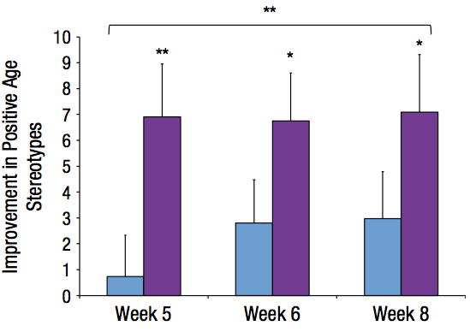
Age Stereotypes
Levy, Pilver, Chung, & Slade, 2014

Slide 32
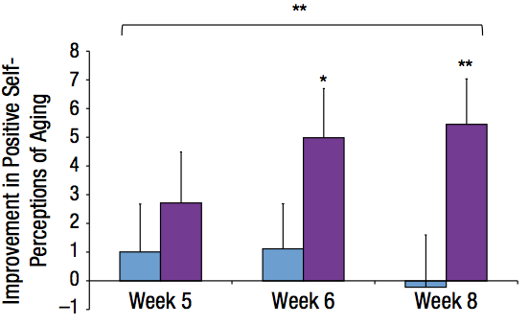
Self Perceptions of Aging
Levy, Pilver, Chung, & Slade, 2014

Slide 33
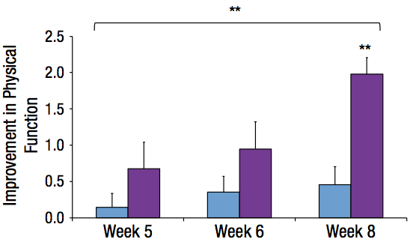
Physical Functions: Strength, Gait, and Balance
Levy, Pilver, Chung, & Slade, 2014

Slide 34
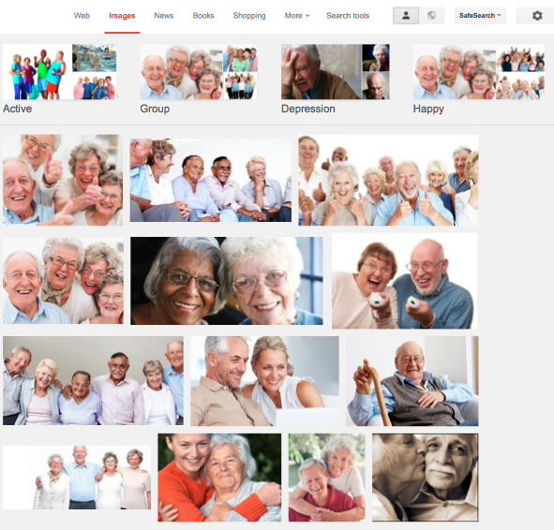
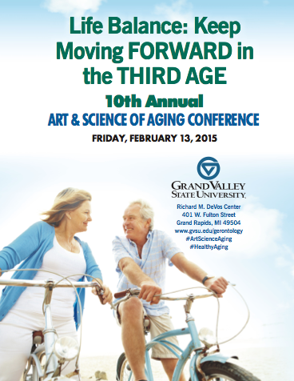
The implications:
We are creating new images of older adults

Slide 35
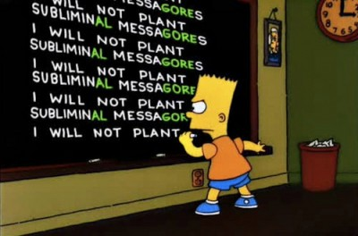
But we may need something more
subtle and subliminal
Perhaps we should….
Thank you

