Slide 1


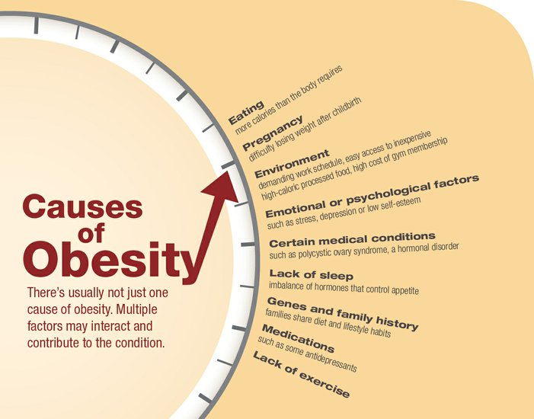
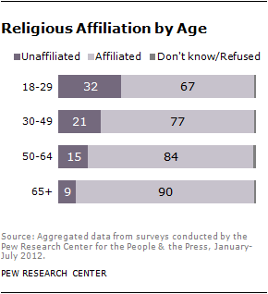
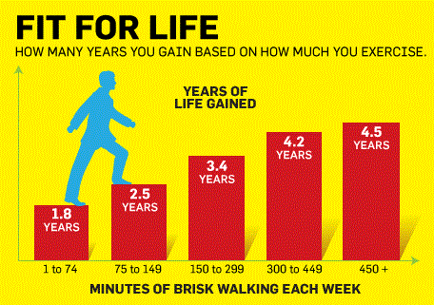
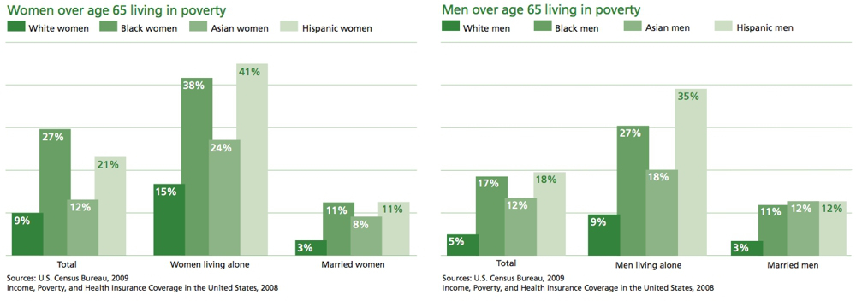
Brent K. Berson, BSW,
Joan Borst, Ph.D., LMSW
Grand Valley State University, Grand Rapids, MI
Holistically Aging: An Analysis of Vigor in Older Adulthood
“Aging is not lost youth but a new stage of opportunity and strength.” – Betty Friedan
Heart
Soul
Physical Health
Social Support
Faith
Aerobic exercise shows significant increase in both bone and muscle strength in persons over the age of 55.
Brisk walking for 75 minutes per day increases life expectancy by more than 1.5 years.
Walking builds heart muscle.
Physical exercise has been shown to combat stress and develop improved sleep patterns.
  Subsequently, correlating with a healthy well-rounded life.
Older adults who report having supports within and outside of their family lived healthier lives than their peers.
Presence or absence of a spouse is not a strong predictor of life satisfaction in older adulthood.
Research overwhelmingly suggests spirituality offers a coping and support mechanism for older adults.
Having a sense of meaning and purpose in an unseen reality is substantially linked to greater life satisfaction.
Spirituality and religiosity acts as a source of resilience for older adults
Older adults make up the largest spiritual cohort of any age group
Religiosity continually instills hope and reduces stress
Nourishment
Resources
References
Both quality and quantity of food is linked to healthy longevity in individuals.
Diet, along with exercise, is recognized as one of the largest contributor s to decreasing health defects in older adults.
However, individuals over the age of 55 make up the largest percentage of obesity in North America.
In late adulthood those who live in a household where the income exceeds $50,000 have a significantly lower chance of mortality than those with lower incomes.
Educational and advocacy programs such as The Older Americans Act, continually assist older adults.
Extreme stress is the largest risk factor for older adults in poverty.
Carr, D. (2010). Golden years? poverty among older americans. Retrieved from http:// contexts.org/articles/winter-2010/golden-years-poverty-among-older- americans/
Faigin, C. A., & Pargament, K. I. (2011). Strengthened by the spirit: Religion, spirituality, and resilience through adulthood and aging. In Resilience in Aging (pp. 163-180). Springer New York.
Fried, L. P., Kronmal, R. A., Newman, A. B., Bild, D. E., Mittelmark, M. B., Polak, J. F., & Gardin, J. M. (1998). Risk factors for 5-year mortality in older adults. JAMA: the journal of the American Medical Association, 279(8), 585-592.
Lawler-Row, K. A., & Elliott, J. (2009). The role of religious activity and spirituality in the health and well-being of older adults. Journal of Health Psychology, 14(1), 43-52.
Manley, H., & Miller , M. (2013, October 10). America’s battle against obesity. Retrieved from http://baystatebanner.com/news/2013/oct/10/americas-battle-against- obesity/?page=2
“Nones” on the rise. (2012, October 09). Retrieved from http://www.pewforum.org/ 2012/10/09/nones-on-the-rise
Reid, K. J., Baron, K. G., Lu, B., Naylor, E., Wolfe, L., & Zee, P. C. (2010). Aerobic exercise improves self-reported sleep and quality of life in older adults with insomnia. Sleep medicine, 11(9), 934-940.
Wacker, R. R., & Roberto, K. A. (2013). Community resources for older adults: Programs and services in an era of change. SAGE Publications, Incorporated.
Wessell, R., & Edwards, C. (2012). Principles of longevity and aging: Interventions to enhance older adulthood. Journal of Educational and Developmental Psychology, 2(1), 108-121. Retrieved from http://search.proquest.com.ezproxy.gvsu.edu/docview/ 1045485296?accountid=39473
White, A. M., Philogene, G. S., Fine, L., & Sinha, S. (2009). Social support and self-reported health status of older adults in the United States. American Journal of Public Health, 99(10), 1872-1878.

