Slide 1
Movement influences cognition: So why don't we MOVE more
Meri Goehring, PT, PhD
Board Certified Geriatric Clinical Specialist
Board Certified Clinical Wound Specialist
Certified Expert in Exercise for the Aging Adult

Slide 2
Objectives
LEARNING OBJECTIVES/OUTCOMES
Upon completion of this workshop attendees will be able to:
  Understand how cognition changes with aging.
  Describe how movement can influence cognition.
  Understand the common barriers to movement encountered by older adults and how these may be overcome.

Slide 3
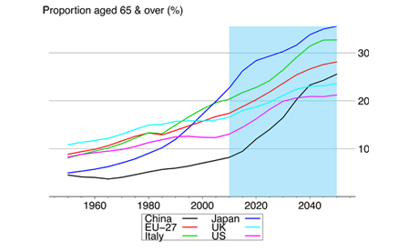
Cognition Changes and Aging

Slide 4
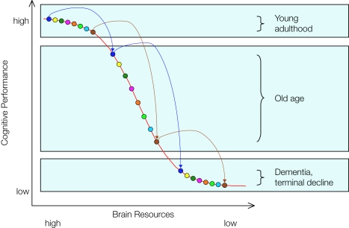
Lindenbarger et al, 2008
Notes:
Hypothesis based on genetic studies.

Slide 5
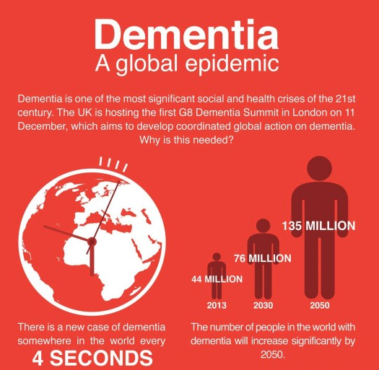

Slide 6
Larson et al, Annals of Internal Medicine, 2006
Notes:
Let’s consider physical activity and dementia risk. 1740 pe9ple over 65, self report exercise, followed for 6 years. White, all had health insurance.

Slide 7
Body and Brain Benefit from Activity
The brain consumes 20% of the bodies oxygenated blood, but is only a small part of your body
PT’s are VERY knowledgeable regarding how a physically health body is important
  Better heart/lung function
  Reduced hypertension and diabetes
  Many other effects
Exercise is medicinal – aerobic training, balance/agility training, yoga, Tai-Chi, dance
Notes:
Why did I say ‘Exercise is medicinal”, not “EXERCISE is MEDICINE?” Because, “exercise is medicine” has been copyrighted as a registered slogan by the American College of Sports Medicine. Interesting…

Slide 8
What is the BEST type of exercise?
Effects of aerobic exercise on cognitive and brain health in older adults.
Notes:
Whatever you will do!

Slide 9
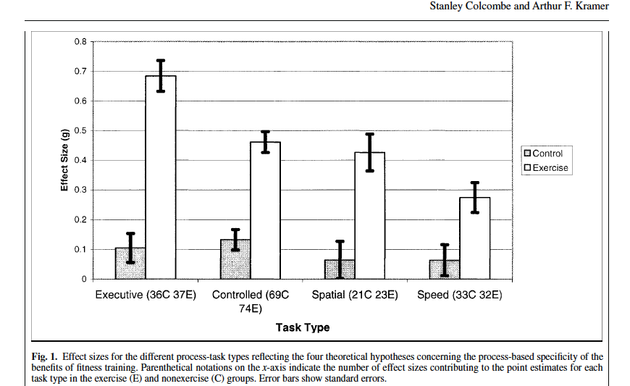
Notes:
Systematic review of 18 studies / controlled processing is learning through practice/ visual/spatial controlled processing/ processing speed

Slide 10
Colcombe and Kramer study
Exercise training positively benefits different cognitive skills
Most beneficial for executive functions like planning, decision making, multi-tasking
Studies with more women show a larger effect of training on cognition
Benefit of training is similar for both normal and cognitively impaired adult

Slide 11
Cognition and Aerobics
Another study by Colcombe et al (PNAS, 2004)
  Proceedings of National Academy of Sciences (PNAS)
  A 6 month, 3x/week walking program improved
    Cognitive performance of executive functions
    Brain function as assessed by fMRI
Erickson et al, PNAS, 2011
  A 12 month, 3x/week moderate intensity walking program improved and/or increased
    Cognitive performance of spatial memory
    Hippocampus volume by 2%
Notes:
Colcome- relatively small N (41 subjects)

Slide 12
Mild Cognitive Impairment
What is it?
A clinical state that can be transient
  Associated with an increased risk of dementia
NIH Alzheimer’s Association (NIH-AA) Criteria:
  1. Subjective memory complaints
  2. Objective cognitive impairment
  3. No significant function impairment (i.e. intact IADL)
  4. No dementia.

Slide 13
Exercise and MCI
Research shows that 150 minutes (three, 50 minute sessions each week)
Randomized controlled trial with good methodology and adequate n ( 138 participants)
In this study of adults with subjective memory impairment, a 6-month
program of physical activity provided a modest improvement in cognition over an 18-
month follow-up period.
(Lautenschlager et al, JAMA 2008)

Slide 14
Aerobic training
A 6-month, 4x per week walking program improved cognitive performance of executive functions in women
There was a reduced fasting plasma level of insulin and cortisol in all subjects
(Baker et al, Arch Neurol, 2010)
A 6 month, 2x/wk moderate intensity walking
  Improved cognitive performance of verbal and spatial memory
  Increased hippocampus volume by 4%
  (ten Brinke et al, BJSM, 2014)

Slide 15
Cochrane Review
Exercise Interventions for People with Dementia
-17 RCT’s included, 1067 participants
- Meta-analysis suggest no clear evidence of benefit for exercise on cognitive function
(low quality evidence, heterogeneous)
BUT- there was an improvement in ADL function
(Forbes et al, Cochrane Database Systems Review 2015)

Slide 16
Resistance exercise
Both 3x/wk moderate and high intensity resistance training for 6 months significantly
  Improved cognitive performance of memory (verbal and spatial) and improved executive functioning
  Increased IGF-1 (growth factors) levels in men age 65-75 years old
  (Cassihas et al, MSSE, 2007)

Slide 17
Brain power study
Aim was to assess the efficacy of resistance training on executive function
Well designed, randomized controlled trial, N=155
Certified instructors, 60 minute classes, 40 minutes of training with progressive loading based on 8 rep max, 2 sets of 8 reps
VERSUS
Balance and tone activities, 2x per week, no progressive loading

Slide 18
Brain Power study
Tested response inhibition and conflict resolution (using standardized tests of executive functioning)
Did functional and structural MRI’s
Results
  Improved executive functioning in subjects who received resistance training when compared with those received balance and tone training shown with f-MRI and standardized tests of executive functioning)
  Resistance training reduced white matter lesion progression
  Improved executive functioning in the group that received resistance training was maintained in the 2 year follow up as compared with the balance and tone training group
  Liu-Ambrose et al, 2010, 2011

Slide 19
Evidence keeps Coming
Walking ≥ 1 km per day
  Maintains brain volume and reduces the risk of cognitive impairment over 9 years
  (Erickson et al., Neurology, 2010)
  What does 1km per day mean?
  -2.5 times around a standard track
  -13 minute of walking for a healthy, older adult at a gait speed of 1.35 m/sec
  -For a frail, older adult, 26 minutes of walking at a gait speed of 0.65 m/sec

Slide 20
Intensity? Type?
Intensity should be sufficient to challenge, but not overdo (moderate intensity)
Evidence supports aerobic as well as resistance exercise
Find personal preference and ability
Balance/coordination activities are important as well
Barriers include adherence
  Clear communication, personalize, make it fun, achievable, provide feedback, supportive environment

Slide 21
Thoughts?
Starting to exercise late in life is not futile: even those who are sedentary can improve function
Those who are more frail may benefit the MOST.
(Sink et al, JAMA, 2015)

Slide 22
Barriers to Exercise- Why Interventions Fail?
Only about 20% of those with an unhealth habit are in the Action stage (ready for change)
40% are in preconteplation
40% are in contemplation
However, MOST intervention programs are geared toward people in the preparation or action stages
SO- we need to identify and work at the patient’s level of functioning
(Zimmerman et al, 2000)

Slide 23
Barriers to Exercise
BARRIERS to Physical Activity
If the patient is not engaged in physical activity, it is critical to understand why
Recommend asking:
1. ‘Is there a reason that you are not active or do not exercise?
2. ‘Are you willing to start exercising? If not, why?’
Wingood M, Billek-Sawhney B (2019) in conjunction with the Academy of Geriatric Physical Therapy, Educational Monograph, Physical Activity and Exercise: Needs and Prescription for Older Adults.

Slide 24
Benefits of Exercise
STRONG EVIDENCE
• Lower risk of early death
• Lower risk of coronary heart disease
• Lower risk of stroke
• Lower risk of hypertension
• Lower risk of adverse blood lipid profile
• Lower risk of Type II Diabetes Mellitus
• Lower risk of metabolic syndrome
• Lower risk of colon cancer*
• Lower risk of breast cancer*
• Prevention of weight gain
• Weight loss, particularly when combined with
reduced calorie intake
• Improved cardiorespiratory and muscular
fitness
• Prevention of falls
• Reduced depression
• Better cognitive function (for older adults)

Slide 25
Benefits of Exercise
MODERATE TO STRONG
EVIDENCE
• Better functional health (for older adults)
• Reduced abdominal obesity
MODERATE EVIDENCE
• Lower risk of hip fracture
• Lower risk of lung cancer
• Lower risk of endometrial cancer
• Weight maintenance after weight loss
• Increased bone density
• Improved sleep quality
BENEFITS OF EXERCISE
Office of Disease Promotion and Health Prevention
*The Physical Activities Guidelines for Americans 2nd ed,highlights 8 cancers, which have a lower risk with physicalactivity including: bladder, breast, colon, endometrium,esophagus, kidney, lung, and stomach

Slide 26
Know why
Find what motivates.
If they don’t know why, you can help them to find their why
You can’t help everyone, but you should try.
Every patient encounter is an opportunity to promote change.

Slide 27
Provide information
Exercise Slows the Aging Process: Aging muscles have trouble regenerating and have fewer and less efficient mitochondria, the energy powerhouses of our cells. But exercise, especially when it’s high intensity, increases the number and health of mitochondria — essentially helping to reverse aging at the cellular level.
People Who Exercise Are Happier: Exercise can alleviate symptoms of depression and help you better cope with stress and anxiety. Even just getting up and moving around may make you feel happier, studies show.
It May Lengthen Your Lifespan: Exercise has been linked time and time again in studies both large and small to reductions in mortality from all causes. But some of the most fascinating research comes from extensive analyses carried out at the Cooper Institute in Dallas, which show that compared with nonrunners, runners tend to live about three years longer. Every hour of running you do adds an estimated seven hours to your life expectancy. In fact studies have found that as little as five minutes of daily running is associated with longer life spans.
Exercise Improves Your Body Composition: Most people gain fat as they get older. It’s essentially inevitable. But lifting weights and following a good diet have the opposite effect: They help you put on muscle and lose fat, even if you are older than 60.
It Can Boost Your Brain Health: Studies of aerobic exercise have found that it protects your memory and helps stave off cognitive decline as we age.
Exercise Improves Your Microbiome: Studies show that exercise can drastically improve the composition of the trillions of microbes that live in the gut, which may be one reason it strengthens the immune system, fights inflammation and helps with weight control.

Slide 28
Set goals
Be very specific. Rather than setting a vague goal “to exercise more,” set a specific goal to exercise a certain number of days each week. Formulate a plan. For example, aim to exercise three days per week.
Set short-term goals. Rather than setting a goal to be able to run 10 miles within a year, set a short-term goal to run one mile in your first month. Then set another short-term goal after that — perhaps, say, to run two or three miles. Setting short-term goals, even if they are minor accomplishments, can help you stay motivated.
Emphasize “process” short-term goals over “outcome” short-term goals. If you’re new to regular exercise and your activity is walking on the treadmill, focus on a goal of increasing the amount of time you spend on the treadmill (the process) rather than reaching an outcome that is harder to control, like getting your resting heart rate down to 70 beats per minute.
Be realistic. If you have just started working out and can only do 10 pushups at one time, don’t set a goal to be able to complete a set of 50 pushups within a month. Focus on getting to a set of 20 pushups in your first month. Then work your way up first to 30, then 40 and then 50 pushups as time goes on.

Slide 29
Put it on your calendar, but have a back up plan ; helpful applications
Workout Plan helps you create custom workouts and plan your weekly fitness routine.
Fitlist lets you log your workouts and track your fitness whether you’re doing cardio, weight lifting, circuit training or other types of exercise.
Fitbod keeps track of your workouts and takes into account which muscles are sore. Then it recommends strength-building workouts for you to do and suggests rep counts and weight ranges.

Slide 30
But, some frail older adults may shun technology
AND, we tell our PT students that the best program is one YOU help them develop because YOU are the movement expert!
Help them to find something they like that includes a weight routine, aerobic routine
Find ways to help each individual control things that might get in the way., Let them know to expect setbacks. Encourage them to start off slow and build gradually. Encourage movement throughout the day.

Slide 31
1. Lindenberger U, Nagel IE, Chicherio C, Li S-C, Heekeren HR, Bäckman L. Age-Related Decline in Brain Resources Modulates Genetic Effects on Cognitive Functioning. Frontiers in Neuroscience. 2008;2(2):234-244. doi:10.3389/neuro.01.039.2008.
2. Larson, E. B., Wang, L., Bowen, J. D., McCormick, W. C., & al, e. (2006). Exercise is associated with reduced risk for incident dementia among persons 65 years of age and older. Annals of Internal Medicine, 144(2), 73-81.
3. Colcombe, Stanley J. (11/2006). Aerobic exercise training increases brain volume in aging humans.. The journals of gerontology. Series A, Biological sciences and medical sciences. (61)11. p.1166 - 1170.
4. Lautenschlager NT, Cox KL, Flicker L, Foster JK, van Bockxmeer FM, Xiao J, Greenop KR, Almeida OP. Effect of Physical Activity on Cognitive Function in Older Adults at Risk for Alzheimer DiseaseA Randomized Trial. JAMA. 2008;300(9):1027-1037. doi:10.1001/jama.300.9.1027
5. Cassilhas, Ricardo C. (08/2007). The impact of resistance exercise on the cognitive function of the elderly.. Medicine and science in sports and exercise. (39)8. p.1401 - 1407
6. Liu-Ambrose, Teresa. (05/2010). Changes in executive functions and self-efficacy are independently associated with improved usual gait speed in older women.. BMC geriatrics. (10)1. p.25.

Slide 32
7. Liu-Ambrose, Teresa. (08/2012). Resistance training and functional plasticity of the aging brain: a 12-month randomized controlled trial.. Neurobiology of aging. (33)8. p.1690 - 1698.
8 .Erickson, K I. (10/2010). Physical activity predicts gray matter volume in late adulthood: the Cardiovascular Health Study..Neurology. (75)16. p.1415 - 1422.
9. Sink, Kaycee M. (08/2015). Effect of a 24-Month Physical Activity Intervention vs Health Education on Cognitive Outcomes in Sedentary Older Adults: The LIFE Randomized Trial.. JAMA : the journal of the American Medical Association. (314)8. p.781 - 790.
10. Zheng, G., Xia, R., Zhou, W., Tao, J., & Chen, L. (2016). Aerobic exercise ameliorates cognitive function in older adults with mild cognitive impairment: A systematic review and meta-analysis of randomized controlled trials. British Journal of Sports Medicine. doi:10.1136/bjsports-2015-095699.
11. Ahlskog JE, Geda YE, Graff-Radford NR. & Petersen RC. (2011, September). Physical exercise as a preventive or disease-modifying treatment of dementia and brain aging. In Mayo Clinic Proceedings (Vol. 86, No. 9, pp. 876-884).
12. Öhman H, Savikko N, Strandberg TE., Pitkälä KH. (2014). Effect of physical exercise on cognitive performance in older adults with mild cognitive impairment or dementia: A systematic review. Dementia and Geriatric Cognitive Disorders, 38(5-6), 347-365.

Slide 33
13. Heyn P, Abreu BC, Ottenbacher KJ. (2004). The effects of exercise training on elderly persons with cognitive impairment and dementia: A meta-analysis. Arch Phys Med Rehabil,85,1694 -704.
14. Forbes D, Forbes SC, Blake CM, Thiessen, Forbes S. Exercise programs for people with dementia. Cochrane Database Syst Rev. 2015:CD006489.
doi:10.1002/14651858.CD006489.pub4.
15. Young J, Angevaren M, Rusted J et al. Aerobic exercise to improve cognitive function in older people without known cognitive impairment. Cochrane Database Syst Rev. 2015; 4:CD005381.
16. ten Brinke LF, Bolandzadeh N, Nagamatsu LS, Hsu CL, Davis JC., Miran-Khan L., Liu-Ambrose T. (2015). Aerobic exercise increases hippocampal volume in older women with probable mild cognitive impairment: A 6-month randomised controlled trial. British Journal of Sports Medicine, 49(4), 248-254.
17. Suo C, Singh MF, Gates N, Wen W, Sachdev P, Brodaty H, et al. (2016) Therapeutically relevant structural and functional mechanisms triggered by physical and cognitive exercise. Molecular Psychiatry. 2016. doi: 10.1038/mp.2016.19.
18. Nagamatsu LS, Handy TC, Hsu CL, Voss MW, Liu-Ambrose T. (2012). Resistance training promotes cognitive and functional brain plasticity in seniors with probable mild cognitive impairment. Archives of Internal Medicine, 172(8), 666-668.

Slide 34
19. Baker LD, Frank LL, Foster-Schubert K, Green PS, Wilkinson CW, McTiernan A, Duncan GE. (2010). Effects of aerobic exercise on mild cognitive impairment: A controlled trial. Archives of Neurology, 67(1), 71-79.
20. Nagamatsu LS, Chan A, Davis JC, Beattie BL, Graf P, Voss MW, Liu-Ambrose T. (2013). Physical activity improves verbal and spatial memory in older adults with probable mild cognitive impairment: A 6- month randomized controlled trial. Journal of Aging Research, 2013.
Basic Mechanisms
21. Cotman CW, Berchtold NC, Christie LA. Exercise builds brain health: Key roles of growth factor cascades and inflammation. (2007). Trends Neurosci, 30, 464-72.
22. Rockwood K, Song X, Mitnitski A, et al. A global clinical measure of fitness and frailty in elderly people. CMAJ: Canadian Medical Association Journal [serial online]. August 30, 2005;173(5):489-495. Available from: CINAHL Complete, Ipswich, MA. Accessed March 16, 2017.
23. Studenski, S., Perera, S., Wallace, D., Chandler, J. M., Duncan, P. W., Rooney, E., Fox, M. and Guralnik, J. M. (2003), Physical Performance Measures in the Clinical Setting. Journal of the American Geriatrics Society, 51: 314–322. doi:10.1046/j.1532-5415.2003.51104.x
24. Boult, C., Boult, L. B., Morishita, L., Dowd, B., Kane, R. L. and Urdangarin, C. F. (2001), A Randomized Clinical Trial of Outpatient Geriatric Evaluation and Management. Journal of the American Geriatrics Society, 49: 351–359. doi:10.1046/j.1532-5415.2001.49076.x
25. Zimmerman GL1, Olsen CG, Bosworth MF. A 'stages of change' approach to helping patients change behavior. Am Fam Physician. 2000 Mar 1;61(5):1409-16.

