Slide 1

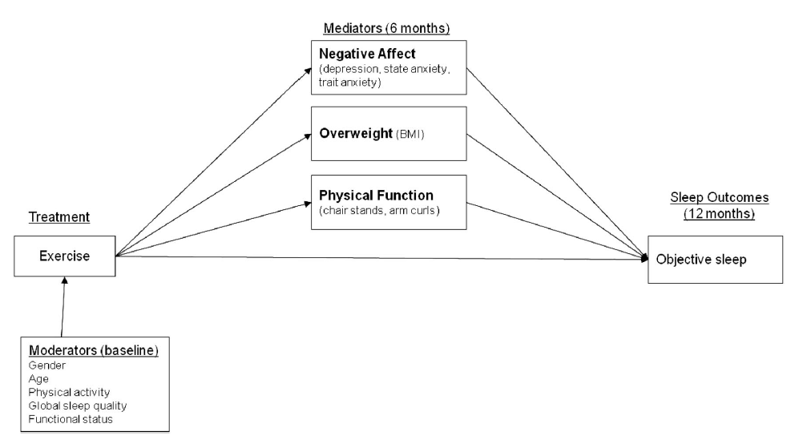
The Physical and Mental Wellness Intervention
Kristen Apol Department of Psychology Grand Valley State University apolk@mail.gvsu.edu
Introduction
Cognitive-Behavioral Therapy (CBT)
Physical and Mental Wellness (PMW) Intervention
Older adults who have just quit the work force, have their first couple of grandchildren to finally spoil, and who are just ready to relax may experience an interruption of these tasks. When picturing the average older adult, generally sleep is an activity that is paired with age. This stereotypical activity may not be as easy for some.
Over half of adults over the age of 65 have sleeping disorders or issues. Previous treatment methods such as exercise, cognitive-behavioral therapy, and pharmacological treatments have helped sleeping disorders but have not helped enough. The physical and mental wellness intervention was designed to improve these sleeping problems as well as to help the overall physical health of older adults. Educational presentations, relaxation techniques, group discussions, and physical exercise both in and outside the classroom are incorporated into this intervention.
  CBT condition included:
  Educational presentation
  Question-and-answer period
  Reviews of sleep logs that each participant recorded
  Placebo condition (stress management and wellness) included:
  Breathing exercises
  Relaxation techniques
  Educational presentation involving sleep, stress, nutrition, and exercise
Major finding:
CBT intervention significantly improved sleep patterns compared to the SMW intervention (Rybarczyk et al., 2005).
The cognitive-behavioral therapy has worked for many older adults, however, it may not decrease all effects of a sleep disorder because no physical activity is involved in this therapy session.
I designed this intervention based on previous research. It has the following features:
It will adopt the multicomponent approaches (Stepanski et al., 2003).
The treatment plan will involve exercise (Buman et al., 2011) and cognitive-behavioral therapy. To date, there has been no program developed that merges these two popular treatment plans together.
No medication is used. All side effects from taking medication is avoided in these treatment plans.
The goal of this plan is to increase older adults’ health and wellness as a whole in addition to helping with sleep problems.
Specific Treatment Plan for PMW
Exercise as a Treatment
This program will meet once a week for two and half hours. During the meetings, the following things are conducted:
An educational presentation about sleep, the body, and the mind will be given.
Relaxation techniques will be taught and will be used before going to sleep at night.
A question-and-answer period will be offered for the participants at their discretion.
Sleep logs that the participants recorded will be discussed in small groups.
This will be followed by a group discussion of how to solve problems that everyone is experiencing when trying to fall asleep.
The last half an hour of the class meeting will be dedicated to exercise to get the heart rate up and the blood flowing.
It will also require the participants to do outside work:
Participants will be asked to keep a sleep log throughout the entire class to help discuss irregularities for the individuals
Participants will be asked to exercise at home four times a week for a half hour
One of the easiest and cheapest ways to decrease insomnia and other sleep disorders is exercise.
Exercise-induced Sleep Improvement Model (Buman et al., 2011)
Pharmacological Treatment
Certain cases of severe insomnia are best to treat with medication (Stepanski et al., 2003):
  Transient insomnia: lasts less than a week due to hospitalization, severe pain, change in sleep environment, or stress.
  Acute insomnia: inability to sleep consistently for less than a month.
  Chronic insomnia: lasts longer than a month.
Downfalls of Pharmacological Treatment:
Side effects:
  Psychomotor performance impairment, memory impairment,
  residual sedation the following day, hypotension,
  restlessness, anxiety, and confusion
Drug interaction effects
No pill is perfect for every case of insomnia
Cognitive-Behavioral Therapy
Buman and colleagues (Buman et al., 2011) reported:
Participants (age 55 and older) were asked to attend exercise classes two days a week for 60 minutes in addition to home-based exercise three days a week for thirty minutes during a twelve month period.
Older adults who were physically inactive at the beginning of this study received sleep benefits from physical activity.
Multicomponent Insomnia Intervention
Benefits of the PMW Treatment Plan
It could be 20% more effective than using only one treatment approach (Stepanski et al., 2003) .
It involves a use of stimulus control, sleep restriction, relaxation training, and a cognitive treatment component tailored to older adults.
This treatment, however, seems very complicated and difficult for an older adult to keep up with and to maintain.
PMW will not only decrease sleeping problems but it will help older adults become more active in their old age and will encourage adults to continue with their exercise routine.
PMW will also teach older adults about their bodies and the changes that they are going through while aging which will help to maintain their cognitive abilities.

