Slide 1
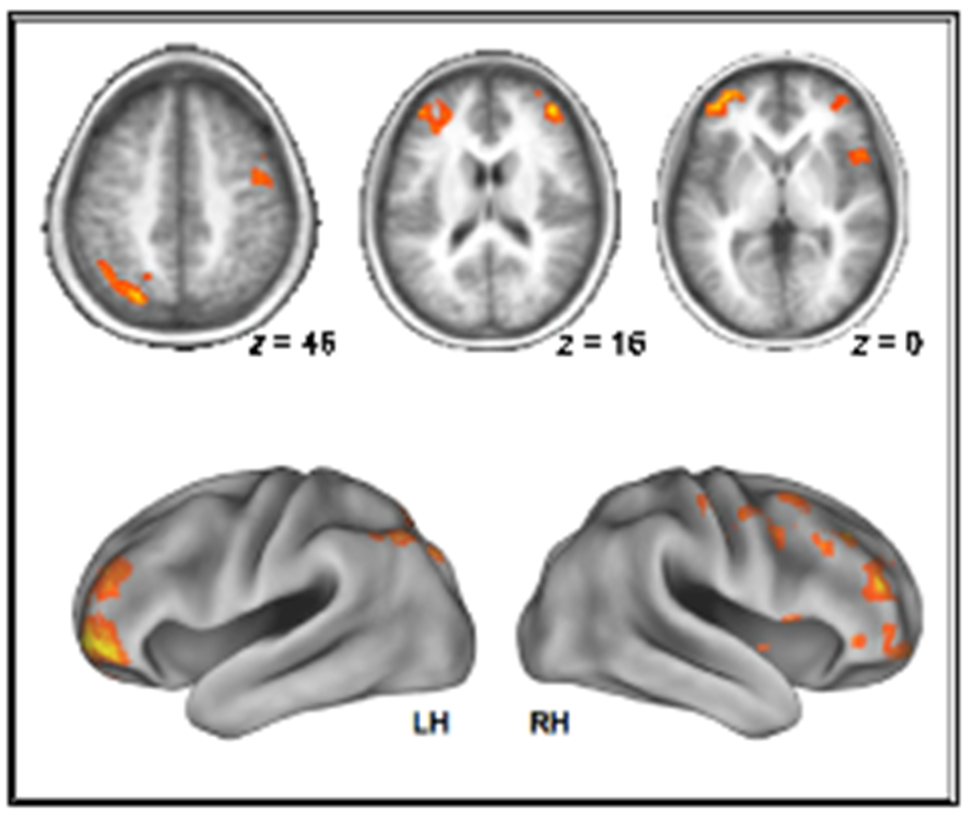
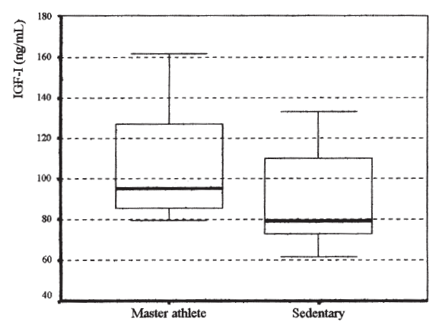
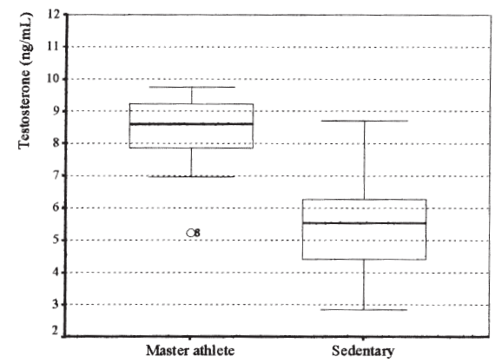
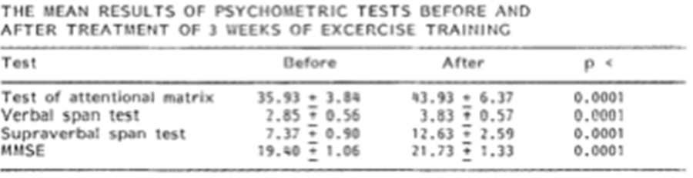
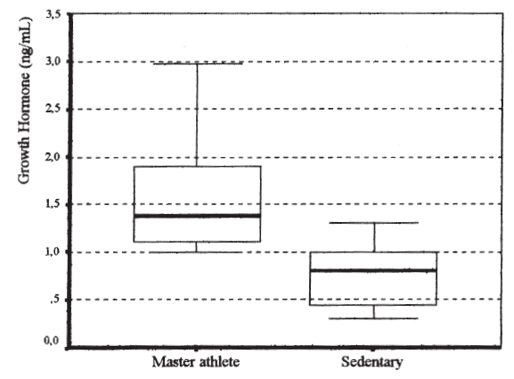
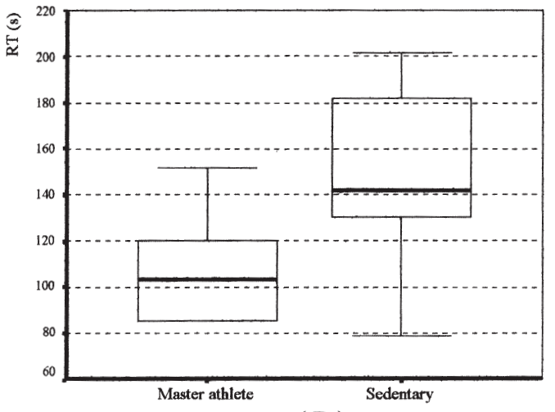
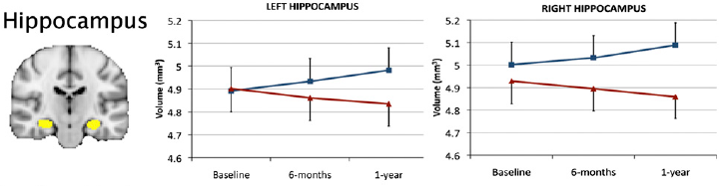

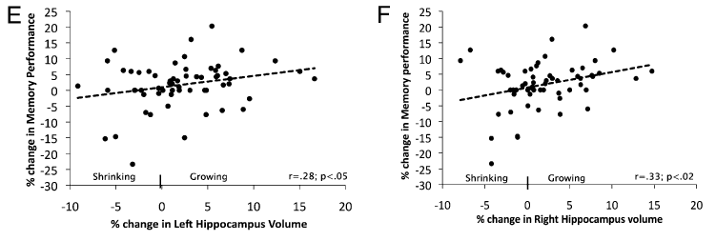
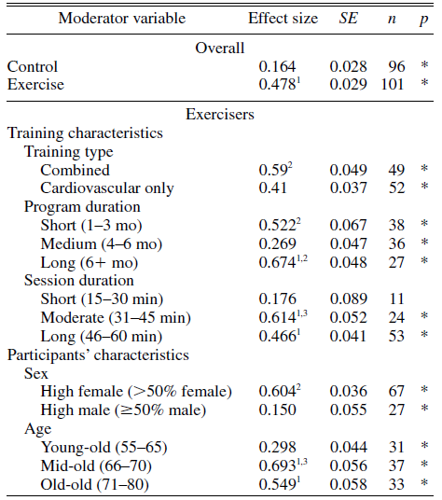
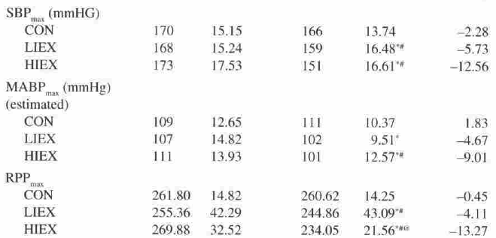
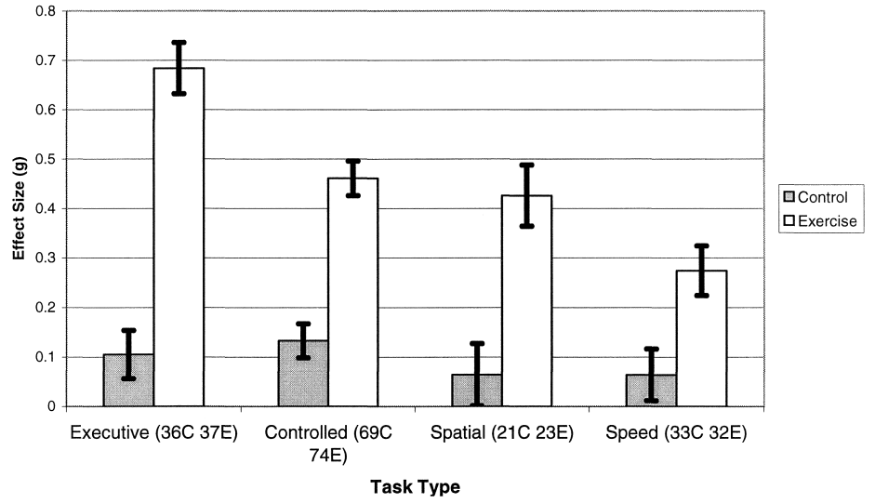
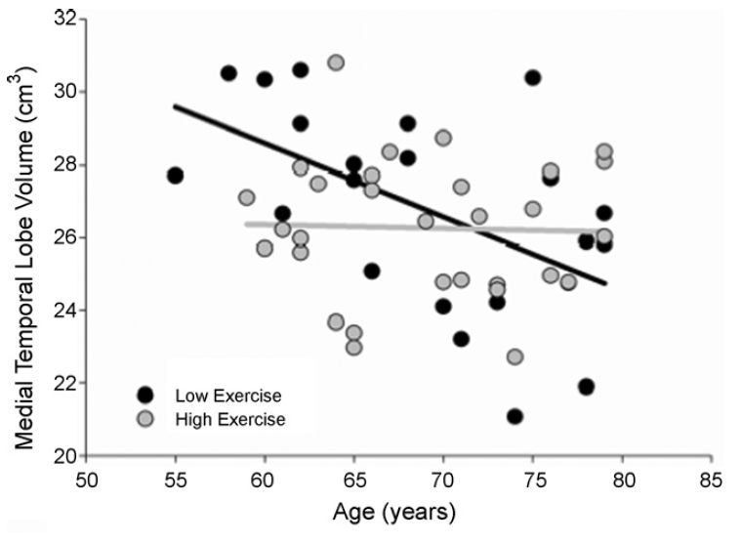
Aging and the Effects of Aerobic Exercise
Rachel VanDyken Department of Movement Sciences Grand Valley State University
Detraining and Functional Ability
As increase in functioning is directly proportional to aerobic training, it appears that detraining has just as strong of relationship) found that after 1 month of detraining gait speed was back to pre-training levels and ability to ascend/descend stairs had also started diminishing within the first month.
Effects on the Brain
Effects on Diseases Cont.
Introduction
Sex Hormone Levels
Introduction
The existence of domestic violence perpetrated against women over 50 years of age is problematic in our society. It has typically been seen as afflicting younger women (as cited in Leisey , Kupstas & Cooper, 2009). The review of studies done on domestic violece against women over 50 is far less extensive and available than research for younger women (Straka & Montminy, 2006).
The Prefrontal Cortex
Senile Dementia of Alzheimer Type Patients
A wide body of research has been done on the effects of aerobic training in older adults. Compelling evidence has shown that with consistent aerobic exercise atrophy of the brain can be delayed or possibly even reversed (Erickson et al., 2011; Colcombe & Kramer, 2003; Prakash et al.,2011).
As the baby boomer cohort ages and with the increase in life expectancy, there are more elderly individuals in the population than before. This directly increases healthcare costs associated with age-related declines in neurological and physical functioning. Intervention with aerobic exercise may not only be beneficial to older adults, but also more cost effective and will work as a means of preventative care.
Increases in aerobic exercise allow for greater recruitment in the prefrontal cortex.
Enables the prefrontal cortices to respond more quickly to task demands.
Highly trained males had overall higher hormone levels than sedentary males.
Serum testosterone and growth hormone are advantageous for brain functioning.
Scores on all competency tests improved after exercise training.
Aerobic training can help restore cognitive functions in individuals who suffer from brain disease.
Indirect benefits include prevention of immobilization and isolation.
Prakash et al., 2011: Activation areas that showed a positive correlation with aerobic exercise during the Stroop task.
Researchers and community advocates are becoming aware of the reality of domestic violence against older omen, and they expect it to increase as the baby boomer cohort ages (as cited in Straka & Montminy, 2006).
Palleschi et al, 1996
Socioeconomic Factors
The Hippocampus
Implications
Aerobic Exercises
Aerobic training but not stretching and toning had led to
An increase in hippocampus volume.
Better spatial memory.
  The American College of Sports Medicine recommends a minimum of 30 minutes of aerobic exercise 3-5 days per week.
  Combined training (aerobic and strength) for 31-45 minutes may have the most benefit.
  Regardless of age or health status aerobic exercise is critical for maintenance of cognitive functioning.
  Within one month of detraining, aerobic functioning can revert to pre-training levels (Teixeira- Salmela, 2005).
The Exercise Training Group:
The training regimen in these studies was typically 30 to 60 minutes long and occurred 3 to 5 times a week.
The aerobic training most frequently included walking, but also involved cycling.
A few of the studies did not entail a training program, but looked at the differences between trained and sedentary individuals.
Ari et al, 2004
Effects on Diseases
Post-Coronary Artery Bypass Graft Patients
The Control Group:
It mainly consisted of a stretching group or strength training.
Erickson et al., 2011
Systolic blood pressure and mean arterial blood pressure showed significant improvement.
Higher intensities show greater improvement.
None of the individuals had any complications with the program.
Hippocampal volume and spatial memory
Effects on Cognitive Functions
The Medial Temporal Lobe
Aerobic exercises have been associated with significantly better performance in certain cognitive tasks (Meta-analysis by Colcombe & Kramer, 2003).
Aerobic exercise prevents atrophy on the medial temporal lobe.
This area is directly related to Alzheimer’s and suggests that aerobic exercise acts as a prevention measure.
Bugg and Head, 2009
Colcombe & Kramer, 2003
For Further Information
.
Willoughby et al, 1997
Please contact Rachel VanDyken at vandykrc@mail.gvsu.edu

