Slide 1
Vintage Status: Shock, Awe . . . awesome! ; Powered and empowered aging
Elaine Ragsdale Schott, Ph. D., LMSW
College of Community and Public Service
Grand Valley State University
School of Social Work

Slide 2
Quotes
“Once a man and twice a child.”
“God takes care of babies and fools.”
“Age is nothing but a number.”

Slide 3
Vintage
A prized vine…representative of the best.
Representative of or dating from a period long past.
(Webster’s New World Dictionary)
Status
Position; Rank; Standing; Prestige
(Webster’s New World Dictionary)

Slide 4
DESCRIPTIONS COMMONLY MENTIONED IN DISCUSSIONS THAT REFERENCE AGING INCLUDE WORDS LIKE:
Ancient
Antique/Antiquated
Bygone
Dated
Dowdy
Decayed
Elderly
Enduring
Faded
Frail
Mature
Passe’
Shriveled
Stale
Used up
Veteran
Vintage
Wrinkled
Wise
Yellowed (as with age)

Slide 5
The associations of positive attributes connected with aging are far outnumbered by negative connotations.
( weil, a. 2007)

Slide 6
But not so fast!!!!
There are examples ‘a plenty’ that prove that…..

Slide 7
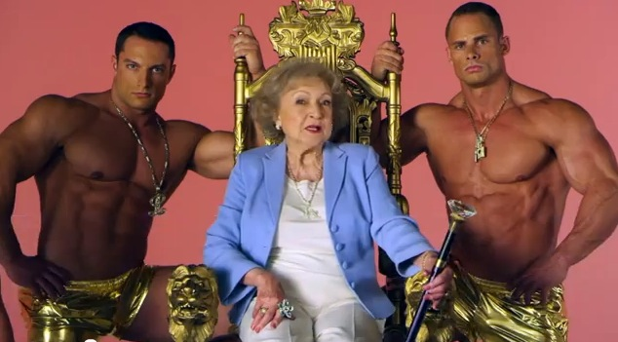
We still got it going on !!!!

Slide 8
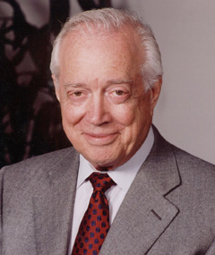
Hugh Downs

Slide 9
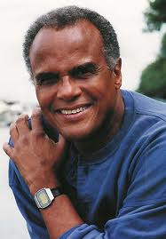
Harry Belefonte

Slide 10
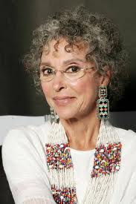
Rita Moreno

Slide 11
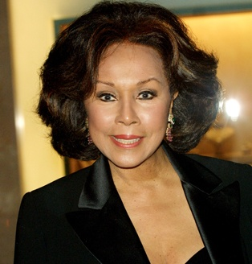
Diahann Carroll

Slide 12
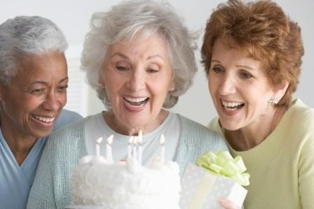

Slide 13
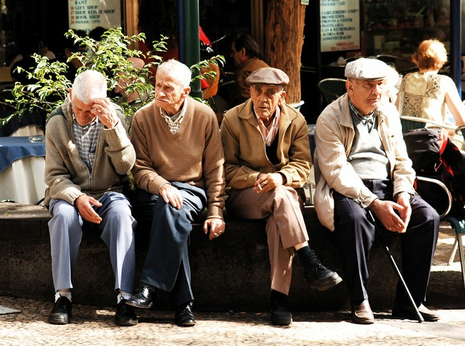

Slide 14
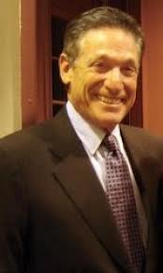
Maury Povich

Slide 15
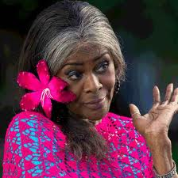
Cicely TYSON

Slide 16
By 2030, the number of U.S. adults aged 65 years or older will more than double to about 71 million. The rapidly increasing number and diversity of older Americans has far reaching implications for the U.S. public health system and will place unprecedented demands on aging services and the nation’s entire health care system.
Tilly, 2010

Slide 17
In 2004, about 34 million people were providing unpaid care for adult family members, friends, or neighbors aged 50 years or older.

Slide 18
Challenges
Poverty rates are highest among families headed by a single woman
It is not uncommon for the rigors of life often associated with mid-life to extend well into advancing years of the lives of aging populations.
The empty nest frequently is NOT empty. It is occupied by grandchildren or young adults who may not have left home, or have found it necessary to return.

Slide 19
Older persons are the world’s fastest growing population group.
Between 2010- 2015, the annual growth rate for the 60 or over - 3.2 % is almost three times that recorded for the total population
King & Calasant (2005) p.1

Slide 20
Older persons are the world’s fastest growing population group.
World wide by 2050 there will be more people over 60 than children under 15. Globally, the number of people over 60 with Dementia will account for 70% of the population.
King & Calasant, 2005

Slide 21
Pressures to prepare for financial security in an ever increasing “insecure” economic and social environment abound.
Responsibilities for aging parents can begin in mid-life and extend for decades.
In 2001 roughly seven to twelve percent of all workers assisted an elderly parent or relative financially, with daily living activities, health care, or residential moves.
Schriver, 2011

Slide 22
One might argue that what heretofore characterized the middle years (40s – late 50s) may start a bit later and continue…
Later onset of child bearing may extend childrearing activities into later adulthood. This may come at a time when physical, mental, or emotional health are compromised by the process of aging.

Slide 23
Healthy
Aging
In
later life

Slide 24
Positive factors associated with healthy aging
Despite many myths and stereotypes about aging, there are many advantages associated with aging Knight, 2004
Such advantages include psychological and mental development as well as continued social engagement and intellectual stimulation.

Slide 25
Adults may begin to apply the wealth of their experiences, their perspectives on time, and their adaptations to life crises to personally satisfying answers to the most fundamental of existential questions.
Memory, reasoning, information, problem-solving abilities, and mental rigidity or fluidity can influence the capacity of older adults to introspect, assess personal past history, and make plans for the future (Knight, 2004).

Slide 26
The accumulation of experiences throughout each older person’s life also undoubtedly adds to the framework and self-evaluation of one’s life.
Older persons exercising positive and hopeful attitudes can aide them in gaining special perspectives on conditions of continuity and change within their culture that can help them shape their own lives.
Onedera & Stickle, 2008

Slide 27
In the process of developing a psychohistorical perspective, very old adults can develop a personal understanding of stability and change, effects of history on individual lives, and one’s place in the chain of evolution.
Onedera & Stickle, 2008

Slide 28
Particular forms of ageism – exclusion of the old- have been shaped by nations’ unique interplays of cultures…..histories….and positions within the global economy…….Western forms of ageism include the depiction of the old as a social burden in an apocalyptic scenario…..
King & Calasanti (2005, pp. 139-140)

Slide 29
… Ageism targets the old and stigmatizes their dependency as burdensome, just as it maligns their unpaid labor as unproductive” King & Calasanti 2005, pp. 139-140.

Slide 30
Power
Ability to act or produce an effect
To be able
(synonym) grip, mastery, energy
Empower
To invest with power or official authority
To equip or supply with ability

Slide 31
References to empower
“Empower” and “Empowerment” are commonly used in contemporary communication.
However, the word’s origin can be traced to the mid 17th century.
The initial emphasis of the word empower was a more legalist meaning- “ to invest with authority; authorize.”
American Heritage Dictionary of the English Language, 2009

