Slide 1
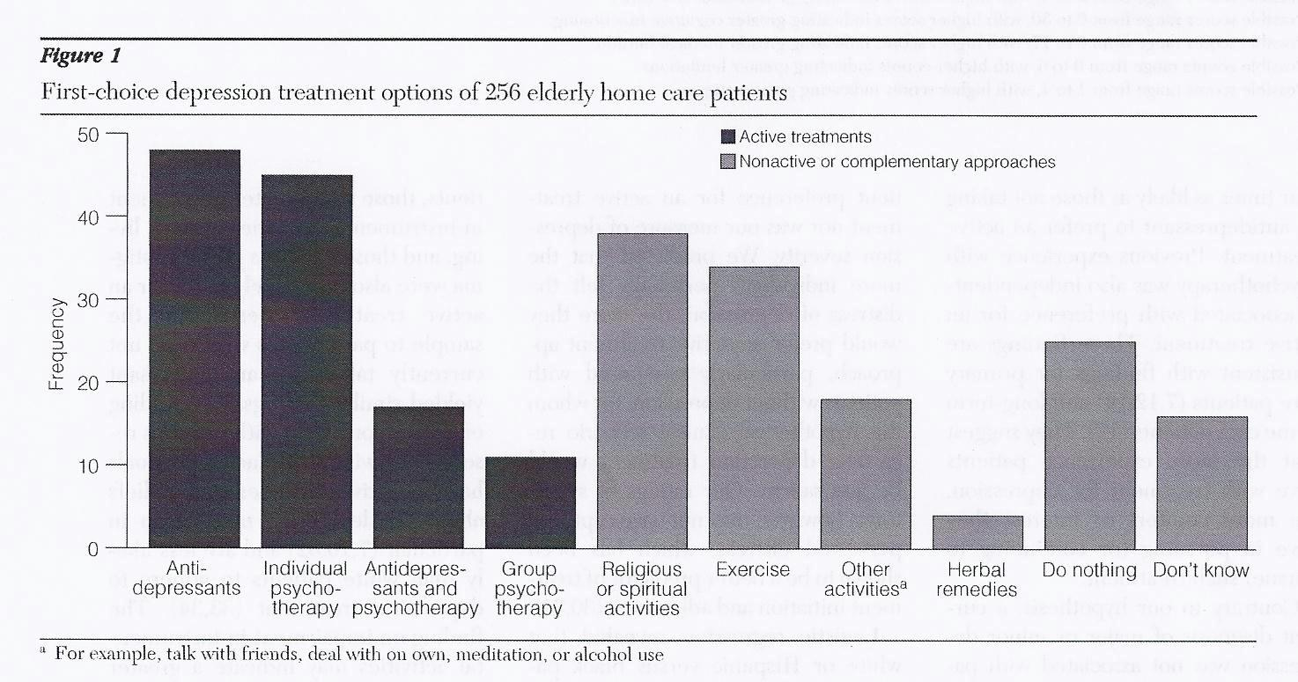
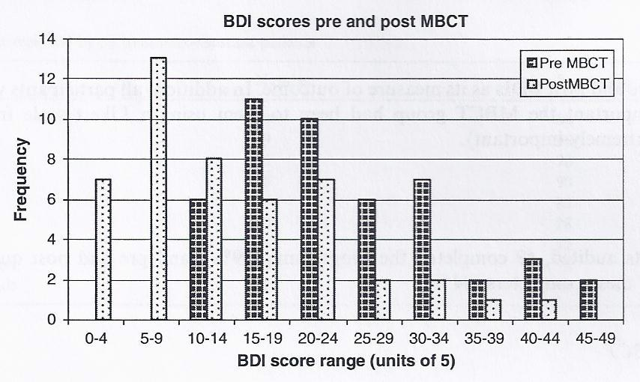
Psychotherapy for Depression in an Aging Population By: Katelyn Buchholz
Major Depressive Disorder is the most prevalent of all lifetime disorders with one of the highest rates of the disorder occurring in those over the age of 75 (Rothermund & Brandstater, 2003). Often in research, this aging population is underrepresented. Important differences between depressive episodes in middle adulthood versus depression in old age include the physical symptoms and illnesses that accompany the diagnosis, and the loss of autonomy due to cognitive and physical decline (Smyer & Qualls, 1999). Not only must older adults deal with bodily and cognitive deterioration, but they must also face bereavement, as death of loved ones is unavoidable, and come to terms with a new sense of self that is different than the view they held in their youth. With important differences such as these present, it is imperative that treatment for depression is examined specifically within the context of an aging population, in order to truly determine the best treatment modalities.
Interpersonal Psychotherapy
Extensive psychoeducational component helps geriatric clients comprehend depression
Focus on role transitions is perfect for those accepting a different role than they had in middle adulthood
Important modifications to better serve older adults is the integration of caregivers
(Miller & Reynolds, 2007)
Treatment Modality | Effect Size
Psychotherapy as a Whole | 0.72
Cognitive-Behavioral Therapy | 0.93
Behavioral Activation | 0.69
Interpersonal Psychotherapy | 0.52
Mindfulness | 0.59
Life-Review Therapy | 0.84
Antidepressant Medications | 0.79
Mindfulness
“Paying attention in a particular way; on purpose, in the present moment, and nonjudgmentally.” (Kabat-Zin, 1994)
Theme of acceptance
Mindfulness-based cognitive therapy (MBCT)
Elements such as meditation and yoga combined with principles of cognitive therapy
Negative thoughts are simply “mental events” v. accurate reflections of the self
Provides skills necessary to prevent negative thought patters from triggering a depressive episodes (Segal, Williams, & Teasdale, 2002)
Although antidepressant medications can be effective in the treatment of depression, many older adults would prefer non pharmacological treatments. Psychotherapy offers options for those suffering from geriatric depression, and empowers them to choose a course of treatment that best fits their needs. (Raue, Weinberger, Sirey, Meyers, & Bruce, 2011).
Cognitive-Behavioral Therapy
Targets maladaptive thinking, dysfunctional emotions
Works well with older adults who may get stuck focusing on things they used to do that they are no longer able to
Geriatric modifications include administering material at a slower pace and increasing the use of visual aids
(Broomfield et al., 20011)
The statistic used is Cohen’s d; effect sizes of .2 are considered small, .5 considered medium, and .8 is considered large. When comparing psychotherapy to antidepressant medications, effect sizes as small as -0.01 have been found, suggesting no significant different between treatment types. (Cuijpers et al., 2006)
Life-Review Therapy
Engineered specifically for use in aging populations
Older adults and people suffering from depression tend to over generalize memories
Clients recall a balance of positive and negative memories and work with the therapist to redefine the negative experiences
Goal is for the individual to gain a balanced view of their past
(Preschl et al., 2012)
Behavioral Activation
Focuses on the relationship between activity and mood
Clients create activity hierarchies
Most Difficult
Easiest
By working from bottom to top, depressed individuals gain more access to natural reinforcers that serve an antidepressant function
(Hopko, 2004)
Volunteer
Visit a friend
Exercise
Play with dog
Cook dinner
Sleep in
The lower the score on the BDI, the less depressive symptoms a person exhibits. Looking at the graph, this means that the farther left the bars move, the better. As you can see, the pre MBCT depression scores as represented by the black bars are farther right on the graph than the post MBCT depression scores as represented by the white bars. Prior to treatment the mean BDI score was 24.3, while after the MBCT program, the mean score dropped to 13.9; which is a highly significant change. Improvements in depressive symptoms such as these are representative for psychotherapy treatments as a whole. (Kenny & Williams, 2007)

