Slide 1
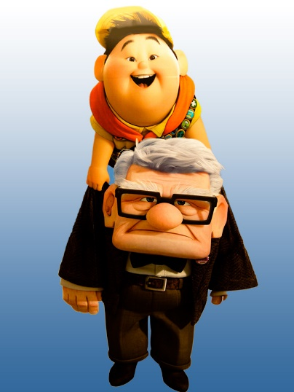
Exploring the Potential of Intergenerational Mentorship in Health and Resilience
11th Annual Art and Science of Aging Conference
Grand Valley State University, Feb. 19, 2016
Presented By: Heather Wallace, PhD wallaceh@gvsu.edu

Slide 2
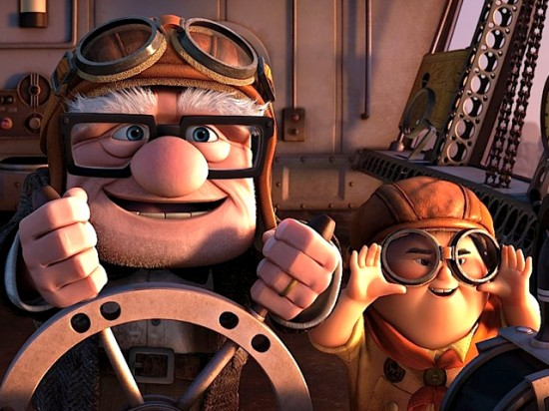
Overview
Explore what is meant by “Intergenerational Mentorship (IGM)”
Identify how IGM can enhance health and wellbeing.
Discuss the various types of IM relationships and programs.

Slide 3
What is a Mentor?
Relationships between generations have changed across time and space.
  Family structure
  Longevity
  Occupation
  Social position
  Communication
Mentorship: “A mentor is a more experienced individual willing to share their knowledge with someone less experienced in a relationship of mutual trust. A mixture of parent and peer, the mentor’s primary function is to be a transitional figure in an individual’s development. …. Mentoring includes coaching, facilitating, counselling and networking. “ David Cutterbuck, 1991

Slide 4
What is a Mentor?
“Wherever there are beginners and experts, old and young, there is some kind of learning going on, some kind of teaching. We are all pupils and we are all teachers.”
  Glibert Highet

Slide 5
Mentorship, health and well-being
Physical
Immune Response
Stress Response
Emotional
Self esteem
Life review and legacy
Spiritual
Meaning
Mental/Psychological
Life Satisfaction
Perceived health and wellbeing
Occupational
Personal satisfaction
Gratitude
Societal
Social Connectedness

Slide 6
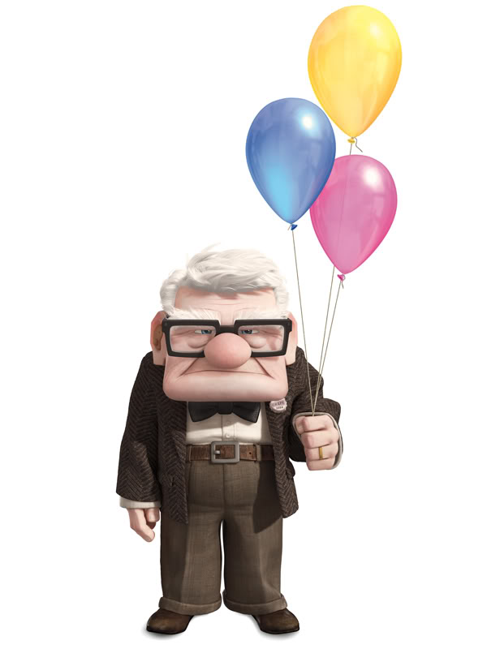
Developmental Changes in Late Life
Spiritual health has the capacity to EXPAND in late life.
  Connection
  Meaning
  Purpose
  Acceptance
Theory of Gerotranscendence – GROWTH

Slide 7
What does IM look like?
“It takes a village” – naturally occurring, often familial. Dynamic and long term
Wellness Programs – formal, goal based, short term and or acute events
Care-giving – organized around an intent to assist or care for someone. Often educational and supportive in nature
Health Care – Is it mentorship? Desire to engage different generational groups in activities that are believed to enhance health or well being.

Slide 8
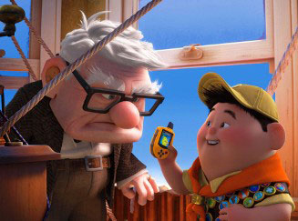
What does IM look like? Relationships
Old to young
Young to old
Interaction, socialization, and or companionship?
Identifiable outcome as the purpose or intent?
Intentional, purpose driven

Slide 9
Developing Healthful IGM Opportunities
It starts with you. What knowledge and skills do you have to pass on or to learn?
How can your organization benefit from intergenerational engagement?
  Review your mission and value statements
  Community resources
  Skills and knowledge
  Intergenerational work environment

Slide 10
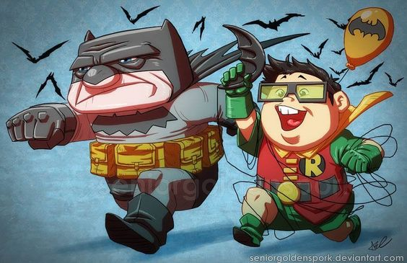
Developing a IGM Program
A statement of purpose
  Goals
Recruitment Plan
  Eligibility, strategy, retention
Orientation
  Expectations and outcomes
Evaluation and reflection
  Expectations and outcomes

Slide 11
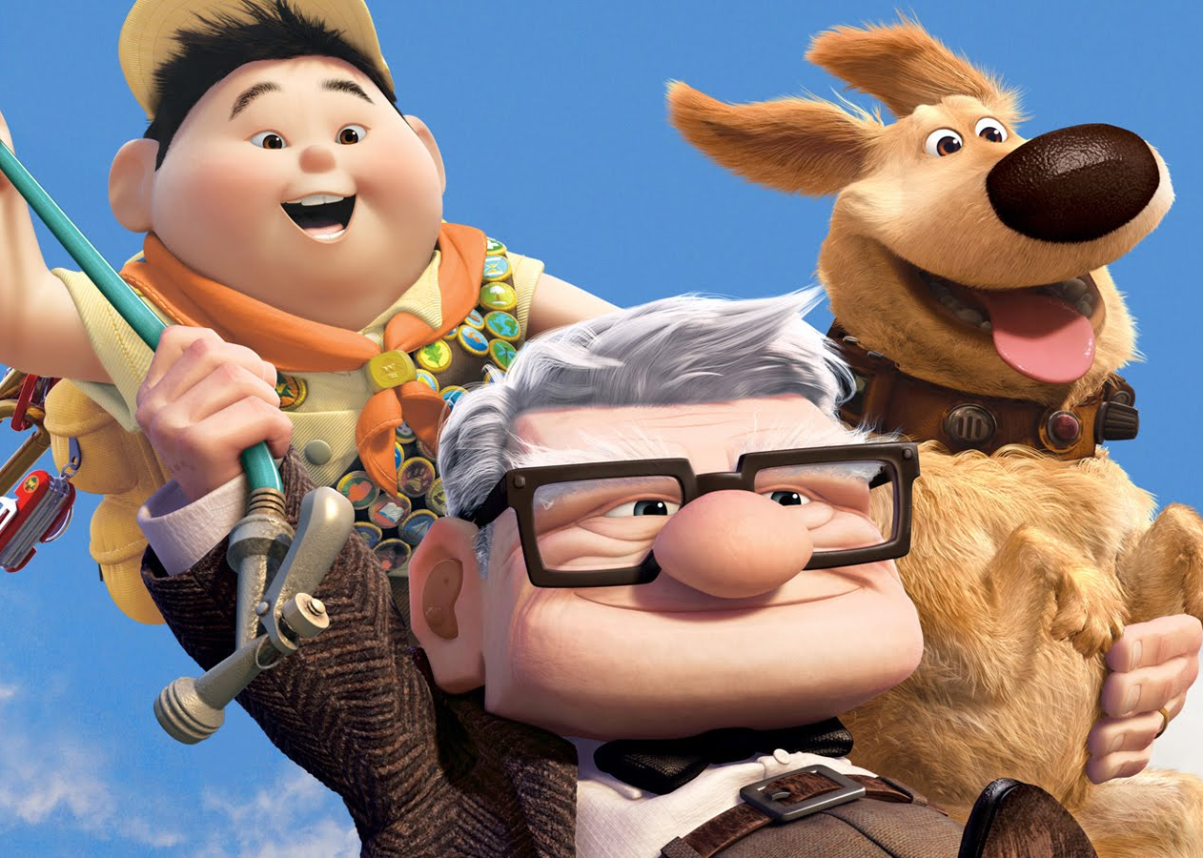
Question and Discussion
Thank You!
Heather M. Wallace-Renter, PhD
Assistant Professor
GVSU, Dept. of Public Health, Office #319
545 Michigan St. NE, Suite 300
Grand Rapids MI
Phone: 616-331-5584
E-mail: wallaceh@gvsu.edu

