Slide 1

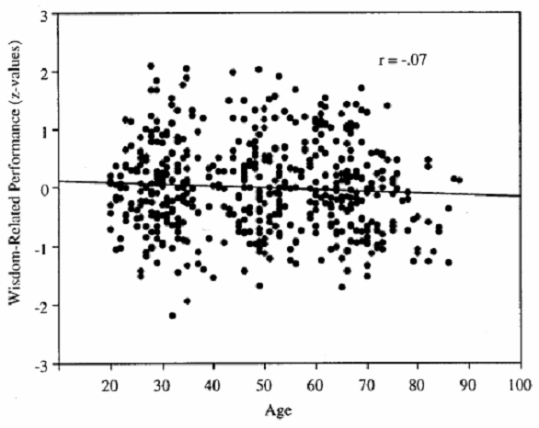
Aging and Wisdom Acquisition
Hannah Schweikart & Valerie Ahee
Grand Valley State University
Introduction
methods
Conclusions & Discussions
Wisdom is considered a broad and widely understood concept by people all over the world. In many models, wisdom entails cognitive, reflective, and affective dimensions (Ardelt, 2003). High cognitive levels would insinuate someone who is well capable of understanding life and its correlating interpersonal and intrapersonal relationships. The reflective dimension is telling of someone who is capable of viewing a situation from different vantage points and is aware of self. The affective measure speaks to one’s ability to maintain positive emotions and behavior towards others, often demonstrated by acts of sympathy. Understanding wisdom can also guide society and individuals to a higher level of maturity and generativity (Baltes & Smith, 2008).
In this experiment, we scored wisdom levels using two different means among both older and younger adults, and examined the age differences. The first measure of wisdom allowed the participants to apply their wisdom in a practical approach to made-up situations. They were asked to give their advice on a certain life issue. The second measure was a self-report measure that asked the participant questions about themselves regarding key components of wisdom.
Participants:
  6 adults between ages 66-91 (50% male, 50% female)
  6 adults between ages 20-23 (50% male, 50% female)
  Education levels varied
Wisdom measures:
  Task 1: Procedural measures tested the participants knowledge of situational wisdom in cognitive, reflective, and affective circumstances. These consisted of three situations in which the participant gave their input. The first was a measure of cognitive ability, the second was reflective, and the third was a measure of affectivity. Procedural measures were read aloud to participant (see Example 1 below). The researcher then recorded the participants’ responses.
  Task 2: Participant was given 3D-WS (self-report measure) to complete on their own. They were given a list of statements with a scale from 1-5 asking them to report how much they agreed/disagreed with each statement. This is a previously used empirical measure to gauge wisdom levels in adults. This also included questions about cognition, reflection, and affectivity (see Example 2 below).
Conclusion 1: Age is not correlated with wisdom.
  Older age is not associated with higher scores of wisdom. It is probable that wisdom can be enhanced through learning experiences and those with increased longevity have an increased likelihood of being exposed to more experiences. However, the tasks used in this study failed to tap into the unique experiences of older adults that may reveal potentially higher wisdom among the elderly.
  It is also possible that younger generations have a higher level of education than older adults, which could affect the way they approach cognitive and affective measures. Individuals from a younger generation may have gone to college and learned techniques for better handling situations than those lacking a formal education.
Conclusion 2: Wisdom levels were higher in the procedural measures.
  Across both the younger and older age groups the procedural measure of a life review task showed higher wisdom scores than the self-report measure.
  Desirability bias, where the individual has a tendency to answer questions in a way that will be viewed more favorably by others , could play a role in the accuracy of self-reported measures.
  People who are genuinely wise are less likely to answer a question in a fashion to self-proclaim themselves as wise (Gluck, 2013).
  In a procedural measure, such as open ended questions, the participants are more likely to have authentic responses, allowing wiser people to excel in the testing process.
Limitations:
  Font size was not large enough for all of the elders to read on their own.
  Cohort differences may have affected the way in which ideas were communicated and understood between the two cohorts.
  Small sample size.
Example 1. An example of a situational question given to the participants for Affective Measure.
You are in charge of a group of people at work to see that a particular project gets finished. The group has five different people in it. Jane and Elizabeth have very progressive ideas and tend to speak very quickly during the meetings. Ron isn’t quite catching on to the main point of the project and continues to ask basic questions. Joanie hardly participates and doesn’t give much eye contact. Timothy stares at you blankly. Your boss said that the last resort will be to disband the group if it doesn’t work out. What do you think is the solution? How do people’s actions in the meetings affect how you feel towards them/your solution?
Example 2. An example of self-report questions pertaining to the affective measure. Participant was asked to circle a number. (1 = strongly agree, 5 = strongly disagree).
Affective Measure
I am annoyed by unhappy people who just feel sorry for themselves.
2 3 4 5
It’s not really my problem if others are in trouble and need help.
1 2 3 4 5
There are some people I know I would never like.
1 2 3 4 5
Background Research
Wisdom has been studied using various methods. The Berlin Model defined wisdom as expert knowledge in dealing with important but uncertain matters of life (Baltes & Straudinger, 1993). Wisdom was measured in the following five domains when presented with difficult problems involving life review, life planning, or existential life management.
Major findings from research using the Berlin model.
  There is no relationship between wisdom-related performance and chronological age (20-89) (Staudinger & Baltes, 1999).
  The primary age window for wisdom to emerge is during late adolescence and early adulthood. (Pasupathi, Staudinger, & Baltes, 2001).
Future Studies
results
According to Staudinger (1999), matching the age of the fictitious character in the life review task to the participant’s age generally leads to a stronger performance. In future studies more accurate results for both younger and older adults could be achieved by changing the age of the character in the life review task to be closer to each participant’s age.
Personality has been shown to be a factor in wisdom acquisition. Extroversion and having openness to experience are personality traits that lead to higher wisdom-related knowledge (Staudinger, Maciel, Smith, & Baltes, 1998). A longitudinal study would allow for assessment of variables, such as personality, throughout one’s lifetime and be useful in further studying factors that affect wisdom.
There is strong incentive to continue research in this field because wisdom has been shown to increase both men and women’s overall well being. Social decision making, emotional well-being, reflection, tolerance, and coping with uncertainty are all positive outcomes associated with having wisdom (Bergsma & Ardelt, 2012).
Wisdom levels were measured by calculating a score for each person. Those scores were then averaged for each age group. Mean scores on the two tasks were also calculated.
Results 1:
Age differences in wisdom measures
Results 2:
Different measures of wisdom
Wisdom has been measured in other ways.
  The 3-D Wisdom Scale (3DWS) measures wisdom across three areas (cognitive, affective, and reflective dimensions) and uses a self report questionnaire to assess wisdom scores. This is a valid and reliable instrument for measuring wisdom (Ardelt, 2003).
  Procedural measures, such as life review tasks, ask the participant to give advice about difficult or confusing life dilemmas that correspond to a specific wisdom measure (affective, reflective, or cognitive). One can analyze the application of wisdom based on the answers given for various situations. Procedural approaches produce a more accurate measure of wisdom because they allow for more authentic responses but self-report measures, such as the 3DWS, take less time and are easier to perform (Glück, König, Naschenweng, Redzanowski, Dorner, Straßer, & Wiedermann, 2013)
Contact Information: Hannah Schweikart: schweikh@mail.gvsu.edu
Valerie Ahee: valerieahee@gmail.com

