Slide 1
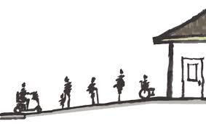
AGING WITH DISABILITIES
Do people with disabilities face a greater challenge than older adults without disabilities to age in place?
Elizabete Saukas, MPA, Grand Valley State University
The older population is projected to nearly double, growing from 43 Million in 2012 to 84 Million in 2050. Because disability rates rise with age – with the largest increases occurring at the oldest ages – it is likely that population aging will bring large increases in the number of people with physical and cognitive impairments. These increases will have major implications for homebuilders, planners, policy makers and others concerned about the accessibility of the housing stock.
38 % Americans aged 65 years and older have a disability.
Possible Solutions:
Promote awareness concerning aging in place with disabilities.
Increase the support to community based programs.
Promote Universal Design
Support Visitability Laws
Main challenges to age in place
House Design
Healthcare
Stigmas – Ostracized and stripped of power
Unaware or unable to access resources available in the community
What is visitability?
A legislation that requires that all new affordable homes to be built to certain accessibility features.
Falling leads to more than 1.7 million injuries and almost 17,000 deaths per year among the older population of the USA.
Lack of accessible features in the home.
Limited ability to visit friends and families, what cause social isolation and depression among the elder population.
At least one no-step entrance to main level.
Main level with wider door and hallways.
Minimum half bath on main level accessible by mobility aids.
Including these accessible features from the beginning creates a greater supply of accessible homes and reduces the need for residents to spend large sums of money on modifications in the future.
5.5 million of veterans with a disability (Census, 2009).
“Soon, the world will have more people who live to see their 80s or 90s than ever before.” (World Health Organization)

