Slide 1

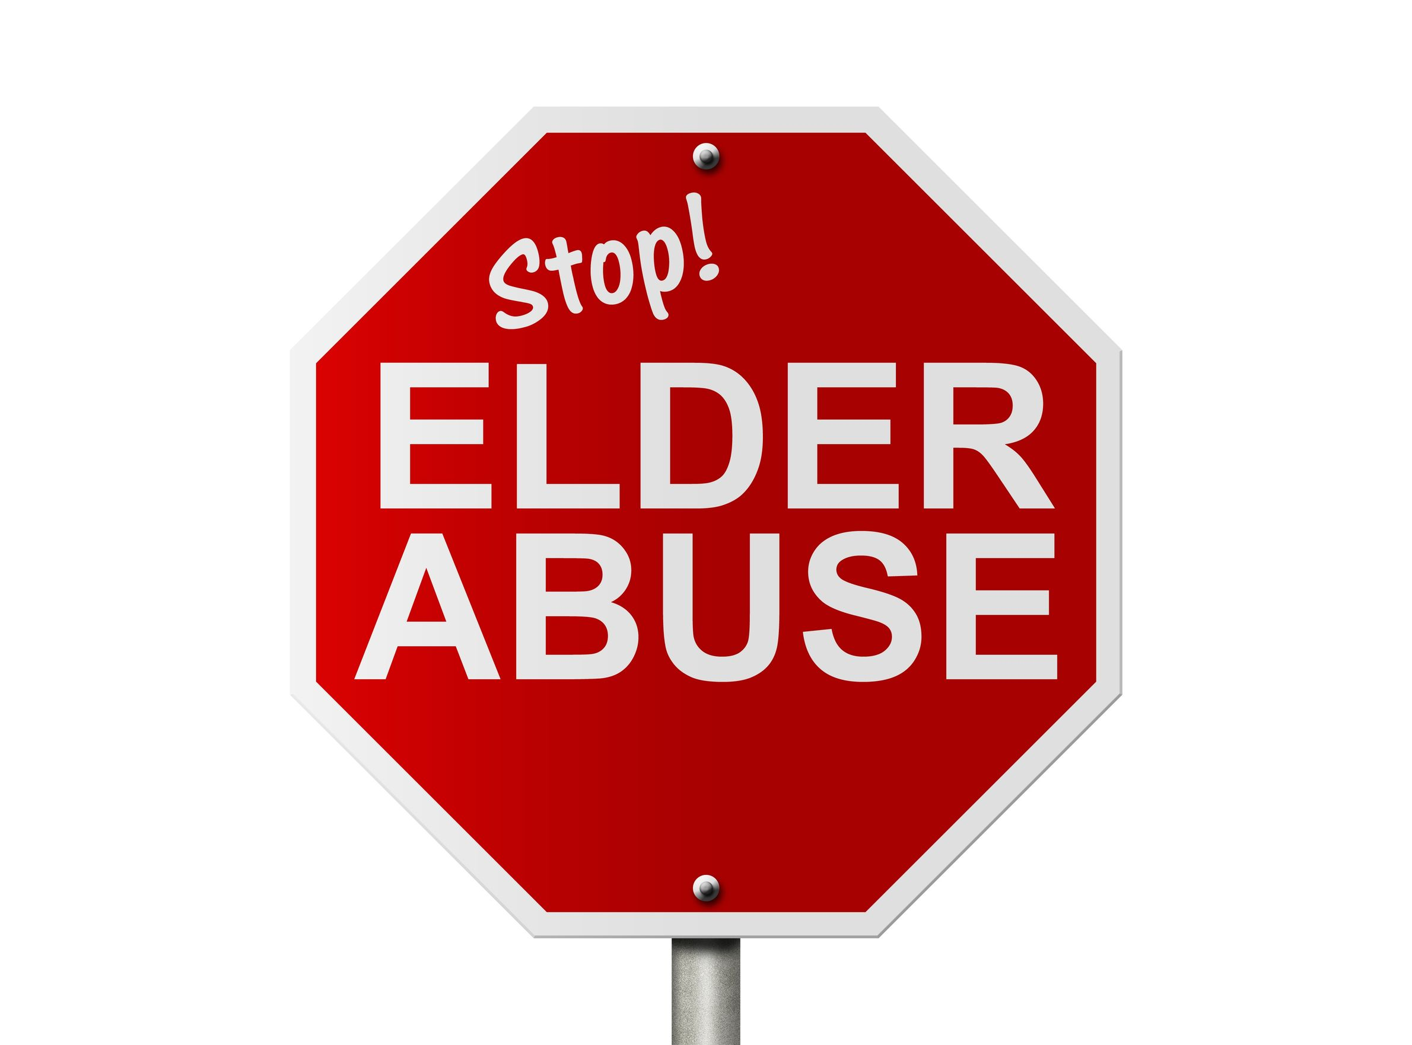
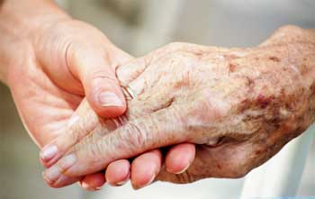
Elderly Abuse: A Systematic Review of Vulnerability and Prevention
Brittany Fleming-Allied Health Sciences, Pre-SLP, Nicole Houskamp-Allied Health Sciences, Pre-SLP, and Lindsay Hunt-Allied Health Sciences,Pre-SLP
Grand Valley State University
Introduction
The purpose of this systematic review was to summarize literature on correlations between elderly patients with dementia and the vulnerability to elder abuse in long-term care facilities. In addition, the researchers were interested in discovering if there are intervention methods to prevent the abuse
Prevalence of elder abuse in long-term care facilities ranges from 2% to 10% (Conner et al., 2011)
Elderly abuse may be related to mental illness or depression and resentment of caregivers
“To date, however, major steps forward in national policy and strategy on elder abuse have not been taken, in part because Congress has failed to provide sufficient funding” (Kohl, Sanders, & Blumenthal, 2012)
Results
Types of Abuse and Prevalence
Six abuse types: verbal and psychological, physical, neglect, financial, sexual, and discriminatory
Self-neglect is a forgotten component of abuse
A study showed 158 incidents of abuse with 56% being self-neglectful (Caspi, 2013)
In the older populations, 6.3% reported abuse with the most common forms being psychological, verbal, and/or financial abuse (Selwood and Cooper, 2009)
Dementia and Vulnerability
Proactive aggression from stress, resentment, and the positive results in patients led to abuse
Cognitive impairment had an indirect correlation to abuse
Low relationship satisfaction with the patient resulted in abuse
25% of vulnerable patients suffered from abuse (Selwood and Cooper, 2009)
Policies and Prevention
Early detection
National Alzheimer's Project Act of 2011: guide and train those who are caring for those with the disease
Adult Protective Services (APS): first response to elder abuse cases
The Elder Justice Act: mandates that APS receives $100 million per year and $25 million is given to the state for testing methods of improvement (Chen, Dong, & Simon, 2014)
  also mandates charging civil fines of $200,000 to facilities that do not report abuse cases within 24 hours
Skills training manual: to improve coping strategies, emotional well-being, and level of fatigue of healthcare workers of elderly patients
Training high-quality, knowledgeable and long-term health care professionals can prevent elderly abuse in patients with dementia
Appropriately deeming guardianship for elders with dementia
Conclusions
Previous research done on general elder abuse, this review was more specific focusing on vulnerability and prevention
There is much still to be done, including prevention and policies regarding abuse
Since vulnerability is correlated to elder abuse, patients such as those with dementia should be carefully monitored
Education is key (general public, family members, caregivers, patients)
References
Caspi, E. (2014). Does self-neglect occur among older adults with dementia when unsupervised in assisted living? An exploratory, observational study. Journal of Elder Abuse and Neglect, 26(2), 123-149. doi: 0.1080/08946566.2013.830532
Chen, R., Dong, X.& Simon, M. A. (2014). Elder Abuse And Dementia: A review of the research and health policy. Health Affairs, 33(4), 642-649 8p. doi:10.1377/hlthaff.2013.1261
Conner, T., Prokhorov, A., Page, C., Fang, Y., Xiao, Y., & Post, L. (2011). Impairment and abuse of elderly by staff in long-term care in Michigan: Evidence from structural equation modeling. Journal of Interpersonal Violence, 26(1), 21-33. doi: 10.1177/0886260510362880
Kohl, H., Sanders, B., & Blumenthal, R. (2012). Elder abuse: What is the federal role? Generations, 36(3), 106-110.
Selwood, A. and Cooper, C. (2009). Abuse of people with dementia. Reviews in Clinical Gerontology, 19(1), 35-43. doi: 10.1017/S095925980999013X
Materials and Methods
The databases of CINAHL, PubMED and ProQuest Medical were used to search for articles pertaining to the following inclusion and exclusion data
  Inclusion: peer reviewed articles, published 2007-2015, elderly U.S. citizens, long-term care, and patients with dementia
  Exclusion: articles prior to 2007, individuals not considered elderly, and individuals without dementia
8,501 articles resulted from searching with the key terms of elder abuse AND dementia
When applying exclusion criteria 8,216 articles were excluded, providing a total of 285 articles for the researches to review
The researchers read abstracts and excluded 270 more articles to find a total of 15 articles to include in the systematic review
Further Information
Brittany Fleming: fleminbr@mail.gvsu.edu
Nicole Houskamp: houskamn@mail.gvsu.edu
Lindsey Hunt: huntli@mail.gvsu.edu
Acknowledgments
Julia VanderMolen, Ph.D
Assistant Professor-Allied Health Sciences
Grand Valley State University
Notes:
Copyright Colin Purrington (http://colinpurrington.com/tips/academic/posterdesign).
1

