Slide 1
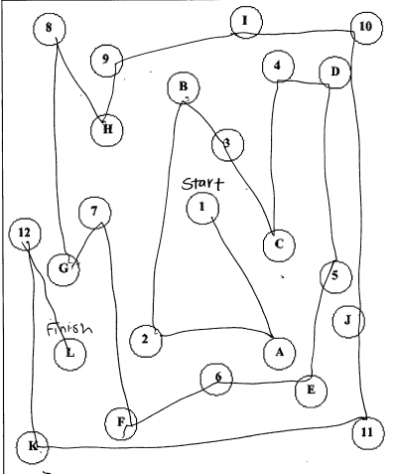
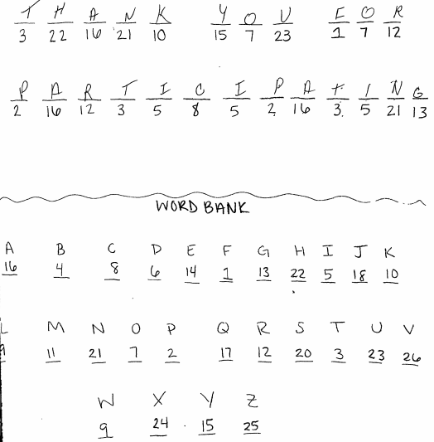
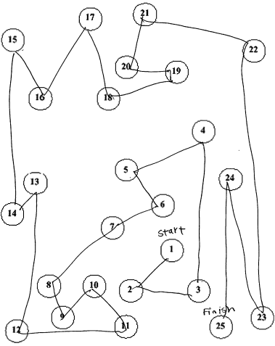
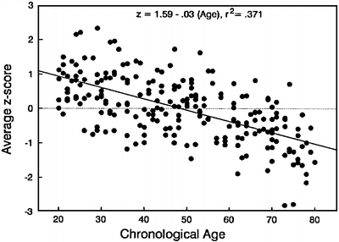
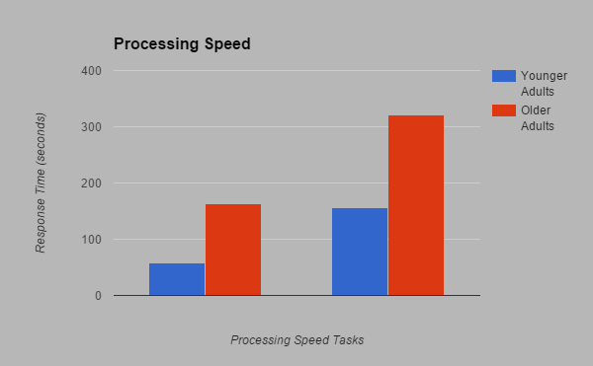
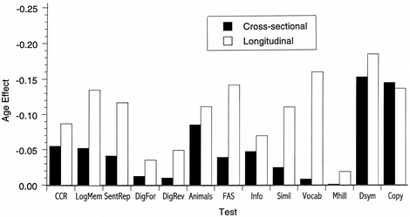
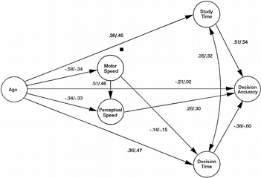
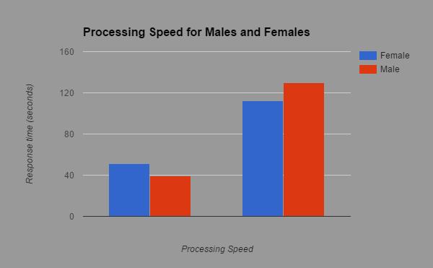
Changes in Speed Between Older and Younger Adults
Sydney Cody Department of Psychology Grand Valley State University
Introduction
Method
Discussions
Participants:
8 older adults (65-80 years old, M=77.88)
8 young adults (18-30 years old, M=20.88)
Half of the participants were female in each age group.
The results of the study support previous research (Salthouse, 1996; Salthouse, 2004). Both processing speed tasks used in the study demonstrated young adults have a faster response time compared to older adults. Processing speed can be an indication of cognitive functioning and there could be several reasons for this general slowing of processing speed over time.
Two specific theories help guide an understanding as to why older adults are slower in response time than younger adults.
Compensation hypothesis
    posits that older adults recruit other parts of their brain to complete a task, like the trail making task used in this study. This then takes them longer to process information because the different parts of the brain have to be activated and work together, somewhat inefficiently.
The dedifferentiation hypothesis
similar to compensation but focuses in on the loss of specialization in aging brains. Instead of having each part of the brain an expert in one area, all of the parts of the brain work together to accomplish a task. This could lead to a slower response time.
The amount of time it takes for information to be taken in and understood at a cognitive level is known as processing speed. Salthouse (2000) makes distinctions between decision speed which is assessed by the time it takes to complete a moderately difficult task while perceptual speed is how many items of an easier level of difficulty a person can get right in a given time allotment.
In the present study, we measured processing speed in both young and older adults. Specifically, we were interested in age differences in simple pencil and paper tasks involving spatial and visual processing speed tasks. The tasks used here address both perceptual and decision speed.
Task 1: Message Decoding: Use a key provided to fill in blanks where each blank has a number beneath it that corresponds to a letter in the key.
Task 2: Trail Making (Salthouse, 2011): Make a continuous line connecting numbers that are distributed around a page (A) and then connect numbers and letters in an alternating pattern distributed around a page (B).
Previous Research
Results
Salthouse (1996) suggested that as age increases, there is a general slowing pattern.
Age is not only correlated with a decline in processing speed but also correlated with declines in memory span, cued recall, and word fluency (Sliwinski & Buschke, 1999).
Increasing age is also correlated with slowed psychomotor speed and reduced executive functioning (Keys and White, 2000).
Salthouse (1996) presented the following model to illustrate that increasing age and it’s associated decrease in speed leads to cognitive functioning deficits.
It has been suggested that processing speed can be used as a biomarker for aging (Dreary, Johnson and Star, 2010). Greater processing speed was associated with higher scores on cognitive ability tests at age 70.
Age differences: The results were analyzed by comparing the means for each of the processing tasks completed by participants. As expected, older adults, on average, took significantly longer to complete each task. Our data shows that younger adults response time is about half of older adults.
Implications and Future Studies
Implications
People need more time to process information as they age.
This is important for older adults themselves as well as those that work closely with older adults.
Future research
Investigate the correlation of processing speed and cognitive abilities.
Examine ways in which this general slowing pattern can be slowed or at least stabilized.
The more ways that are explored in to how we can help older adults maintain their cognitive abilities through processing speed or other aspects, the better we can protect our grandparents, parents, and some day, ourselves.
Trail Making Decoding Message
Gender Differences: There were also significant gender differences. Means were computed for both male and female participants. In the decoding task, female participants were faster, on average, than male participants to complete the task. In the trail making task, male participants were faster, on average, than female participants.
Trail Making Decoding Message
Contact Information
Sydney Cody: codysy@mail.gvsu.edu

