Slide 1
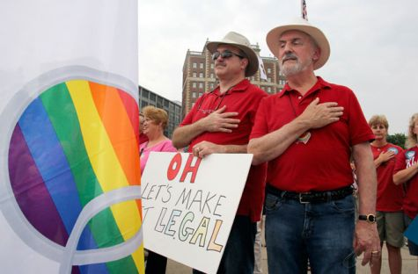

Video Clip:
LGBT Oral History

Slide 2
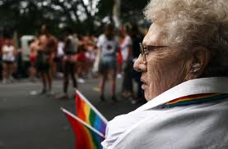
Sunrise and Sunset of the LGBT Aging Community
Grace Hoyer, EdD, MSN, RN
Assistant Professor
Grand Valley State University
Kirkhof College of Nursing

Slide 3
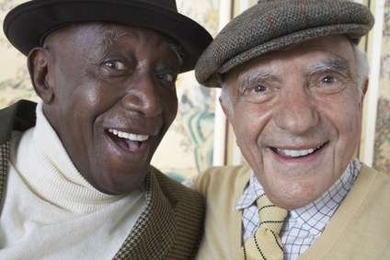
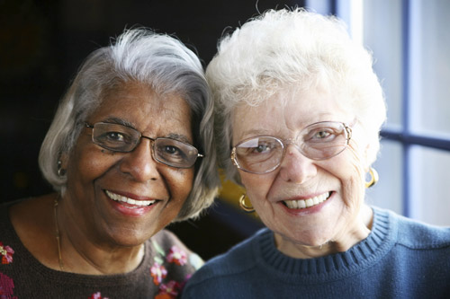
Objectives
To raise awareness of potential discrimination against LGBT seniors
To stimulate greater cultural competence in senior care institutions through education
To facilitate the awareness of history and resilience of individuals within the older LGBT community.
To promote discussion related to strategies to bridge gaps for LGBT older adults in the West Michigan environment

Slide 4

How Many Americans Identify as LGBT?
It is estimated that more than 2.4 million adults ages 50 and older in the US identify as lesbian, gay, bisexual, or transgender (LGBT), accounting for 2.4% of the population (Fredriksen-Goldsen,2015).

Slide 5
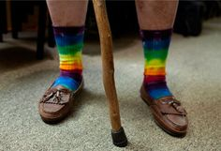
As Baby Boomers age (1946-1964) increasing numbers of older adults will openly identify as LGBT
The MetLife Study of LGBT Baby Boomers, Percentage of respondents who are completely or mostly “out”
Lesbian | 76%
Gay | 74%
Bisexual | 16%
Transgender | 39%

Slide 6
Experiences of Discrimination Over a Lifetime
1962
1969
1980s
1993
2008
Illinois becomes the first state to decriminalize private, consensual homosexual acts. Until then, sodomy could be punished by lengthy terms of imprisonment of hard labor
1952
The American Psychiatric Association lists homosexuality as a mental disorder. It would be removed 20 years later in the DSM IV, 61 years until transgender is removed.
Patrons of the Stonewall Inn respond to a police raid with a violent riot, inciting a series of protests and sparking the modern gay civil rights movement.
The AIDS crisis galvanized the LGBT community, but also showed lack of governmental action to protect LGBT individuals health.
President Clinton implements the “Don’t Ask, Don’t Tell” policy prohibiting LGBT service men and women from serving openly in the military. The policy was repealed in 2010.
Californians pass a state constitutional amendment banning gay marriage after the state supreme court had ruled previous bans as unconstitutional. The Supreme Court ruled the amendment unconstitutional in 2013.
The “Moral Majority”starts crusade against LGBT community.
Notes:
The timeline in this slide highlights major events in LGBT history that a 75-year old woman like Marlena would have lived through. As the timeline illustrates, the current older LGBT population grew up in a society that both criminalized and pathologized LGBT people. Prior to 1973, the American Psychiatric Association defined same-sex orientation as a psychiatric disorder; and up until 2003, there were still states that criminalized sex between men. It was not until 1969, with the Stonewall Riots in NYC, that the gay civil rights movement is thought to have begun. Understandably, LGBT people like Marlena who are over 65 and came of age before 1969 are more likely to hide their sexual orientation from peers, family, and health care providers, in order to protect themselves from stigma and discrimination. In comparison, LGBT older adults who are part of the American baby boomer generation, currently in their 50’s and early 60’s, and who took part in or benefited from the gay rights movement, are more likely to live at least part of their lives more openly, and to expect and demand health care services that address their unique needs. However, despite many positive strides, LGBT baby boomers still have had to deal with a great deal of societal rejection and intolerance, as well as great losses of friends and partners during the height of the AIDS crisis.

Slide 7
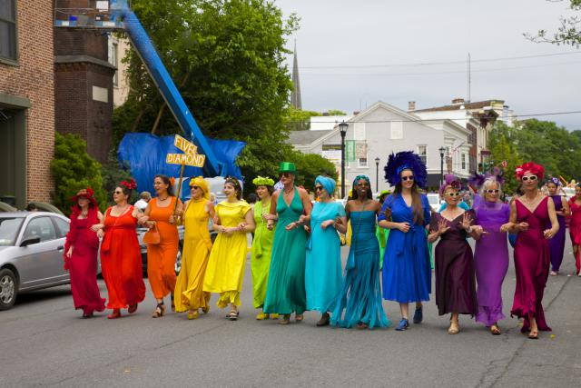
Improving the Lives of LGBT Older Adults: Policy Report (March, 2010)
The LGBT older adult population will double by 2030
This population has a history of making social changes, therefore they are more likely to assert their rights as older LGBT Americans

Slide 8

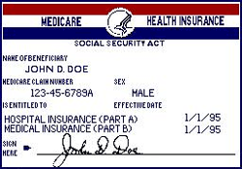
Medicare Offers Benefits, Joint Placement to LGBT Seniors
In September 2013, HHS announced
  legally married same-sex couples on Medicare will be eligible for equal benefits
  joint placement in nursing homes around the country
Medicare applies equally to all married couples
Must allow patients to decide who has visitation rights and who can make medical decisions for them, regardless of sexual orientation, gender identity or family makeup
Notes:
New rules regarding Medicare eligibility and non-discrimination will have a huge impact on many same-sex older adult couples.

Slide 9
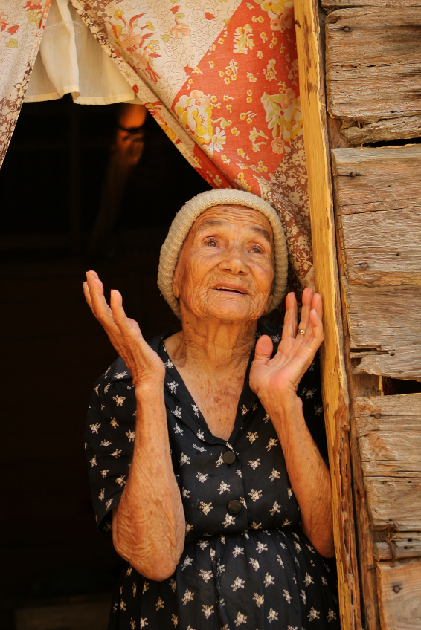
Challenges & Opportunities: General
Michigan LGBT older adults face additional and sometimes extreme barriers to resources and care.
90% LGBT older adults have no children to help care for them (compared to 20% of heterosexual older adults)
Twice as many LGBT older adults live alone as compared to heterosexual older adults.
LGBT older adults are nearly 3 times as likely to live in poverty as heterosexual adults.
Summit for LGBT older adults coming. (2012, Jun 14). Between the Lines. Retrieved from http://search.proquest.com.ezproxy.gvsu.edu/docview/1023800613?accountid=39473

Slide 10
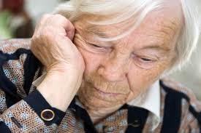
Challenges & Opportunities: Invisibility
LGBT older adults have been largely invisible within health and aging services research, despite being disproportionately burdened by poor health and aging outcomes (Cloyes, 2015).
Psychotherapy with LGBT older adults has not received enough attention in research and literature (Baron & Cramer, 2000)
LGBT seniors are only 20% as likely as heterosexuals elder to access needed services (Haber, 2009)

Slide 11


Challenges & Opportunities: Older LGBT Michiganders
Federal and state civil rights laws do not include the terms sexual orientation and gender identity, and therefore do not protect these individuals.
Due to the lack of a concrete policy, aging providers are not required to go through cultural competency training.

Slide 12


Challenges & Opportunities: Housing
34 % 127 participants said they thought hiding their sexual identity would be necessary if they moved to a retirement home Johnson(2005)
One half of senior centers do not welcome gay men and lesbians who are open about their sexual orientation (Knauer, 2009).
Gay elders are likely to be rejected by retirement communities and nursing homes (Haber, 2009)
Strong initiative for LGBT specific housing

Slide 13
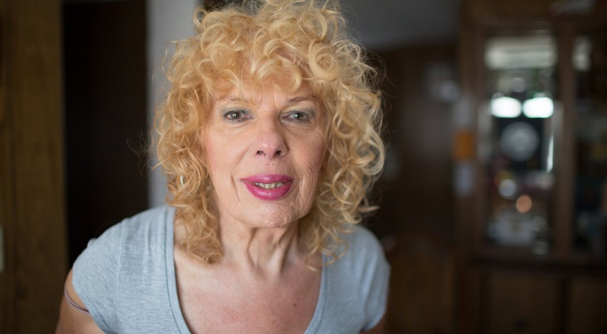
Challenges & Opportunities: Older Transgender Adults Health Concerns
Less likely to receive preventive care:
  Examples: Breast cancer screening and cervical cancer screening needed in Trans Men (female to male transgender); prostate screening needed in Trans Women (male to female transgender)
  Underscores why it is important to learn about both gender identity, sex assigned at birth, and current anatomy.
Long-term effects of hormone therapy should be monitored
Higher risk for HIV in trans women, and risk of STI’s based on behavior
12% of trans women and 1% of trans men transition after age 55
Cahill et al, 2000
Notes:
Older transgender adults may be less likely to receive preventive care. This is particularly true for anatomy that is not consistent with their gender identity. For example, a transgender man may still need cervical cancer and breast cancer screening, depending on surgical and family history. Transgender adults who have been on hormone therapy for many years should be monitored carefully for side effects (see Module 7). In addition, transgender women are at very high risk for HIV and should receive testing based on a thorough sexual history. Finally, providers should be aware that although most transgender people “transition” (begin to live full time in a gender different than their sex at birth) between the ages of 18-44, there are some that transition after age 55.

Slide 14
Challenges & Opportunities: Financial
Higher poverty in lesbian couples
Lack of benefits for spouses in unmarried couples
Goldberg, NG., The Williams Institute, 2009
Notes:
LGBT older adults have additional stresses to their finances when living in states without legal marriage for same-sex couples. For example, they are unable to access benefits that protect spouses from poverty, such as social security, and protections for assets upon death, illness, or going into long-term care.

Slide 16
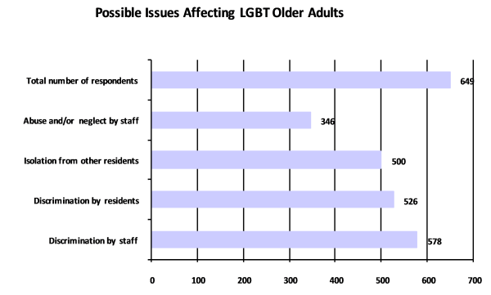

Slide 17
Gender Identity Experiences Related to Resident’s Real or Perceived Number of Percent of Sexual Orientation and/or Gender Identity | Number of Instances | Percentages of All Instances
Verbal or Physical Harassment From Other Residents | 200 | 23%
Refused Admission or Re-admission, Attempted or Abrupt Discharge | 169 | 20%
Verbal or Physical Harassment From Staff | 116 | 14%
Staff Refused to Accept Medical Power of Attorney from Resident’s Spouse or Partner | 97 | 11%
Restriction of Visitors | 93 | 11%
Staff Refused to Refer to Transgender Resident by Preferred Name or Pronoun | 80 | 9%
Staff Refused to Provide Basic Services or Care | 51 | 6%
Staff Denied Medical Treatment | 47 | 6%
Total | 853 | 100%

Slide 18
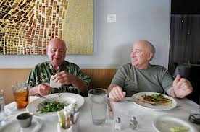
Quotes
I’ve not known anyone in a facility who has stated their alternative sexual orientation, which says a lot in itself.
Most feel that there are no LGBT residents in their facilities.
A gay couple moved into my mother’s facility. The residents kept talking about: “Which one is the man and which one is the woman?” They moved out in a couple of months.”
Several residents’ offhand comments about gays and fags make me (and any gays) uncomfortable.
My partner was in the long-term skilled nursing facility for 30 days— it was a difficult time for both of us, but particularly because of some staff who seemed to “resent” our relationship and my advocacy on his behalf.
I have been haunted for years by what happened to two lesbian friends of mine. They had been “married” for more than 50 years, when they both fell ill. Their families sent them to separate nursing facilities despite all protests. They each shortly passed away. It was heartbreaking

Slide 19
Health Disparities & LGBT Elders
Stigma and Discrimination
Bias in Health Care
Health Care Disparities
Social Determinants
Adapted from IOM 2011:The Health of Lesbian, Gay, Bisexual and Transgender People
Notes:
We are going to look at some of the history of stigma and discrimination, evidence of bias in care and the social determinants of health to better understand the dynamics of health disparities impacting LGBT people.

Slide 20
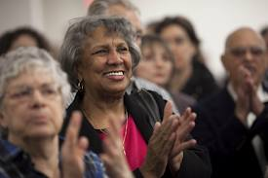
Enhancing Resilience
Learn to cope with stigma from an early age
Role flexibility
Ability to cope with crises
Importance of social support in successful aging: social support from other LGBT members is crucial in healthy aging

Slide 21

Enhancing Resilience
91% engage in wellness activities
89% feel good about belonging to the LGBT community
71% percent reported having a person in their life to love and make them feel wanted
83% have people with whom to do something enjoyable
  The Aging and Health Report
Notes:
Although many LGBT older adults experience isolation and discrimination, many also exhibit resilience and have positive outlooks. The 2011 Aging and Health report shows that the majority of respondents had friends and/or loved ones in their lives, and engaged in wellness activities. Some theorize that LGBT adults are better able to cope with aging than non-LGBT people because LGBT people have had to develop adaptive skills over time, and have already been through a process of reconstructing their identities when they were coming out. These skills and experiences create internal resilience.

Slide 22

Role of Sex & Sexuality
Sexuality
  How we view ourselves as sexual beings
  Ways we reveal ourselves physically, emotionally, and psychologically.
Gendered stereotypes focus on asexuality or an overdeveloped interest in sex
  postmenopausal woman may be seen as frigid
  “dirty old man”
“Greater sexual freedom" among baby boomers (Jacoby 2005).
  maintaining sexual activity throughout the lifespan
  overcoming the physical limitations
  Culturally sensitive counseling

Slide 23
Encourage Advance Planning
Living will
  Provides instruction if person is incapacitated
Health care power of attorney/proxy
  Allows the individual to designate a surrogate decision maker
Often combined into an “Advance Directive”
Very important for same-sex couples, especially those who are unable to marry
Advance Directives Resources: http://www.hrc.org/resources/entry/protecting-your-visitation-decision-making-rights
Notes:
Another way to help LGBT patients is to encourage them to do advance planning, including completing advance directives so that their chosen partner or friend will be designated as the decision maker, rather than a default decision-maker. Other advance planning issues should be encouraged such as wills, living wills, financial planning, and long-term care facility planning. Without a will, a surviving partner would have no claim on their partner’s assets and might even lose the right to stay in their joint home.

Slide 24
LGBT Older Adults in Long-Term Care Facilities, Supportive Organizations
National Senior Citizens Law Center
National Gay and Lesbian Task Force
Services & Advocacy for GLBT Elders (SAGE)
Lambda Legal
National Center for Lesbian Rights
National Center for Transgender Equality
National Council on Aging
AARP
Family Caregivers Alliance
Old Lesbians Organizing for Change

Slide 25






Organizations

Slide 26
Be Open
Be Knowledgeable
Be Aware
Notes:
26
In summary, patients like Marlena can benefit from health care providers who follow a few basic principles:
Be aware that your older patients may be LGBT, and that they have specific medical, psychological and social needs.
Be open in your questioning and attempts to gather patient information, using inclusive language that will facilitate open dialogue, and do so in a nonjudgmental manner. Be honest about your own feelings and biases, and refer your LGBT patients to another provider if you do not feel comfortable taking care of them.
Be knowledgeable of the agencies and services available, and be sensitive to the specific challenges faced by this group. Training for staff on the unique needs of LGBT older adults should be available to provide the optimal environment to care for older LGBT adults.

Slide 27
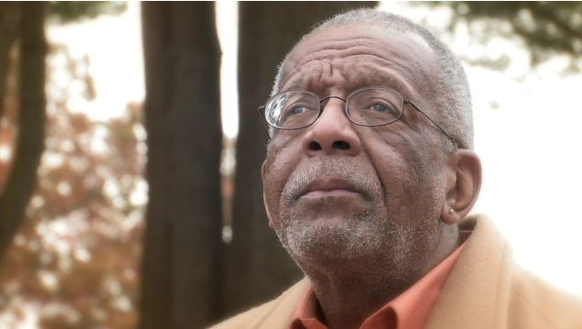
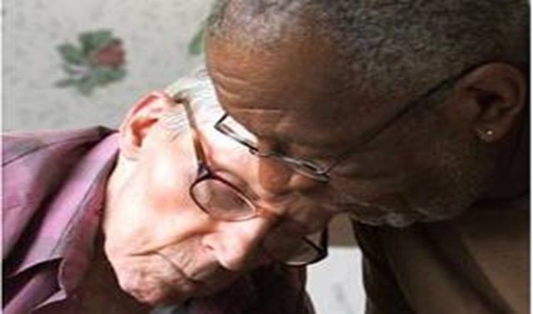
Poem: Piecing the Quilt
Lawrence Johnson
Gay
African American
Poet

Slide 28

Resources
Services and Advocacy for Gay Elders (SAGE):http://sageusa.org/about/
American Society on Aging (ASA)
The LGBT Aging Issues Network (LAIN)
LGBT older adults in Long term care facilities: http://www.lgbtlongtermcare.org
Gay and Lesbian Medical Association
  www.glma.org
American Society on Aging
  www.asaging.org
National Gay and Lesbian Task Force
  www.thetaskforce.org
Improving the Lives of LGBT Older Adults, March 2010
  http://www.lgbtmap.org/file/improving-the-lives-of-lgbt-older-adults.pdf

Slide 29
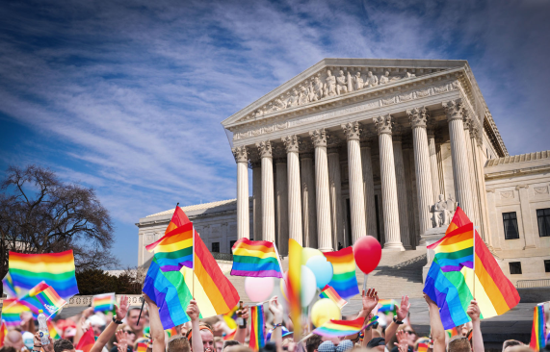
References
Addis S, Davies M, Greene G, Macbride-Stewart S, Shepherd M. The health, social care and housing needs of lesbian, gay, bisexual and transgender older people: a review of the literature. Health Soc Care Community. 2009;17(6):647-658.
Arien, K. M., & Adeyinka, M. A. (2013). Older adults and sexuality: Implications for counseling ethnic and sexual minority clients. Journal of Mental Health Counseling, 35(1), 1-14. Retrieved from http://search.proquest.com.ezproxy.gvsu.edu/docview/1269701620?accountid=39473
Baron, A., & Cramer, D. (2000). Potential Counseling Concerns Of Aging Lesbian, Gay, And Bisexual Clients. In R. M. Perez., K. A. Debord., K. J. Bieschke (Eds.), Handbook of counseling and psychotherapy with lesbian, gay, and bisexual clients (pp. 207-223). Washington, DC: American Psychological Association, 2000.
Berger, R. M. (1982)."The Unseen Minority: Older Gays and Lesbians. Social Work,27(3),236-242. Retrieved from http://web.ebscohost.com/ehost/resultsadvanced?sid=f8029f21-5b85-4031-
Brennan-Ing, M., Seidel, L., Larson, B., & Karpiak, S. E. (2014). Social care networks and older LGBT adults: Challenges for the future. Journal of Homosexuality, 61(1), 21-52. doi:10.1080/00918369.2013.835235
Claes JA, Moore W. Issues confronting lesbian and gay elders: the challenge for health and human services providers. J Health Hum Serv Adm. 2000;23:181-202
Haber, D. (2009) Gay Aging. Gerontology & Geriatrics Education 30 (3) 267-80. doi:10.1080/02701960903133554

Slide 30

References
Cloyes, K. G. (2015). The silence of our science: Nursing research on LGBT older adult health. Research in Gerontological Nursing, , 1-13. doi:http://dx.doi.org/10.3928/19404921-20151218-02
David, S., & Cernin, P.A. (2008) Psychotherapy with Lesbian, Gay, Bisexual, and Transgender Older Adults. Journal of Gay & Lesbian Social Services 20(1), 31-49. doi:10.1080/10538720802178908
Fredriksen-Goldsen, K.I., Kim, H., Murac,,A., & Mincer, S. (2009). Chronically Ill Midlife and Older Lesbians, Gay Men, and Bisexuals and Their Informal Caregivers: The Impact of the Social Context." Sexuality Research and Social Policy: Journal of NSRC 6 (4), 52-64. Retrieved from http://web.ebscohost.com/ehost/resultsadvanced?sid=f8029f21-5b85-4031-bab5
Grant, J.M. (2010). Outing Age 2010: Public Policy Issues Affecting Lesbian, Gay, Bisexual and Transgender Elders. Retrieved from National Gay and Lesbian Task Force website: http://www.thetaskforce.org/reports_and_research/outing_age_2010
Jacoby, S. (2005, July & August). Sex in America. AARP: The Magazine. Retrieved from http://www.aarpmagazine.org/lifestyle/relationships/sex_in_america.html/

