Slide 1
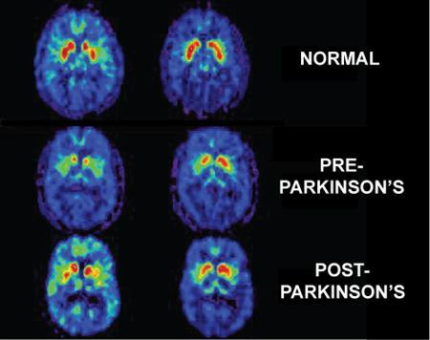
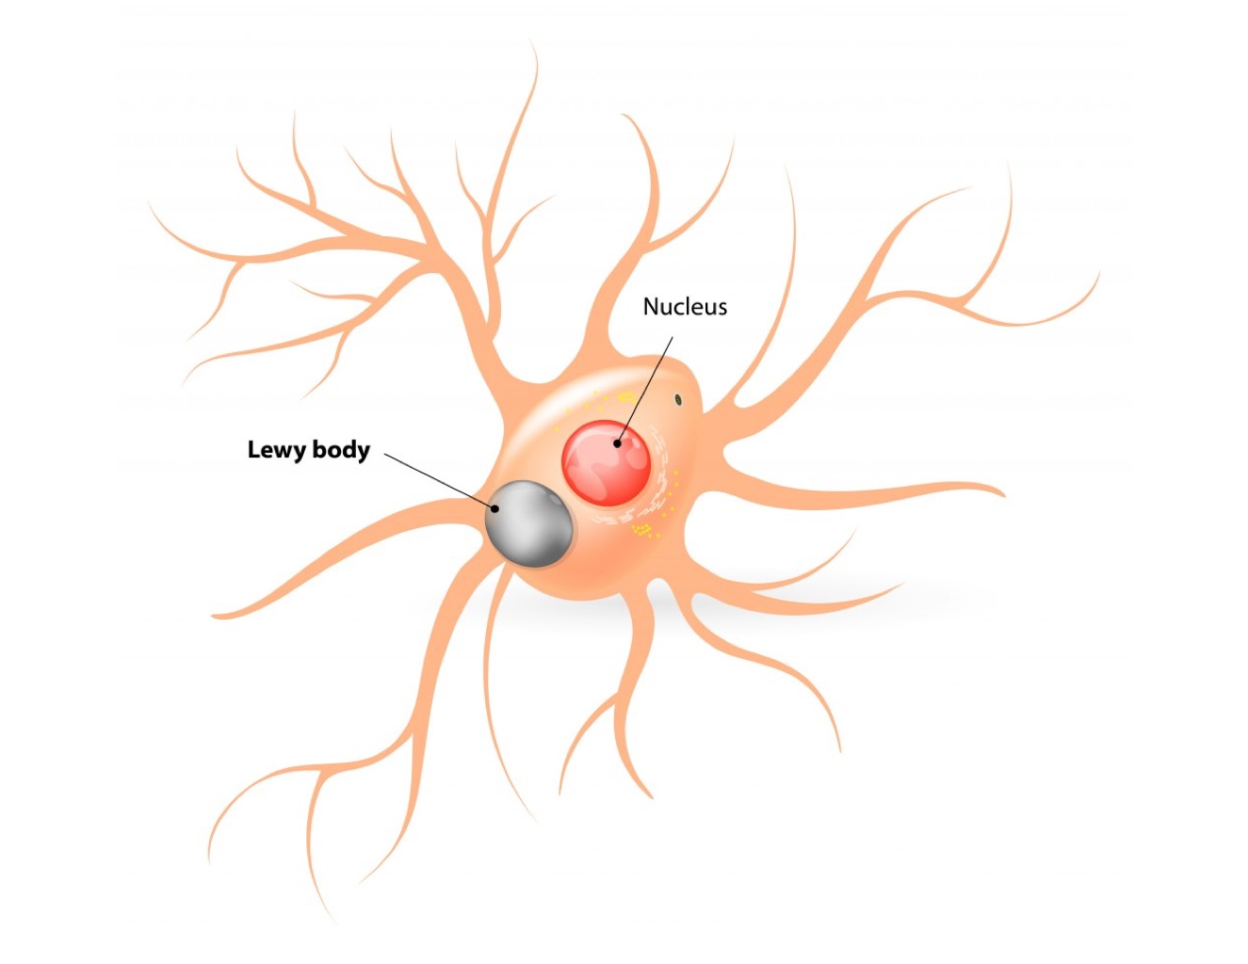
The Effects of Dementia in Parkinson’s Disease
Emma Hahs, Brooke Armistead, Sarah Brown, Sok Kean Khoo
Department of Cell and Molecular Biology, College of Liberal Arts and Sciences, Grand Valley State University
Introduction
Brain Affected by Parkinson’s
Parkinson’s disease (PD) is a neurodegenerative disorder characterized by the α-synuclein protein aggregation in dopaminergic neurons found in the substantia nigra of the midbrain. PD affects 1-2% of adults over the age of 50 in the United States today.¹ In most cases, PD isn’t diagnosed until the disease has already manifested and caused serious effects on the patients motor skills and cognitive function.
In addition to PD, it is common for patients to develop other diseases, such as dementia. Dementia is characterized by a combination of several neuropsychological deficits creating cognitive impairment. Parkinson’s Disease Dementia (PDD) is frequently emerges from the mild cognitive impairments (MCI) that many PD patients are prone to.
Researchers are currently working on finding an earlier diagnosis to improve the treatments for PD. Throughout this research there is potential to discover stratification markers to differentiate among PD, MCI, and PDD. This will provide more specific treatments to fit the needs of PD patients.
PD is usually diagnosed based on motor onset. This is problematic because the patient on average has already lost 50-70% of their dopaminergic neurons that produce neurotransmitters, which controls motor functions.
In the photo on the left, the depletion of neurons is expressed through the dark spots on the PET Scan. The patient who is Pre-PD has already lost some of their neuron function. When diagnosed with PDD this neuron function is depleted even further. Patients are diagnosed with PDD when dementia symptoms start to arise at least one year after the motor onset of PD.
The Stages of Dementia²
Symptoms are still unnoticeable to others
Mild
Affected individual needs prompting for everyday tasks
Behavioral problems commence at this stage
Moderate
Needs full assistance to eat/drink and confined to chair/bed
Resists assistance, may hit or bite caretakers
Mild loss of memory (i.e. names of new people)
Pre-Diagnosis
End Stage
Severe
Affected individual is confused most of the time and can no longer survive without assistance
Memories of past life are sporadic
Unaware of recent events and experiences
Figure 1. From top to bottom, the PET scans are showing the progression of PD in a brain and how it affects the neurons. The dark spots are where the neurons are being degraded.³
Lewy Body Aggregation within Neurons
Lewy Bodies are aggregates of the α-synuclein protein in nerve cells and in neurons commonly found in PD patients. Lewy bodies first deplete the neurotransmitter dopamine and as the disease progresses, the abnormal proteins diffuse to other parts of the brain, disrupting many areas of brain function like acetylcholine production which helps to regulate thinking and perception. PD first develops as a movement disorder in patients and eventually progresses to dementia symptoms. Symptoms of PDD include changes in thinking and reasoning, confusion, memory loss, visual hallucinations, and malfunctions in the autonomic nervous system, in addition to PD symptoms such as tremor, hunched posture and balance problems. PDD is diagnosed when patient experiences dementia and movement symptoms at the same time or within one year of diagnosis.
Lewy Neurites are commonly found in diseased neurons. They are similar to Lewy bodies in their makeup, but the aggregation in the protein is located in the projection off of the neuron rather than in the cell body. The build up of Lewy Bodies is the second most common cause for Dementia and accounts for between 10-25% of all dementia patients.
References
¹ Hong-rong, X. Lin-sen H. & Guo-yi L. (2010). SH-SY5Y human neuroblastoma cell line: in vitro cell model of dopaminergic neurons in Parkinson’s disease. Chinese Medical Journal, 123(8), 1086-1092.
² http://forum.alzheimers.org.uk/showthread.php?56267-Stages-of-dementia
³ http://in.reuters.com/article/us-parkinsons-protein-idINL2843428320080103

