Slide 1
Optimizing Healthy Aging Through Physical Activity

Slide 2
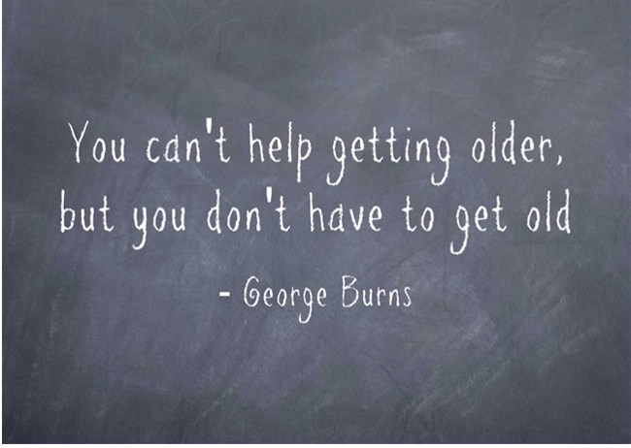
What is Healthy Aging?
A different mindset and approach than “getting older”
Thought of as an inevitable decline, which forces changes to your lifestyle
Rather, “healthy aging” is a comprehensive approach to managing – even improving - health across the lifespan
The aim is to enhance mindfulness of the aging process

Slide 3
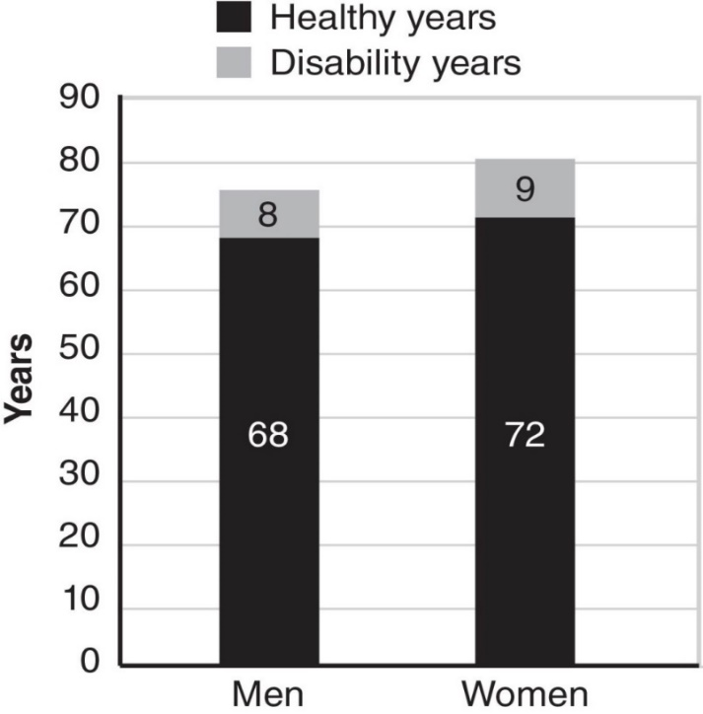
Health
Health is relative rather than absolute.
You can experience any type of health impairment in the absence of disease.
Healthy life expectancy vs longevity

Slide 4
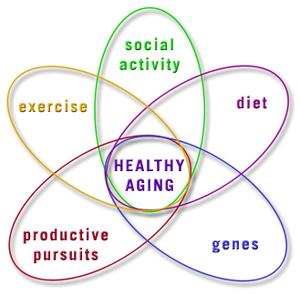
Approach to Healthy Aging
Balanced diet
Lifestyle
Adjustments in environment (rather than stopping activities)
Monitoring health, check ups
Keep both mind and body active
Physical activity is all bodily movement…
…different than exercise – which is purposeful behaviors aimed
at increasing your fitness level

Slide 5
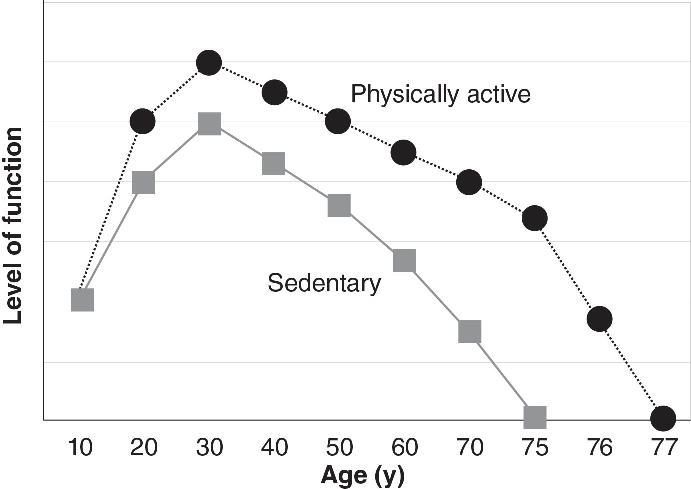
Benefits of Physical Activity
Prevent/treat numerous chronic diseases and disorders
Cardiovascular, metabolic, musculoskeletal, psychological
Economic impact
Maintain physical capacity…
…and independence
Social interaction
Self-confidence
Overall quality of life

Slide 6
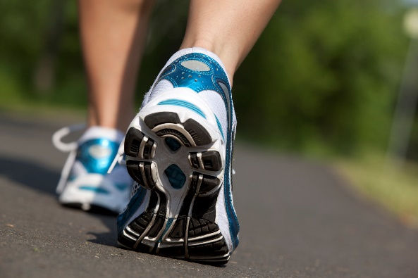
How Much Physical Activity?
30 minutes a day of moderate intensity activity on ≥5 days per week
or
20 minutes of vigorous intensity activity on 3 or more days per week
Moderate: breathing and heart rate increase, can speak complete sentences
Vigorous: can speak short, choppy sentences, breathing and heart rate increase significantly
Step Recommendations:
10,000 steps/day
2,000 steps/day ≈ 1 mile

Slide 7
…More is Better…
Dose-Response Curve for Physical Activity and Health
Dose-Response Curve
Health Benefit
A = Sedentary B = Moderately Active C = Active
A
B
C
Low
High

Slide 8
Is it too little too late?
NO!
The human body is able to adapt and receive benefits
Progressing to an appropriate activity level, though, is important
Some research studies show similar health between active older adults and sedentary adults in midlife
Two struggles are…
Overcoming difficulty to start becoming active
Maintaining a physically active lifestyle for the long-term
Notes:
Link with the previous slide

Slide 9
Risks and Associated Barriers
Fear of injury/falling
Failing at reaching goals or letting yourself down
Lack of knowledge of how to perform exercise
Lack of knowledge about benefits
Social support
Lack of resources
Transportation
Monetary costs

Slide 10
Enabling an Active Lifestyle
Start small and progress!
Anticipate obstacles and plan alternatives
Share with others
Track your engagement, progress, successes
Reward yourself
Keep things Fresh!
Explore new activities or try something that you have not done before

Slide 11
Community Resources
YMCA
Senior Neighbors
Social interaction, activity classes
Healthy Aging Programs offered by the West Michigan Area Agency on Aging
Health-specific programs for chronic conditions
Grand Rapids Parks and Recreation
Activity classes
Trails, parks

Slide 13
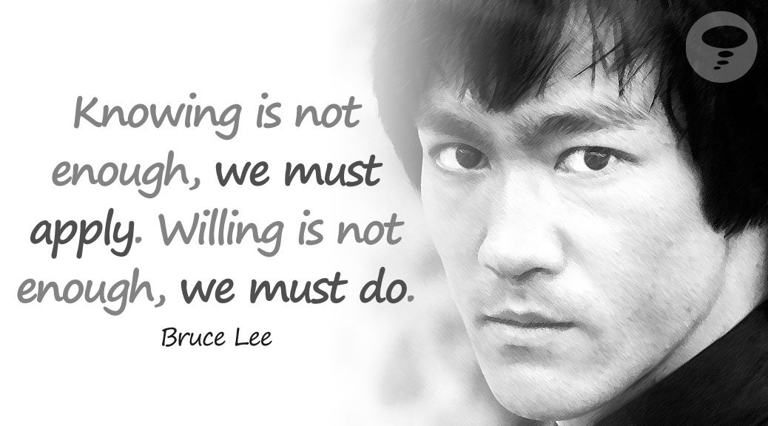
Questions?

