Slide 1

Changes in Memory and Thinking with Age: What Can Be Done about It?
Jing Chen, PhD
Department of Psychology
Grand Valley State University
Chris Kurby, PhD
Department of Psychology
Grand Valley State University
The 11th Annual Art and Science of Aging Conference
February 19, 2016

Slide 2
Outline
What are the changes in our memory and thinking?
What account for these changes?
The Scaffolding Theory of Aging and Cognition
- Park & Reuter-Lorenz, 2009
The Scaffolding Theory of Aging and Cognition
- Reuter-Lorenz & Park, 2014
What can we do about these changes?
Cognitive interventions
Enrichment activities
Interactive cognitive and physical training
Cognitive training on daily functions

Slide 3
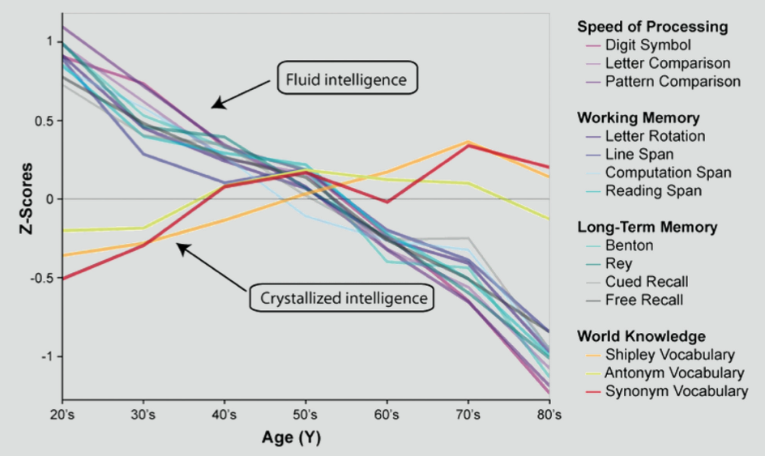
As we age, most of the basic cognitive processes show age-related decline.
Park et al., 2002; Park, Gerard, & Bischof, 2013

Slide 4
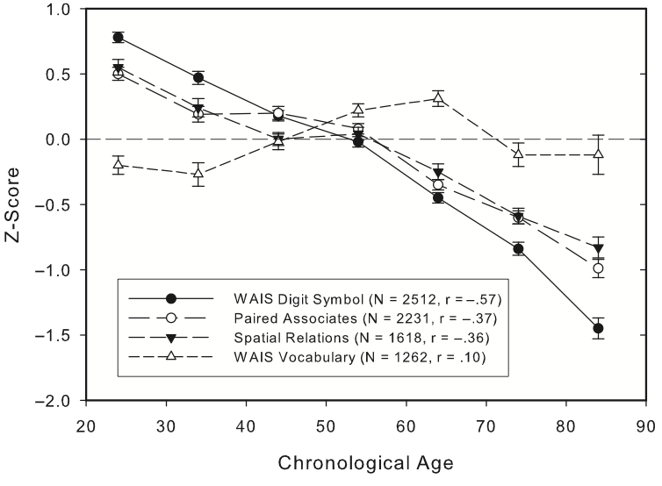
Salthouse, 2006

Slide 5
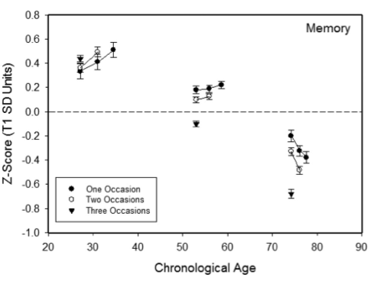
Salthouse, 2014

Slide 6
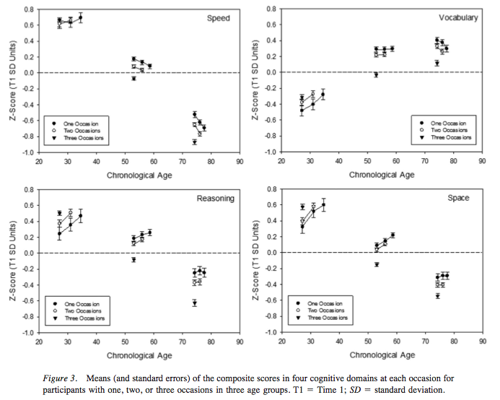
Salthouse, 2014

Slide 7
What accounts for these declines?
Shrinkage
White Matter Changes
Cortical Thinning
Dopamine Depletion
Amyloid/Tau Burden
Dopaminergic Activity
Cortical Thickness
Brain Volume
White Matter Integrity
Biological
Aging
Neural
Challenges
Brain
Structure
Aging
Functional
Deterioration
Brain
Function
Dedifferentiation of Ventral Visual Area
Medial Temporal Recruitment
Increased Default Activity
Neural Specificity
MTL Activity
Network Connectivity
Default Network Modulation
The scaffolding theory of aging
Park & Reuter-Lorenz, 2009
The scaffolding theory of aging-R
Reuter-Lorenz & Park, 2014

Slide 8
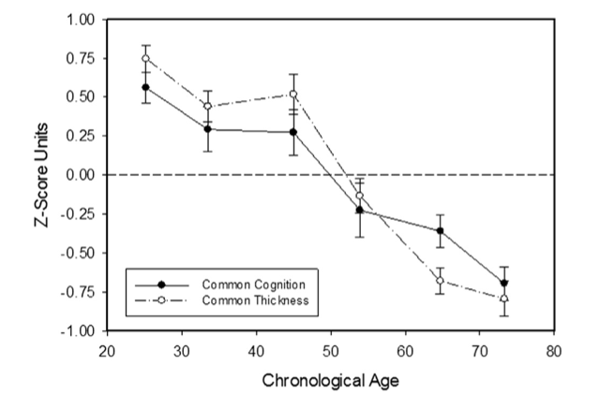
Cortical thickness and cognitive performance on 12 tasks
Salthouse, 2015

Slide 9
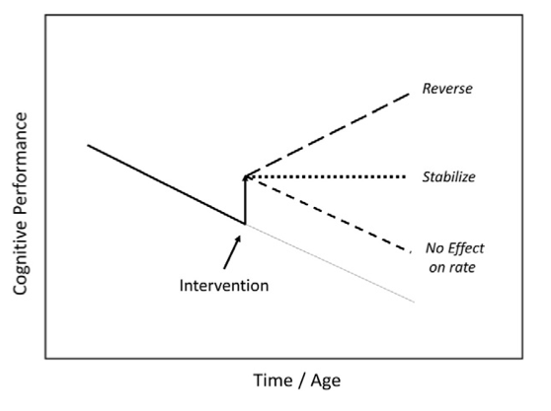
What can we do to slow down, abolish, or reverse the declines?
Salthouse, 2015

Slide 10
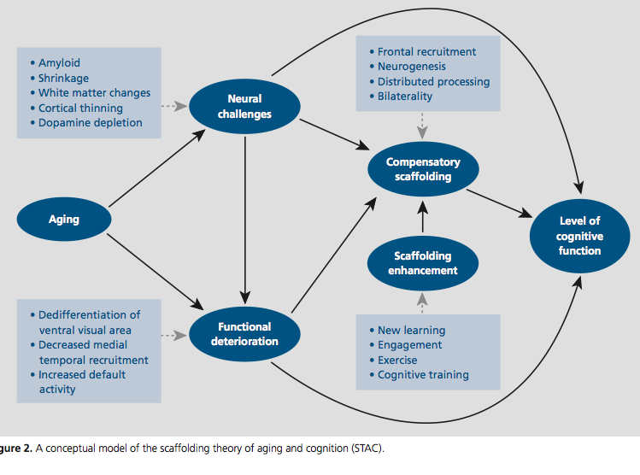
The Scaffolding Theory of Aging and Cognition
Park & Reuter-Lorenz, 2009

Slide 11
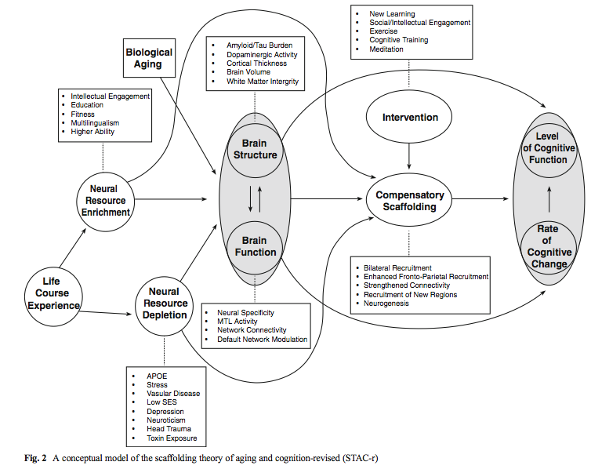
The Scaffolding Theory of Aging and Cognition
Reuter-Lorenz & Park, 2014

Slide 12
The Scaffolding Theory of Aging and Cognition
Reuter-Lorenz & Park, 2014
Amyloid/Tau Burden
Dopaminergic Activity
Cortical Thickness
Brain Volume
White Matter Integrity
Intellectual Engagement
Education
Fitness
Multilingualism
Higher Ability
Biological
Aging
Brain
Structure
Neural
Resource
Enrichment
Life
Course
Experience
Neural
Resource
Depletion
Brain
Function
APOE
Stress
Vascular Disease
Low SES
Depression
Neuroticism
Head Trauma
Toxin Exposure
Neural Specificity
MTL Activity
Network Connectivity
Default Network Modulation

Slide 13
Neural resource enrichment: influences that act to enhance brain structures or function (Reuter-Lorenz & Park, 2014)
More direct pathway:
promoting efficient connectivity
increasing cortical thickness
synaptic density
Increasing brain-derived neurotrophic factor (BDNF)
Improve vasculature
Less direct pathway:
increase the capacity for compensation
Enable enhanced scaffolding
better able to cope with pathology

Slide 14
The Scaffolding Theory of Aging and Cognition
Reuter-Lorenz & Park, 2014
Amyloid/Tau Burden
Dopaminergic Activity
Cortical Thickness
Brain Volume
White Matter Integrity
New learning
Social/Intellectual Engagement
Exercise
Cognitive Training
Meditation
Biological
Aging
Intervention
Level
of Cognitive
Function
Brain
Structure
Compensatory
Scaffolding
Rate
Of
Cognitive
Change
Brain
Function
Bilateral Recruitment
Enhanced Frontal-Parietal Recruitment
Strengthened Connectivity
Recruitment of New Regions
Neurogenesis
Neural Specificity
MTL Activity
Network Connectivity
Default Network Modulation

Slide 15
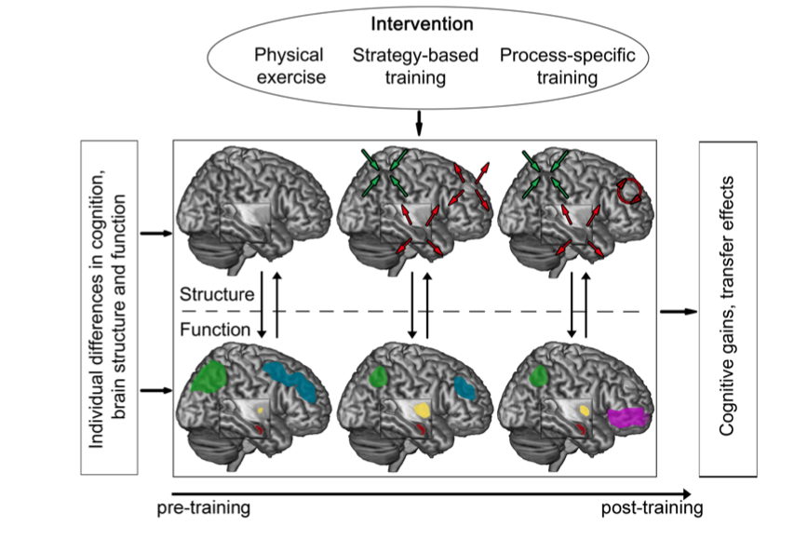
Intervention/training induced brain changes:
Brehmer, Kalpouzos, Wenger, & Lovden, 2014

Slide 16
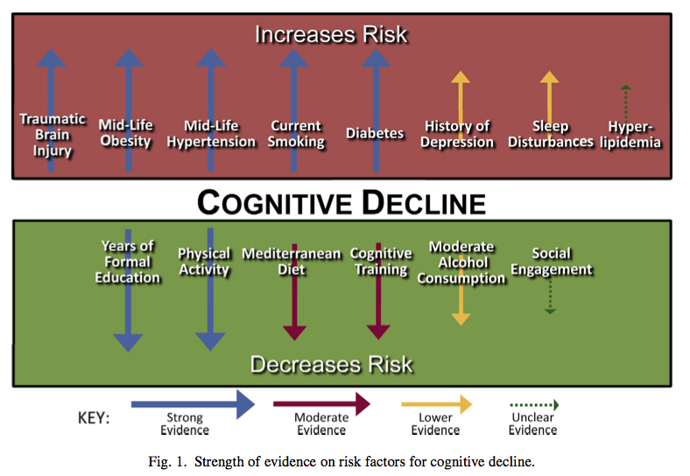
Modifiable risk factors for cognitive decline:
The Alzheimer’s Association evaluate and reported on the state of evidence on modifiable risk factors (Baumgarta et al., 2015)

Slide 17
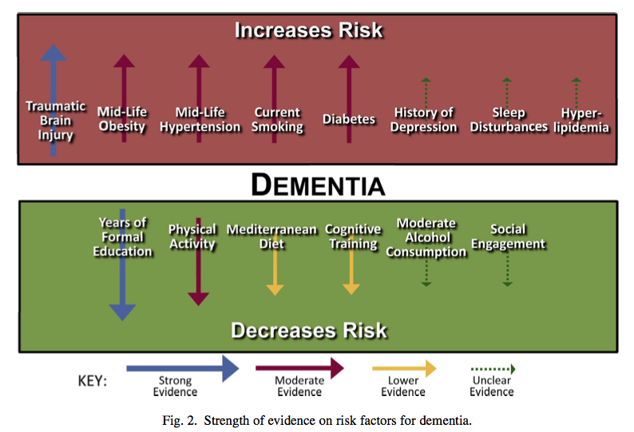
Modifiable risk factors for dementia: Baumgarta et al., 2015

Slide 18
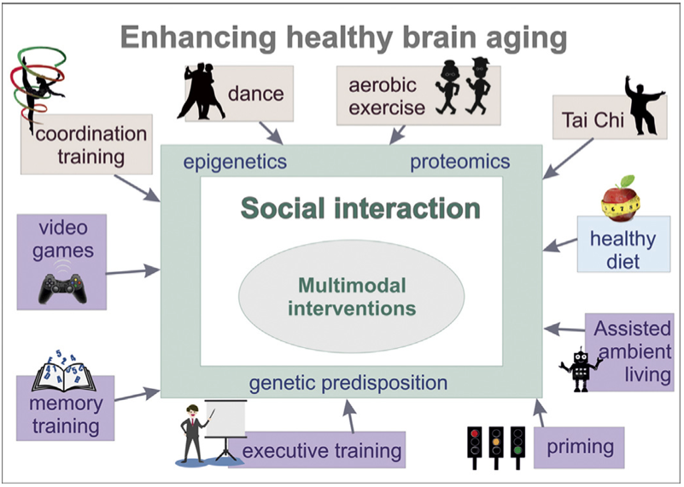
Ballesterosa, S., Kraftb, E., & Tzirakid, C (2015). Maintaining older brain functionality: A targeted review. Neuroscience and Biobehavioral Reviews, 55, 453–477.

Slide 19
Aerobic/physical exercises:
Cognitive exercises/interventions:
Life style factors: Mora, 2013
Reduction of food intake and healthy diet:
A reduction of food intake by 20% to 40% (proper nutrition)
Decrease in the detrimental effects produced by free radicals
Increase in neurogenesis in hippocampus
The effects are regionally specific.
Protective in AD and Parkinson’s disease.
Reduction in chronic stress:
Stress increases in glucocorticoids in different areas
Stress decreases in neurogenesis in hippocampus

Slide 20
What was found in intervention/training studies?
Cognitive Interventions
Salthouse, 2015 – A modest amount of cognitive intervention
Part of the Virginia Cognitive Aging Project (VCAP)
Age: 18-80; healthy adults
N >1000; Time1 to Time 2: 1-12 years
Measures:
Memory tasks
Speed tasks
Spatial visualization
Intervention group: Time 1 – perform 3 versions
Control group: Time 1 – Perform 1 version

Slide 21
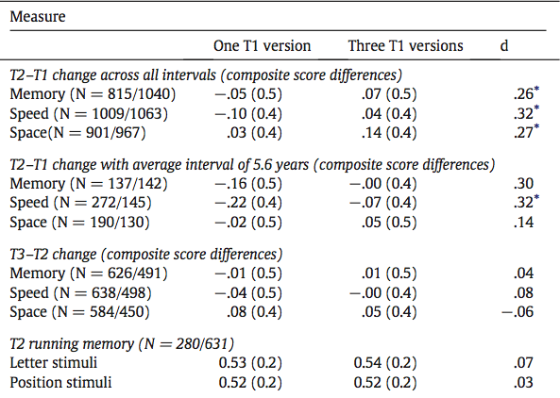
Major finings: Salthouse, 2015
The effects of intervention were significant.
The effects of intervention may persist.

Slide 22
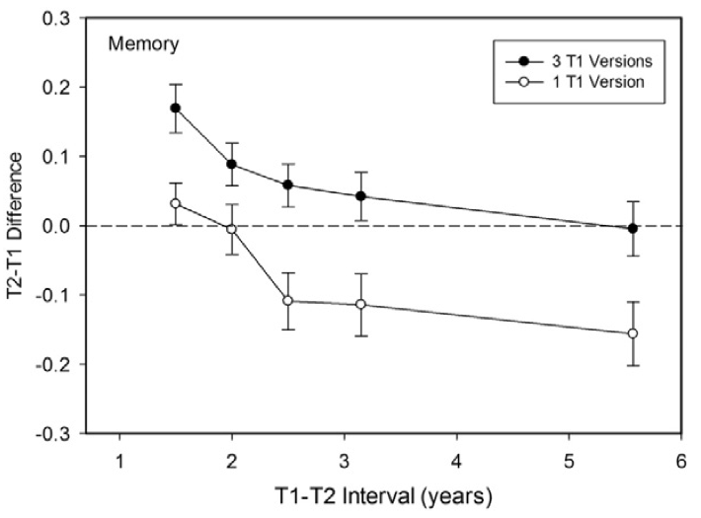
Major finings: Salthouse, 2015
There is no evidence for transferring the intervention effects to other measures.
Intervention may not alter the rate of age-related changes in these cognitive abilities.

Slide 23
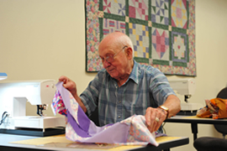
The Impact of Sustained Engagement on Cognitive Function
The Synapse Project : Park et al., 2014
N = 259 (N=211 – 85% completed the 14-week training)
Age range: 60-90 (M=71)
Training/control conditions: 14 weeks
15 -18 hours /week
Productive-Engagement Conditions:
Photo:
Quilt:
Dual: Photo (half) + Quilt (half)
Receptive-Engagement Conditions:
Social: like a social club – instructor-directed activities (cooking, field trip)
Placebo: structured cognitive engaging activities (assigned word games)

Slide 24
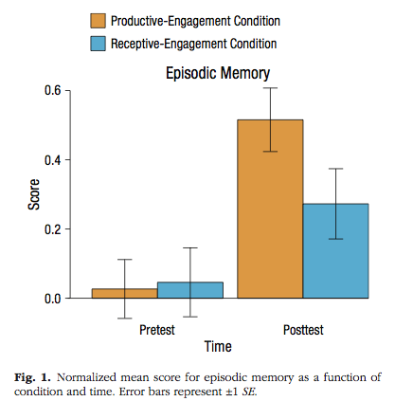
Active engagement seemed to help episodic memory – Park et al., 2014

Slide 25
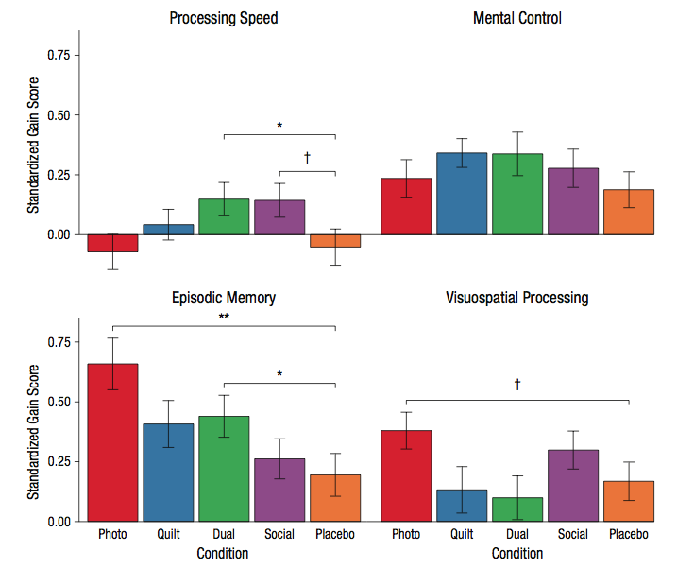
Active engagement seemed to help episodic memory – Park et al., 2014

Slide 26
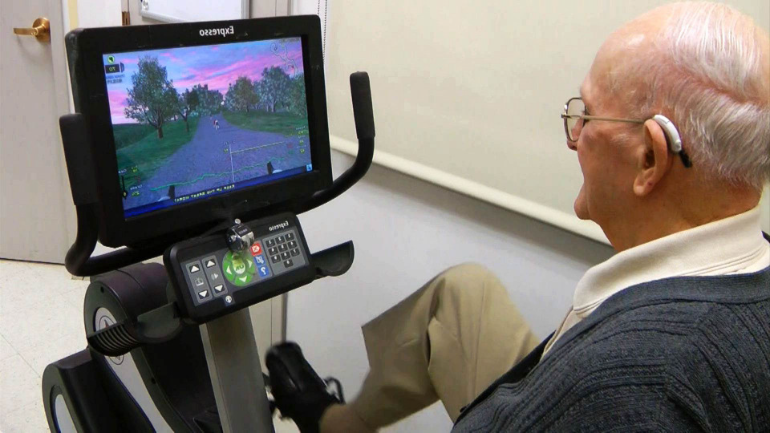
Interactive mental and Physical exercise
Barcelos et al., 2015
N=64 (Mean age = 82)
Training for 3 months:
Stationary bike + Low cognitive demand task (Bike tour)
Stationary bike + High cognitive demand task (Video game)
45 minutes, 3-5 times/week
Higher demand video game

Slide 27
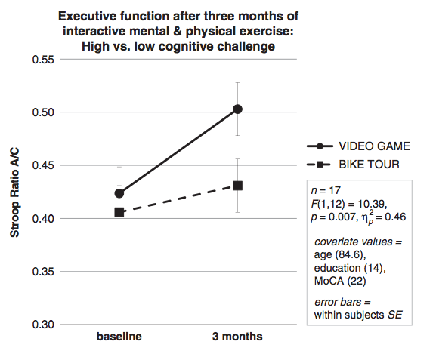
Barcelos et al., 2015
Higher demands training benefited some executive functions more than lower demands training (cognitive + physical -exergaming).
Self rated everyday functioning in regards to memory and concentration were higher after 3 months of exergaming regardless the level of cognitive demands.

Slide 28
Long term effects of cognitive training:
The ACTIVE project
Advanced Cognitive Training for Independent and Vital Elderly
Rebok et al., 2014
N=2832
Mean age=73.6
10 years later, around 400 participants in each of the three training groups and the control group
Intervention:
Initial training: 10 training sessions (60-75 mins over 5 to 6 wks).
memory, reasoning, or speed processing
Booster Training: 4 sessions, 11-35 months after the initial training.

Slide 29
The ACTIVE project
Advanced Cognitive Training for Independent and Vital Elderly
Rebok et al., 2014
Outcome Measures:
Cognitive abilities (3 tasks each)
Everyday function:
Self-reported: (Instrumental Activities of Daily Living)
Performance-based:
Everyday Problem Solving
Everyday speed

Slide 30
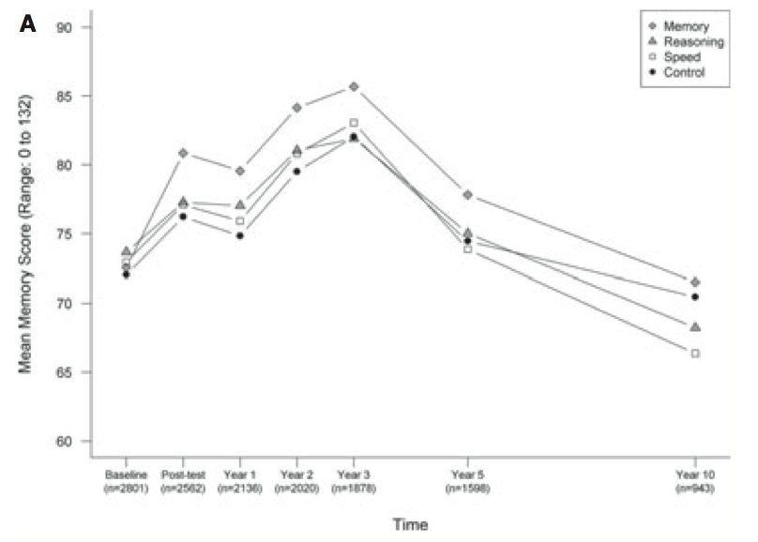
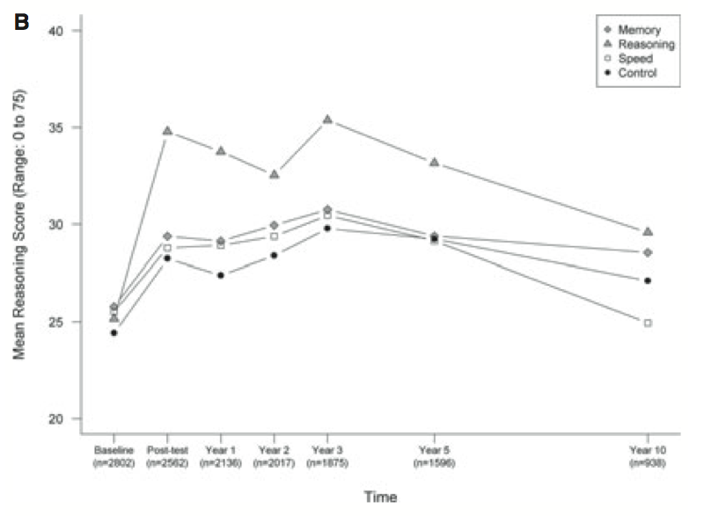
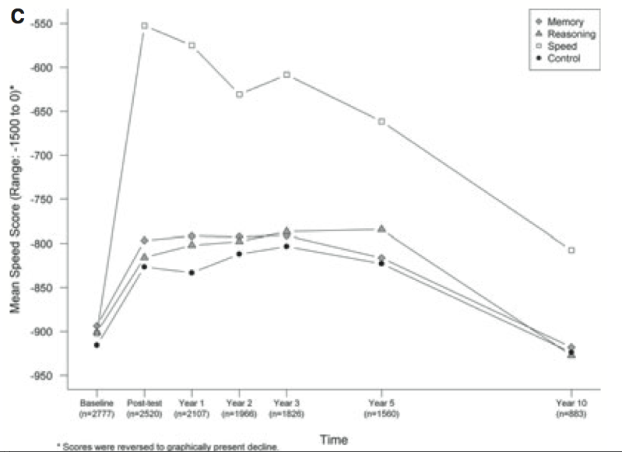
Memory
Reasoning*
Speed**

Slide 31
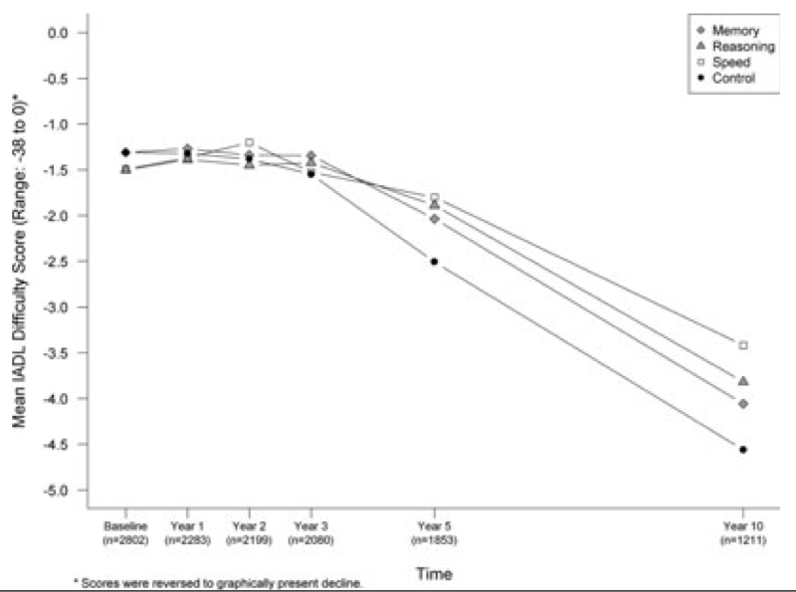
Training effect was significant only on self-reported measure of daily function (IADL)

Slide 32
Can we do targeted mental training to improve mental functioning?
Christopher A. Kurby

Slide 33
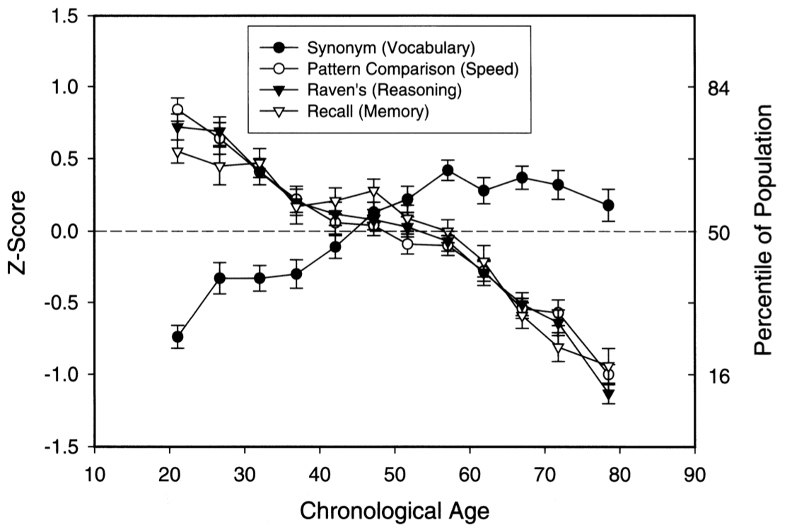
If we exercise our minds can we change our developmental trajectory?
Salthouse (2004)

Slide 34
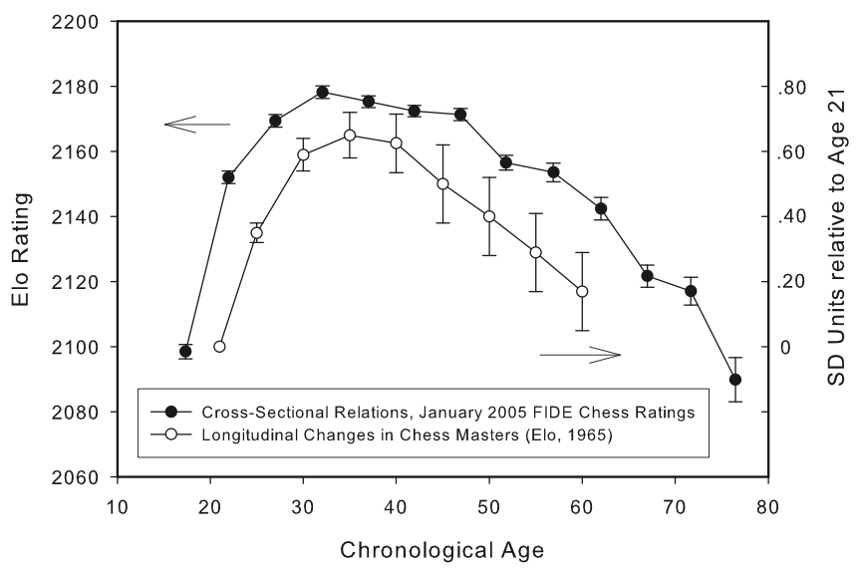
If we play chess frequently, do we maintain chess performance?
Salthouse (2006)

Slide 35
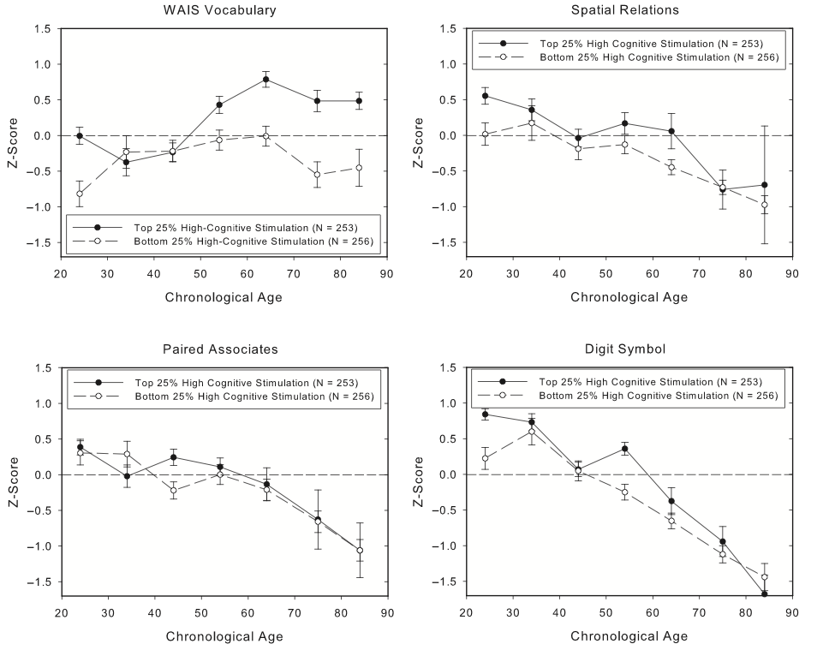
If we exercise our minds can we change our developmental trajectory?
Salthouse (2006)

Slide 36
If we exercise our minds can we change our developmental trajectory?
Do people who engage in mental exercise often (i.e., 10 hours a week of crossword puzzles) age different cognitively?

Slide 37
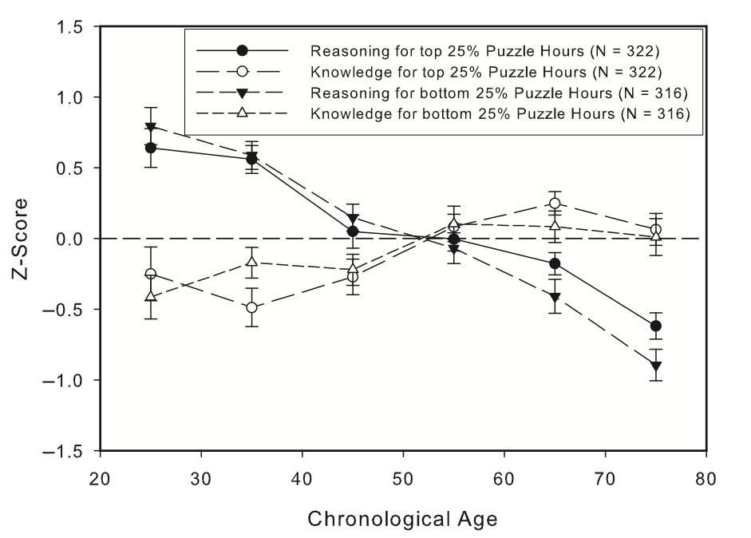
If we exercise our minds can we change our developmental trajectory?
Salthouse (2006)

Slide 38
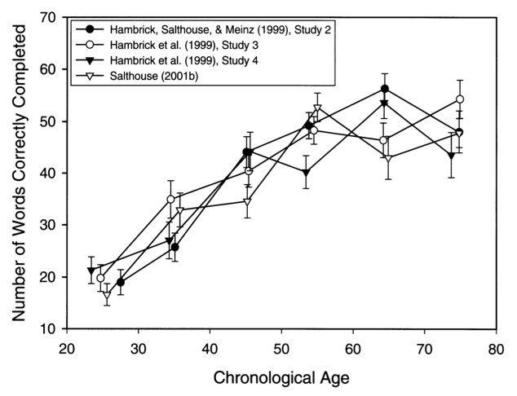
So what mental functions does mental exercise improve?
Salthouse (2004)

Slide 39
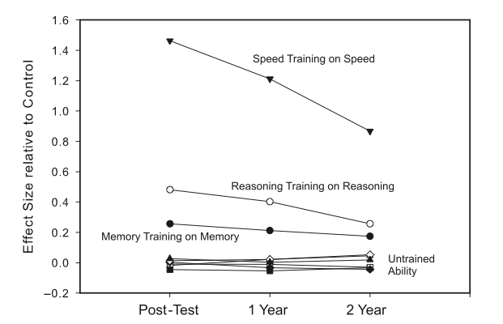
But can targeted and systematic training be beneficial?
ACTIVE clinical trial – Ball et al. (2002), JAMA
Notes:
ten 60- to 75 minute sessions over a 5- to 6-week period.

Slide 40
Let’s take a step back
Hmm, what is going on?
What produces cognitive functioning? What is the part of the mind that “does the thinking?”

Slide 41

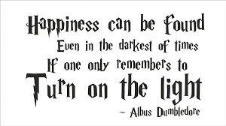

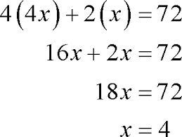
Working Memory
Mental system that stores and processes information.
  Most subjectively experience it as “the mind”
  Does the “work”
We could certainly slow the aging process down if it had to work its way through Congress.

Slide 42
Working Memory
Two critical defining features:
  1) Has limited “space,” and the amount of “space” can differ from person to person.
  2) Has limited “processing power,” which can differ from person to person.

Slide 43
How is it measured?
Reading Span Test
  Task 1: indicate whether the sentence makes sense. (Processing component)
  Task 2: remember the word in red (Storage component)

Slide 44
The cat chased the mouse in the banana. ?
TYPE

Slide 46
Tim practiced the new skating routine. ?
CANDY

Slide 47
The store was almost destroyed by tomato. ?
GUN

Slide 48
???
Notes:
Candy, gun

Slide 49
The fans at the football game wore bikes. ?
FOOD

Slide 50
The chef prepared dessert for her guests. ?
TRADE

Slide 51
In the library, the girl read her book. ?
LEAD

Slide 52
Last fall the farmers had a good sofa. ?
FACT

Slide 53
The bear looked for food in the pencil. ?
HAND

Slide 54
Yesterday, the mailman brought the letter. ?
COLOR

Slide 55
???
Notes:
Food, trade, lead, fact, hand, color

Slide 56
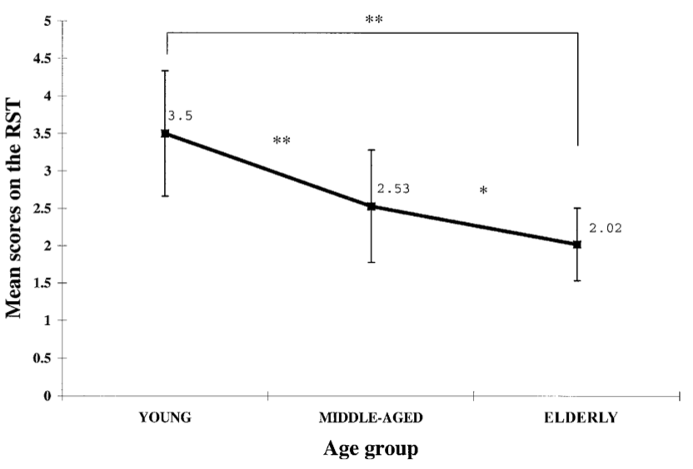
Does WM decline with age?
Meguro et al. (2000)

Slide 57
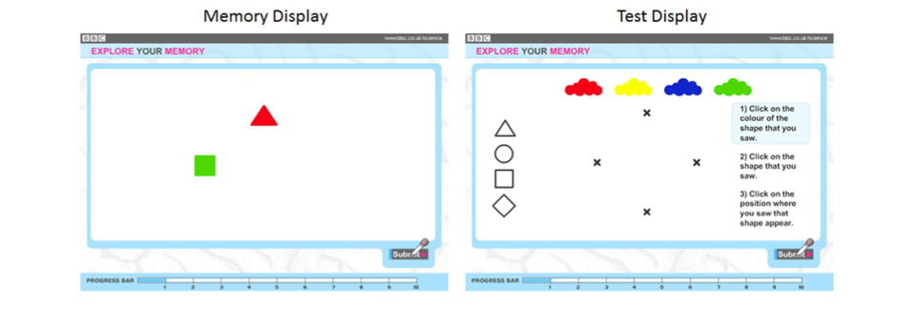
Visual working memory changes with age (e.g., Brockmole & Logie, 2013)
Notes:
55,753 subjects from 138 countries

Slide 58
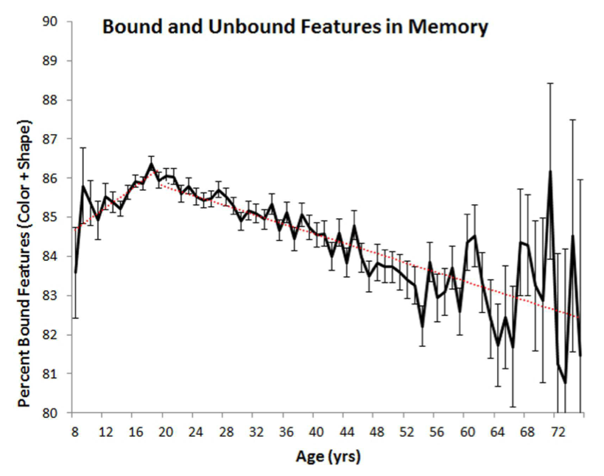

Slide 59
Can Working Memory be Trained?
(RICHMOND, MORRISON, CHEIN, AND OLSON, 2011)
Assessed if practicing WM tasks can improve performance on those tasks.
Assessed whether training WM can cause transfer to other tasks.
  Near transfer: Other WM tasks that they did not practice
  Far transfer: Reasoning/attention and memory

Slide 60
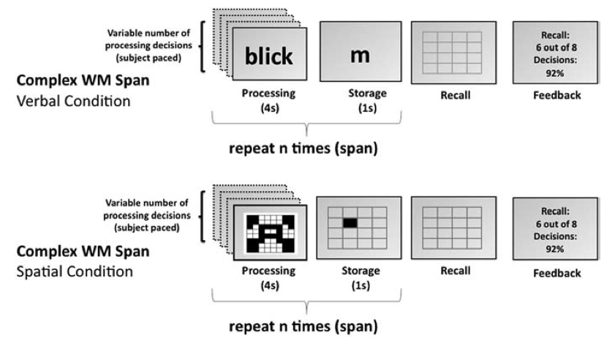
WM training regime
Twenty 30 minute training sessions over a span of 4-5 weeks

Slide 61
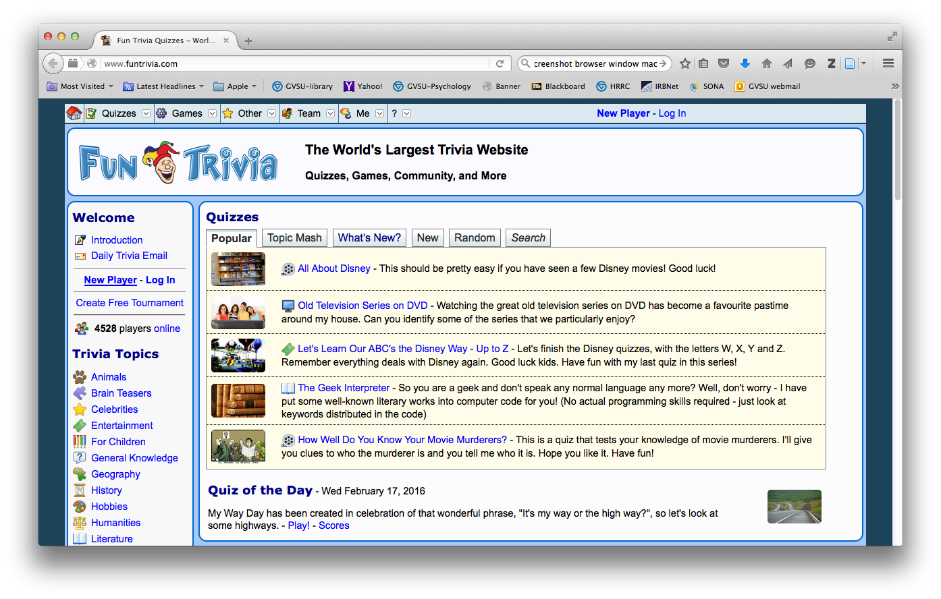
Control group
Twenty 30 minute training sessions over a span of 4-5 weeks

Slide 62
Near transfer post tests:
  Reading span
  Digit span
    4, 8, 2
    5, 7, 3, 8
    6, 8, 3, 2, 5
    8, 6, 7, 4, 5, 9

Slide 63
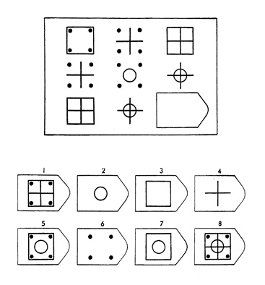
Far transfer post tests:
  Raven’s Standard Progressive Matrices
Notes:
7

Slide 64
Far transfer post tests:
  Test of Everyday Attention (TEA)
    Six different counting and search tasks
      E.g., “Elevator Counting with Distraction: counting low-pitched tones and ignoring higher-pitched tones”
Notes:
7

Slide 65
Far transfer post tests:
  Episodic memory (California Verbal Learning Test – CVLT)
    16 item list-learning task
      A) recall words immediately
      B) recall words after a distracter list
      C) recall words after a 20-min delay
Notes:
7

Slide 66
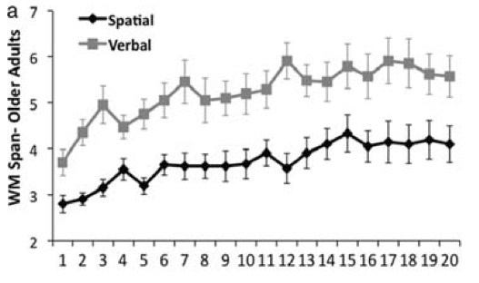
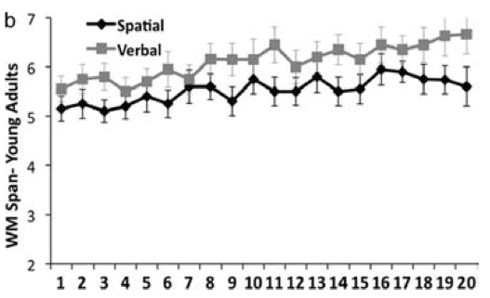
Practicing WM tasks improves performance on those tasks

Slide 67
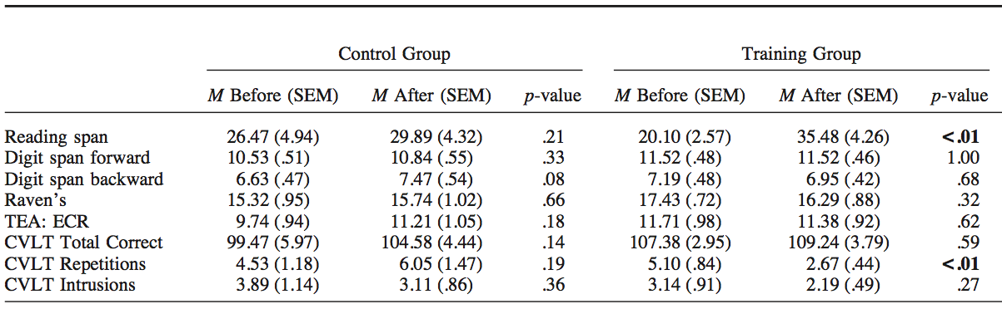
Does WM training lead to transfer?
But, if you only include the older adults who actually showed improvement in WM performance during their 5 week training, they improved in the 20-min delay condition for the CVLT.

Slide 68
Richmond et al (2011) showed that WM can cause *some* near and far transfer
What does that mean?
  WM training may generally improve WM
  WM training may improve long term memory functioning (but maybe not intelligence)

Slide 69
Does this effect replicate across studies?
Meta-analysis tested whether WM training improves WM, across a large collection of studies (Melby-Lervåg & Hulme, 2013)
  Delay
  Far transfer
  Near transfer

Slide 70
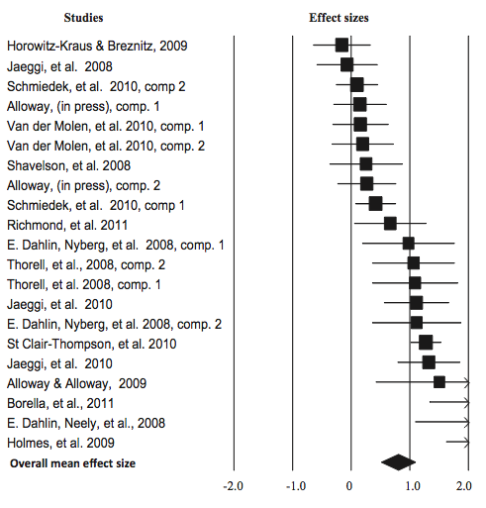

Verbal WM: Immediate Test

Slide 71
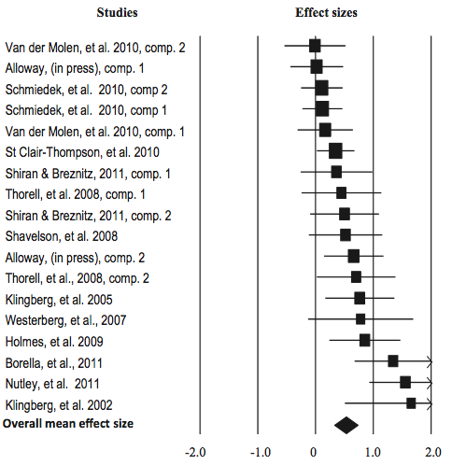
Visuospatial WM: Immediate Test

Slide 72
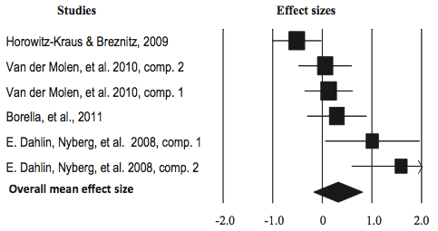

Verbal WM: Long-term delay (9 mo)

Slide 73
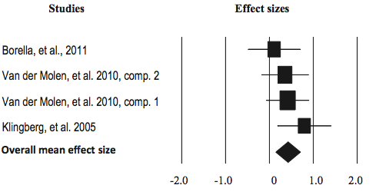
Visuospatial WM: Long-term delay (9 mo)

Slide 74
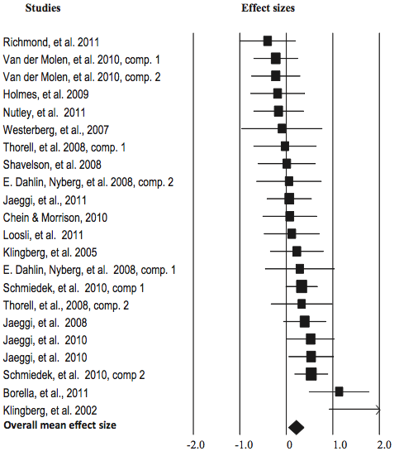
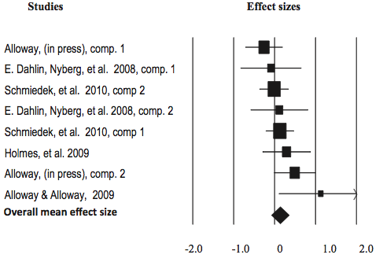
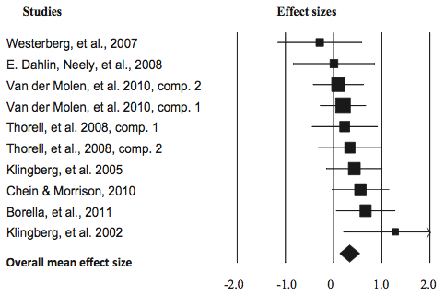
Far transfer
Non-verbal problem solving
Verbal Ability
Attention

Slide 75
Subjective feelings
More people in the training indicated they felt that their attention and memory improved, than in the control condition.

Slide 76
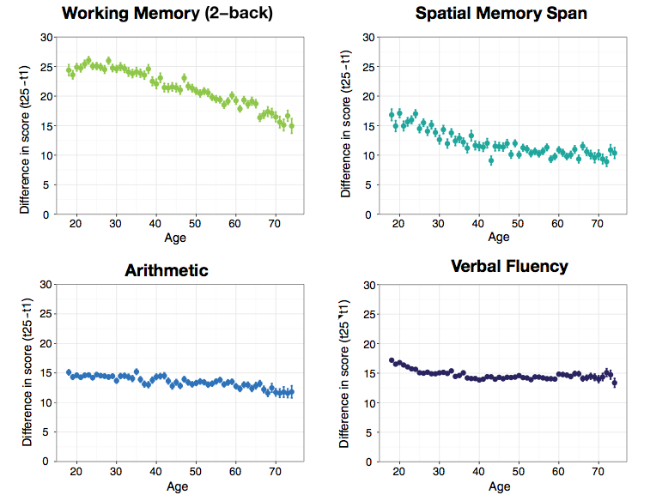
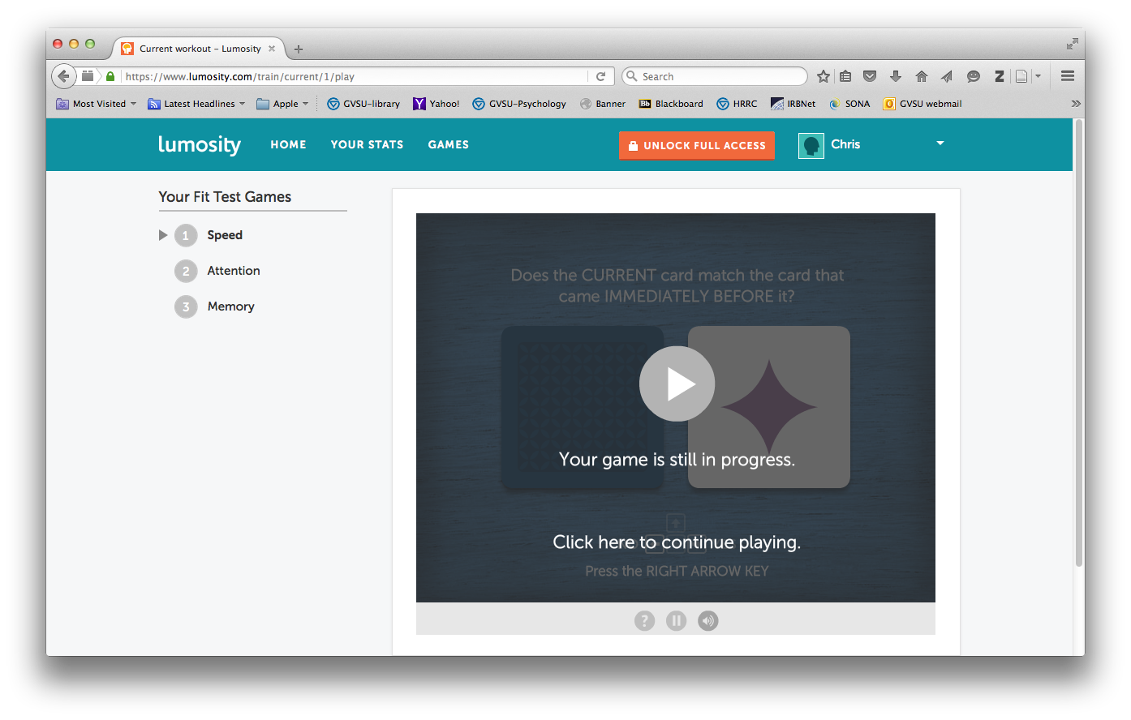
Can I “train” at home?
Lumosity (www.lumosity.com)
  Does it work?
    Probably not (see FTC lawsuit against Lumosity for false claims)
    (warning: most studies conducted by founder and people at Lumosity!!) – e.g., Sternberg et al (2013)
Notes:
The chief scientific officer at Lumosity only has a bachelor’s degree in Psychology, and only have 1 scientific publication, as far as I can tell.

Slide 77
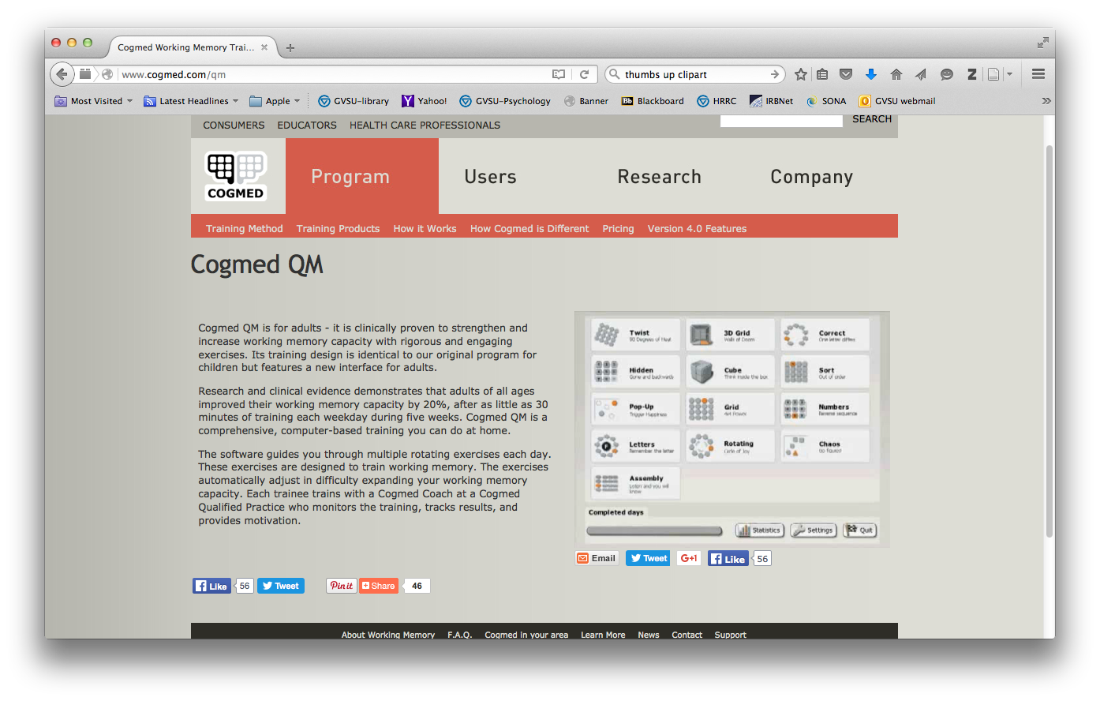
Can I “train” at home?
CogMed
  Does it work?
    The research shows *some* positive gains (Melby-Lervåg & Hulme, 2013) in immediate testing (but no transfer)
    Cognifit (http://www.cognifit.com/) and Jungle Memory (http://www.junglememory.com/) show similar effects to CogMed

Slide 78
My advice: If you like brain games because they are fun then go for it. But, don’t expect large changes in thinking ability beyond the game.

Slide 79
What does this all mean for working memory and training?
WM is quite stable, but it can be modified
  WM training improves WM in the short term
  Sometimes training can produce transfer to attention and memory
But, its effects are limited and maybe short lived
But, clearly more research is needed

Slide 80
Thank you!!

Slide 81
GVSU Psychology Study on Aging
Participants needed (60 yrs and older)
I am conducting a study on memory and perception in aging.
A one-time 1.5-2 hour session
If you are interested please give me your contact information and we can talk further.
  Email: kurbyc@gvsu.edu
  Phone: 616-331-2418

