Slide 1
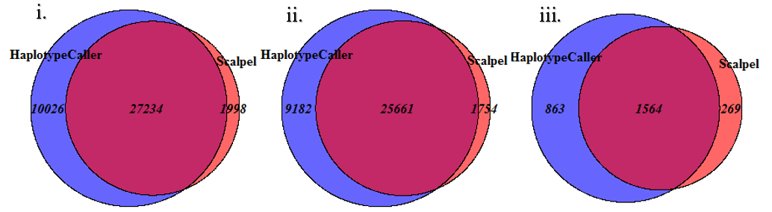
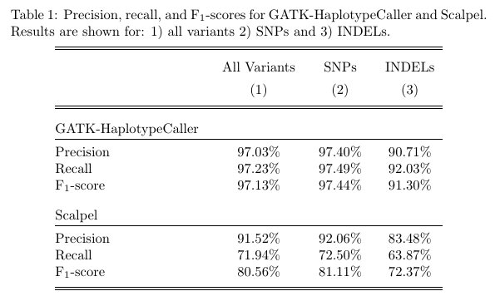
Comparing the Performance of Scalpel to GATK-HaplotypeCaller Using Simulated Reads
Matthew Lueder
Medical and Bioinformatics Graduate Program, School of Computing and Information Systems,
Grand Valley State University
Abstract
Data Simulation
In order to test the performance of Scalpel and GATK-HC I used simulated data
Reasoning: With simulated data I knew exactly what variants should have been found and should not have been found.
Simulated data needs to be accurate.
Variants in simulated data should be biologically relevant.
Errors associated with NGS process should also be simulated
VarSim
Generates perturbed genome from reference genome.
Perturbed genome can be made biologically relevant by sampling induced variation from a user provided file.
Creates a truth set of variants
ART
Generates sequencing reads from a user provided genome
Induced technology-specific sequencing errors based on known error profiles
Simulation of reads
Performed using the tools VarSim + ART
FASTQ files representing paired-end reads from a HiSeq 2500 sequencer were generated.
Simulated data was made to mimic a human genome
VarSim sampled variants from a validated set of 5.4 million variants, provided by Eberle et al.
Mean coverage = 30x
Read length = 150 bp
Mapping reads to a reference genome
Used BWA-MEM w/ default parameters
Output piped directly into biobambam2’s bamsormadup tool.
Sorts + marks duplicates
Calling variants with Scalpel and GATK-HC
Used default parameters
Analysis was limited to exomic locations (as defined by BED file)
GATK-HC creates a variant call format (VCF) file
Scalpel creates a database of variants
Splitting variants into groups
Variants split into 3 groups for each pipeline:
All variants
Only SNPs
Only INDELs
Comparing variants to calculate metrics
Variants compared using PrecisionFDA’s comparison tool
Concordance between GATK-HC and Scalpel was calculated for SNPs, INDELs, and all variants.
Precision, recall, and F1-score of Scalpel and GATK-HC calculated for SNPs, INDELs, and all variants.
Discussion
The ability to accurately call variants from next-generation sequencing data (NGS) is a necessity for the success of NGS in clinical genomics. Therefore, there is a need for continuous in-depth reporting on the accuracy of state-of-the-art variant calling algorithms. In this paper, the performance of two local de novo reassembly-based variant calling tools are benchmarked using a simulated dataset. Genome Analysis Tool Kit HaplotypeCaller (GATK-HC) is consistently reported to be one of the best performing variant callers. Scalpel is a newer tool which has recently been reported to outperform GATK-HC in calling insertion/deletion elements (INDELs). The goal of this study is to provide an up to date and in-depth comparison of these two variant callers using a realistic simulated dataset. Simulated reads were generated using the tools VarSim and ART, then aligned to a reference genome using BWA-MEM. Precision, recall, and F1-scores were calculated by comparing variants called by GATK-HC and Scalpel to a truth-set of variants using PrecisionFDA’s comparison tool. GATK-HC was observed to have higher precision and recall for single nucleotide polymorphisms (SNPs) and INDELs.
The concordance of INDELs between GATK-HC and Scalpel closely mirrors what was found in Narzisi et al., which found a concordance of 59.45%.
2.6% of called SNPs where false positives, which is consistent with Yi et al. which reported error rates of 3.27% and 2.53% for SNP calls made by two versions of GATK-HC
The results found in this study are consistent with the view of GATK being the ‘gold standard’ variant calling tool.
GATK-HC outperformed Scalpel in calling SNPs and INDELs
These results are significantly different than the results reported in the Narzisi et al. (which reported Scalpel to have higher precision). This could be due to:
Using different versions of GATK/Scalpel
An additional filtering step performed by Narzisi et al.
Further analysis could be done to:
Determine how changing Scalpel's and GATK-HC’s parameters affect their ability to call variants.
Test performance of Scalpel’s other usage modes:
De novo mode is used to call de novo germline variants in nuclear families of four people
Somatic mode is used to detect somatic mutations given data for a tumor/normal pair
Test performance of GATK-HC and Scalpel with different steps in pipeline.
Filtering reads before alignment based on quality scores
Use base quality score recalibration (BQSR) in GATK-HC pipeline
Applying quality filters after the variant calling procedure
Background
Variant Calling
Variant calling is an important step in next-generation sequencing (NGS) analysis.
Variant calling = Finding areas of the genome which are different (from a reference genome)
Discrete areas of variation = variants
Types of variation:
Single nucleotide polymorphisms (SNPs)
Insertion/deletion elements (INDELs)
Structural variation (SV)
Variant calling is not 100% accurate
It is important to have a good understanding of the performance of variant calling tools. This is accomplished in benchmarking studies.
These give researchers an understanding of what tools will give them the most accurate results.
Variant calling tools are rapidly evolving.
Needs to be continuous reporting
Scalpel vs. GATK-HC
Scalpel and GATK-HC are state-of-the-art variant calling tools.
GATK-HC is considered a ‘gold standard’ tool
Both perform local de novo reassembly using de Bruijn graphs.
Local reassembly:
Smaller regions of genome reassembled.
Previous alignment information used to localize reads.
Helps with computation.
This approach has been shown to result in more accurate INDEL calls.
Differences between GATK and Scalpel:
Specifics of de Bruijn graph assembly
How area to reassemble is defined
How genotype is inferred from assembled sequences
Materials and Methods
Results
References
Broad Institute. Genome Analysis Toolkit Guide. [Online].; 2009 [cited 2017 April 8. Available from: https://software.broadinstitute.org/gatk/ documentation/article.php?id=4148
Eberle M, Fritzilas E, Krusche P, Källberg M, Moore B, Bekritsky M, et al. A reference data set of 5.4 million phased human variants validated by genetic inheritance from sequencing a three-generation 17-member pedigree. Genome Research. 2017; 27.
Fang H, Bergmann E, Arora K, Vacic V, Zody M, Iossifov I, et al. Indel variant analysis of short-read sequencing data with Scalpel. Nature Protocol. 2016 November; 11(12).
Mu J, Mohiyuddin M, Li J, Bani Asadi N, Gerstein M, Abyzov A, et al. VarSim: a high-fidelity simulation and validation framework for high-throughput genome sequencing with cancer applications. Bioinformatics. 2015 December; 31(9).
Narzisi G, O'Rawe J, Iossifov I, Fang H, Lee Yh, Wang Z, et al. Accurate de novo and transmitted indel detection in exome-capture data using microassembly. Nature Methods. 2014 August; 11(10).
U.S. Food and Drug Administration. PrecisionFDA. [Online].; 2017 [cited 2017 March 30. Available from: https://precision.fda.gov.
Yi M, Zhao Y, Jia L, He M, Kebebew E, Stephens R. Performance comparison of SNP detection tools with illumina exome sequencing data––an assessment using both family pedigree information and sample-matched SNP array data. Nucleic Acids Research. 2014 May; 42(12).
Figure 2. Venn diagrams showing the concordance between GATK-HC and Scalpel for: i) all variants ii) only SNPs iii) only INDELs. The blue area represents number of calls specific to GATK-HC. The red area represents calls specific to Scalpel. The purple area represents calls shared by GATK-HC and Scalpel.
Total concordance between the two pipelines = 69.37%
Concordance for SNP calls = 70.12%
Concordance for INDEL calls = 58.01%
Figure 1. Flowchart representing project workflow. Files used as input/output are represented by square boxes. Tasks are represented by ellipses. Databases are represented by cylinders. The final task is shown as a double ellipse. Resources with an arrow pointing to a task represent that the resource was used in the task. Tasks with arrows pointing to a resource represent that the resource was produced by the task
This analysis can be broken into 5 basic steps:
Simulation of reads using
Mapping simulated reads to a reference genome
Calling variants with Scalpel and GATK-HC
Splitting variants into groups based on variant type
Comparing variants and calculating metrics
GATK-HC had better precision and recall for all variants, SNPs, and INDELs

