Slide 1
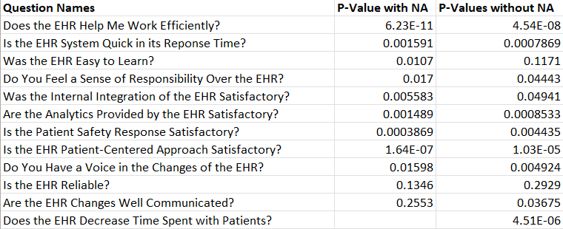
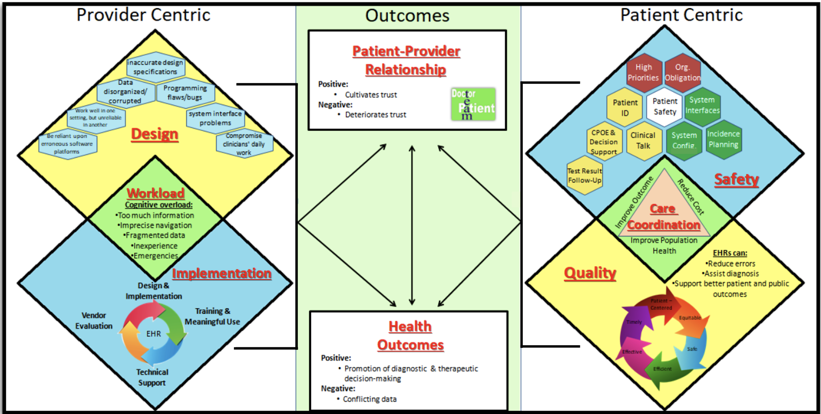
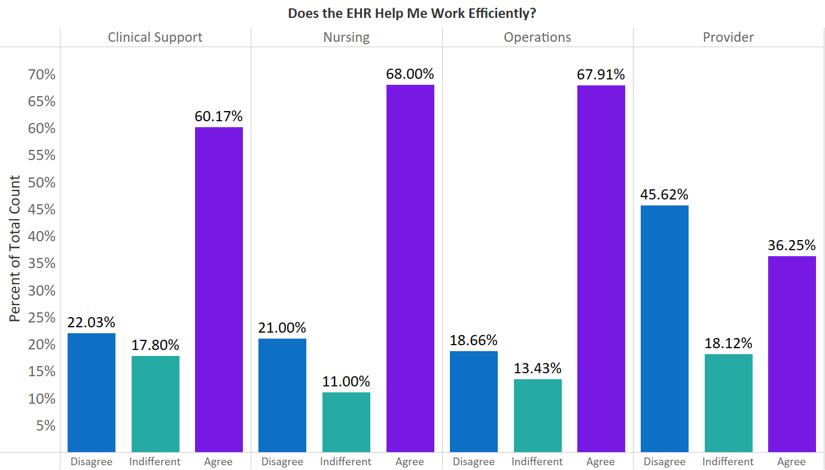
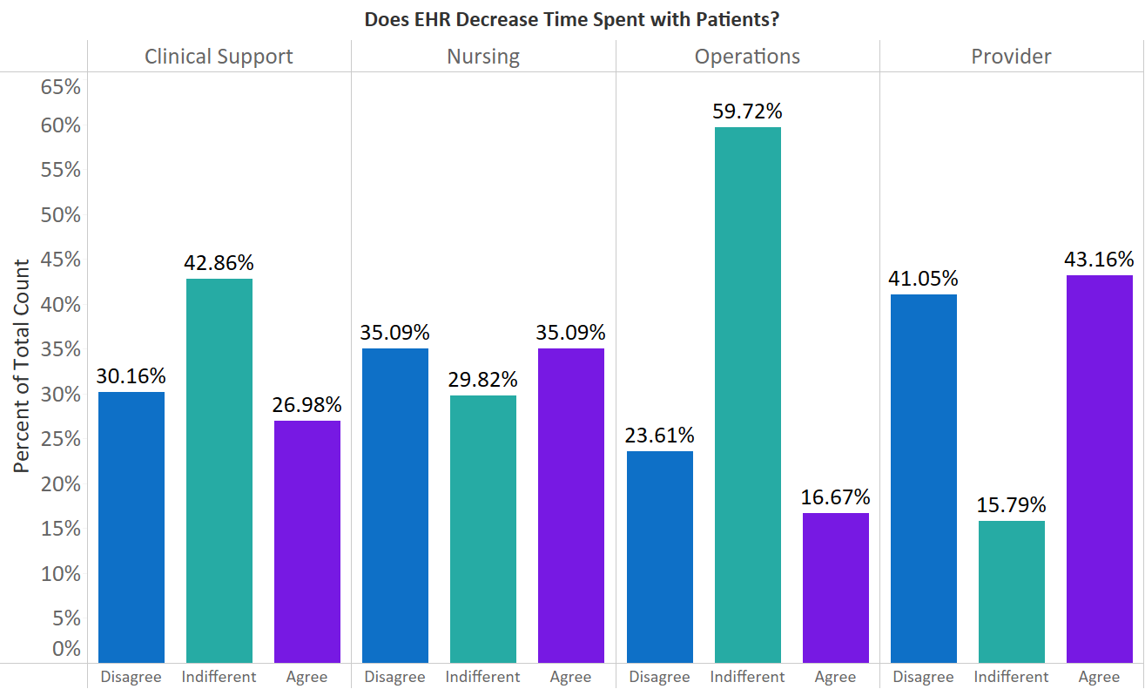
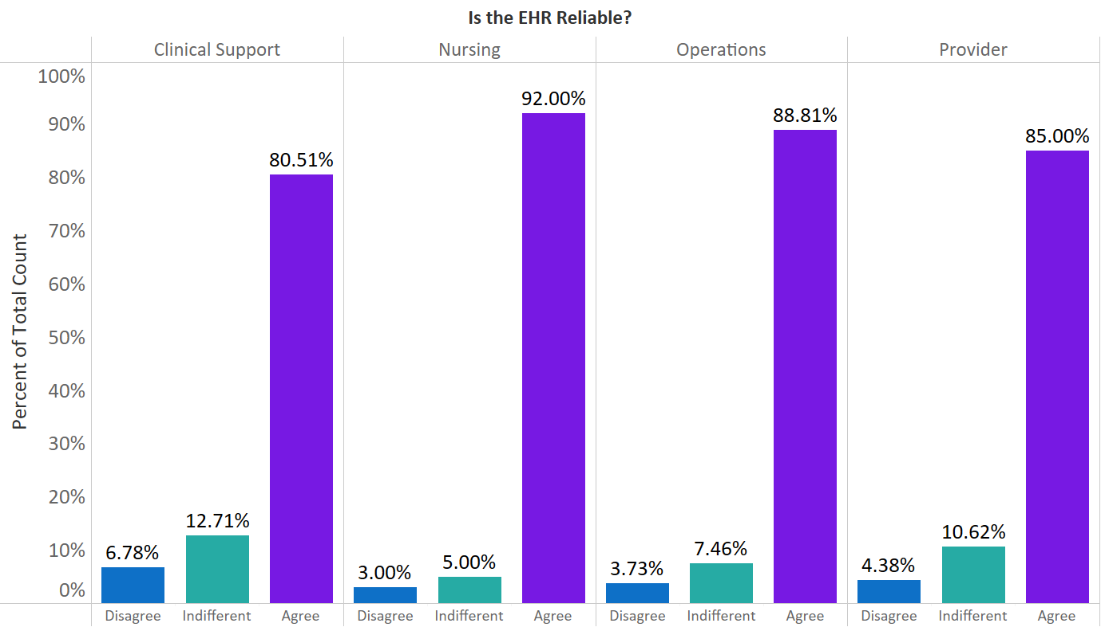
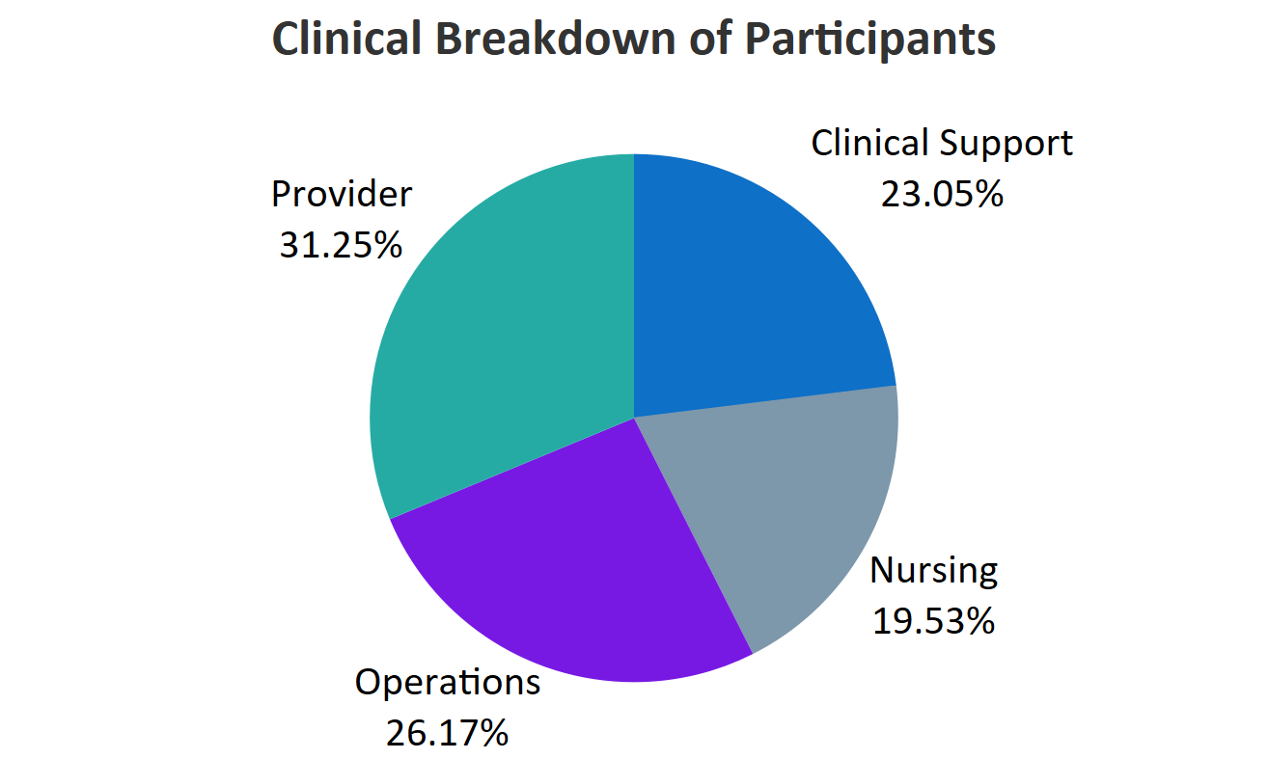
ELECTRONIC HEALTH RECORD USABILITY AND PATIENT SAFETY STUDY
Jacob Jackson, Sierra Strutz, Guenter Tusch, PhD, Raymond J. Higbea, PhD, Marie VanderKooi, DNP, Larry Warkoczeski, JD
Abstract
EHR usability and patient safety impact the effectiveness of the system’s use and the satisfaction of the EHR users when trying to accomplish specific tasks. This study aims to analyze the benefits and drawbacks of electronic health record implementation in physician offices in order to mitigate the drawbacks of implementing an electronic health record. A survey was administered to a large medical group, data were mapped and analyzed using R and Tableau. The survey questions were based on a model including three categories and eight subcategories. A focus group was conducted using an interview guide with physicians and clinical office staff. Results identified several strengths and weaknesses of a current EHR implementation.
Background
EHR usability and patient safety impact the effectiveness of the system’s use as well as the satisfaction of the EHR users when trying to accomplish specific tasks. These tasks include providing quality care to patients, securely storing all patient information, as well as the user-friendly design supporting the implementation. EHRs have a wide variety of designs, possibly resulting in physician burnout as well as negative impact on patient-provider trust and general office productivity. Given that most healthcare interactions take place in non-hospital settings, identifying the usability of EHRs in this area would have a large impact on the field. This study aims to analyze the benefits and drawbacks of electronic health record implementation in physician offices in order to mitigate the drawbacks of implementing an electronic health record.
Purpose & Goals
Assess usability of EHR systems in non-hospital settings
Evaluate EHR system design and implementation
Identify challenges that impact EHR usability regarding workload, efficiency, quality, and patient safety
Determine how use of the EHR impacts patient-provider relationships, from the provider and allied health staff point of view
Participants
Physician offices recruited by research team
Survey distributed electronically for individual participation
Group interviews conducted with physicians and medical assistants
Methods & Materials
A survey was administered by a commercial vendor to a large medical group, data were mapped and analyzed using R and Tableau. The survey questions and interview guide were based on a model including three categories and eight subcategories:
These categories were aligned with four themes present within the vendor survey and focus groups were conducted using a prepared interview guide, with participants including clinical and administration physician office staff. These four themes include the following:
Qualitative (Tableau) and quantitative (R) methods were used in analyzing the collected data. Descriptive and inferential statistical analysis were performed using Chi-Square Tests and these results were later visualized. Through data discovery, a large proportion of null values were discovered in the collected survey data; specifically, one section of questions was identified as optional for study participants to complete. To this end, we performed statistical analysis on the data including and excluding null values to compare the end results. Using these findings, data visualizations were created to investigate the responses categorized by clinical background.
Null and non-null Chi-Square results are presented for comparison (see below), however, for brevity, the following visualizations do not contain nulls.
Physician-specific complaints are practice efficiency (see Does the EHR Help Me Work Efficiently below), analytics, and decreased time talking to patients. Physicians and nurses also agreed that the EHR improves quality, continuity, and communication (see Does the EHR Decrease Time Talking to Patients below), but not particularly patient-centered care. All clinical staff were satisfied with EHR reliability (see Is the EHR Reliable below), functionality, and vendors, whereas participation in EHR changes, IT delivery and system response needed improvement.
Abstract
Methods
Results
Patient Centric
Workload
Implementation
Provider Centric
Patient Safety
Quality
Outcomes
Health Outcomes
Design
Care Coordination
Patient-Provider Relationship
Background
Does the EHR Help Me Work Efficiently?
Purpose & Goals
Does the EHR Decrease Time Spent with Patients?
Participants
Patient
Technical
Workflow
Preparation & Change
Is the EHR Reliable?
Analysis
Conclusion
Assessing EHR implementation can help improve population health and streamline clinical care. Clinical perspectives were gathered on a current implementation of an EHR. Qualitative and quantitative analyses were performed to compare responses between clinical background. Results identified several strengths and weaknesses of this implemented EHR.

