Slide 1
Hidden Wounds of War Conference May 6, 2021
Community Resources Review
Brought to you by

Slide 2
Agenda
West Michigan Veterans Coalition (WMVC) Overview
Area of Focus: Education
Area of Focus: Employment
Area of Focus: Healthcare
Area of Focus: Quality of Life
Intent is to be as comprehensive and diverse as possible, within our 90-minute timeframe.

Slide 3
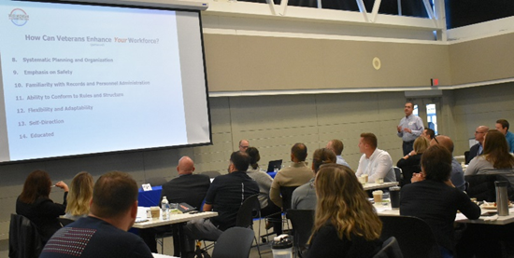
WMVC Overview
501(c)(3) organization
13 counties: Allegan, Barry, Ionia, Kent, Lake, Mason, Montcalm, Mecosta, Muskegon, Newaygo, Oceana, Osceola and Ottawa
Mission: “To improve the lives of anyone who has served or is serving in the Armed Forces and their families by connecting them to resources including education, employment, healthcare, and quality of life services.”
Philosophy: “We are in the business of making connections. There is no wrong door.”

Slide 4
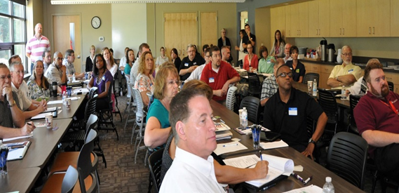
WMVC Overview
continued
Over 600 member organizations
Government agencies, non-profit organizations, academia, private-sector employers
Leadership:
Executive Board Chair: Brandi McBride
Executive Board Vice Chair: Paul Ryan
Operations Manager: Debra Unseld
WMVC website: www.westmichiganveterans.org
WMVC Facebook page: https://www.facebook.com/WMVeteranCoalition
WMVC phone: (616) 209-8563

Slide 5
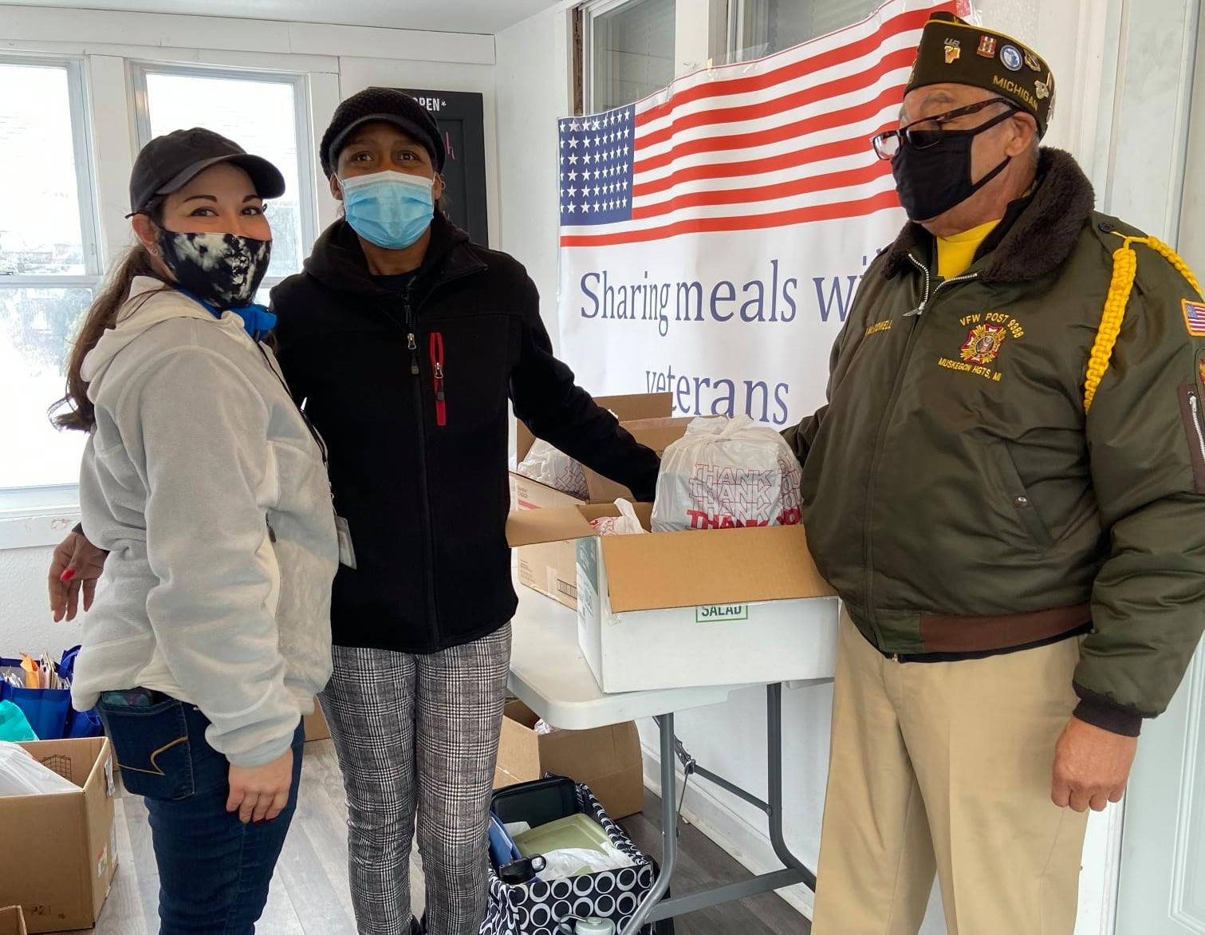
WMVC Overview
continued
Committee structure follows the Four Areas of Focus: Education, Employment, Healthcare and
Quality of Life
Key Partners:
Armed Forces Thanksgiving: https://www.armedforcesthx.org/
Disability Advocates of Kent County: www.dakc.us
County Veterans Services Officers (VSOs):
https://www.macvc.net/michigan_county_veterans_counselors_search.php?f=4
WINC (Women Injured In Combat): https://wincforall.com/

Slide 6
QUESTIONS
or
COMMENTS???

Slide 7
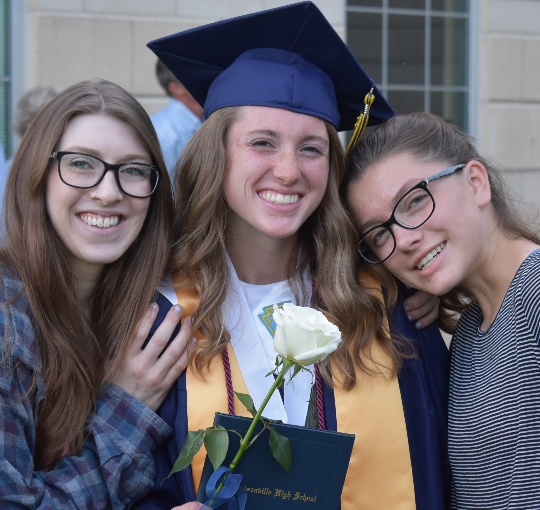
EDUCATION
Overview: A network of academic organizations, and affiliates who assist in informing military-connected individuals and their families regarding educational opportunities, GI Bill benefits, scholarships and other forms of financial aid.
Education Committee Co-Chairs:
Jason Bos (Davenport University)
Jacob Schrot (Ferris State University)

Slide 8
EDUCATION
HIGHLIGHTED RESOURCES
Davenport University: Jason Bos
Ferris State University: Jacob Schrot
Grand Valley State University: Jill Wolfe
Veterans Upward Bound: Belinda Coronado
Aquinas College: Brenda Hennick

Slide 9
EDUCATION
ONGOING PROGRAMS & ACTIVITIES
WMVC Scholarships
Armed Forces Scholarship: Active Duty, National Guard/Reserve, retired or honorable discharged
Armed Forces Dependent Scholarship: spouse, children of above
Apply at www.westmichiganveterans.org

Slide 10
QUESTIONS
or
COMMENTS???

Slide 11
EMPLOYMENT
Overview: The Employment Committee seeks to improve the lives of those who served in the Armed Forces and their families by connecting them to available employment benefits, services and resources and by helping employers understand the benefits their knowledge and experience bring to their institutions, and the obstacles they may face while seeking employment and furthering their careers.
Employment Committee Co-Chairs:
Josh Jordan
Elena Bridges

Slide 12
EMPLOYMENT
COMMITTEE MEMBERS / ALLIES / EMPLOYERS
West Michigan WORKS! : John Walker
Vocational Rehabilitation programs through VA – apply online through your eBenefits account
Michigan Rehabilitation Services: Mike Kivinen
Bureau of Services for Blind Persons, BSBP - (616) 356-0180 main intake line
Disability Advocates of Kent County – Trina Edmondson

Slide 13
EMPLOYMENT
ONGOING PROGRAMS & ACTIVITIES
Veterans’ Networking Job Club: for veteran job seekers and employers
3rd Thursdays @ 10:00 AM: register at www.vnjc.org
Disability Advocates of Kent County, gas card, bus pass, work boots, clothing
Trina Edmondson
Grand Rapids Vet Center: employment referrals, counselling, community outreach/education
Carlos Castillo

Slide 14
QUESTIONS
or
COMMENTS???

Slide 15
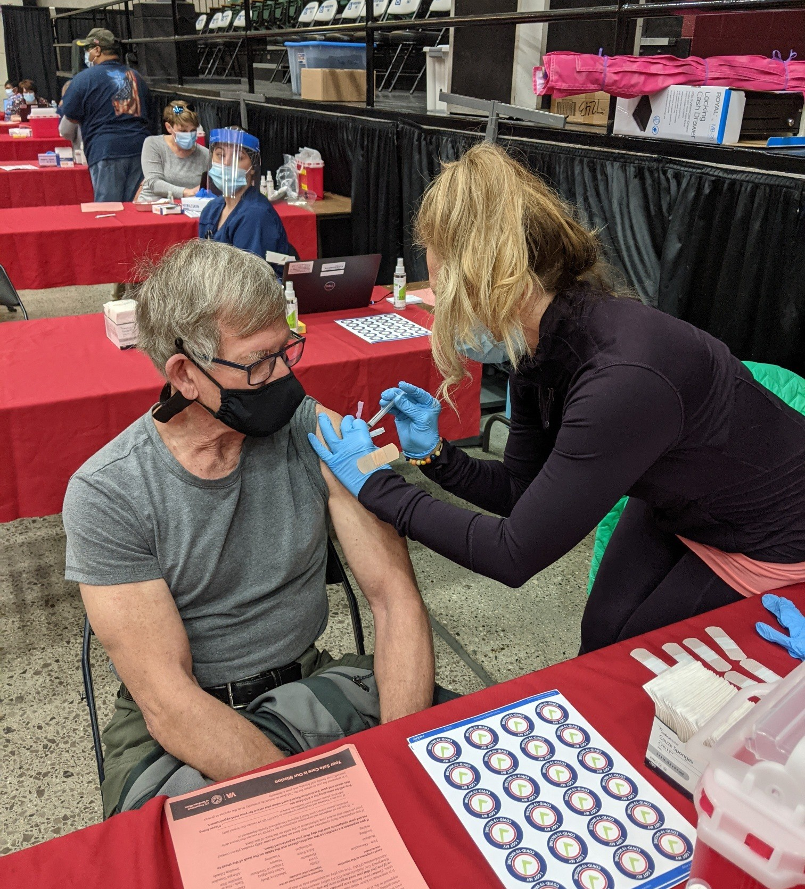
HEALTHCARE
Overview: WMVC provides connections to a variety of healthcare resources for military-connected individuals and their families, including but not limited to: VA, community service providers, mental health, and more. Areas of focus in 2021 are: mental health, suicide prevention, military sexual trauma, and women's health.
Healthcare Committee Co-Chairs:
Dana Hill
Belinda Coronado

Slide 16
HEALTHCARE
HIGHLIGHTED RESOURCES
VA MEDICAL CENTER BATTLE CREEK
WYOMING VA COMMUNITY-BASED OUTPATIENT CLINIC (CBOC): 616-249-5300, https://www.battlecreek.va.gov/locations/Wyoming.asp
MDHHS VETERAN NAVIGATORS: https://www.michigan.gov/mdhhs/0,5885,7-339-71550_2941_93573-501026--,00.html
DISABILITY ADVOCATES OF KENT COUNTY: Home accessibility, medical equipment
Lisa Nelson-Williams
HEALTHCARE FOR HOMELESS VETERANS

Slide 17
QUESTIONS
or
COMMENTS???

Slide 18
QUALITY OF LIFE
Overview: The Quality-of-Life (QoL) Committee strives to identify assistance available to military-connected individuals and their families in the following areas, including but not limited to: Housing, food insecurity, Barriers to employment, Legal issues, Female veterans’ issues, Spiritual well-being and social support, and Transportation.
Quality of Life Committee Co-Chairs:
Paul Ryan
Trina Edmondson
Monthly meetings: 3rd Wednesdays at 12:00 PM (via Go To Meeting, for now)

Slide 19
QUALITY OF LIFE
HIGHLIGHTED RESOURCES
CAPTION CALL: Gerid Adams
DISABILITY ADVOCATES OF KENT COUNTY: Trina Edmondson
FINISH THE MISSION VETERAN RELIEF FUND: Paul Ryan
VETERANS’ TREATMENT COURTS: Allegan/Ottawa/Van Buren; Ionia; Kent; Muskegon
Michigan Rehabilitation Services: Mike Kivinen
MICHIGAN STATE UNIVERSITY EXTENSION: Steve Whittington
COUNTY VETERAN SERVICES OFFICES
WINC

Slide 20
QUALITY OF LIFE
ONGOING PROGRAMS & ACTIVITIES
WMVC Military Family Assistance Fund
WMVC Share-A-Meal Program
DAKC/Feonix-Mobility Rising/WMVC Transportation Project
Emergency Food Vouchers
West Michigan Veterans Assistance Program Food Pantry – www.WMVAP.org
Home Care options through VAMC Battle Creek or Wyoming VA CBOC
Aid & Attendance / Caregiver Support / Community-Based Home Care

Slide 21
QUALITY OF LIFE
ONGOING PROGRAMS & ACTIVITIES
continued
The Patriot Fund (American Legion Foundation): Emergency temporary financial assistance
Volunteers of America: Wide variety of services
Tightlines for Troops: Fishing trips for veterans – www.tightlinesfortroops.org
American Legion Wilwin Lodge at Cygnet Cove: Recreational facilities, especially for disabled/handicapped veterans - http://www.wilwin.org

Slide 22
THANK YOU!
Trina Edmondson: (616) 323-2203, trina.e@dakc.us
Paul Ryan: (616) 340-6183, paul.j.ryan@iservonline.net
Debra Unseld: (616) 209-8563, debraunseld01@gmail.com
Final Thought…

Slide 23
“Power is the ability to do good things for others.”
Brooke Astor (1902-2007)
American philanthropist, socialite, and writer

