Slide 1
Intro to Submitting Grants at GVSU
Notes:
Abbey

Slide 2
Learning Objectives
Understand the 10 steps to submitting a grant at GVSU
Understand the role that University Development plays in the submission process.
Learn how to start a proposal form in our internal routing platform, One Aegis.
Notes:
Abbey

Slide 3
10 Steps to Submitting a Grant at GVSU
Read the funding announcement
Meet with your Grants and Contract Specialist
Talk with your Chair/Director/Unit head/Dean
Start a proposal approval form in One Aegis
Create a budget
Write your narrative and ask others for critique
Get your submission approved internally
Finish all other required paperwork
Finalize your narrative
Submit your proposal
Notes:
Abbey

Slide 4
Step 1: Read the Funding Announcement
Gain an understanding of the project, noting the rules and limitations
Note any special requirements that could hold up the submission.
Send the announcement to your Grants and Contract Specialist
Think of questions you have that the grants and contracts specialist or the program officer may be able to answer.
Notes:
Abbey

Slide 5
Step 2: Meet with your Grants and Contract Specialist
Call us very early in the process
We will assist you in making a checklist of required documents
Narrative
Budget
Budget justification
Certifications
Assurances, etc.
Discuss the required forms and any potential problem areas
Discuss what information you will need from others:
Authorized signatures
University demographics
Subaward forms
Notes:
Abbey

Slide 6
Step 2 Continued
Are you going to do a peer review?
Consider having a conversation with the sponsor’s program officer.
Develop a timeline to determine when documents/parts of the project will be completed
Determine what day you will submit the project and understand how the submission process will work.
Every project is different
Every sponsor is different
Every grant writer is different
We, as GCS’, are different
Talk through the process so there are no assumptions or surprises!
Notes:
Abbey

Slide 7
Step 3: Talk with your Chair/Director/Unit Head and Dean
Work out/discuss issues like:
how much time you will need to commit to the project
buy out or release from other duties if you were to get funded
Potential needed departmental resources
They can also give you valuable input on writing your proposal
Address problems before they arise.
If there are members on the project team from different departments, they will need to do this too.
Notes:
Melissa

Slide 8
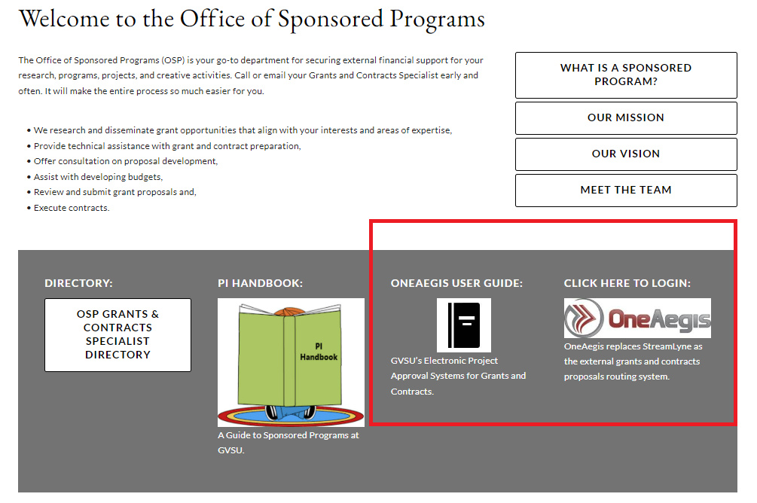
Step 4: Start a grant proposal approval form in One Aegis
One Aegis is the system we use to internally approve all proposals.
Gvsu.edu/grants
Here you will find the link to log into One Aegis and a step-by-step user guide.
We will go through a practice submission at the end of the presentation.
Notes:
Melissa

Slide 9
Step 5: Create your Budget
Start the budget as soon as possible.
Working on the budget can help you think through all aspects of the project which can be a helpful step prior to writing the proposal narrative.
Time commitment of personnel
Supplies
Travel
OSP can work with you from the start to develop your budget, or we can fine tune it while you go onto other elements of the project.
Notes:
Melissa

Slide 10
Budget categories
Senior personnel
Other personnel (GA’s, Student employees)
Fringe Benefits
Equipment
Travel – meals, lodging, airfare, mileage, parking, ground transportation
Participant support
Materials and supplies
Publication costs/documentation/dissemination
Consultants
Subawards
Other
Graduate Assistant Tuition
Remember…
The budget is a key part of the GVSU internal approval process which is required for all sponsored programs before submission can take place.
There are often questions about the budget, so it is important to get them out of the way early to avoid holding up the submission.
Notes:
Melissa

Slide 11
Step 6: Write your narrative and ask others for critique
If you wrote a concept paper, start with that.
Have a conversation with the program officer if the sponsor allows it.
Outline the RFP to ensure you are not missing anything
Schedule time in your day to write
Send your proposal out for a peer review about 2-4 weeks before you want to submit it.
Notes:
Outline the RFP to ensure you will not miss anything
create a template that incorporates every section that is required- need statement, evaluations, work plans
Send your proposal out for a peer review about 2-4 weeks before you want to submit it
- send it to your friends, co-workers, colleagues, and others who have had experience submitting proposals.
Melissa

Slide 12
Step 7: Get your submission approved internally
All projects must go through OSP to be routed for internal approval 5 days before the submission day.
Plan ahead and work closely with you GCS so that we can help you keep things on track.
Projects cannot be submitted to the sponsor without full internal approval.
Notes:
Melissa

Slide 13
Step 8: Finish all other required paperwork
There are often documents other than the project narrative that have to be prepared for the submission:
Letters of Support
Indirect cost agreements
Cover Sheets
Abstracts
IRS Determination Letters
List of current board of directors and their affiliations
Diversity and Inclusion policy
Organizational demographics
Financial Audits
CV’s or biographical sketches
Letters of support from organizational leadership
Notes:
These can be time consuming to gather, so factor them into your timeline (your GCS will help you make sure you’re not forgetting something important)
Abbey

Slide 14
Step 9: Finalize your Narrative
Finalize your narrative at least 4 days before the submission day, making sure you incorporate feedback from the peer review.
Put your narrative away for a few days, then re-read it for a final polish 1-2 days before you submit it.
Notes:
Abbey

Slide 15
Step 10: Submit your Proposal!
You’ve gathered everything from the checklist.
All internal approvals have been completed.
Work with your GCS to submit the proposal to the sponsor.
Notes:
Abbey

Slide 16
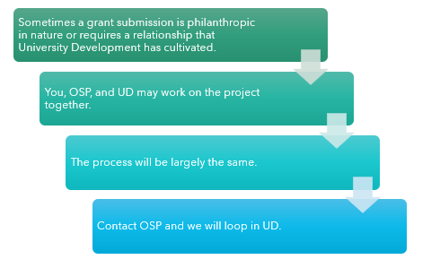
What role does University Development play in all of this?
Notes:
Abbey

Slide 17
Key things to remember
Call us early and often! We are meant to be your guide and resource to making this submission process easy.
Our contact information is located on our website, gvsu.edu/grants, along with a directory of how we divide up the colleges.
ALL sponsored programs must be routed through OSP.
The budget, budget justification, and project narrative must be received by OSP and routed for approval at least 5 days before the sponsor’s deadline.
Proposals submitted to OSP after the internal deadline will be processed on a first-come-first-served basis. Priority is given to those who have submitted their proposals to us on time.
Late, incomplete, or not fully approved proposals may not be submitted to the sponsor.
Notes:
Abbey

Slide 18
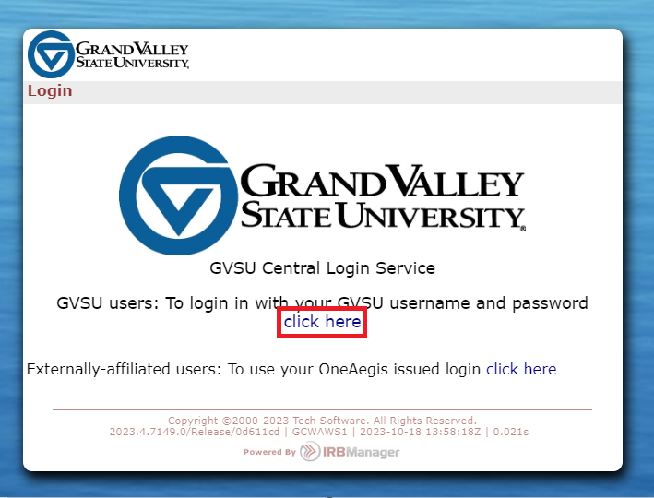
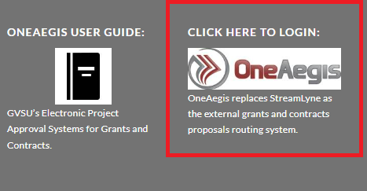
Starting a Grant Proposal Approval Form in One Aegis
1. Navigate to gvsu.edu/grants and use your GVSU credentials to login.
Notes:
Melissa

Slide 19
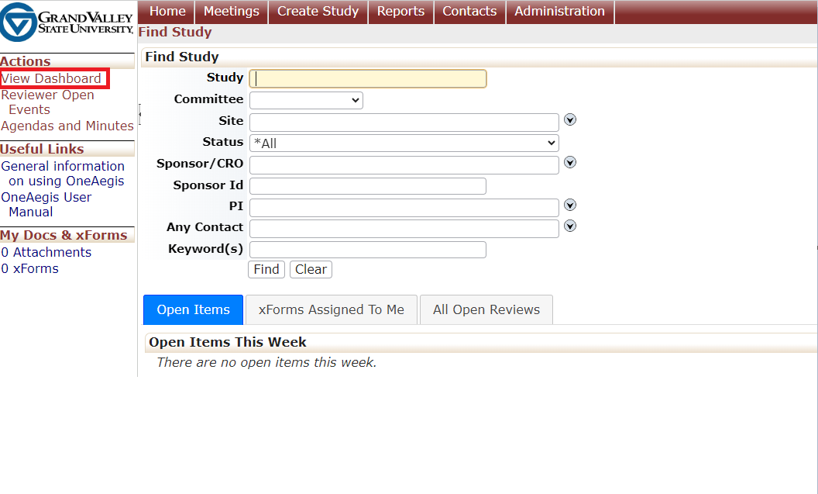
2. Logging in will take you to this home page. On the left-hand side under actions, select view dashboard.
3. Select start xForm
Notes:
Melissa

Slide 20
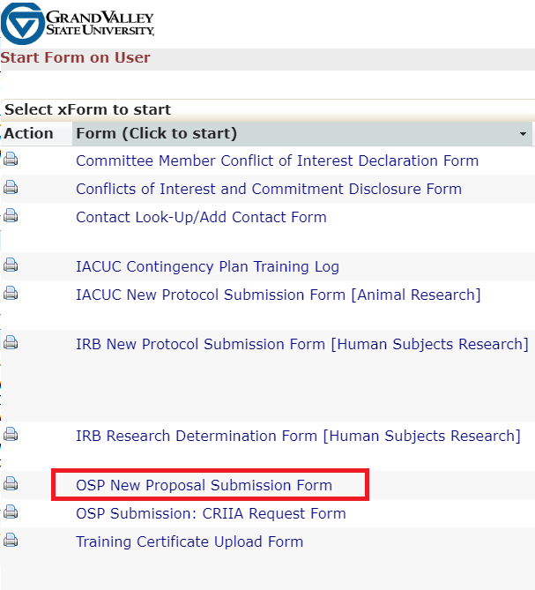
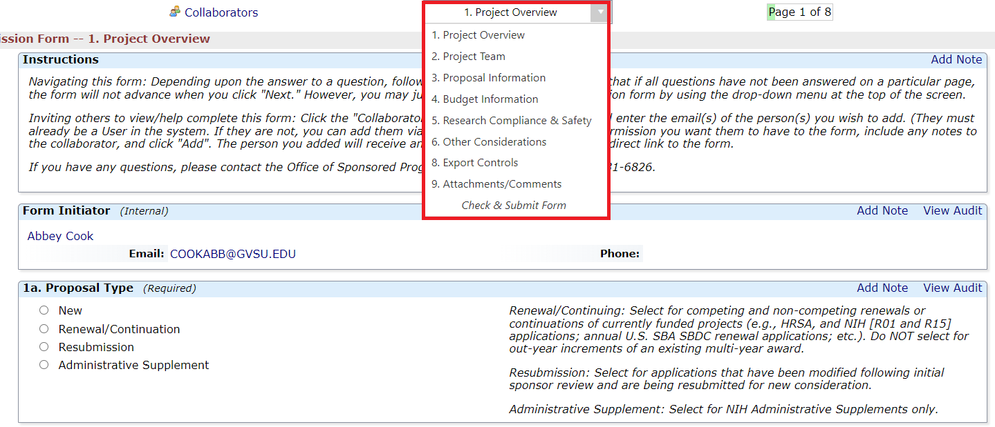
4. Select OSP New Proposal Submission Form
5. Begin entering your grant proposal information into the One Aegis System.
- You can skip ahead to different sections within the xForm by using the drop-down feature. Our One Aegis User Guide provides additional information on the specific questions that you will be asked.
Notes:
Melissa

Slide 21
Thank you for joining us today!
Notes:
Melissa

