Slide 1
Thank you for joining us for Research Matters – External Funding!
The presentation will begin at 12:10
Please use the chat to ask questions throughout the presentation.

Slide 2
Grant Funding Searches

Slide 3
Learning Objectives
Who is your Grants and Contract Specialist
Important Things to Know
Preparing for the funding search
Types of Funding
Current Research Data
Where to find funding
Searching awarded grants
Internal funding
Other helpful links
Find an opportunity- what’s next?
OSP Contact Info
Notes:
Melissa

Slide 4
Who is your Grants and Contract Specialist?
Abbey Cook - KCON, CHP, Brooks, CLAS (social sciences)
Sara Ledford – PCEC, Seidman, all Non-Academic, contracts
Melissa Wright – CLAS (Hard Sciences), TRIO, CECI
Link to the OSP Directory: https://www.gvsu.edu/grants/grants-contracts-specialist-directory-30.htm
Notes:
Melissa

Slide 5
Important Things to Know
OSP will work closely with you to find funding that aligns with what you want to do
You are the subject matter experts, and your role is critical in finding the appropriate opportunity
Notes:
Melissa

Slide 6
Funding Types
Government: Federal, State, Local
Foundations and Nonprofits
Corporations
Foreign
Institutional (internal)
Notes:
Abbey

Slide 7
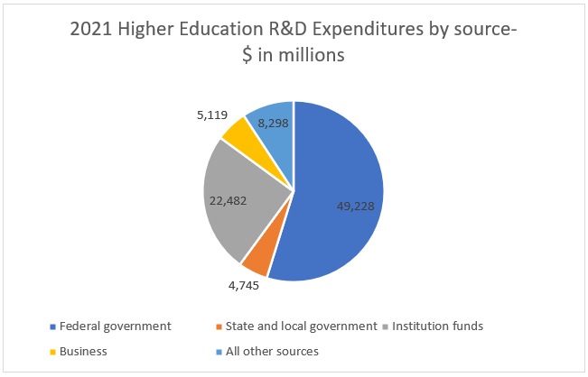
Current Research Data- R&D Expenditures by Source
Notes:
Abbey

Slide 8
Preparing for the Funding Search
Develop a project plan:
What is the project/programming idea?
What is the problem that will be addressed?
Who will benefit from the project?
What is the geographic area of the project?
How much funding is needed?
How long will it take to fully develop the project?
What resources are needed to make the idea a success – staffing, student assistance, equipment, space, materials, etc.?
Who are possible collaborators- internal and external?
What are the key words to identify opportunities?
Notes:
Abbey

Slide 9
Project Plan Worksheet
Take a few minutes to fill out the worksheet you were given when you walked in (or were emailed) based on a research topic you might be interested in
We will use the key words you come up with in a few minutes to do a funding search.
Notes:
Abbey

Slide 10
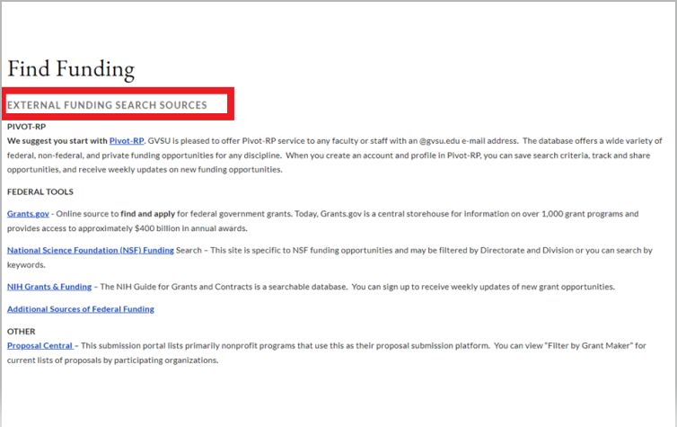
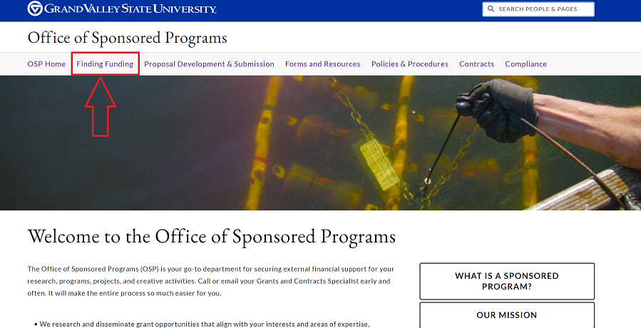
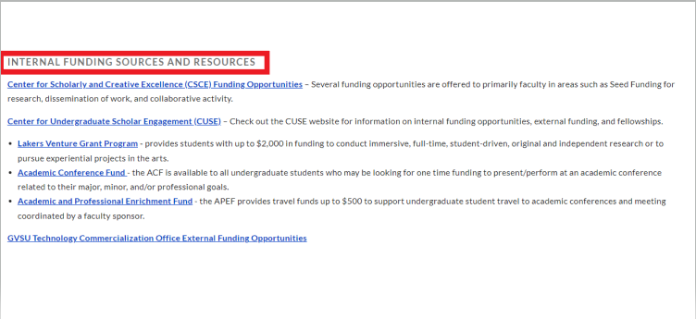
Where to Find Funding
Gvsu.edu/grants
Notes:
Sara

Slide 11
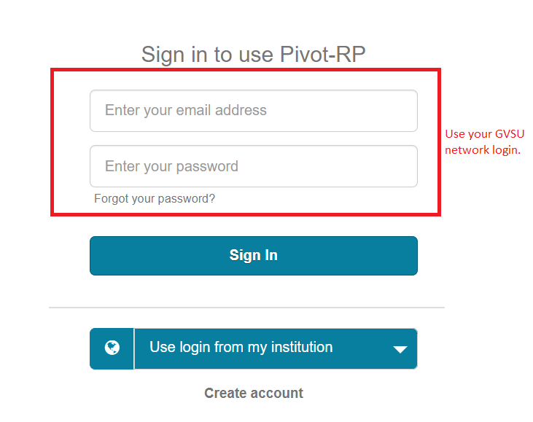
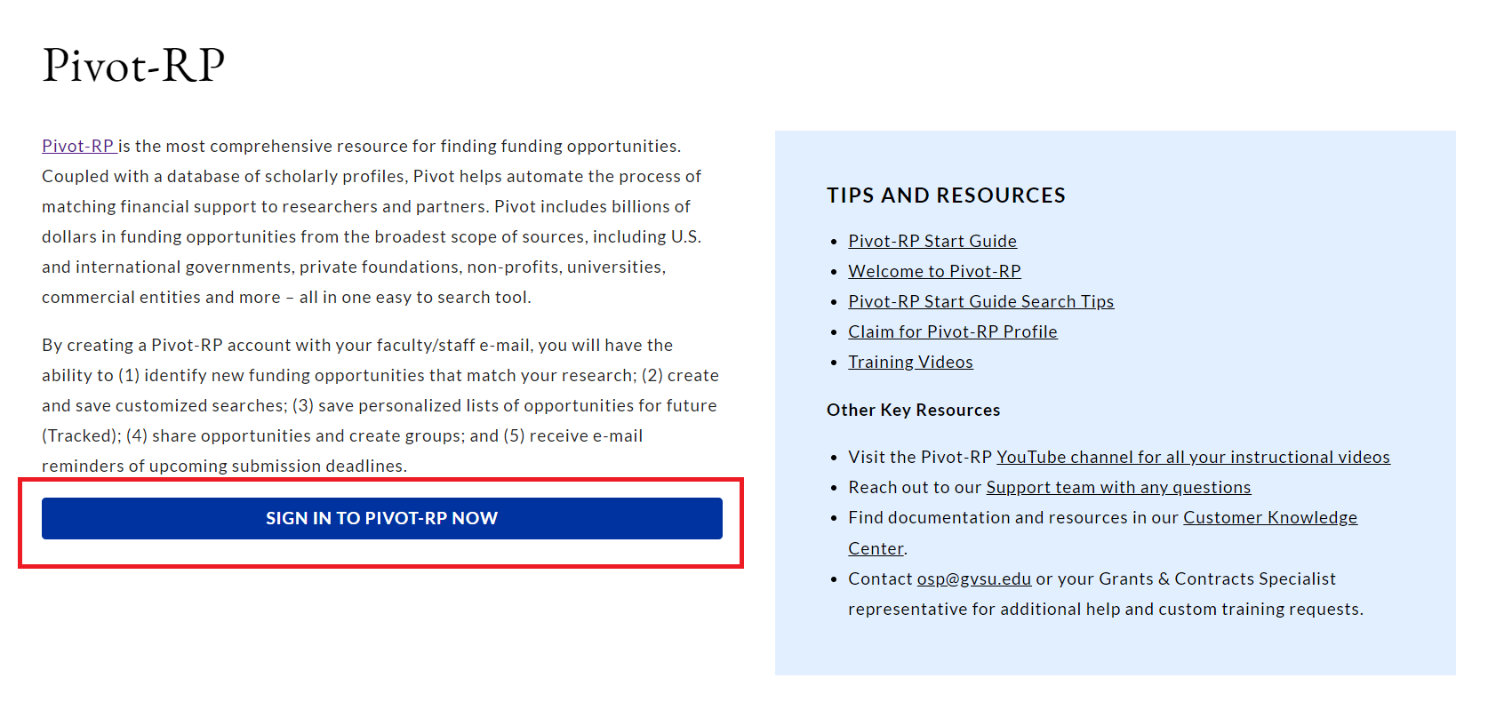
Pivot
Sign in using your GVSU Network login.
Notes:
Sara

Slide 12
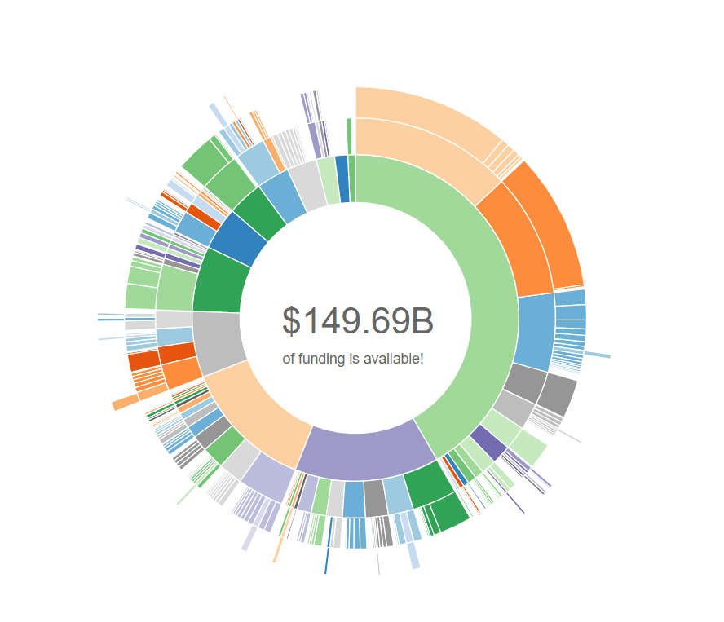
Pivot
Type in key words to search for funding or click funding along the top bar to use the wheel.
We will now demonstrate a search using the pivot wheel https://pivot.proquest.com/funding_main
Notes:
Sara

Slide 13
Your turn!
Go to PIVOT and sign in.
Complete your profile/add key words if needed.
Perform a search that could be beneficial for your department.
Shout out keywords and we will demonstrate a search.
Notes:
Sara

Slide 14
Grants.gov
Clearinghouse for all federal grants.
No login is needed to complete a funding search!
Notes:
Melissa

Slide 15
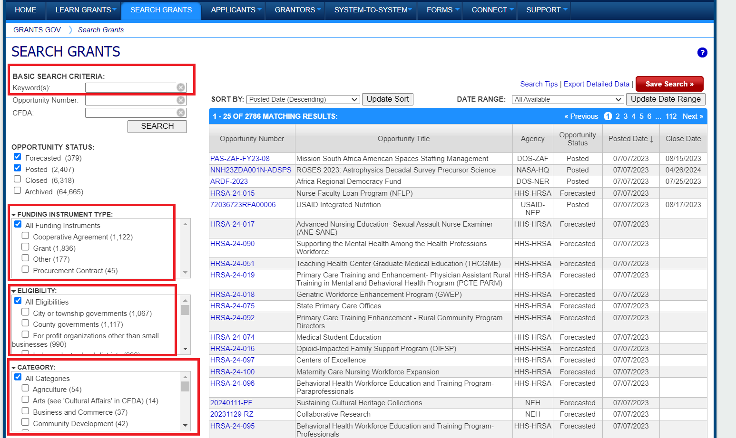
Grant.gov
Enter keywords and select appropriate filters to narrow search results.
Notes:
Melissa

Slide 16
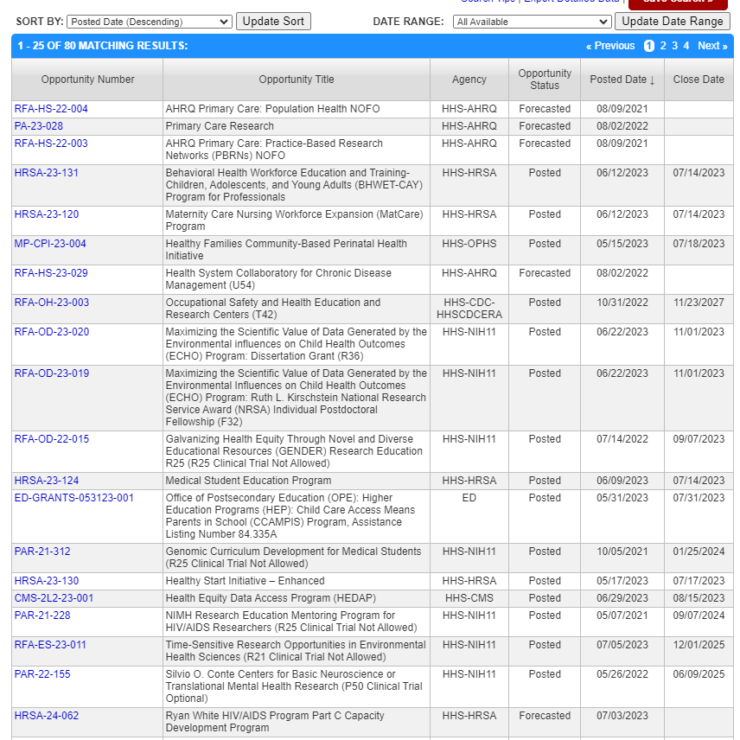
Grant.gov Example
Notes:
Melissa Speak to what Forecasted Opportunities are.

Slide 17
Searching Awarded Grants
Reading awarded grants can help:
Identify:
who the sponsor is giving money to- universities, religious organizations, K-12
the kinds/topics of projects a sponsor supports
collaborators and competitors
the geographical area and how much is given
Serve as an example of what a well-written proposal looks like
Uncover which sponsors are supporting projects in the project field
Identify publications that are coming out of the research
Sites for award information:
NSF Award Search: Simple Search.
Home | RePORT (nih.gov)
Other federal grant awarding agency websites
Nonprofit data for donors, grantmakers, and businesses | GuideStar | Candid
Foundation and grant maker websites
Notes:
Abbey

Slide 18
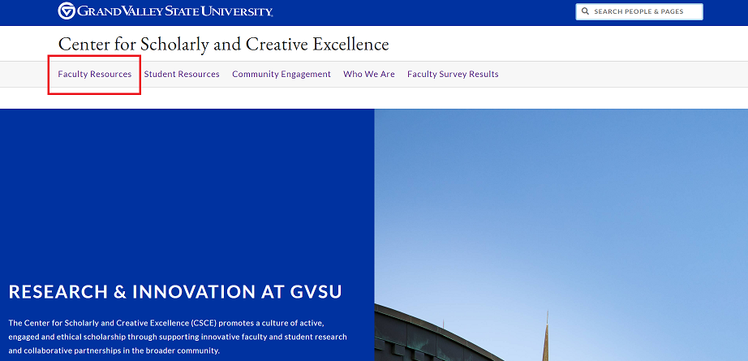
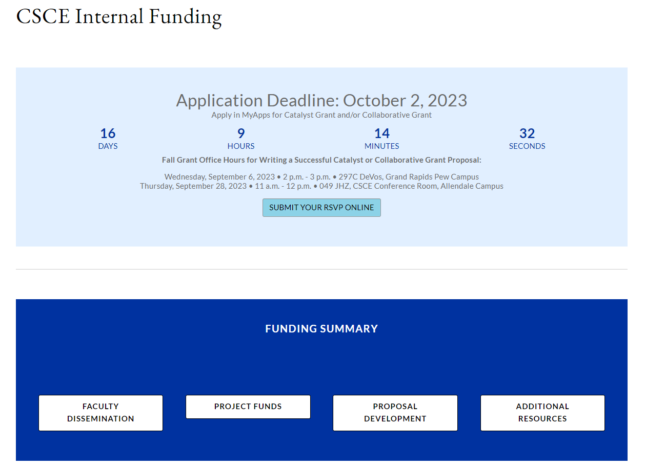
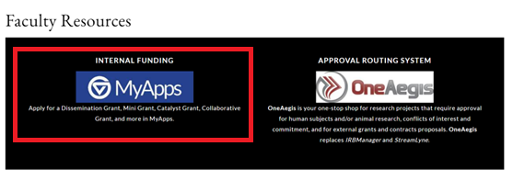
Internal Sources
GVSU Center for Scholarly and Creative Excellence: www.gvsu.edu/csce
Notes:
Abbey

Slide 19
Internal sources
Faculty Dissemination
Dissemination grant- in person or virtual conference support
Book publication subvention fund
Open access publishing support
Project Funds
Catalyst grant for research and creativity
Collaborative research and creative activity initiative
Mini-grant program
Pre-tenure supplement for research and creativity
Faculty fellowships
Faculty course reassignment for research and creative expression
Proposal Development
Laker extramural proposal development
GVSU’s Laker match fund
Laker innovation commercialization fund
Additional Resources
Office of Undergraduate Research and Scholarship
LGBTQ Faculty/Staff Association Grant Opportunity
Notes:
Abbey

Slide 20
Other Helpful Links/Key things to remember
OSP can help you search for funding opportunities!
A resource for various Michigan grants and foundations:
https://fundsnetservices.com/michigan-grants-and-foundations
Other federal and state agencies:
http://www.nsf.gov/funding/
http://grants.nih.gov/grants/oer.htm
http://www.ed.gov/fund/grants-apply.html
http://ies.ed.gov/funding/
http://www.neh.gov/grants
http://arts.gov/grants/apply-grant/grants-organizations
Professional associations and higher ed associations also may offer funding opportunities
Remember, if you put your keywords in your PIVOT, it will do a lot of the work for you.
Sometimes just entering key words in a web search engine works too!
Notes:
Abbey

Slide 21
You found an opportunity, what’s next?
Read the funding announcement to understand the rules and limitations and share it with your grants and contract specialist.
**Talk with your chair/director/unit head and dean about the project and work out any foreseen issues.**
All sponsored programs must be routed through OSP, so call us early in the process.
We will assist you in making a checklist of all the required documents for submission.
Come to our upcoming sessions! ☺ Next session is October 27 on Submitting Grants at GVSU.
Notes:
Abbey

Slide 22
Questions for OSP?
Notes:
Abbey

Slide 23
OSP Contact Information
Abbey Cook
cookabb@gvsu.edu
Sara Ledford
ledforsa@gvsu.edu
Melissa Wright
wrighme@gvsu.edu
Notes:
Abbey

