Slide 1

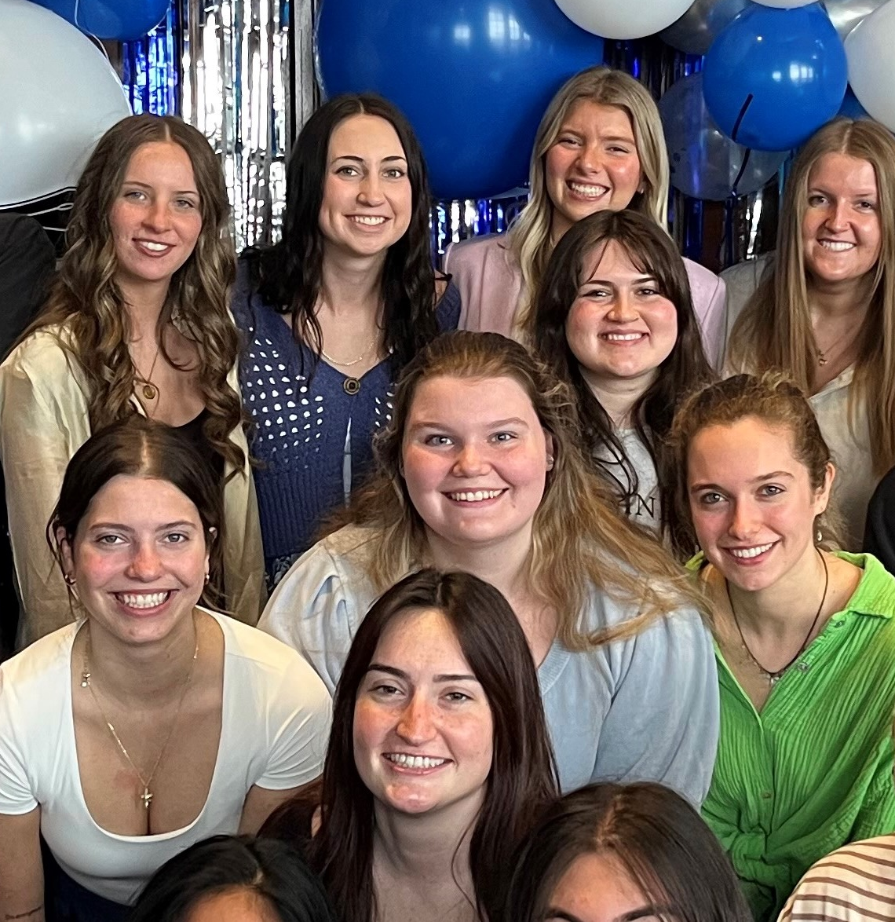
1. RECENT JOB/INTERNSHP OPENINGS | New week, new opportunities to learn and grow as an HTM professional. Check out the listings for jobs and internships!
2. HTM 240 STUDY BREAK | HTM 240 is hosting a study break event on the Kirkhof Lawn on April 24th 3pm-5pm. Come hang out with cats and dogs from the Harbor Humane Society! Raffle and food & beverages provided.
3 AAHOACON 2026 | Congratulations to both teams attending the Collegiate Hotel Simulation Competition at AAHOACON 26. Marrin & Sydney won the overall competition! Noah & Ryan were one o f four teams that advanced to the finals.
4. ADA TOWNSHIP DDA INTERN SEARCH | The Ada Township Downtown Development Authority is hiring a summer intern to help the DDA director with summer community events and downtown development initiatives. Find out more at the Ada Township website. Anticipated start date is May 4th.
4.20.2026

Slide 2
New Internship and Employment Opportunities
Experience Manager
Blandford Nature Center - Grand Rapids , Michigan
Application Deadline: Until Filled Posted: 4/15/26
Event Assistant Wedding Planning
All Buttoned Up Events - Grand Rapids, Michigan
Application Deadline: 5/1/2026 Posted: 4/10/26
Amway Grand Plaza Housekeeping Internship
AHC Hospitality - Grand Rapids, Michigan
Application Deadline: 4/30/2026 Posted: 4/9/26
Experiential Marketing Intern
Activate Inc - Ferndale , Michigan
Application Deadline: Until Filled Posted: 4/8/26
1

Slide 3

HTM 240 EVENT
2

Slide 4
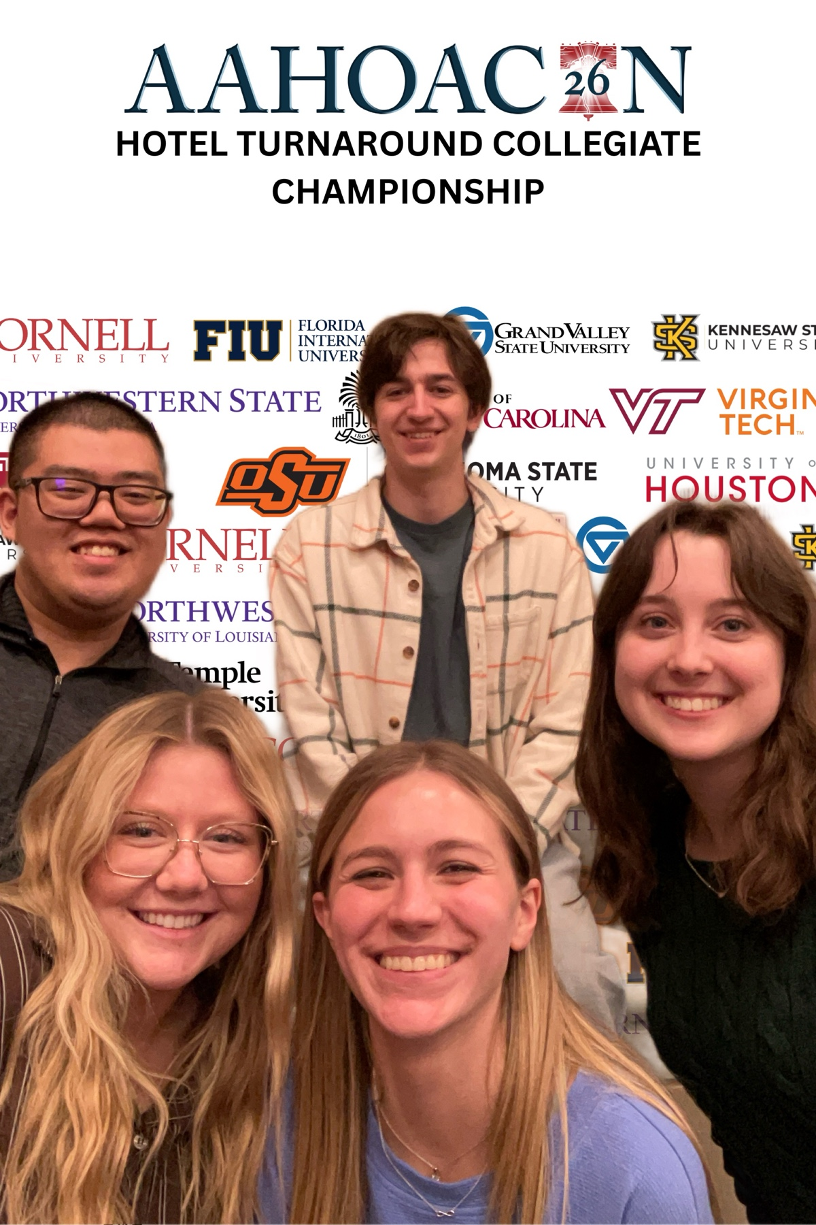
AAHOACON 2026
Congratulations to the HTM students attending the Asian American Hotel Owners Association Convention 2026!
Five HTM students attended AAHOACON Hotel Turnaround Collegiate Competition this year in Philadelphia.
The students attending this year are:
Audrey Burnside, Ryan “Boot” Hough, Sydney Markey, Marrin McAnelly, and Noah Prysock
Marrin & Sydney won the overall competition! Noah & Ryan were one of four teams that advanced to finals. Congratulations to both teams!
3

Slide 5
SUMMER INTERN SEARCH
4
Ada Township seeks an enthusiastic individual to aid the DDA Director in managing community events and supplementing work on downtown development initiatives.
Events include:
Ada Farmers Market
Beers at the Bridge Concert Series
4th of July Celebration
Job description and application information can be found here

Slide 6
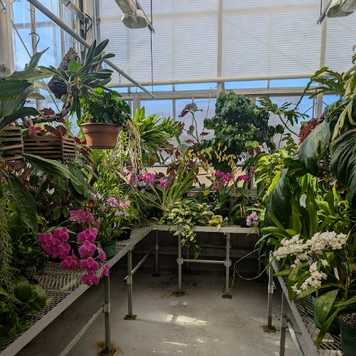
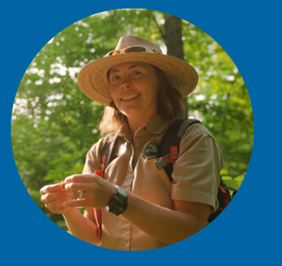

CAMPUS EVENTS
'Exam Jam!' Open Hours
April 21-23, 2026
10:00 a.m. - 2:00 p.m.
Barbara Kindschi Greenhouse
Come and visit the beautiful plant collection located in the Barbara Kindschi Greenhouse! Take some time to destress amongst the greenery and under the lights. We are located on the second floor of the Kindschi Hall of Science, room 2241.

