Slide 1


1. RECENT JOB/INTERNSHP OPENINGS | New week, new opportunities to learn and grow as an HTM professional. Check out the listings for jobs and internships!
2 . SENIOR SEND-OFF | Congratulations to all our seniors!
3. DISNEY PROGRAM | The Disney internship is still accepting applications until the beginning of May. Virtual information sessions are provided throughout April. Use the link to join a session or apply at the Disney Program page.
4. EXTRAVAGANZA RAFFLE WINNER | Congratulations to A’monie for winning the raffle from the scavenger hunt at the Networking Extravaganza.
5. RECIPE FROM HTM 250 | Recipe from this semester’s HTM 250 class! Lemon pudding cake with a blueberry sauce.
4.14.2025
Click here to learn more about all GVSU HTM opportunities available to you

Slide 2
New Internship and Employment Opportunities
Server | brick + brine | PT
Greenleaf Hospitality - Kalamazoo, Michigan
Application Deadline: 5/3/2025 Posted: 4/4/25
Server Assistant | brick + brine
Greenleaf Hospitality - Kalamazoo, Michigan
Application Deadline: 5/3/2025 Posted: 4/3/25
Intern - Business and Hospitality
W Talent Solutions - Grand Rapids, Michigan
Application Deadline: Until Filled Posted: 4/3/25
Seasonal Event Assistant
Meadow Brook Hall - Rochester, Michigan
Application Deadline: 5/1/25 Posted: 3/28/25
1

Slide 3
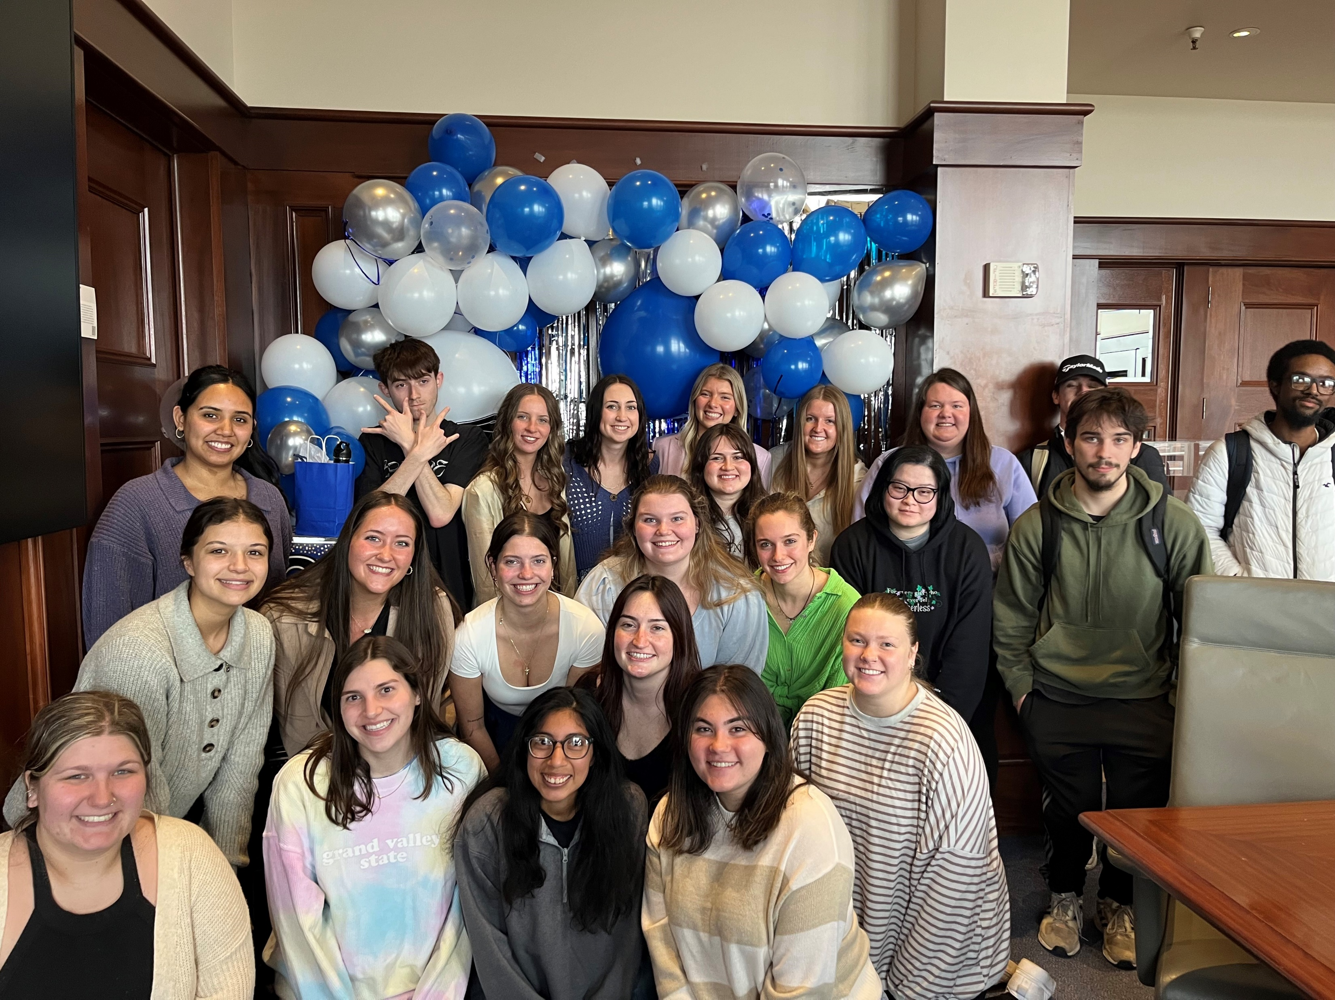
SENIOR SEND-OFF
2
Congratulations to all our graduating seniors!
We had a wonderful time sending you off last week. Hope you enjoyed the camaraderie and the lunch from Condado.

Slide 4


DISNEY INTERNSHIPS
5
There’s still time to apply to the Disney College Program! Applications still accepted until the first week in May (culinary applications until mid-June).
Information sessions run throughout April. Register here for a session!
To apply, go to the Disney Program page!

Slide 5
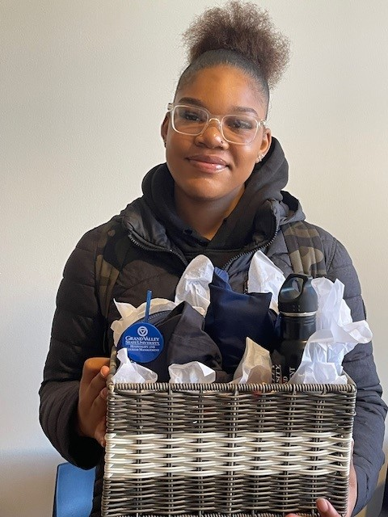
RAFFLE WINNER
Congratulations to A’monie Jamison-Crawford for winning the raffle drawing from the Networking Extravaganza! A’monie won a gift basket full of HTM swag and candy.
Thank you to everyone who attended the Extravaganza and participated in the scavenger hunt.
6

Slide 6



IMPORTANT STUDENT RESOURCES
It is important that all students are given the resources they need to thrive here at GVSU. Learn more about the resources available to you on campus, many of which are available to students at NO COST.
Available Resources Include: Academics, Academic Support, Belonging and Campus Climate, Campus Safety, Finances, and Wellness
Do finals have you feeling overwhelmed? Come destress with the University Counseling Center and West Michigan Therapy Dogs!
Health Campus - April 15 11:00-1:00 pm
Allendale - April 16 6:00pm – 8:00 pm

Slide 7
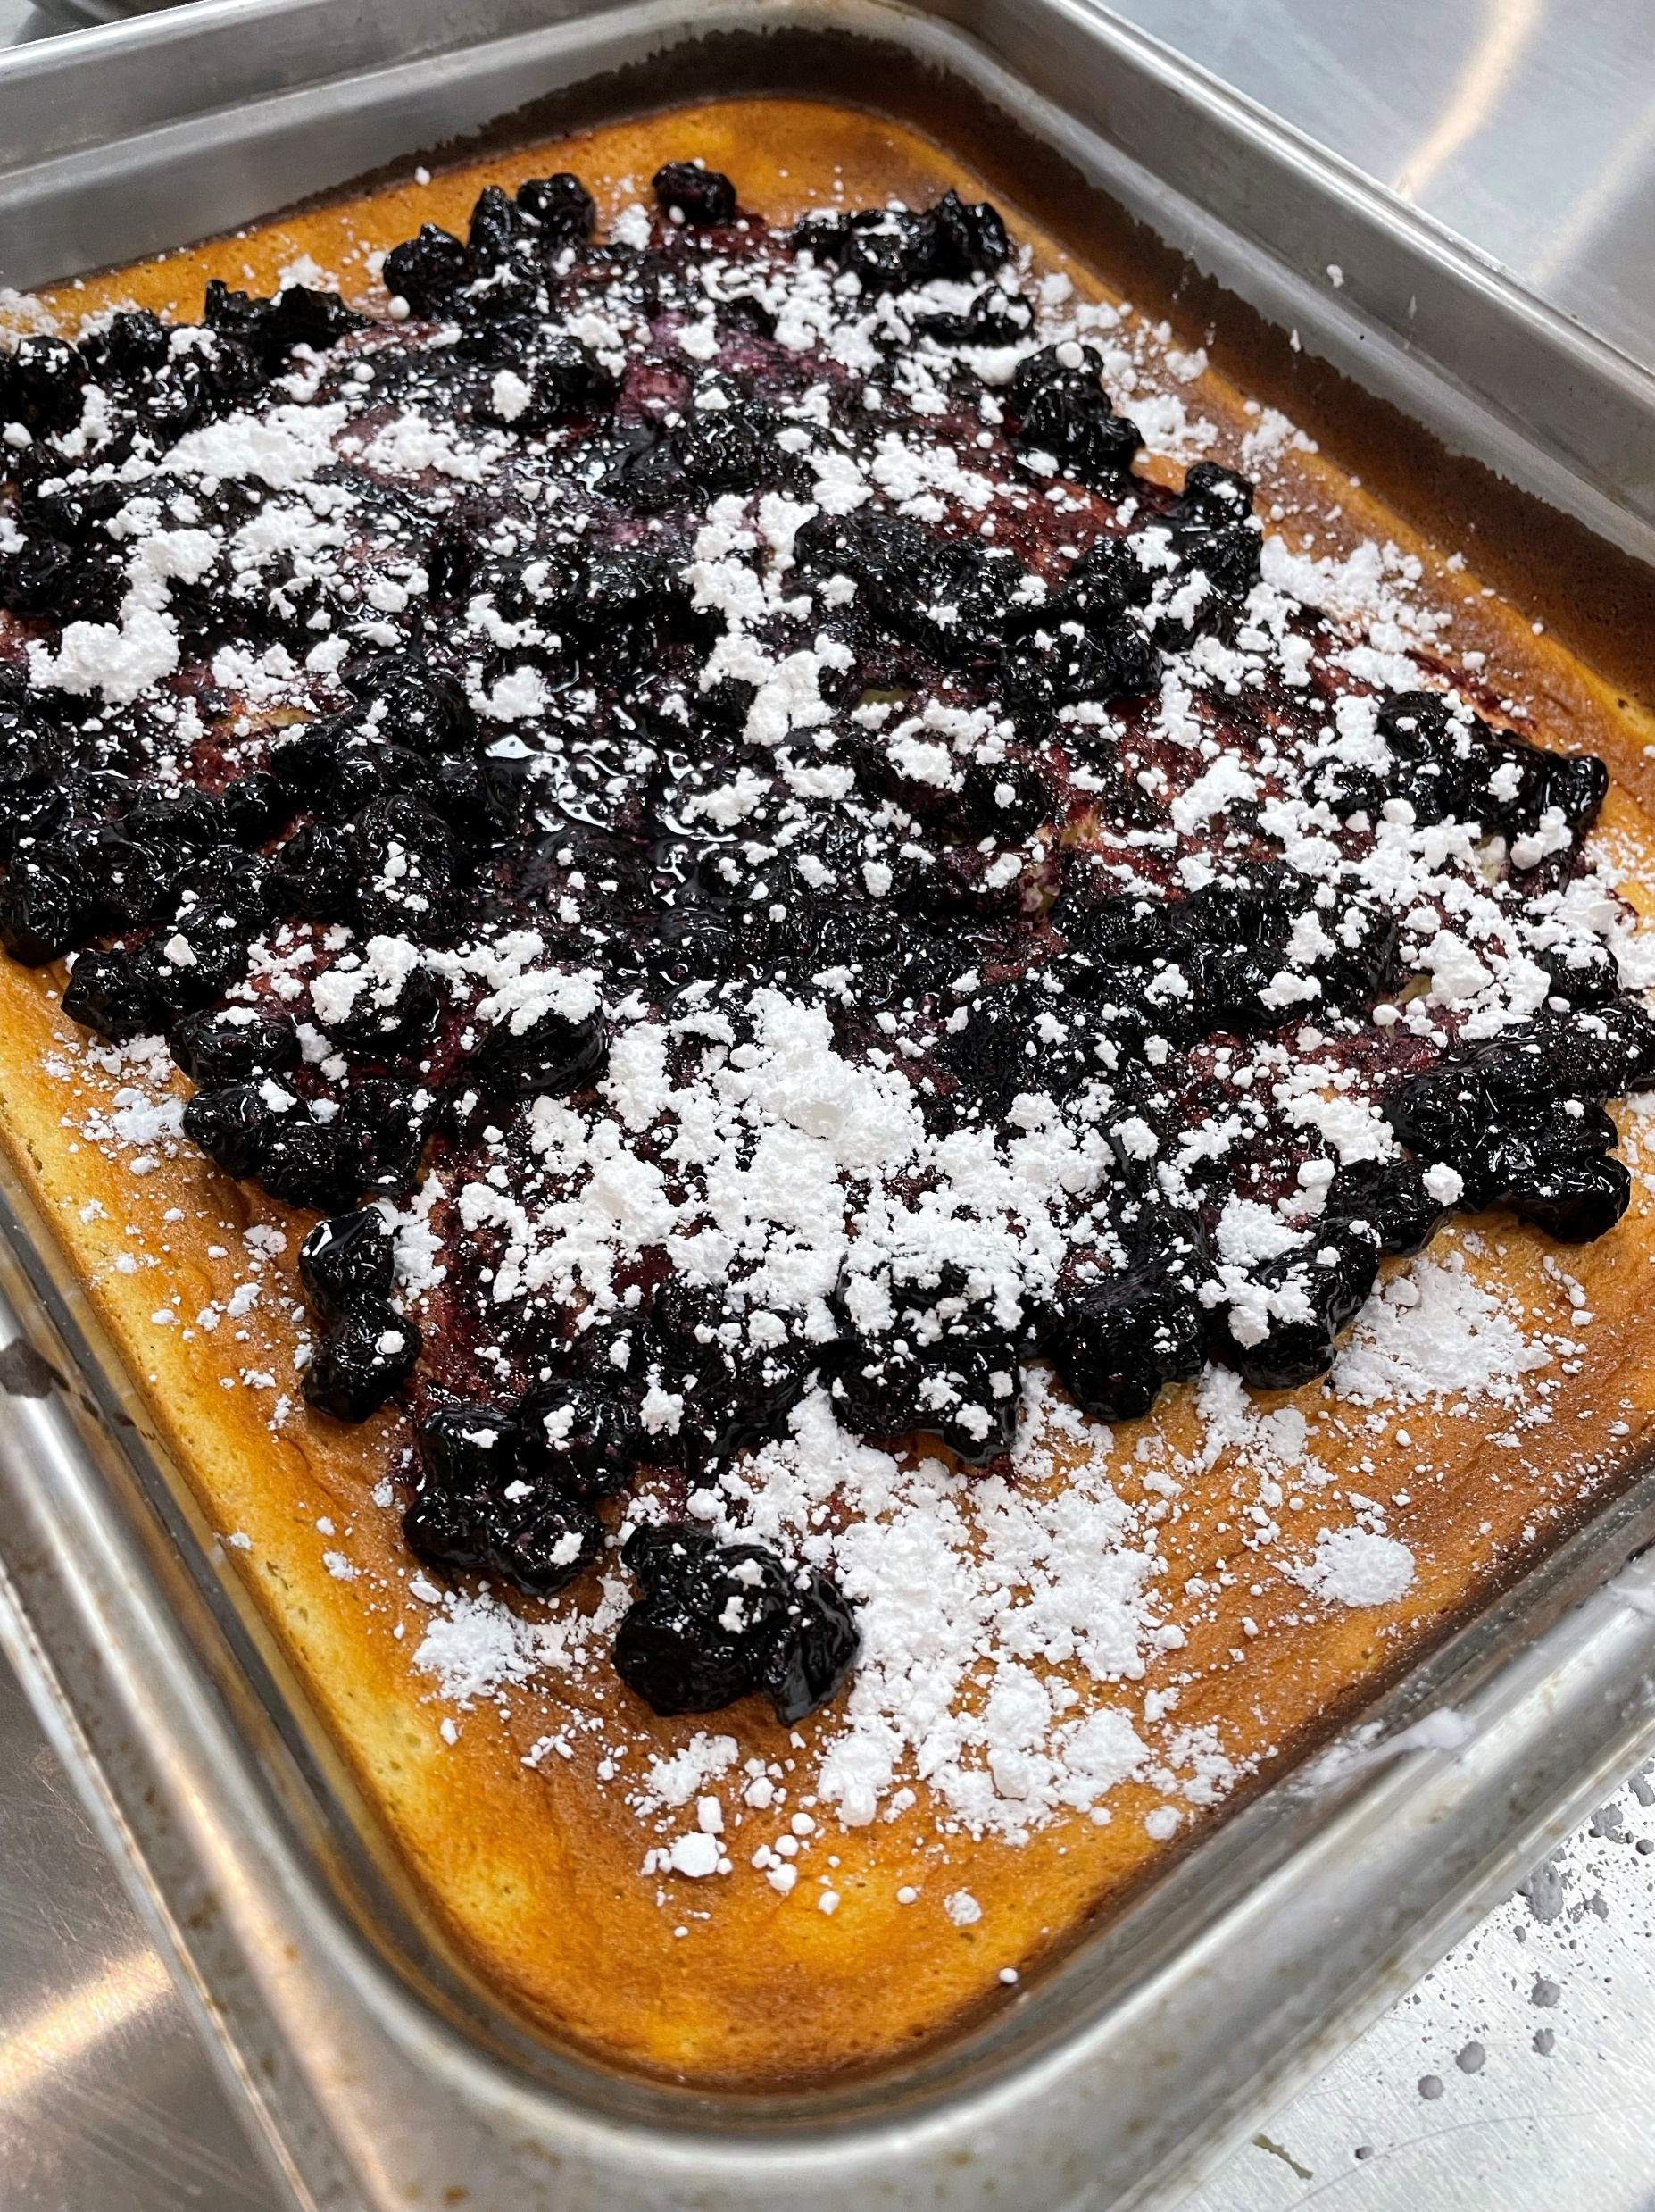
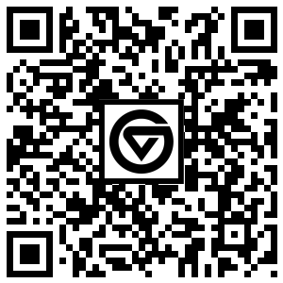

RECIPE FROM HTM 250
As the semester winds down, it’s time to share some of the recipes from HTM 250.
This week: Lemon Pudding Cake with Blueberry Sauce. The batter separates into cake on the top and lemon pudding on the bottom. Best served warm!

