Slide 1

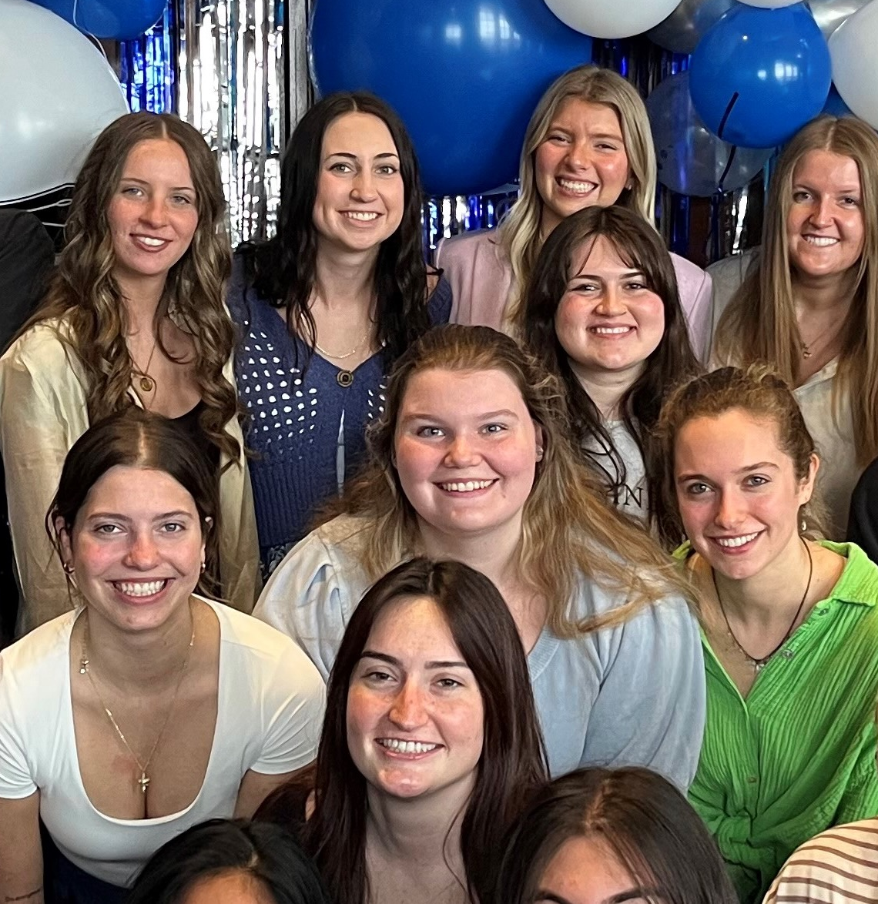
1. RECENT JOB/INTERNSHP OPENINGS | New week, new opportunities to learn and grow as an HTM professional. Check out the listings for jobs and internships!
2. INTERNATIONAL SUMMER CAMP | The University of Macau is excited to share that the Department of Integrated Resort and Tourism Management will be launching a new program: the 2026 DRTM International Student Summer Camp, scheduled for June 21-25, 2026.
3. AHLA HOSPITALITY SCHOLARSHIP | The AHLA Foundation Scholarship application cycle is now open for the 2026-2027 academic year. Applications are being accepted until March 30, 2026.
4. SPRING COURSE | The Anthropology Summer Field School 2026 immerses students in daily life on the Westside of Grand Rapids while studying the Las Canchas public courts on Seward Ave.
5. REGISTRATION REMINDER | Registration begins on March 23rd for spiring/summer 2026. fall 2026 and winter 2027. Check your personal registration date in Banner and make an appointment with an advisor for further assistance.
3.23.2026

Slide 2
New Internship and Employment Opportunities
Line Cook
Sheraton Grand Rapids - Grand Rapids, Michigan
Application Deadline: N/A Posted: 3/18/26
Executive Chef
Sheraton Grand Rapids - Grand Rapids, Michigan
Application Deadline: N/A Posted: 3/18/26
Operations Intern
Canopy by Hilton Grand Rapids Downtown - Grand Rapids , Michigan
Application Deadline: 5/1/26 Posted: 3/18/26
Agritourism Positions
Deep Roots Produce - Alto , Michigan
Application Deadline: April 10, 2026 Posted: 3/16/26
1

Slide 3


INTERNATIONAL SUMMER CAMP
Camp Highlights & Opportunities
You will also engage in a rich blend of academic and cultural experiences, including but not limited to:
Interactive academic lectures by DRTM faculty members
Campus tour and treasure hunt challenge
Networking with students, professors, and industry practitioners
Field trip to leading integrated resorts in Macao
The Summer Camp is fee-waived.
UM will cover on-campus accommodation (in shared rooms), local transportation, meals and activities expenses included in the Summer Camp. A welcome kit will be provided to each student.
Students are responsible for their round-trip traveling expenses, insurance, visa fees (if applicable) and other personal expenses.
2

Slide 4
HOSPITALITY SCHOLARSHIP
Each year, the AHLA Foundation administers a competitive scholarship process that awards more than 300 students with scholarships ranging from $2,000 to $7,000. Both school-allocated scholarship funds and general self-nominated scholarship funds, depending on eligibility, are available.
Deadline Change!
Application Deadline
Monday March 30, 2026
Apply through the QR code or at this link
3

Slide 5
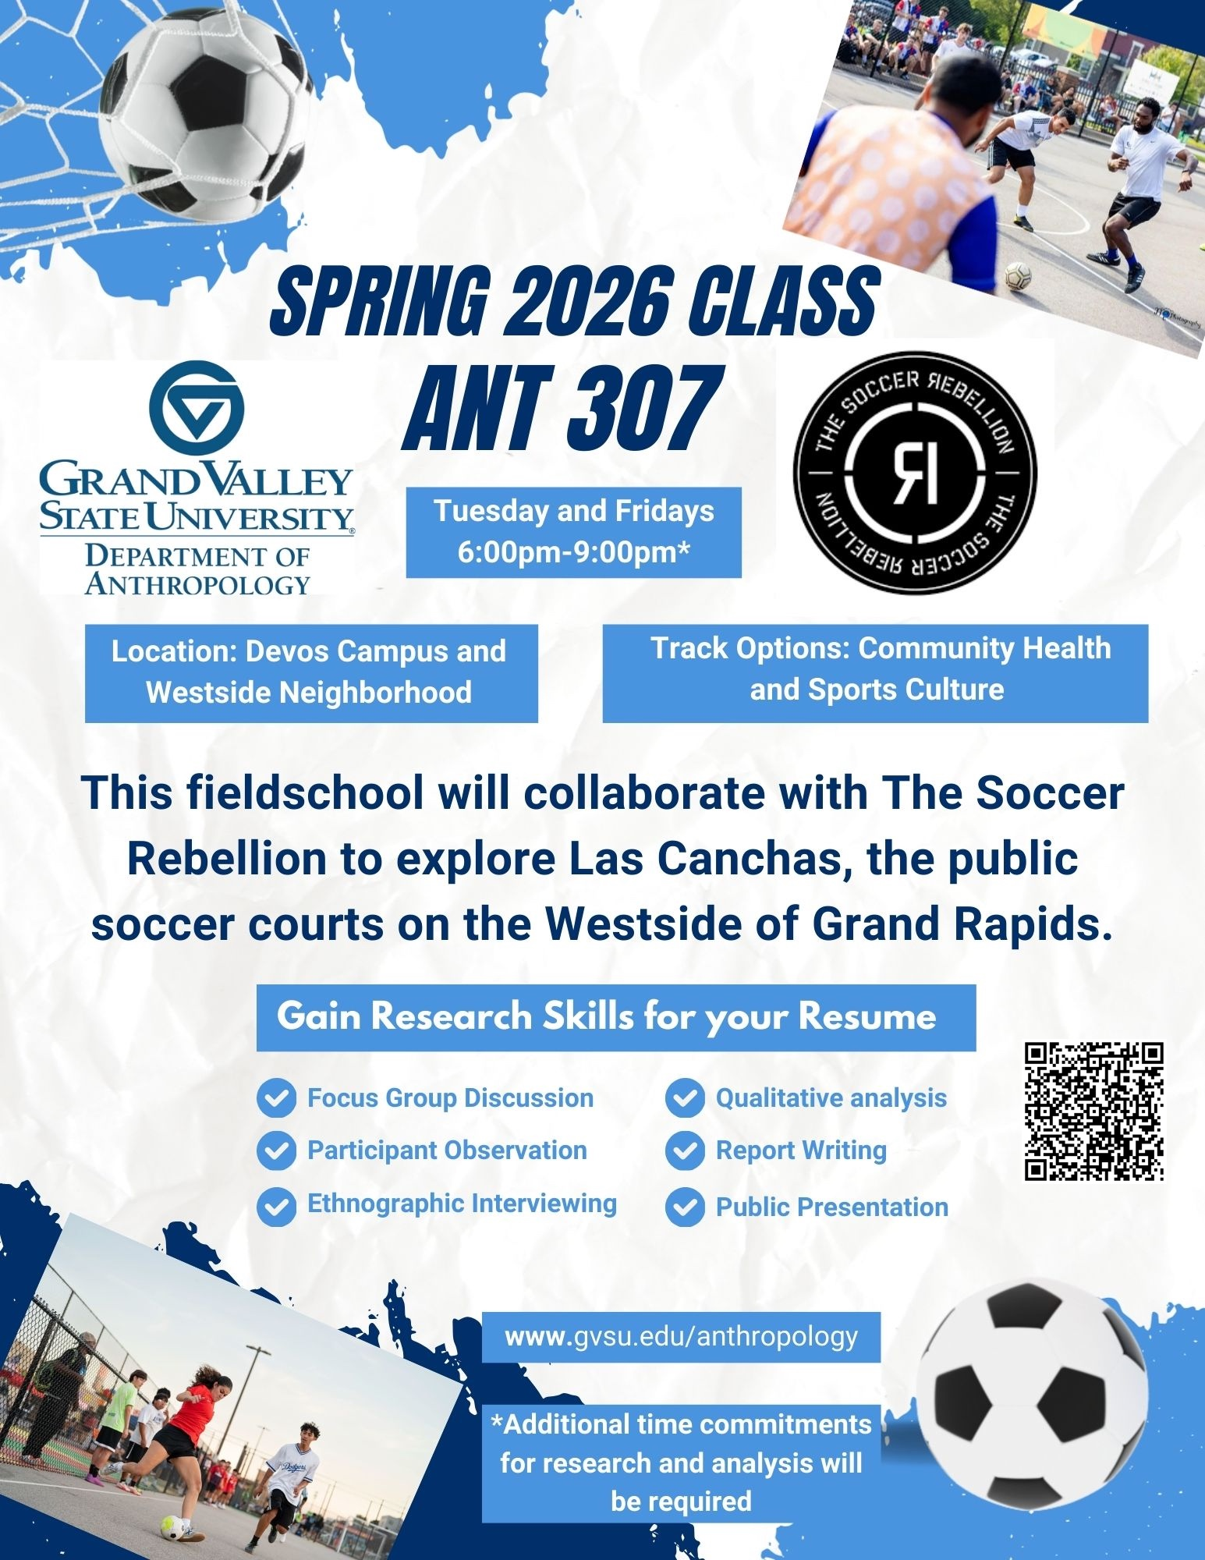
SPRING COURSE ANT 307
Dates May 11 – June 24, 2026
Times Tuesdays & Fridays 6-9 PM*
The Anthropology Summer Field School 2026 immerses students in daily life on the Westside of Grand Rapids.
During the six-week field school, students will partner with The Soccer Rebellion and Las Canchas to gain an in-depth understanding of the needs, assets, motivations, and meanings related to sports and community health among those living and playing on the Westside.
For more information, contact Dr. Tara Hefferan hefferta@gvsu.edu; 616-331-8924 or Dr. Kristin Hedges hedgeskr@gvsu.edu; 616-331-8212
4

Slide 6
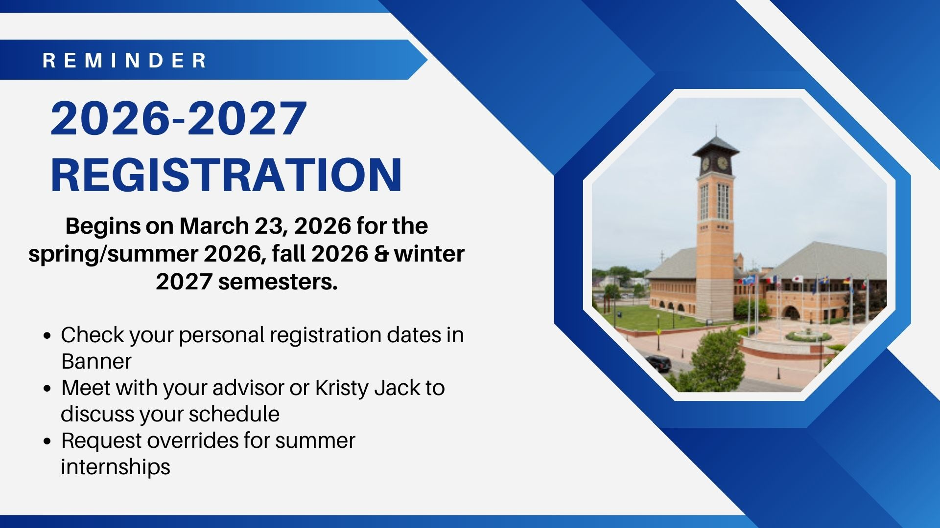
REGISTRATION REMINDER
5

Slide 7
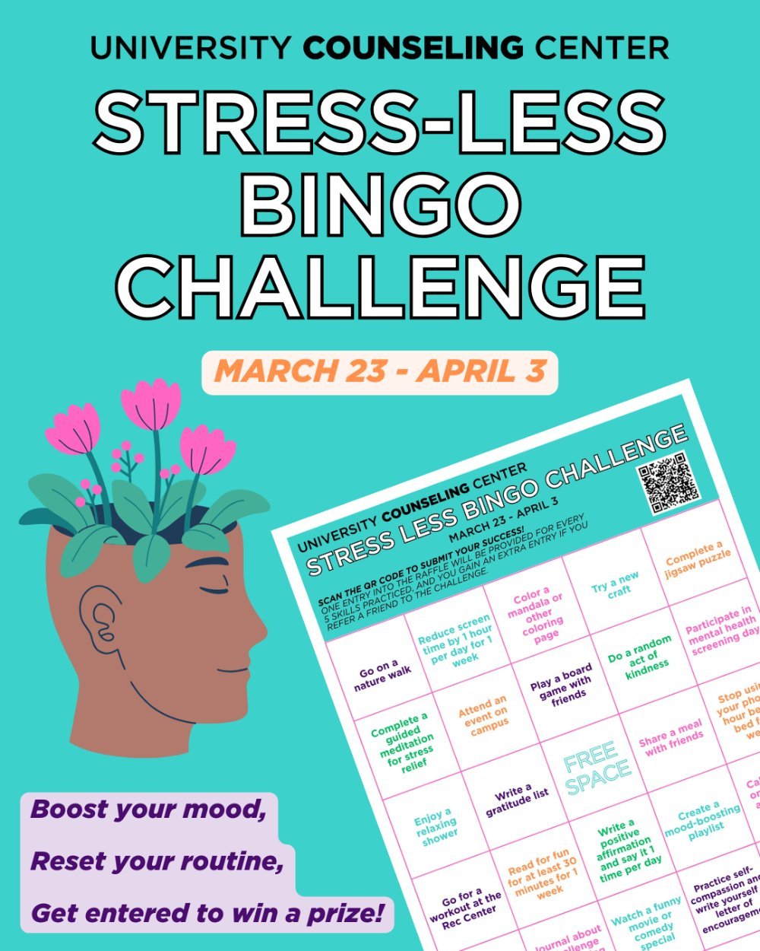
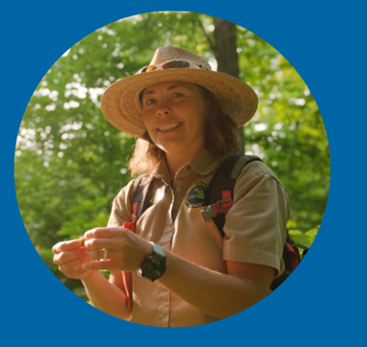

CAMPUS EVENTS
Stress Less Bingo Challenge Kickoff Tabling
Thursday, March 26, 2026 3:00 p.m. - 5:00 p.m.
Kirkhof Lobby
Try a few new ways to take care of your mental health this month with the University Counseling Center's Stress Less Bingo Challenge. The bingo card includes 24 simple activities designed to help you recharge, reduce stress, and build healthy habits. Complete as many as you want, whenever it fits your schedule.
For every 5 challenges you complete, you’ll earn one entry into a raffle for a wellness prize pack that includes a weighted blanket, sunrise alarm clock, magnetic fidget, and a to-do list planning board. Refer a friend to the challenge and you’ll get an extra raffle entry!
Pick up a bingo card when in Kirkhof on March 26 from 3–5 p.m. orfrom the University Counseling Center.

