Slide 1

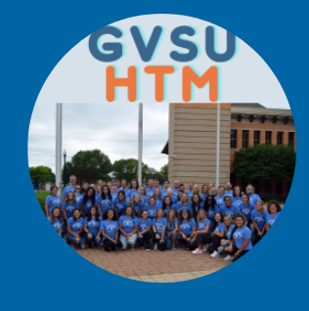
1. RECENT JOB/INTERNSHP OPENINGS | New week, new opportunities to learn and grow as an HTM professional. Check out the listings for jobs and internships!
2. HTM NETWORKING EXTRAVAGANZA | Stop by before, after, or even during classes from 11:30am-3:30pm on Monday, March 24, 2025 in the Hager-Lubbers Exhibition Hall (105E DeVos Center) to chat to local managers from a variety of hospitality organizations! Ask questions about the company, upcoming openings, and more.
3. GVSU HTM SPEAKER SERIES | Join us for our HTM Speaker Series! March 18th at 1:00 pm via Zoom hear from the founder of Mrs. Barr’s Natural Foods, Jodi Barr, about how she went from making granola to opening a natural foods business.
4. CAREER CENTER SUIT UP | All Grand Valley students and alumni are invited to attend a GVSU/JCPenney Suit-Up Event! This event will include options to participate in-person or virtually. March 23 4:00 – 7:00 pm at the Rivertown JC Penney Store or online at jcpenney.com
5. NETWORKING EVENT | Indigrow in Muskegon is hosting a cannabis industry networking event on March 26th from 3:00 pm to 5:00 pm. Students are invited to come hear about job opportunities in the industry. 21+ can tour the whole facility.
6. STUDENT SCHOLARS DAY | Student Scholars Day (SSD) celebrates scholarship, research, and creative work performed by GVSU students. Beginning as a single-day research symposium almost 30 years ago, SSD evolved into a multi-day event that celebrates the scholarly process and showcases faculty-mentored student work. Student presentations will be on Wednesday, April 9, 2025.
3.17.2025
Click here to learn more about all GVSU HTM opportunities available to you

Slide 2
New Internship and Employment Opportunities
Cook | The Morning Dish
Greenleaf Hospitality - Kalamazoo, Michigan
Application Deadline: 4/11/2025
Posted: 3/13/25
Kitchen+Bar Lead (Supervisory Position!)
Drury Hotels - Grand Rapids, Michigan
Application Deadline: Until Filled
Posted: 3/13/25
Server Assistant | brick + brine
Greenleaf Hospitality - Kalamazoo, Michigan
Application Deadline: 4/9/2025
Posted: 3/12/25
Line Cook | Kalamazoo Country Club
Greenleaf Hospitality - Kalamazoo, Michigan
Application Deadline: 4/10/2025
Posted: 3/12/25
1

Slide 3

HTM CAREER FAIR
2

Slide 4
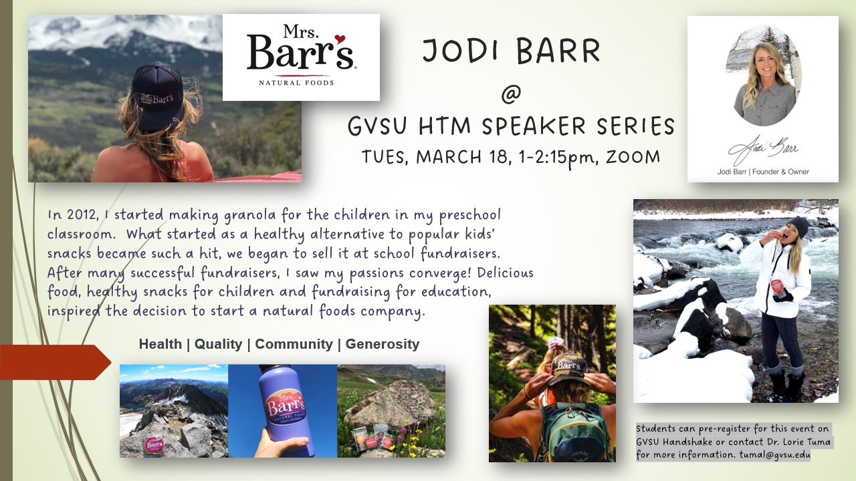
GVSU HTM SPEAKER SERIES
3

Slide 5

CAREER CENTER SUIT UP
All Grand Valley students and alumni are invited to attend a GVSU/JCPenney Suit-Up Event! This event will include options to participate in-person or virtually.
In-person:
Join us at JCPenney at RiverTown Crossings Mall on March 23 from 4:00 pm – 7:00 pm and receive an EXTRA 30% off on top of pre-existing discounts.
Friends and family are welcome too!
Virtual:
To receive your coupon, text GVSU to 67292.
4

Slide 6

NETWORKING EVENT
5
Indigrow in Muskegon is hosting a networking event on March 26h for any student interested in working the Michigan cannabis industry. Anyone can attend the networking event; those aged 21+ can have a tour of the facility.

Slide 7



IMPORTANT STUDENT RESOURCES
It is important that all students are given the resources they need to thrive here at GVSU. Learn more about the resources available to you on campus, many of which are available to students at NO COST.
Available Resources Include: Academics, Academic Support, Belonging and Campus Climate, Campus Safety, Finances, and Wellness
Replenish is hosting their first cooking demo on March 20th from 5:30 – 7:30 pm in the Niemeyer Living Center. Sign up on Laker Link!
On the Menu: West African Jollof Rice and Fruit Smoothie

Slide 8

STUDENT SCHOLARS DAY
Student Scholars Day (SSD) is held once each year to celebrate the scholarship and creative work performed by GVSU students. The day showcases faculty-mentored student work, shared through many venues, including (but not limited to) oral presentations, discussion and panel sessions, fine arts exhibits and performances, and poster presentations.
April 8 – Keynote Speaker
April 7 -25 – Art Exhibition, Calder Art Center
April 9 – Presentations and Performances
6

