Slide 1

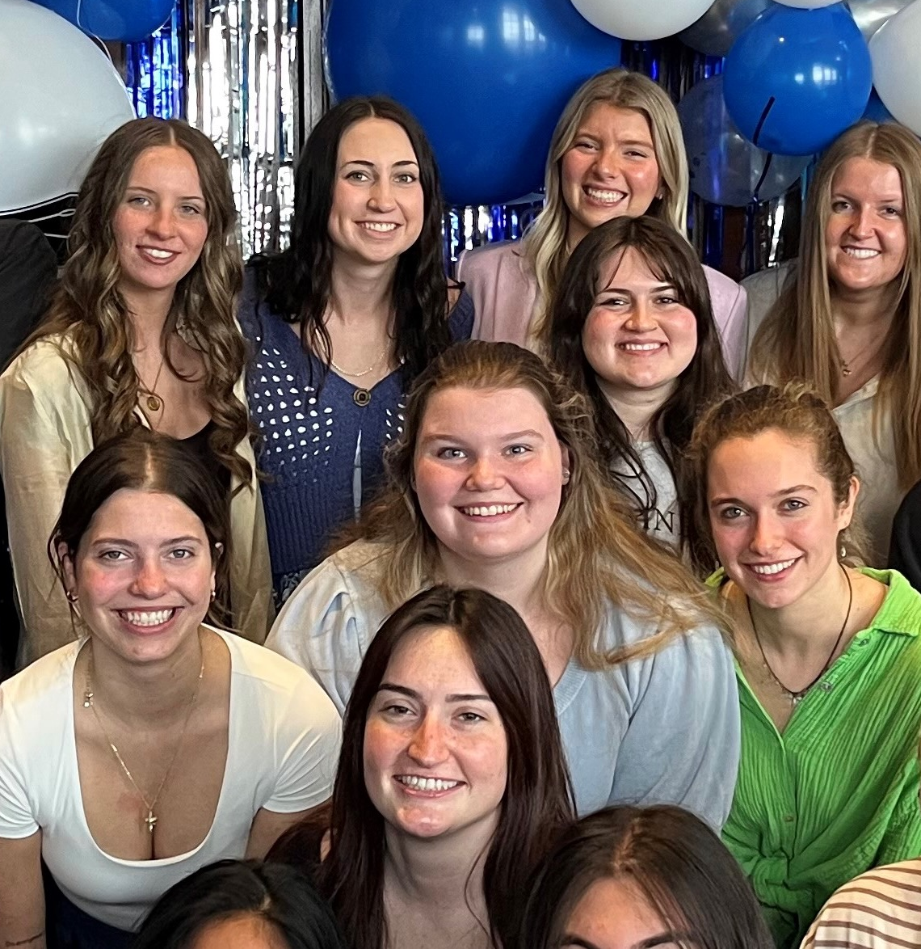
1. RECENT JOB/INTERNSHP OPENINGS | New week, new opportunities to learn and grow as an HTM professional. Check out the listings for jobs and internships!
2. INTERNATIONAL SUMMER CAMP | The University of Macau is excited to share that the Department of Integrated Resort and Tourism Management will be launching a new program: the 2026 DRTM International Student Summer Camp, scheduled for June 21-25, 2026.
3. AHLA HOSPITALITY SCHOLARSHIP | The AHLA Foundation Scholarship application cycle is now open for the 2026-2027 academic year. Applications are being accepted until March 30, 2026.
4. SPRING COURSE | The Anthropology Summer Field School 2026 immerses students in daily life on the Westside of Grand Rapids while studying the Las Canchas public courts on Seward Ave.
5. HTM SPEAKER SERIES | On Tuesday, March 17, 2026, from 1:00–2:00 PM EST via Zoom, join us for keynote speaker Amani Roberts and his presentation titled “UNLOCK Your Next Level.”
6. MICHIGAN SUSTAINABLE BUSINESS FORUM WEBINAR | Join MiSBF and University of Illinois Chicago for the second session in the Safe & Sustainable Foodware webinar series as we hear from restaurants and institutions that have already made the switch.
3.16.2026

Slide 2
New Internship and Employment Opportunities
Front of House Supervisor
Legends Global - Van Andel Arena - Grand Rapids, Michigan
Application Deadline: 3/27/2026
Posted: 3/2/26
Front of House Staff
Legends Global - Van Andel Arena - Grand Rapids, Michigan
Application Deadline: 3/27/2026
Posted: 3/2/26
Assistant Front of House Manager
Legends Global - Van Andel Arena - Grand Rapids, Michigan
Application Deadline: 3/13/2026
Posted: 3/2/26
Weddings and Special Events Associate
Wellfield Botanic Gardens - Elkhart, Indiana
Application Deadline: March 31, 2026
Posted: 2/26/26
1

Slide 3


INTERNATIONAL SUMMER CAMP
Camp Highlights & Opportunities
  You will also engage in a rich blend of academic and cultural experiences, including but not limited to:
  Interactive academic lectures by DRTM faculty members
  Campus tour and treasure hunt challenge
  Networking with students, professors, and industry practitioners
  Field trip to leading integrated resorts in Macao
The Summer Camp is fee-waived.
UM will cover on-campus accommodation (in shared rooms), local transportation, meals and activities expenses included in the Summer Camp. A welcome kit will be provided to each student.
Students are responsible for their round-trip traveling expenses, insurance, visa fees (if applicable) and other personal expenses.
2

Slide 4
HOSPITALITY SCHOLARSHIP
Each year, the AHLA Foundation administers a competitive scholarship process that awards more than 300 students with scholarships ranging from $2,000 to $7,000. Both school-allocated scholarship funds and general self-nominated scholarship funds, depending on eligibility, are available.
Deadline Change!
Application Deadline
Monday March 30, 2026
Apply through the QR code or at this link
3

Slide 5

SPRING COURSE ANT 307
Dates May 11 – June 24, 2026
Times Tuesdays & Fridays 6-9 PM*
The Anthropology Summer Field School 2026 immerses students in daily life on the Westside of Grand Rapids.
During the six-week field school, students will partner with The Soccer Rebellion and Las Canchas to gain an in-depth understanding of the needs, assets, motivations, and meanings related to sports and community health among those living and playing on the Westside.
For more information, contact Dr. Tara Hefferan hefferta@gvsu.edu; 616-331-8924 or Dr. Kristin Hedges hedgeskr@gvsu.edu; 616-331-8212
4

Slide 6

HTM SPEAKER SERIES
5

Slide 7

MI SUSTAINABLE BUSINESS FORUM WEBINARS
6
The next webinar from MISBF, Green Restaurants, on March 17 at 10am EST will focus on restaurants and institutions that have already made the switch. Presenters will share candid stories about what worked, what didn’t, and how they overcame barriers such as costs, customer preferences, and sourcing challenges. Hear from Aldea Coffee and Brewery Vivant about there green initiatives.
Learn more and register here

Slide 8



CAMPUS EVENTS
Brick by Brick: A Printmaking Pop-Up
Wednesday, March 18, 2026
6:00 p.m. - 8:00 p.m.
Kirkhof Center Room 0058
Looking for a creative escape? Join us on campus for a unique DIY session where childhood nostalgia meets professional art-making. We’re reimagining Lego Dots as relief printing plates to create textured, geometric designs on tote bags and mini notebooks.
No art experience? No problem. We’ll show you the ropes!
This event is hosted by the Art Museum and facilitated by Hot Glue Creux, a Grand Rapids-based craft club.
While supplies las

