Slide 1

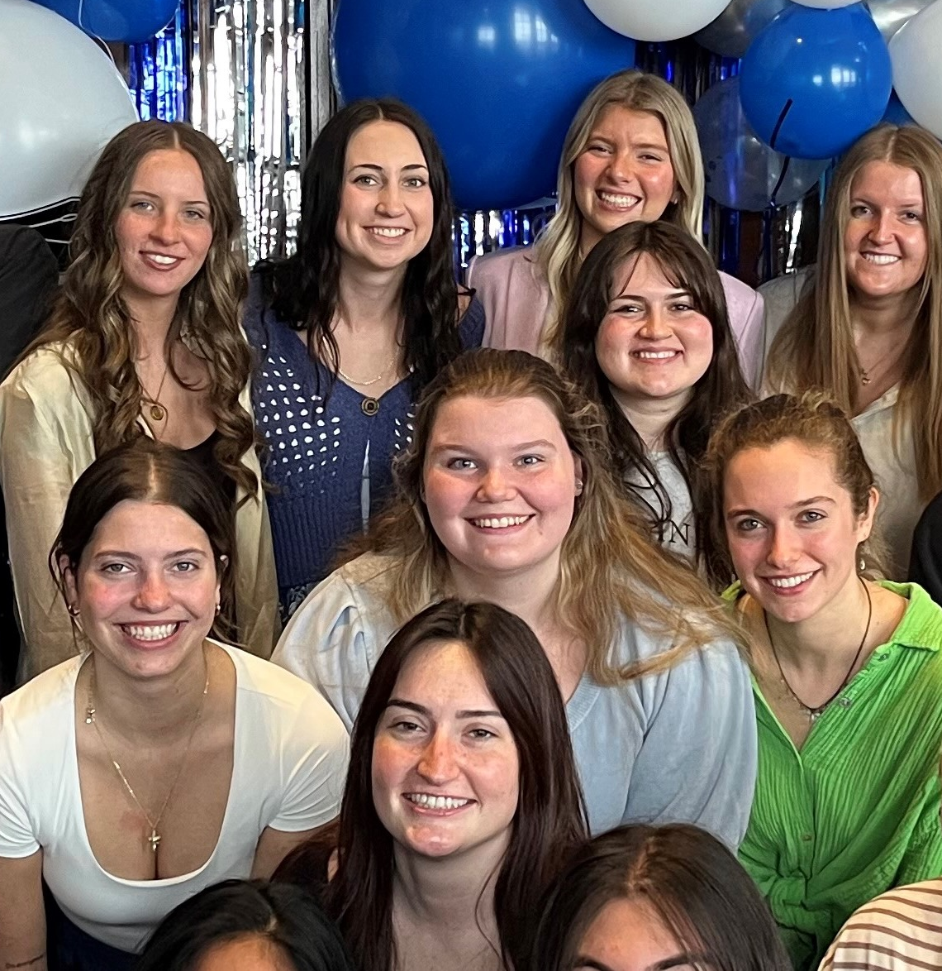
1. RECENT JOB/INTERNSHP OPENINGS | New week, new opportunities to learn and grow as an HTM professional. Check out the listings for jobs and internships!
2. INTERNATIONAL SUMMER CAMP | The University of Macau is excited to share that the Department of Integrated Resort and Tourism Management will be launching a new program: the 2026 DRTM International Student Summer Camp, scheduled for June 21-25, 2026.
3. AHLA HOSPITALITY SCHOLARSHIP | The AHLA Foundation Scholarship application cycle is now open for the 2026-2027 academic year. Applications are being accepted until March 23, 2026.
4. SPRING COURSE | The Anthropology Summer Field School 2026 immerses students in daily life on the Westside of Grand Rapids while studying the Las Canchas public courts on Seward Ave.
5. HTM SPEAKER SERIES | On Tuesday, March 17, 2026, from 1:00–2:00 PM EST via Zoom, join us for keynote speaker Amani Roberts and his presentation titled “UNLOCK Your Next Level.”
6. WEST MICHIGAN CANNABIS GUILD | West Michigan Cannabis Guild is inviting HTM students and faculty to their quarterly meeting on campus. The director of the Cannabis Regulatory Agency is speaking about the new MI cannabis tax.
2.23.2026

Slide 2
New Internship and Employment Opportunities
Visitor Services / Tourism & Hospitality Intern (Summer 2026)
Holland Museum - Holland, Michigan
Application Deadline: March 31, 2026 (or until filled)
Posted: 2/20/26
Assistant event planner
Grand Valley State University- Storytime in the Park-Garfield - Grand Rapids, Michigan
Application Deadline: April 1, 2026
Posted: 2/17/26
Front Desk Service Agents All Shifts
Home2 Suites Grand Rapids North - Grand Rapids, Michigan
Application Deadline: 06/01/2026
Posted: 2/13/26
Room Attendant
Shinola Hotel - Detroit, Michigan
Application Deadline: Ongoing
Posted: 2/12/26
1

Slide 3

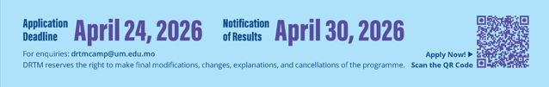
INTERNATIONAL SUMMER CAMP
Camp Highlights & Opportunities
  You will also engage in a rich blend of academic and cultural experiences, including but not limited to:
  Interactive academic lectures by DRTM faculty members
  Campus tour and treasure hunt challenge
  Networking with students, professors, and industry practitioners
  Field trip to leading integrated resorts in Macao
The Summer Camp is fee-waived.
UM will cover on-campus accommodation (in shared rooms), local transportation, meals and activities expenses included in the Summer Camp. A welcome kit will be provided to each student.
Students are responsible for their round-trip traveling expenses, insurance, visa fees (if applicable) and other personal expenses.
2

Slide 4

HOSPITALITY SCHOLARSHIP
Each year, the AHLA Foundation administers a competitive scholarship process that awards more than 300 students with scholarships ranging from $2,000 to $7,000. Both school-allocated scholarship funds and general self-nominated scholarship funds, depending on eligibility, are available.
Application Deadline
Monday March 23, 2026
Apply through the QR code or at this link
3

Slide 5

SPRING COURSE ANT 307
Dates May 11 – June 24, 2026
Times Tuesdays & Fridays 6-9 PM*
The Anthropology Summer Field School 2026 immerses students in daily life on the Westside of Grand Rapids.
During the six-week field school, students will partner with The Soccer Rebellion and Las Canchas to gain an in-depth understanding of the needs, assets, motivations, and meanings related to sports and community health among those living and playing on the Westside.
For more information, contact Dr. Tara Hefferan hefferta@gvsu.edu; 616-331-8924 or Dr. Kristin Hedges hedgeskr@gvsu.edu; 616-331-8212
4

Slide 6

HTM SPEAKER SERIES
5

Slide 7

CANNABIS GUILD MEETING
6
The next West Michigan Cannabis Guild quarterly meeting is being held on the
GVSU City Campus. Any students and faculty interested in the event are invited to attend.
The Director of the Cannabis Regulatory Agency, Brian Hanna, and the Policy & Legislative
Specialist, Derek Sova are speaking at the event.
Thursday February 26, 8:30 – 10:30 am
Downtown Campus Room 109D
RSVP casey@pharmhousewellness.com by Friday Feb. 20

Slide 8



STUDENT EVENTS
2026 Ramadan Iftar is a welcoming campus gathering hosted by the MSA where students, staff, and community members—Muslims and non-Muslims alike—come together to break their fast, experience the spirituality of Ramadan, learn about the religion, and connect in an inclusive environment where everyone is welcome.

